Slide 1
International Patent Examination Outcomes
ESNIE Summer School,
Cargese, Corsica
May 2015
Professor Paul H. Jensen
University of Melbourne
(www.paulhjensen.com)

Slide 2
Introduction
Patents: important part of global innovation system
They are supposed to solve under-investment in innovation (i.e. a market failure)
But: very expensive system beset with problems
This workshop provides an overview of research on:
  Do outcomes differ across offices?
  ‘Bad’ patents: Type I/II errors in examination
  National treatment: are all inventors equal?
  Implications for trade flows

Slide 3
Background
Patents are not global: country-specific rights
  However, note the EPO is different
International agreements to promote consistency and fairness e.g. TRIPs
Universal agreement on patent criteria: novelty, non-obviousness and utility
  However, legal differences and subjectivity
  Having a patent does NOT guarantee validity
Costs of enforcement are high, privately borne and country-specific: no world patent court

Slide 4
Significance of results
Important to understand why this matters:
  Patent examination is costly and currently quite inefficient (duplication of investment)
  Disharmony in examination outcomes
    Increases costs of enforcement (patchwork of IP)
    Distorts innovation investment decisions
    Causes social costs (e.g. unnecessary litigation)
    Might induce discrimination against foreigners
    Affects trade flows (i.e. gains from trade)

Slide 5
Do outcomes differ? (Part I)
Evidence there are differences in grant rates:
  Quillen et al. (2001): USPTO 95-97%, EPO 50%
However, they don’t control for invention quality
How can we control for invention quality?
  Using a ‘matched sample’ of patents
Outcomes: granted, rejected, pending, withdrawn
Four factors affect patent outcomes:
  Legislation: first-to-invent vs first-to-file
  Institutions: resource allocation and incentives
  Applicants: how persistent is the applicant?
  Characteristics e.g. technology area, priority country

Slide 6
Dataset
We built our own dataset from scratch using online sources provided by major patent offices
  Europe, Japan and US are the trilateral offices, which account for majority of world’s patents
Our dataset consists of:
  70,477 single priority patents granted by the USPTO with applications in the EPO, JPO; priority years 1990-95
Potential problems with the dataset:
  Selection bias: USPTO grant bias? Single priority bias?
  Truncation: increase in patents pending?

Slide 7
Observations
Interesting observations:
  High withdrawal rates at EPO, JPO: applicant behavior?
  37.7% of US patents granted by both the JPO and EPO
  0.6% were rejected by both the JPO and EPO
  JPO rejected 10% of USPTO and EPO patents

Slide 8
Bad patents (Part II)
Recent crisis: preponderance of “bad” patents
  Some seem harmless (i.e. never enforced)
  Others might hinder innovation (e.g. trolls, thickets, submarines)
However, little systematic evidence. We ask:
  Do patent offices make systematic errors?
  What factors may explain observed errors?
New evidence using our matched sample
Remedies: raise inventive step and/or increase examination rigour

Slide 9
Definitions
What is a “low quality” or “bad” patent?
  Economic definition: the patent not required to stimulate the R&D expenditure
  Legal definition: patent would not have been granted if novelty/non-obviousness properly evaluated
We consider the legal definition here
Novelty means ‘new to the world’, which is objective (but search is hard)
Non-obviousness means that it passes over an inventive step, which is subjective

Slide 10
Methods
Misclassification: measurement error in dep. var
  Other applications: insurance, smoking
Patent examination subject to misclassification:
  Examiners fail to properly search universe of prior art;
  Examiners incorrectly estimate inventive step.
Matched sample: 24,690 applications at EPO/JPO and granted at the USPTO
USPTO citation data used to estimate grant probability with misclassification
Forward citations measure inventive step

Slide 11
Observations
Sample: 24,690 applications with complete set of variables (decision, citations, claims, renewals)
22.4% applications rejected in at least 1 office
Table: citation ratio by application outcome
 | EPO
JPO | Withdrawn | Pending | Rejected | Granted | Total
Withdrawn | 0.804 | 0.845 | 0.857 | 0.836 | 0.827
Pending | 0.937 | 0.899 | 0.902 | 0.955 | 0.946
Rejected | 1.051 | 1.227 | 1.173 | 1.079 | 1.090
Granted | 1.028 | 1.043 | 1.263 | 1.114 | 1.110
Total | 0.891 | 0.925 | 1.084 | 1.026 | 1.000

Slide 12
Results
Joint probability of Type I (6.1%) and II (9.8%) error
  Type I error: false negative (reject when should grant)
  Type II error: false positive (grant when should reject)
Determinants of errors:
  Examination duration associated with reduction in Type I/II errors. Longer duration (i.e. more resources) means fewer errors (trade-off quality vs speed)
Presence of local inventor: ↓ Type I and ↑ Type II error
Decision year:
  suggests an increasing trend in Type I errors
  suggests a decreasing trend in Type II errors

Slide 13
Are inventors equal? (Part III)
“To affect profit flows favorably, each country wants the strongest possible protections in foreign countries, and the weakest possible protections for foreigners in its own domestic market” (Scotchmer 2004)
International agreements ban beggar-thy-neighbor patent policies (e.g. 1873 Paris Convention)
‘National treatment principle’: foreign and domestic applicants treated alike
Yet, no systematic analysis of this issue
Addressed here using international patent data

Slide 14
Background
Since same criteria used for examination, outcomes across offices should not be systematically related to inventor nationality
Same matched sample approach as before:
  Patents granted in the US with applications made in Europe and Japan
  Inventors from all over the world in the sample
  Japanese inventor: at JPO is domestic, at EPO is foreign
  Estimate grant probability
Inferences are about the EPO/JPO, not USPTO

Slide 15
Data
48,000 single priority applications 1990-95
‘Domestic inventor’ if there is at least one inventor with a local address (NB: results robust to other measures of ‘local’)
Final examination outcome (i.e. ‘grant’ or ‘refusal’) in 33,880 instances
14,067 applications are ‘quasi-refusals’: i.e. withdrawn in response to negative EPO feedback
[In the extension, we expand the approach to use PATSTAT data]

Slide 16
Model
  Probability of granting application i by office j:
  where n is whether inventor resides in the same jurisdiction as patent office; α invention fixed-effects; q are control variables
Estimated as: FE logit using full conditional ML
Domestic inventor: at least 1 local inventor
Inventor experience: # granted triadic applications
Claims: number of ex ante claims
Office dummy: differences in exam thresholds

Slide 17
Results
Our results:
  Marginal effect of local inventor is huge: 10 to 16 percentage points more likely to be granted a patent
  Adding control variables doesn’t change main result
Alternative explanations explored
  e.g. do locals accept ‘lower quality’ patents?
  We examined this as follows:
    using EPO data on ‘X’ and ‘Y’ citations
    Interacted Domestic variable with XY citation
No evidence that this matters

Slide 18
Extension
Recently expanded to included PATSTAT: does our result still hold?
New data covers 5 jurisdictions: Korea, China, Europe, Japan, US
  Covers 75% of world’s patents
  More recent period (2000-06)
  Includes ~750,000 patent families
  Application per family varies
    577,000 families are ‘twins’ (i.e. applications in 2 countries)
    234,000 families have applications in all 5 countries

Slide 19
Patent families
202k
162k
288k
107k
232k

Slide 20
New results
Our results hold in the larger, more comprehensive dataset
  The effect varies from 10-30 percentage points across countries
  It is largest in Korea and smallest in China
However, there are differences according to the application route
  PCT vs non-PCT applications
More research required to uncover why…

Slide 21
Trade implications (Part IV)
Does this ‘local advantage’ affect trade flows?
  Do firms export to countries if local advantage exists?
  Are patents really trade-related?
Why would patents affect trade flows?
  Fear of imitation or fear of infringement
Others use Ginarte-Park to proxy patent strength
Our approach: use a new measure of local bias in a gravity-type model
Ideally, time-varying and export country-specific

Slide 22
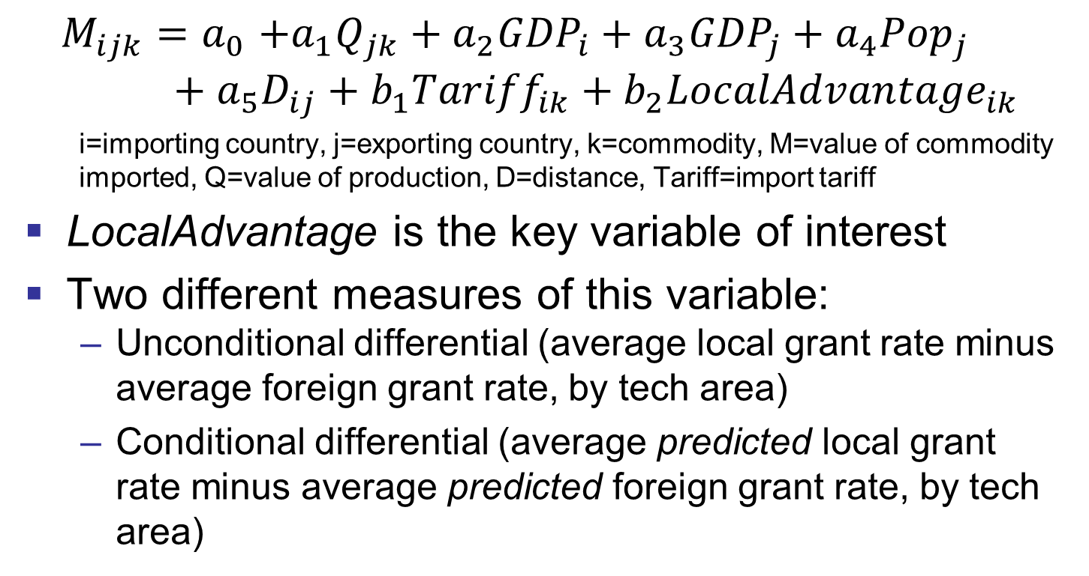
Model
$$M_{ijk}{=a}_{0}+a_{1}Q_{jk}+a_{2}{GDP}_{i}+a_{3}{GDP}_{j}+a_{4}{Pop}_{j}+a_{5}D_{ij}+b_{1}{Tariff}_{ik}+b_{2}{LocalAdvantage}_{ik}$$
    i=importing country, j=exporting country, k=commodity, M=value of commodity imported, Q=value of production, D=distance, Tariff=import tariff
LocalAdvantage is the key variable of interest
Two different measures of this variable:
  Unconditional differential (average local grant rate minus average foreign grant rate, by tech area)
  Conditional differential (average predicted local grant rate minus average predicted foreign grant rate, by tech area)

Slide 23
Results
Patent refusal inhibits export:
  When local inventors have an advantage in terms of getting a patent
  In high-tech industries
  In industries with more dense technology landscape
Possible reasons why:
  Threat of imitation (less likely)
  Local competition (less likely)
  Entry barriers (more likely): fixed costs of exporting; threat of infringement

Slide 24
Summary and conclusions
Hopefully, you have learnt a bit more about the global innovation system
And have a deeper understanding of the role that patents play
This is part of an ongoing research program with colleagues around the world
  We are still working on the trade paper
Please keep in touch! My email address is pjensen@unimelb.edu.au

