Slide 1
Rules, Governments, Organizations and Social Dynamics
John Wallis
University of Maryland and NBER
Wallis@econ.umd.edu

Slide 2
Governments and Rules
Institutions are the rules of the game, the means of enforcement, and the organizations that play the game.
Governments have a central role in institutions.
“The state is the organization with a comparative advantage in violence.” North, 1981.
Governments enable greater political, economic, and social coordination through the provisions and enforcement of rules backed by coercive power (the threat of violence).

Slide 3
I want to talk today about the dynamic relationship between rules, enforcement, and organizations. Please give me 10 minutes to lay out where I am going.
I begin with a simple schematic description of society.
Then consider the kind of rules that can be enforced within and between organizations, in a world where everyone is potentially violent.
The kind of rules that can be enforced and sustained are “identity” rules, rules that depend on the identity of the organizations that individuals belong to, ala Greif’s community responsibility system.

Slide 4
Understanding organizations and identity rules transform the schematic description of society into a theory of society, a theory of how individuals, rules, organizations, rule enforcement, and social hierarchies interact.
While it is a simple theory, I hope it isn’t simple minded.
Government organizations can then be considered in such a society.
Even if the governments are to serve a Hobbesian function, they have to “organize” violence.

Slide 5
Identity Rules and the Organization of Violence
Hobbes assumes that all individuals have roughly the same capacity for violence, so the only way to escape the “state of nature” is for them to agree to concede control of violence to the Leviathan, who then makes the rules.
Agreement

Slide 6
Identity Rules and the Organization of Violence
Hobbes assumes that all individuals have roughly the same capacity for violence, so the only way to escape the “state of nature” is for them to agree to concede control of violence to the Leviathan, who then makes the rules.
Agreement > Coercion

Slide 7
Identity Rules and the Organization of Violence
Hobbes assumes that all individuals have roughly the same capacity for violence, so the only way to escape the “state of nature” is for them to agree to concede control of violence to the Leviathan, who then makes the rules.
Agreement > Coercion > Rules
But violence cannot be organized by violence

Slide 8
Identity Rules and the Organization of Violence
If we follow the logic of the natural state (NWW) and identity rules, in which it is the rents from organizations that makes rule enforcement credible, then before violence can be organized their must be a coordinated agreement on the rents (the economic, political, and social privileges) that make the agreement credible.
Agreement

Slide 9
Identity Rules and the Organization of Violence
If we follow the logic of the natural state (NWW) and identity rules, in which it is the rents from organizations that makes rule enforcement credible, then before violence can be organized their must be a coordinated agreement on the rents (the economic, political, and social privileges) that make the agreement credible.
Agreement > Rules

Slide 10
Identity Rules and the Organization of Violence
If we follow the logic of the natural state (NWW) and identity rules, in which it is the rents from organizations that makes rule enforcement credible, then before violence can be organized their must be a coordinated agreement on the rents (the economic, political, and social privileges) that make the agreement credible.
Agreement > Rules > Coercion

Slide 11
Defining Governments
Once we acknowledge that violence cannot be organized by violence, and that there must be an agreement about non-coercive aspects of relationships, i.e. rules about arrangements within the economy and society, before violence can be credibly organized and limited,
Then it seems natural to define governments as “organizations that publicly signify agreements.”
Agreement > Rules > Coercion

Slide 12
The Organization of Coercion
Which organizations are able, under the terms of the agreement, to use violence is endogenous, not only to the agreement but the ongoing relationships between powerful individuals and organizations (elites).
The privileges that some individuals and organizations enjoy under the agreement, including the central privilege of forming organizations that the network recognizes, will sustain the identities that make coordination through identity rules possible.
Government organizations will not necessarily have a monopoly on coercion under these arrangements. (Weber)

Slide 13
Impersonal Rules
Most societies in the world today, and almost all societies in history are what NWW call “natural states.” Societies where networks of powerful organizations limit the ability to form organizations, and the resulting rents are used to coordinate the use of violence and the political relationships within the network.
These societies are fundamentally incapable of credibly creating and enforcing “impersonal rules:” rules that treat everyone the same and are enforced impersonally.

Slide 14
One “test” of whether thinking of governments as organizations that signify public agreements provides a useful alternative to governments as organizations with a comparative advantage in violence, is how each approach explains the emergence of societies capable of creating and enforcing impersonal rules. What NWW call open access societies.

Slide 15
The Emergence of Impersonal Rules
The birth of “modern” developed societies occurs with the appearance of the ability of those societies to create a limited set of rules (not all rules) that treat citizens (not all people) impersonally.
A central question for economic history and for development economics, therefore, is why do privileged individuals decide to give up their privileges and accept impersonal rules?

Slide 16
Many existing explanations revolve around the appearance of Leviathans (e.g. Britain and France) capable of disciplining every one in society (Tilly and many others).
The problem is, powerful governments usually result in tyranny, not open access.
I will argue that the inability of elites to commit themselves to follow rules in an identity rule regime, lies at the heart of the incentives that lead elites to move toward impersonal rules.

Slide 17
OK, 10 minutes is up. (I hope).

Slide 18
Three logical pieces
1) How a “theory” of society can be built using the idea of identity rules and the primacy of organizations.
2) Why the logic of Hobbes has a basic problem with the organization of violence.
3) Why elites would be willing to give up privileges in exchange for impersonal rules.

Slide 19
A model of society
At the first level of society are individuals and their relationships as individuals.
At the second level are organizations, like the family, which are bundles of individual relationships.
At the third level are societies, which are bundles of organizational relationships, and, by inclusion, individual relationships.

Slide 20
Relationships, Rules, and Enforcement
Rules exist within relationships, and they exist at all levels of relationships.
My wife and I have a “garbage rule”: I take out the garbage.
But my wife usually takes out the garbage on a day to day basis. The rule gives her the “option” of asking me to take it out.
What “enforces” the rule is the value of our relationship.

Slide 21
A model of society
At the first level of society are individuals and their relationships as individuals

Slide 22
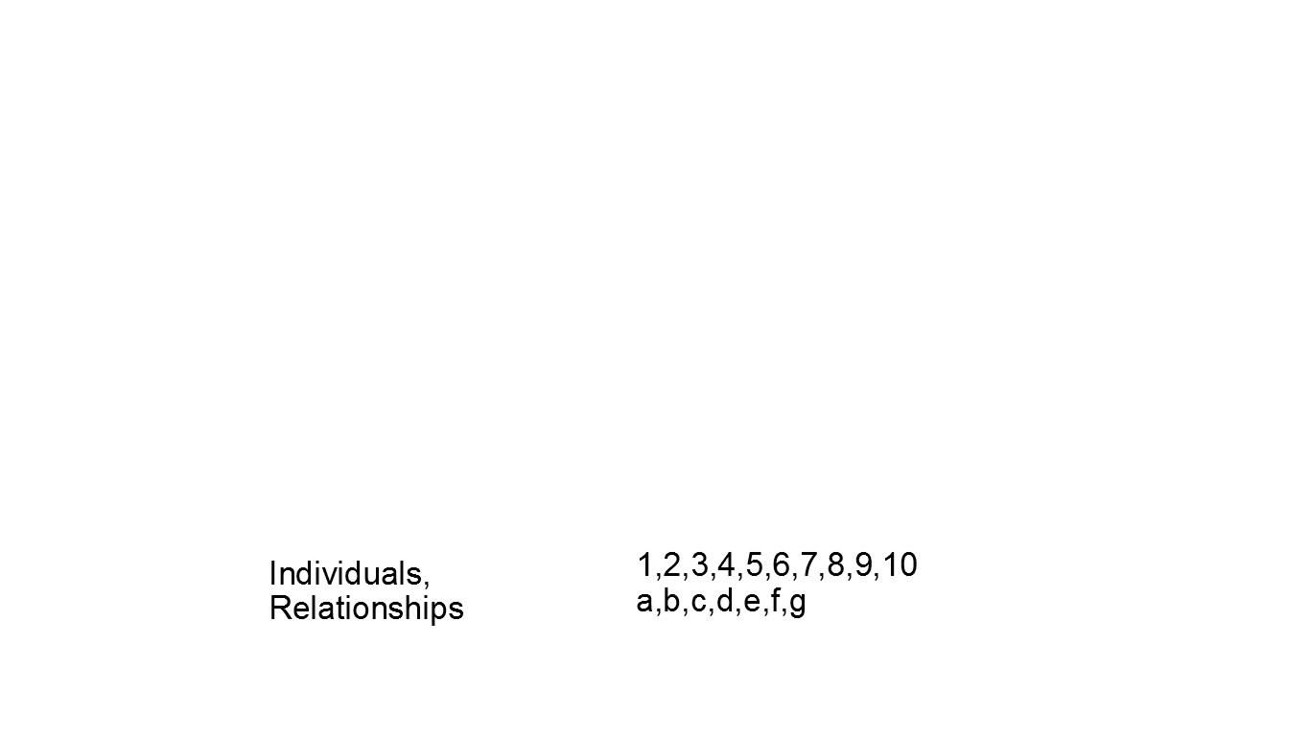

Slide 23
A model of society
At the first level of society are individuals and their relationships as individuals.
At the second level are organizations, like the family, which are bundles of individual relationships.
Organizations span families, groups, tribes, neighborhoods, churches, schools, corporations, towns, and multinational business entities.

Slide 24
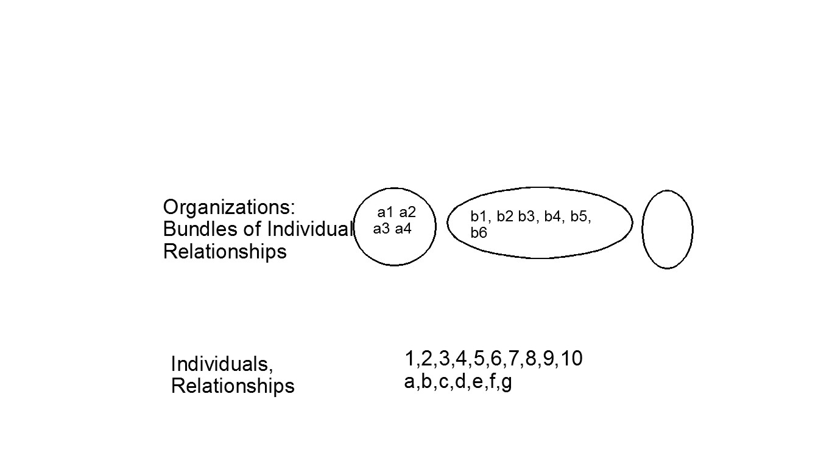

Slide 25
A model of society
At the first level of society are individuals and their relationships as individuals.
At the second level are organizations, like the family, which are bundles of individual relationships.
At the third level are societies, which are bundles of organizational relationships, and, by inclusion, individual relationships.

Slide 26
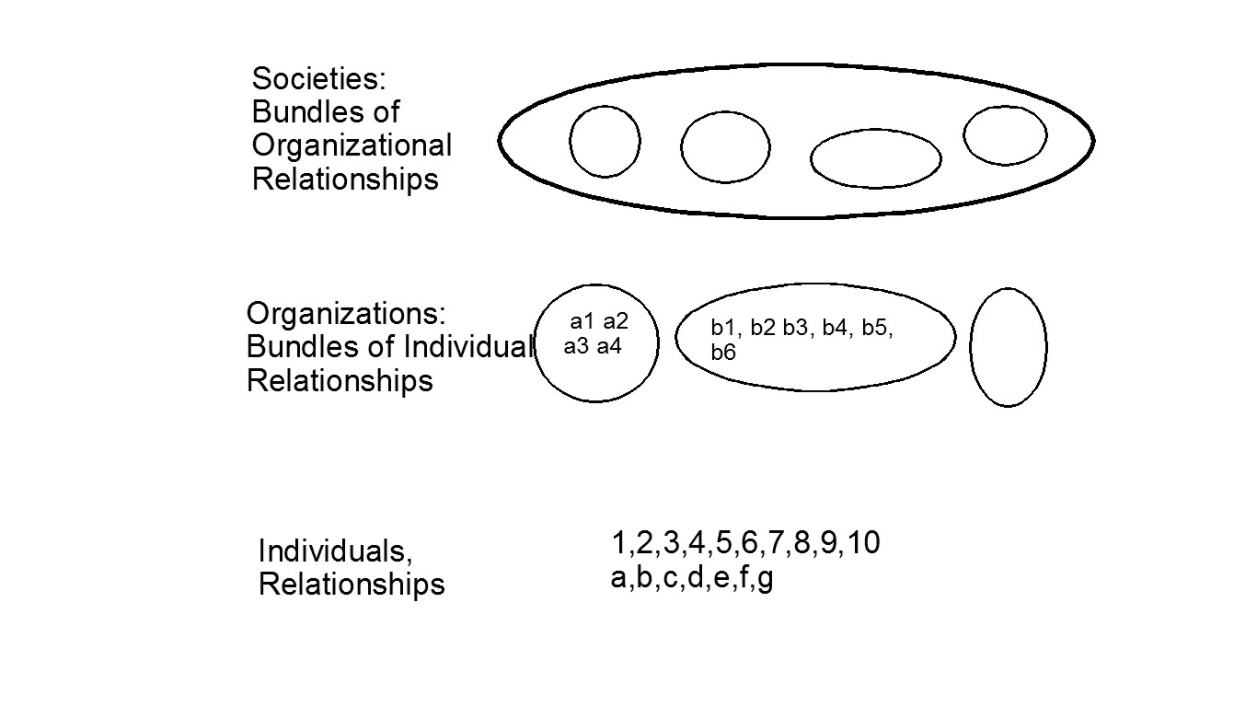

Slide 27
A simple model of society
Institutions are, following North, the rules of the game, the methods of enforcement, and the organizations that play the game.
What drives the formation of institutions is the value of relationships, at all three levels of society.

Slide 28
Enforcement
Rules (institutions) are enforced by a variety of ways:
The ongoing value of the relationships.
Reputation.
Institutional arrangements like bonding and hostages, or Greif’s Community responsibility system.
Third party enforcers who may use coercion (the threat of violence).

Slide 29
What about the State?
Hobbes argues that without a state, a Leviathan, capable of overawing everyone, that the inevitable outcome of social interaction is civil war:

Slide 30
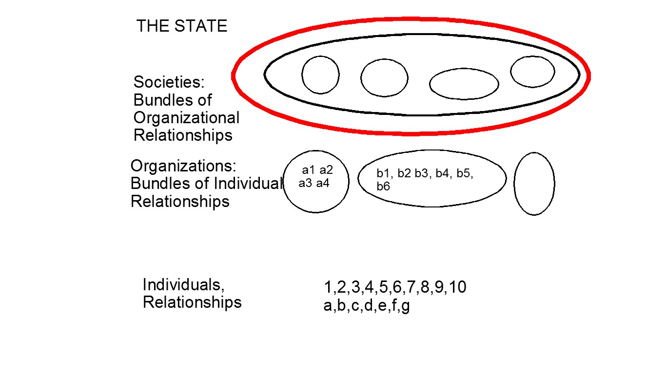

Slide 31
For Hobbes, this is very much “the King above the law.” Indeed, it is the Sovereign above society.
Centuries of medieval political thinkers debated the nature of sovereignty, which is precisely this question, “can the king be bound by the law if he is truly sovereign?”
Despite the modern concern with “limited government” we still use the leviathan model as a way to think about the state.

Slide 32
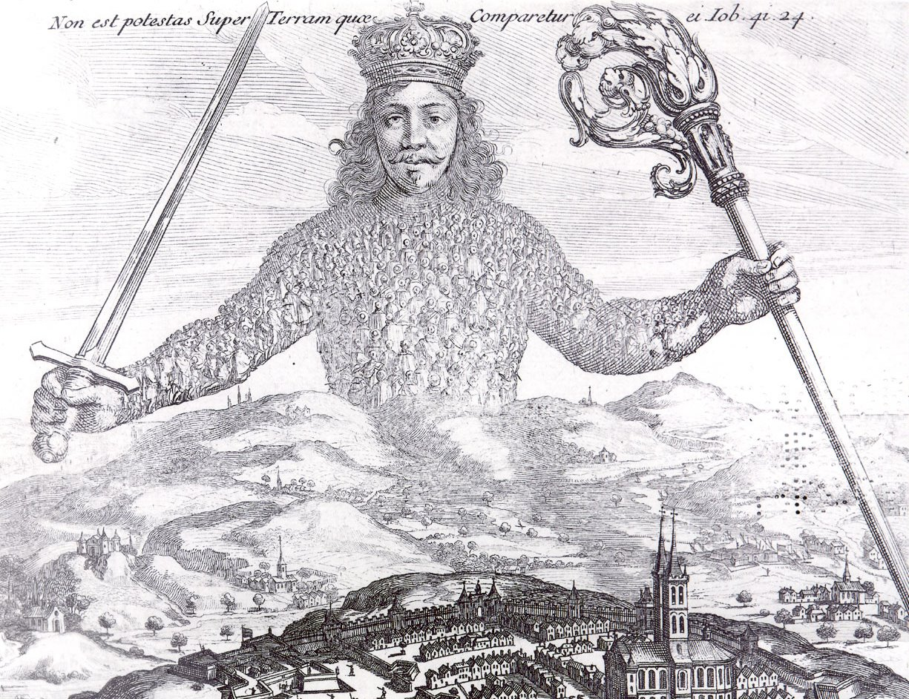

Slide 33
The alternative is to think of governments as organizations within the larger network of organizations.
We will return to their function, and their relationship to coercion in a few slides.
Before that we need to have an idea of how credible third party enforcement takes place, without assuming that one party has a comparative advantage in coercion.

Slide 34
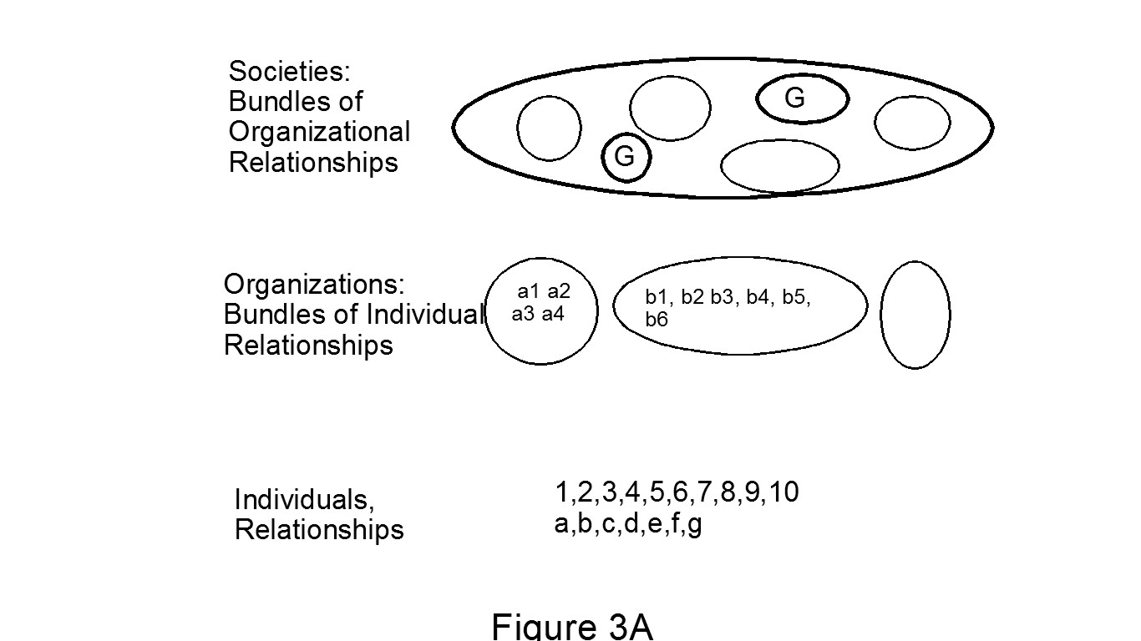

Slide 35
Third parties
How are third parties and enforcement organized?
North, Wallis, and Weingast offer a theory in Violence and Social Orders.
They call it the Logic of the Natural State.
Third parties and rule enforcement do not require a government.

Slide 36
Two Fundamental Types of Organizations
Adherent Organizations:
-- Organizations whose internal arrangements depend only on incentive-compatible, self-enforcing agreements.
Contractual Organizations:
-- Organizations that utilize third parties to enforce some or all of their internal arrangements.

Slide 37
Adherent Organization
A
B
a
b
a
b
a
b
Contractual
Contractual

Slide 38
The Nature of Rents
By enabling the formation of larger and better coordinated groups and organizations, the natural state creates rents from increased output and productivity through greater coordination and scale.

Slide 39
A
B
a
a
Rents
a

Slide 40
Identity Rules
1) The logic of the natural state that underlies the A & B world is capable of explaining the organization of violence within a society.
2) There is no government, neither A or B has a monopoly on violence. Both use coercion, that is, they threaten violence.
3) There is credible third-party enforcement of rules, but the rules are, by necessity, identity rules.
A enforces rules for B, and B for A, and as well for the a’s and b’s. How the rules apply depend on whether you are A or B, or an “a” or a “b.”

Slide 41
From description to theory
Note that the following figure which is a description of society, viewed from above (or below)

Slide 43
From description to theory
Note that the description of society, viewed from above (or below)
Is the same as the following figure of society viewed from the side

Slide 44
Adherent Organization
A
B
a
b
a
b
a
b
Contractual
Contractual

Slide 45
From description to theory
Note that the description of society, viewed from above (or below)
Is the same as the figure of society viewed from the side
Which is a theory of society, with rules, enforcement and organizations.

Slide 46
SIOE
The role of organizations is central to the creation of rules and their credible enforcement.
It is the rents from organizations that make commitments to honor and enforce rules credible. Most enforcement comes from within relationships (at many levels),
Institutional and Organizational Economics

Slide 47
Governments as Coordinators
The A & B world way of thinking about elite organizations and coalitions of elite organizations, government organizations are coordinators, not (necessarily) coercers.
When it is important for elites to coordinate on an outcome, a government organization is created.
Governments are organizations “that signify public agreements.”

Slide 48
Hobbes’s Logic
Hobbes argues that there is
1) an agreement
2) coercive sovereign power is created
3) rules are created
Instead
1) an agreement about rules
2) rules are created
3) coercion and other arrangements emerge/adjust in the context of relationships and third parties

Slide 49
The Agreement
The agreement can be about a lot of things.
What functions are undertaken by public and private organizations.
How governments are organized.
What are the rules and the means of enforcement the government uses? Courts.
Who gets to form organizations?
What can those organizations do?

Slide 50
Who uses the Hobbesian Logic?

Slide 51
New Institutional social science
North
Olson
North and Weingast
Weingast
Bates
Levi
Greif
Boix
Acemoglu and Robinson
North, Wallis, and Weingast
Economists like Wicksell, Schumpeter, Lindstrom
Sociologists like Marx, Weber, Tilly, Skocpol, Evans, and Ruschmeyer
Political scientists like Huntingdon, Finer Poggi, ... Fukuyama
Anthropologists like Morris and Carneiro.

Slide 52
Barry Weingast neatly summarized existing theories about government and development when he asked “how can a government strong enough to secure property rights be prevented from expropriating them” (paraphrase, Weingast, 1995, p. 1)
Coercion first, rules second

Slide 53
“But what is government itself, but the greatest of all reflections on human nature? If men were angels, no government would be necessary. If angels were to govern men, neither external nor internal controls on government would be necessary. In framing a government which is to be administered by men over men, the great difficulty lies in this: you must first enable the government to control the governed; and in the next place oblige it to control itself.” James Madison, writing as Publius in The Independent Journal, Wednesday February 6, 1788; Federalist #51.
Coercion first, rules second

Slide 54
Agreements and organized violence
Before violence can be organized, there must be an agreement between the organizations in the dominant network about the rules governing the economic, religious, and other privileges that credibly limit violence within the network.
The government(s) are the organizations that signify those agreements

Slide 55
Today, however, we have to say that a state is a human community that (successfully) claims the monopoly of the legitimate use of physical force within a given territory. Note that ‘territory’ is one of the characteristics of the state. Specifically, at the present time, the right to use physical force is ascribed to other institutions or to individuals only to the extent that the state permits it. The state is considered the sole source of the ‘right’ to use violence. Hence, politics for us means striving to share power or striving to influence the distribution of power, either among states or among groups within a state. (Max Weber, from “Politics as a Vocation”)

Slide 56
Note that Weber’s definition does not require the state to have a monopoly on the use of violence, but on the licensing of violence. A modern state appears when all of the “legitimate” uses of violence are specified in the agreement that the state signifies.
Weber’s definition is a special case of the larger definition of governments as organizations that publicly signify agreements.

Slide 57
Agreements?
Can governments simply announce agreements and have them followed?
NO.
I am going to skip the fascinating question of how societies structure the rules for forming rules, what H.L.A. Hart calls secondary rules.
As societies become better organized, even as they remain natural states, the agreement about how to form rules become clearer and more stable.
Now on to impersonal rules.

Slide 58
From identity to impersonal rules
If most societies have identity rule regimes, in which either the rules, their enforcement, or likely both vary depending on the organizational identity of individuals, how can elites be induced to give up their privileged position?

Slide 59
Moving to Impersonal Rules
If elites want to move to impersonal rules and reach an agreement to that effect, will it work?
In Hobbes’s world, yes.
In a world where governments are the organizations that publicly signify agreements, probably not, at least at first.

Slide 60
The Paradox of Privilege
Although identity rules privilege elites and elite organizations, they create a paradox.
Because courts are less likely to rule against a more powerful elite, the more powerful an elite is, the less able he is to bind himself by a rule.
In an identity rule regime, all elites are different, some are more powerful than others, based on their identities.

Slide 61
Suppose the two elites form a business. Both partners put in resources, time, and money, but one partner does more that is difficult for the other partner to observe; a typical theory of the firm problem.
How can the “active” partner ensure the “passive” partner that he will expend the agreed upon effort?
One solution would be for the active partner to give the passive partner a promissory note, for an amount larger than the costs of effort to the active partner and smaller than the benefits of the ongoing relationship to the passive partner.

Slide 62
The arrangement is incentive compatible, and expectations are that the promissory note will never be enforced.
What, however, if the two elites are not equal? Elites often have fine gradations of status. What if the more powerful elite is able to prevent the promissory note from being enforced against him?
This is where identity rules work against elites: the more powerful the elite is, the less able the elite is to bind himself with a rule.

Slide 63
Asymmetry
Suppose there are six elites, ranked in status from 1 to 6.
In the following table the column player writes the promissory note, the row player holds it.
Credible commitments are marked with an X.
The more powerful elite can hold a note, but cannot write one.

Slide 64
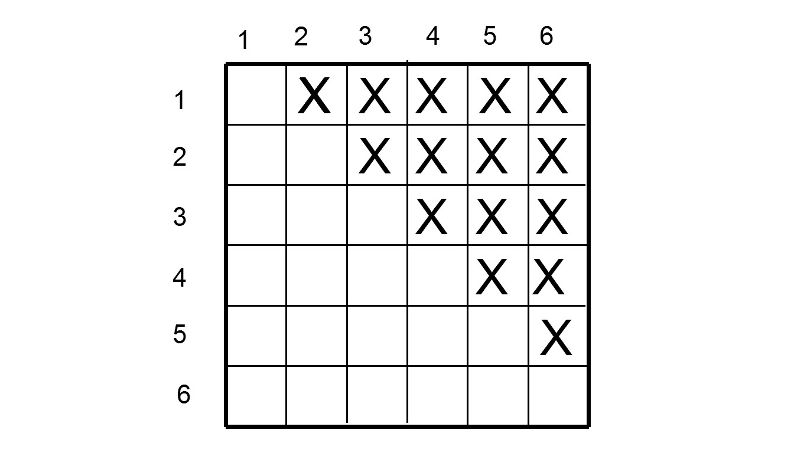

Slide 65
Impersonal rules
Now what happens if elites all agree to “treat each other the same.” To have courts enforce promissory notes no matter who the parties are.
The matrix of credible contracts now doubles.

Slide 66
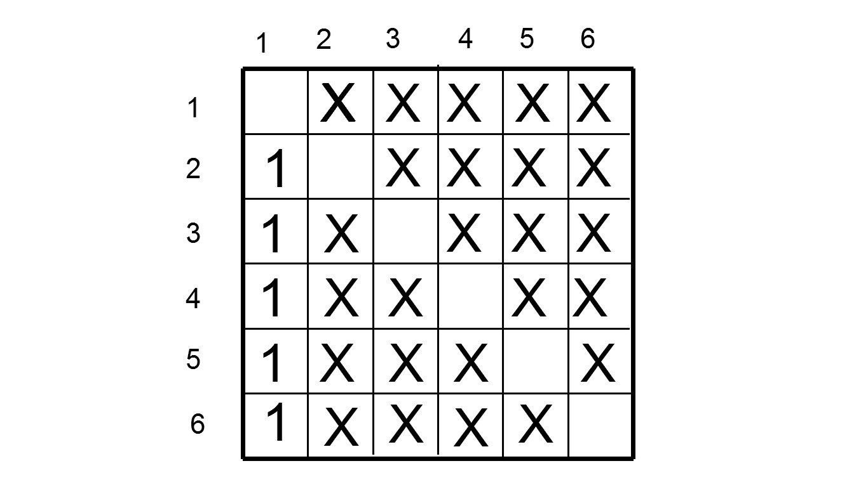

Slide 67
More importantly, it is the most powerful elite who gains the most from adopting the impersonal rule (the ‘1”s).
Under an impersonal rule the more powerful elite can be active or passive partner.
If the gains from moving to impersonal rules are asymmetric, and benefit more powerful individuals and organizations more than less, then the powerful elites will be willing to coordinate impersonal rules through the government.

Slide 68
Conclusions
The ability to create and enforce impersonal rules is a central element in the emergence of modern developed societies.
I have presented a different way to think about rules, governments, and social dynamics.
1) Rules can be identity or impersonal rules.
2) Governments are coordinating organizations.
3) Social dynamics regulate the use of violence and the relationship between powerful organizations

Slide 69
In most societies, identity rules are the best institution available, because the rents created by identity rules enable a network of coalitions to maintain some stability.
Impersonal rules are not sustainable, and therefore not adopted.
It is when the coordinating benefits of government enforced impersonal rules becomes large enough for powerful individuals and organizations, that societies move toward “modernity.”

Slide 70
New Social Dynamics
How can elite organizations in the dominant network create a government that will credibly enforce some impersonal rules?
It must change the social dynamics the government faces.
It can do so by changing the rules for forming organizations, but that is dangerous if the government can use the tool to side with one coalition or another.
The key is to take away the tool, let everyone form an organization.
That is the most important impersonal rule: let everyone form an organization.

Slide 71
Default Rules and Freedom of Contract

Slide 72
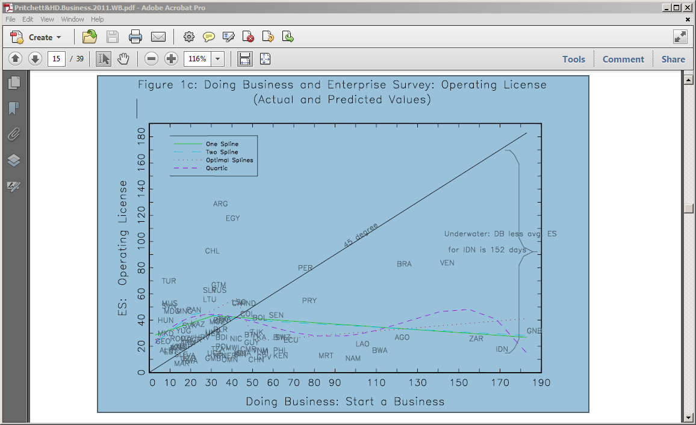

Slide 73
Figure 14

Slide 74
Figure 15

Slide 75
This system is not an experiment. We tried it, to a slight extent, in the Constitution of 1849. We there declared that certain things were never to be provided for by a special or local act. In 1865 Missouri followed our example, and took the lead we gave her, largely increasing the number of classes entirely excluded, and forbidding the passage of other local or special acts which general acts could provide for. In 1870 Illinois tried the same plan and enlarged the list. In 1871 Wisconsin followed suit. In 1872 West Virginia tried the Missouri Constitution of 1965. In 1873 Pennsylvania still further increased the number of classes excluded, and required that a notice should be published before any other private bills should be passed, and forbade the enactment of any private act if a general law could be made applicable. In 1874 New York followed Pennsylvania and Missouri. In 1875 Missouri, after and experience of ten years, of the plan I have described, enlarged it. In fact, she adopted restrictions that are, in effect, as severe as any as those we recommend. This shows that Missouri found she was moving in the right direction. In 1875 New Jersey imitated Pennsylvania and Missouri, and in 1876 Texas completely copied the provisions of the Pennsylvania Constitution. We compared all of these provisions, and we embodied in this section the best of them, and we examined a great many of the local and private acts of our State.” (Remarks of Mr. McDermott, Official Report of the Proceedings and Debates in the Convention Assembled at Frankfort,1890, III: 3992.)

