Slide 1
The Impact of Globalization on the Organization of Firms
Professor Maria Guadalupe
INSEAD, CEPR and IZA

Slide 2
“Globalization”
Decrease in information, transportation and trade costs
Increase in competition in product markets
How do firms adapt to those changes?

Slide 3
Effect of Competition on Organizations
How does product market competition affect the way firms pay and interact with their workers?
Important theoretical question. Many papers… but theory has delivered few unambiguous predictions.
Empirically we know little and the problem is plagued with endogeneity issues. Competition changes a lot of factors and a lot of factors affect competition.
Measuring “competition”
Objective: Isolate the causal effects of competition through exogenous shocks to competition.

Slide 4
Roadmap: Organizational Changes
Incentives, executive compensation
  Cuñat, V., and Guadalupe M., 2009, "Globalization and the provision of incentives inside the firm: The effect of foreign competition", Journal of Labor Economics
Wages and returns to skill
Guadalupe M., 2007, “Product Market Competition, Returns to Skill and Wage Inequality” Journal of Labor Economics
Hierarchies
  Guadalupe, M., and Wulf, J., 2010, "The flattening firm and product market competition: The Effect of Trade Liberalization on Corporate Hierarchies», American Economic Journal: Applied Economics

Slide 5
Leitmotifs in this work
Going “inside the firm”
Establish causal effects:
  “Quasi-natural” experiments
  Instrumental variables
Rich set of facts
Theory: Stimulate or illustrate?

Slide 6
I. Incentives, Executive Compensation

Slide 7
Increases in Competition and Explicit Incentives
Theoretical framework: Standard principal agent model + competition:
  Boone (2002), Vives (2005), Raith (2003), Schmidt (1997)
Principal: Shareholders, set incentive scheme as a function of performance. Inducing effort is increasingly costly.
Agent: Manager, exerts productive effort that“sets up” the firm, affecting marginal cost (workers’ efficiency).
Competition affects the optimal incentive scheme through changes in the profit function.

Slide 8
Principal agent + competition affects profits
Profits
Standard profit function.
Managerial effort leads to higher efficiency
Positive relationship between effort and profits.
How does competition affect this picture?
Effort

Slide 9
Principal agent + competition affects profits
Profits
First effect: competition makes profit function more elastic to effort due to market stealing.
Firms should therefore be willing to pay more to give incentives to their managers
Effort

Slide 10
Principal agent + competition affects profits
Profits
Second effect: More Competition reduces markups. Given market share lower profits.
Proportional shift, not parallel!! Affects slope
If this was the only effect, firms should be willing to pay less to give incentives to their managers
Effort

Slide 11
Principal agent + competition affects profits
Profits
The overall effect on the slope at a given point is ambiguous.
How general is this?
It applies to most existing competition models
Boone (2002), Vives (2005), Schmidt (1997)
Raith (2003): free entry
Effort

Slide 12
Raith (2003)
Raith (2003): Under free entry, market stealing effect always dominates
Schmidt (1997): Additional mechanism
  Increase in bankruptcy probability increases effort (implicit incentives)

Slide 13
Empirical strategy
Find sources of exogenous variation in competition
Theory is ambiguous: What is the empirical evidence?
Three articles (joint with Vicente Cuñat, LSE)
  How does competition shape incentive contracts? (JEEA)
  Executive Compensation and Competition in the Banking and Financial Sectors (JBF)
  Globalization and the provision of incentives inside the firm (JOLE)

Slide 14
  Globalization and the provision of incentives inside the firm
Firms face increasing competition from foreign markets
How does this affect the structure of compensation contracts:
  Explicit incentives (bonus etc)
  Returns to a promotion
  Demand for talent at the top

Slide 15
Data description: a) Executive Compensation data
Execucomp: top 5 executives, S&P1500 firms
Detailed compensation since 1992

Slide 16
Data description: b) Data on foreign competition
Instrumented Independent Variable:
Import penetration by firm and year:
  Demeaned at the industry level
Instruments:
Average tariff by firm and year: from (UNCTADS)
Real effective exch. rate and exchange rate by firm and year: weighted bilateral exchange rate between US and importing countries (weight of the country in total imports in 91-92) (Bertrand 2004):

Slide 17
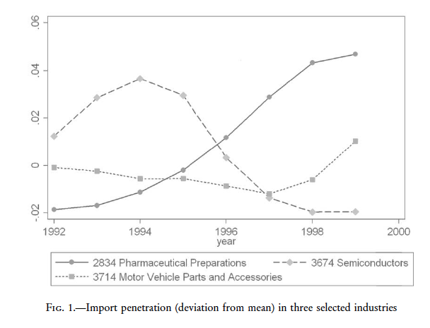

Slide 18
1.The effect of globalization on the compensation structure
Effect on wages
A) fixed part: β1
B) variable part: β2
W
β₀
α
β₀+ β₂
α + β₁
PERF

Slide 19
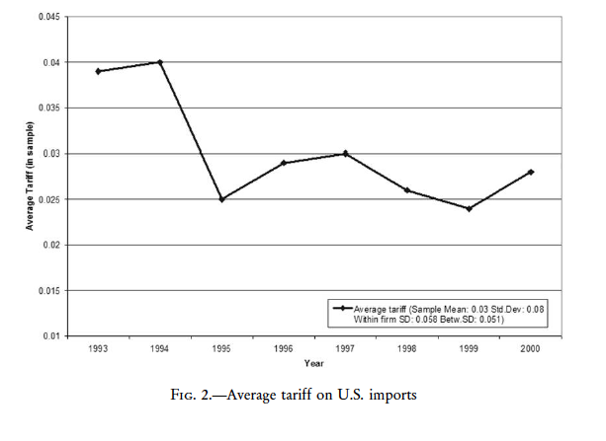

Slide 20
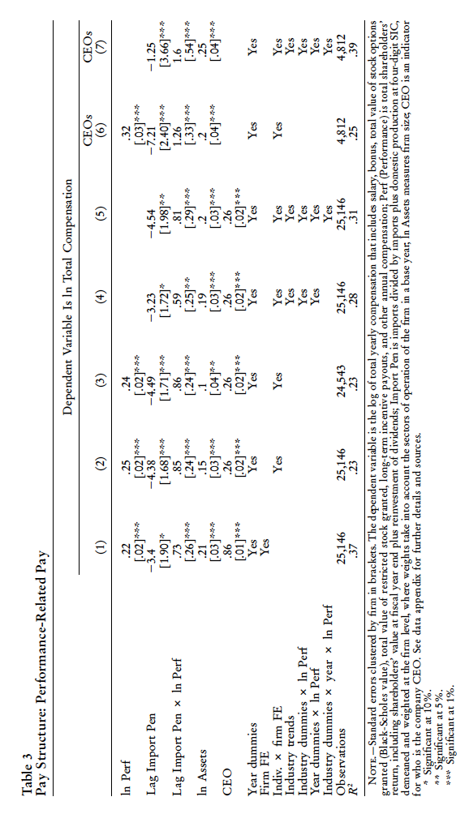
Notes:
Emphazise the fixed effects

Slide 21
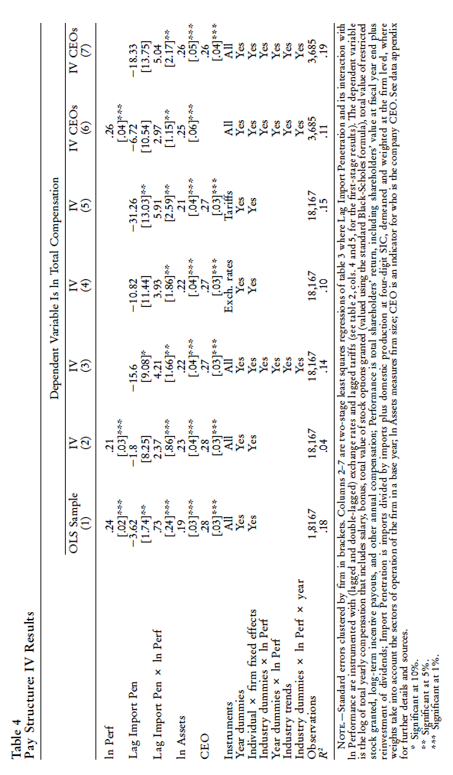

Slide 22
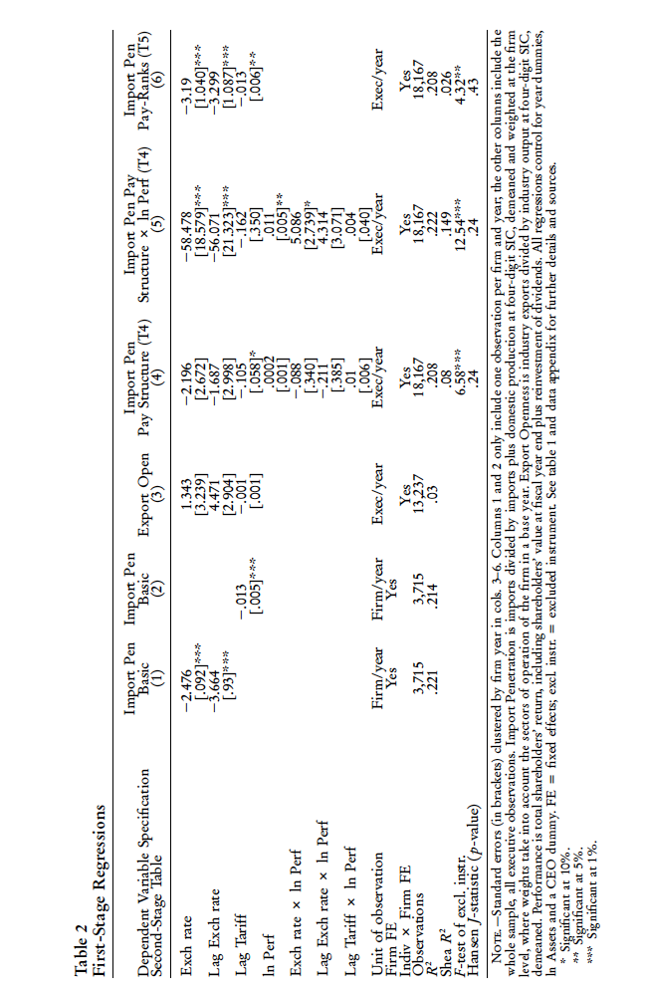

Slide 23
2. The effect of globalization on the wage ladder
‘Wage ladder’:
  distance between two wage levels
  Tournaments and returns to a promotion
W
ceo
ceo
exec2
exec2
exec3
exec5
exec5
Import Penetration

Slide 24
Measuring the wage ladder
Rank individuals in a firm by their wage: D1 (the ceo) to D5
See how the average distance between these two ranks changes
CEO wage change
Average Distance
to the CEO
(CEO=omitted cat.)
Change in distance
to the CEO

Slide 25
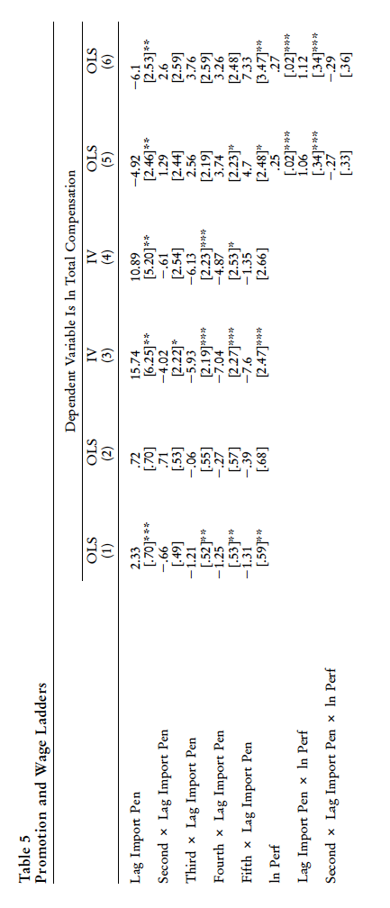
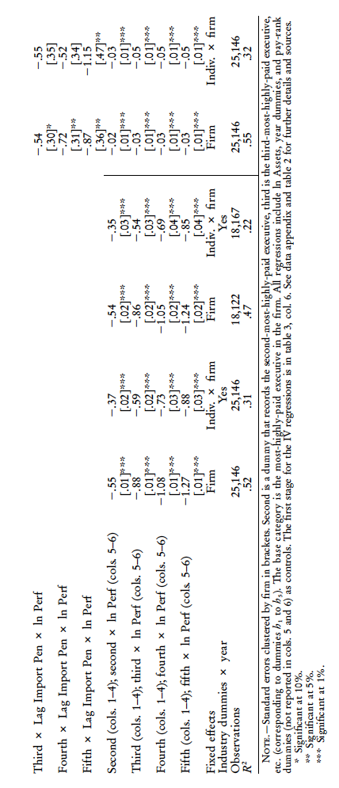

Slide 26
3. Talent
Measure change in the ability of the executives hired following the increase in foreign competition:
First stage: Calculate individual fixed effect of each executive, controlling for the same variables used in section 1
μ_{i} measures the wage premium of an executive, not explained by observable variables.

Slide 27
3. Talent (II)
Introduction Theory UK+ Xrate Dereg. + Banking Globalization Conclusions
Second stage, regress the individual fixed effect against import penetration, year and firm dummies.
Note that the presence of firm dummies makes the estimator be only identified on the basis of movers.

Slide 28
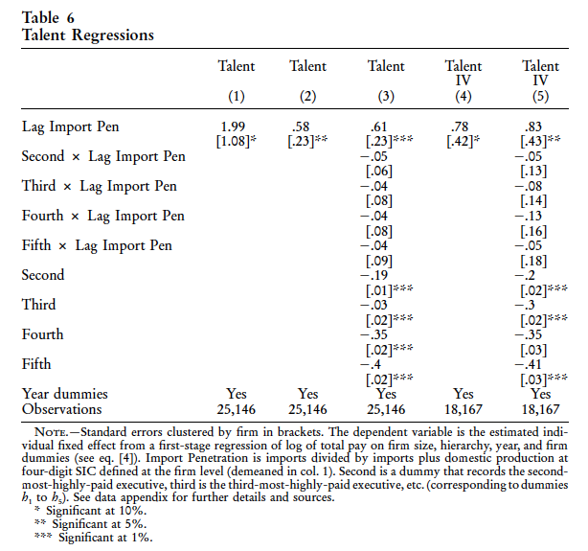

Slide 29
II. Returns to Skill and Wage Inequality
Large increase in wage inequality
  Skilled-biased technical change
  Unionization
Competition: Direct link from product to labor markets?
Is there an effect?
What are the channels?

Slide 30
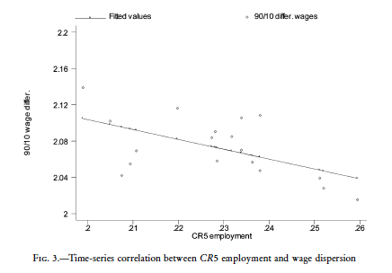
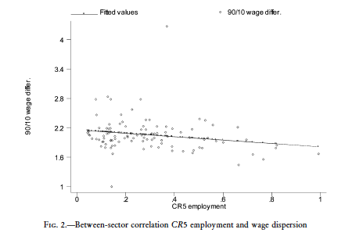
Raw Correlation

Slide 31
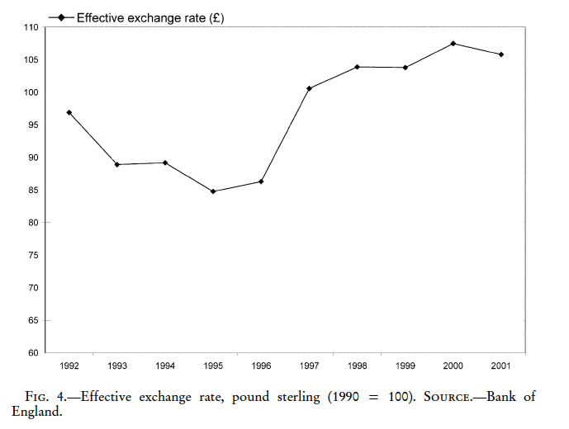
Looking to Establish Causality
Data: UK NES, 2% of UK workforce a panel
Shocks to Competition
European Single Market Program 1992
1996 depreciation of the pound

Slide 32

Empirical Specification
Differences-in-Differences

Slide 33
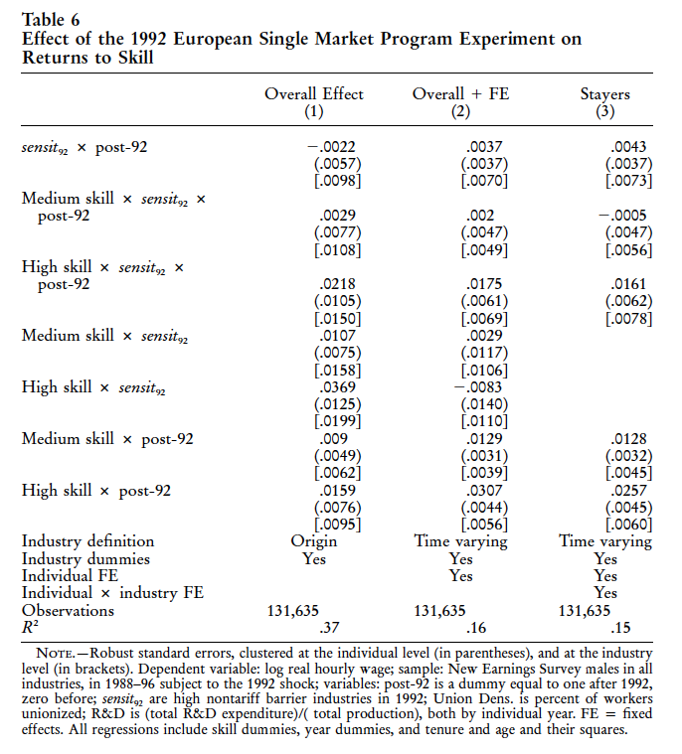

Slide 34
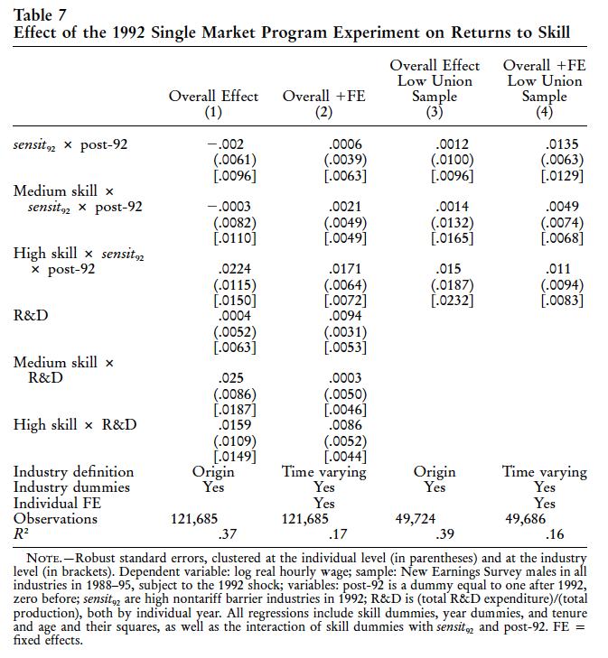

Slide 35
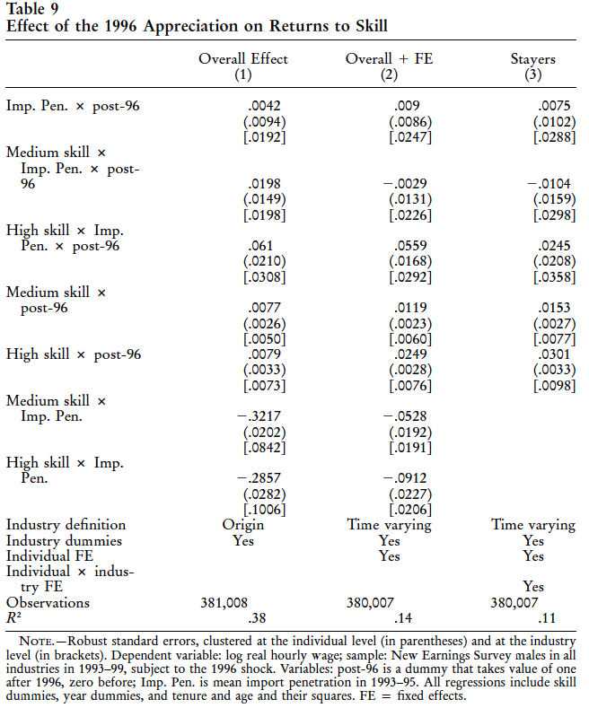

Slide 36
Magnitude of the Effects
SMP: 5% of increase in skill gap over 1998-1996
1996 shock: 38% of increase in skill gap in 1992-1999
Evidence of a direct effect

Slide 37
III. Hierarchies
Guadalupe and Wulf, 2009, The Flattening Firm and Product Market Competition: The Effect of Trade Liberalization, AEJ: Applied

Slide 38
Illustration of a Corporate Hierarchy: Boeing
CEO
Depth = 1
Span of Control = 5
Commercial
Airplanes
Integ. Defense
Systems
CFO
Legal
HR
Div.Mgr
737
Div. Mgr
747
Div. Mgr.
777
Div.Mgr.
Weapons
Satellite
ground
control
Div. Mgr.
Milit.
Airplanes
Plant Mgr.
Plant Mgr.
Notes:
Our measures to characterize the hierarchy: Define Span and Depth

Slide 39
Firms are flattening (Rajan and Wulf, 2006)
Average CEO Span and Div. Depth, 1986-1999
Notes:
Firms are flattening: broader spans of control and fewer levels in the hierarchy.
Shown in a previous paper…span 4.5 to almost 7; depth 1.5 to about 1.2

Slide 40
Why are firms flattening?
IT?
Changes in firm scope?
Product markets?
CHALLENGES:
  Open the “black box” of the firm
  Establish causality
Notes:
Is it IT? Certainly part of it. Number of papers have explored the relationship between IT and organizational characteristics. Luis’s talk last week is one example of this.
Is it changes in firm scope? Again, certainly part of it. Firms were re-focusing and becoming less diversified during this time period.
The focus in our paper: changes in product markets… specifically increases in domestic and foreign competition that come from reductions in the costs of trade, communications and transportation costs. While we recognize the importance of IT and changes in firm scope (and we control for both), our focus is on the effect of increasing competition.
Challenges
Opening the “black box” of the firm…inside the firm data
Measure hierarchies systematically across firms; other aspects of organizational change
Establish causality
Much of the literature consists of correlations
Generalize across industries

Slide 41
Our approach
Use a unique panel dataset of internal firm organization, large US firms 1986-1999
  Span, Depth and Pay
  Within firm (and position) changes
Source of variation to establish causality
  A “shock” to the environment: Trade Liberalization between US and Canada
Interpret observed relationships to understand changes in organizations
Notes:
41
Use of unique panel dataset
Source of variation to establish causality
So, our approach:
Very applied micro approach: panel + arguably exogeous measures
Very little theory: we’ll look at a series of relationships to provide an interpretation of what is going on
Evidence on firm structure, pay and incentives, as well as other outcomes

Slide 42
Why Delayer/ Flatten?
Downsizing/ Cost-Cutting
  X-inefficiency (e.g., Liebenstein, 1966; Hart, 1983): competition forces firms to eliminate slack
Optimal response to changes in the environment
  Value of speed + adaptation to local information in response to competition
    (e.g., Whittington, et. al., 1999)
  Trade-off between adaptation vs. coordination
    (e.g., Dessein and Santos, 2006)
Notes:
downsizing/ cost-cutting: X-inefficiency: firms are not optimizing & greater competition forces firms to eliminate organizational slack
Optimal response to changes in environment:
Value of speed + adaptation to local information in response to competition (e.g., Whittington, Pettigrew, Peck, Fenton, and Conyon, 1999)
Management scholars have long argued that increased competition leads firms to search for new org practices to replace traditional hierarchies Burns and Stalker (1961) and Lawrence and Lorsch (1967)
Additional layers impede information flows & competition increases the value of speed…so firms eliminate layers to improve response times (delayering)
Decentralize decision-making to exploit knowledge of lower level managers (customers, suppliers, competitors) to be more responsive/adaptive to local information
More formally, econ theories focus on assymetric information between CEO and DMs
Tradeoff between information vs. control (e.g., Aghion & Tirole, 1997)
Headquarters may delegate authority to DMs to improve incentives to collect information, but at a cost of loss of control over decisions
Tradeoff between adaptation vs. coordination (e.g., Dessein and Santos, 2006)
Headquarters may delegate authority to DMs to be more responsive to local market conditions, but this increases costs to coordinate when multiple business units & presence of externalities
Econ theories less about hierarchy and more about delegation…later will discuss how to think about relationship b/n hierarchy & delegation
Firms need to acquire information about local conditions, transmit information to decision-maker & make decisions that are optimal for the firm

Slide 43
Interactions in Organizational Design
Beyond series of trade-offs, theory highlights complementarities among subsets of org. choices
  E.g., Milgrom & Roberts (1990); Holmstrom & Milgrom (1994)
Recent papers examine simultaneous determination of incentives & decision-making authority of DMs
  E.g., Athey & Roberts (2001); Prendergast (2002); Freibel & Raith (2007); Alonso, Dessein & Matouschek (2008); Rantakari (2008)
Other related papers on relationship between organization & competition
  E.g., Martin & Verdier (2003), Thesmar & Thoenig (2000), Conconi, Legros, Newman (2008)
Notes:
We observe firms making multiple changes in org design
Beyond series of trade-offs, theory highlights complementarities among subsets of org. choices
More recent papers examine simultaneous determination of incentives & decision-making authority of DMs (solidly in the set-up of Headquarters as principal and DMs as agents)
Athey & Roberts (2001): strong incentives for effort & aligned (balanced) incentives for good project decisions
Prendergast (2002): delegate decisions to better informed DMs, but keep them in check with high-powered incentives
Freibel & Raith (2007): motivate DMs to generate high-quality projects & communicate information to headquarters
Alonso, Dessein & Matouschek (2008)
Rantakari (2008)--Makes predictions about location of decision rights (i.e, CEO or DMs) and strength and balance of incentive provision for DMs…all as a function of volatility of the environment.
Ultimately, the effect of competition on various organizational choices is an empirical issue.
Basic tension: strong incentives to motivate information acquisition & balanced incentives to motivate accurate transmission & use of information

Slide 44
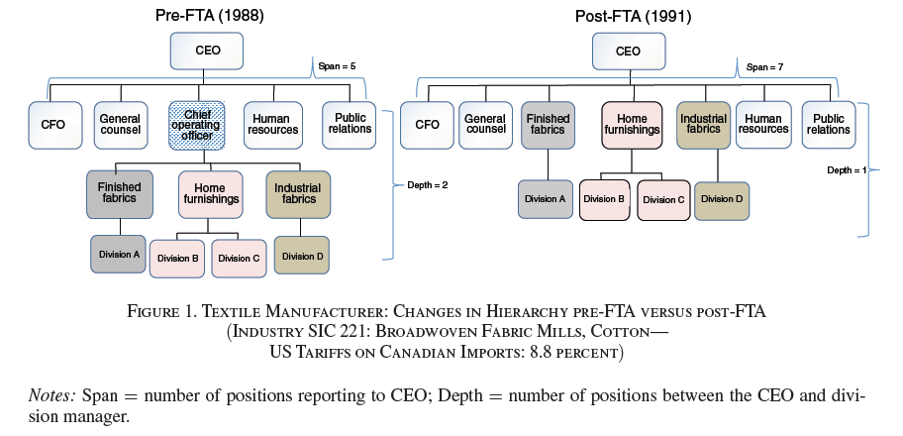

Slide 45
Data (1): Organization
Confidential compensation survey
  300+ Fortune 500 firms -- Hewitt Associates (1986-1999)
  50+ management positions in the US
  Includes pay and reporting relationships
ORGANIZATIONAL MEASURES:
  CEO Span of control
  Division Depth
  ln (total pay) & Incentive Pay
Our Sample: Manufacturing (traded) industries
  14 years; 230 firms (1962 obs.); 1524 divisions (6300 obs)
Merged to Compustat
Notes:
Pay components include salary, bonus, restricted stock, stock options, other LT incentives
Unique aspect of this data set that we exploit is the information about reporting relationships:
1.which titles positions report to
2.the number of reporting levels between the position and the CEO
The typical firm in the sample is a large, mature stable firm, not one whose organizational structure is likely to be in flux. Think of sample firms as a subset of Fortune 500 companies
There are certainly limitations in using these data to infer something about organizational form. However, due to the limited research in the area, we think we can learn something from doing so.

Slide 46
Data (2): Trade Liberalization
Canada-US Free Trade Agreement (FTA) 1989: eliminates all trade barriers
Higher tariff industries: larger competitive shock
Exogeneity of shock?
  Substantial opposition
  Clean experiment (Trefler, AER 2004)
Exogeneity of initial tariff levels?
  Trends and industry characteristics
Economic significance?
Notes:
Empirical Strategy: Exploit Canada-US FTA that eliminated all trade barriers between the US and Canada.
US firms in industries with high US tariffs on Canadian imports prior to the agreement experienced a greater reduction in entry barriers into their industry compared to those with low tariffs….larger competitive shock
But, since Canadian tariffs on US exports also fell, US firms may face market expansion opportunities for exports.
Exogeneity of shock?
Initially, details of agreement met substantial opposition. Liberal party strongly opposed the agreement and had a 20 point lead in a highly contested election in oct 1988. Conservative party won the election and agreement went into effect 3 months later.
Clear experiment (trefler)
3 advantages for our empirical strategy
Passage of agreement was highly unexpected
Not a response to a macroeconomic shock, therefore unaccompanied by other economic policies that affect industries
No other important trade agreements at that time..so unlikely to be confounded with other factors.
Exogeneity of initial tariff levels?
We may worry that pre-89 level of tariffs is not random (declining industries may have higher tariffs). We do 2 things:
Control for pre-existing trends in organizational variables (include division-specific time trends)
Control for pre-existing industry characteristics related to tariff protection: skill intensity, capital intensity, & TFP growth of US industries.
Finally, what is the economic significance of FTA?

Slide 47
Effects of the FTA
Canada is largest trading partner with US
  20% of US imports; world’s largest trade relationship (volume)
  Mean US tariffs on Canadian imports (pre-89): 3.9% [0 to 36%]
Products highly substitutable
  Elasticity of substitution = 8 (Head and Ries, AER 2001)
  Increase in US imports due to FTA (Clausing, CJE 2001)
Dual effect on firms: competitive pressure & market expansion
  Canadian firms: incr. productivity of exporting firms (Trefler, AER 2004)
  US firms: MNCs incr. trade, empl. and sales (Feinberg & Keane, AER 2006)
Notes:
Trade with Canada pre-89
Significant variation in US tariffs at 3 and 4 digit SIC, but even greater variation within less aggregated product categories…plus only represents tariffs, not non-tariff barriers.
Products are highly substitutable
Import price elasticity of substitution
Head & Ries (2001, AER) & Romalis (2007, Restat): estimate import price elasticity of substitution.—a 1% reduction in US tariffs is associated with a roughly 8% increase in imports from Canada)
With average tariff about 4% this suggests an increase in imports of about 30+%
Increase in imports (Clausing, 2001, Canadian Journal of Economics)
Effect of FTA on US imports from Canada and ROW. (uses data at the commodity level-10 digit product categories)
Finds a 1% decrease in tariffs is associated with a 9.6% increase in US imports from Canada (dollar value of imports)
Over ½ of $42 B increase in US imports from Canada between 1989 & 1994 was the result of FTA
Effects on firms: m ore evidence on Canadian firms
Canadian Firms: Trefler: for Canadian industries that received the largest US tariff cuts, labor productivity soared by 14%
US firms: Feinberg & Keane: US based MNCs increase trade, employment and sales (increases in trade with 3rd party not Canadian affiliates)
Our firms:

Slide 48
Empirical Specification
ORG = Span; Depth; Compensation; etc.
AvT89 is mean tariff on Canadian imports in 86-88 at SIC4 (3)
Zs = {US skill int. , US capital int. , TFP growth }
ESTIMATION: First differences, Std. Errors clustered by industry throughout.

Slide 49
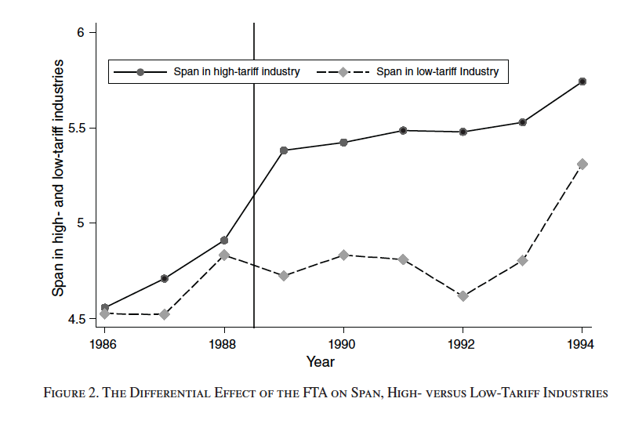

Slide 50
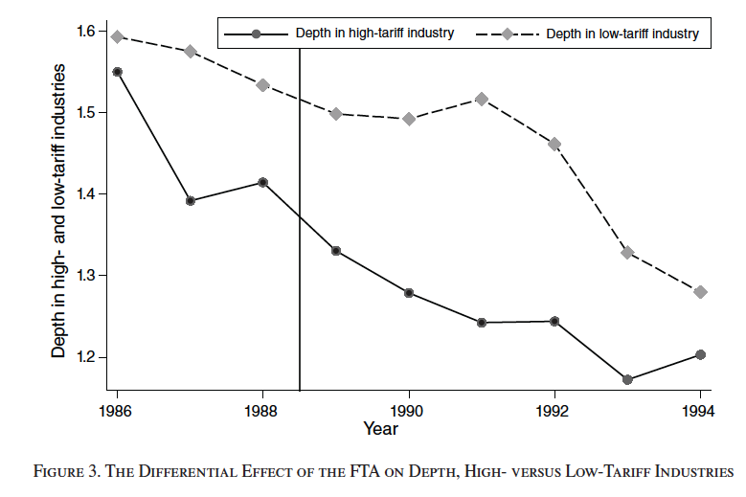

Slide 51
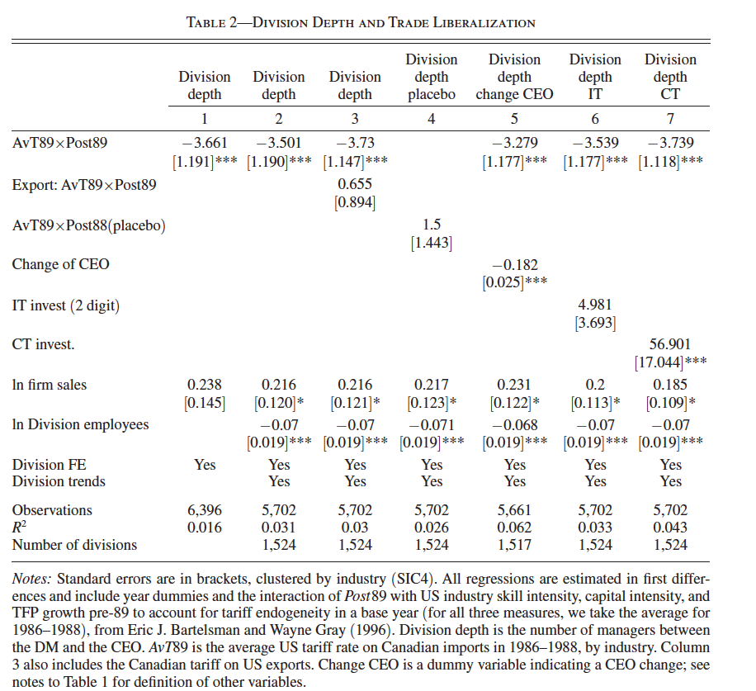

Slide 52
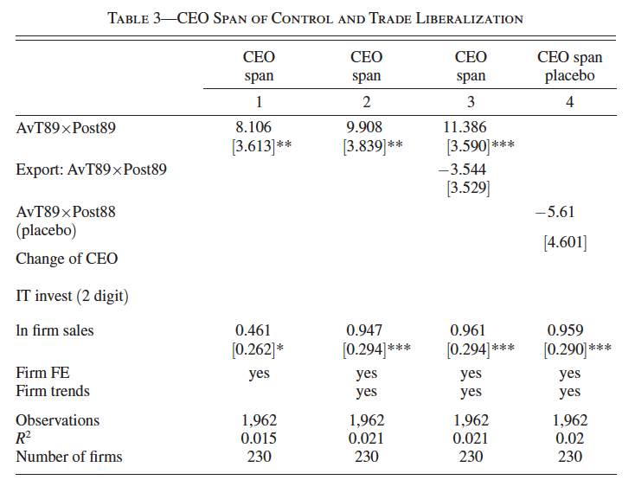

Slide 53
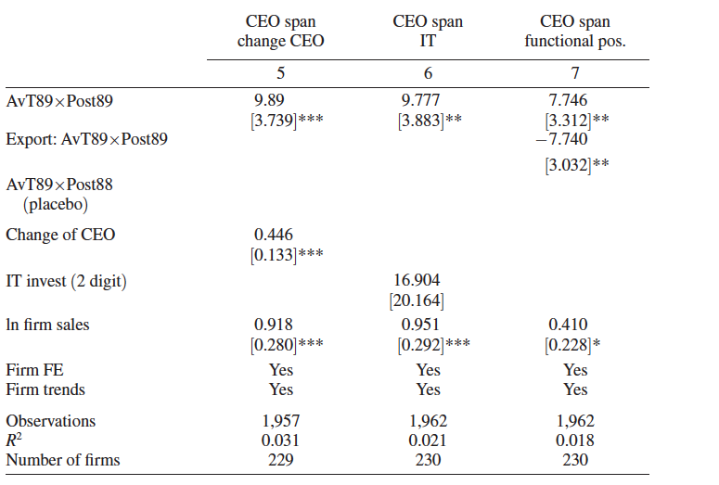

Slide 54
Increased Competitive pressure from FTA → Flattening Hierarchies
But, why are firms flattening?
Is this consistent with delegation of decision-making?
  Look at what else is changing inside the firm.
Notes:
We believe we have established a strong relationship between the external shock and our measures of org change. But, why are firms flattening? What is the mechanism?
There is no single theory that explains the set of changes that we observe. Our approach is to look at other changes in the firm to infer something about the mechanism.
Is flattening consistent with delegation of decision-making?
On the one hand, DM is closer to top so may be broader job scope and more authority, plus CEO span is broader, so less time to spend with each report (greater delegation).
However, DMs now report directly to CEO, so possibly closer monitoring (less delegation)
We Don’t have measures of delegation….but, do know DM pay.
Our approach is to infer something about delegation from changes in proximity to CEO & changes in DM pay

Slide 55
Alternative Explanations for Flattening
Downsizing?
  # of group managers (intermediaries) is declining, but wages of group managers increasing
  Downsizing suggests pay cuts, but we find the opposite
    Increases in DM and CEO pay with increases in competition
Corporate restructuring?
  Is broader span due to firm diversification?
    Firms becoming more focused (less diversified) with increases in competition
  Are org changes due to closing of Canadian subsidiaries?
    Firms reduce the # of subsidiaries with increases in competition, but not significant
Notes:
Are changes due to changes in Canadian subsidiaries?
We might expect the benefit of being in Canada to change with falling tariffs.

Slide 56
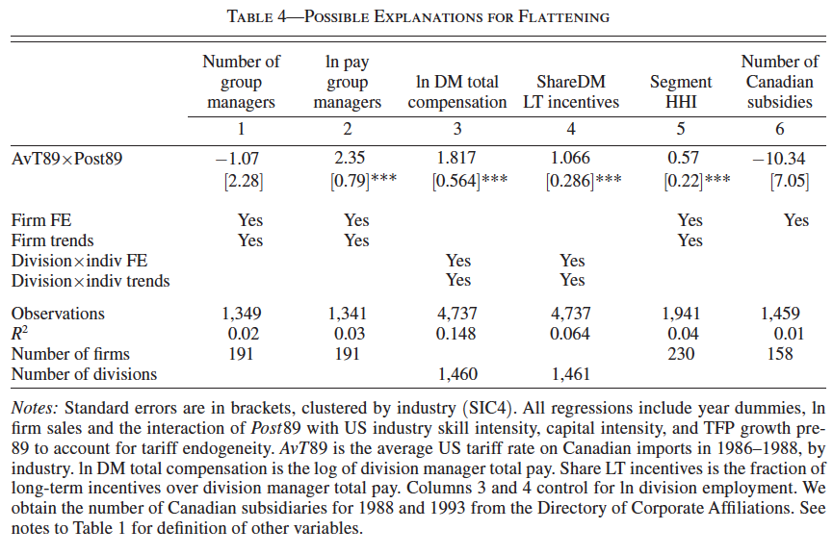

Slide 57
Further robustness checks
Sample present in 1988
Include services as control group
Exchange rate and import penetration
Subsidiaries in Canada
Differential speed of tariff reductions
Beyond Canada:
Correlation between organizational & competition variables (trade costs, lerner index, import penetration)

Slide 58
Flattening and Competition beyond Canada…
Table A4: Correlation between Organizational and Competition Variables
 | Div.Depth | Div.Depth | Div.Depth | CEO Span | CEO Span | CEO Span
 | 1 | 2 | 3 | 4 | 5 | 6
Trade Costs | 2.822 |  |  | -21.927
 | [1.304]** |  |  | [9.384]**
Lerner Index |  | 0.14 |  |  | 0.128
 |  | [0.067]** |  |  | [0.367]
Import Penetration |  |  | -0.781 |  |  | -0.01
 |  |  | [0.362]** |  |  | [1.448]
Division FE& trends | yes | yes | yes
Firm FE& trends |  |  |  | yes | yes | yes
Observations | 4503 | 5600 | 4018 | 1378 | 2046 | 1196
Number of Div. | 1161 | 1500 | 1100
R-squared | 0.021 | 0.014 | 0.02 | 0.025 | 0.009 | 0.011
Number of Firms |  |  |  | 157 | 258 | 156
NB: Std.err. clustered by firm. All regressions include year dummies, ln div. empl, ln firm sales.
Notes:
58

Slide 59
Interpretation of FTA effects on organizational change
Increased pressure from imports:
Higher value of adaptation to local markets, speed of decision making
Flattening as delegation of authority
  Delayering
    More direct reporting as delegation of authority to DMs
    “Complementary” increase in local incentives (initiative)
    Increase in firm-based incentives for coordination
  Higher span of control:
    Headquarters as a coordinator, less involved in daily operations
  Stronger effects in R&D/ Advertising- intensive industries
Notes:
Flattening as simply Cost-cutting? Evidence against this: increases in pay levels and performance sensitivity
Pay is increasing….inconsistent with simple cost-cutting
Changes in decision-making:
don’t observe who makes decisions, but DMs getting closer to top, plus getting paid more (levels, incentive pay (both local and firm)), plus CEO’s have more direct reports with less time to monitor.
Effects are more pronounced in industries that are R&D and advertising-intensive.

Slide 60
Conclusions
Work depicts how firms adapt their internal organization and compensation to product market changes
Change in competitive environment
  → Flatter Firms + Change in compensation structures (incentives and wage differentials)
Coordinated adoption of “complementary” practices
Effect on firms, workers and wages: an important aspect of globalization, increasing competition
Notes:
Coordinated adoption of “complementary” practices
Evidence of flattening as delegation to DMs
Weaker evidence for simple cost-cutting

Slide 61
Next Steps
(what is still missing in the picture)
Better tracing of mechanism(s)
  How much are indirect effects
  Differences by types of competition?
Tracing it all back to firm performance

Slide 62
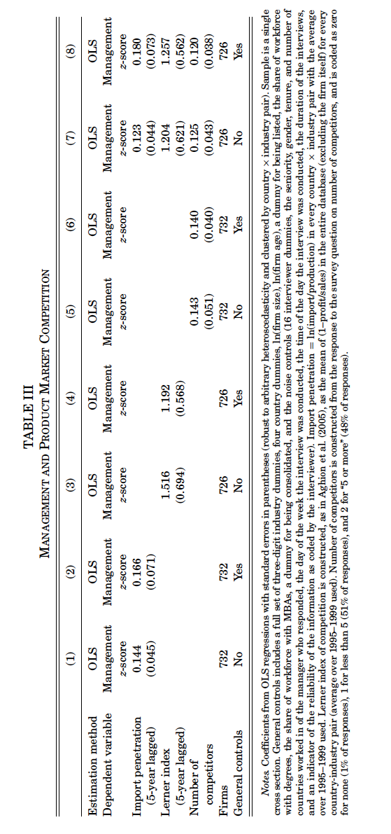

Slide 63
THEORY

Slide 64
Effect of competition on incentive provision:
Potential channels
Principal agent + competition affects profits
Competition provides implicit incentives
Principal agent + competition affects signal extraction
Pay as commitment to a competitive strategy
Rent extraction and competition
Other

Slide 65
Effect of competition on incentive provision:
Potential channels
Principal agent + competition affects profits
Competition provides implicit incentives
Principal agent + competition affects signal extraction
Pay as commitment to a competitive strategy
Rent extraction and competition
Other

Slide 66
Effect of competition on incentive provision:
Potential channels
Principal agent + competition affects profits
Competition provides implicit incentives
Principal agent + competition affects signal extraction
Pay as commitment to a competitive strategy
Rent extraction and competition
Other

Slide 67
Competition provides implicit incentives
More competition leads to more implicit incentives (bankruptcy, large dismissals, profit pressure…) therefore less need for explicit ones
  Theory (Schmidt, 1997)
  Empirical evidence (Nickell, 1996; Griffith, 2000; Schmitz, 2005)

Slide 68
Effect of competition on incentive provision:
Potential channels
Principal agent + competition affects profits
Competition provides implicit incentives
Principal agent + competition affects signal extraction
Pay as commitment to a competitive strategy
Rent extraction and competition
Other

Slide 69
Principal agent + competition affects signal extraction
Holmstrom & Milgrom (1987) a risk neutral principal (Owner) wants to give incentives to a risk averse agent (CEO)
Owner maximizes shareholders wealth (net of pay)
R=A + δO + u
Where
R = returns of the firm (returns to shareholders + CEO pay)
A = actions of the manager
O = observable random factors
u = unobservable random factors

Slide 70
Principal agent + competition affects signal extraction
CEO maximizes utility and has a participation constraint E[U(pay)] > Umin
Optimal payoff structure
Pay = α+β(R - δO ) = α+β(a+u)
Pay for observable effort and unobservable luck
More competition (measured as number of firms or how similar products are) should lead to better signal extraction that is, better knowledge of δO (easier to disentangle luck vs. effort in performance).

Slide 71
Principal agent + competition affects signal extraction
More or better benchmarks should allow to pay higher slope on the “effort component” of performance without exposing to more risk. Positive effect on performance related pay
(Hart, 1983; Scharfstein, 1988; and Hermalin, 1992).
However we should also observe more weight give to relative performance evaluation.

Slide 72
Effect of competition on incentive provision:
Potential channels
Principal agent + competition affects profits
Competition provides implicit incentives
Principal agent + competition affects signal extraction
Pay as commitment to a competitive strategy
Rent extraction and competition
Other

Slide 73
Pay as commitment to a competitive strategy
Firms use their compensation packages to commit to (or signal) particular competitive strategies
Again strong emphasis on relative performance pay.
  Collude if: mild positive slope on own profits, negative slope on “overtaking” rivals
  Compete if: strong positive slope on own profits, positive slope on “overtaking” rivals
Highlights the need to control for reverse causality
Incentive Pay Competition

Slide 74
Effect of competition on incentive provision:
Potential channels
Principal agent + competition affects profits
Competition provides implicit incentives
Principal agent + competition affects signal extraction
Pay as commitment to a competitive strategy
Rent extraction and competition
Other

Slide 75
Rent extraction
Worker (executive?) compensation may have a rent extraction component (not optimal contracting)
Can extract on fixed part (optimal for given rent extraction) or on slope (camouflage, “pay for luck”)
Set own pay, capture rents (also perks), could also be efficiency wages, rent sharing
Effect of competition:
May affect rents and the risk inherent to the sector
May also affect governance, implicit discipline effect

Slide 76
Effect of competition on incentive provision:
Potential channels
Principal agent + competition affects profits
Competition provides implicit incentives
Principal agent + competition affects signal extraction
Pay as commitment to a competitive strategy
Rent extraction and competition
Other

Slide 77
Other
Firms hierarchies change with competition. Ambiguous theoretical effect (Rossi-Hansberg et al 2005), empirical evidence in favor of “flattening” and higher incentives (Guadalupe and Wulf, 2009).
Globalization leads to higher demand for talent (Marín & Verdier, 2003) firms should pay more for talent and hire higher talented individuals.

Slide 78
Summary
From a theoretical point of view quite ambiguous predictions about the effect of competition on incentives, sometimes ambiguous within papers, surely ambiguous if one takes the literature as a whole.
Important empirical question
Need to control for reverse causality – use exogenous variation in competition

Slide 79
4. Competition and Corporate Governance
Mueller, H. and Giroud, X., 2010, “Does Corporate Governance Matter in Competitive Industries?”
Guadalupe and Perez-Gonzalez, 2010, “Competition and Private Benefits of Control”, mimeo

Slide 80


Competition and Private Benefits of Control,
Guadalupe and Perez-Gonzalez
OECD regulation indeces

Slide 81
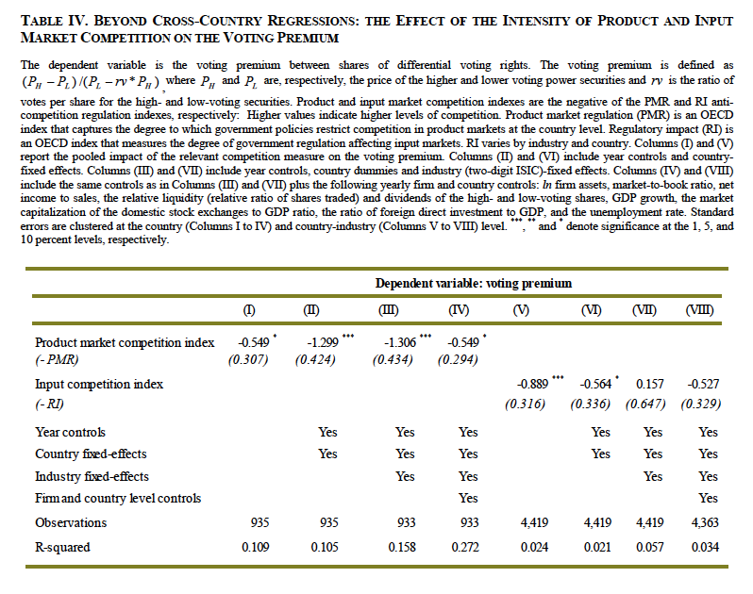

Slide 82
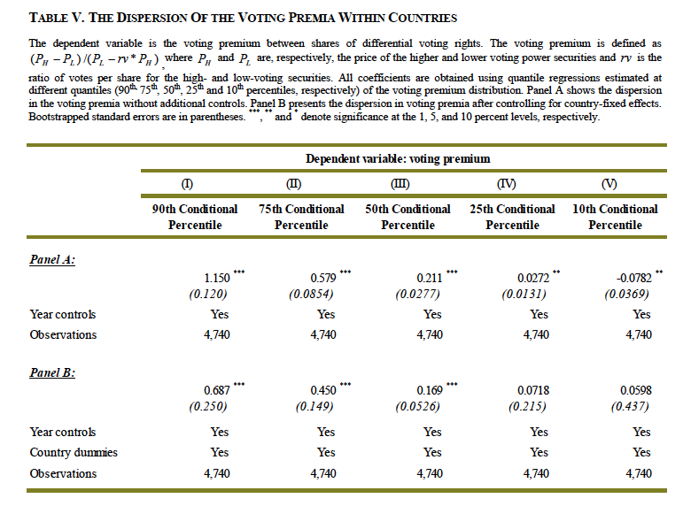

Slide 83
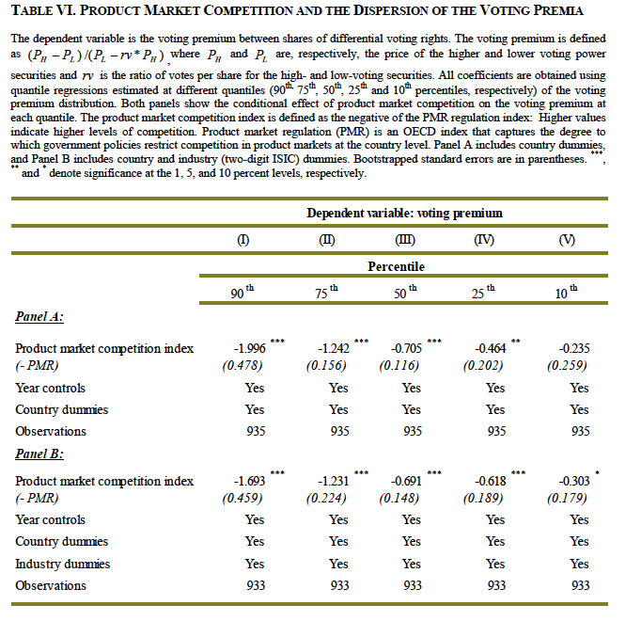

Slide 84
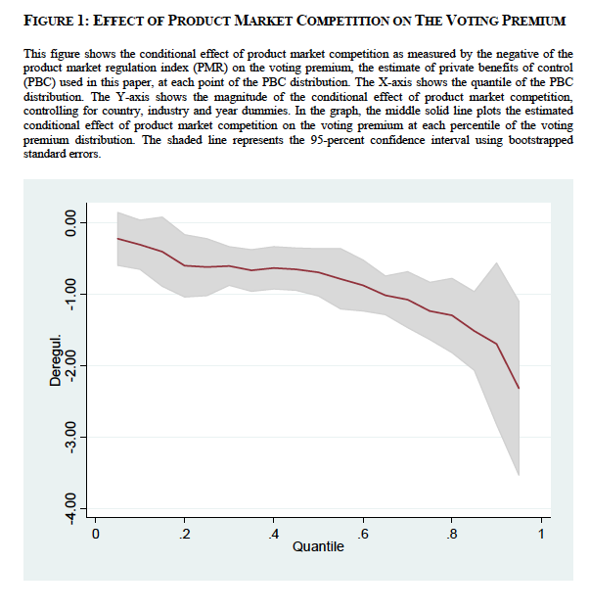

Slide 85
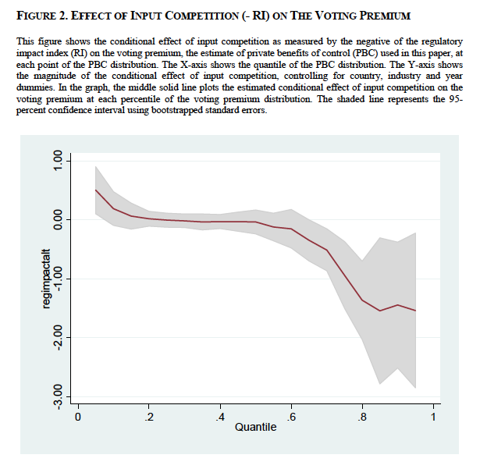

Slide 86
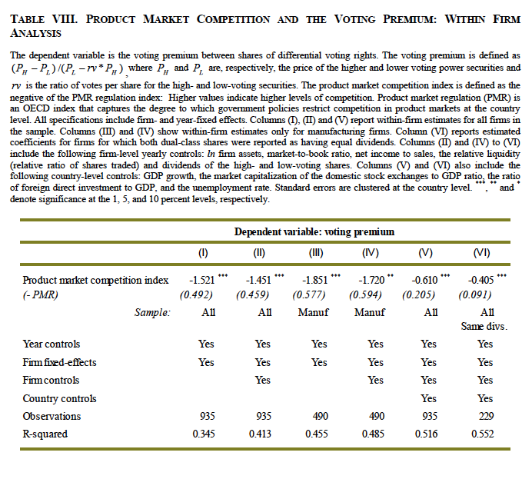

Slide 87
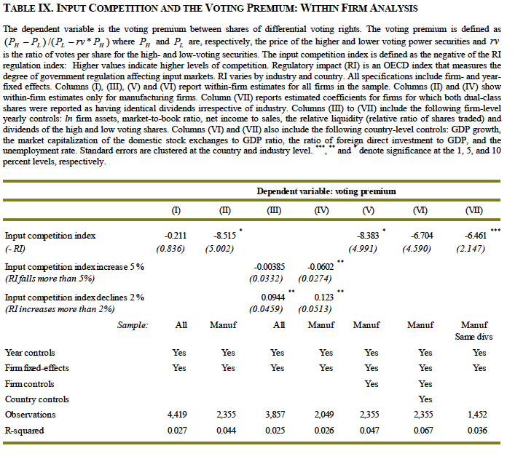

Slide 88
Summary
Significant effects of competition on organizational choices
  Explicit incentives
  Wage differentials
  Demand for talent
  Hierarchies
  Management practices
  Corporate governance
Difficulty and remaining challenge: tracing this back to performance

