Slide 1
Public Sector Personnel Economics
John de Figueiredo
Duke University
with
Charles Cameron
Princeton University
David Lewis
Vanderbilt University
Presented at the ESNIE Annual Meeting, May 2015, Corsica, France

Slide 2
Agenda
Motivation
Theory
Empirical Evidence

Slide 3
Agenda
Motivation
Theory
Empirical Evidence

Slide 4
Institutional and Organizational Economics
Focus on how institutions and organizations work
  Opening up the black box
  Interdisciplinary
  Microanalytic
  “What is really going on here?”

Slide 5
Organizations and Institutions
Coase, Simon, March, Barnard, Williamson, Alchian, Demsetz,
Klein, Gibbons, …….
North, Weingast, Wallis, Eichengreen, Spiller, McCubbins, Spitzer, …..
Labor Economics
Personnel Economics
Lazear, Shaw, Oyer, Waldman, Hubbard, Garicano, Baker…

Slide 6
A New Day at Apple?
Thought Experiment

Slide 7

Apple Inc.
Producer of consumer electronics … famous for integrating design, engineering, manufacturing, marketing, and retailing at a very high level

Slide 8
Personnel Policies
72,000 employees
Employees specialize tightly in order to have extremely high expertise in functional areas
Projects have a “directly responsible individual” with high accountability
Compensation often uses stock options
Apple “fellows” reward contributions, paid sabbaticals for top engineers

Slide 9
Imagine Tim Cook tries an experiment in personnel policies ….
All top decision makers are fired and re-hired from people outside Apple on the basis of personal loyalty to Cook
Henceforth no Apple employee is allowed to rise into a top decision-making job – only Cook appointed outsiders
Cook expands the central office and runs many projects from his headquarters, over-ruling or ignoring Apple employees
Otherwise, many design, engineering, manufacturing, and marketing projects are sub-contracted to companies outside Apple
Sub-contractors are encouraged to make cash payments to Apple Board members who are allowed to intervene below
At random intervals Cook imposes hiring freezes, furloughs, and pay cuts

Slide 10
What would these policies do to Apple’s culture and competence?
Think about it …

Slide 11

The New iPhone
It weighs 40 pounds, costs $10K, doesn’t work, and can’t be repaired

Slide 12
The Big 4 Federal Personnel Policies
Short-term political appointees hold most of the good jobs
Presidents meddle opportunistically from the Center
Much work is subcontracted, esp. to a select group of big private contractors
Congress imposes random hiring freezes and pay cuts

Slide 13
The Black Box
Preferences
Bureaucratic
Agencies
Policies
Structures
Procedures

Slide 14
Bureaucratization:
The Case for Candor
Oliver E. Williamson
University of California, Berkeley
November 30, 2012

Slide 15
V. Government Bureaucracy
1. The employment relation
Civil servants and private sector employees are “different”
- incentive intensity
- job security (James Q. Wilson)
- rules proliferate (constrain)
- urgency
2. Regulatory hazards
  Enforcement is theory-dependent (as with A/T)
  So if the economic theory is defective, enforcement will be defective
  Turf (politicized)
  Over-matched: excellence notwithstanding, cannot presume parity

Slide 16
  3. Political process
  3.1 A digression
  Financial Engineering and proposed collaboration with Transaction Cost Economics.
  I demure
  Clarification: Not design but implementation is the concern
  Yes, contract implementation is the main TCE focus
  (to which design changes may be made)
  3.2 Political
  Passage (design) of programs gets priority, the presumption being that implementation can wait to be addressed later
  So: Politics moves on; problems await

Slide 17
Organizations and Institutions
Coase, Simon, March, Barnard, Williamson, Alchian, Demsetz,
Klein, Gibbons,…….
North, Weingast, Wallis, Eichengreen, Spiller, McCubbins, Spitzer, …..
Labor Economics
Personnel Economics
Lazear, Shaw, Oyer, Waldman, Hubbard, Garicano, Baker…
Public Sector
Personnel Economics

Slide 18
Literature
Intersection:
Public Sector Personnel Economics
Economics of Organizations
Personnel Economics
Public Administration
Notes:
We think that to really understand and work at solving this problem, we require an interdisciplinary approach (Carnegie lesson #2!). In order to gain traction, we are going to integrate contract theory, personnel economics, and the literature on public administration.

Slide 19
Public Sector Personnel Economics
Personnel
In Addition:
Private Sector
Economics
Public Sector Personnel
Public Sector
Economics
Wage
Structures
•
Pay
for Performance
•
No Pay for
Performance
Sorting on Performance
Well
-
Promotions
•
•
Documented
•
Tournaments
Promotion Standards
Firm
-
Specific
Government
-
•
•
Specific
Human Capital
•
Generic
•
Private Sector
Valuable
Careers
•
Fast Trackers
•
Tenure
•
Exit/Stay
Motivation
•
Intrinsic
Motivation
•
Agency Mission
Policy Outcomes
•
Politicization
Notes:
What is Personnel Economics about? Wage, Promotion, Human Capital, and Careers
How does the private sector think about it?
What is happening in the public sector?
What is Public Sector Personnel Economics—we add three additional features.
This paper is about the first six of these. That is our model has wages, promotions, human capital, careers, motivation, and policy outcomes. Does NOT have multiple principals.

Slide 20
The Overall Project
Institutional
Analysis
Theory
Building
Large Scale
Data Analysis
Case Studies (FEMA, CIA, Treasury,…)
Interviews
Descriptive
Internal Labor Markets
Institutional Economics
Mechanism Design
Public Administration/ Bureaucracy
Mathematical
Surveys
CVs
Personnel Records
Statistical

Slide 21
Research Areas/Questions
Do public sector labor markets look like private sector labor markets? If not, what is the impact?
What differentiates a poor performing bureaucracy from a high performing bureaucracy?
How do we achieve a high performing bureaucracy?
How do we best develop human capital in the government?
How does the government attract, develop, and retain the best people?
What kind of agency designs/policies foment human capital development?
What is the effect of politics on the human capital development and policy outcomes of the bureaucracy?
How do we incentivize government employees to invest in expertise when output is difficult to measure and we cannot hire/fire them or provide incentive pay?

Slide 22
Agenda
Motivation
Theory
Empirical Evidence

Slide 23
Behavioral Assumptions
Some Employees Have A “Mission Orientation”
  Intrinsically Motivated (Besley and Ghatak 2005; Prendergast 2008)
  Purpose (Benabou and Tirole 2010; Henderson and Van Den Steen 2015)
  Mission (Wilson 1989; Perry and Wise 1990; Golden 2000; Gailmard and Patty 2007)
    Value policy creation (investigation and discovery)
    Value policy implementation
    Don’t like to be told what to do
Employees Have Differing Levels of Expertise
  Expertise is hard to observe
  Expertise levels are endogenously chosen by employees

Slide 24
Role of Expertise
Expertise is Important to Agency Performance
  Non-Expert or “Meddling” Leaders Can Cause Agencies to Degrade (Lewis 2008)
    FEMA and Hurricane Katrina
    CIA and WMD in Iraq
    EPA and Political Turnover
  Mechanisms
    Quitting in Protest
    “Retiring on the Job”
    Hiring “Zombies”

Slide 25
Pubic Sector Personnel Economics: Wages, Promotions and the Competence-Control Trade-off
Charles M Cameron
Princeton University and New York University
John M. de Figueiredo
Duke University and Institute for Advanced Study
David Lewis
Vanderbilt University
March 2015
Notes:
This is joint work with Charles Cameron who is sitting right here, and David Lewis who could not make it.
Thank you. Oliver’s talk last night was a great introduction.
Apparently we are heading into the “swamp” of bureaucracy. This is an early foray into modeling bureaucracies for us, so you can think of us as being in the swamp with very short boots!
This paper is about internal labor markets in government bureaucracies and its effect on agency performance.

Slide 26
Initial Question
Why do some public agencies have difficulty in achieving high human capital and high performance?

Slide 27
Dual Contracting Problem
Difficult for civil servants & political principal to contract on hard-to-measure activities and performance outcomes.
Difficult for political principal & civil servants to contract on forbearance from political meddling in agency operations and policy making.
Notes:
We believe that the bureaucracy is fundamentally a contracting problem. This is an innovative way of thinking about bureaucracy, we believe. The contracting problem is bureaucracy is more extreme than in firms.
Performance is hard to measure in agencies:
Nature of job: how to measure the foreign service office or park ranger?
Public sector unions means you can’t get fired and can’t have performance based pay
Political meddling is hard to stop.
Can’t contract the decision rights to not meddle, so statements not credible.
Electoral pressures, interest groups encourage meddling

Slide 28
Proposed Solution
Well-designed internal labor markets can mitigate the dual contracting problem
Notes:
Our claim in the paper is that……

Slide 29
Our Approach
We integrate three aspects of bureaucratic agencies into a model of agency performance
  Policy-making module (which policy to choose)
  Internal labor market module (career paths for civil servants)
  Agency design module (wages, promotion standards, and political meddling)
Notes:
This is Oliver’s Carnegie Lesson #1: Be disciplined.

Slide 30
1-Nature selects agent type q
2-Contract Design (w_{c}, w_{m}, )
Agency
Design
Mechanism Design—
Bolton and
Dewatripont (2004)
3-Politicization (π)
4-Employment decision
Internal
Labor
Market
5-Expertise Investment (e)
Lazear and Oyer
(2012)
with modifications
6-Promotion
  7- Stay/Go decision
8-Policy Effort (a)
Policy Making
Baker, Gibbons,
Murphy (1999)
9-Project Recommendation
10-Accept/reject

Slide 31
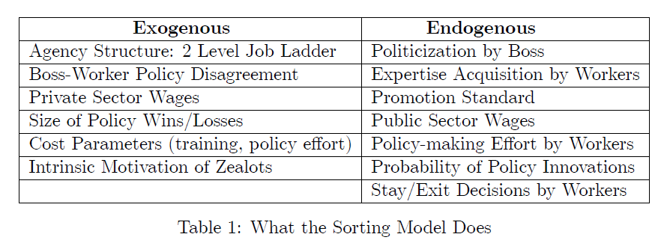
What the Model Tries to Explain

Slide 32
Slight Variants to the Standard Models
1. A political appointee (Boss) and two types of civil servant subordinates (slacker and zealot)
  Slackers only wage motivated
  Zealots are wage + policy motived (Downs 1961, Gailmard and Patty 2007, Prendegast 2008)
    Mission oriented
Wage
Policy utility/ satisfaction

Slide 33
Slight Variants to the Standard Models
2. Two types of agencies
  Type I: Acquired policy expertise has low value to the outside market, e.g. air traffic controllers
  Type II: Acquired policy expertise has high value to the outside market, e.g. antitrust attorneys
  So, different outside options available to agency managers result in difference agency design
Notes:
Two types of agencies:

Slide 34
Illustrative Example:
Treasury Department
Type I: Office of Public Debt
Type II: Office of Comptroller of the Currency
Design and execute U.S. Treasury bond auctions, operates direct bond sales to US Citizens
To be promoted, must demonstrate can effectively execute on these goals
Regulates financial institutions
To be promoted, must pass UCC Exam and learn
  Risk management
  Asset soundness
  Bank management

Slide 35
Figure 1: Departures at the Department of Treasury
FY2011 Turnover Rate
Comptroller of Currency: 8.7%
Bureau of Public Debt: 4.6%
Percent of Workforce Departures
Years of Service
Note: Data from Fedscope, Office of Personnel Management, FY2011; Includes GS-5 (college educated) and above employees who have a minimum of 12 months of service; departures averaged across interval
Notes:
There is much higher turnover at OCC (Type II) than Type I
This is, in a roughly descriptive way, the hazard rate of leaving the two agencies at the Treasury Dept. The horizontal access is the years of service, and the vertical axis is the percentage of worker with that many years of service who leave the agency. What you see is the blue line, OCC, employees, leave much earlier in their careers. Indeed, they take the OCC exam 2-5 years into the their career and then they leave. The red line, OPD, have few skills for the public sector and they become lifers.
Note: At 20 years there is bump in pension; and then both OCC and OPD look pretty much the same.

Slide 36
Key Intuition: Type I Bureaus
Poor outside opportunities for public sector managers
The managerial wage must compensate employees for training costs
Set the managerial wage so that it compensates zealots but not slackers
Only zealots will seek promotion
Given an inside wage like this, set promotion standard and politicization to maximize Boss utility
Notes:
What this means is that these guys don’t leave the agency so private sector wages are not that important.

Slide 37
Key Intuition: Type II Bureaus
Excellent outside opportunities for public sector managers
The managerial wage must be attractive enough to retain managers in the face of good outside opportunities
Set the wage so that it retains zealots but not slackers
Both will seek promotion but only zealots will stay
Given an inside wage like this, set promotion standard and politicization to maximize Boss utility
  Caution: Promotion standard will affect outside wage
Notes:
Outside wages here are really important. However, we want to set wages so that slackers go and zealots stay.

Slide 38
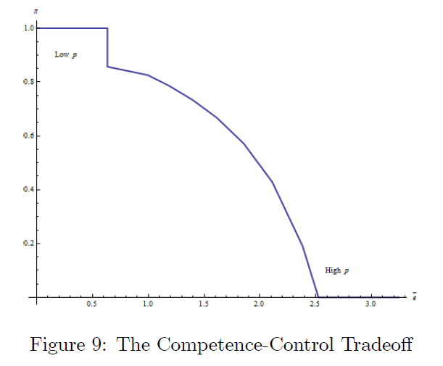
Competency – Control Tradeoff
Lower levels of of policy agreement (p) lead to higher levels of politicization (π) and low promotion standards (e-bar)
  Public sector managers do not develop human capital
High levels of agreement result in low politicization and high promotion standards
  Public sector managers develop high levels of human capital
Notes:
Put it together
Horizontal axis: promotion standard
Vertical axis: degree of politicization.
Top left: High politicization=>low promotion standards (low p, High conflict)
Bottom right: Low politicization=> high promotion standards (high p, Low conflict)

Slide 39
Quitting in Protest
Presidential Policy Making and Agency Response
Charles Cameron John de Figueiredo David Lewis
Princeton Duke Vanderbilt
April 2015

Slide 40
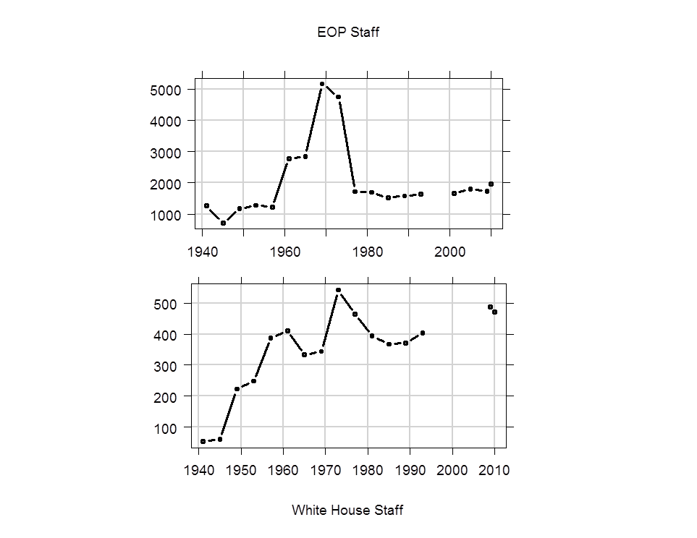
Growth of Presidential Resources

Slide 41
Growth of WH and EOP creates the opportunity for presidents to intervene anywhere in the government as they wish
Over-riding the plans, programs, and desires of civil servants

Slide 42
Basic Idea
(Informed) Presidents can take a “unilateral” action
  Executive order, departmental memorandum
This forces policy on bureaucrats in an agency
  “Slackers” and “zealots”
Policy-oriented bureaucrats may quit rather than implement the policy
  “clean hands”

Slide 44
Main Results
Meddling undermines policy initiative in agencies
Moderates most vulnerable to quitting
Extremists may stay to “wait out” a hostile president, or stay with a meddling friendly president in order to set policy under a friendly non-meddler
Alternation of left and right presidents hollows out moderate agencies leaving only slackers
Destroys capacity for policy initiative in agencies

Slide 45
Agenda
Motivation
Theory
Empirical Evidence

Slide 46


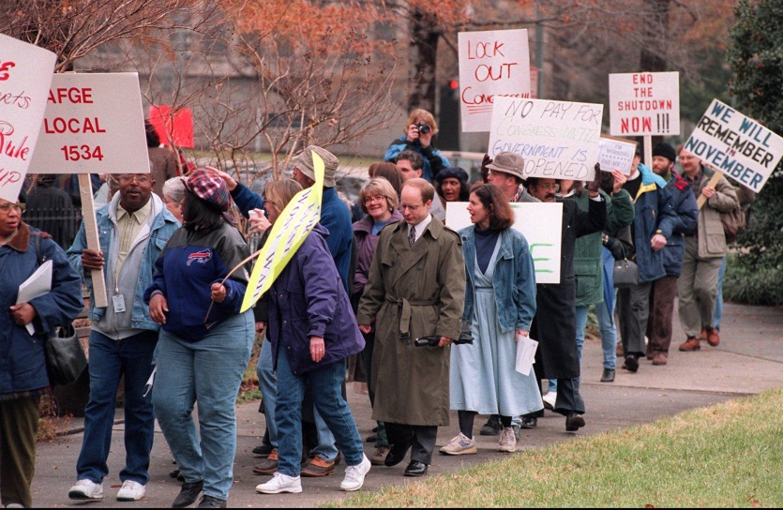
Federal Government Employees

Slide 47
Scope of the Data
1988-2011 => 24 years of data
6.3 million unique non-DOD employees
28.2 million person-year observations
50 variables about each person
132 federal agencies
600+ sub-agency bureaus

Slide 48
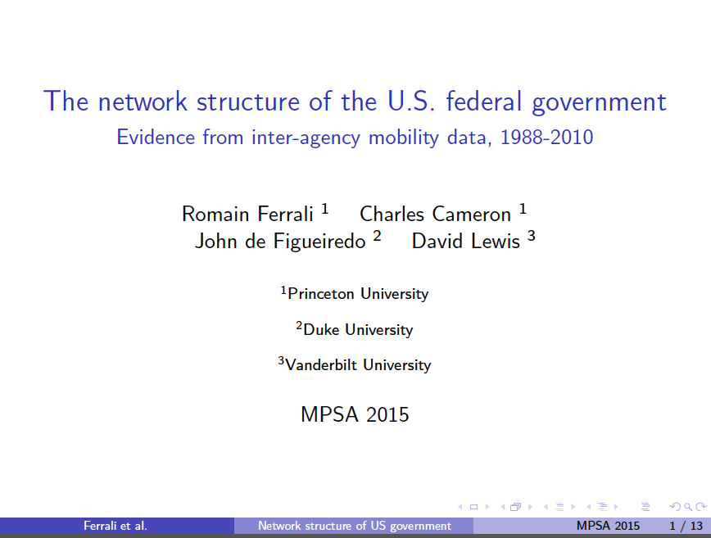

Slide 49
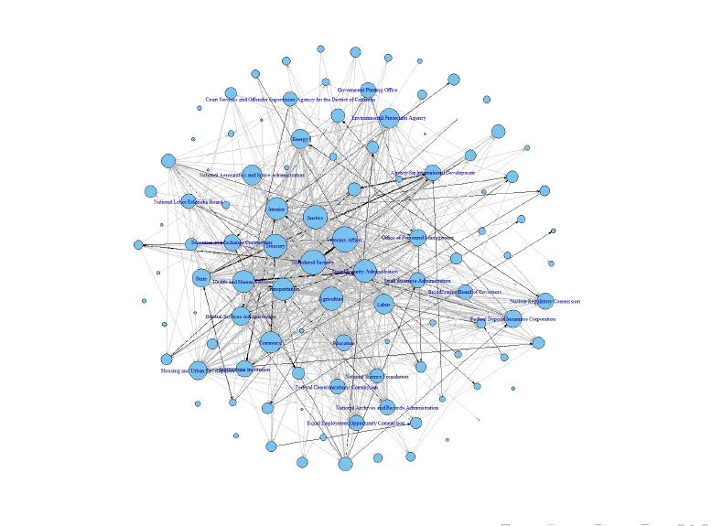

Slide 50
Where can this take us?
Describe the structure of government
Where are the innovation factories in the government?
  What are the human capital characteristics?
What kinds of structures/practices disseminate innovations
  Personnel rotation?

Slide 51
Do Public Sector Labor Markets Look Like Private Sector Labor Markets?
John de Figueiredo, Duke University
Charles Cameron, Princeton University
David Lewis, Vanderbilt University
January 2014
This work is supported by the National Science Foundation and Smith Richardson Foundation. The views presented here do not necessarily reflect either grant-making organization. We are grateful to the U.S. Government Office of Personnel Management who has kindly provided us with the data.

Slide 52
Ten Questions
Gibbons (1997)
What are the career paths in organizations?
Are nominal wage cuts rare?
Are changes in wages (and wage residuals) serially correlated?
Are there cohort effects on wages?
Are wage increases upon promotion large compared to normal wage changes but small compared to the difference in average wages between the two levels?
Do wage increases forecast promotions?
Do promotions come from and go to all the deciles of the wage distribution?
Are wage increases smaller for those who begin their careers in the higher quartile of the wage distribution for that level?
Are wage increases and promotions more likely with higher performance evaluations?
Is the effect of seniority on wages independent of the presence for controls for performance evaluations?

Slide 53
Basic Facts in Private Sector Personnel Economics (Waldman 2012)
Real wage decreases are not rare, but nominal wage decreases and demotions are rare
Wages and promotion rates are serially correlated
  Workers quickly promoted from one level to another will rise to the next level more quickly
  “Fast tracks”
There is serial correlation in wage changes (evidence mixed)
Promotions are associated with large wage increases
Large wage increases early at a job level predict subsequent promotion (weak evidence)
Wages exhibit cohort effects=> a cohort’s average wage in the future is tied to its starting wage (weak evidence)

Slide 54
10 Key Questions (Gibbons 1997)
Question | Private | Public (all answer are tentative!)
What are the career paths in organizations? | Four Methods | Grade and Step
Are nominal wage cuts rare? | Yes, <1% | Yes, 1-2%
Are changes in wages serially correlated? | Yes (.30) | Yes (.12)
Are there cohort effects on wages? | Yes, Strong | Yes, Weak?
Are wage increases upon promotion large compared to normal wage changes but small compared to the difference in average wages between the two levels? | Yes | ? Should be able to answer
Do wage increases forecast promotions? | Yes | Yes, but with lag
Do promotions come from the top deciles of the wage distribution? | Yes | Yes
Are wage increases smaller for those who begin their careers in the higher quartile of the wage distribution for that level? | Yes | ? Should be able to answer
Are wage increases and promotions more likely with higher performance evaluations? | ? | ?
Is the effect of seniority on wages independent of the presence for controls for performance evaluations? | ? | ?

Slide 55
Are Recessions Good for Government?
The Human Capital Consequences of Unemployment for the Public Sector
Congshan Zhang, Duke University
John de Figueiredo, Duke University
Charles Cameron, Princeton University
David Lewis, Vanderbilt University
April 2015
This work is supported by the National Science Foundation and Smith Richardson Foundation. The views presented here do not necessarily reflect either grant-making organization. We are grateful to the U.S. Government Office of Personnel Management who has kindly provided us with the data.

Slide 56
Research Question
How does unemployment affect the
human capital in government?
Does starting employment with the government in recession result in a long-term wage cut for college graduates and new employees?
Does the government attract higher quality/better matched workers in recession than it does in periods of macroeconomic growth?
Are the workers who begin government service in a recession likely to stay in government service after the recession?

Slide 57
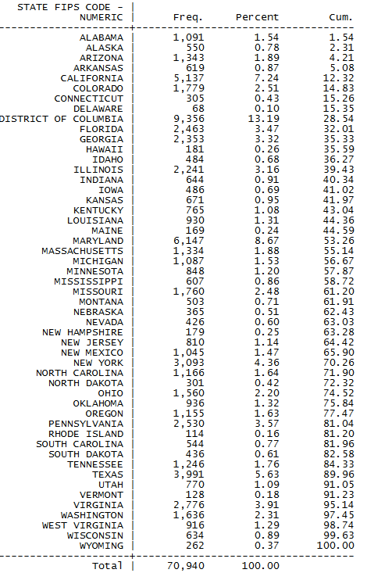

Slide 58
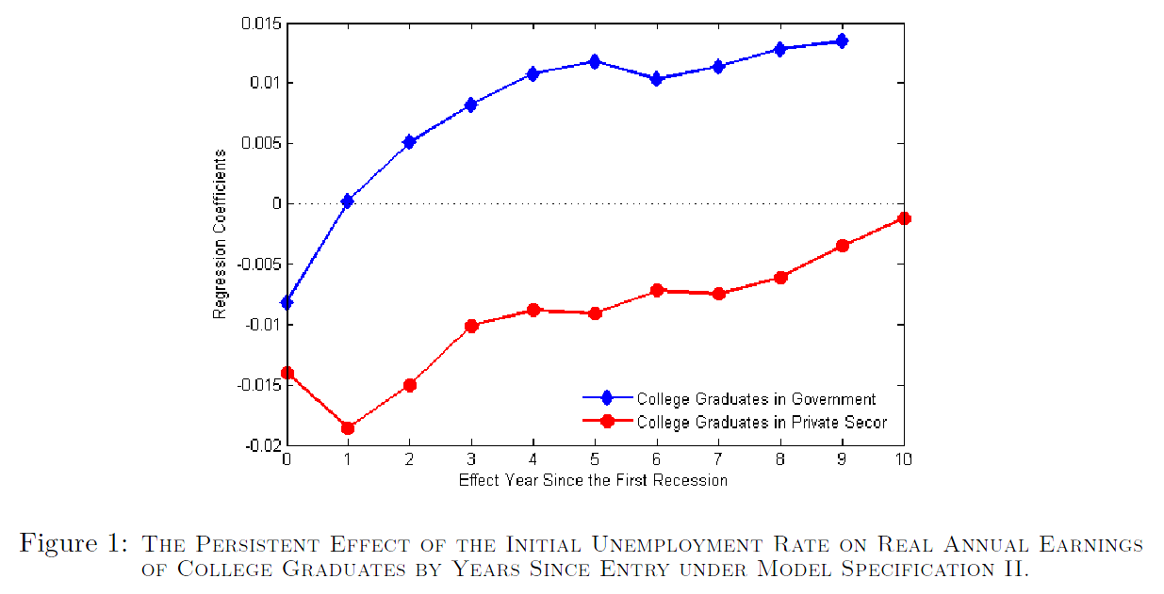
College Graduates in Recession
Oreopolous et al 2012

Slide 59
Part II: Does the Government Attract Higher Quality Workers (Better Matched) in Recession Than it Does in a Boom?

Slide 60
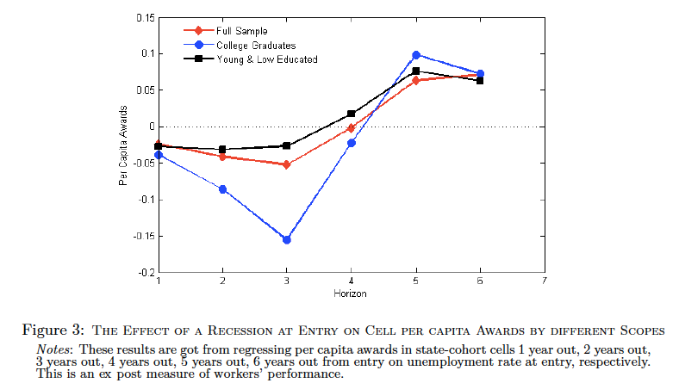
Awards Won (Unweighted)

Slide 61
Part III: Do Workers Hired in Recession Stay in Government Service?

Slide 62
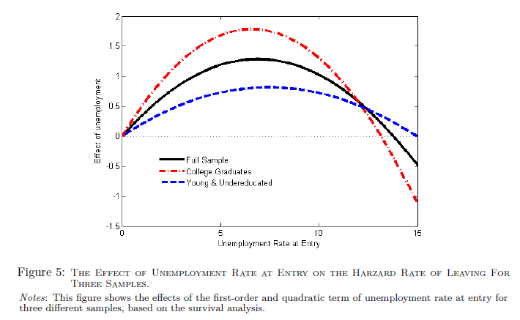
Survival Analysis Results

Slide 63
Why is there “poor” matching of college graduates in recession?
Whether a job candidate is mission oriented is private information
Government randomly hires conditional on observables (grades, scores, college)
In boom
  Slackers go to Goldman Sachs
  Only true zealots go to government
In recession
  Slackers and zealots go to government
    Proportion of zealots is lower
  Slackers quit government and go to Goldman when economy picks up.

Slide 64
Grade Inflation in the U.S. Government
Alex Bolton, Princeton University
John de Figueiredo, Duke University
Charles Cameron, Princeton University
David Lewis, Vanderbilt University
April 19, 2015
This research has been financially supported by the Smith Richardson Foundation and the
National Science Foundation.

Slide 65
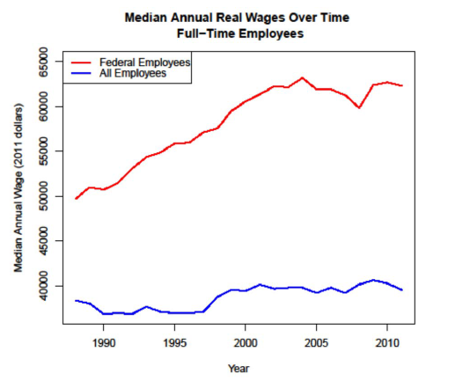
Government Wages Rising
Federal government median wage increasing faster than private sector

Slide 66
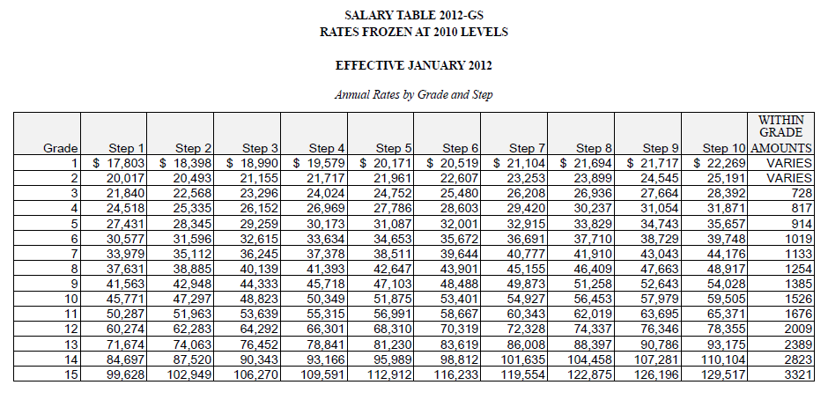
Grades and Steps in the General Service
Grades = Promotions; Steps = Raises

Slide 67
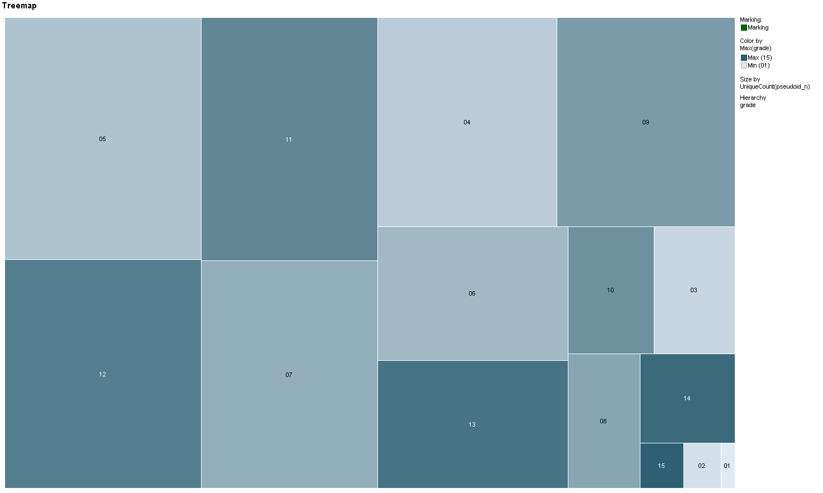
Grade Composition of Federal Government 1988
Filter Settings
- pid_dups: (0)
- year: (1988)
- workschd_n: (2 <= workschd_n <= 2) without empty values
- occ_cat: (A, B, C, O, P, T)
- pay_plan: (GS)
- grade: (01, 02, 03, 04, 05, 06, 07, 08, 09, 10, 11, 12, 13, 14, 15)

Slide 68
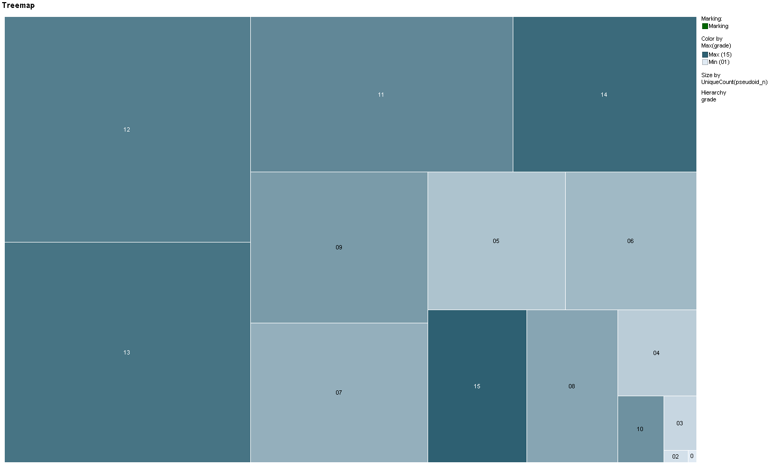
Grade Composition of Federal Government, 2011
Filter Settings
- pid_dups: (0)
- year: (2011)
- workschd_n: (2 <= workschd_n <= 2) without empty values
- occ_cat: (A, B, C, O, P, T)
- pay_plan: (GS)
- grade: (01, 02, 03, 04, 05, 06, 07, 08, 09, 10, 11, 12, 13, 14, 15)

Slide 69
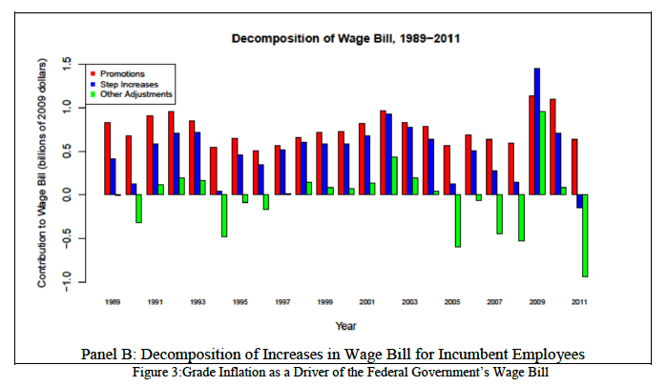

Slide 70
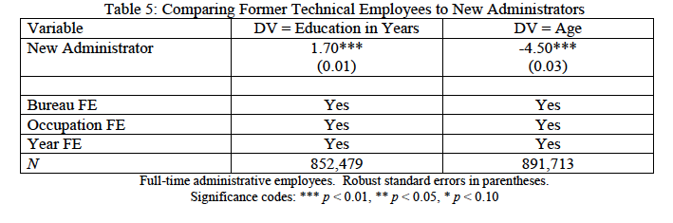

Slide 71
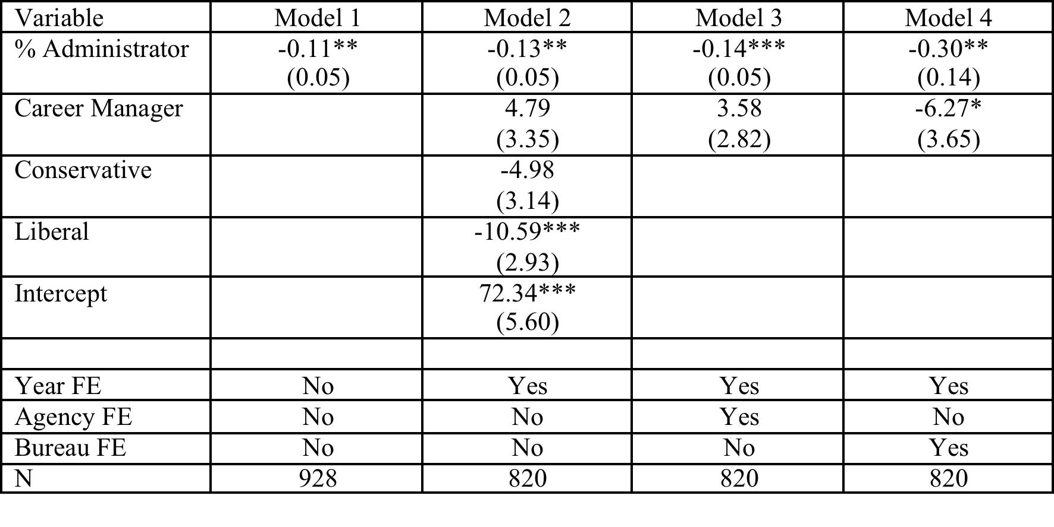
PART Score Models

Slide 72
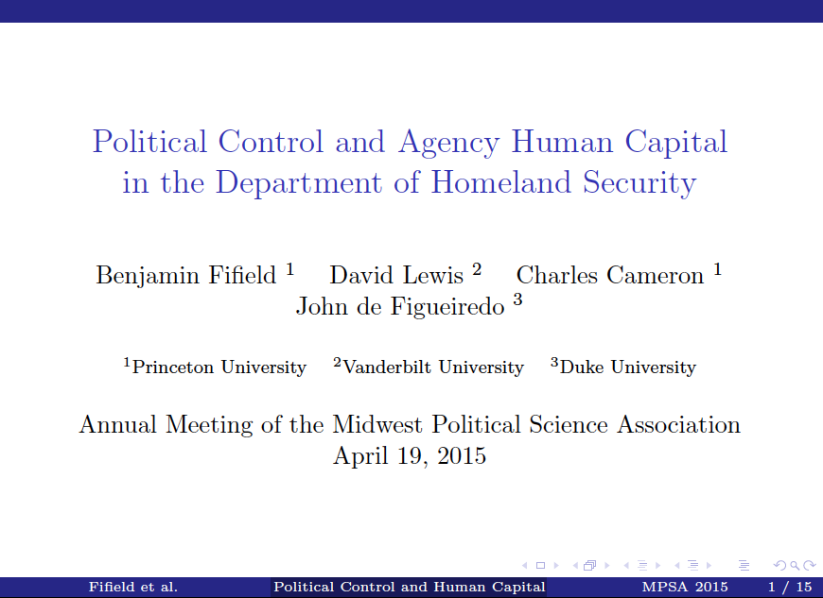

Slide 73
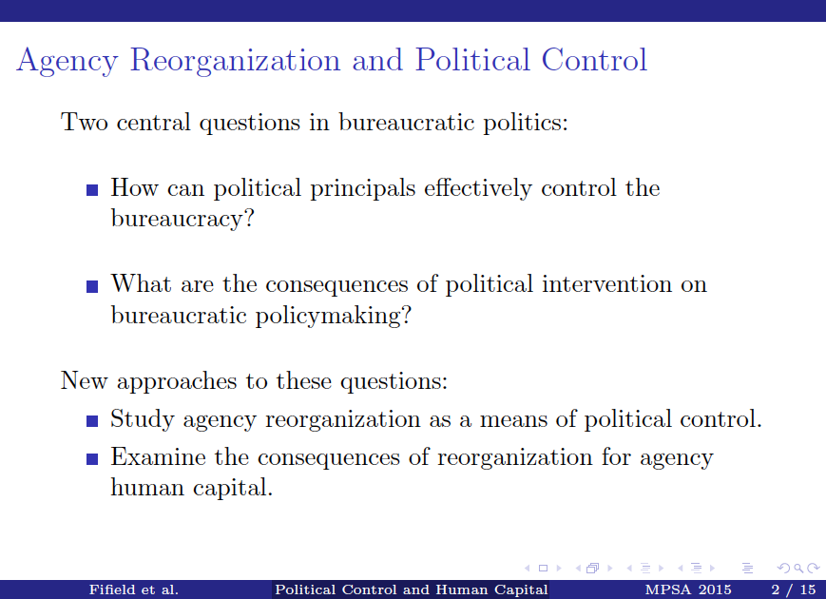

Slide 74
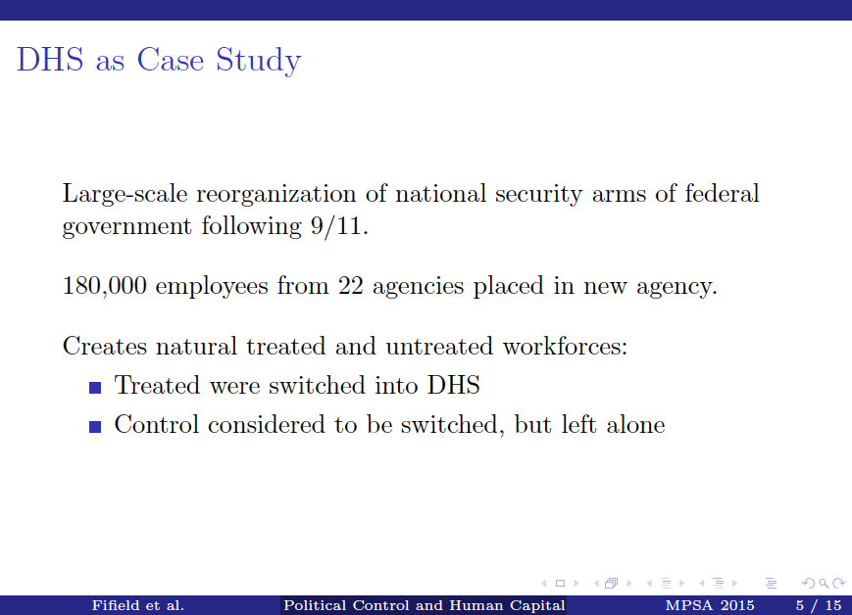

Slide 75
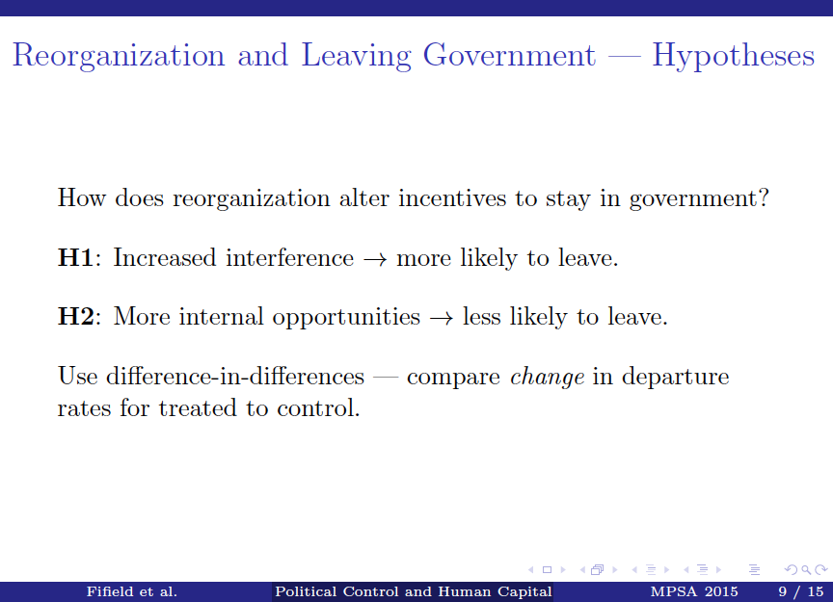

Slide 76
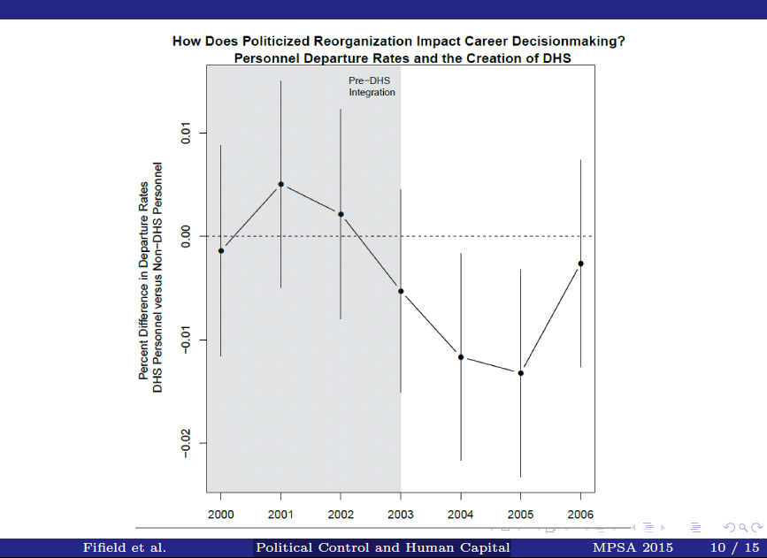

Slide 77
The Best and the Brightest
John de Figueiredo, Duke University
Charles Cameron, Princeton University
David Lewis, Vanderbilt University
Spring 2014
This research has been financially supported by the Smith Richardson Foundation and the
National Science Foundation.

Slide 78
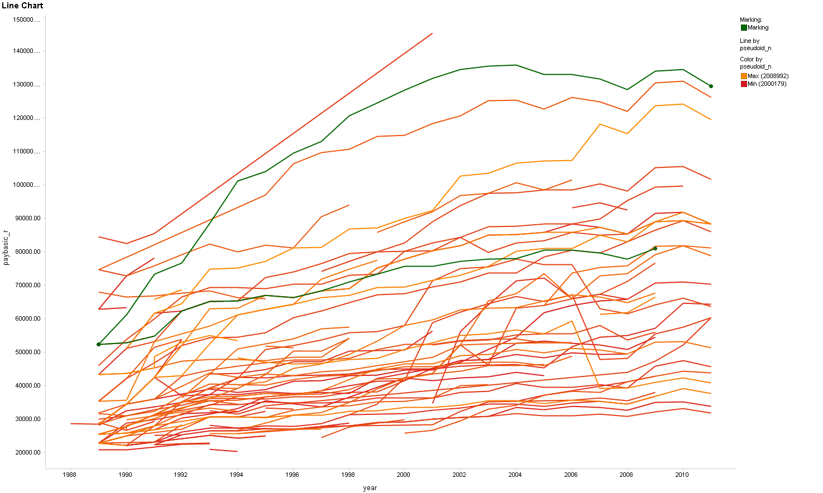
Career Paths in Federal Government
Eric
John
Filter Settings
- pseudoid_n: (2000000 <= pseudoid_n <= 2009000) without empty values
- pay_plan: (GS)
- grade: (01, 02, 03, 04, 05, 06, 07, 08, 09, 10, 11, 12, 13, 14, 15, 16)
- year_start: (1989 <= year_start <= 1989) and empty values

Slide 79
Conclusion
Public Sector Personnel Economics—An Emerging Agenda
Future Work
  For us, finish the papers
  For researchers……
    Wide open
    European governments (EU, national, local)
    Civil service v. political appointees
    Linking to policy outcomes

