Slide 1
Stateless Commerce
IOEA 2016
Barak Richman
Duke University

Slide 2
Overview
Introduction to the Diamond Industry
    Transactional Hazards & Governance Infrastructure
Private Legal Systems in Context
    Variation & Categorization of Private Ordering Models
Comparative Efficiencies and Predictive Model
    A Theory!
New Developments…

Slide 3
From Mine to Jeweler
DeBeers
Other Mines
Dealers
Brokers/Cutters
Dealers
Brokers/Cutters
Diamond Dealers’ Club (DDC)
(47th Street, NYC)
End Buyers
$72b global market for diamond jewelry
  $15b rough diamonds from mines, ~50% mark-up to polished wholesale
Dis-integrated supply chain: stones pass through many intermediaries, can double in value in one day

Slide 4
From Mine to Jeweler

Slide 5
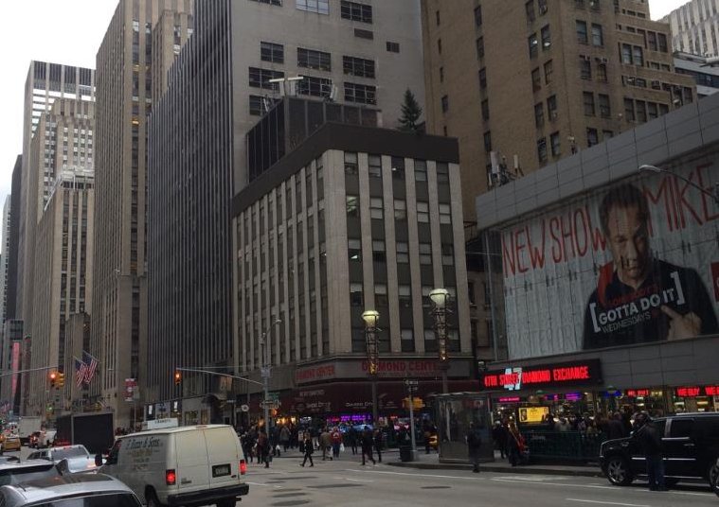
47th Street, New York

Slide 6
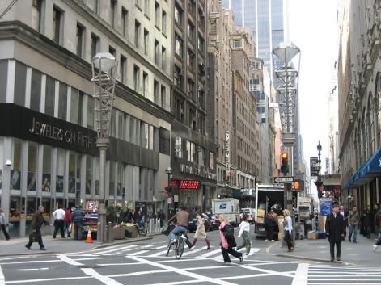
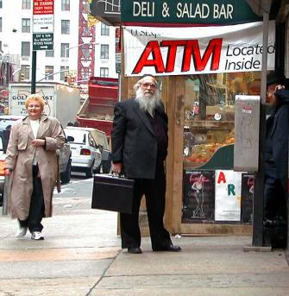
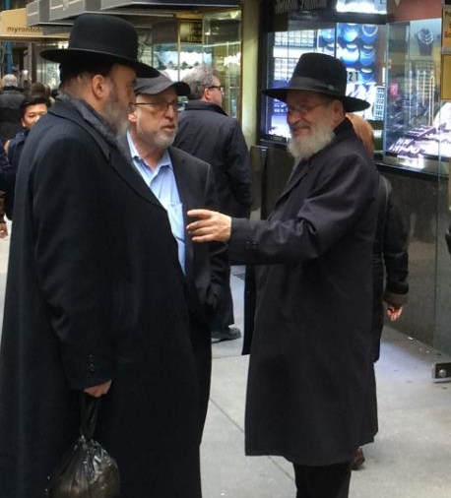
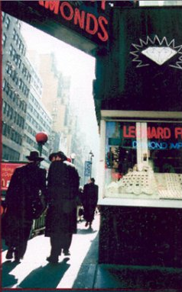
47th Street, New York

Slide 7



47th Street, New York

Slide 8


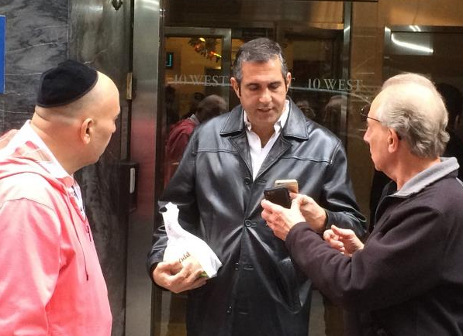
47th Street

Slide 9
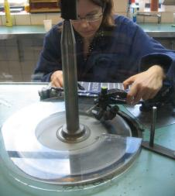
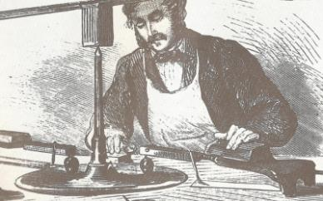

Diamond Industry: Unique Challenges
Subjective Valuation
  Objective is to match a particular stone with a particular buyer
Verifiability Problems
  Origins (e.g. Angola); Laser Treatments
Court Failure
  Credit Sales Highly Preferable, Little Simultaneous Exchange
  Diamonds Concealable, Portable, & Universally Valuable
    Limitations of Public Legal System

Slide 10
“The Real Treasure of 47th Street” – A Response to Court Failure
“When I first entered the business, the conception was that truth and trust were simply the way to do business, and nobody decent would consider doing it differently.” -- Elderly diamond dealer (Bernstein 19992)
“Legal and moral accountability is the foundation for the very survival of the diamond industry.” --Shor (1993)
“Informal contracts are heavy with moral weight and embody certain principles: to honor commitments, to produce a good product and to stand behind it, and to preserve reputation.” -- Shield (2002)
“In this business, everything works on credit, loan, and trust.” – Otulski (2011)

Slide 11

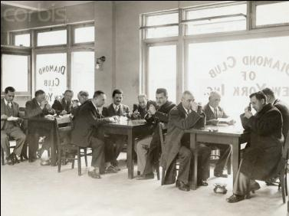
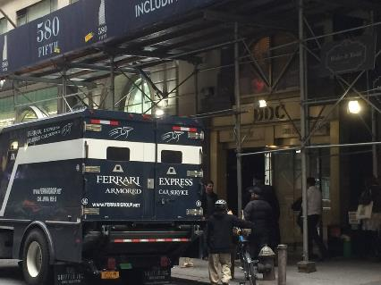
The New York Diamond Dealers’ Club (DDC)
Voluntary association, with by-laws, ~1,800 members
Gateway for 95% of diamonds imported into US, $30b in sales
Mandatory arbitration, arbitration panel of fellow members

Slide 12
How Trust Works – Enforcing Diamond Credit Sales
Dispute
Arbitration
Hearing
Ruling:
Determination of
Wrongdoer
Pay
Or
Publication of Wrongdoer:
Expulsion from DDC
Picture on Wall
Informal Information Network
No
Future
Dealings
Non-
Economic
Sanctions
Notes:
Contrast to normal arbitration, where “Or” turns it over to a court

Slide 13
How Trust Works – Enforcing Diamond Credit Sales
Or…
Publication of Wrongdoer:
Expulsion from DDC
Picture on Wall
Informal Information Network
No
Future
Dealings
Non-
Economic
Sanctions
DDC Arbitration has no actual power to enforce rulings. ONLY as respected source & disseminator of information
Arbitration ruling triggers a group boycott
Supports reputation mechanism, enables impersonal exchange
Notes:
DDC Arbitration has no actual power to enforce rulings. ONLY has power as respected source & disseminator of information. INFORMATION. (See Milgrom, North, & Weingast on Champaign Fairs). Works because:
Quality of information high
Distribution of information widespread & effective
Enforcement works because of family businesses & community institutions
A word on why it works?
Difficulties to enforce diamond sales. State courts toothless.
Game theory problem: need to overcome tempting shirk, and solve end-game problem
SO use endless time horizons (family businesses) and noneconomic club goods (religious institutions)

Slide 14
How Private Ordering Works…
Works because of Who Diamond Merchants are
Two Categories of Players:
Long-Term Players
  Family Businesses, Bequeath Businesses & Bequeath Reputations
  Guaranteed future profits (over many generations); Solves end-game problem
Members of Ultra-Orthodox Community
  Demand Religious/Community Goods with no good substitutes
  U^{i} = U(S^{i}, R^{i}, Q); Iannaccone (1992) & Berman (2000)
Reputation, reputation, reputation! O I have lost my reputation! I have lost the immortal part of myself, and what remains is bestial. -Casio, Othello, 2:3
Notes:
Recall Game Theory problem -- need to overcome tempting shirk, and solve end-game problem
SO use endless time horizons (family businesses) and noneconomic club goods (religious institutions)
State courts toothless. This is all that would work.
Casio – not true for everyone
But IS true for these indiv. What are Ri?
Honors at synagogue, religious ceremonies
Access to religious learning
Similar honors & opportunities for children
Community Esteem
Community distinctions that not costly to impose but are of real importance to members
Excommunication? Unlikely. Sanctions seem to be levied with compassion; an effort/understanding to keep members within community.
Key: the allocation of these religious goods is connected to a community member’s commercial standing.

Slide 15
Two Categories of Private Ordering
In the Shadow of the Law
  Macaulay (1963)
  Mnookin & Kornhauser (1979)
  Galanter (1981, 1986)
Order Without Law
  Ellickson (1990)
  Champaign Fairs, Milgrom et al., (1990)
  Grief (1994, 1996)
  Clay (1997); Leeson (2009);

Slide 16
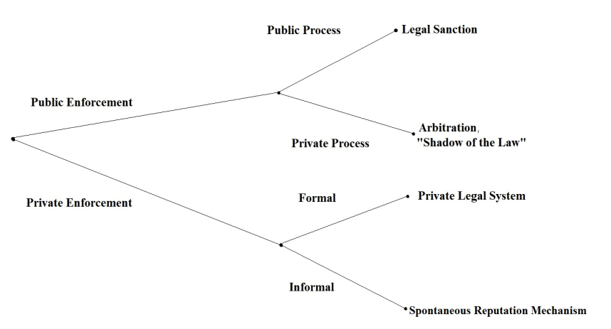
Governance Alternatives (The Cart and the Horse)

Slide 17
Private Legal Systems: e.g. Diamond Industry
Bernstein (1992), Richman (2006)
  New Formalism or Institutional Economics?
Private Law Scholarship Focuses on Administrative Costs
Substantive Law Supports New Formalism
The Real Action is in Enforcement Costs
Arbitration is Just Informational Mechanism for Private Sanctions
→ And some private enforcement systems DON’T HAVE arbitration systems
Multilateral Private Ordering is a Discrete Structural Enforcement Mechanism
→Transaction Cost Economics can predict its emergence

Slide 18
Why Private Ordering:
Tradeoffs and Institutional Efficiencies
Transaction Cost Economics:
  Transactional security Incentive Intensity
Public vs Private Ordering:
  Transactional security Entry
Notes:
Probably most impt slide

Slide 19
Why Private Ordering:
An Institutional Efficiency Explanation
 | Public Law, Arms-Length Exchange | Private Ordering, Reputation Mechanisms | Vertically Integrated Firm
Transactional Security, Low-Cost Enforcement | - | + | +
Allows Entry | + | - | +
High-Powered Incentives | + | + | -
Notes:
Probably most impt slide

Slide 20
Costs of Multilateral Private Ordering: Collusion
Antitrust violations
    Group Boycotts & Tacit Collusion
    Essential Facilities
    Information Sharing & Facilitating Anticompetitive Practices
BUT: Procompetitive justifications:
    Contract enforcement
    → Theory of Court Failure
    Less restrictive alternatives? e.g. Vertical Integration?
    → Comparative Institutional Analysis

Slide 21
Recall: “The Real Treasure of 47th Street”
“When I first entered the business, the conception was that truth and trust were simply the way to do business, and nobody decent would consider doing it differently.” -- Elderly diamond dealer (Bernstein 19992)
“Legal and moral accountability is the foundation for the very survival of the diamond industry.” --Shor (1993)
“Informal contracts are heavy with moral weight and embody certain principles: to honor commitments, to produce a good product and to stand behind it, and to preserve reputation.” -- Shield (2002)
“In this business, everything works on credit, loan, and trust.” – Otulski (2011)

Slide 22
No Longer True
“It used to be like that. It’s not like that anymore.”
“But there are some people who cheat [and] they reenter the business. … That’s what happened to me. I was cheated and I see the cheater back on the streets here.”
“It doesn’t pay to be honest anymore. When you’re honest, you’re viewed as a sucker.”
DDC Scandals
Financial Self-Dealing Among Officers
Packing of Arbitration System
Rigging Director Elections
Refusing DDC Membership to Avoid Mandatory Arbitration

Slide 23
Why the Erosion of Cooperation?
Examine Changes to Diamond Industry’s Value Chain:
Production – DeBeers’ New Strategy
Retail – Internet Sales and Competitive Pricing
Intermediaries (Dealers & Cutters) – Excessive Entry

Slide 24
DeBeers Monopoly, 1929-1998

Slide 25
DeBeers Declining Market Share, 1990-2015

Slide 26
DeBeers Retail Strategy

Slide 27
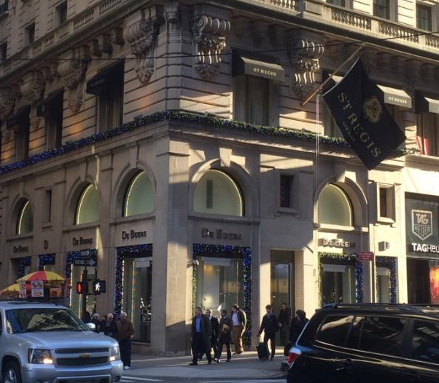
DeBeers Retail Strategy

Slide 28
DeBeers Pricing Strategy – Remains Monopolistic

Slide 29
Internet Retail & Competitive Pricing

Slide 30
Retail Price Changes

Slide 31
Intermediaries & Entry
Predominance of Ethnic Networks & Family Businesses
Dramatic Rise of India’s Diamond Sector, 1980-2010
Significant entry by Kathiawaris, First-Generation Businesses, ~1995
Indian Bank Subsidies

Slide 32
Intermediaries & Entry

Slide 33
Intermediaries & Entry

Slide 34
How Trust Breaks Down
Entry reduces margins
  Fewer returns (and thus incentives) for longterm cooperation
Kathiawaris & Indian bank policies disrupt traditional mechanisms for allocating & securing credit
  Wave of bankruptcies
  Uncertain enforcement mechanisms, diminished contractual reliability
Grief (2007): “Institutional Life Cycle”
  Success of reputation-based systems invite newcomers, with peripheral interests, increases the size of netowrks beyond capacity

Slide 35
Consequences of Eroding Trust
Background: Conventional understanding of diamond chain derived from Barzel (1977) and Kinney & Klein (1983)
  DeBeers remained exclusively upstream to avoid costs of distribution & measurement
  Or, really, dis-integrated networks measured & distributed stones more efficiently
BUT: now see growing vertical integration
  Miners/Producers entering designer & retail space
  Retailers acquiring wholesalers, entering longterm contracts with suppliers
  Sightholders acquiring polishing factories, entering exclusive contracts with retailers
This conforms with Organizational Economics/Theories of the Firm

Slide 36
Consequences of Eroding Trust – Vertical Integration
 | Public Law, Arms-Length Exchange | Private Ordering, Reputation Mechanisms | Vertically Integrated Firm
Transactional Security, Low-Cost Enforcement | - | + | +
Allows Entry | + | - | +
High-Powered Incentives | + | + | -
Notes:
Probably most impt slide

Slide 37
Consequences of Eroding Trust – Vertical Integration
 | Public Law, Arms-Length Exchange | Private Ordering, Reputation Mechanisms | Vertically Integrated Firm
Transactional Security, Low-Cost Enforcement | - | - | +
Allows Entry | + | - | +
High-Powered Incentives | + | + | -
Notes:
Probably most impt slide

Slide 38
Lessons
Trust is breaking down in the diamond industry
  Need to rethink Bernstein (1992)
Vertical integration is displacing DeBeers Block Booking
  Need to rethink Barzel (1977) and Kenney & Klein (1983)
Institutional economics suggests a linkage between #1 and #2
Insights into the efficiencies and limits of reputation-based exchange
  Reputation mechanisms are an attractive substitute/alternative to vertical integration
  BUT, sustained cooperation is sensitive to institutional environment

