Slide 1
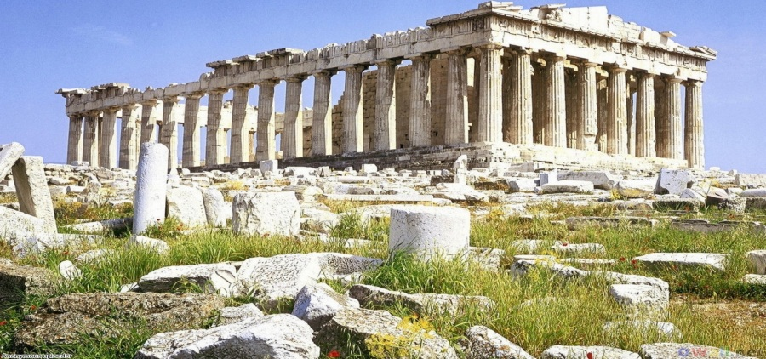
The Building and Dynamic of Democratic Institutions
Understanding the expansion (and contraction?) of political rights
with special application to ancient Greece
ESNIE 2014
F. Andrew Hanssen
Clemson University
Notes:
Special application:
My research focuses on
Very important: democracy is a Greek word

Slide 2
Questions and objective
How does democracy emerge (“path to democracy”)?
What makes democracy stable?

Slide 3
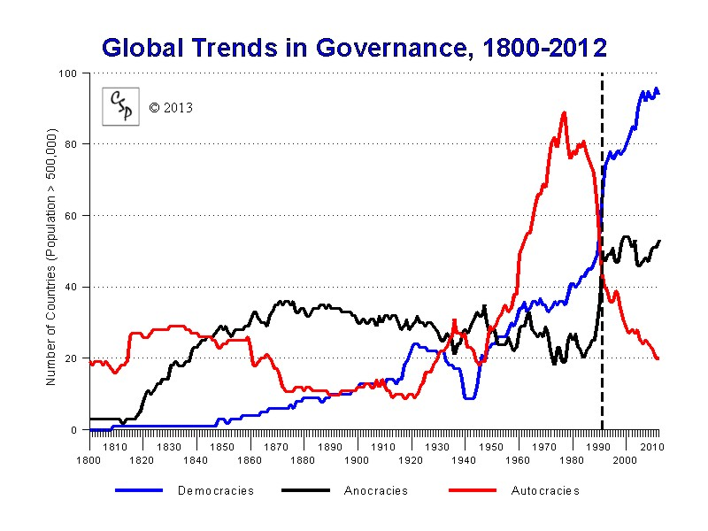
Why focus democracy?
Arguably most successful political form of past two-plus centuries
Associated with good things for citizens:
higher levels of material well being
higher levels of freedom and liberty
But despite apparent advantages, converting non-democracies to democracies appears to be very difficult
Furthermore, democracy not always stable even once established
Understanding how democracies arise (or don’t) thus very important research question
Lipset (1959)
Notes:
May seem obvious, or may be others. But is list of how I justify looking
Higher levels of wealth
Winston Churchill: “The best argument against democracy is a five minute conversation with the average voter.”
“No one pretends that democracy is perfect or all-wise. Indeed, Democracy is the worst form of government, except for all those other forms that have been tried from time to time."

Slide 4
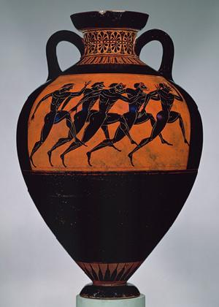
Why ancient Greece?
Birthplace of democracy (mother of western art, literature, philosophy, etc.)
If you’re interested in transition to democracy, first several hundred democracies (and thus democratic transitions) were Greek
Highly comparable set of states
Very successful set of states (fierce inter-state competition)
Varied paths to democracy
Cons: Not a lot of data by modern standards
But new sources of data are emerging
Notes:
New sources of data as classicists increasingly collaborate, new findings, importing methods from social sciences
So my goal is to explain, refer to various models and historical examples. But focus most intensively on Greece.

Slide 5
Caveat
Names I won’t be mentioning:
Hobbes
Locke
Montesquieu
etc.
Buchanan and Tullock
Coase
Riker
etc.
I will focus on a small number of economic models
of transition to democracy
Notes:
Not a review of the history of political thought

Slide 6
Defining democracy
A Greek word meaning “rule by the people” (or “masses”)
“Government of the people, by the people, for the people” (Abraham Lincoln)
As far as this talk is concerned, one regime more democratic than another to the degree that a larger proportion of its population is able to participate in public decision making and thereby influence policy.
For example, “aristocracy” (very narrow group) versus “oligarchy” (broader and more permeable group) versus “democracy” (broader group still)
Notes:
Start with bullet 1
Then qualify for slaves
Then go bullet two
Then note that even LEAST democratic more than rest of world

Slide 7
Transition to Democracy
However defined, the transition to democracy involves policy control passing from a narrower group to a broader group
Notes:
I will review some broad families of theory and then examine how well they appear to explain the expansion of political rights in ancient Greece

Slide 8
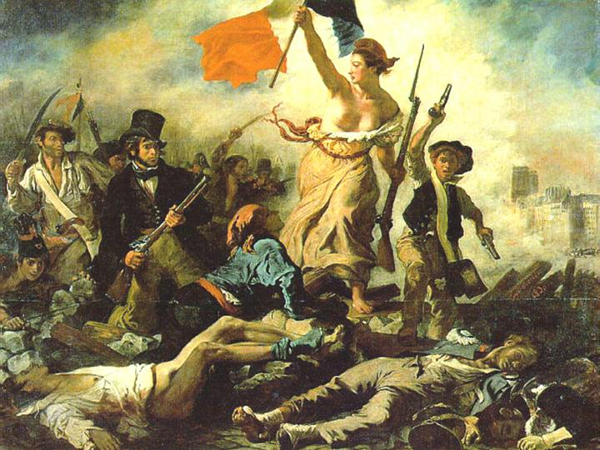
Why would a narrower group cede control of policymaking power to a broader group?
Daron Acemoglu and James A. Robinson (2000, 2001):
“Why Did the West Extend the Franchise? Democracy, Inequality, and Growth in Historical Perspective”, Quarterly Journal of Economics, 115: 1167-1199
“A Theory of Political Transitions” American Economic Review, 91: 938-963
Revolution!
Voluntary (makes them better off)
To improve incentives for productive activity
To alter the identity of the median voter
How about the elite simply becomes more enlightened?
Endogenous! (consider survival)
Douglas North and Barry Weingast (1989):
“Constitutions and Commitment: The Evolution of Institutional Governing Public Choice in Seventeenth-Century England” Journal of Economic History, 49: 803-832
Alessandro Lizzeri and Nicola Persico (2004) :
“Why Did the Elites Extend the Suffrage? Democracy and the Scope of Government, With an Application to Britain’s “Age of Reform”. Quarterly Journal of Economics 119:707-65
Notes:
aux barricades, camarade
Plausible
Note about France that wasn’t very durable
Note about those examples that elites supported though may have reduced own individual power
May be others, but these encompass most of what will focus on

Slide 9
Factors common to these (families of) models
Rational actors
Issue of commitment front and center
Political institutions as contracts
“bargaining . . . voluntarily entered into . . . specifies rights and duties”
Notes:
Contractual doesn’t have to mean conscious – survival
Madison quote on govt controlling self
The models appear to explain at least some modern episodes. How about ancient Greece?

Slide 10
Ancient Greece (Time line)
Mycenae characterized
by highly centralized palace economies
Great laboratory for exploring rights expansion/transition to democracy!
Collapse of
Mycenaean
civilization
Alexander
the Great
dies
Dark Age
Archaic Period
Classical Period
1150 BCE
800 BCE
500 BCE
323 BCE
Aristocracy
everywhere
Oligarchy
everywhere
Democracy
many/most places
Notes:
What we will see is that it somewhat more complicated than that.

Slide 11
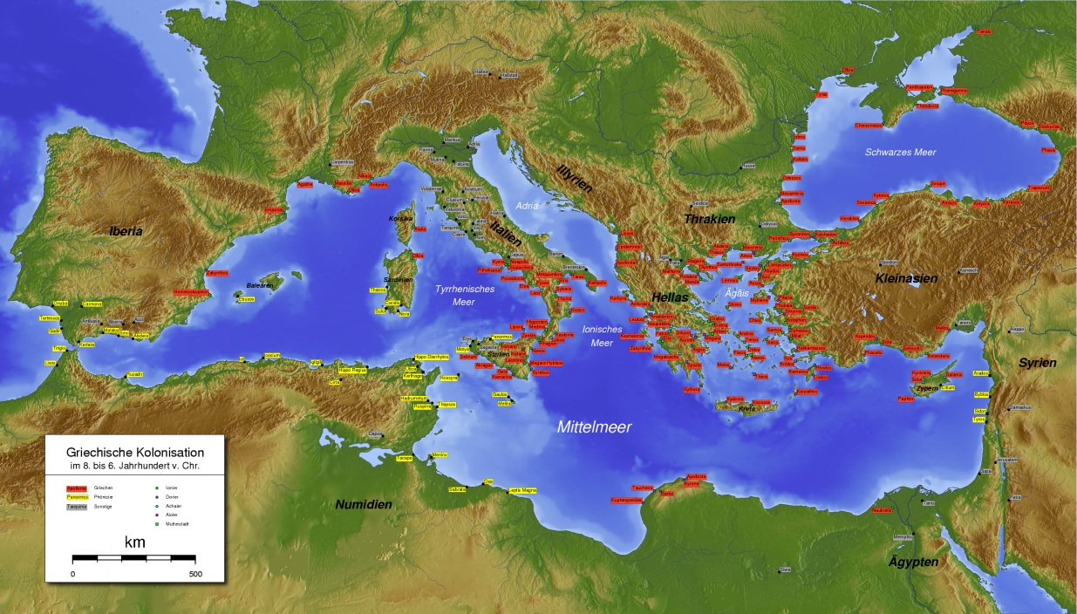
The Greek World

Slide 12
Voluntary A: Improve incentives for productive activity
Robert K. Fleck and F. Andrew Hanssen:
“The Origins of Democracy: A Model with Application to Ancient Greece”, Journal of Law and Economics, Vol. 49, No. 1 (April 2006), pp. 115-146
Two players: aristocrat and demos.
Initial period decisions:
Aristocrat decides whether to retain control of tax rates, or pass control to demos.
Demos decides whether to make unobservable investment (at cost c) which will raise output in future periods.
Per period output without investment = r.
Per period output with investment = r+i.
Aristocrat seeks to maximize spending on a public good (e.g., defense)
Demos seeks to maximize combination of public good and own consumption

Slide 13
Two Nash equilibria
The aristocrat retains control of tax rates, the demos does not undertake the unobservable investment.
The aristocrat grants the demos control of tax rates, the demos undertakes the unobservable investment.
Prediction: the lower r and the higher i, the more likely is the aristocrat to relinquish tax rate
Low r and high i are thus democracy-promoting factors.
Note: The effects of aristocrat’s incentives parallel the effects of regime survival
Notes:
We get the same predictions from a stochastic model with heterogeneous aristocrats.

Slide 14
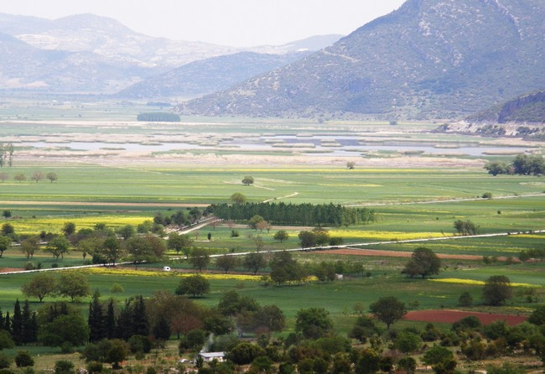

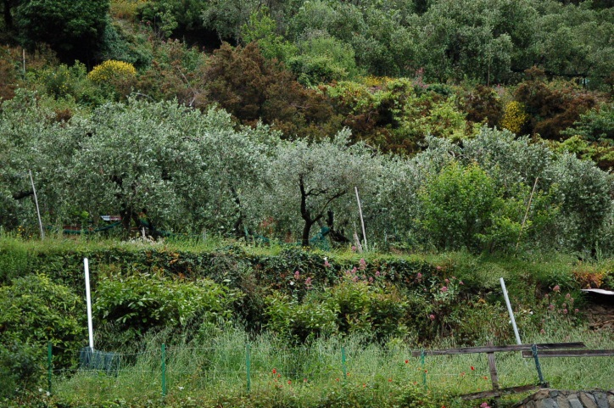
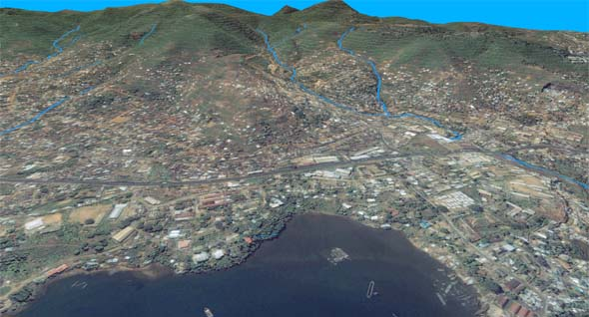
Testing the model: Classical Athens (most democratic) versus Classical Sparta (least democratic)
Also Athens over time
Something exogenous: Different terrain
Spartan fertile plains versus Athenian rocky hillsides
Therefore different crops
Grain (in homogenous flatlands of Sparta)
versus olives (on heterogenous hillsides of Athens)
These two crops involve different types of investment
Wheat production easy to monitor
Olive production costly to monitor
In other words, Sparta is high r and low i . . .
. . . while Athens is low r and high i
Therefore different incentives to grant farmers (those who worked the land) secure residual claims
Sparta didn’t; Athens did
Therefore different assignment of political rights
Athens democracy; Sparta oligarchy
Also small cross section
Consistent with prediction that probability of
democracy rises with returns to costly
to monitor investment

Slide 15
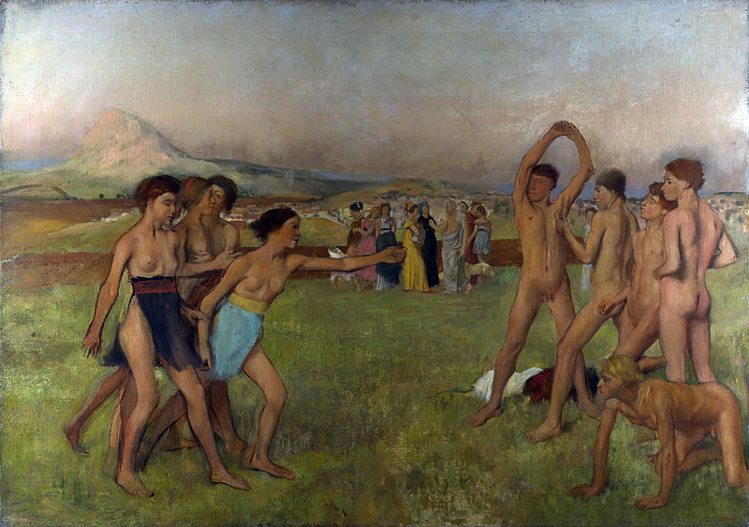
Implications for modern world
Democracy risen dramatically in recent 150 years. Any valuable but costly to monitor investment possibly involved?
Human capital?
Model predicts that wealth per se doesn’t lead to democracy (depends on type of wealth). Any easy to monitor wealth producing investment impeding democracy?
The “resource curse”?
Can rights enjoyed by Spartan women tell us something about women’s rights today?
Role of high returns to human k?
Robert K. Fleck and F. Andrew Hanssen (2009):
“‘Rulers Ruled by Women: An Economic Analysis of the Rise and Fall of Women’s Rights in Ancient Sparta”, Economics of Governance, 10: 221-245

Slide 16
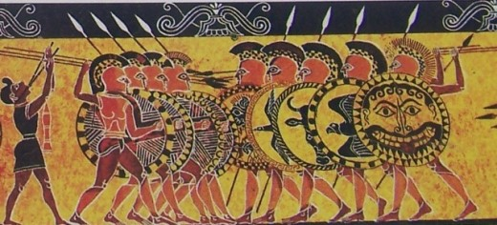
An aside on commitment
Recall that all the models portray democracy as a commitment device.
But how do you commit to democracy?
In ancient Greece, at least two things helped commit to democracy:
Widespread ownership of arms (raised cost of aristocrats attempting to renege on promise of political rights)
Shared policy objectives:
Members of enfranchised demos paid essentially uniform tax for defense of city-state: clear incentives to set substantial tax rate.
Also, structured to avoid problems with cycling, tyranny of the majority (as will discuss)

Slide 17
Voluntary B: Alter median voter
Robert K. Fleck and Andrew Hanssen “How Tyranny Paved the Way to Democracy: The Democratic Transition in Ancient Greece”, Journal of Law and Economics, Vol. 56: (2013), pp. 389-416
Lizzeri and Persico story (19th century Britain):
Industrial revolution produces divided elite (old agriculture versus new commerce)
New commerce supports urban infrastructure investment; old agriculture does not
New commerce changes identity of median voter to produce durable political coalition in favor of those policies
Expands franchise to include urban interests
Parallel to ancient Greece is striking
Reintegration of Greece into regional trading networks in Archaic period produces intra-elite conflict akin to old ag versus new commerce
New commerce supports urban infrastructure investment; old agriculture does not
New commerce changes identity of median voter to produce durable political coalition in favor of those policies
Big difference: Did not expand the franchise, but rather contracted it, giving power to a single man, the tyrant.
YET . . . places where tyrants ruled became most democratic subsequently
Notes:
Story thus far is about big change from aristocracy to democracy over two –three centuries.
Focus on factors make democracy efficient
Can work through conscious action or regime survival
What does path to democracy look like?
Models are complementary
Yet led to democracy in longer run!

Slide 18
How does a tyrant lead to democracy?
Exogenous commercial potential (“location on coast”)
➔ divides elites (“old ag versus new commerce”)
commercial elite installs tyrant
Tyrant engages in pro-commerce investment
Puts down opposing members of elite
where policies successful, economic growth produces demos with stable pro-commerce policy preferences
democracy replaces tyranny
Now sounds a lot like L&P: Establish new median voter that forms basis of pro-commerce coalition
Implication: path to democracy can be non-monotonic
Notes:
Will combine model and empirics on this slide
Tyrants arose only among coastal poleis, where commercial potential high and elites divided
More than 90% of former tyrannies became democracies, as compared to 25% of non-tyrannies
Location on coast affects probability of democracy only through tyranny
Historical narrative supports

Slide 19
Do we see “tyrants” like this in the modern world?
Story in a nutshell: Tyrants quashed intra-elite conflict, engaged in growth-promoting investment, and thereby laid the groundwork for the emergence of stable democratic polity
Where might we see/have seen in modern world?
Korea?
Latin America?
China versus Russia?
The Arab spring?

Slide 20
Stable democracy
Robert K. Fleck and F. Andrew Hanssen (2014):
“The Foundations of Wealth-Enhancing Democracy:
Aristotle, Lindahl, and Institutional Design in Ancient Greece”
Establishing democracy is one thing; establishing a stable democracy is another.
Theme : Successful use of majority rule rests on designing institutions that provide voters with good incentives regarding society’s most important activities

Slide 21
Mechanism Design (pre-Lindahl)
[O]f the private land, part should be near the border, and the other near the city, so that, each citizen having two lots, they may all of them have land in both places; there is justice and fairness in such a division, and it tends to inspire unanimity among the people in their border wars. Where there is not this arrangement some of them are too ready to come to blows with their neighbors, while others are so cautious that they quite lose the sense of honor. Wherefore there is a law in some places which forbids those who dwell near the border to take part in public deliberations about wars with neighbors, on the ground that their interests will pervert their judgment. For the reasons already mentioned, then, the land should be divided in the manner described.
-Aristotle, Politics

Slide 22
Greek city-states devoted great efforts to designing institutions that engineered support for major sources of wealth creation
Both Athens and Sparta experienced shocks to wealth sources
Sparta: conquered a neighboring territory
Athens: gained and then lost an empire
Each redesigned its institutions accordingly to align policy incentives
Key difference (in a nutshell)
Spartans enforced homogeneity (cost of which was foregone gains from specialization)
Sparta established the famous Spartan institutions
Athens allowed specialization (cost of which was need to design institutions that aligned voter incentives through distribution of benefits and costs)
Under empire, Athens established “radical” democracy
After losing empire, established system of checks and balances
Both “second best”, but very effective

Slide 23
“Modern” comparisons (from the United States)
Founders (white men) had aligned incentives over economic growth (e.g., settle new land vs fight over wealth).
Not aligned over slavery – design of institutions delayed the (bloody) resolution.
Roosevelt’s New Deal (engineered to last)
Social Security: FDR on taxes and benefits for all
By contrast, stimulus spending very partisan
Not obvious that split is natural right vs left (unlike, e.g., ACA)
But federal income tax structure has zero rates for many
If funded with consumption tax, might be very different

Slide 24
Modern implications
Is it Feasible to “Engineer Prosperity”?
In their book, Acemoglu & Robinson essentially say no
Good reason to think not (entrenched interests, etc.)
Exporting democracy thus is, at best, complicated
But Athens and Sparta did engineer their political and economic systems for durable prosperity.
And the broad citizenry did the engineering and reengineering.
U.S. founders looked to Greece.
Perhaps polarization has increased in recent decades because of reduced alignment.

Slide 25
Lessons?
Institutions as commitment devices
But also must commit to institutions!
Successful institutions get the incentives right

