Slide 1

Corporate governance
Ania Zalewska
Centre for Governance and Regulation, School of Management, University of Bath, UK
CMPO, University of Bristol, UK
22 May 2014, ESNIE, Corsica

Slide 2
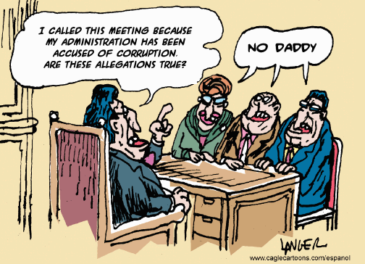
Why corporate governance?

Slide 3
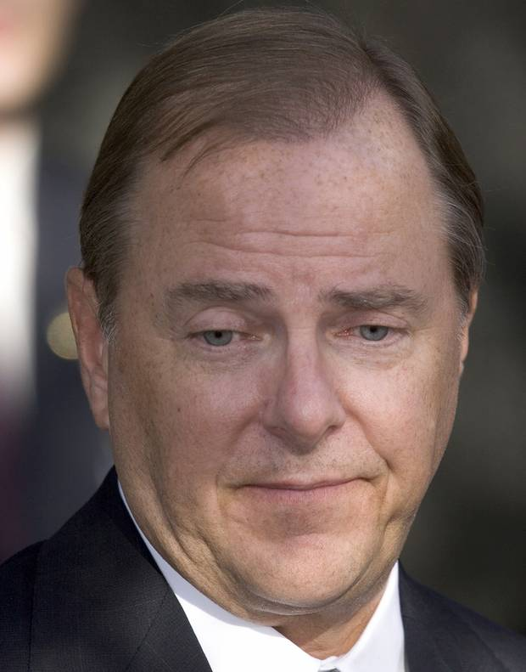
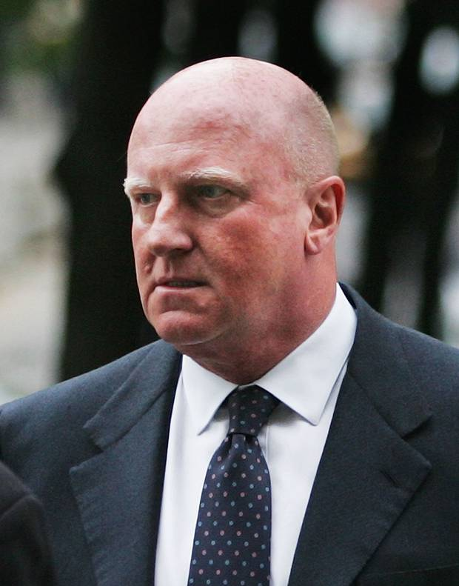


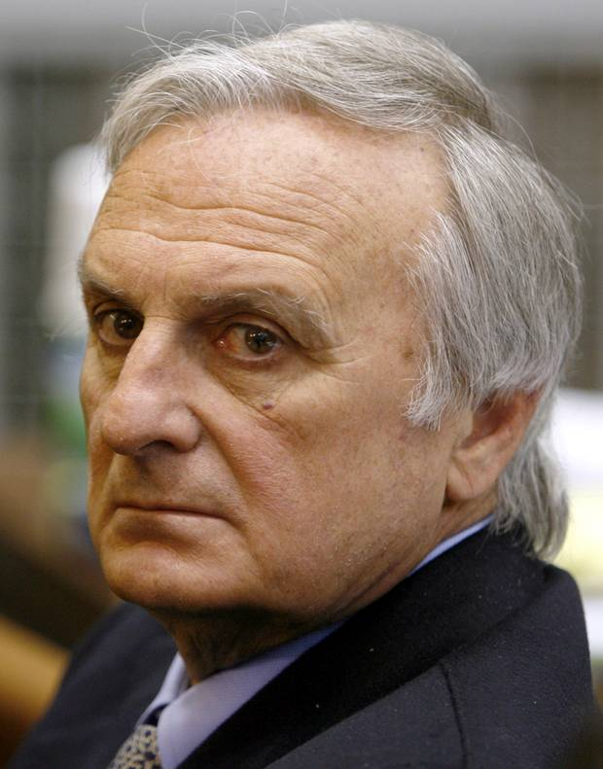
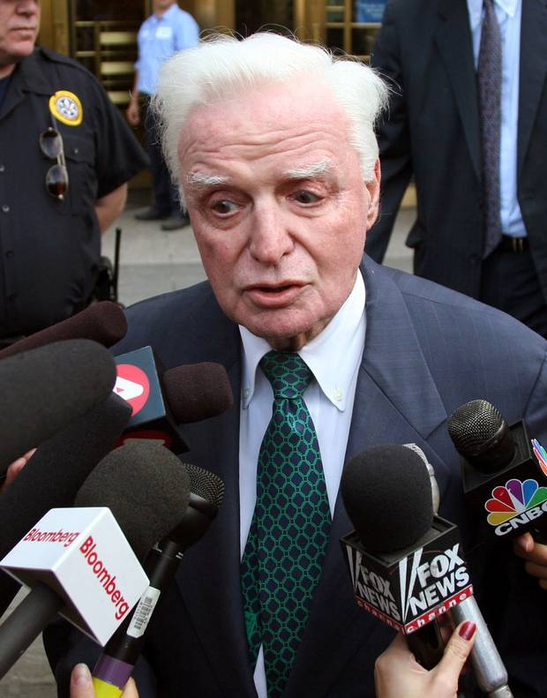

Why corporate governance?
Jeff Skilling, Enron,
Denis Kozlowski,
Tyco
Ramalinga Raju,
Satyam
Bernard Ebbers, Woldcom
Calisto Tanzi,
Parmalat
John Rigas,
Adelphia Communic.
Frank Dunn,
Nortel

Slide 4
Why corporate governance?
Direct factors
Privatisation (SOE, pensions)
Regulatory reforms
Indirect factors
Growth of equity markets
In size
In number
Change in the ownership structure
Growth of dispersed ownership
Growth of institutional investors
Globalisation of businesses

Slide 6
Numbers of countries per region with various groups of stock markets

Slide 7
Number of countries with
Population of countries with

Slide 8
Overview of corporate governance reforms
Trigger
(e.g., Corporate scandals)
Method of implementation:
Voluntarily codes of good practice
Law enforced changes
Issues addressed:
Monitoring
Incentives
Notes:
Ask students which route has been chosen by the UK and the USA

Slide 9
The UK
1985: Companies Act established a few rules, but only a few
Board structure was not specified, although boards of publicly listed companies had to have at least two NEDs
Boards were responsible for the production of annual financial reports
1992: Cadbury’s Report known as Code of Best Practice on Corporate Governance is a set of self-regulated standards of governance, e.g.,
Separation of CEO and Chairman
Minimum 3 NEDs
Inclusion of independent directors
An independent audit committee
Review of the effectiveness of companies’ internal controls

Slide 10
1995: Greenbury Report:
Executives not to be involved in remuneration committee
Remuneration disclosure
Restrictions on all option plans
1998: Hampel Report:
“we urge caution to the use of inter-company comparisons and remuneration surveys in setting levels of directors’ remuneration”
“we do not recommend further refinement in the Greenbury code provisions relating to performance related pay. Instead we urge remuneration committees to use their judgement in devising schemes appropriate for the specific circumstances of the company”
The majority of NEDs should be independent
The board should consider introducing procedures to assess
their own collective performance
performance of individual directors

Slide 11
2003: Higgs Report and Combined Code (Cadbury Report + Higgs Report): Empowering NEDS and non-executive Chairmen
NEDs should constitute at least half of the board
NEDs should serve maximum six years
NEDs should be lead by an independent director
CEO should not progress to chairman
Advised to provide shareholders with an annual report on the board’s performance
The ISC Report 1991, 2005
The Myners Report 2001, 2004,
Combined Code 2006 section D
Financial Reporting Council, 2010, 2012

Slide 12
Stewardship Code, 2010 Financial Reporting Council, UK
Principles and guidelines directed at institutional investors i.e., "firms who manage assets on behalf of institutional shareholders such as pension funds, insurance companies, investment trusts and other collective investment vehicles“ who hold voting rights
"comply or explain" approach, i.e., a compliance with principles is not required, but if institutional investors do not comply with any of the principles set out, they must explain why they have not done so on their websites
If shareholders are not satisfied with the explanation given, they can use their powers, including the power to appoint and remove directors, to hold the company to account.
Notes:
There are a number of advantages to the 'comply or explain' approach. Its inherent flexibility means that it is possible to set more demanding standards that can be done through hard rules. Experience has shown that the vast majority of companies attain these standards. In addition, requiring companies to report to shareholders rather than regulators means that the decision on whether a company's governance is adequate is taken by those in whose interest the board is meant to act. The Stewardship Code similarly makes investors more accountable to their clients and beneficiaries, as well as helping companies.

Slide 13
The USA: Remuneration as incentives
Companies are generally required to
describe their executive compensation programme
for most recently competed fiscal year
Securities Act of 1934
Securities Act of 1993
Internal Revenue Code of 1993: performance-based compensation is tax exempt, while ‘fixed’ remuneration in excess of $1mln cannot be treated as company’s expense
SOX of 2002:
prohibits personal loans to directors and executive offices (which were commonly granted to facilitate conversions of options
Puts restrictions on stock sales during retirement plan blackout periods
Compensation Disclosure and Analysis Act of 2006:
‘plain English’ statements how much and in what form CEO and CFO are paid
Dodd-Frank Act 2010:
Disclosure of median annual total compensation of all employees, and of the ratio of this median to the total compensation of the CEO
Separation of CEO and Chair positions for firms that received assistance under 2008 Troubled Asset Relief Programme (TARP)

Slide 14
Sarbanes-Oxley Act (SOX) 2002
Introduced a broad set of new reforms regarding the corporate governance of publically held companies. It was designed to:
increase a level of corporate accountability to shareholders
increase transparency of financial statements
reform the oversight of corporate accounting
direct the SEC to issue enabling rules for certain provisions and engage in an extensive rulemaking process
The SOX applies to non-US issuers whose ADRs have been publically offered in the US (Level III ADRs), are listed on the US exchanges (Level II) but not to those whose ADRs are trade OTC only (Level I) or privately.

Slide 15
Audit Committee
Composed of entirely independent directors
SOX requires to disclose in periodic reports whether or not at least one ‘financial expert’ serves on the AC
Its responsibilities include: overseeing and approving outside auditors
Under SEC rules Audit Committee’s members:
cannot receive directly, or indirectly, advisory or compensatory fees (including compensation as an officer or employee) from the company, other than for board services
cannot be affiliates of the company
To recognise differences in corporate governance structures in foreign countries, in certain cases of ADR issuers, AC members can be drown from management employees, representatives of controlling shareholders, government officials, etc.

Slide 16
Assessment of SOX: Costs
Very expensive and unneeded obligations
Delisting of companies from the NYSE and NASDAQ
Reduction of US IPOs
Reduction of foreign listings on NYSE and NASDAQ
Reduction of competitiveness of the American Stock Exchanges on the international scene
The adoption of Compensation Disclosure and Analysis (CD&A) by SEC in 2006
Detailed information on compensation earned by CEO, CFO and the three highest paid executive officers and members of the board of directors
Notes:
Discuss why informing about compensation may be a cost:
Rather than paying for their club memberships , they pay in cash directly to the directors
Information about remuneration can reduce comparative advantage: let say that a CEO has been appointed under the understanding that he will seek a particular acquisition, and that part of his compensation will depend on the success of this acquisition. Should the company voluntarily disclose such information? should SEC have the right to demand this information?

Slide 17
Dodd-Frank Wall Street Reform and Consumer Protection Act, 2010
‘Softening’ SOX’s auditing requirements of internal control assessment by management
Exception for firms with a market cap < $75mln
Requested SEC to investigate and propose new rules for firms with a market cap $75mln – $250mln
“The 2,319 pages contained the blueprint for 243 rule-makings along with numerous studies and reports ensuring that it will take years before the reforms aimed at preventing the recurrence of a similar financial crisis in the future are actually in place and operational”
“(i)n early 2013, nearly three years from its enactment, a quarter of mandatory rule-making provisions were yet to be proposed, with many of the other three-quarters still in the provisional stage and some of the most significant facing challenge”
(Demsey, 2013)

Slide 18
Executive remuneration at Dodd-Frank Act
Disclosure and justification of awarded executive remuneration
Disclosure of the median annual total compensation of all employees
Disclosure of the ratio of the above median to the total compensation of the CEO.
Disclosure whether any directors/employees were permitted to buy financial instruments to hedge/offset a potential decline in the value of company’s shares held as part of compensation
Shareholders have a non-biding vote (at least once every three years) on executive pay

Slide 19
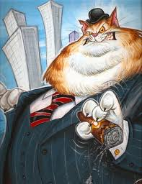
Executive pay

Slide 20
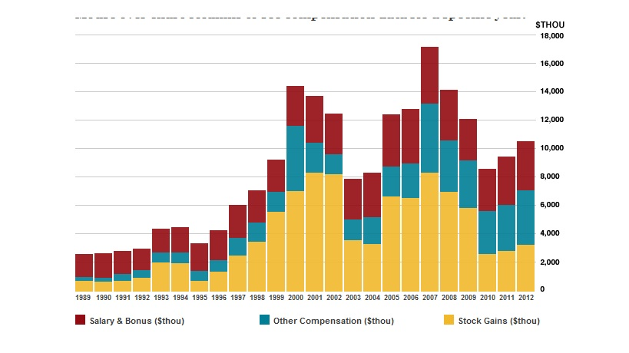
CEO pay, USA annual statistics

Slide 21
Relative importance of components of pay
 | UK - % total pay | US - % total pay
Base salary | 59 | 29
Annual bonus | 18 | 17
Share options | 10 | 42
LTIP shares | 9 | 4
Other pay | 5 | 8
Source: Conyon and Murphy (2000)

Slide 22
Agency theory – illustrative example
V – output of the firm
ε – random shock to the firm’s payoff; ε ~ NIID (0, σ²)
e – effort of the agent
c – cost of effort; c’(e)>0, c”(e) >0
– sharing rate, i.e., the proportion of the firm’s output V that is paid to the agent
α – the agent’s salary
W – the agent’s wage
W₀ – market wage, exogeneous
U – the agent’s utility function
S – payoff of the firm (net profit)
r – the agent’s risk aversion (the agent is risk averse, but the principle is risk neutral)
Notes:
r >0 because the agent is risk averse
The principal is risk neutral

Slide 23
Firm output V = e + ε
Agent’s wage W = α + βV
Cost of effort c(e) = 0.5e²
3 Qs:
How much effort is the agent going to exert?
What is the optimal sharing rate?
What is the optimal level of salary?
The agent maximises his utility:
where
So, the utility to maximise is:

Slide 24
FOC: The agent sets the marginal returns to effort equal to marginal cost of effort:
Incentive compatibility constraint
The agent accepts the contract if E(U) ≥ W₀, i.e.,
Participation condition
Notes:
Marginal return to effort = marginal cost of effort

Slide 25
Let us turn to the principal who wants to maximise the expected surplus, i.e., S = E(firm output) – E(wage paid out) = E(V) –E(W)
subject to the agent taking the job and extracting the optimal level of effort. Therefore,
Output sharing rate:
β
1
r > r
σ²
Notes:
Ask how sharing changes with project risk

Slide 26
The optimal level of salary is:
What is the optimal salary the agent will request?
Putting together the optimal level of sharing and the PC we get:
α∗
W₀
W₀ -0.5
σ²

Slide 27
Do relative performance measures solve the problem?
Let us assume that E(ε) = k ≠0 → E(W) = α + β E(V) = α +β(E(e) + k) what may result in undue rewards.
The principle imposes ‘performance standards’, i.e., pay only above a pre-defined level of performance P = E(e) + k.
The agent is paid W = α + β(V-P) and chooses the level of effort:
The (new) optimal effort of level:
The (new) optimal sharing rate:
The (new) optimal salary level:
α∗
W₀
W₀ -0.5
σ²

Slide 28
“We have been mystified for many years why boards do not formally restrict managers’ freedom to unwind incentives the remuneration committee constructs for them”.
Jensen et al. (2004)

Slide 29
The general idea is that options are granted to align incentives. However,
+
payoff
payoff
price
price
Long call option
payoff
price
Portfolio of a long call and short share

Slide 30
Mixed view of incentives:
Positive: Core and Larcker (JFE 2002), Core and Guay (JFE 2001), Kato et al. (2006, JFE), Morck, Schleifer and Vishny (JFE 1988)
Diluted or absent: Bebchuk and Fried (2004), Dow and Raposo (JF2003), Himmelberg, Hubbard and Palia (JF 1999) (but see Zhou (JFE 2001)), Bergstresser and Philippou (JFE 2006), Stivastava and Swanson (JFE 2007)
Mixed evidence on stock sales:
Yermack (JFE 1995)
No significant inter year changes in stock ownership transactions;
Ofek and Yermack (JF 2000)
Managers hedge the risks of stock-based pay by selling some shares after receiving equity-based incentive compensation (but significant differences in responses);
Johnson, Ryan and Tian (WP 2006)
Managers who’s companies loose value sell stocks
Some evidence that managers time their share purchases:
Jenter (JF 2006), Bartov & Mohanram (AccR 2004), Bergman & Jenter (JFE 2007)

Slide 31
Company has a project and needs a manager
X
X+ε
Expected value of the company
Managers differ in effectiveness of delivering the project
(i.e., probability of success) and possibly in cost of making an effort
Probability of success π is manager specific
- learned by a manager once hired
- private information to a manager
Manager’s pay consists of:
- basic salary
- δ options (α=δ/(1+δ))
Manager can also purchase shares

Slide 32
Timeline
Manager learns π
Noise traders and
manager submit orders
(0, y or 2y)
Market price set
Manager
determines
effort
State of the world
revealed
Payoffs realised
Manager hired
S, δ fixed

Slide 33
Two counteracting effects
Manager has private information whether he/she intends to make the additional effort is private information. This private information creates an incentive for the manager to purchase shares.
However, the market realizes that granting more options increases a good manager’s incentives to work and to purchase stock and so the market looks at aggregate trades to try to infer whether the manager in place is a good manager and, hence, likely to make an additional effort. This affects the price that the manager has to pay for the shares.

Slide 34
Manager’s expectation of the terminal value of the company
X+ π ε
X
α”(π)
α'
1
α
Manager’s expected gain from options and shares
options
shares
1
α
c(π)

Slide 35
Two critical probabilities:
π_{s}: managers with π ≥ π_{s} buy shares and make the additional effort
π_{o}: if share purchases barred or a manager chooses not to buy shares, then a manager with π ≥ π_{o} makes an additional effort

Slide 36
There exists an α’ such that shares and options are:
complements if α less than α’
substitutes if α is greater than α’.
1-π
1
1-π_{o}
1-π_{s}
α’
1
α

Slide 37
1-π
1-π
1
1
1-π_{o}
1-π_{s}
1-π_{s}
1-π_{o}
α’
1
α
α’
1
α
(a)
(b)
“Superstars”
“Ordinary executives”

Slide 38
Board remuneration: Tournament versus collegiate
Tournament theory suggests that large differences in compensation between the CEO and next highest rank executive can provide motivation for the executives occupying that rank by promoting competition among them
Career incentives
Performance incentives
Collegiate theory argues that large pay gaps within the executive teams may lead to failures of coordination
Temptations for executives to sabotage their team members to win promotion
Feelings of relative deprivation among team members
Reduction of a team spirit

Slide 39
Tournament? what tournament?
Yes:
Eriksson, JLE 1999
Conyon, Peck, and Sadler, Strat. Man. J 2001
Kale, Reis and Venkateswarn, JF 2009
Note that testing for tournament is associated with a comparison of a CEO’s remuneration and those who compete to replace him/her.
No:
Main, O’Reilly, and Wade, JLE 1993
Bognanno, JLE 2001
Ang, Hauser & Lauterbach, EFM 1998

Slide 40
Does tournament work?
Tournament structures supporters
Lazear and Rosen, JPE 1981
Main, O’Reilly, and Wade, JLE 1993
Lee, Lev, and Yeo, RQE&A 2008
Eriksson, JLE 1999
Kale, Reis and Venkateswaran, JF 2009
Collegiate structures supporters
Milgrom and Roberts, Amer. J. Sociology 1988
Lazear, JPE 1989
Conyon, Peck, and Sadler, Strat. Man. J 2001
Lindquist, J. Soc-Economics 2010
Vandegrift and Yavas, JITE 2010
Literature seems to have the apparent conundrum that there are different responses to tournament remuneration incentives

Slide 41
Does the remuneration differences positively covary with firm performance?
Main, O’Reilly and Wade, JLE 1993
Ang, Hauser & Lauterbach, EFM 1998
Eriksson, JLE 1999
Bognenno, JLE 2001
Conyon, Peck, and Sadler, Strat. Man. J 2001
Conyon and Sadler, 2001
Henderson & Fredrickson, Acc Manag. J. 2001
DeVaro, RAND 2006; Strat Manag. J, 2006
Lee, Lev and Yeo, Rev. Quant, Fin&Acc 2008
Kale, Reis and Venkateswarn, JF 2009
Rankin and Sayre, Acc. Org. & Soc. 2011

Slide 42
 |  | Whole sample |  |  |  |  |  |  |  | Boards with British executives only
 |  | Dispersion_{salary} |  |  |  | Dispersion_{total-pay} |  |  |  | Dispersion_{salary} |  |  |  | Dispersion_{total-pay}
Basic model |  | ROCE |  | Returns |  | ROCE |  | Returns |  | ROCE |  | Returns |  | ROCE |  | Returns
Firm-size |  | 0.067*** |  | 0.000 |  | 0.066*** |  | 0.001 |  | 0.077*** |  | -0.000 |  | 0.077*** |  | 0.000
 |  | (0.000) |  | (0.599) |  | (0.000) |  | (0.413) |  | (0.000) |  | (0.942) |  | (0.000) |  | (0.773)
Leverage |  | -0.302*** |  | -0.013** |  | -0.314*** |  | -0.011* |  | -0.352*** |  | -0.008 |  | -0.349*** |  | -0.008
 |  | (0.000) |  | (0.023) |  | (0.000) |  | (0.053) |  | (0.000) |  | (0.259) |  | (0.000) |  | (0.213)
Insiders |  | 0.041 |  | -0.010** |  | 0.044 |  | -0.010** |  | 0.046 |  | -0.006 |  | 0.050 |  | -0.006
 |  | (0.217) |  | (0.045) |  | (0.193) |  | (0.042) |  | (0.249) |  | (0.376) |  | (0.220) |  | (0.370)
Board-size |  | -0.006 |  | -0.000 |  | -0.005 |  | -0.000 |  | -0.007** |  | 0.000 |  | -0.006* |  | 0.000
 |  | (0.193) |  | (0.968) |  | (0.213) |  | (0.998) |  | (0.044) |  | (0.724) |  | (0.074) |  | (0.704)
NED% |  | -0.164*** |  | 0.011 |  | -0.173*** |  | 0.012 |  | -0.227*** |  | -0.001 |  | -0.232*** |  | 0.000
 |  | (0.008) |  | (0.184) |  | (0.005) |  | (0.150) |  | (0.000) |  | (0.946) |  | (0.000) |  | (0.982)
CEO-tenure |  | 0.036*** |  | 0.004*** |  | 0.037*** |  | 0.004*** |  | 0.034*** |  | 0.005*** |  | 0.034*** |  | 0.005***
 |  | (0.000) |  | (0.000) |  | (0.000) |  | (0.000) |  | (0.000) |  | (0.000) |  | (0.000) |  | (0.000)
CEO-chair |  | -0.008 |  | 0.010*** |  | -0.013 |  | 0.010*** |  | -0.012 |  | 0.008* |  | -0.014 |  | 0.008*
 |  | (0.722) |  | (0.004) |  | (0.595) |  | (0.003) |  | (0.614) |  | (0.052) |  | (0.561) |  | (0.050)
CEO-on-boards |  | -0.022*** |  | -0.001 |  | -0.020*** |  | -0.001 |  | -0.012 |  | -0.000 |  | -0.013 |  | -0.001
 |  | (0.003) |  | (0.583) |  | (0.004) |  | (0.517) |  | (0.180) |  | (0.884) |  | (0.117) |  | (0.684)
Dispersion |  | -0.159* |  | -0.031*** |  | -0.057 |  | -0.029*** |  | -0.263** |  | -0.059*** |  | -0.152* |  | -0.042***
 |  | (0.089) |  | (0.008) |  | (0.345) |  | (0.002) |  | (0.026) |  | (0.000) |  | (0.051) |  | (0.001)
Ch-2(45) |  | 1163.8 |  | 1122.8 |  | 1181.2 |  | 1128.7 |  | 1087.6 |  | 824.3 |  | 1074.9 |  | 792.7
R-squared |  | 0.304 |  | 0.320 |  | 0.296 |  | 0.324 |  | 0.367 |  | 0.337 |  | 0.366 |  | 0.331
Observations |  | 2243 |  | 2223 |  | 2252 |  | 2232 |  | 1530 |  | 1513 |  | 1530 |  | 1513

Slide 43
 |  | Boards with at least one overseas executive
 |  | Dispersion_{salary} |  |  |  | Dispersion_{total-pay} |  |  |  | Dispersion_{salary} |  |  |  | Dispersion_{total-pay}
 |  | ROCE |  | Returns |  | ROCE |  | Returns |  | ROCE |  | Returns |  | ROCE |  | Returns
Firm-size |  | 0.041*** |  | -0.000 |  | 0.045*** |  | -0.000 |  | 0.041*** |  | -0.000 |  | 0.045*** |  | -0.000
 |  | (0.000) |  | (0.893) |  | (0.000) |  | (0.873) |  | (0.000) |  | (0.918) |  | (0.000) |  | (0.881)
Leverage |  | -0.205** |  | -0.016 |  | -0.210** |  | -0.015 |  | -0.214** |  | -0.016 |  | -0.223** |  | -0.015
 |  | (0.019) |  | (0.118) |  | (0.020) |  | (0.133) |  | (0.013) |  | (0.105) |  | (0.013) |  | (0.126)
Insiders |  | 0.032 |  | -0.025*** |  | 0.033 |  | -0.025*** |  | 0.036 |  | -0.024*** |  | 0.039 |  | -0.025***
 |  | (0.441) |  | (0.002) |  | (0.427) |  | (0.001) |  | (0.389) |  | (0.002) |  | (0.361) |  | (0.001)
Board-size |  | -0.002 |  | -0.001 |  | -0.003 |  | -0.001 |  | -0.002 |  | -0.001 |  | -0.003 |  | -0.001
 |  | (0.793) |  | (0.300) |  | (0.683) |  | (0.253) |  | (0.758) |  | (0.287) |  | (0.595) |  | (0.256)
NED% |  | 0.106 |  | 0.025* |  | 0.104 |  | 0.026** |  | 0.115 |  | 0.025* |  | 0.109 |  | 0.026*
 |  | (0.308) |  | (0.066) |  | (0.342) |  | (0.048) |  | (0.263) |  | (0.067) |  | (0.320) |  | (0.051)
CEO-tenure |  | 0.040*** |  | 0.003** |  | 0.041*** |  | 0.003* |  | 0.043*** |  | 0.003* |  | 0.043*** |  | 0.003*
 |  | (0.001) |  | (0.049) |  | (0.000) |  | (0.052) |  | (0.000) |  | (0.054) |  | (0.000) |  | (0.056)
CEO-chair |  | 0.077* |  | 0.013** |  | 0.083* |  | 0.013** |  | 0.082* |  | 0.013** |  | 0.087* |  | 0.013**
 |  | (0.079) |  | (0.012) |  | (0.066) |  | (0.015) |  | (0.065) |  | (0.014) |  | (0.057) |  | (0.018)
CEO-on-boards |  | -0.016* |  | 0.001 |  | -0.019** |  | 0.001 |  | -0.020** |  | 0.001 |  | -0.021** |  | 0.001
 |  | (0.085) |  | (0.507) |  | (0.039) |  | (0.542) |  | (0.040) |  | (0.350) |  | (0.027) |  | (0.424)
Dispersion |  | -0.070 |  | 0.016 |  | 0.051 |  | 0.002 |  | -0.161 |  | 0.019 |  | -0.017 |  | 0.004
 |  | (0.689) |  | (0.334) |  | (0.559) |  | (0.895) |  | (0.378) |  | (0.313) |  | (0.859) |  | (0.780)
Dispersion x US-execs% |  |  |  |  |  |  |  |  |  | 0.905*** |  | -0.033 |  | 0.503*** |  | -0.027
 |  |  |  |  |  |  |  |  |  | (0.003) |  | (0.291) |  | (0.006) |  | (0.261)
Ch-2(45) |  | 606.327 |  | 413.163 |  | 622.200 |  | 418.057 |  | 629.289 |  | 413.397 |  | 633.424 |  | 419.508
R-squared |  | 0.273 |  | 0.348 |  | 0.284 |  | 0.348 |  | 0.287 |  | 0.348 |  | 0.291 |  | 0.348
Observations |  | 757 |  | 757 |  | 760 |  | 760 |  | 756 |  | 756 |  | 759 |  | 759

Slide 44
 | Dispersion_{salary} |  |  |  | Dispersion_{total-pay} |  |  |  | Dispersion_{salary} |  |  |  | Dispersion_{total-pay}
 | ROCE |  | Returns |  | ROCE |  | Returns |  | ROCE |  | Returns |  | ROCE |  | Returns
Firm-size | 0.070*** |  | 0.001 |  | 0.069*** |  | 0.001 |  | 0.070*** |  | 0.000 |  | 0.069*** |  | 0.001
 | (0.000) |  | (0.524) |  | (0.000) |  | (0.336) |  | (0.000) |  | (0.573) |  | (0.000) |  | (0.444)
Leverage | -0.350*** |  | -0.012** |  | -0.357*** |  | -0.009 |  | -0.298*** |  | -0.012** |  | -0.306*** |  | -0.009*
 | (0.000) |  | (0.033) |  | (0.000) |  | (0.119) |  | (0.000) |  | (0.030) |  | (0.000) |  | (0.092)
Insiders | 0.030 |  | -0.009* |  | 0.031 |  | -0.008 |  | 0.051 |  | -0.009* |  | 0.051 |  | -0.009*
 | (0.346) |  | (0.065) |  | (0.342) |  | (0.104) |  | (0.142) |  | (0.065) |  | (0.150) |  | (0.079)
Board-size | -0.010*** |  | 0.000 |  | -0.010*** |  | 0.000 |  | -0.005 |  | -0.000 |  | -0.005 |  | 0.000
 | (0.001) |  | (0.843) |  | (0.000) |  | (0.884) |  | (0.229) |  | (0.976) |  | (0.212) |  | (0.986)
NED% | -0.120** |  | 0.011 |  | -0.126** |  | 0.010 |  | -0.169*** |  | 0.010 |  | -0.179*** |  | 0.011
 | (0.035) |  | (0.177) |  | (0.026) |  | (0.200) |  | (0.005) |  | (0.183) |  | (0.003) |  | (0.167)
CEO-tenure | 0.035*** |  | 0.004*** |  | 0.035*** |  | 0.004*** |  | 0.035*** |  | 0.004*** |  | 0.036*** |  | 0.004***
 | (0.000) |  | (0.000) |  | (0.000) |  | (0.000) |  | (0.000) |  | (0.000) |  | (0.000) |  | (0.000)
CEO-chair | 0.002 |  | 0.010*** |  | -0.003 |  | 0.009*** |  | -0.008 |  | 0.009*** |  | -0.010 |  | 0.010***
 | (0.934) |  | (0.002) |  | (0.900) |  | (0.005) |  | (0.731) |  | (0.009) |  | (0.679) |  | (0.004)
CEO-on-boards | -0.024*** |  | -0.001 |  | -0.024*** |  | -0.001 |  | -0.024*** |  | 0.000 |  | -0.025*** |  | -0.000
 | (0.003) |  | (0.351) |  | (0.002) |  | (0.220) |  | (0.001) |  | (0.642) |  | (0.001) |  | (0.991)
Dispersion | -0.179* |  | -0.030*** |  | -0.081 |  | -0.032*** |  | -0.168* |  | -0.031*** |  | -0.049 |  | -0.034***
 | (0.078) |  | (0.010) |  | (0.216) |  | (0.001) |  | (0.083) |  | (0.006) |  | (0.460) |  | (0.001)
Dispersion x USboard% | 0.570** |  | -0.019 |  | 0.337* |  | -0.031
 | (0.050) |  | (0.558) |  | (0.084) |  | (0.163)
Dispersion x Non-US/UK board% | 0.196 |  | 0.019 |  | 0.381* |  | 0.023
 | (0.499) |  | (0.542) |  | (0.089) |  | (0.434)
Dispersion x US-CEO |  |  |  |  |  |  |  |  | -0.032 |  | 0.069*** |  | -0.105 |  | 0.039**
 |  |  |  |  |  |  |  |  | (0.818) |  | (0.001) |  | (0.211) |  | (0.010)
Dispersion x US-listed | -0.411 |  | -0.031 |  | -0.318* |  | -0.016 |  | -0.361 |  | -0.033 |  | -0.271 |  | -0.015
 | (0.153) |  | (0.202) |  | (0.087) |  | (0.327) |  | (0.173) |  | (0.131) |  | (0.113) |  | (0.311)
Dispersion x US-sales | 0.214* |  | 0.015 |  | 0.174* |  | 0.015 |  | 0.212* |  | 0.007 |  | 0.147 |  | 0.013
 | (0.069) |  | (0.256) |  | (0.087) |  | (0.172) |  | (0.077) |  | (0.576) |  | (0.149) |  | (0.244)
Ch-2(45) | 1088.489 |  | 1102.9 |  | 1099.624 |  | 1113.0 |  | 1142.738 |  | 1124.672 |  | 2220 |  | 1130.691
R-squared | 0.323 |  | 0.323 |  | 0.311 |  | 0.325 |  | 0.311 |  | 0.326 |  | 1161.600 |  | 0.327
Observations | 2177 |  | 2157 |  | 2186 |  | 2166 |  | 2211 |  | 2191 |  | 0.299 |  | 2200

Slide 45
Is it really Americans that matter?
One-tailed tests for statistical significance of changes in Dispersion when new CEOs are appointed.
 |  | Mean |  | T-statistic |  | Obs.
US nationality CEOs
ΔDispersion_{salary} |  | -0.010 |  | -0.543 |  | 20
ΔDispersion_{total-pay} |  | 0.086** |  | 1.999 |  | 20
Δ2Dispersion_{salary} |  | 0.038* |  | 1.437 |  | 12
Δ2Dispersion_{total-pay} |  | 0.0498* |  | 1.448 |  | 12
UK nationality CEOs
ΔDispersion_{salary} |  | 0.008 |  | 1.034 |  | 212
ΔDispersion_{total-pay} |  | 0.015** |  | 1.654 |  | 212
Δ2Dispersion_{salary} |  | -0.010* |  | -1.370 |  | 123
Δ2Dispersion_{total-pay} |  | 0.005 |  | 0.737 |  | 123
Difference between UK nationality CEOs and US nationality CEOs
ΔDispersion_{salary} |  | 0.018 |  | 0.898 |  | 232
ΔDispersion_{total-pay} |  | -0.071* |  | -1.606 |  | 232
Δ2Dispersion_{salary} |  | -0.483* |  | -1.746 |  | 135
Δ2Dispersion_{total-pay} |  | -0.044 |  | -1.251 |  | 135
Δispersion_{salary} |  | 0.011 |  | 0.957 |  | 232
Δispersion_{total-pay} |  | 0.011 |  | 0.660 |  | 232

Slide 46
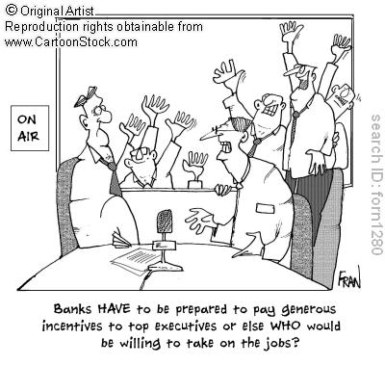

Slide 47
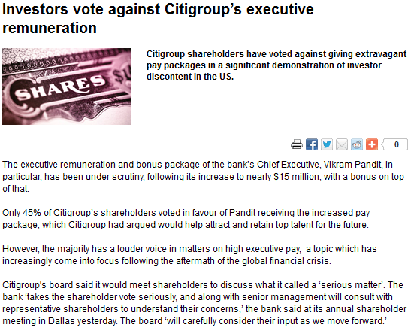
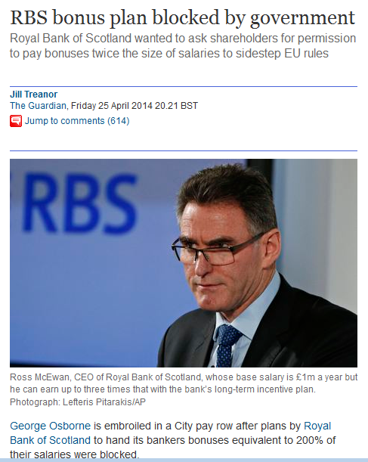
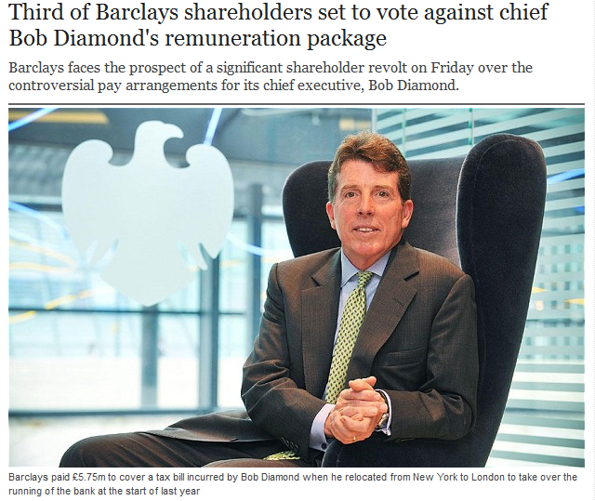

Slide 48
From January 2014 the EU has a rule that:
The amount of bankers’ bonuses does not exceed the fixed remuneration (1:1) ratio
The cap can be increased to 2:1 with supermajority of shareholders.

Slide 49
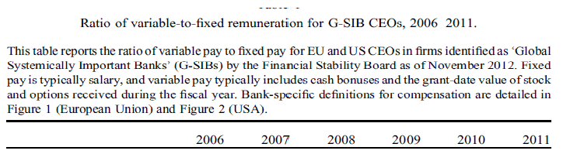
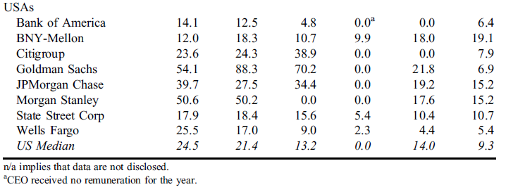
Bankers’ bonuses K.J. Murphy, Regulating Banking Bonuses in the European Union: a Case Study in Unintended Consequences, 2013, EFM 19(4), 631-657

Slide 50
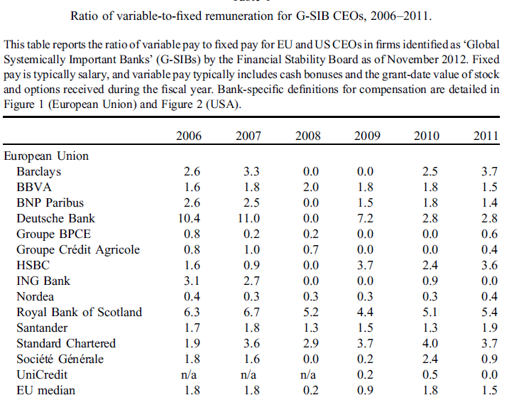

Slide 51
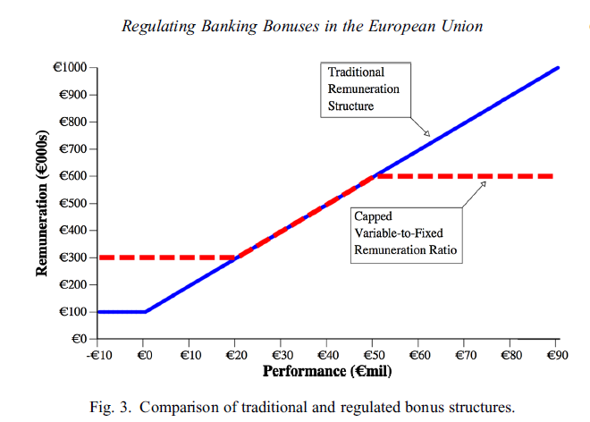
Risk taking

Slide 53
A few quotes
“the government is not stopping RBS handing McEwan £1m a year in “allowances” – in effect doubling his salary – as a route to sidestep the EU bonus cap”
“one shareholder in RBS warned that the bank might now have little option but to increase salaries”
“it is not easy to accept, but if RBS is to thrive we must do what it takes to attract and keep the people who will help us achieve the goals. We think that the right position of the business is to be commercial. (…) the ability to pay competitively is fundamental to getting RBS to where we need it to be”

Slide 54
Corporate Governance research
The world (stakeholders, political & regulating bodies, competitors)
Does ownership matter?
Market for corporate control
Does board structure matter?
Owners
(shareholders, principals)
Management
CEOs
Executives
Nonexecutives
(boards)
Optimal ownership?
Cross-country differences
Board issues?
Balance between regulation and control
Impact of groups of owners?
CEO issues?
Politicians, lobby groups
Incentives?
Controlling owners?
Etc…
Etc.
Etc.

