Slide 1
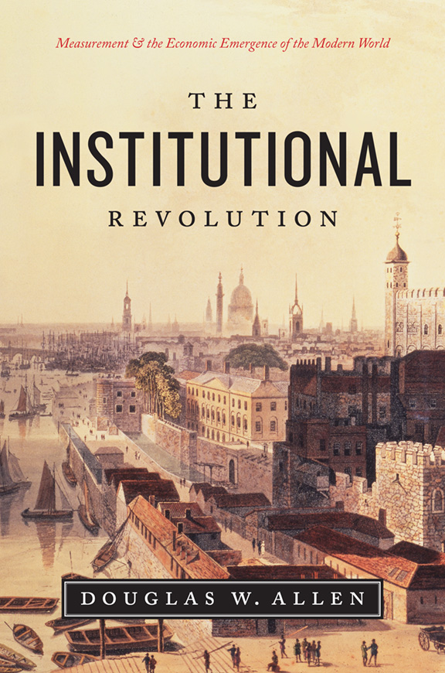
Recognizing and Solving Institutional Puzzles
The Doug Allen Approach
“How did you write
that book?”
“Five Lessons”

Slide 2
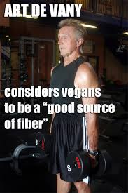
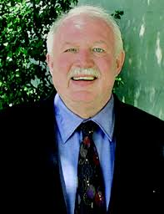
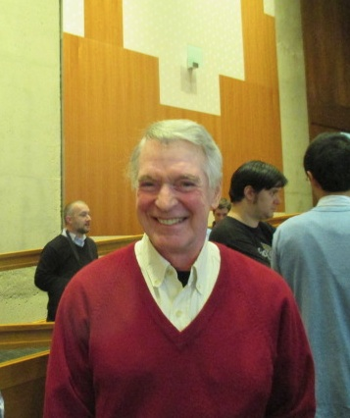
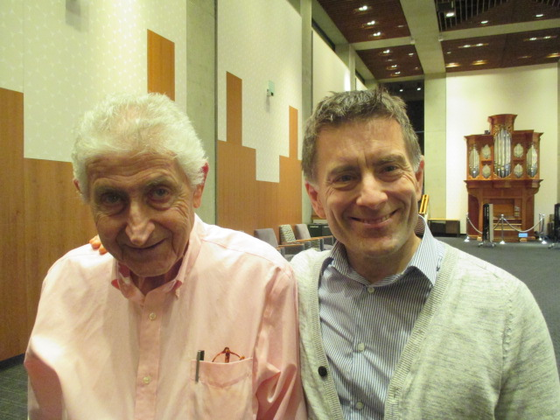
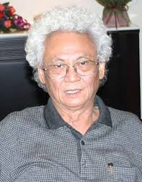
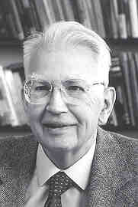
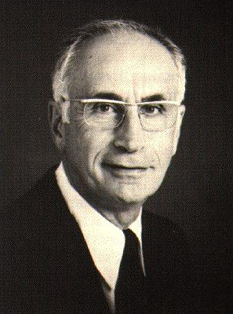
Credit, where credit is due:

Slide 3
1.Efficiency is a constraint on the Economist.
“Efficiency is a condition of market equilibrium logically deduced from
the theory of choice, subject to the constraint of private property rights
under a freely competitive market. It is a positive term, devoid of
welfare implications.”
Steven Cheung, (p. 159, 1969)
The term “efficient” means only that the economist has sufficiently constrained the maximization process with enough assumptions to generate a logical theoretical implication. Therefore, “inefficient” can mean only that the economist has failed, logically, to derive his theory.
Staten and Umbeck, 1989

Slide 4
A Typical Economics Paper:
Construct a model of something.
Examine equilibrium characteristics, one way or another.
Identify some DWL, Inefficiency, etc.
Specify Policy Recommendation.
Modern empirical papers skip the first three steps. After some
identification, specify the policy recommendation.
In welfare economics, where an idealized observer chooses between alternatives, “efficient” means one chooses the alternative that yields the most total surplus.
Bohanon, 1990

Slide 5
A Classic Elementary Example:
The firm maximizes profit.
The consumer maximizes utility.
And in the end, neither maximizes.
This is the basic reasoning of competition
policy.
The right answer is there is a hidden constraint.

Slide 6
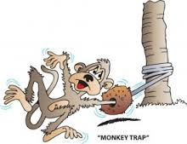
So much in economics relies on the Monkey Trap:
We’re so interested in telling
the world how to behave, and so
wanting to make the world a
better place, that we forget about
the constraints.
“The desire to be of service to one's fellows is, no doubt, a noble motive,
but it is not possible to influence policy if you do not give an answer.''
Ronald Coase, (p. 66, 1988).

Slide 7
Our Starting Assumption Implies Economists
Should be “Modified Panglossian”
We live in an efficient world not worth changing.
This is a good thing, because it forces us to see puzzles everywhere
instead of problems.
I’ve made a career with this starting point.

Slide 8
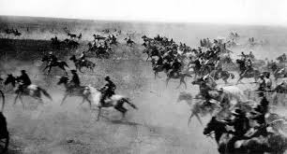
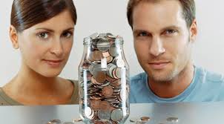
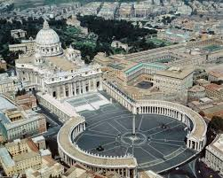
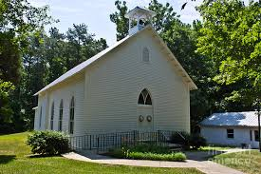
Why homestead when it makes
people rush and arrive too early?
“The most expensive mistake the U.S.
government ever made.”
David Friedman
Why do couples share rather than
one hire the other?
Vs.

Slide 9
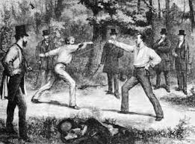
Economists and others
look at this and think:
- how crazy
- how inefficient
- how wrong
“The duel was like a lawsuit where the judge, after establishing that indeed there was a
wrong, flips a coin to decide who, between the plaintiff and the defendant, should be
executed for the wrong. ... No doubt then, the duel often misfired, either because the
challenge itself was wrongful and the challenged suffered death, or because the
challenge itself was correct but the challenger suffered death. ... To us, certain features
are clearly ridiculous: the practice is random, it strikes down some of the community's
most valuable citizens, and its sanction is not proportional to its harm.”

Slide 10
I look at this picture and ask:
Who are these men standing around?
Why no defensive weapons?
Why the specific and weird rules?
Why are they hiding in the bush?
Why didn’t it matter who won or
lost?
Why did this last for 400 years and
then suddenly stop?
Why were some people allowed to
duel and others not?
You cannot recognize an institutional puzzle if you start by thinking
you know all the answers.
Maximization ➔
people are doing the best they can, under the circumstances.

Slide 11
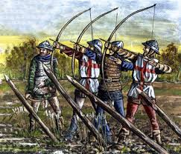
My Latest Institutional Puzzle.
An incredible weapon:
-accurate at 150m
-rapid rate of fire
-could penetrate mail, armor,
a horse
-cut the size of army by 1/3
-no weapon like it until 1850
Yet, only one country used it, and only for a short time!

Slide 12
Lesson 1:
You can’t see puzzles if you think economics
is about “efficiency,” “policy,” and generally
passing judgment.

Slide 13
2. Putting Preferences in the Backseat …
Where they Belong.
The literature of risk aversion and risk preference is one of the richest
sources of ad hoc assumptions concerning tastes. ... No significant
behavior has been illuminated by assumptions of differences in tastes
... such theories have been a convenient crutch to lean on when the
analysis has bogged down ... [giving] the appearance of considered
judgment, yet really have only been ad hoc arguments that disguise
analytical failures. [Stigler and Becker, 1977, p. 89]
-Behavioral, experimental, evolutionary, and neuro economics,
have resurrected “tastes” as a respectable argument.
- The existence of preferences doesn’t mean they’re useful in the
game of explanation.

Slide 14
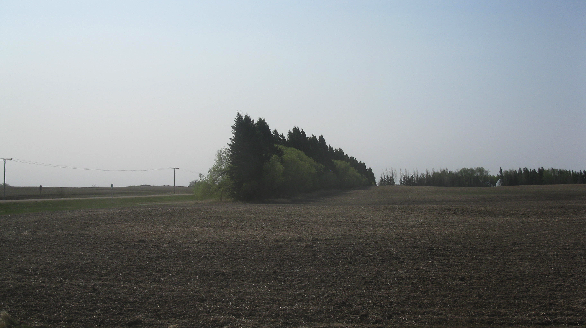

Slide 15
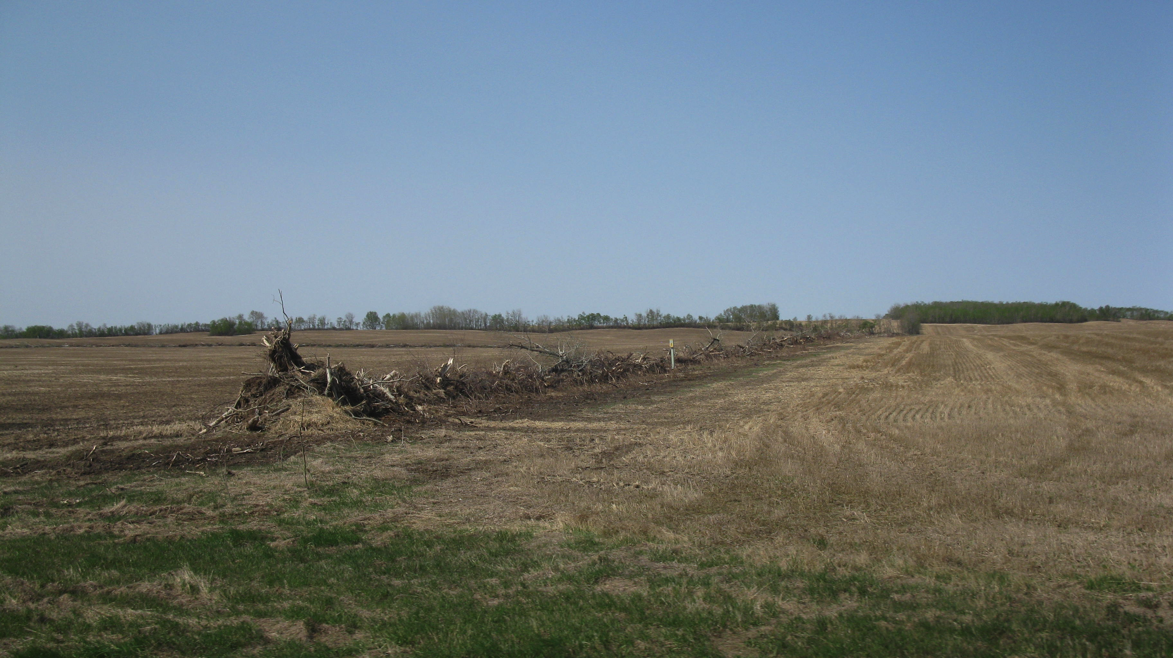

Slide 16
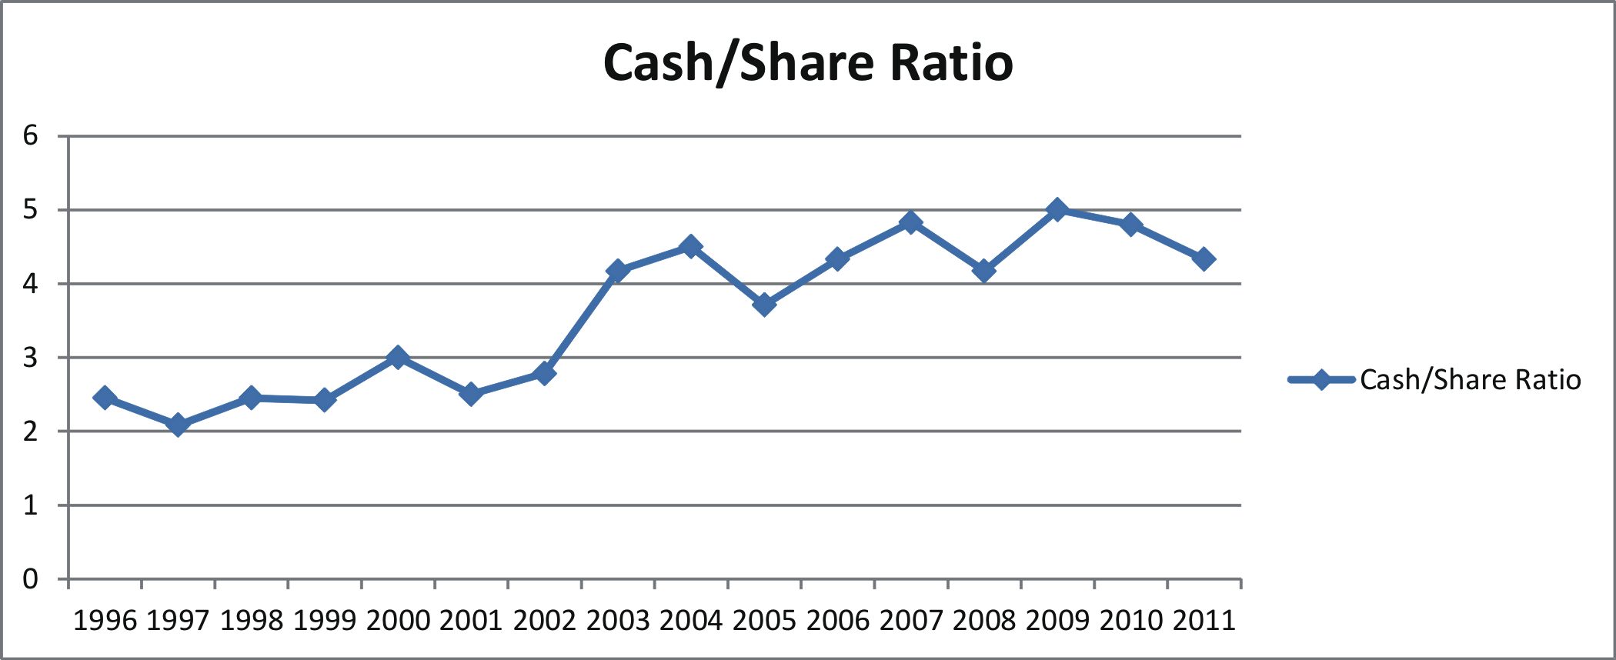
“Risk sharing is also used to explain the growing dominance of
cash rental agreements in the US. Huffman and Just (2004) suggest the
benefits of risk sharing have changed, as owners who rent out farmland
are now more risk averse than farmers.”

Slide 17
Or changes in the risk faced:
“The long-standing practice of share leasing for farmland, especially in
Mid-Western U.S. agriculture, is increasingly giving way to cash leasing
…The drivers of change primarily involve risk, income, managerial
control, and land value … These strongly influence the risk of the
respective leasing parties.”
Could “Something Else” be going on?

Slide 18
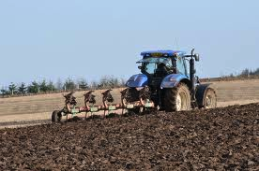
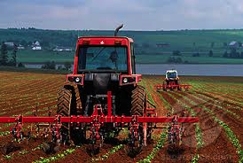
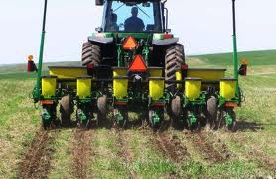
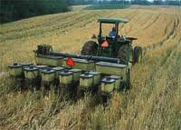
VS.

Slide 19
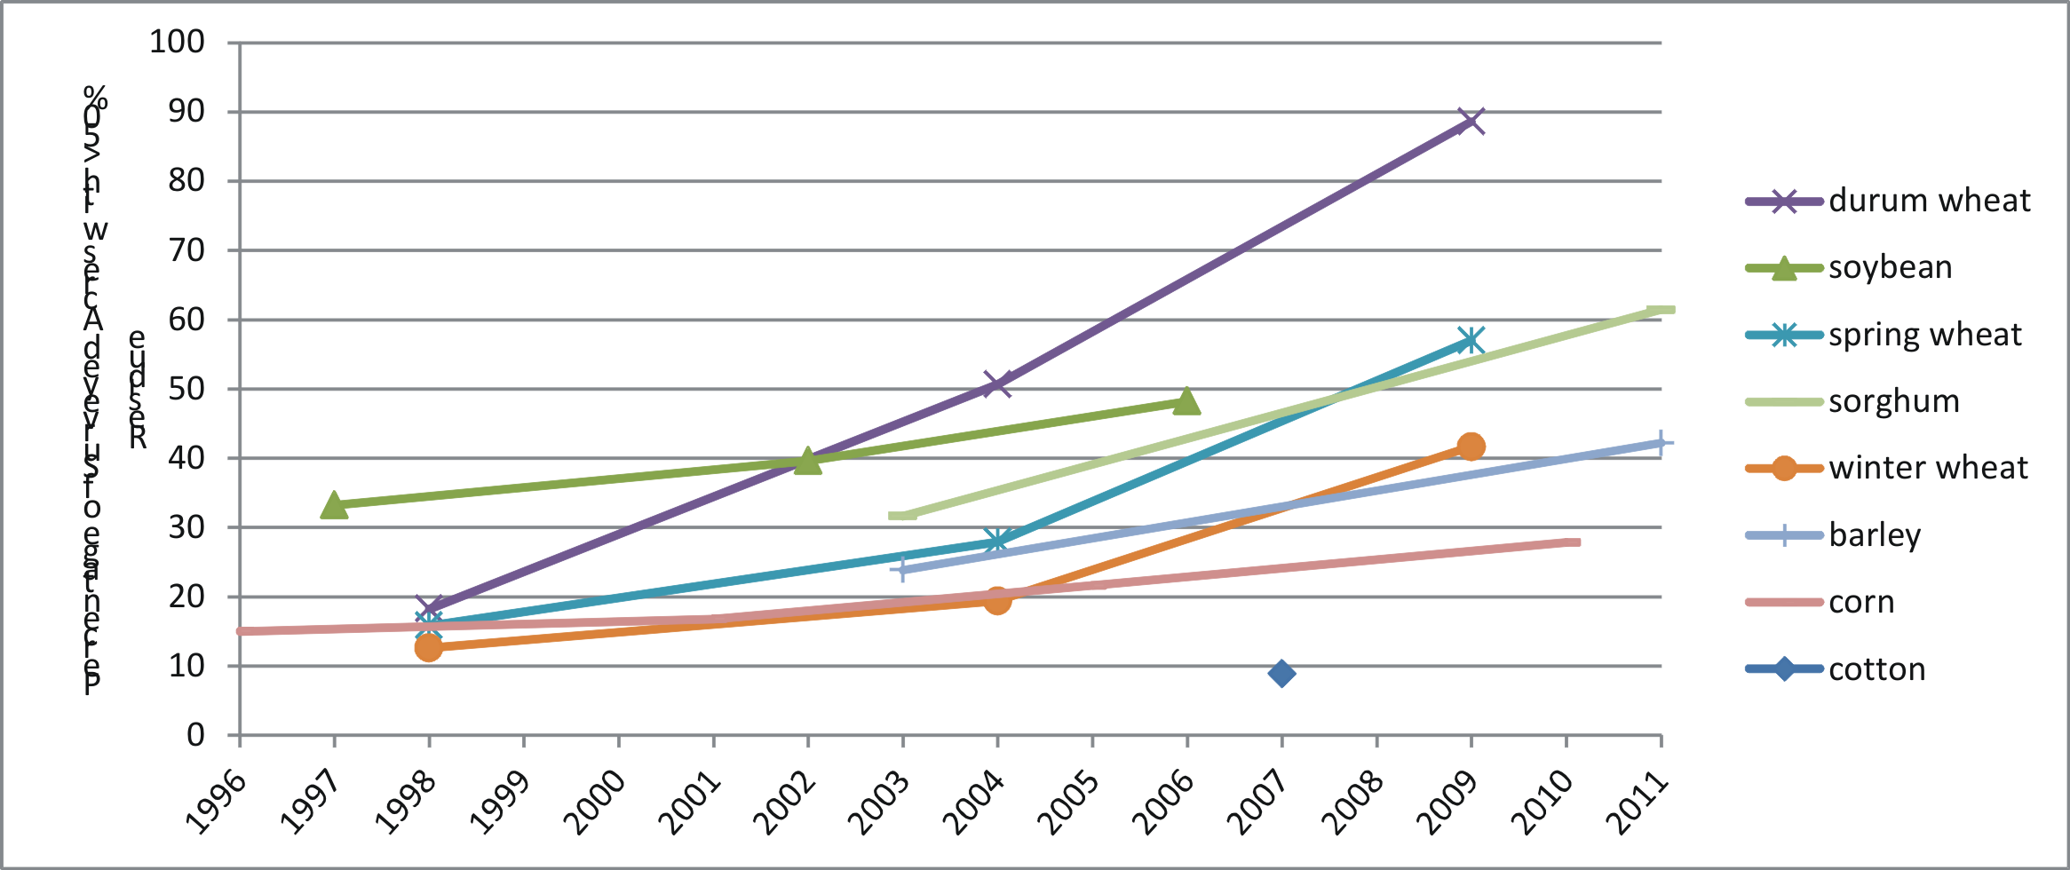
Perhaps the felling of the windrows and growth in cash renting,
is related to the new method of farming?

Slide 20
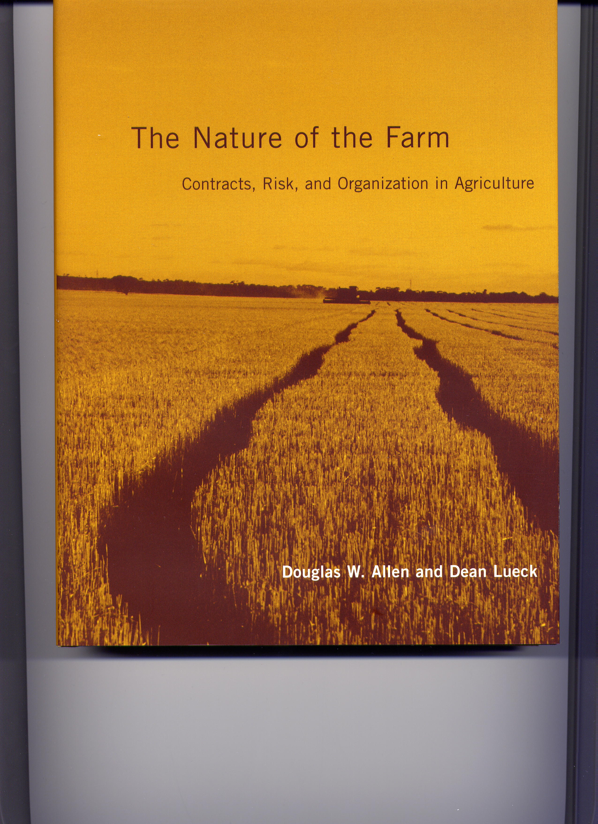
1. Allen and Lueck, TC theory.
Cropshare contract “slows”
the farmer down to prevent
soil manipulation.
Cropshare has the problem of
under reporting crop, and
reducing labor effort.
So, if no-till eliminates ability
to exploit the soil ...
cash rent.

Slide 21
Findings from USDA panel of 9 crops, 14 years, all states:
Controlling for farmer and region characteristics, clustering by
state, running bivariate probit
No Till cultivation is the number 1 predictor of cash renting by a
mile, followed by field characteristics (crop, soil erosion, temp.).
Farmer personal characteristics, zero effect.
Field level federal crop insurance, zero effect.
Size of farm, zero effect.
Corporate structure, small positive.
The point: once again, risk fails as a theory of institutions.
Why did the Wind rows come down?.

Slide 22
Lesson 2:
Explanation based on unobservable
Preferences is bad religion.
Blinds us to the real cause.
“the appearance of considered judgment, yet … only been
ad hoc arguments that disguise analytical failures.”

Slide 23
3. The Core of Institutional Explanations:
The Core Idea of Coase is found in Section VI of Social Cost
Speaking about how an efficient allocation of resources
might be achieved, Coase stated:

Slide 24
… such an arrangement would be made through the market whenever
this would lead to an increase in the value of production. (p. 115, 1988)
… an alternative form … which could achieve the same result at less
cost than [the market] would enable the value of production to be
raised. . … the firm represents such an alternative. (p. 115, 1988)
… the firm is not the only possible answer … An alternative solution
is direct governmental regulation. (p. 116-117, 1988)
… a further alternative, which is to do nothing about the problem at
all. (p. 118, 1988)
… the problem is one of choosing the appropriate social arrangement
for dealing with the harmful effects. (p. 118, 1988)

Slide 25
On What Criteria do we choose? … Transaction Costs
But we cannot use an inadequate notion of transaction costs
-e.g., some neoclassical friction.,
Any definition of transaction costs that excludes efforts to create
property rights or includes costs that arise only out of scarcity cannot
be consistent with the Coase theorem.
Allen 1991
Transaction Costs : the costs of establishing and maintaining
economic property rights.
Allen 1988

Slide 26
Transaction Costs and Property
Rights are two sides of the same coin.
Zero TC ➔ Perfect Property Rights.
Zero TC ➔ The Coase Theorem.
➔ Rules Irrelevant.
Perfect Property Rights ≠ Zero TC.
CT can empirically hold
in some real world cases.

Slide 27
TC depend on 1. Costly information of some sort.
2. Alterability and Variability.
Changes in any of these things lead to changes in TC, and likely
changes to institutions.
In the book I focused on the radical
change in Variability over the
Industrial Revolution Period.

Slide 28
Lesson 3:
Explanations of Institutions must be based
on transaction costs.

Slide 29
4. The Necessity of Institutional Detail.
Transaction costs are not sexy
… require “on the ground knowledge”
“If economists wished to study the horse, they wouldn’t go and
look at horses.They’d sit in their studies and say to themselves,
‘What would I do if I were a horse?’”
Coase ISNIE 1999
This knowledge comes from two sources:
Personal knowledge.
Hard work in the trenches.

Slide 30
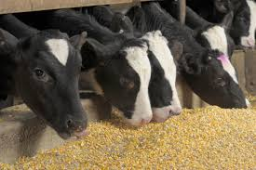
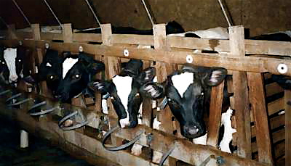
I’ve done well with personal knowledge from the farm.
Google “Veal Calves” and
the only breed you’ll find
are Holsteins.
Only a farm boy is
going to find this odd.
Only a farm boy is
going to know why.

Slide 31
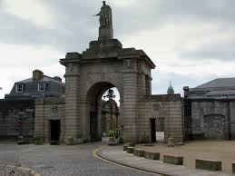
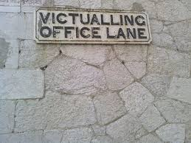
When contractors supplied
the British Navy during the age of
sail with beef, they were required
to supply “only oxen” that was
butchered at the naval yard.
What are oxen? Why oxen?
Why bring live animals
across the country?

Slide 32
Lesson 4:
Recognize and Exploit the personal
knowledge and passions that you have.

Slide 33
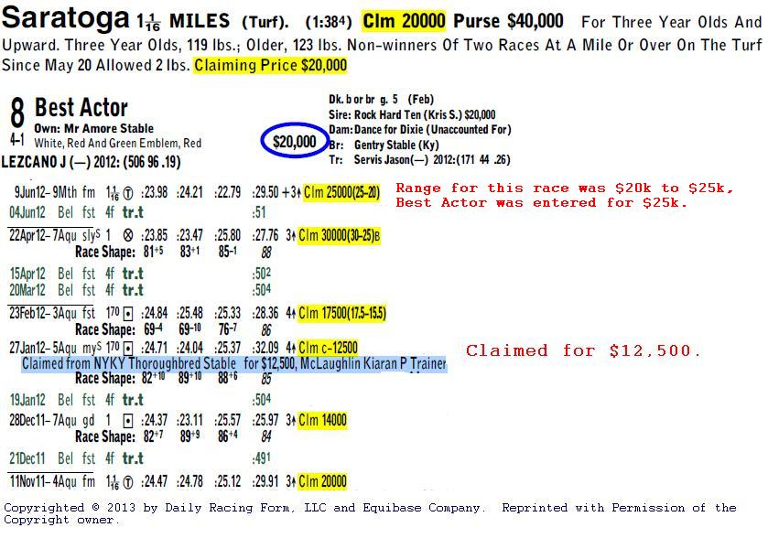
5. Institutional Identification and Testing.
Puzzle: Why offer your horse for sale when racing?

Slide 34
Initial Hypothesis: The track was really a market for horse sales.
- consistent with movements in purse and claim price.
- but inconsistent with ties.
Second Hypothesis: The practice policed the track over horse
switching.
Relentless Institutional Testing:
-restrictions on right to claim.
-allocation by chance with ties.
-claimers do not receive purse.
-lower weights can by purchased with lower claim prices,
etc.

Slide 35
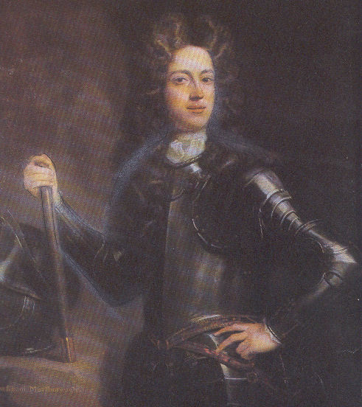
Institutional Detail provides a rich source of non-econometric testing.
One last example:
What was the
purpose of the
aristocracy?

Slide 36
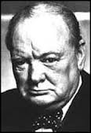
My Answer:
“The Crown and the Executive found in this system
guarantees of fidelity and good conduct, …
Winston Churchill
The Aristocrats were part of an enormous system of
administration, that was designed to generate
trusting servants through sunk investments.
And so I look at every margin of their behavior:

Slide 37
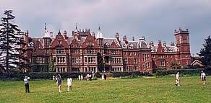
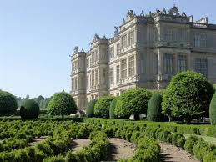
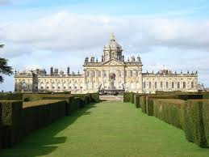
Incredible “Seats” in the Middle of Nowhere.
Hotels where the guests
paid nothing

Slide 38
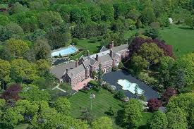
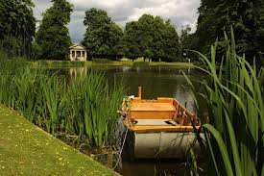
Large parts of their lands
were taken out of farm
production, and made into
Parks.

Slide 39
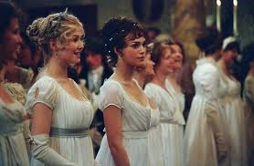
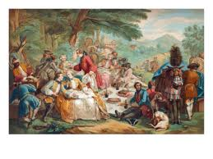
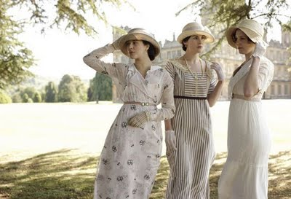
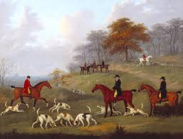
They spent large amounts of time
and money on dances, garden parties,
picnics, fox hunts, etc.

Slide 40
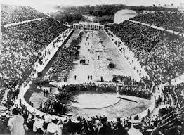
The modern olympics were
for amateurs … because they
were intended for aristocrats.

Slide 41
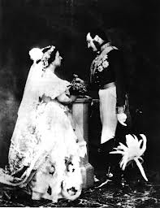
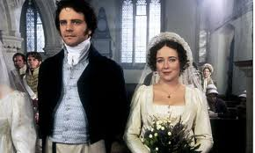
They married their cousins.
Consumed with social
mobility.

Slide 42
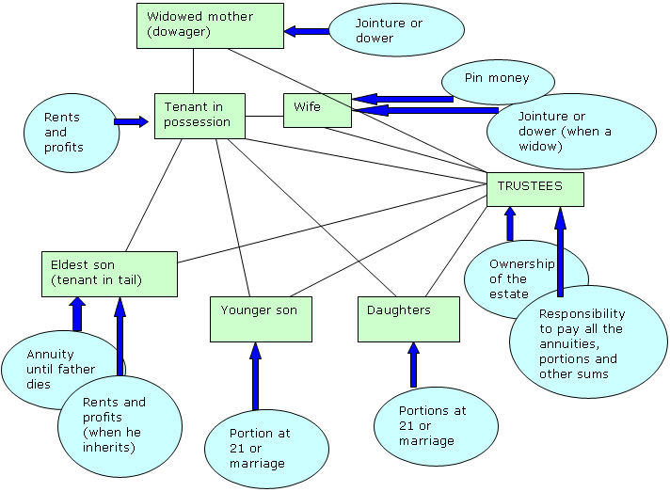
Understanding Aristocrats: The Strict Family Settlement

Slide 43
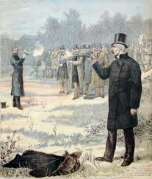
Strangest of all, … they engaged in
dueling.
John Churchill, 1st Duke of
Marlborough dueled twice on
his way up.

Slide 44
Lesson 5:
Be relentless in bringing forth the evidence
for your hypothesis.

