Slide 1
The Boundaries of Government: normative and positive analysis of privatization
Paulo Furquim de Azevedo
Insper

Slide 2
“I don't want to live in a society where the military is private”
Powell, M. (May 18th, Cargèse)
Why not?
DeFigueiredo, João

Slide 3
The boundaries of government
  Privatization vs Statization
More sophisticated approach:
fragmentation of activities
What decisions rights should be delegated to private parties?
What decisions rights are indeed delegated?

Slide 4
Still controversial
“Perhaps no subject in development arouses more passions – on both sides – than privatization.” (Stiglitz, 2013)
“[Privatization] has not saved money, instead they have contributed to an unacceptable level of neglect and violence against inmates” (Friedman and Parenti, 2013).
“Empirical evidence from several sectors strongly suggests that service quality, productivity, and profitability rise significantly following privatization” (Shleifer and Vishny, 1994)

Slide 5
Our subject: boundaries of government

Slide 6
Some examples
Private or public provision of public services
  Water; education, health assistance, prisons; police, judiciary
Private or public provision of potentially competitive services
  Petrochemical; Steel, Oil, Energy
More sophisticated view: fragmentation of activities
  Bundle of decisions rights that may or may not be delegated to private parties
  Ex: How much a PPP may rely on private parties?

Slide 7
Two perspectives on this subject
What should be the boundaries of government? (normative perspective)
What are the boundaries of government? Who decides? What are the underlying incentives? (positive perspective)

Slide 8
Still controversial
“Perhaps no subject in development arouses more passions – on both sides – than privatization.” (Stiglitz, 2013)
“[Privatization] has not saved money, instead they have contributed to an unacceptable level of neglect and violence against inmates” (Friedman and Parenti, 2013).
“Empirical evidence from several sectors strongly suggests that service quality, productivity, and profitability rise significantly following privatization” (Shleifer and Vishny, 1994)

Slide 9
Why so controversial
Theory?
Two well received models
  Hart, Shleifer and Vishny (1997)
  Williamson (1999)
Tension:
  Empirical literature: mixed results
  Incongruence between theoretical predictions and empirical findings

Slide 10
Theory: incomplete contract approach
Boyko, Shleifer and Vishny (1996)
  A case for private firms: stronger incentives and political motivated resource allocation
Hart, Shleifer and Vishny (1997)
  Private operation more efficient if
    market mechanisms can cope with quality signaling, or
    regulatory authority contract (and enforce) quality attributes
  Otherwise: if a dimension of quality is non-contractible, cost-quality trade-off (e.g. prisons)
  Public provision would be preferred in countries with ‘weak institutions’

Slide 11
Theory: TCE approach
Williamson (1999)
  In transactions that require probity (e.g. sovereign or judiciary), public governance is superior, for its features of
    low-powered incentives,
    administrative controls,
    independent leadership terms, and
    an elite independent staff
The argument applies to this type of bureaucracy

Slide 12
HSV vs Williamson
Different:
  HSV focus on hold-up problems and incentives derived from contract incompleteness; OW also accounts for governance mechanisms for ex-post adaptations
But convergent:
  For some transactions it is efficient to avoid high-powered incentives (e.g prisons, judiciary)

Slide 13
Normative or Positive Theories?
HSV are explicit: “a public-spirited politician chooses”
OW: claims that TCE is a positive theory
  It is necessary to have an underlying selection mechanism to ensure that the efficient solution will prevail
  In the case of firm boundaries (e.g. vertical integration), competition is the selection mechanism
  But usually there is no competition in public services
Consequence: what we observe is not what should be. A positive theory of privatization is wanted

Slide 14
Related Literature: positive theory
Financial constraints (Yarrow, 1999; Miralles, 2009; Bal et al. 2010; Dinc and Gupta, 2011)
  Public expenditures
  Taxation
Political costs and benefits
  Constituencies identification (e.g. tax payers vs employers): political preferences
  Geographic identification, both patronage and political competition (Dinc and Gupta, 2011)

Slide 15
Meanwhile in the empirical literature…
Mixed results (for sensible sectors, e.g. prisons, water)
Pro-State Control
  Tan 2012, Hirsch 1995, Boyne 1998, Hodge 2000
Pro-Private (no cost-quality tradeoff)
  Estache et al. (2001), Megginson and Netter (2001), Birdsall and Nellis (2003), Makadok and Coff (2009)
  Privatization of prisons and basic sanitation in countries with ‘weak institutions’ reduces costs and increases quality

Slide 16
Why mixed results?
Part of the conflicting results are due to problems of identification
  Privatization or re-statization are endogenous
  It is difficult (or impossible) to foresee the direction of the selection bias
  Usually privatization is part of a larger reform, that may also affect performance.

Slide 17
A promising path
Galiani et al (2005)
  Privatization of water in Argentina: effect on mortality rates
  Database with horizontal and longitudinal variability
  Dif-in-dif with matching
  Similar pre-treatment trends (treated and non-treated)
  Additional (smart) identification based on the age and type of disease

Slide 18
Results and implications
Privatization decreased mortality rates in 8%
Mortality rates fell 26% in poorest areas
Similar result in Brazil (Saiani and Azevedo, 2014)

Slide 19
Morbidity for water-related diseases all ages
Age | 0-1 |  | 1-5 |  | 6-15 |  | 16-64 |  | >64
Private | 0,002 | 0,000 | -0,006* | -0,005* | -0,001 | -0,001 | -0,001 | 0,000 | -0,002 | -0,001
 | (0,011) | (0,008) | (0,002) | (0,002) | (0,001) | (0,000) | (0,000) | (0,000) | (0,001) | (0,001)
Controls | No | Yes | No | Yes | No | Yes | No | Yes | No | Yes
Year Dummies | Yes | Yes | Yes | Yes | Yes | Yes | Yes | Yes | Yes | Yes
Constant | Yes | Yes | Yes | Yes | Yes | Yes | Yes | Yes | Yes | Yes
# Obs | 39.033 | 38.322 | 39.037 | 38.326 | 39.037 | 38.326 | 39.037 | 38.326 | 39.037 | 38.326

Slide 20
Morbidity for other diseases age group 2
Variáveis | Outras Doenças - Saneamento Básico |  | Aparelho Respiratório |  | Demais Doenças
Private | -0,001 | 0,000 | 0,001 | -0,001 | 0,000 | -0,002
 | (0,000) | (0,000) | (0,004) | (0,003) | (0,003) | (0,003)
Controls | No | Yes | No | Yes | No | Yes
Year Dummies | Yes | Yes | Yes | Yes | Yes | Yes
Constant | Yes | Yes | Yes | Yes | Yes | Yes
#Obs | 39.037 | 38.326 | 39.037 | 38.326 | 39.037 | 38.326

Slide 21
WHY?
No cost-quality tradeoff
In developing countries, with ‘weaker’ institutions
Galiani et al: because water quality is observable
  HSV: if contractible, privatization dominates public provision

Slide 22
But
Anecdotal evidence shows that contracts do not have provisions for detailed quality measures
To be contractible, quality should be not only observable, but also verifiable
Argentinian and Brazilian judiciary is too slow to properly enforce quality, if observable and verifiable
So WHY?

Slide 23
A possible explanation: governance design
Could an appropriate design of the outsourcing of public services to private parties mitigate or eliminate the cost-quality trade-off?
Is there learning?
  Quelin et al, 2015 – PPPs
Hybrids?

Slide 24
Prisons in Brasil: a hybrid arrangement
(Cabral, Lazzarini e Azevedo, 2010;2013)
Data: Paraná State
19 prisons
2001-2009
116 observações
Background information:
Six prisons operated by private party built between 1999 and 2002
In 2006, the new state governor re-statized all privately operated prisons (exogenou to the prisons’performance)

Slide 25
Contract features
5 years
Private party responsible for several services to inmates: internal security, legal assistance, cleaning, food service, etc.
Public supervision: warden, vice-warden and chief of security are public servants.
  Task: supervision and liable for the prison performance
Payment: fixed fee for a pre-established capacity regardless occupancy. Payment is not conditional on quality measures

Slide 26
Variables
For indicators of quality
  # of escapes and deaths
  Legal and medical assistence
Target variable: private operator
Controls
  Number of inmates and inmate type
  Prison facilties
  Year, trend, fixed effects warden replacement

Slide 27
 | Security and order indicators
 | Escapes |  | Deaths
 | (1) R.E. | (2) F.E. | (3) R.E. | (4) F.E.
Private | -2.169*** (0.8021) | -2.934*** (0.9516) | -0.900*** (0.3477) | -1.325*** (0.5024)
Working inmates | 0.960 (0.8736) | 1.408 (0.9550) | -0.942* (0.5666) | -0.115 (0.8986)
Easy inmates | -3.467*** (1.2616) | -7.595*** (1.7468) | -1.281 (0.4685) | -1.622* (0.9067)
Number of inmates | -0.001 (0.0013) | -0.005 (0.0034) | 0.001 (0.0004) | 0.0067** (0.0027)
Overcrowding | 0.234 (1.6725) | 0.664 (2.0028) | 0.811 (1.0196) | 1.808 (1.6019)
Location | -0.647 (0.9122) |  | 0.0402 (0.3369)
Convicted inmates | -0.876 (0.8149) |  | -0.315 (0.3182)
Warden replacement | -1.130*** (0.3502) | -1.438*** (0.3857) | 0.360 (0.2556) | 0.444 (0.2877)
Trend (year count) | 0.1562** (0.0748) | 0.189** (0.0818) | -0.250*** (0.0434) | -0.409*** (0.0704)
Intercept | 1.780 (2.2770) |  | 0.920 (1.1874)
N | 115 | 87 | 116 | 116

Slide 28
 | Services to inmates
 | Medical appointments |  | Legal appointments
 | (5) R.E. | (6) F.E. | (7) R.E. | (8) F.E.
Private | -0.365 (1.0487) | -0.643 (1.1850) | -4.999*** (1.6495) | -6.476*** (1.9443)
Working inmates | 1.989 (1.9639) | -0.362 (2.3315) | 3.224 (3.0713) | 1.847 (3.8256)
Easy inmates | -2.123 (1.6109) | -1.747 (2.0910) | 1.168 (2.5060) | -0.635 (3.4310)
Number of inmates | -0.003 (0.0021) | -0.013* (0.0072) | -0.009*** (0.0032) | -0.006 (0.0119)
Overcrowding | 11.526*** (3.2389) | 15.121*** (3.9776) | 17.093*** (5.0878) | 16.988** (6.5267)
Location | 0.279 (1.4441) |  | -3.299 (2.1859)
Convicted inmates | -0.211 (1.3920) |  | -1.336 (2.1082)
Warden replacement | -1.292 (0.8035) | -1.114 (0.8237) | 0.523 (1.2775) | -0.123 (1.3515)
Trend (year count) | -0.329* (0.1699) | -0.369* (0.2033) | 0.597** (0.2672) | 0.428 (0.3336)
Intercept | -3.485 (4.0634) | -0.366 (4.8076) | -4.359 (6.3482) | -5.604 (7.8886)
N | 116 | 116 | 116 | 116
Legal efficiency
(9) R.E. | (10) F.E.
0.052*** (0.0180) | 0.061*** (0.0201)
-0.035 (0.0339) | 0.005 (0.0396)
0.066** (0.0279) | 0.110*** (0.0356)
0.000 (0.0000) | 0.000 (0.0001)
-0.148*** (0.0557) | -0.203*** (0.0676)
0.034 (0.0256)
0.043* (0.0247)
0.002 (0.0137) | 0.005 (0.0140)
-0.003 (0.0029) | -0.001 (0.0035)
0.140** (0.0702) | 0.182** (0.0817)
116 | 116

Slide 29
Findings
No evidence of cost-quality trade-off in private prisons
In legal assistance, more efficient use of inputs (lawyers)
Results indicate that hybrid form may circumvent information asymmetry.
Implicit contracts (future contracts) and probability of detection (external pressure) may explain the absence of a trade-off.

Slide 30
Alternative explanation for the lack of tradeoff
Take care when testing normative theories
Who decides?
What are the underlying incentives?
Leeway for advances in a positive theory of the boundaries of government
Interdisciplinary with Economics, Law and PolSci

Slide 31
Privatization as an outcome from a political game
A mayor decides to privatize or not the local water and sewage companies
Privatization has two effects:
  changes incentives, increase efficiency, and, as such, create opportunities for political gains
  Decreases discretion of the incumbent mayor, and hence the gains from political motivated allocation of resources
Political competition: decreases the likelihood of an incumbent to retain power (to be re-elected)

Slide 32
Simple model: timing
An incumbent mayor may decide to privatize a public service at any moment during her term, of duration T.
The Legislative ratifies or not mayor’s proposition
Privatization is irreversible. If a previous major decides to privatize, the subsequent mayor loses discretion
If during her tenure the major decides to keep the public provision of sanitation services, the subsequent major will face exactly the same problem.
For sake of Simplicity we assume that the second term goes to infinity.

Slide 33
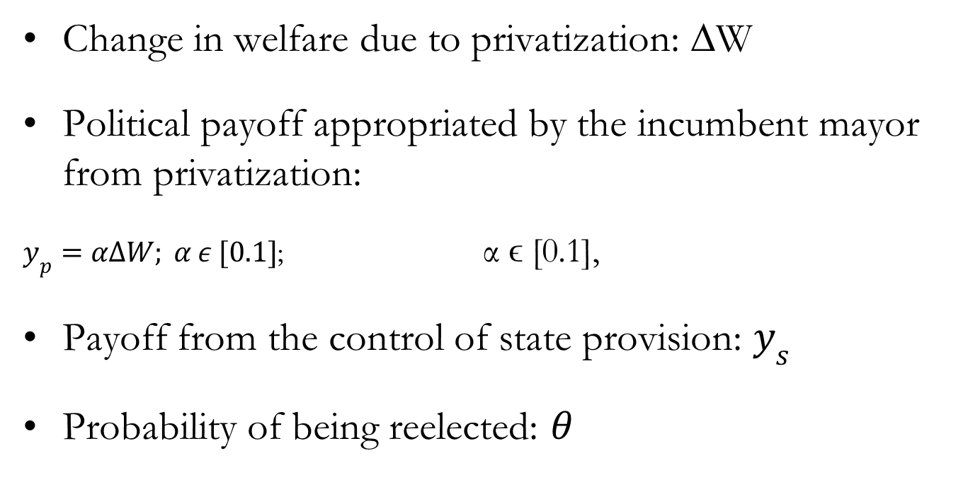
Model: payoffs
Change in welfare due to privatization: ∆W
Political payoff appropriated by the incumbent mayor from privatization:
$y_{p}=α∆W; α ε [0.1]$; α ϵ [0.1],
Payoff from the control of state provision: $y_{s}$
Probability of being reelected: $θ$

Slide 34
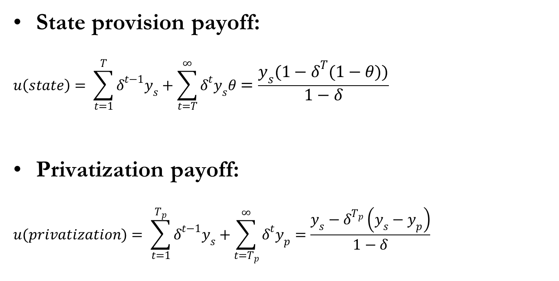
To privatize or not to privatize?
State provision payoff:
$$u\left(state\right)= \sum_{t=1}^{T}{δ^{t−1}y_{s}+\sum_{t=T}^{∞}{δ^{t}y_{s}θ}}=\frac{y_{s}(1−δ^{T}\left(1−θ\right))}{1−δ}$$
Privatization payoff:
$$u(privatization)= \sum_{t=1}^{T_{p}}{δ^{t−1}y_{s}+\sum_{t=T_{p}}^{∞}{δ^{t}y_{p}}}=\frac{y_{s}−δ^{T_{p}}\left(y_{s}−y_{p}\right)}{1−δ}$$

Slide 35
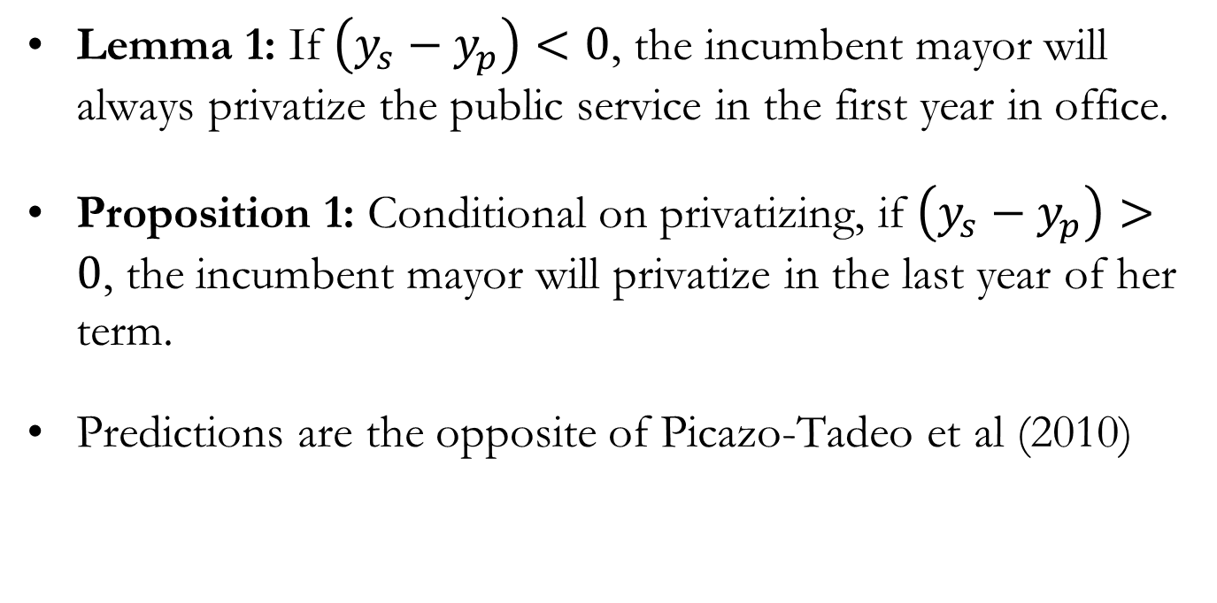
When privatize
Lemma 1: If $\left(y_{s}−y_{p}\right)<0$, the incumbent mayor will always privatize the public service in the first year in office.
Proposition 1: Conditional on privatizing, if $\left(y_{s}−y_{p}\right)>0$, the incumbent mayor will privatize in the last year of her term.
Predictions are the opposite of Picazo-Tadeo et al (2010)

Slide 36
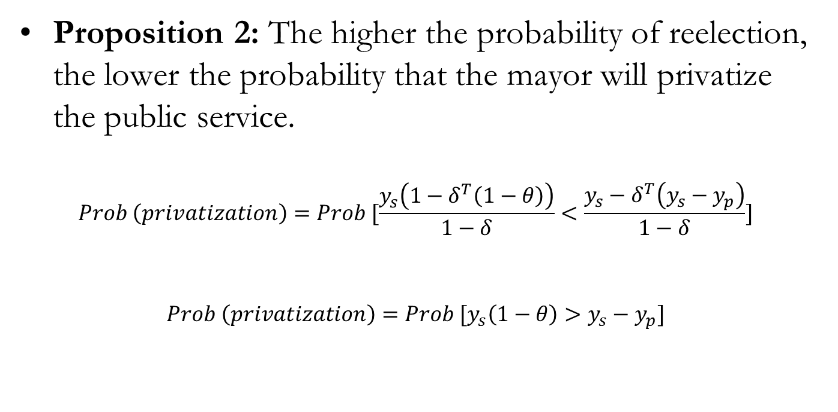
Effect of political competition
Proposition 2: The higher the probability of reelection, the lower the probability that the mayor will privatize the public service.
$$Prob \left(privatization\right)=Prob [\frac{y_{s}\left(1−δ^{T}\left(1−θ\right)\right)}{1−δ}<\frac{y_{s}−δ^{T}\left(y_{s}−y_{p}\right)}{1−δ}]$$
$$Prob \left(privatization\right)=Prob [y_{s}\left(1−θ\right)>y_{s}−y_{p}]$$

Slide 37
Legislative ratification
Opposition will try to block the strategic privatization
Proposition 3: Size of the incumbent coalition in the Legislature increase the probability of privatization
Proposition 4: Fragmentation, given the size of the coalition, increases the probability of privatization

Slide 38
Basic sanitation in Brazil: institutional background
1970’s: PLANASA; regional state companies
1988: Municipal responsibility, but still some overlap with states. Juridical uncertainty.
1995: Concessions Law (Law No. 8,987) establishes the rules to be followed in public service concessions; and included in the National Privatization Program

Slide 39
Data
Brazilian municipalities from 1997 to 2007
Dependent variable: decision to privatize (year and municipality)
Target variables
  Political competition, size of coalition in the legislature, affinity with state and federal levels, and electoral cycles
Controls
  Demographic, service coverage, municipality financial restraints, and ideology (party coalition)

Slide 40
Privatization as a political strategy: additional test
Privatization reduces discretion of state incumbents (governors), who also have competencies on basic sanitation
But affinity with higher governmental levels may relax fiscal constraints
Proposition 5: Political affinity with the governor reduces the probability of privatization; but not the affinity with the president

Slide 41
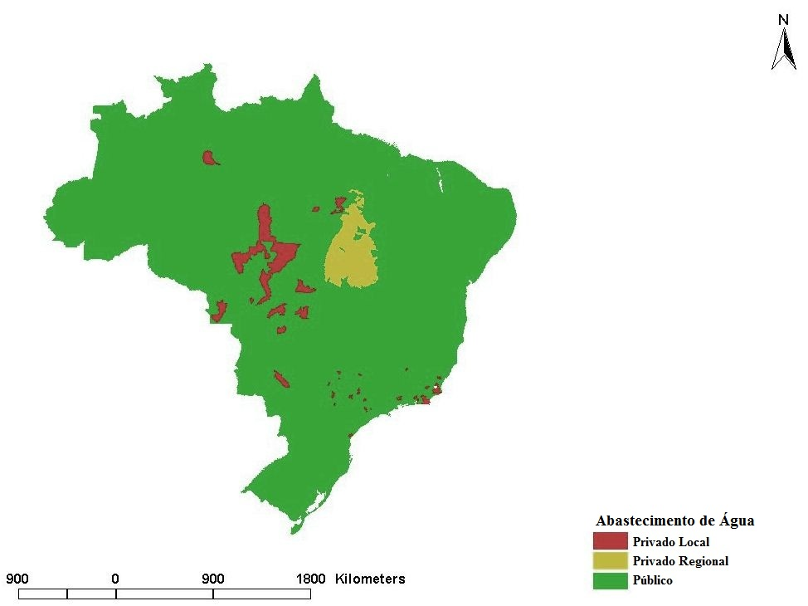

Slide 42


Slide 45
Summary of specifications
Specifications / Features | I | II | III | IV | V | VI
Ideological and Political Variables | Yes | Yes | Yes | Yes | Yes | Yes
Proportion of Votes Variable | Yes | No | Yes | Yes | No | Yes
Competitive Mayoral Election Variable | No | Yes | Yes | No | Yes | Yes
Control Variables | Yes | Yes | Yes | Yes | Yes | Yes
Exclusion of States without Privatization | Yes | Yes | Yes | Yes | Yes | Yes
Exclusion of Municipalities from Tocantins | No | No | No | Yes | Yes | Yes

Slide 46
Variables/Services | Water |  |  |  |  |  | Sewage
 | I | II | III | IV | V | VI | I | II | III | IV | V | VI
Proportion of votes | -1.215^{(a)} |  | -0.770 | -0.518 |  | -0.032 | -1.778^{(a)} |  | -1.431^{(a)} | -0.956^{(b)} |  | -0.500
 | (0.458) |  | (0.484) | (0.500) |  | (0.517) | (0.446) |  | (0.486) | (0.486) |  | (0.512)
Competitive mayoral election |  | 0.361^{(a)} | 0.280^{(b)} |  | 0.333^{(a)} | 0.330^{(b)} |  | 0.341^{(a)} | 0.187 |  | 0.327^{(a)} | 0.276^{(b)}
 |  | (0.113) | (0.124) |  | (0.127) | (0.138) |  | (0.105) | (0.117) |  | (0.118) | (0.129)
Coalition | 0.373^{(b)} | 0.326^{(c)} | 0.344^{(c)} | 0.899^{(a)} | 0.884^{(a)} | 0.884^{(a)} | 0.360^{(b)} | 0.316^{(c)} | 0.343^{(c)} | 0.865^{(a)} | 0.855^{(a)} | 0.857^{(a)}
 | (0.186) | (0.187) | (0.188) | (0.288) | (0.291) | (0.291) | (0.179) | (0.179) | (0.180) | (0.276) | (0.277) | (0.278)
Fractionalization | 1.519^{(b)} | 1.401^{(b)} | 1.339^{(b)} | 3.651^{(a)} | 3.358^{(a)} | 3.360^{(a)} | 1.324^{(b)} | 1.309^{(b)} | 1.210^{(c)} | 3.468^{(a)} | 3.319^{(a)} | 3.264^{(a)}
 | (0.671) | (0.671) | (0.672) | (1.055) | (1.057) | (1.058) | (0.643) | (0.642) | (0.644) | (1.003) | (1.004) | (1.005)
Competitive councilor election | -0.055 | -0.050 | -0.084 | 0.073 | 0.031 | 0.031 | -0.159 | -0.120 | -0.178 | 0.070 | 0.067 | 0.041
 | (0.128) | (0.128) | (0.130) | (0.207) | (0.210) | (0.212) | (0.121) | (0.120) | (0.122) | (0.203) | (0.205) | (0.207)
Cycle 2 | 0.865^{(a)} | 0.869^{(a)} | 0.873^{(a)} | 0.113 | 0.114 | 0.115 | 0.774^{(a)} | 0.779^{(a)} | 0.781^{(a)} | 0.162 | 0.168 | 0.169
 | (0.142) | (0.142) | (0.143) | (0.146) | (0.147) | (0.147) | (0.133) | (0.133) | (0.134) | (0.142) | (0.142) | (0.143)
Cycle 3 | 0.515^{(a)} | 0.515^{(a)} | 0.520^{(a)} | 0.051 | 0.057 | 0.057 | 0.459^{(a)} | 0.462^{(a)} | 0.463^{(a)} | 0.115 | 0.123 | 0.122
 | (0.166) | (0.166) | (0.167) | (0.156) | (0.157) | (0.157) | (0.154) | (0.154) | (0.154) | (0.150) | (0.151) | (0.151)
Cycle 4 | 0.626^{(a)} | 0.626^{(a)} | 0.632^{(a)} | -0.184 | -0.197 | -0.198 | 0.518^{(a)} | 0.522^{(a)} | 0.521^{(a)} | -0.053 | -0.063 | -0.061
 | (0.163) | (0.163) | (0.164) | (0.197) | (0.199) | (0.199) | (0.153) | (0.153) | (0.153) | (0.177) | (0.178) | (0.179)
Governor affinity | -0.309^{(a)} | -0.308^{(a)} | -0.315^{(a)} | -0.341^{(b)} | -0.343^{(b)} | -0.343^{(b)} | -0.233^{(b)} | -0.221^{(b)} | -0.236^{(b)} | -0.295^{(b)} | -0.293^{(b)} | -0.296^{(b)}
 | (0.106) | (0.107) | (0.107) | (0.132) | (0.133) | (0.133) | (0.099) | (0.098) | (0.099) | (0.122) | (0.122) | (0.122)
President affinity | 0.159 | 0.189 | 0.171 | 0.128 | 0.140 | 0.138 | 0.084 | 0.114 | 0.090 | 0.066 | 0.080 | 0.073
 | (0.146) | (0.145) | (0.146) | (0.166) | (0.167) | (0.167) | (0.135) | (0.134) | (0.136) | (0.156) | (0.156) | (0.156)
Controls | Yes | Yes | Yes | Yes | Yes | Yes | Yes | Yes | Yes | Yes | Yes | Yes
Tocantins’ munic | Yes | Yes | Yes | No | No | No | Yes | Yes | Yes | No | No | No
N | 31,950 | 32,222 | 31,950 | 31,585 | 31,857 | 31,585 | 32,064 | 32,336 | 32,064 | 31,594 | 31,866 | 31,594

Slide 47
Summary
Political competition increases the probability of privatization
Political discretion in SOE is a private benefit appropriated by the incumbent authority
Indirect evidence of suboptimal level of privatization
Explains the absence of cost-quality trade-off in countries such as Brazil and Argentina (‘weak institutions’)
Political reform, so as to foster political competition, may induce privatization towards the optimal level

Slide 48
Variables | Descriptions
Proportion of Votes | Proportion of valid votes in the first round of the election in which the mayor was elected
Competitive Mayoral Election | Dummy that takes the value of one if the mayoral election was competitive
Coalition | Dummy that takes the value of one if more than 50% of councilors are in the mayor's coalition
Fractionalization | Rae and Taylor’s (1970) index of fractionalization on the council
Competitive Councilor Election | Dummy that takes the value of one if the councilor election was competitive
Cycle 2 Dummy | Dummy that takes the value of one in the second year of the electoral cycle (mayor's second year in office)
Cycle 3 Dummy | Dummy that takes the value of one in the third year of the electoral cycle (mayor's third year in office)
Cycle 4 Dummy | Dummy that takes the value of one in the fourth year of the electoral cycle (mayor's fourth year in office)
Governor Affinity | Dummy that takes the value of one if the mayor belongs to a party that is in the governor’s coalition
President Affinity | Dummy that takes the value of one if the mayor belongs to a party that is in the president’s coalition
Public Administration | Ratio of employees in public administration to total number of formal employees
Low Income | Ratio of formal employees earning less than twice minimum wage to total formal employees
PSDB Dummy | Dummy that takes the value of one if the mayor belongs to PSDB or traditionally affiliated parties *
PT Dummy | Dummy that takes the value of one if the mayor belongs to PT or traditionally affiliated parties**
FHC Dummy | Dummy that takes the value of one during the government of President Fernando Henrique Cardoso (FHC)

Slide 49
Variables | Descriptions
Fiscal Restriction | Ratio of total expenditure to total revenue (mean of the previous four years)
Degree of Dependency | Ratio of revenues from transfers to revenue budget (mean of last four years)
GDP per Capita | Municipal GDP per capita (R$ 2000)
Education | Ratio of employees with formal education of at least high school level to total formal employees
Youths | Ratio of population with less than 19 years of age to total population
Seniors | Ratio of population with over 60 years of age to total population
Population | Total population (millions of inhabitants)
Density | Ratio of total population to area, subtracting the area used for cultivation (1,000 inhabitants per km²)
Capital Dummy | Dummy that takes the value of one if the municipality is a state or federal capital
Metropolitan Region Dummy | Dummy that takes the value of one if the municipality belongs to a metropolitan area
Tocantins Dummy | Dummy that takes the value of one if the municipality belongs to the state of Tocantins
Mato Grosso Dummy | Dummy that takes the value of one if the municipality belongs to the state of Mato Grosso
Health and Sanitation Spending | Ratio of expenditure on health and sanitation to total expenditure (mean of last four years)
Sanitation Morbidity | Number of hospitalizations due to diseases related to sanitation per 100 inhabitants
Access to Water | Proportion of households with access to public water mains
Sewage Access | Proportion of households with access to public collection of sewage

Slide 50
Determinants of privatization: political and ideological variables (panel probit)
Variables | I | II | III | IV | V | VI
Proportion of votes | -1.505^{(a)} |  | -1.112^{(a)} | -0.826^{(c)} |  | -0.365
 | (0.391) |  | (0.418) | (0.467) |  | (0.492)
Competitive mayoral election |  | 0.354^{(a)} | 0.235^{(b)} |  | 0.325^{(a)} | 0.288^{(b)}
 |  | (0.096) | (0.106) |  | (0.116) | (0.127)
Coalition | 0.282^{(c)} | 0.235 | 0.260^{(c)} | 0.852^{(a)} | 0.839^{(a)} | 0.843^{(a)}
 | (0.153) | (0.153) | (0.153) | (0.270) | (0.271) | (0.272)
Fractionalization | 0.831 | 0.833 | 0.712 | 3.486^{(a)} | 3.284^{(a)} | 3.254^{(a)}
 | (0.557) | (0.552) | (0.556) | (0.977) | (0.981) | (0.981)
Competitive councilor election | -0.226^{(b)} | -0.214^{(b)} | -0.254^{(b)} | -0.068 | -0.054 | -0.035
 | (0.102) | (0.103) | (0.104) | (0.200) | (0.202) | (0.204)
Cycle 2 | 0.703^{(a)} | 0.709^{(a)} | 0.710^{(a)} | 0.148 | 0.153 | 0.154
 | (0.117) | (0.117) | (0.117) | (0.136) | (0.137) | (0.137)
Cycle 3 | 0.311^{(b)} | 0.322^{(b)} | 0.315^{(b)} | 0.077 | 0.084 | 0.083
 | (0.137) | (0.137) | (0.137) | (0.146) | (0.146) | (0.146)
Cycle 4 | 0.406^{(a)} | 0.413^{(a)} | 0.406^{(a)} | -0.100 | -0.110 | -0.110
 | (0.134) | (0.134) | (0.135) | (0.174) | (0.176) | (0.176)
Governor affinity | -0.203^{(b)} | -0.201^{(b)} | -0.208^{(b)} | -0.287^{(b)} | -0.288^{(b)} | -0.290^{(b)}
 | (0.091) | (0.091) | (0.092) | (0.119) | (0.119) | (0.119)
President affinity | 0.032 | 0.049 | 0.035 | 0.082 | 0.095 | 0.088
 | (0.121) | (0.121) | (0.121) | (0.154) | (0.154) | (0.154)
Dummy PSDB | 0.041 | 0.032 | 0.044 | 0.144 | 0.134 | 0.139
 | (0.125) | (0.125) | (0.126) | (0.146) | (0.146) | (0.146)
Dummy PT | -0.057 | -0.050 | -0.051 | -0.124 | -0.123 | -0.116
 | (0.159) | (0.159) | (0.160) | (0.200) | (0.199) | (0.200)
Dummy FHC | 0.288^{(b)} | 0.289^{(b)} | 0.285^{(b)} | -0.226 | -0.225 | -0.226
 | (0.126) | (0.126) | (0.126) | (0.192) | (0.194) | (0.194)
Tocantins’ municipalities | Yes | Yes | Yes | No | No | No
N | 33,284 | 33,559 | 33,284 | 31,967 | 32,242 | 31,967

