Slide 1
“From quasi market to real market: institutional evolution during economic transition from socialism to capitalism”
Dr. Marina Rosser James Madison University
U.S.A.

Slide 2
Prologue: the landscape of issues and concepts
The history of market economy and the end of history
The age of economic experimentation: Marx as a geneticist (the historical prerequisites for the socialist overhaul) and the Soviet Union as a teleology (a construction of an economic system according to a plan) the transitology and the Big Bang (Washington consensus)
Market economy redefined and redesigned: from barter to money, from money to fiat money, from fiat money to Bidcoin and to markomata: market exchange embedded in various economic systems, and world markets of capital and labor
Emergent markets: building, arranging and consolidation appropriate and optimal economic institutions, building a new path

Slide 3
The overview
Almost 100 year since the Russia revolution that ushered the period of “engineering “better than market economic system repairing the macroeconomic ills of inflation and unemployment and seeking to eliminate income inequality
70 years since the end of WWII that originated the split into two competing worlds based on economic systems. The divide that later went through individual countries like Germany and Vietnam and Korea and separated China and Taiwan
Over 25 years of economic transition that challenged to undo socialism and re-usher market efficiency and growth of income
The new age of the global community of rapid and growing exchange in goods and services and massive movements of capital and labor: truly worldwide markets offering tremendous opportunities to growth
What is the scorecard of the previously socialist economies?
Looks like a C at best…

Slide 4
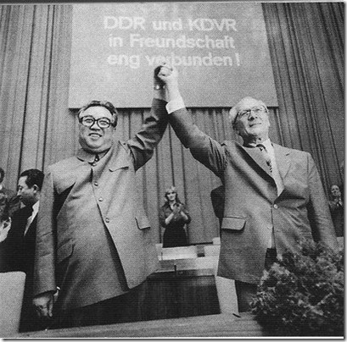

Slide 5
The institutions
The institutional context in in constant evolution
The institutions are both formal and informal i.e. laws and protocols on the one hand and norms and customs , on the other
Based on history and a variety of other factors institutions can be viewed as :good”( a fit with the agenda of the system in question) or “bad” ( in conflict with the agenda mentioned)
Individual institutions co-evolve with the their peers and develop a strong interlocking structure and interdependence Thus the institutional complementarity
Some institutions are rigid( path dependence ) and some are fluid( reformable and pliable)
Institution building is prone to a variety of constraints and thus it is very possible to see interim institutions being important for the eventual consolidation of the final institutional architecture

Slide 6
The current status of the FSE
Underachievement in income and growth ( the best are Slovenia and the Czech Republic at 75% of the EU average and the worst are Ukraine and Tajikistan)
Stalled out economic and political democratization
Massive distortions in economic incentives and performance
Increasing frustration of the population with the reform process and pressure to reverse it
The evolution of the state as a self serving economic actor
Un-happiness index in FSE
How did economic transition get of the map?

Slide 7
The economic transition from the socialist system to a capitalist system
Three prong agenda:
To alter the property rights structure as a prerequisite of the systemic overhaul
To re-launch market allocation of resources through price liberalization
To mitigate the instability and volatility of the regime switch through state control of money supply and external assistance and safety nets

Slide 8
The map
Geographic and historical diversity of the FSE
Disparities in the level of economic development
The respective length of the socialist experience
The nature of system adjustment while being socialist: reforms and experimentation with markets
The polity, the politics, and policies of the state in addressing debilities of socialism: the vast gamut ranging from resolute suppression to romancing profit incentives and conditional opening to world markets
Openness of the individual culture/religion/otherwise norms to world exposure
The original conditions and the permanence of path dependence? The old termers and the new comers…

Slide 9
The destination
Economic and political freedom
National self-determination
Income and overall economic mobility and wellbeing
Happiness
Can market warrant all of these with no costs of instability and insecurity and inequality?

Slide 10
Was the end of socialism the triumph of the market?
The end of history( F. Fukuyama) and the hypothesis of the convergence of economic models, especially in Europe, on liberal market «species».
In 1992, eight months after the breakup of the Soviet Union, then Premier of Russia Y. Gaidar declared, “Henceforth books on comparative economic systems will be found on the shelves dealing with economic development”
Divergent paths of the FSE: disruptive deconstruction of the “before” and hybridization of the “after”(cocktail capitalisms). The old institutions consigned but still present, the new institutions are weak and oftentimes incompatible
“Natural” experiment in systemic transformation: the proliferation of outliers and Black swans
The example of German reunification: East Germany being effectively absorbed into West Germany was not a triumph of liberal markets but the victory of the Germany unity tradition going back to Bismarck. The continuity in social welfare after the reunification and the continuity of the Church presence during the existence of GDR attest to the more profound path dependence than the experience within the COMECON.

Slide 11
The synergy and the challenge of two transformations: globalization and a movement from state socialism to state capitalism
Intensive growth of international trade and factor movements as the external growth of markets of commodities and resources
The failure of second economy quasi markets to compensate for the distortions of socialist bureaucracy and the collapse of the socialist regime
Widening gap in consumption and income performance between the capitalist and socialist worlds, the developed nations and the developing ones
The multitude of options for the post-socialist countries to compare and contrast existing market economies as blueprints for the systemic remake
The window of opportunity for the established markets to capture promising emergent markets
What is the choice and what determines it?

Slide 12
The “market” of the available models. Or one size fits all?
Varieties of Capitalism VoC(Hall and Soskice, 2001): the limits of applicability in transition environment due to the respective models being of those that are established in response to different constraints and therefore not readily transferable(Streeck, 2009)
K. Polanyi inspired post socialist regimes(Bohle and Greskovits, 2012): country specific configurations and particularist institutions
Growth models (Drahokoupoil and Mayant, 2011): models designed primarily to catch up in rates of economic growth
Newcomer VoC? The newly evolving varieties of post socialist market economies?

Slide 13
Typology of emerging post socialist capitalisms ( King and Szeleny, 2005)
Capitalism from without( Central Europe):liberal in nature for the most part
Capitalism from above( Russia, Romania, Serbia) neo-patrimonial in nature
Capitalism from below(China, Vietnam) the continuity of power institutions and administrative capacities
These emphasize the emergent order of ownership in Weberian tradition but insufficient to exact the performance

Slide 14
Laughing curve
CAPITALISM. You have two cows. You sell one and buy a bull. Your herd multiplies, and the economy grows. You sell them and retire rich on the income.
SOCIALISM. You have 2 cows. You give one to your neighbor.
COMMUNISM You have 2 cows. The State takes both and gives you some milk.
AN AMERICAN CORPORATION: You have two cows. You sell one, and force the other to produce the milk of four cows. Later, you hire a consultant to analyze why the cow has dropped dead.
A FRENCH CORPORATION: You have two cows. You go on strike, organize a riot, and block the roads, because you want three cows
A GERMAN CORPORATION: You have two cows. You re-engineer them so they live for 100 years, eat once a month, and milk themselves
A BRITISH CORPORATION: You have two cows. Both are mad.
AN ITALIAN CORPORATION You have two cows, but you don't know where they are. You decide to have lunch.

Slide 16
The VoC app and its limits
VoC extended and expanded versions assume well established rational state capacities and a functional differentiation between politics and the private sector
This model in mostly microeconomic in nature and provides little insight into the causes of rent seeking, corruption and clientelism
One can apply the same criticism to VoC in this context as once made of R. Putnam ignoring the ”dark side” of social capital”
A comparison between Estonia and Slovenia(allegedly inserted into LME and CME classification boxes) is demonstrative of these limits

Slide 17
New addition to VoC DME
Dependent market economy(the Czech republic, Poland and Hungary)
The central institutional effect is a high degree of trans-nationalization, i.e. Western countries heavily invested in banking and manufacturing
These countries managed to escape de-industrialization but effectively are subsidiaries of Western companies
They also are the sources of out-migration of highly qualified labor force

Slide 18
Field economic experiment: economic transition or systemic transformation
K. Polanyi The Great Transformation: the political and economic origins of the collapse of nineteenth-century civilization, and the great transformation in the twentieth. Four institutions governed the economic and political order in the nineteenth century: a balance of political power, the international gold standard, a self-regulating market system, and the liberal state. The self-regulating market was “the fount and matrix of the system,” the “innovation which gave rise to a specific civilization”.
K. Marx The Critique of the Gotha Program: the period of economic transition between capitalism and communism: the use of market exchange to smooth disparities in urban and rural income and the gap between the menial and intellectual labor
Color coded revolutions and the economic transition to a market economy: peaceful( for the most part) transfer of political power and establishing the drivers for the self regulation market
World Bank and the role of institutions: the selection of the pace and the scope of the transition(Institutions matter, 1992, World Bank)

Slide 19
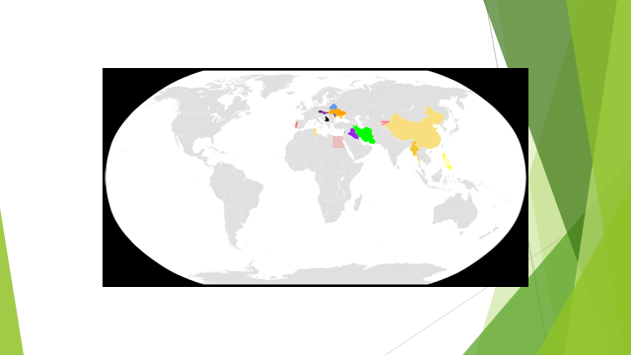
Color coded revolutions

Slide 20
Neo Polanyian model: markets are embedded
Politics as center stage
Sufficient state capacity
The reform movement to embrace self regulated markets
Baltic states neoliberal regime freeing market from the state
The countermovement of the policy intervention through industrial, labor or social policy
Embedded neoliberal regime Central Europe: upfront fast liberalization but later more of a counterbalance of the its costs through “shock absorption”.

Slide 21
Continued
Neo-corporatist regime
No regime type
Least radical marketization with generous compensation of transformation costs Slovenia
Romania and Bulgaria

Slide 22
Growth models: The wake of financial crisis
Jan Drahokoupil and Martin Myant (2010, 2011) differentiate between five modes of growth and international integration:
1. International integration through the export of relatively high-value products manufactured in branches of large MNCs (DME – Central Europe).
2. Integration through export in complex sectors without reliance on FDI (which fits only Slovenia).
3. Integration through exports in simple manufacturing (Southern and Eastern Europe, Baltic states).
4. Integration in the world economy through exporting raw materials and semi-manufactures that requires a less sophisticated business environment (Russia, Ukraine).
5. Integration through ‘financialised’ growth in which foreign borrowing supports public and private sector activities (Baltic states, Hungary).

Slide 23
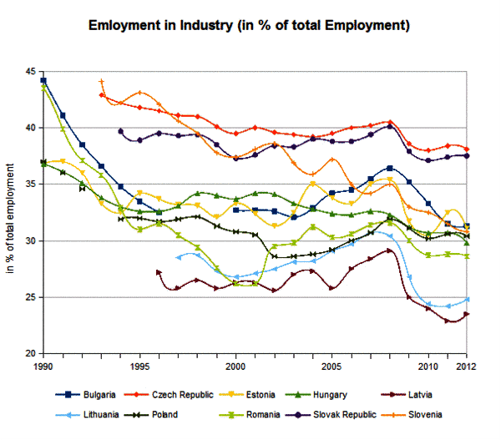

Slide 24
The market: success and failure: persistent economic divergence and institutional dysfunction
Markets and efficiency Inefficient Market regulation
Markets and competition Informal/ Illegal work
Markets and growth Middle income trap
Markets and income inequality Wider income differentials
Markets and instability Susceptibility to cyclical and other crises of the established markets
Markets and hyperbolic discounting Environmental disasters

Slide 25
Lessons learnt
The socio-economic evolution imitates the biological one: it is a simultaneous process of divergence and convergence as it is continuous and discontinuous
The initial conditions and endowments do matter but so do the patterns of imitation and competition. The destinations are not given and singular as well.
The change is local and global at the same time and its outcomes are diverse and complex and uncertain
The singular institution approach is a poor predictor of the change and its intensity and direction
The fixed pattern institutions and respective path dependence will counteract with the new institutions imposed by globalization thus New Traditional Economy
The policy guidelines should be revised in the light of institutional affinity making allowances for complementarity and covariance that can either augment or cancel out institutional overhaul

Slide 26
The institutional approach: Economic science responds to the new situation
The new institutional economics of Coase (1937), Williamson (1975), and North (1980) shift to the societal level rather than the firm level.
Institutions are “ a set of rules, compliance, procedures, and moral and ethical behavioral norms designed to constrain the behavior of individuals.” Later he added “If institutions are the rules of the game, organizations and their entrepreneurs are the players. Organizations are made up of groups of individuals bound together by some common purpose to achieve certain objectives. Organizations include political bodies (e.g., political parties, the Senate, a city council, regulatory bodies), economic bodies (e.g., firms, trade unions, family farms, cooperatives), social bodies (e.g., churches, clubs, athletic associations) and educational bodies (e.g., schools, universities, vocational centers).”
Whereas the old institutional economics of Veblen (1898) and Commons (1931) emphasized the evolution of an intertwined set of social, cultural, political, and legal structures, the new institutional economics argues that such evolution involves some form of optimization. For firms this optimization is the minimization of transactions costs as firms define the boundaries of their zones of control and action
This approach has mostly microeconomic focus

Slide 27
New thinking : new methodology
New Comparative Economics and New Institutional Economics seek to provide an adequate intellectual and empirically solid response to the challenge of accelerated systemic changes and shifting paradigms
New Institutional economics and its focus on market transaction and their costs formally and informally sheds light on social interaction beyond scope of pure impersonal exchange
New Comparative Economics introduces a combination analysis of institutions framing economic interactions with the emphasis on complementarity and co-variance.

Slide 28
New Comparative Economics: Institutions matter but how much?
Models and cases: generalizations versus particularism (K. Polanyi, The Great Transformation, formalists and substantivists)
Models(economic systems) evolving in competitive and complementary fashion, and in a globalized context
Cases( individual countries): the divergent and the convergent trends
The notion of embeddedness of economic elements or how economic institutions are socially construed and how networks, politics and culture shape economic action as a relational process
Djankov et al The New Comparative Economics: institutions revisited and connected to social capital

Slide 29
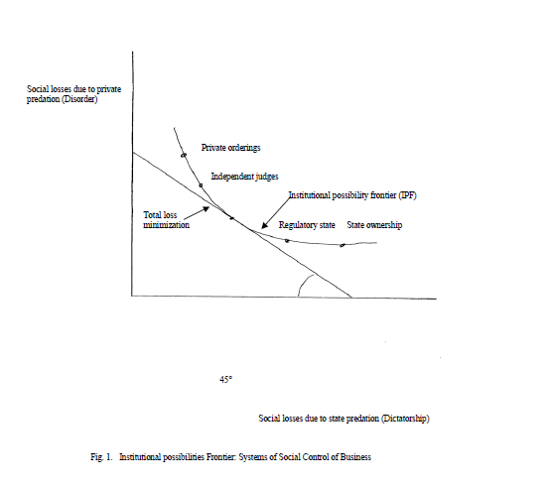

Slide 30
Apps of the NCE
NCE attempts to create order out of the stew of different kinds of institutional frameworks (Djankov et al)
This framework is embodied in the idea of the institutional possibilities frontier (IPF), which varies from disorder to dictatorship, arguably a more generalized replacement for the older socialism-capitalism tradeoff.
Legal frameworks, methods of socially controlling businesses, or other issues, possible institutional solutions are arrayed along this IPF, whose position is determined by social, cultural, and other factors, with closer-in IPFs supposedly reflecting lower general social costs of institutions and presumably arising from greater levels of civic capital. Given its shape there will presumably be some locus on this tradeoff for the various institutions that will minimize social costs.

Slide 31
Problems with IPF
The central idea of the IPF is that it reflects a tradeoff between disorder and dictatorship. In particular, the social costs of disorder are associated with expropriation by private parties whereas the social costs of dictatorship are associated with expropriation (or “takings”) by government
The IPF curve in effect resembles a conventional production function isoquant or indifference curve in utility analysis. The straight line at a 45 degree angle to each axis represents a total social cost line, with the two sources of social cost treated equally. Following the new institutionalist framework, it is argued that over time a society will move to the institutional balance (point on its IPF) that minimizes these total social costs of expropriation or predation Figure 1 exhibits the convexity pattern that Djankov et al. argue is generally found in most cases. It essentially depicts the rank ordering of possible institutional frameworks for social control of business Further there are different costs of dealing with disorder versus dictatorship costs of predation, then this quasi-budget line may well not be at 45 degree angles to the axes.

Slide 32
NCE continued
Acemoglu and Robinson (2006) in their discussion of democracy versus dictatorship cite the role of income distribution as crucial. They argue that the prospects for moving from dictatorship to democracy are most favorable when income inequality is intermediate in degree, with 19th and early 20th century Britain their main example. Democracy arises from demands by the lower strata for greater power and voice with the elites seeing themselves as not losing too much by granting such power, presumably with a stabilizing middle class arising out of it. Very unequal systems see elites resisting democracy, as was the case a long period of time in South Africa and also off and on in much of Latin America. On the other hand, if a system is very equal there may be insufficient demand for democratic reform as in Singapore.
This is more obvious in the case of dictatorship in which the leaders may simply have the power to keep the society in a non-optimal position where they gain rents. However, it can arise even in a democracy, even if one suspects that democracies have a better chance of moving to a more efficient outcome more easily than a dictatorship. This might occur if a rent-seeking private group is able to control a political machine within a democracy by making appeals to nationalism, or racism, or ethnocentrism, or religious identity, or some other prejudice or fervor unconnected to economic efficiency per se.
Wittman (1989) has famously argued for the political efficiency of democratic systems, even as we express doubt regarding this matter here.

Slide 33
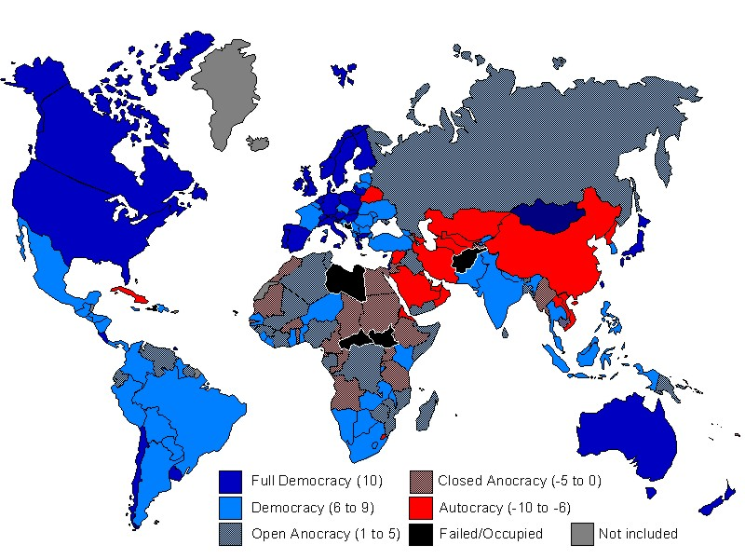

Slide 34
NCE further
Finally, let us consider seriously the possibility of non-convexity and multiple equilibria. We pose as a possible example the two Koreas perhaps in the 1960s, at a point when their respective economic growth rates were approximately equal and depict it in Figure 2. The two may have had about equal social costs from private and public predation, but with very different systems, even as they might have been sharing a nearly identical IPF, given their great cultural similarity. Indeed, during the period of the 1950s and early 1960s it is widely accepted that North Korea’s economic growth rate exceeded that of South Korea, with North Korea being substantially ahead of South Korea in real per capita GDP as of the mid-1960s. After this time, South Korea’s growth rate began to move ahead of North Korea’s, and during the 1970s, it moved decisively ahead in per capita GDP, with the divergence dramatically widening as time has gone on (Kim, 1992; Rosser and Rosser, 2004, Chap. 19).
Another example of such non-convexity might be the case of the temporarily planned, command capitalist economies one sees in wartime in many peacetime market capitalist ones, such as Germany in World War I and the US and UK in World War II. The increase in social capital due to increased patriotic fervor may bend an IPF inward near the dictatorship end for the wartime and allow for a temporarily productive such economy, although such a system tends to stagnate in longer run peacetime. It should be remembered that Lenin was partly inspired to pursue planning by the example of the World War I German economic system, and Hayek’s fear of the popularity of this model in the US and UK in World War II was a powerful impetus to his (1944) writing The Road to Serfdom.

Slide 35
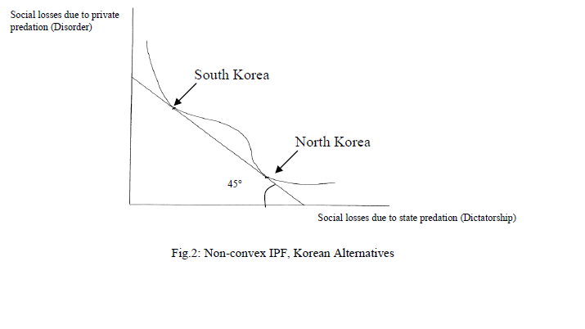

Slide 36
Cluster analysis
The methodology to quantify institutional complementarity within economic systems
The methodology of assessment and specification of the convergent traits
The methodology of identifying divergence of cases
F. Pryor: testing embeddedness of market economies at the different levels of economic development and its properties (2006, 2010)

Slide 37
Cluster analysis findings: the alternative perspective on the weight and scope of institutions
Market economies comprise distinctive clusters of institutional configurations which can be subdivided roughly into 4 clusters(alternative taxonomies are Varieties of capitalism (Hall and Soskice), others by Visser and Kitschelt
These clusters are derived empirically and not derived from a pre-conceived models
A better tool to track the changing nature of the institutions over time in comparison to similar cases

Slide 38
Novelty of cluster analysis
The taxonomy of economic systems based on a complementary set of institutions instead of the focus on an individual institution
Economic systems classification in the context of the economic development: formative institutions and informal ones measured by development elasticity to GDP growth
A departure form the dichotomy plan or market and a greater emphasis on multi-dimensional assessment of economic systems
Combining economic institutions with the non-economic ones and tracing their interactive properties

Slide 39
The technique
Iterative regression analysis to optimize the multidimensional distance between the similarities and the differences( the Eucledian space)
The findings attest to greater concentration within a cluster and the greater distance among the clusters over time

Slide 40
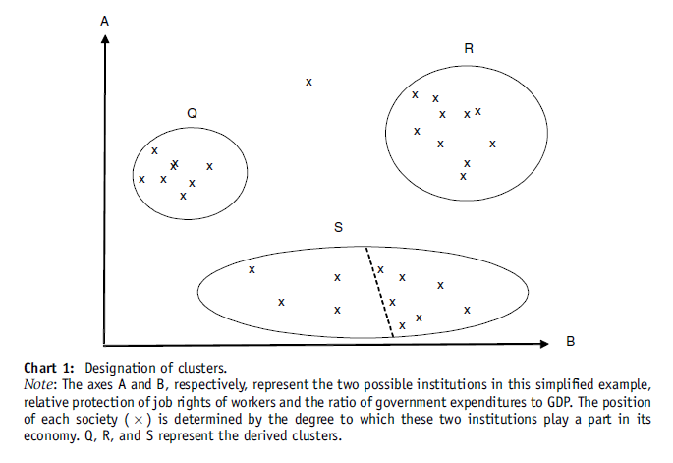

Slide 41
Matrix of economic performance and institutions
Economic endowment and institutionalized authority and organizational logic
Economic growth and democracy
Income inequality and shadow economy
International trade and system identity remaking remaking
Natural resource curse and oligarchy
Competitive disadvantage and military buildup

Slide 42
Matrix reloaded
The economic failure (input markets and globalization versus regionalization) and its traits
The breakdown of statehood and state legitimacy
The institutional turmoil: anchor’s lost – the state being delegated to build institutions can turn the process into a rent generating enterprise
The institutional trap: a stable state of interim institutions that might force out desirable institutions in the long run and augment transformation costs

Slide 43
Matrix revolutions
The fast and “discontinuous” political changes
The slow adjustment of the normative environment
The challenge of the “good” institutions” and the “bad” institutions”
The German reunification debate revisited: lessons for Korea?
Copenhagen protocol and the requirements of acquis communautaire

Slide 44
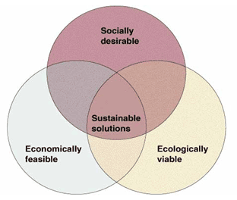

Slide 45
Economic transition = institutional re-engineering
The specification of the economic transition is the process of undoing of the old institutions and the introduction of the new institutions
This process is marked by pronounced uncertainty and chaos
The institutions mostly derived from culture, religion or history and geography have a fixed pattern and greater rigidity
The institutions derived from politics, ethics and social inactions are more fluid and adaptable
There is dual causality between the level of market liberalization and its institutional framework: new institutions are the precondition of the true liberalization of markets and maintaining them competitive, and the competitive markets are the reinforces of the appropriate institutions
Partial and conditional market liberalization in the name of social balancing precludes appropriate institutions from consolidation and leaves the room for an uncomfortable alignment of the old and the new. This alignment frequently leads to the greater presence of informal institutions which imposing additional costs for the non-network participants

Slide 46


Slide 47
The pre-existing culture of markets
Quasi-markets, also sometimes described as planned markets or internal markets, are organized and implemented markets intended to bring us more efficiency and choice than bureaucratic delivery systems while maintaining more choice than conventional markets. Under socialism the example would be farmers markets and markets of services. Under the conditions of the socialist shortage economy a market is an exchange mechanism of commodities that matches limited supply with excess demand, mostly through price discrimination.

Slide 48


Slide 49
New Traditional economy: Will Tradition survive in economic transition?
The new traditional economy comprises the elements of path dependent institutional and overall economic pattern with greater integration into the regional and possibly global trade and the use of modern technology
The institutional makeup of a NTE is thus a product of the long cycle of historical continuity economically and politically where the rigidity of old way and norms is stronger than the promise of the new institutions that are viewed as inferior and a poor match. The economic transition in Asia and in Russia can be examples of this case.

