Slide 1

Institutional Transplantation and Complementarities: How to measure them
Dr. Martin Mendelski
University of Trier
Cargese, 22 May 2015
Notes:
Adress professors, collegues and friends
Does the EU matter for the rule of law? Does EU conditionality work to promote the rule of law?
In the past 3 years I had the time of my life. I learned a lot and I met many interesting people. The project was challanging but I brought it to an end.

Slide 2
Agenda
1. Introduction
2. Institutional complementarities (concept and measurement)
3. Institutional transplants (concept and measurement)
4. Conclusion

Slide 3
1. Introduction

Slide 4
Research questions and hypotheses
What explains institutional and economic performance among post-communist countries?
H1: The way how you reform matters (reform process), i.e. creating institutional complementarities and well-functioning institutional transplants matters.
2. What type of capitalism has emerged in CEE?
H2: Coherent and incoherent varieties of capitalism.
3. How has the rule of law developed in CEE?
H3: While post-communist countries have improved judicial capacity and aligned their development with international standards, most of them failed to assure judicial impartiality and a stable and coherent legal framework.

Slide 5
2. Institutional complementarities

Slide 6
2.1 What are institutional complementarities?

Slide 7
Institutional complementarity concept (Aoki 2001)
Complementary institutions = “mutually reinforcing institutions”
E.g. “market-supporting moral codes (first-party mechanism) and a just system of the rule of law (formal third-party mechanism) can be complementary” (Aoki 2001: 88)…because they reduce monitoring costs
→1. “The presence of complementarity implies that the configuration of overall arrangements can be internally coherent and robust”
2. “individual institutions therein may not easily be altered or designed in isolation” (Aoki 2001:225)
3. Complementary relationship can be suboptimal (inefficient)

Slide 8
Institutional complementarity (Hall/Soskice 2001)
Institutions are complementary “if the presence (or efficiency) of one increases the returns from (or efficiency) of the other” (Hall/Soskice 2001:17)
efficiency (institution A + institution B) > efficiency (institution A) + efficiency (institution B)
→ Main message: Institutions are not only alone important, but also in their composition

Slide 9
Example of institutional complementarity
The creation of firm-specific skills (education/vocational training) requires a high level of job protection.
In Germany experienced workers who don’t face easy dismissal have incentives to further invest in their firm-specific skills. Then they can pass their knowledge to younger workers → firm-specific knowledge is preserved. (see Aoki 1998)
And vice versa! In the US general skills do not need to be protected and firms can acquire them by hiring/firing workers.

Slide 10
Institutional complementarities between 4 sub-systems of the political economy (Hall/Soskice 2001)
1. education and vocational training
2. corporate governance/ financial system
3. industrial relations
4. inter-company-relations (e.g. cooperation in r&d)
(5.) Company needs (internal structure of the firm, codetermination)

Slide 11
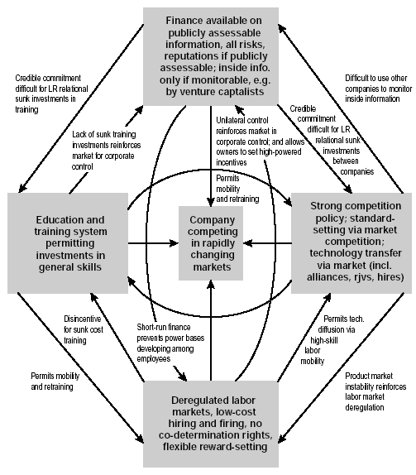
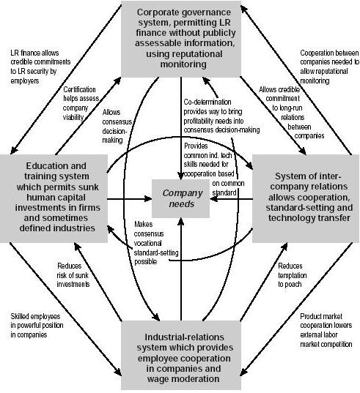
Germany
USA
Fig 1: Complementarities across subsystems in the German coordinated market economy,
Fig 2: Complementarities across subsystems in the American liberal market economy

Slide 12
Main argument to explain Varieties of Capitalism among nations (Hall/Soskice 2001)
Coordination between sub-sectors of the political economy matters!
i.e.: the complementary coordination of firms’ activities with suppliers, customers, capital providers and workers explains comparative institutional advantage of the firm which then aggregates into national economic performance (Hall/Soskice 2001:6 and 37).

Slide 13
Implications of complementarities
In the long-run complementary institutions (understood also as skills and activities) are more efficient than non-complementary ones. → complementary systems tend to be economically successful
Recommendation: “nations with a particular type of coordination in one sphere of the economy should tend to develop complementary practices in other spheres as well” (Hall/Soskice 2001:18)

Slide 14
Implications of complementarities
2. National institutional frameworks provide firms/nations with institutional comparative advantage in particular activities and products:
- Liberal Market Economies (US) →radical innovation for biotechnology, semiconductors;
- Coordinated Market Economies (Germany) →incremental innovation: machine tools, cars, engines

Slide 15



Complementary types of capitalism/coordination
1. Liberal Market Economies (coordination via market relationships, e.g. USA, GB)
2. Coordinated Market Economies (strategic coordination via non-market modes, e.g. Germany)
3. Hybrid economies (mixed system with strong influence of the state, e.g. France, Italy)

Slide 16
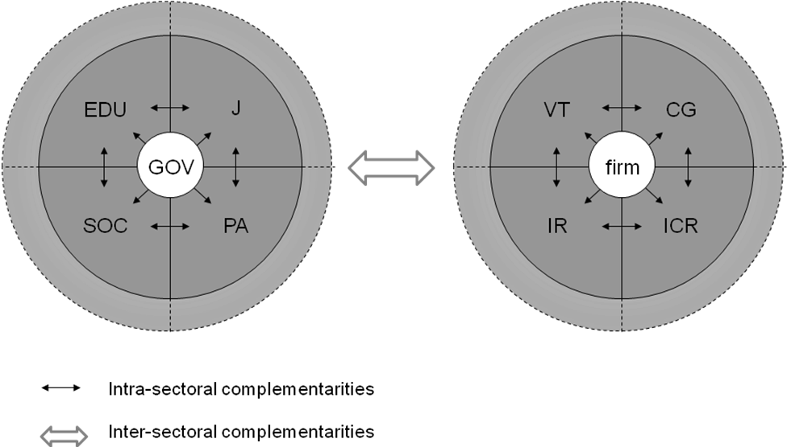
Extension of the VOC framework: Intra and inter-sectoral complementarities of the political economy (Mendelski)
Graph 1: Intra and inter-sectoral complementarities of the political economy
Note: Intra-sectoral complementarities of the political sector exist between the sub-sectors of education (EDU), judiciary (J), social/health sector and the public administration (PA); Social System (SOC); intra-sectoral complementarities of the economic sector exist between the sub-sectors vocational training (VT), corporate governance (CG), industrial relations (IR) and inter-company relations (ICR). Inter-sectoral complementarities exist between the political and the economic sector (government-business relations).

Slide 17
Discussion question
Can you tell us other examples of institutional complementarity from your research area?

Slide 18
2.2 How to measure institutional complementarities?

Slide 19
Main problem
Complementarities are not directly observable, they are latent (unobservable) variables
→ What methodology can be applied?

Slide 20
Solution: Factor analysis
To measure latent variables we can use latent variable models, for instance factor analysis (latent variable analysis)

Slide 21
Confirmatory Factor Analysis
To identify commonalities that may be unobservable (e.g. complementarities, character of coordination) in themselves but that correlate with a range of observable variables (indicators)
Factor analysis measures latent variables indirectly by establishing correlations with a range of observable variables (indicators)

Slide 22
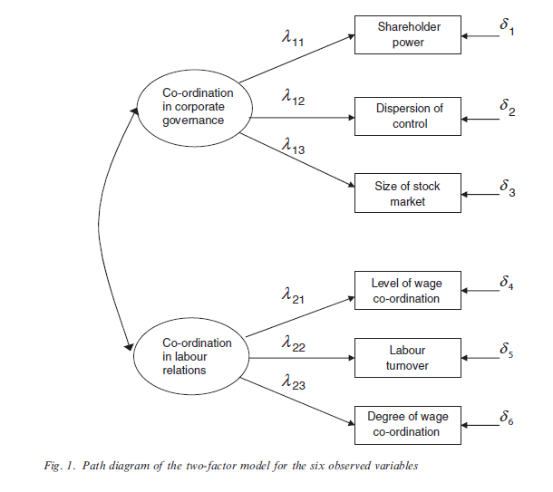
Example 1: Factor analysis to measure coordination
Manifest variables (indicators)
Latent variables
(degree of coordination)
Source: Hall/Gingerich 2009

Slide 23
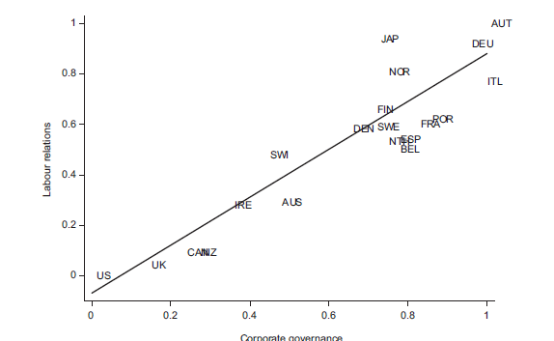
Types of coordination in Labor relations and Corporate governance
Source: Hall/Gingerich 2009

Slide 24
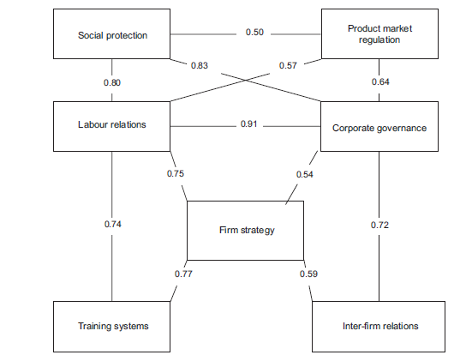
Potential complementarities among sectors of the political economy
Source: Hall‘/Gingerich 2009

Slide 25
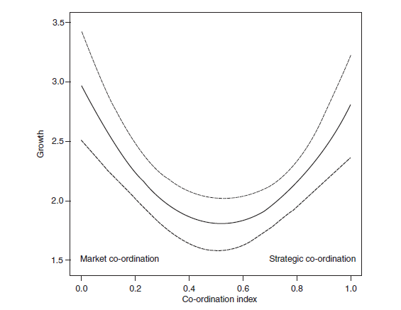
U-shaped relationship between coordination and rates of economic growth
HC
HC
Source: Hall/Soskice 2009
LC

Slide 26
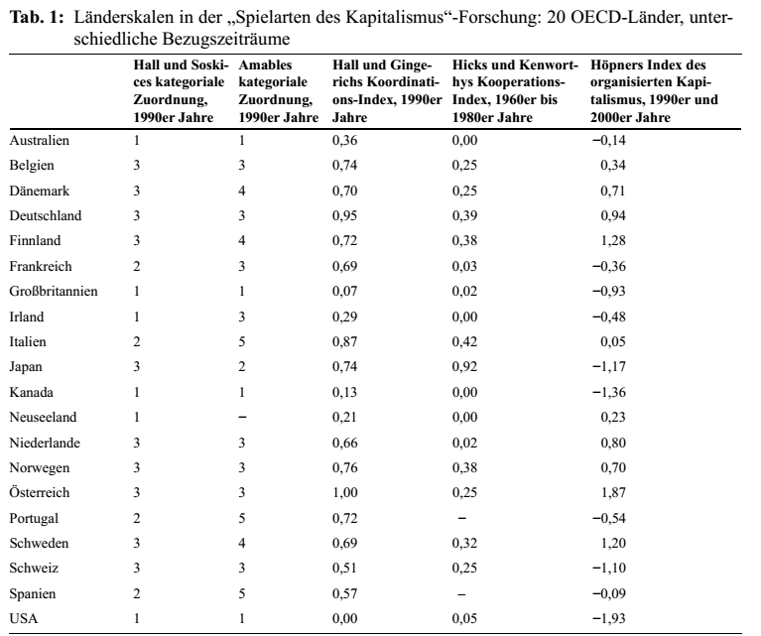
Different indicators to measure capitalism result in different varieties (rankings, clusters)
LME, CME (Hall/Soskice 2003)
Market-based, Asian, Continental Social-democratic, Meditarrean (Amable 2003)
Coordination-Index (Hall/Gingerich 2009)
Cooperation Index (Hicks/Kenworthy 1998)
Organized capitalism Index (Höpner 2007)
Source: Schroeder 2009

Slide 27
Measuring institutional complementarities in CEE
Markus, Stanislav and Martin Mendelski (2013) “Institutional Complementarity, Economic Performance, and Governance in the Post-Communist World and Beyond”, Comparative European Politics, (14 October 2013) | doi:10.1057/cep.2013.26

Slide 28
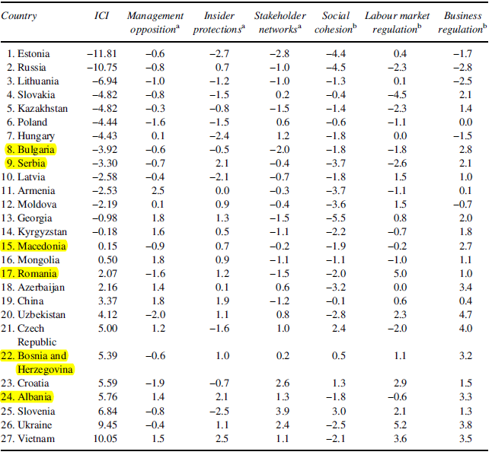
Institutional Complementarity Index for CEE
Cocktail capitalism and hybrid systems in less performing countries from SEE and CIS
Notes:
-ICI is the sum of six complementarity dimensions displayed in the table.
-Lower scores reflects market coordination typical in LMEs.
-Higher scores means strategic coordination typical of CMEs.
Source: Markus/Mendelski 2013

Slide 29
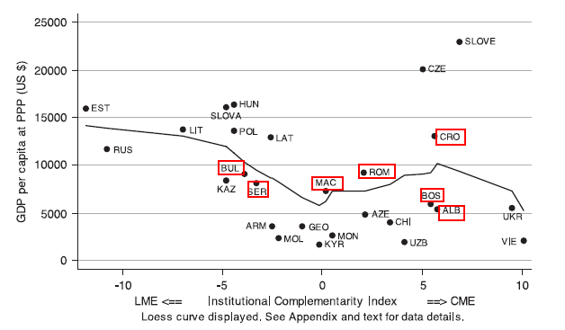
Institutional Complementarity and economic performance (2001-2008): lack of correlation
Source: Markus/Mendelski 2013

Slide 30
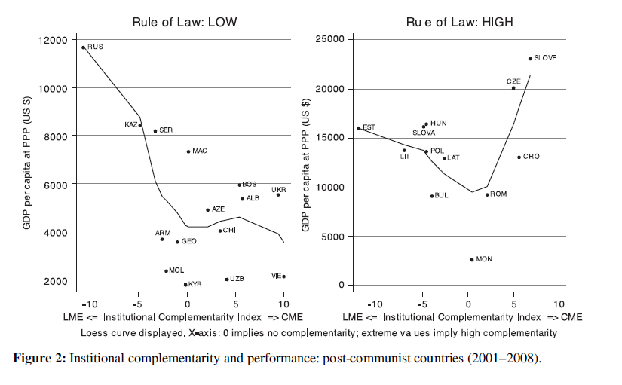
Institutional complementarity + RoL:
U-shaped relationship with economic performance

Slide 31
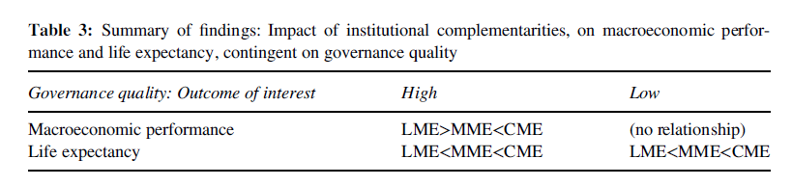
Relationship between complementarity, life expectancy
and economic performance
Source: Markus/Mendelski 2013

Slide 32
3. Institutional transplants

Slide 33
3.1 What are institutional transplants?

Slide 34
Conceptualizing institutional transplants
'legal transplants' refer to 'the moving of a rule ... from one country to another, or from one people to another” …
“Massive borrowing of rules” (Watson 1993)
“Institutional transplantation is the transfer of policy concepts and institutions to a recipient country from either policy models promoted by international organizations or donor countries which are subsequently implemented in this recipient country” (de Jong et al. 2002).

Slide 35
The transplant effect (Berkowitz et al. 2003)
“Our basic argument is that for legal institutions to be effective, a demand for law must exist so that the law on the books will actually be used in practice”
“If the transplant adapted the law to local conditions, or had a population that was already familiar with basic legal principles of the transplanted law, then we would expect that the law would be used.”
Countries where law is not adapted and imposed “are thus subject to the “transplant effect: their legal order would function less effectively” (Berkowitz et al 2003:167)

Slide 36
Examples of institutional transplants
Foreign and international Legislation, standards, solutions (e.g. Law from France and England)
Plea bargaining (Common law system element from US)
Agencies (Competition and regulatory agency, Anti-corruption agency from Hong Kong, Ombudsman from Sweden etc.)
Judicial councils (transplanted from Spain)
European work councils

Slide 37
3.1 How to measure institutional transplants?

Slide 38
Main Problem
Efficiency/effectiveness of legal transplants depends on the transplanting process and the domestic conditions (embeddedness)

Slide 39
Solution
In order to measure the effectiveness of legal transplants distinguish between process and outcome (de jure and de facto).
Questions:
Process-related: How were transplants diffused ? By coercion, copy/paste, learning, legitimate, socially/nationally/systematically embedded, speedy/gradual?
Outcome-related: Are legal transplants adopted in law and enforced/implemented (de jure and de facto.)

Slide 40
Measuring legal transplants: Process-related indicators
Concept | Indicator (Source)
Legal transplant process | -Classification Origins/transplants (e.g. Berkowitz et al.) -Demanded/imposed -Copy pasted/adapted to local conditions -familiar/not-familiar
Reform approach (Time/timing of reforms) | Speedy/gradual (in days, or counting reforms)
Donor heterogeneity | Number of donors in a country Foreign (OECD)
Donor dominance | aid disbursement by donor (OECD database)

Slide 41
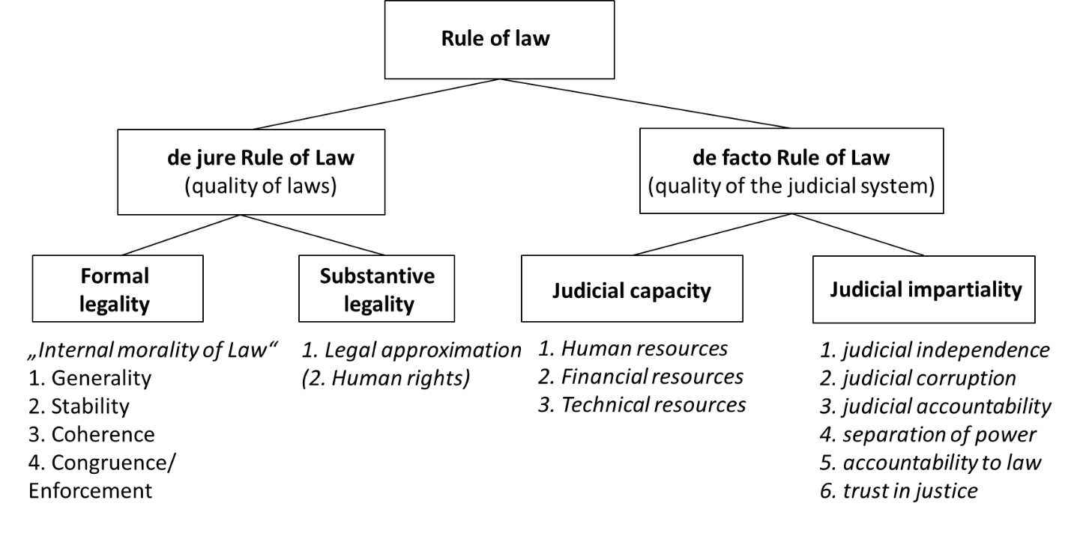
A multi-dimensional concept of the rule of law (Mendelski 2014)

Slide 42
Measuring the rule of law
Concept | Indicator (Source)
De JURE Rule of law: 1. Substantive legality (alignment with international standards) 2. Formal legality (inner morality of law) | -Number of signed international treaties/conventions (e.g. adopted UN resolutions on transnational crime, Human Rights treaties) (UN, Simmons 2009) Legislative output (national parliaments), Stability of laws (World Justice Project) Enforcement gap (global integrity)
De FACTO Rule of law Judicial capacity Judicial impartiality | Judicial budget p.c, Number of judges, public prosecutors and court staff (CEPEJ) Judicial independence (WEF), Separation of powers (BTI), Prosecution of office abuse (horizontal accountability) (BTI), Irregular payments in judicial decision (WEF) , Judicial Corruption (Transparency International), Citizens trust into justice/courts, in % (Eurobarometer

Slide 43
The de jure RoL: While substantive legality increased…
Source: Based on data from Simmons 2009

Slide 44
…..formal legality deteriorated (however less in CEB)
Source: National parliaments

Slide 45
The de facto RoL: While judicial capacity improved…..
Source: CEPEJ

Slide 46
…judicial impartiality stagnated
Source: World Economic Forum ‘s Executive Opinion Survey (Global Competitiveness Reports)
Note: Scale from 1-7,
To what extent is the judiciary in your country independent from influences of members of government, citizens, or firms? (1 = heavily influenced; 7 = entirely independent)

Slide 47
Recommendations for measuring institutional transplants (institutional performance)
Distinguish between process and outcome
Combine qualitative with quantitative methodology (mixed-method)
Avoid a quantitative “the more the better approach”, otherwise perverse evaluation of performance is possible (e.g. more judicial independence does not necessarily enhance the RoL)
Consider that a deficient transplanting/reforming process can make the situation/system worse (reform pathologies, pathological effects of legal transplants, i.e. legal irritants)
Be critical with indicators which can be biased, non-reliable etc. (e.g. WB, FH)
Combine subjective and objective indicators

Slide 48
4. Conclusions

Slide 49
 | Legal transplants | Legal complementarities
Intention | Enhanced functioning of “dysfunctional” institutions, increasing effectiveness/efficiency | Enhanced efficiency due to more complementary institutions
Interest in | Processes and Outcomes of legal borrowing | Relationships between institutions
Questions we ask | How? From where? With what effects? | What interactions?
Relationship | Between the transplanted institution and the domestic environment (structure, agency, institutions) | Between institutions/actors/sectors
Main mechanism | Enforcement, Embeddedness | Complementarity
Relevance of time/institutional change | Processes of change are very relevant. How institutions are transplanted matters | Does it matter how complementarities are built?
Relationship between both concepts | Legal transplants as primary, i.e. selective transplants result often in more incoherence (i.e. less complementarity) | Complementarities as secondary (i.e. after institutions were transplanted or between existing institutions)

Slide 50
Typology: Towards complementary transplants
How to get here?
high
Imposed social order (transplanting by coercion) creating legal pluralism and incoherent systems in (post-conflict) developing/transition countries e.g. Bosnia | Effective complementary transplanting (open access) Estonia: complete externally-driven transformation, Slovenia, Poland: adaptation and resistance towards some foreign transplants in
Dysfunctional rejection (incoherent and not-enforced transitional order) failure of legal transplants in laggard transition countries from Western Balkans and CIS | Complementary (in)formal systems (closed-access) reluctant or gradual transformers in which complementarity was maintained but where impartial institutions are missing, e.g. China, Belarus
enforcement
low
low
complementarity
high
Low

Slide 51
Policy implications
It’s the process stupid! How you transplant something matters for its effectiveness/efficiency (relevance of transplanting process)
Think and reform in a systemic way Make use of reform and institutional complementarities. If you transplant certain institutions, transplant also the complementary and accompanying/supportive secondary-institutions.
Does Institutional design work? Designing complementarities from above (master plan as found in Asia) vs. creating them from below through trial and error (however inefficient, i.e. non-complementary lock-ins are possible!)

Slide 52
References
Aoki, M. (2001). Toward a comparative institutional analysis. MIT press.
Berkowitz, D., Pistor, K., & Richard, J. F. (2003). Economic development, legality, and the transplant effect. European Economic Review, 47(1), 165-195.
Hall, P. A. and Gingerich, D. W. (2009) ‘Varieties of Capitalism and Institutional Complementarities in the Political Economy: An Empirical Analysis’, British Journal of Political Science,39(03): 449.
Markus, S./Mendelski, M. (2013) “Institutional Complementarity, Economic Performance, and Governance in the Post-Communist World and Beyond”, Comparative European Politics, (14 October 2013) | doi:10.1057/cep.2013.26

Slide 53
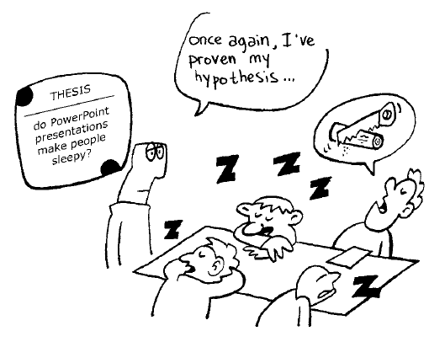
THANK YOU!

