Slide 1
Methodological Approaches in Applied Innovation Economics
IOEA Workshop
5/16/2016

Slide 2
Overview
Survey of the Literature
Common Data Sources, Outcome of Interest, and Econometric Methods
How Do We Measure Innovation?
Basic Terminology
Innovation Process – Outputs and Inputs
Basics of IP – patents, copyrights, trademarks, trade secrets
Overview of Common Empirical Approaches
Patent Production Function
Market Value of R&D (Tobin’s Q Approach)
Productivity Measures (TFP)

Slide 3
Part 1
Survey of the Literature

Slide 4
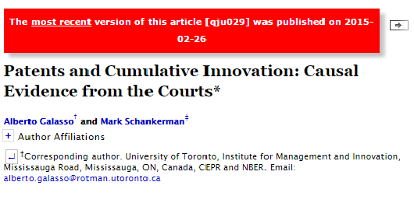


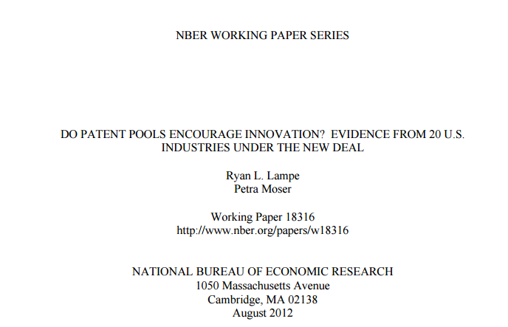
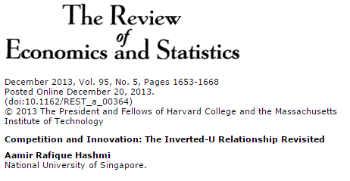
What is the current state of the art?
A quick and dirty survey
Papers published in the AER, QJE, Econometrica, ReStat, and/or disseminated through the NBER Working Paper Series
Time period: 2011-2016
Search Criterion: title contains “innovation” and/or “invention”
Manual removal of exclusively theoretical and experimental papers
Sample contains 66 unique empirical papers in innovation economics
Notes:
At the very outset, we need to distinguish between something I’ll call intellectual capital and intellectual property.
[Read bullets]
Only some of America’s IK or the world’s IK can be effectively protected through the use of the formal legal instruments of intellectual property.

Slide 5
Units of Observation
 | Unit of Observation | #
 | Firms | 31
 | Inventions / Patents | 15
 | Countries / States | 9
 | Individuals / Inventors | 8
 | Industries | 3
Most papers focus on exploring firm behavior and performance.
Many try to understand the occurrence and characteristics of inventions themselves.
We will focus our discussion on methodological approaches using firm-level and invention-level data.

Slide 6
Data Sources
 | Data Sources / Types | # | Examples
 | Patent Data | 39 | USPTO, EPO
 | Firm Financial Data | 26 | Compustat, U.S. Census, BVD/Amadeus
 | Innovation Data | 21 | CIS Survey, FDA/EU Trials/Entry, Historical Datasets, Adoption Data
 | Other Data | 11 | Public Health Data, Stock Market Data, Household Income, International Travel
 | Policy Data | 6 | Competition, R&D Incentives, Patent Policy
 | R&D Activity Data | 5 | R&D Investment Accounts
 | Country Data | 4 | Religiosity, Economic Data, Genetics, Health
 | Firm Characteristics | 3 | CEOs, Market Entry/Presence
 | Market Data | 2 | Demand, Competition
 | Publication Data | 2 | Web of Science, SCOPUS
Most papers use data on Intellectual Property (IP), predominantly patent data.
Many papers use data on firm financial accounts, supplemented by other data sources.
We will focus our discussion on common ways to use IP and firm-level financial accounts data.

Slide 7
Outcomes of Interest
 | Outcomes of Interest | # | Examples
 | Patenting Rate | 31 | Applications/Grants
 | Firm Performance | 19 | Survival, Exit, Productivity
 | Innovation Frequency | 14 | Clinical Trials, Publications
 | Patent Characteristics | 14 | Citations, Assignment, Inventors, Technology Classes
 | R&D Intensity | 8 | Investment Measures
 | Other Measures | 6 | IT Investment, Health Outcomes
 | Stock Market Performance | 4 | Tobin's Q, Share Price Movements
 | Technology Adoption | 4 | Survey Measures
The most common outcome of interest is the rate of innovation activity, measured using patent application/grant counts
The second most common approach is to understand drivers of firm performance.
We will focus our discussion on understanding common approaches to operationalizing these measures.

Slide 8
Empirical Approaches
 | Methods | # | Examples
 | Patent-Based Regressions | 37 | Patenting Rate, Licensing Frequency
 | Firm Performance Regressions | 23 | Productivity, Survival, R&D Intensity, Stock Market Performance
 | Innovation-Frequency Regressions | 11 | Scientific Publications, New Product Introductions
 | Technology-Adoption-Based Regressions | 7 | Innovation Diffusion/Adoption Frequency
The vast majority of papers adopt a reduced-form approach.
Most papers use patent-based and firm-performance-based regression models.
We will focus our discussion on common examples of these patent-based and firm-performance-based regression models.

Slide 9
Part 2
How Do We Measure Innovation?

Slide 10
What is innovation?
Innovation can be defined as the application of new ideas to the products, processes, or other aspects of the activities of economic agents that lead to increased “value.” (Greenhalgh and Rogers, 2010)
Examples
New or improved products or services (“product innovation”)
New or improved industrial processes (“process innovation”)
Improved organizational designs (“process innovation”)
Sources of innovation:
Individual inventors
Firms
Universities and public research laboratories

Slide 11
Invention, Innovation, and Diffusion
“The Schumpeterian Trilogy”
Invention: creation of an idea to do or create something new
Innovation: new product/ process commercially valuable and available (i.e. successfully developed inventions)
Diffusion: the spread of a new inventions/innovations throughout the economy
Key to realizing economic benefits of innovation
Can include ‘spillovers’ or ‘positive externalities’

Slide 12
The Innovation Process
Innovation Process
R&D Investment
New Products/Processes
Inputs
Outputs
Greenhalgh and Rogers (2010)

Slide 13
Various Innovation Indicators
Innovation Process
Inputs
Outputs
R&D Investment
Patent Applications/Grants
# of R&D Personnel
Scientific Publications
Education-Based Indicators
New/Improved Products
Other Investment Indicators
Sales of New/Improved Products
New/Improved Processes
Process Cost Savings
Productivity Improvements

Slide 14
Common Forms of Intellectual Property
Patents
Novel products and processes, including business models
Trademarks
Unique names, logos, and shapes
Copyright
Works of authorship -- specifically fixed expressions of “original” idea, not idea itself
Trade Secrets
Commercially valuable information intentionally kept secret
Patent statistics are the most commonly used indicator of technological innovation.

Slide 15
Patent Basics
Patent protection, in the typical form of “utility patents,” is available for:
“anything under the sun” including methods for optimizing financial portfolios, with some exceptions
The three main standards for patentability:
Utility: The invention must be “useful“ (potential commercial application)
Novelty: The invention must be “novel“
It must be something that no one did before
The invention must be “non-obvious" to "a person having ordinary skill in the art to which said subject matter pertains”
Should not be an idea per se, or something that is naturally occurring (in practice, we are getting very close to both).

Slide 16
“Doctrine of equivalents”
An essential feature of patent law that strengthens patent protection as compared to copyright.
“If two devices do the same work in substantially the same way, and accomplish the same result, they are the same, even though they differ in name, form, or shape.”
(Graver Tank vs. Linde Air Products,
U.S. Supreme Court, 1950)
Implies cosmetic changes in specifics of an invention are insufficient to avoid charge of infringement.
Notes:
The strength of patents in the US and in most other advanced industrial countries is undergirded by the so-called doctrine of equivalents
[READ]
Took some time for this legal doctrine to firmly take root in all major industrialized countries, but by the late 1990s, it had, even in Japan.

Slide 17
Patent Documents (1)

Slide 18
Patent Documents (2)

Slide 19
Additional Information - Example 1

Slide 20
Additional Information – Example 2

Slide 21

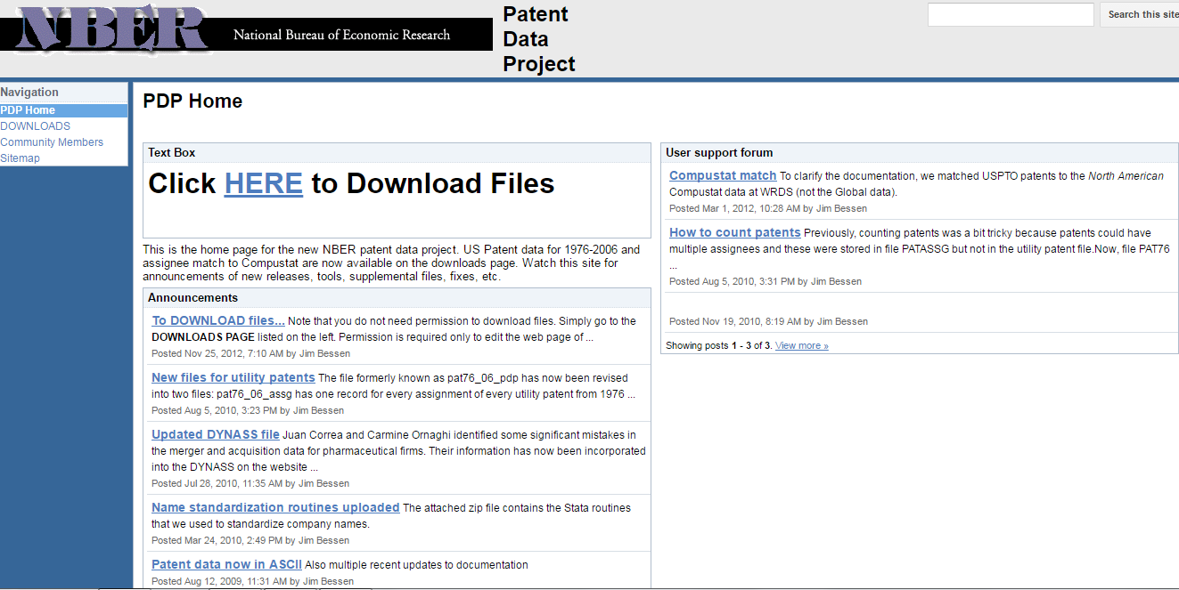

MANY Database Options

Slide 22
The Usefulness of Patent Data
Pros
Publically available (monopoly rights in exchange for publication of inventions)
Global coverage (USPTO, EPO, various other national jurisdictions)
Objective observable data with lots of detailed information
Cons
Not everything is patented / patentable
The decision to patent (or not) is strategic
What exactly do patents measure?
Intellectual Property

Slide 23
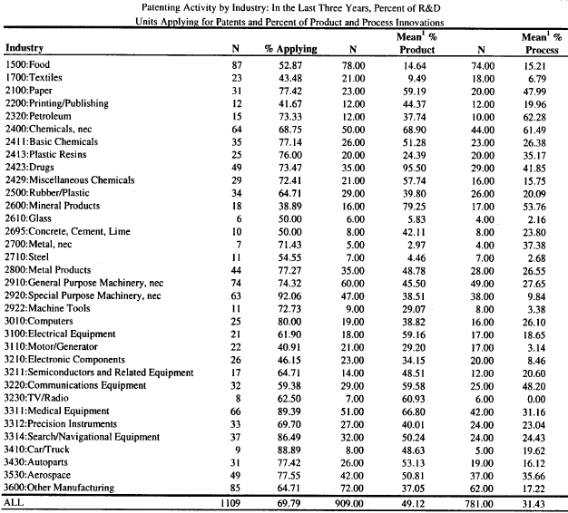
Share of inventions that are patented
Notes:
To see this, consider evidence in this table. Based on a survey by former CMU prof. Wes Cohen and co-authors in the early 1990s. Surveys corporate R&D facilities of (mostly) large US manufacturing firms which, in the early 1990s, accounted for the vast majority of private sector R&D spending.
1) What we see is that, across all industries, nearly all firms are patenting.
2) But the fraction of new products and new processes that are patented varies enormously across industries. (give some examples).
ON average, only about HALF of new products are patented, and only about ONE THIRDS of new processes.
CONCLUSION: PATENTS are clearly VERY IMPORTANT, but there is FAR MORE TO IK than this particular form of IP

Slide 24
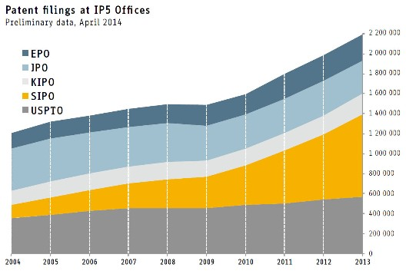
Patent surge in the U.S: Patents issued
Patenting rates have skyrocketed in the past few decades
Overall R&D investment has increased
Policy has become more pro-patent
Stronger enforcement (TRIPS)
Newly patentable subject matter
Eligibility extended to federally funded research (USA)
Business attitudes have changed markedly
Patents per R&D dollar in the U.S. have increased over 50%
New challenges and opportunities for measuring innovation using patent data
Notes:
Now, the use of a mix of strategies to appropriate returns from innovation goes back a long way.
But over time, and especially over the LAST 20 YEARS or so, it seems that the MIX OF STRATEGIES HAS CHANGED in important ways. PATENTS have become MUCH MORE important. You can see this in the patent statistics. And this CHANGE REFLECTS, in part, more FAVORABLE LEGAL treatment of patents. [read bullets]

Slide 25
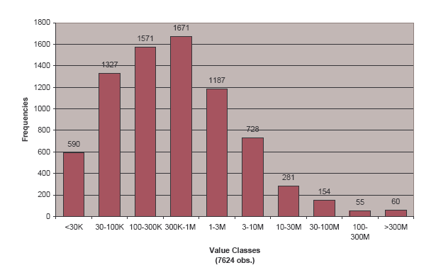
Not All Patents Are Equally Valuable
The distribution of patent values is skewed, but the average value is likely high
(Gambardella, Harhoff and Verspagen, “Value of patents”, 2005)
Notes:
This graph gives you a sense of the distribution of patent values in Europe. Note the number of patents with a value of over 300 million Euro!

Slide 26
Evidence of Patent Value from Litigation
The almost $900 million, January, 1991, award in Polaroid v. Kodak (at that time the all-time winner for a patent suit)
August 9, 2000: When the courts invalidated Lilly’s Prozac patent, the stock price crashed from $108 to $76, wiping out nearly $35 billion in market value in a couple of hours.
Prozac generated more than 30% of the drug maker's revenue.
More recently
Medtronic’s April, 2005 agreement to acquire the rights over Dr. Gary Michelson’s patents for $1.35 billion
Research In Motion’s (i.e., Blackberry) June, 2005 agreement to access NTP’s patents for $450 million.
One source lists more than 40 cases over the past 20 years with damage awards exceeding $100 million

Slide 27
Reasons to Patent Inventions
(Cohen, Nelson, and Walsh, 2000)

Slide 28
Reasons NOT to Patent Inventions
Many valuable inventions are not patentable
Importance of disclosure and inventing around
If a patented invention can be invented around, then disclosure becomes a particular concern
Often patents are only valuable when “arrayed in mass formation”
Legal costs of defending a patent (more than application costs)
Most important for smaller firms
A patent is only as good as the legal resources you are willing to put behind it
(Cohen, Nelson, and Walsh, 2000)
Notes:
Patents are limited in their effectiveness. Why do firms not patent?
Well, Wes Cohen and co-authors asked their respondents about this, too. Here’s what they learned.

Slide 29
Effectiveness of Appropriability Mechanisms
(Cohen, Nelson, and Walsh, 2000)
Notes:
And it is interesting to compare the results of the previous slide to these results.

Slide 30
A Key Difference Across Industries
When number of patents per commercializable innovation are great, unlikely that any one firm holds all necessary rights, fostering mutual dependence
Cross-licensing negotiations and use of patents as “chips” in a bargaining process
access one another’s technology holdings or gain freedom of operation/design
Suggests different uses of patents across industries
Complex product industries:
Where a product protected by numerous (i.e., hundreds or even thousands) patents (e.g., computers, communications equipment)
Discrete product industries:
Where a product protected by relatively few patents (e.g., drugs, chemicals)
This distinction can apply across products even within some industries such as medical devices

Slide 31
Two Ways of Appropriating Return to R&D
Embodying knowledge in a new process, product
Selling the knowledge itself (i.e., not embodied in anything) via, for example, licensing
Importance: If you can license, you can exploit other firms’ sales to earn returns on your innovation
However, in manufacturing sector, its sale in such “disembodied” form (e.g., licensing) is less common.
Because patents alone do not confer effective protection in most industries
Some exceptions: pharma, medical equipment
Other vehicles: contract R&D, consulting
Notes:
[read]

Slide 32
Licensing Revenue for IBM
2000+: Equals about 5-15% of total operating profit

Slide 33
Markets for Intellectual Property Are Large
Markets for intellectual property are growing rapidly, globally and in the United States
(Athreye and Cantwell, 2005)
Notes:
What’s happening at IBM reflects a broader phenomenon that is showing up clearly in the aggregate statistics.
If we look at royalty and licensing revenue globally, we see very rapid growth in recent years. By early 2000s, the trade in intellectual property was on the order of 100billion per year. This is a pretty big market and the growth trends have been very strong and very robust

Slide 34
Part 3
Examples of Common Empirical Approaches

Slide 35
Example 1
“Get With the Program”

Slide 36

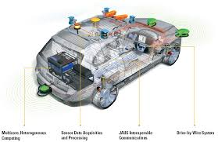

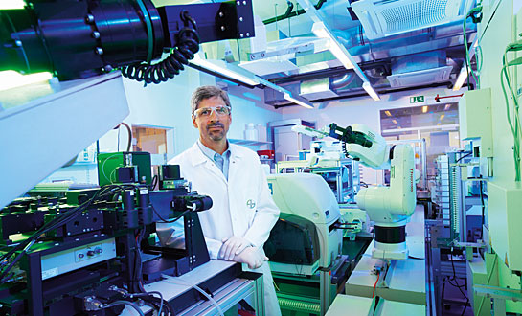


Get With the Program: Software-Driven Innovation in Traditional Manufacturing
Lee Branstetter, CMU, NBER, and Peterson Institute
Matej Drev, Georgia Institute of Technology
Namho Kwon, CMU
Version: 3.0 (May, 2016)
IOEA Workshop

Slide 37
Software is a critical driver of innovation in the modern world
“Software is having a huge impact on every traditional area, because all the functionalities you might have in electronics or mechanical (systems) are being shifted to software” (Dominic Tavassoli, director of IBM Rational, 2011)
“Of the five industries we deal with most -- automotive, industrial equipment, A&D, medical devices, electronics and high tech -- software is what’s bringing about new capabilities,” (Matt Klassen, PTC’s director of solutions marketing for the Integrity business line, 2012)
“We believe that every industrial company will become a software company.” (Jeff Immelt, CEO of General Electric)
Notes:
The starting point for this paper is the observation that SOFTWARE is an increasingly important driver of innovation throughout the economy.
Increasingly, producers throughout the economy are relying on software, rather than more conventional mechanical or chemical engineering, to differentiate their products, expand functionality for users, and raise the capability of their products.
The quotes on this slide speak to this increasingly salient reality.

Slide 38


Cars and planes used to look like this…
Automobiles
Aerospace
Notes:
And even regular consumers like me can see with our own eyes the rising software intensity of everyday products. Not just our phones, but the cars and airplanes we took to get here. Cars and planes used to look like this. This is the dashboard of a premium car in the early 90s and the cockpit of a 747 in the 80s.

Slide 39

And now they look like this!
Automobiles
Aerospace
Notes:
Now planes and cars look like this.
Cars today are equipped with up to 70-80 microprocessors, connected by 5-6 internal digital networks (Nelson, 2004), and the latest electric vehicles such as Chevrolet Volt rely upon more than 10 million lines of computer code. This is very different from even premium cars a generation ago.
Boeing 787 Dreamliner, relies on 8 million lines of code.
And emerging developments in the domains of aerial drones and self-driving cars promise that the near future of these industries will be even more software-driven than is the present. And just yesterday, in the WSJ, Toyota announced that it will invest one BILLION dollars to create an artificial intelligence firm in Silicon Valley…

Slide 40
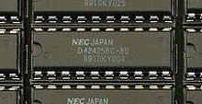

Prior research finds that innovation in IT is increasingly driven by software…
Arora, Branstetter, and Drev (2013)
Arora, A., Branstetter, L., and Drev, M., "Going Soft: How the Rise of Software-Based Innovation Led to the Decline of Japan's IT Industry and the Resurgence of Silicon Valley." Review of Economics and Statistics, vol. 95, no. 3, July 2013, pp. 757-775.
These authors document an increase in the software intensity of innovation in information industry
Innovation performance of Japanese IT firms is increasingly lagging behind that of their U.S. competitors
NEC’s 256K DRAM chip,
circa mid-1980s
The Apple iPod,
circa 2007
Notes:
A couple of years ago, Ashish Arora, Lee Branstetter, and I published a paper in the Review of Economics and Statistics in which we argued that innovation in the IT world has increasingly been driven by software rather than hardware. And we also argued that the revival of U.S. firms as the world’s technology leaders in this domain was driven by their competence in software. There is probably no better exemplar of that than Apple, which makes practically none of its own hardware, but has reshaped multiple industries through its software prowess. But the broader trend extends well beyond Apple and the IT sector and toward traditional manufacturing.

Slide 41
Is this also true in other manufacturing industries?
Hypothesis: Innovative success outside of IT is increasingly related to firms’ ability to utilize software in their R&D and new product development
We document the existence of a software-biased shift in the trajectory of innovation in four “traditional” manufacturing industries
We show that the relative innovative performance of our sample firms is systematically related to their software intensity
We provide suggestive evidence that the geographic distribution of software-related human resources influences the software-intensity of R&D
Notes:
In this paper, we empirically explore whether this trend extends beyond information technology . Do we see something similar happening in other kinds of manufacturing industries? And the answer is yes.
First, using patent data and patent citation data, we provide empirical evidence of a shift in the trajectory of technological change in what we might call “traditional” manufacturing. Successive generations of patents increasingly draw upon software, to an extent that is both statistically and economically significant.
If this shift is a real phenomenon and not just an artifact of patent citation data, then we should observe that the firms that are better able to tap into and exploit this software opportunity should be more productive in their innovation. Namho will show you evidence consistent with the view that firms that exploit software more intensively in their R&D operations generate more patents per R&D dollar and we will show you that equity markets place a higher valuation on their R&D investments.
If using software makes innovation more effective, why are not all firms using it in equal measure? We will present suggestive – but not definitive – evidence supporting the idea that software-based innovation requires specialized human resources whose geographic distribution across national labor markets is very skewed. This implies the cost of shifting toward a more software-based technological trajectory is much easier for firms based in certain economies, such as the United States.

Slide 42

Engineers and technology “experts” suggest a software-biased shift in invention
Medical Imaging
But the evidence to date is anecdotal, drawing upon a small, highly selected sample of firms and products.
We present more comprehensive statistical evidence
Autonomous vehicles
High-Tech Drug Discovery
Notes:
The first section of our paper summarizes a number of engineering studies and industry reports which support the notion of a software-biased shift in the nature of innovation and product development in our target industries.
But anyone who has read that section will note that most of these studies have a very anecdotal flavor – they draw upon a small and highly selected sample of firms and products to make their case.
To convince an audience of economists and management scholars that this shift is real and broad-based, we need far more comprehensive statistical evidence, and that is what Namho will discuss next.

Slide 43
Defining software innovation
Patent data
The United States Patent and Trademark Office (USPTO)
Identifying software patents
Bessen and Hunt (2007) identify software patents through the use of key words
Graham and Mowery (2003) identify a set of International Patent Classification (IPC) codes associated with software.
We take the union: 189,134 patents, 21,755 of which were assigned to firms in our sample
Notes:
If we are going to convince you that software is an increasingly important driver of invention in manufacturing sectors like autos and aerospace, then we first need to define software innovation within and outside of these sectors. Here’s how we do it.
First, we generated a set of patents, granted after January 1st 1985 and before December 31st 2005 whose abstracts used keywords associated with software-based technologies (e.g. “computer program” or “software”), as defined in Bessen and Hunt (2007).
Secondly, we identified all the patents that fell into a narrow set of software-related IPC categories as identified by Graham and Mowery (2003).
Then we took the union of these two sets of patents: 189,134 patents, 21,755 of which were assigned to the sample firms that appear in our four target industries.

Slide 44
Innovation (patent) production function
Pakes and Griliches (1984); Hausman, Hall and Griliches (1984)
Notes:
If we are right, and if this software-biased shift in the nature of invention shown by patent citation data is not just a statistical mirage, then we should find that firms that incorporate software technologies into their new product development more aggressively should also be more productive over time, in terms of their R&D.
To measure relative R&D productivity, we use the well-known patent production function introduced by Zvi Griliches back in the 80s. Since this approach is pretty familiar to the NBER productivity research community, I’m going to move very quickly here, in the interests of time.
Patents P are modeled as a function of R&D investment r, and a vector of industry and firm-specific attributes. We allow for industry-specific differences in technological opportunity and allow for software intensive firms to have a differential level of research productivity.
If we want to estimate an innovation production function with firm fixed effects, then we can no longer recover a time invariant measure of average differential software intensity productivity, but we can still estimate how this relative productivity changes over time – in other words, we can still estimate interaction terms of a software intensity dummy with subperiod dummies.
In the paper, we report results of a negative binomial version of the patent production function, with both fixed and random effects. We also weight patent output by numbers of claims and forward citations.
--------------------------------------------------------------------------------------------------

Slide 45
Innovation (patent) production function
Hausman, Hall and Griliches (1984)
Negative binomial distribution: (1) the number of patents is over-diversified and (2) many observations have zeros
Estimation function
Notes:
To measure relative research productivity, we rely on the well-known patent production function
Patents P are a function of R&D investment r, and a vector of industry and firm-specific attributes. We allow for industry-specific differences in technological opportunity and allow for software intensive firms to have a Japan-specific differential level of research productivity. Finally, we allow for an error term with firm effects that can be either random or fixed.
We can no longer recover a time invariant measure of average differential software intensity productivity, but we can still estimate how this relative productivity changes over time – in other words, we can still estimate interaction terms of a software intensity dummy with subperiod dummies.
Patents P are a function of R&D investment r, and a vector of industry and firm-specific attributes. We allow for industry-specific differences in technological opportunity (see 7) and allow for Japanese firms to have a Japan-specific differential level of research productivity (8). Finally, we allow for an error term with firm effects that can be either random or fixed.
We used negative binomial distribution:
large variance (much larger than the mean)
many zeros
--------------------------------------------------------------------------------------------------
By taking the gamma distribution of λit and integrating by parts, we obtain the following:
We allow the randomness of δi across firms for a random effect model. We condition the joint probability of the number of patent applications for each firm on the total number of patent applications for all the period.

Slide 46
PPF: Negative Binomial – SW intensity (Share of SW patents)
Notes:
The coefficients of Interaction terms are positive and getting bigger over time.
Table II
--------------------------------------------------------------------------------------------------

Slide 47
Software-intensive firms increasingly outperform
Software-intensive firms have a relative innovation performance advantage that strengthens over time
Notes:
Rather than go through all the relevant coefficients, let me summarize the key results with this figure, which shows the increase in the relative R&D productivity of SW patent-intensive firms over time.
The graph is based on the second column of Table II using a dependent variable as a number of patents.
The height of the bar is equivalent to the sum of the coefficient on the dummy variable measuring whether this particular firm is above the median in terms of software intensity and the coefficient on the interaction of this software intensity dummy with a time period dummy.
In the 1980s, there was no statistically significant productivity premium associated with software intensity. But this premium emerged in the 1990s and widened in the 2000s. And the effects are both statistically and economically significant.
-----------------------------------
Whiskers: 95% confidence levels
Standard errors are calculated using the covariance matrix of coefficients.
* SE(b_new): b_new=b1+b2
{(SE1)^2+(SE2)^2+2Cov(b1,b2)}^0.5

Slide 48
The “Tobin’s Q” approach to measurement of research productivity
Assume stock markets value firms as a bundle of tangible (A) and intangible (K) assets (Griliches, 1981; Hall and Oriani, 2006)
Specify a functional relationship between market value of the firm, tangible assets, and intangible assets
Notes:
For those who just cannot accept patents as a valid measure of inventive output, we offer a totally different empirical approach to measurement of R&D productivity, which is Tobin’s Q.
Ever since the early 1980s, productivity researchers have used Tobin’s Q to measure the stock market’s valuation of the knowledge capital of the firm.
Here, we use an approach pioneered by Griliches and Cockburn. And I think this approach should be quite familiar to many people in this room.
We control for the physical capital of a firm, and allow the market’s valuation of the knowledge stock to vary between software-intensive firms and others. We also track how this differential valuation evolves over time.
Those of us old enough to have lived through the dot-com bubble may regard the stock market as a less-than-perfect indicator of true innovative productivity, but the problems of a stock market approach are largely orthogonal to the problems of the patent production function approach.
If these two very different approaches reveal a similar picture, that is probably telling us something we can believe.
-----------------------
Tobin’s Q: ratio of the firm’s stock market value to the replacement value of its assets

Slide 49
Tobin’s Q function
Following Hall and Kim (2000): an additively separable linear specification and a multiplicative separable specification of the Cobb-Douglas form
Where V_it, A_it and K_it represent the market value, tangible assets and R&D stock of firm i at time t, respectively. Converting the equation by taking natural logarithms:
By assuming constant returns to scale (σ_t=1), γ_t measures the shadow value of R&D stock relative to the tangible assets of the firm.
Notes:
We used negative binomial distribution:
large variance (much larger than the mean)
many zeros
By taking the gamma distribution of λit and integrating by parts, we obtain the following:
We apply the model using both a random effect and a fixed effect.
--------------------------------------------------------------------------------------------------
We allow the randomness of δi across firms for a random effect model. We condition the joint probability of the number of patent applications for each firm on the total number of patent applications for all the period.

Slide 50
Tobin’s Q: Nonlinear least square – SW intensity (Share of SW patents)
lnQ | Full Sample | 1981-1988 | 1989-1996 | 1997-2005
 | NLS | NLS | NLS | NLS
RD/Assets | -0.0938* | -0.0257 | -0.134* | 0.0969
 | (0.0562) | (0.187) | (0.0789) | (0.0768)
RD/Assets * | 0.822*** | 0.152 | 0.392** | 1.777***
Software Intensity | (0.142) | (0.298) | (0.163) | (0.317)
Software Intensity | -0.259*** | -0.606*** | -0.162*** | -0.256***
 | (0.0435) | (0.0801) | (0.0572) | (0.0667)
Industry Dummies | Yes | Yes | Yes | Yes
Year Dummies | Yes | Yes | Yes | Yes
Number of Obs | 2363 | 371 | 732 | 1260
Adj R-Squared | 0.417 | 0.488 | 0.420 | 0.507
Notes:
Depreciation rate: 15%
--------------------------------------------------------------------------------------------------

Slide 51
Software intensive firms have relatively higher shadow values of R&D stock
Average difference in shadow value of R&D stock
Consistent with our previous result (from the patent production function)
In the 1980s: No significant performance differential for software-intensive firms
In the 1990s and 2000s: A positive differential that expands significantly over time
Notes:
In the paper, we report the results of our Tobin’s Q regression in Table III. In the interests of time, I will use this figure to summarize the main results. And, fortunately for us, it is indeed a picture very similar to the one sketched out by our patent production function specification. Here, the height of the bars corresponds the interaction term that measures the premium on R&D assets of software-intensive firms.
During the first period, there is no statistically significant effect. In the 1990s, a positive, statistically significant, but economically very modest effect emerges, and it strengthens very substantially in the most recent subperiod. The timing is quite similar to that indicated by our patent production function. And these results are robust to alternative measures of software intensity.
This graph is based on a nonlinear least squares estimation.
In table IV, we report the results of a linearized version with firm fixed effects, and get qualitatively similar results.
The data appear to be showing a strong relationship between software intensity and the relative productivity of firm R&D.
----------------------------
Whisker: 95% CI (coefficient-1.96SE, coefficient+1.96SE)
Whiskers: 95% confidence levels
Standard errors are calculated using the covariance matrix of coefficients.
* SE(b_new): b_new=b1+b2
{(SE1)^2+(SE2)^2+2Cov(b1,b2)}^0.5

Slide 52
Why isn’t everyone using software more intensely?
This question is the focus of ongoing research
We believe the underlying mechanism here is similar to that of Arora, Branstetter, and Drev (2013)
The key idea: a global shortage of skilled software engineers, with the U.S. having the biggest endowment
U.S. firms are disproportionately the most software-intensive firms in all industries
Alternative hypothesis: the failure of (disproportionately non-U.S.) firms to adopt a more software-centric approach to innovation stems from managerial failure rather than a resource constraint
Notes:
But if this effect is real, then what accounts for the fact that some firms fail to take advantage of software-intensive approach to R&D?
That’s a great question, and, at this point in our research, we do not have a complete answer.
BUT, we believe that the underlying mechanism is quite similar to the one sketched out in the REStat paper by Arora, Branstetter, and Drev.
We start with the observation that U.S. firms are disproportionately the most software-intensive firms in all industries.
Next, we posit that software-intensive research requires significant numbers of highly trained software engineers, and there has been a global shortage of skilled software engineers.
But the U.S. has had the the biggest endowment of these engineers, by far, of any major economy. This links variation in software intensity to human resource constraints in national labor markets.
An Alternative explanation for lower levels of measured software intensity, especially among non-US firms, is the failure of these firms’ managers to make appropriate investments in software-related research capabilities. It is a story of disproportionately non-US firms’ managerial failure rather than a resource constraint.
In the next few minutes, we’ll put forward an admittedly incomplete test that tries to discriminate between these two hypotheses.
First, I want to convey just how big the human resource gap is between the US and the other economies that host significant numbers of our sample firms…

Slide 53
Example 2
“Innovation and Productivity”

Slide 54
From Innovation to Productivity Improvements
At the aggregate level, long-run productivity improvements should be highly dependent on the pace of technological innovation (Solow, 1956; Romer, 1986, 1994)
In the short- and medium-run, other factors strongly influence this relationship (business cycles, policy shocks, demographic trends, etc)
At the firm level, the relationship between innovation and productivity is complex for a multitude of reasons (price trends, competitive dynamics, policy shocks, multi-product nature of firms, etc)
But empirical research generally shows a substantial causal effect of innovation on productivity growth (Hall, 2011)
Increasing trend of using productivity measures as indicators of innovation / technological progress at the level of the firm.
Notes:
Benefits: measuring realized innovation gains (potentially). No need to rely on proxies such as patent applications.
Disadvantages: aggregate indicator (other factors), data and analytically intensive.

Slide 55
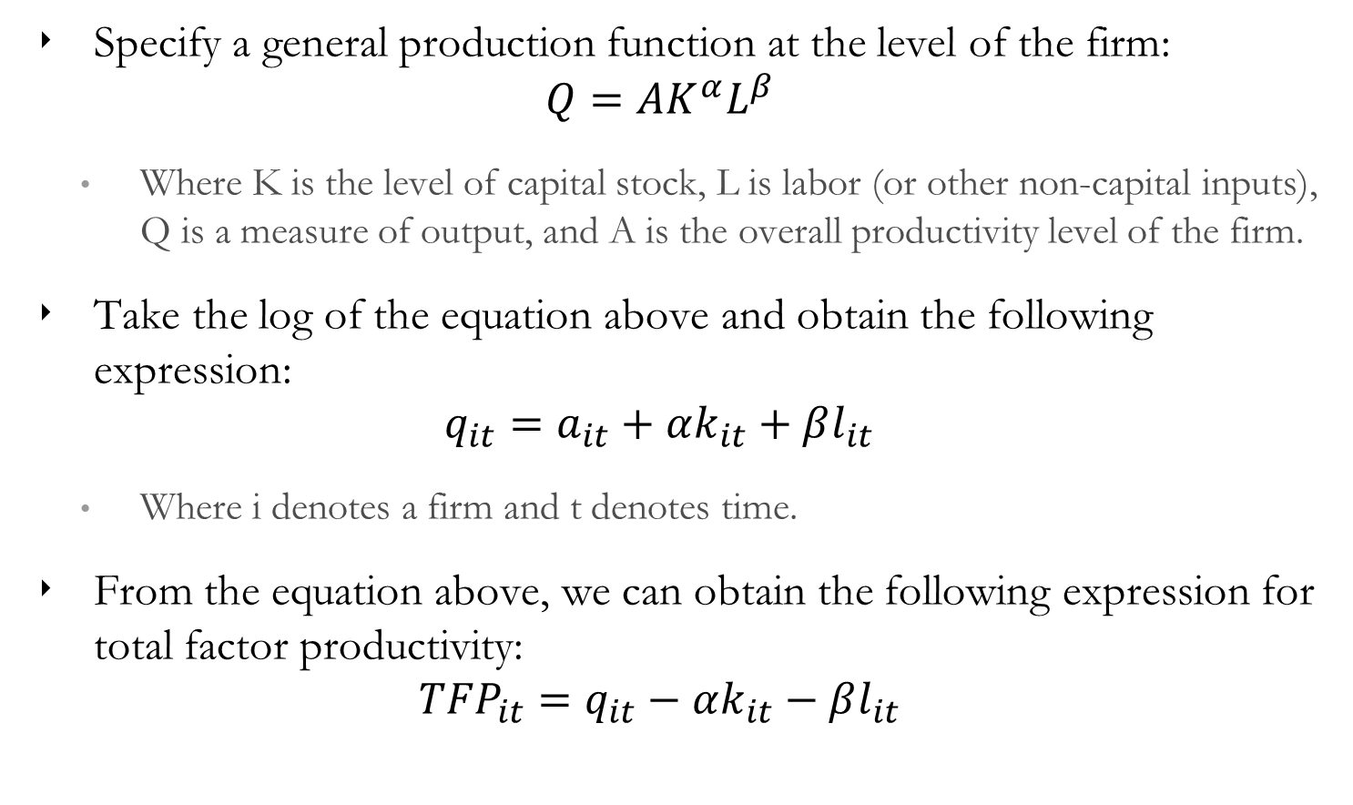
Measuring Productivity at the Firm Level (1)
Specify a general production function at the level of the firm:
$$Q=AK^{α}L^{β}$$
Where K is the level of capital stock, L is labor (or other non-capital inputs), Q is a measure of output, and A is the overall productivity level of the firm.
Take the log of the equation above and obtain the following expression:
$$q_{it}=a_{it}+αk_{it}+βl_{it}$$
Where i denotes a firm and t denotes time.
From the equation above, we can obtain the following expression for total factor productivity:
$${TFP}_{it}=q_{it}−αk_{it}−βl_{it}$$
Notes:
Benefits: measuring realized innovation gains (potentially). No need to rely on proxies such as patent applications.
Disadvantages: aggregate indicator (other factors), data and analytically intensive.

Slide 56
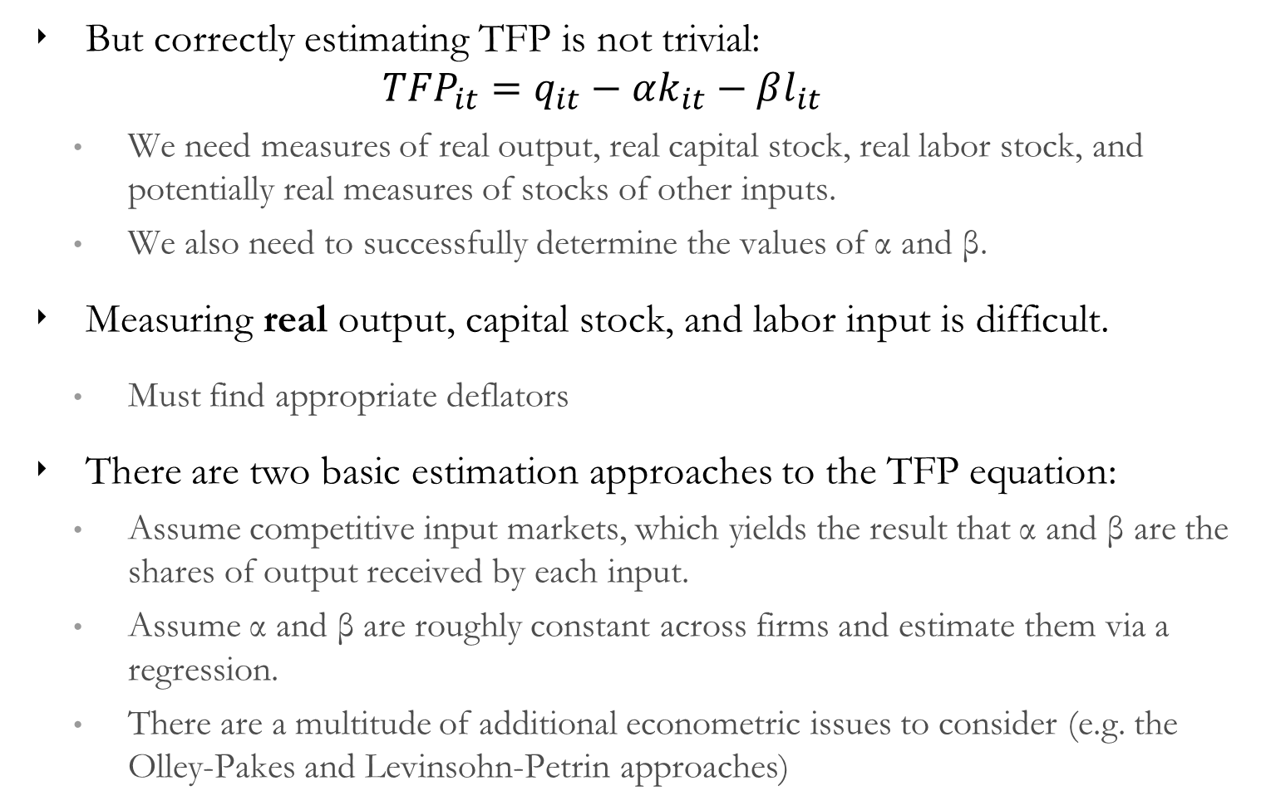
Measuring Productivity at the Firm Level (2)
But correctly estimating TFP is not trivial:
$${TFP}_{it}=q_{it}−αk_{it}−βl_{it}$$
We need measures of real output, real capital stock, real labor stock, and potentially real measures of stocks of other inputs.
We also need to successfully determine the values of α and β.
Measuring real output, capital stock, and labor input is difficult.
Must find appropriate deflators
There are two basic estimation approaches to the TFP equation:
Assume competitive input markets, which yields the result that α and β are the shares of output received by each input.
Assume α and β are roughly constant across firms and estimate them via a regression.
There are a multitude of additional econometric issues to consider (e.g. the Olley-Pakes and Levinsohn-Petrin approaches)
Notes:
Olley-Pakes: Issues related to endogeneity of inputs and selection. Dynamic issues.
Levinsohn-Petrin: Using inputs to control for unobservables.

Slide 57
Quick Example – Brynjolfsson and Hitt (2003)
Brynjolfsson and Hitt (2003): “Computing Productivity: Firm-Level Evidence,” The Review of Economics and Statistics, 85(4), 793-808.
Empirical exploration of the effect of computerization on firm productivity using a sample of large U.S. manufacturing firms over 1987-1994.
Did the surge of computer innovation in the 1970s-1990s boost U.S. firms’ productivity? If so, was the effect economically significant?
An attempt to solve the “Productivity Paradox”, illustrated by Solow’s 1987 statement that “we see computers everywhere but in the productivity statistics”.
Notes:
Olley-Pakes: Issues related to endogeneity of inputs and selection. Dynamic issues.
Levinsohn-Petrin: Using inputs to control for unobservables.

Slide 58
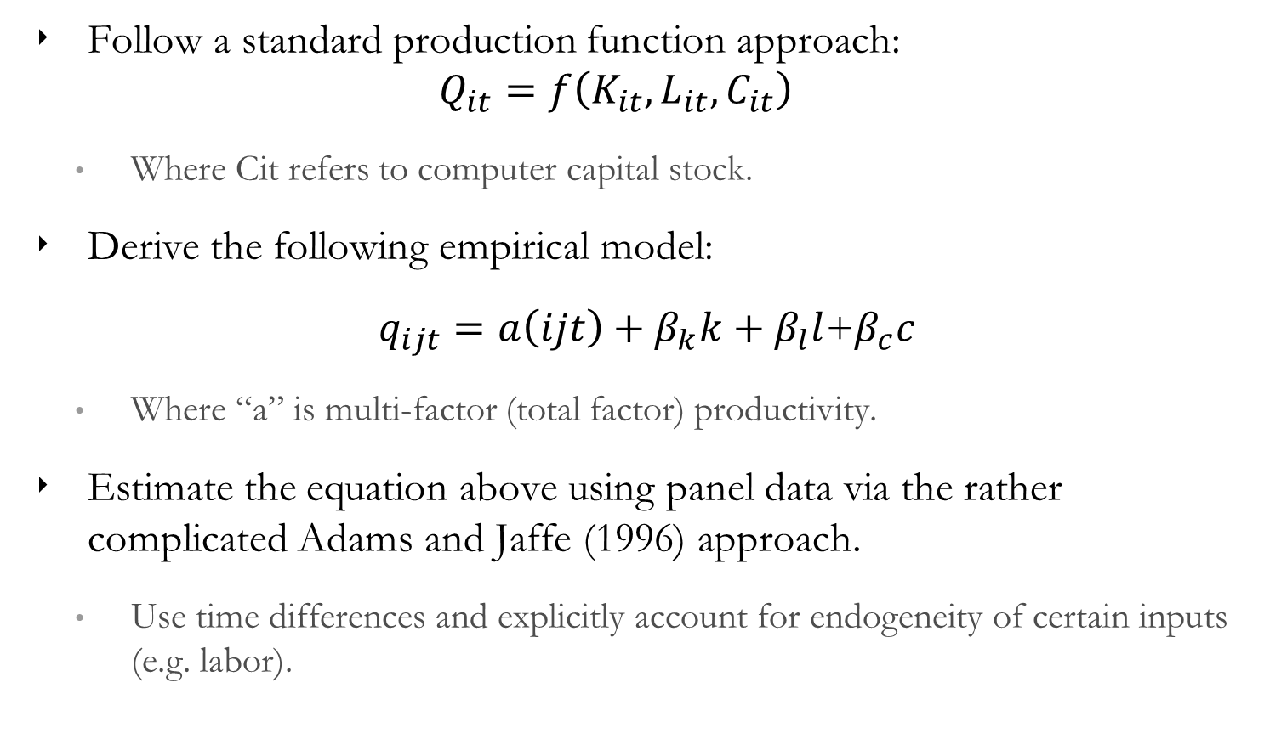
Empirical Approach
Follow a standard production function approach:
$$Q_{it}=f\left(K_{it},L_{it},C_{it}\right)$$
Where Cit refers to computer capital stock.
Derive the following empirical model:
$q_{ijt}=a\left(ijt\right)+β_{k}k+β_{l}l$+$β_{c}c$
Where “a” is multi-factor (total factor) productivity.
Estimate the equation above using panel data via the rather complicated Adams and Jaffe (1996) approach.
Use time differences and explicitly account for endogeneity of certain inputs (e.g. labor).

Slide 59
Data and Variables
Financial information from Compustat, including data on sales, labor expense, capital stock, and industry information.
Computer stock information from Computer Intelligence InfoCorp’s survey of computer equipment at various sites of 1,000 largest firms in the U.S.
Deflators and rental prices for the capital factors from BLS and various other sources.
Final sample contains an unbalanced panel of 527 firms over an 8-year time period.

Slide 60
Results (1)
TFP growth and computer stock growth are highly correlated.

Slide 61
Conclusion
Variety of ways to measure innovation output and performance of firms
Data availability is expanding exponentially, and so are the opportunities for empirical research in this area
Successful application of described approaches is critically dependent on a detailed understanding of the data generating process and its relationship with the research question

Slide 62
Appendix

Slide 63
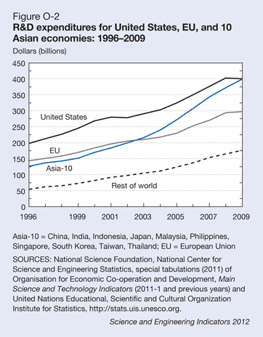
R&D spending
Private rate of return to R&D: 15-40%
Notes:
The industrialized countries alone have been investing nearly a TRILLION US dollars per year in recent years. If we presume that the private rate of return to R&D lies in the 15-40% range, then the ASSETS created by this investment are ON THE ORDER of US GDP.

Slide 64
Knowledge capital vs. tangible assets: AMR
SABRE - American Airlines’ reservation and information system provided to travel professionals.
In 1960’s and 1970’s American invested $40 million to develop SABRE
In 1996, AMR sold 18% of its SABRE subsidiary, implying a value of SABRE of $3.3 billion.
Prior day: AMR had a total market value of about $6.5 billion.
→ A reservation system constituted half of AMR’s value, a world’s top 3 airline, with 600 planes, valuable landing rights and other assets.
Notes:
Now if that is too abstract and macro for your tastes, let’s consider a discrete example of a particular firm
[read]
IK is a big deal…

Slide 65
Copyright
Protects works of authorship—specifically fixed expressions of “original” idea; not idea itself (important issue for copyrighting computer software)
Books, DVDs, etc.
Provides rights to reproduce, distribute, adapt, perform or display publicly for life of author PLUS 70 years (in US)
28 years under 1909 Act; 50 years under 1976 Act; revised in 1998 to life of the author plus 70 years (recently challenged), or, in the case of works for hire, 95 years from publication or, if less, 120 years from date of creation.
Excessive?
Registration encouraged but not mandatory
Notes:
Now, copyrights are quite different from patents [read first bullet]
So, copyrights provide a degree of protection that is much narrower in scope than patents. But the length of patent protection is much longer. Patents expire 20 years after application. But consider how long US law protects copyrights [read]
Excessive….

Slide 66
Trade Secrets
Protection can be provided without any government endorsement.
To qualify under state and federal (1996) trade secrecy law:
The information must have commercial value.
It must have been actively treated as a secret by its owner, which requires some explicit form of recognition in form of nondisclosure agreements (NDA’s), memos, noncompete agreements, etc.
Advantages over patents:
Standards are lower; need not be novel or independently invented; time is indefinite, cheaper (unless it goes to court)
Disadvantages:
Inventions are only protected against misappropriation (firms independently may obtain the information)
Can mix’n’match: Patent some and keep other stuff secret.
Notes:
Then there’s secrecy…. [read 1st bullet]
Companies can, of course, try to keep secret whatever they want. But there are laws that protect trade secrets. [read 2nd, 3rd, 4th bullets]
Outside of the industries where patents have always been very effective, it seems pretty common for firms to rely on a mix of appropriation strategies – some things are patented, some things are kept secret, some ideas are appropriated through lead time or complementary assets.

Slide 67
The U.S. graduates more IT engineers than any other major economy…
Notes:
This figure show crude measures of new graduates in the IT related disciplines. Far more of these graduate in the US than from any other major economy.

Slide 68
America’s advantage is amplified by large numbers of skilled immigrants…
Notes:
And when we add newly admitted immigrant IT engineers to our flows of new graduates, the measured American human resource advantage is magnified.

Slide 69
And is further expanded by estimates of software offshoring…
Notes:
Of course, not all software engineering is done in the United States.
Using Indian data on the destination of Indian software exports, we can make a crude adjustment to the software human resource stocks of various countries to account for how much they offshore to India.
That makes the US advantage even larger….
The U.S. has got the programmers and the software architects.

Slide 70
Estimates of the “stocks” implied by these worker inflows suggest a commanding U.S. advantage…
Notes:
And when we try to estimate the “stock” of software-related human capital available to firms based in these various economies, accounting for attrition, employment in other industries, repatriation, etc., any plausible set of assumptions still implies a commanding advantage for U.S.-based entities and U.S.-based software-centric research activity. We’ve got the programmers and the software architects.

Slide 71
An interesting comparison
Notes:
If you are multinational, you can do R&D outside your home market. And many larger firms based in the US, Japan, and Europe do just that. That allows us to conduct a limited test of the resource-constraint hypothesis versus the managerial failure hypothesis.
If foreign firms’ managers just fail to adopt more software-centric approach, then we would expect these firms to pursue a non-software-intensive style of research at home, but also abroad.
On the other hand, if foreign firms are constrained by the resource limits of their home labor market, then we expect them to conduct more software-intensive research in foreign markets where software-related human resources are more abundant.
Each color represents the location of headquarter of a firm. And X-axle represents the location of invention, which means the address of inventors.
And here is what we find: US firms (the grey color) conduct significantly less software-intensive R&D abroad than they do at home. But for Japanese and European firms, it’s just the opposite. They do more software-intensive R&D in the US than they do at home. In addition, European firms not only do more software-intensive R&D in the US than they do at home – they actually do more software-intensive R&D in the US that US firms do.
This simple statistical comparison is not dispositive, but it clearly points in the direction of the resource-constraint hypothesis as having salience.
-------------------------------------------
Back-up:
We can determine the “nationality” of a patent by noting the home market of the assignee, the company that owns the patent. We can determine where the research producing the patent was actually undertaken by looking at the geographic address of the inventors. We can thus create a set of patents for our US-based firms that were invented at home and compare them to patents invented by the same firms in the EU and Japan. We can do the same thing for the domestically-generated and foreign-generated patents of our US and European firms.

Slide 72
Conclusions
Innovation is becoming more software-intensive in manufacturing industries far beyond the traditional boundaries of IT
More software-intensive firms appear to be more productive in their innovative activities
The variation of measured software intensity across firms appears to be linked to the abundance of specialized human capital in home labor markets
These findings may have implications for public policies related to the patentability of software and the mobility of high-skilled labor across countries
Notes:
Time is short, so let us briefly conclude.
JUST READ THESE FINDINGS

