Slide 1
Lies, Credibility and Deception A Game Theoretical Approach
IOEA, Cargese 2016
David Ettinger
University Paris-Dauphine PSL

Slide 2
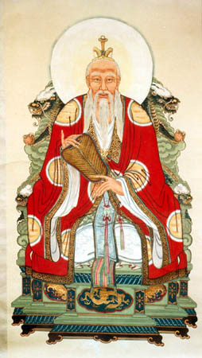
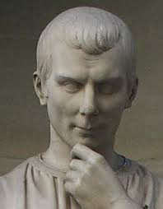
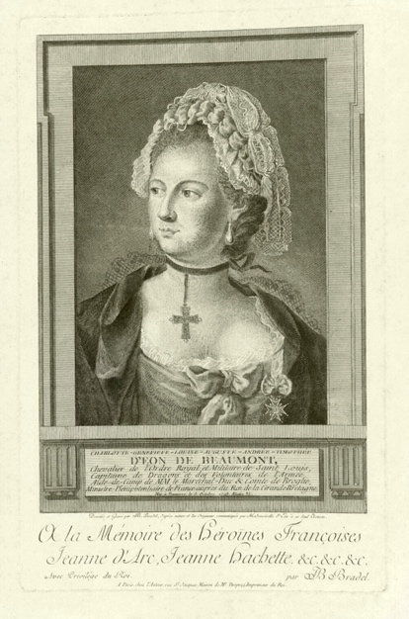
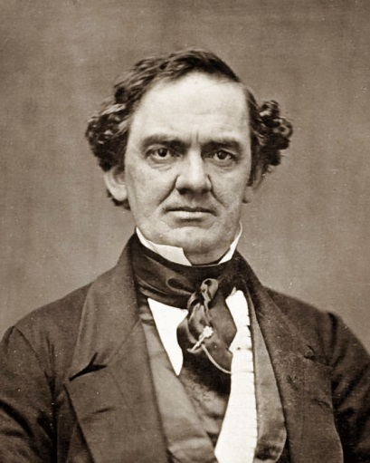
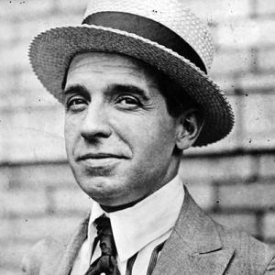
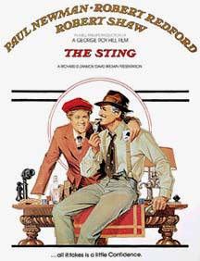
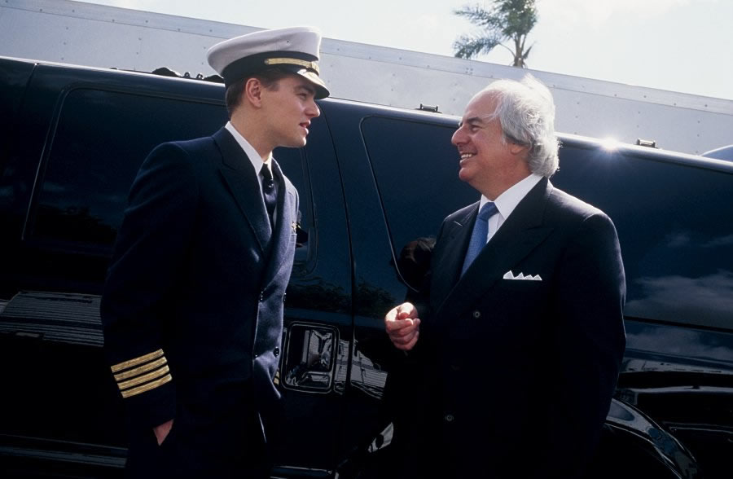

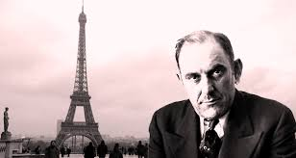
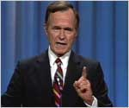

Slide 3
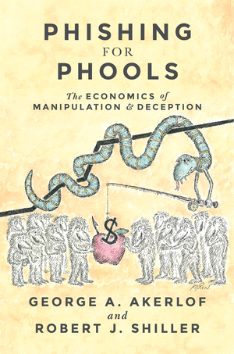

For most of the talk:
Back to unethical,selfish … economic agents.

Slide 4
Two interpretations
Deception: A way to exploit people’s weaknesses or flaws in the system.
Deception: ”A deliberate attempt to create in another a belief that the communicator considers to be untrue in order to increase the communicator’s payoff at the expense of the other side”. (adapted from Vrij (2001)

Slide 5
The first approach
Many consumers are behaviourally biased or boundedly rational (Not only a transitory phenomenon).
Assuming that firms are rational, we may consider how they exploit these weaknesses on the consumer side, how it affects the market and the possible remedies.

Slide 6
The framework: BIO
A second generation of literature after the identification of many consumer biases beginning in the 80’s (Kahneman, Tversky, Thaler …).
A growing literature that focuses on equilibrium behaviors and firms’ exploitations of these biases.

Slide 7
The main behavioural biases considered
Willingnes to pay: misperception of the preferences and desired quantities.
DellaVigna and Malmendier (2004, 2006)
Grubb ((2009))
Search issues: Inertia or misjudgement of prices and offers.
Piccione and Spiegler (2009)
Kalayci and Potters (2010)
Misjudgement of product attributes and quality.
- Spiegler (2006)

Slide 8
Two illustrations
“Shrouded attributes, consumer myopia and information suppression in Competitive markets”, Gabaix and Laibson (2006)
“The market for Quacks”, Spiegler (2006)

Slide 9
Shrouded attributes - Motivation
Some consumers are unaware that they will demand a certain product (they may even ignore the existence of this product).
Not an issue for standard goods but more so for complements to a base goods.
Applications: room service, printer cartridge …

Slide 10
Overview of the model
Firms sell base goods (the price is advertised) and add-ons. They decide whether they advertise or not the existence and price of the add-ons.
Two types of consumers. Sophisticated consumers perfectly anticipate their demands for add-ons and the price, naive consumers are initially unaware of the add-on if advertised.
Sophisticated consumers can exert effort to avoid the add-on. Biased consumers consume the add-on once they have purchased the basic good.

Slide 11
Results (i)
If there are sufficiently many naive consumers, firms will not advertise the add-on (even if there is no cost).
They will offer low prices for the basic good and charge inflated prices for the add-on. They will systematically exploit the unawareness of the naive consumers.
The result is robust to the existence of an intense competition.

Slide 12
Results (ii)
Biased consumers cross-subsidise sophisticated consumers.
Nudge suggestion: A full communication on the price of all the elements should be mandatory in order to avoid the exploitation of biased consumers.
Even with mandatory communication, if biased consumers cannot take into account all the elements of the price matrix, the problem remains (Grubb and Osborne (2015) ).

Slide 13
Market for quacks - Motivation
The quality of a product is inherently uncertain.
Consumers face an additional complexity when forming beliefs about the likely quality of a product.
It is realistic that consumers base their expectations in such cases on small samples of observations or anecdotal reasoning (someone has been cured …).

Slide 14
Overview of the model
Each consumer has exactly one observation for each product in the market and assumes that this observation is a perfect estimator for the true quality.
For each product each consumer believes that it is either of high quality for sure or of poor quality for sure.
Firms choose their prices (assuming exogenous quality).

Slide 15
Results (i)
If consumers understood the true technology, this would be a Bertrand market.
But the consumer’s decision rule is not buy the cheapest product but buy the cheapest product perceived as high type.
Firms charge prices above marginal costs and randomize in an interval of prices.

Slide 16
Results (ii)
Too much competition can harm consumers.
With more firms, it becomes more likely that a consumer hears at least one positive anecdote. More consumers will participate in the market and buy an overpriced product.
It is quite different from models where consumers do not understand the price. A disappointed consumer would rather say 'The product I bought was not as good as I hoped it would be'.

Slide 17
General observations on the field (i)
A growing, consistent and active literature
Formalizes many earlier observations.
As in the standard IO literature, there is no general clear-cut results which can be applied to any specific situation.
Allows to understand the interests and the limits of proposed remedies (Nudge, standardisation, reputation, learning …) with an equilibrium approach.

Slide 18
General observations on the field (ii)
Fostering entry of more firms may not always improve outcomes for consumers.
Competition may not help when there are at least some consumers who do not search properly or have difficulties judging quality and prices.
Firms may not compete by offering better deals but focus on exploiting biased consumers.
This can be made worse through firms' deliberate attempts to make price comparisons and search harder and obscure product quality.

Slide 19
General observations (iii)
Markets cannot always be expected to self correct. Firms may sometimes have little incentive to educate consumers.
Complementary policies such as learning, provision of information and standardization of information and frames can help.

Slide 20
Second interpretation
Deception: A deliberate attempt to create in another a belief that the communicator considers to be untrue in order to increase the communicator’s payoff at the expense of the other side.
(Lies and credibility …)

Slide 21
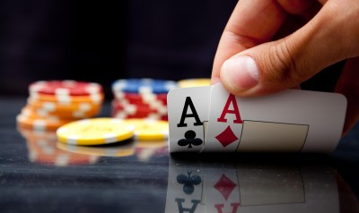
A first game theoretical approach

Slide 22
A basic version of the poker game
Players 1 and 2 put 1€ in the pot.
Player 1 picks a card, equally likely to be High or Low (private info.)
Player 1 can either end the game and pay 1€ to player 2 or add another 2€ in the pot.
Then player 2 can either end the game and give 1€ to player 1 or add another 2€.
If both players put the extra 2€, they observe the card, If H, Player 1 gets 3€, if L, player 2 gets 3€.

Slide 23
Nash equilibrium (anachronical)
When the card is H, Player 1 always pays the extra 2€ and he does it with probability ½ when the card is L.
Player 2 pays the extra 2€ with probability ½.
The value of the game is ½ (zero-sum game), the value of information.

Slide 24
Comments
At the equilibrium, poker players do bluff.
Bluffing is not interesting per se. It does not give a higher payoff when the card is low.
Bluffing increases the expected payoff when the card is high.

Slide 25
Comments
At the equilibrium, poker players do bluff.
Bluffing is not interesting per se. It does not give a higher payoff when the card is low.
Bluffing increases the expected payoff when the card is high.
Deception? (Mixed equilibrium: unpredictability)
Is player 1 credible, to which extent can we say that player 1 imposes a false belief?

Slide 26
A second approach: Reputation and Strategic Information Transmission
Both emerge at the beginning of the Eighties: Kreps and Wilson (1982) and Crawford and Sobel (1982) (emergence of the Sequential Equilibrium concept).
Both provide an answer to existing question in the literature.

Slide 27
Reputation
The origin: An answer to the Selten’s Chain Store Paradox.
If you play a stage game sufficiently many time and there is a probability (even a small one) that you are a crazy type , you can pretend to be crazy and obtain the payment of the crazy type for many periods. (commitment value)
Generalization of the results.

Slide 28
Strategic Information Transmission
Crawford and Sobel (1982), Sender-Receiver game Cheap Talk (Thank you Daniel ):
The sender is informed of the state of the world, S∈[0,1]. The receiver is not.
The receiver has to make a decision, D which has an effect for both players’ utilities but the sender is biased.
Ur = -(D-S)² and Us = -(D-(S+b))²
The sender sends a free message M∈[0,1] about the state of the world the receiver chooses D.

Slide 29
Results
Many equilibria. In the most favorable one for both players, the interval [0,1] is partitioned in intervals and the sender indicates to which element of the partition S belongs.
The bias being known, the Sender cannot fool the Receiver but information precision is lost.
➔ Limited possibilities to represent Lies and Deception with rational agents.

Slide 30
New approaches with non rational agents
Level k approach (seminal paper: Crawford (2003))
Equilibrium approach with boundedly rational agents (Mullainathan et al (2008) or Ettinger and Jehiel (2010)).

Slide 31
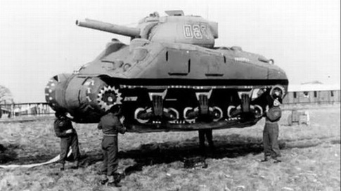
Level k approach
Operation Fortitude

Slide 32
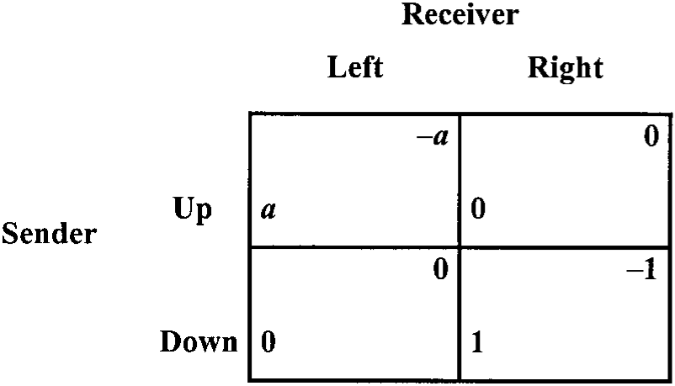
The game
Perturbated matching pennies + Prior to play the game, the sender sends (without any cost) a message: u or d. (a>1)

Slide 33
Nash equilibrium (rational agents)
The message sent is uninformative.
The sender chooses Up with probability 1/(1+a) and the receiver chooses Left with probability 1/(1+a).
Back to the insight of the Poker game.

Slide 34
Level k approach
Players differ by their sophistication levels.
Level 0: You are not sophisticated.
Level 1: You think your opponent is Level 0 and you play a best response to his perceived strategy.
Level 2: You think your opponent is Level 1 and you play a best response …
…
+ Standard rational players.

Slide 35
Level k players
Level 0 senders tell d and attack U (liars)
Level 1 senders tell d and attack U (wily)
Level 2 senders tell d and attack U (liars) ....
Level 0 receivers believe the message (believers)
Level 1 receivers believe the message (believers)
Level 2 receivers invert the message (inverters) ...

Slide 36
Analysis
If players are rational with a high probability, there is a unique mixed equilibrium in which the presence of level k players is completely offset (back to standard).
If it is not the case …

Slide 37
Rational players
If the proportion of level k players is high enough, there exists an equilibrium in which:
Rational senders send message u and choose D.
Rational receivers chooses R.
This is exactly what we observe during Operation Fortitude. Besides, the opposite is not an equilibrium.
Can we say that rational receivers are fooled?

Slide 38
Equilibrium approaches
Mullainathan et al (2008) : Agents extrapolate. They consider that messages which are informative in specific environments are also informative in different environments. Specific Context: Persusasion, Publicity.
Ettinger and Jehiel (2010): A more general theory of deception based on a well known psychological bias: the Fundamental Attribution Error, represented through analogy classes.

Slide 39
Basic idea : Beliefs are based on cues (FAE). This induces erroneous updatings. Deception builds on the exploitation of such wrong inferences (see: Grimms, con artist strategies)
Equilibrium concept: Analogy-Based Sequential Equilibrium. Agents partition decision nodes of their opponent in analogy classes.
They perceive that these opponents behave the same in all the decision nodes of the analogy class.
They update their belief on the type of their opponent.

Slide 40
A simple monitoring game
Employer / Employee relationship.
Employee first chooses between Shirk or Work.
Then, employer decides to Control or Delegate.
Then the employee makes two S/W decisions.
→ Employee prefers S unless he is Controlled.
Standard Approach: Employee Shirks first (this is sunk); Employer chooses C (costly); then Employee Works twice.

Slide 41
1
W
S
2
2
D
C
D
C
1
1
1
1
W
S
W
S
W
S
W
S
1
1
1
1
1
1
1
1
W
S
W
S
W
S
W
S
W
S
W
S
W
S
W
S
(1,4)
(2,3)
(2,3)
(4,1)
(2,3)
(1,3)
(1,3)
(0,3)
(2,3)
(3,2)
(3,2)
(5,0)
(3,2)
(2,2)
(2,2)
(1,2)
The monitoring game

Slide 42
Changing the cognitive environment
→ Two types of Employees:
Rational
Coarse: Knows only the average monitoring strategy (whether C or D) of the employer.
→ Employer is Sophisticated Coarse: Knows only type by type the frequency with which the employee Shirks.

Slide 43
Equilibrium
Initially, employee Shirks when Coarse and Works when Rational.
The employer Controls when Shirking is observed and Delegates when Work is observed.
Last two periods, the employee Works if he is Controlled and Shirks if not (D).

Slide 44
Why does the employer choose to Delegate af- ter observing W initially?
Employer’s view is that: - Coarse: Works 2/3 of the time
- Rational: Works 1/3 of the time
After seeing the employee working, the employer believes there is a large chance she faces a Coarse employee, working type. Delegating is then optimal with his belief.

Slide 45
Observations
1. The rational employee conveys the belief that he is of the working type by choosing an action that the working type does not even make (”too good to be true” or ”too nice to be honest”).
2. The cognitive type of the employer makes her reason as if she faced a screening problem whereas she faces a moral hazard problem.

Slide 46
The deception process
Behave excessively nicely.
Sophisticated but not too sophisticated agents will revise their beliefs about your type (FAE).
Exploit this confidence.
Con artists need naive (but not too naive) agents on both sides.

Slide 47
Applications
Grimm
Vincent, the waiter
Real estate agent
Bargaining
Con artist, The Sting
Spying network, The Funkspiel
…

Slide 48
Experimental Observations
In Communication games à la Crawford Sobel, senders send messages more informative than what the equilibrium describes.
The role of consequences.
With zero-sum games, we observe deception and the main differences may be explained by the distribution of cognitive abilities.

Slide 49
Summary
Unpredictability is a key element in game theory, deception is a more recent concern.
In order to represent deception, you need naive agents (but not too naive).
Conceptual developments: Other cues than FAE may explain deception.
A rich tool for analyzing many economic interactions.
How do we educate people? Should we?

Slide 50
Thank you

