Slide 1
Politics and Banking
Koen Schoors

Slide 2
Political strategies of firms
See Rick’s great lecture on Monday
My focus is a specific subset of this
Direct political connections
There is some work on the corporate sector
But I am interested in banking
Very little work on this

Slide 3
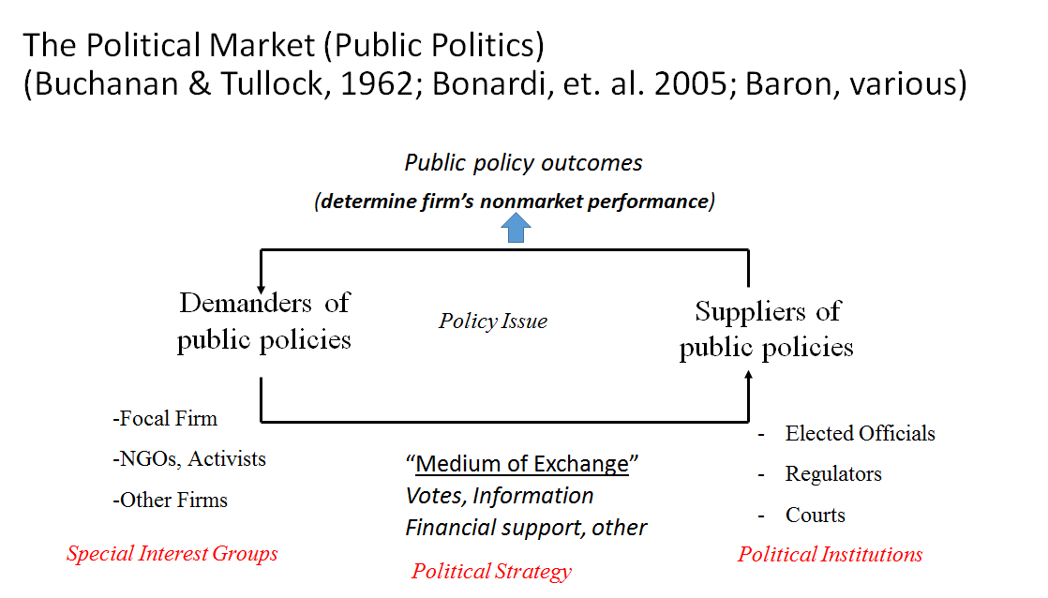
Financial institutions
Direct political connection
(Elected) officials

Slide 4
Value of political connections for firms I
Measured by stock price / event study
Fisman (AER 2001):stock prices of firms connected to the Suharto regime are negatively affected by rumours about Suharto's health.
Faccio (AER 2006) has large cross-country sample of listed firms and finds a positive value effect from the entry of a shareholder or director into politics

Slide 5
Value of political connections for firms II
firms with political ties enjoy preferential treatments
soft budget constraints (Claessens et al. JFE 2008 for Brazil; Khwaja and Mian QJE 2005 for Pakistan),
access to government contracts (Agrawal and Knoeber, JLE 2001, Cingano and Pinotti, JEEA 2013),
favourable IPO conditions in China (Francis et al. JIMF 2009)
Relaxed regulatory oversight (Stigler BJ 1971; De Soto 1990)
Bailout options (Faccio, Masulis, Mc Connell JOF 2006)
Access to bank finance (Hongbin Li, Lingsheng Meng, Qian Wang, Li-An Zhou, JDE, 2008)

Slide 6
Banks too have good reasons for political strategies
Banks have very extensive government-imposed constraints
More than any sector in the economy
Capital rules,
liquidity rules
leverage rules
Limitations of all sorts on their activities, behaviour, pricing and allocation decisions to protect customers
Essentially because in the banking system
Information is very asymmetric
has important externalities: it is “systemically important”

Slide 7
incentives for corporate political strategy at level of banking sector
Government capture by private interest
Especially in industries that are concentrated, regulated (Masters and Keim JP 1985; Schuler et al. AMJ 2002)
and/or oligopolistic (Salamon and Seigfried APSR 1977)
Examples:
lobbying, campaign contributions, etc. by banking sector
Remember how Glass-Steagall Act was repealed in US in 1998 and replaced by Financial Modernisation Act
Remember the structure of bail-outs after 2008 crisis, generally subsidizing bank shareholders (before BRRD)

Slide 8

Is there something like this?

Slide 9
This is not a new insight application to deposit Insurance
Laeven (2004) and Demirgüç-Kunt et al. (JFI 2008)
generous deposit insurance schemes are mainly adopted by countries with poorly capitalized banks as a result of extensive lobbying efforts.
Increased DI In US and Europe after crisis ☺
Increased DI in Russia in crises of 2004 and 2008 ☺
Moral hazard implications and rent appropriation
The benefit is for the bank in reduced depositor discipline
in the short run society gains bank stability
The cost is increased banking sector instability in the longer run because banks take on more risk (Demirgüç-Kunt & Detragiache, JME 2002)

Slide 10
Also incentives for corporate political strategy at level of the individual bank
Revolving doors between banks & government/regulator
Revolving doors between politicians & banks: Hank Paulson, Draghi at ECB from Goldman Sachs, Timothy Geithner
Campaign contributions of individual banks (Clinton versus Sanders)
Preferential treatment of individual banks
Political capital to deal with administrative burdens
Access to government deposits / funds / contracts
Reduced supervisory oversight for mergers
Regulatory forbearance in case of breaches (Claeys, Schoors, JCE, 2007)
Bailout expectations because of implicit guarantees

Slide 11
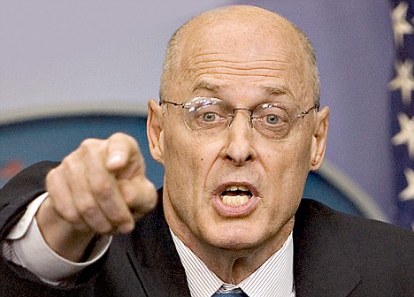

Slide 12
This helping hand hypothesis is not a new insight from recent years
Amakaduri in Japan (descent from heaven)
Revolving doors in the US financial system
Bankers go into policy or regulation
Regulators or policymakers retire into banks
There may be advantages, but also large costs
New nationalised banks in many countries filled with politically connected players
ABN Amro, RBS, Belfius,
Evidence from Turkey (Disli, Meir Schoors, JFS 2013)
Reduced depositor discipline from observable political connections (bail-out expectations)

Slide 13

Depositor discipline: demand and supply shifts
S’
i
S
Market discipline:
➔ i*↑& d*↓
D
d

Slide 14
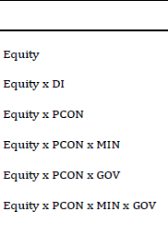
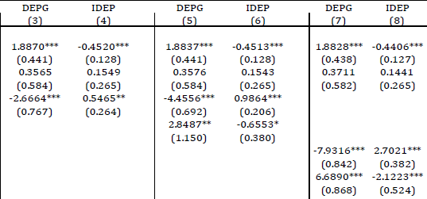
PCON: reduction in market discipline in both equations (Eq. 3 & Eq. 4)
Differential impact between parliamentarians and cabinet members?
PCON: reduction in market discipline in both equations (Eq. 5 & Eq. 6)
MIN: increase in market discipline in both equations (Eq. 5 & Eq. 6)
Political connections induce a far greater reduction in market discipline if the political connection is through a former member of parliament rather than a former minister.

Slide 15
The sensitivity of depositor discipline intensifies when the (last) party of the former politician is currently in power (i.e., GOV).

Slide 16
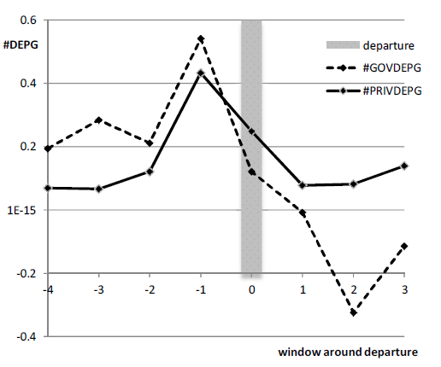

0

Slide 17
More recent evidence
Blau, Brough ,Thomas, JBF 2013: politically-engaged banks
were not only more likely to receive TARP funds,
received a greater amount of TARP support
received TARP support earlier
Ran Duchin, Denis Sosyura, JFE 2014,
Safer ratios, riskier portfolios: Banks׳ respond to government aid by taking more risk
Effects of TARP:
Direct effects
Effects on surrounding banks (wake up call or lullaby?)

Slide 18
Helping hand hypothesis generally assumed ⇔ Grabbing hand hand?
Bertrand, Kramarz, Schoar, and Thesmar, 2006, Politicians, Firms and the Political Business Cycle: Evidence from France
Politically connected CEO’s assist incumbent politicians in their re-election: publicly-traded firms managed by politically connected CEOS
display higher rates of job and plant creation in election years
lower rate of plant destruction, in election years.
especially true when the firms’ operations are located in politically contested areas.

Slide 19
Helping hand hypothesis generally assumed ⇔ Grabbing hand hand for banks
Seminal work of Dinc (2005):
lending of state-owned banks is correlated with the electoral cycle in a cross-country study:
state-owned banks increase lending in election years relative to private banks
lending activity of state-owned banks may be used to influence political outcomes.
This was proven in a very wide sample of countries
More true in non-OECD than in OECD countries
Does it also apply to Russia?

Slide 20
Helping hand hypothesis generally assumed ⇔ Grabbing hand hand in Russia Berkowitz, Hoekstra, Schoors (JDE 2014)
Many privatised former Soviet banks (more than 800 initially ) are still alive today.
Regions with more of these banks
Have substantially more lending
But not more growth (in some regions in fact less)
Yet more employment
Why?
Those banks maintained old political connections
tend to finance state firms and privatised zombie firms.
Especially true if regional institutions are bad

Slide 21
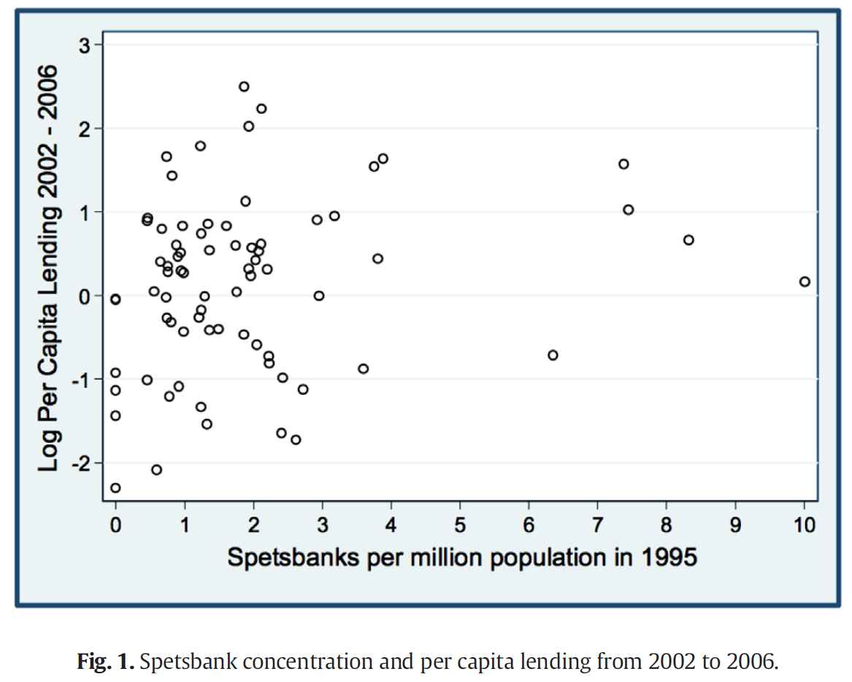

Slide 22
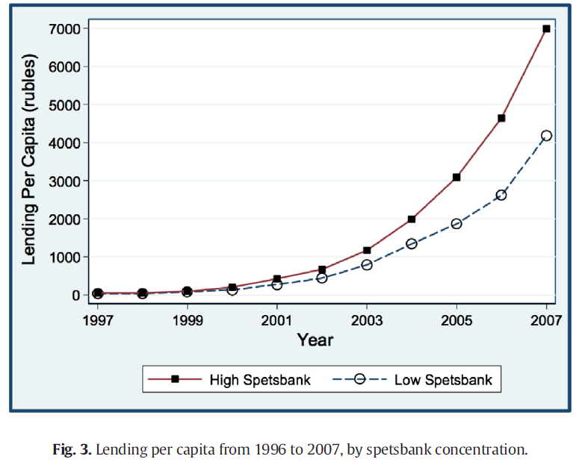

Slide 23
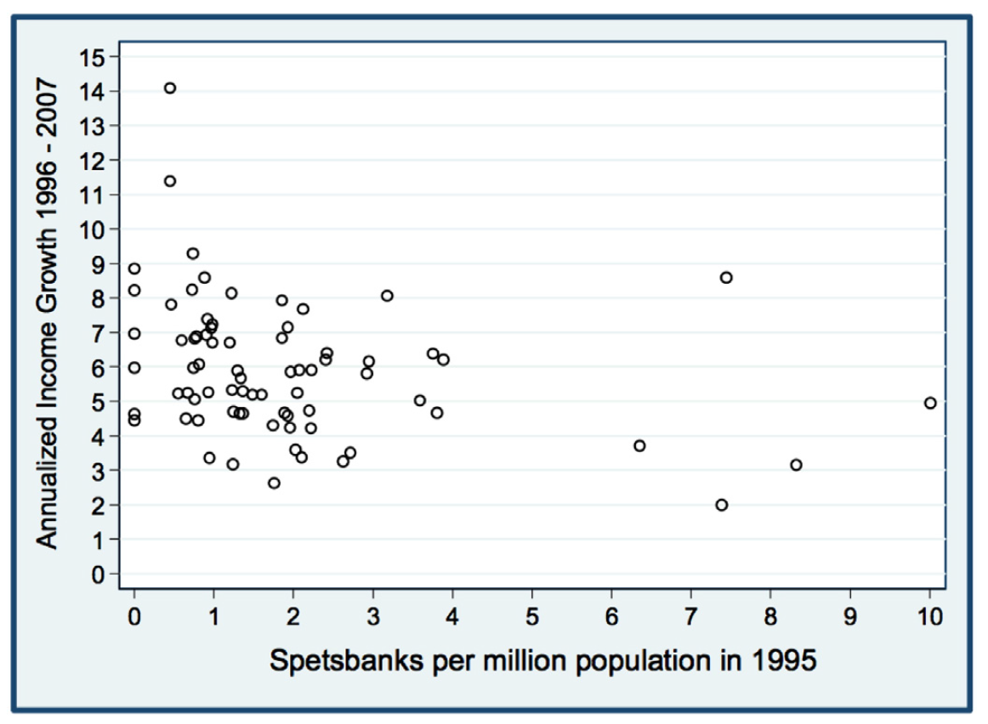

Slide 24
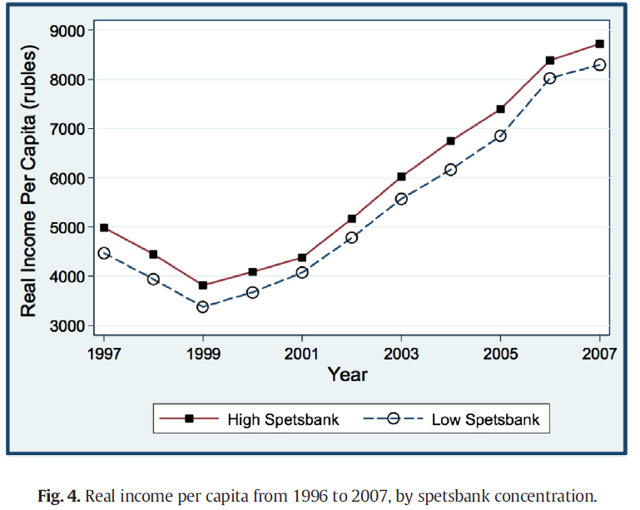

Slide 25
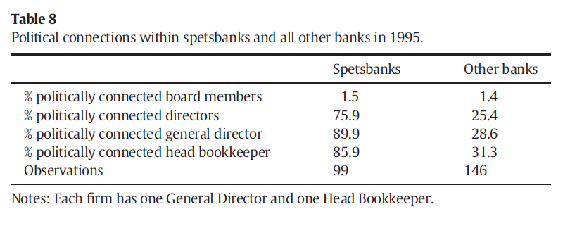

Slide 26
Interesting paradox in Russia
When Putin becomes Prime minister (mid 1999) he is unknown and unpopular
Chechen war increases popularity
New party “Unity” founded with as only clear programme item the desire to support Putin
Unity gets 23% in the duma elections of 19/12/1999
Putin becomes acting president 01/01/2000
Putin wins 03/2000 early presidential elections by a landslide victory
Why?

Slide 27
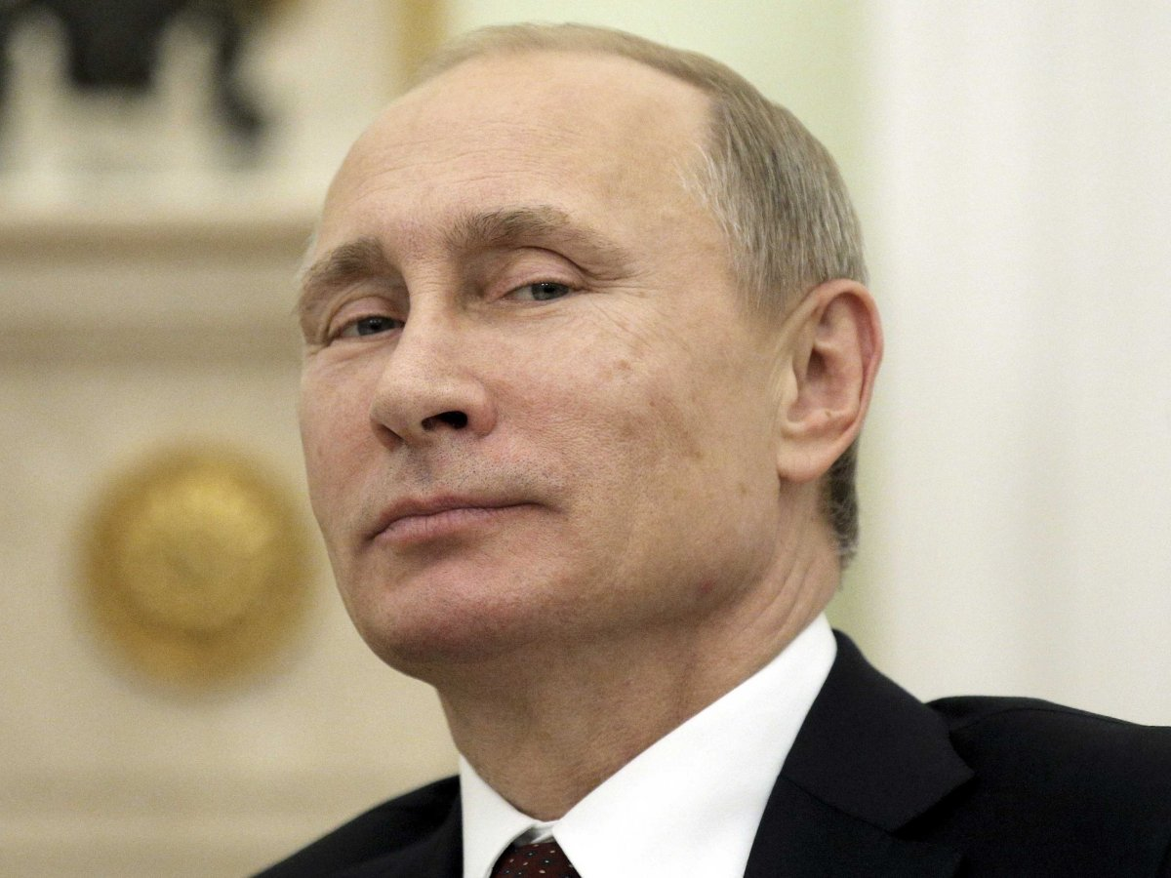
You also wonder how I got to power?

Slide 28
Role of media coverage? Less important in 2000 !!
State channels RTR & ORT friendly to the Kremlin
But the then independent NTV channel, owned by oligarch Gusinksy, is fiercely opposing Putin
In December 1999 duma elections
In March 2000 presidential elections
Only later is NTV taken over by force after a protracted struggle 14/04/2001
But there existed an opposing coverage in 2000

Slide 29
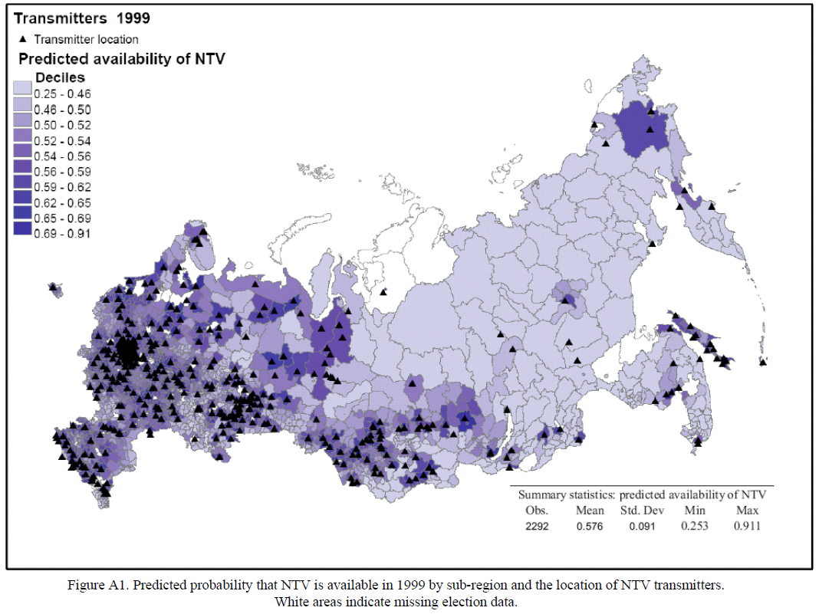

Slide 30
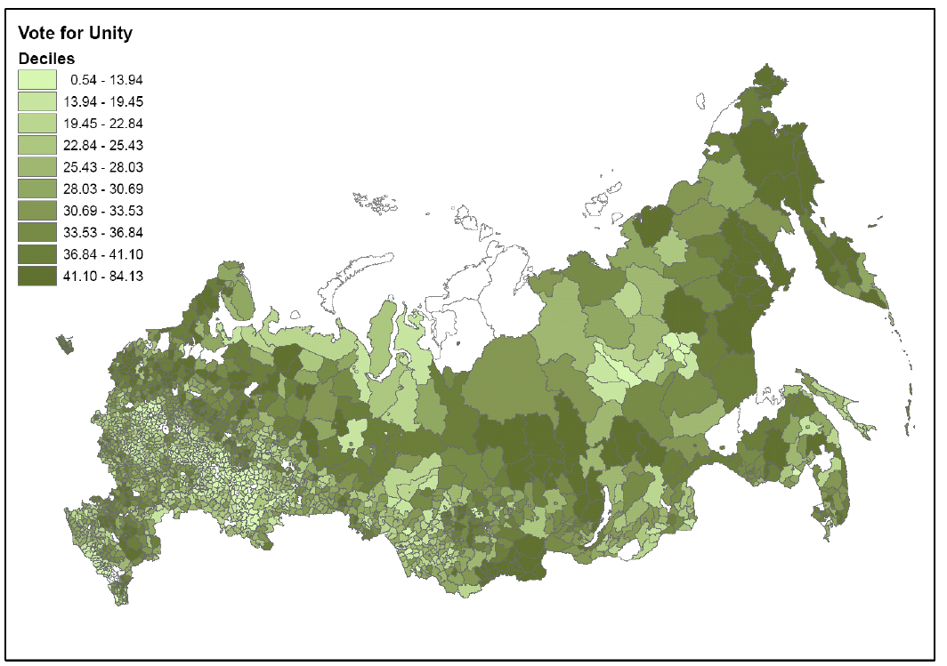

Slide 31
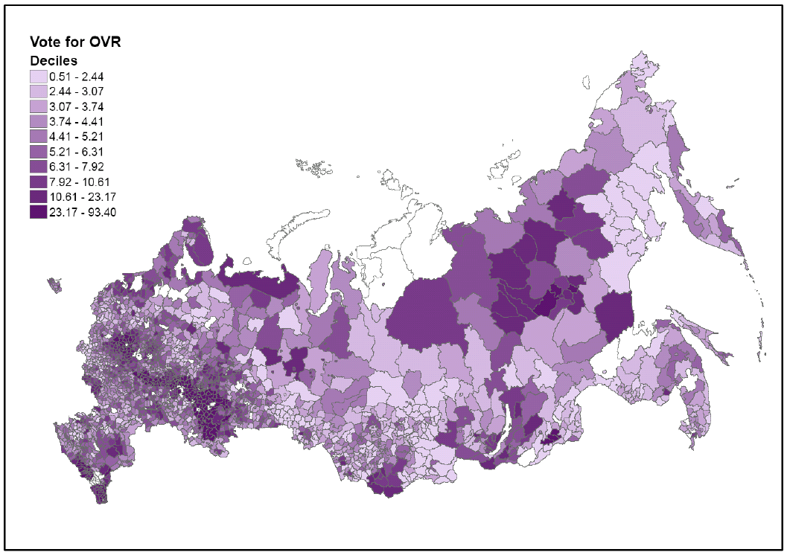

Slide 32
Maybe ballot stuffing?
Theories about ballot stuffing in later elections
But not so much in the 2000 election because the communist party was still going strong
They had local representatives everywhere
Their candidate, Zyuganov, still mattered
Not very likely that ballot stuffing / vote rigging played a mayor role in 2000

Slide 33
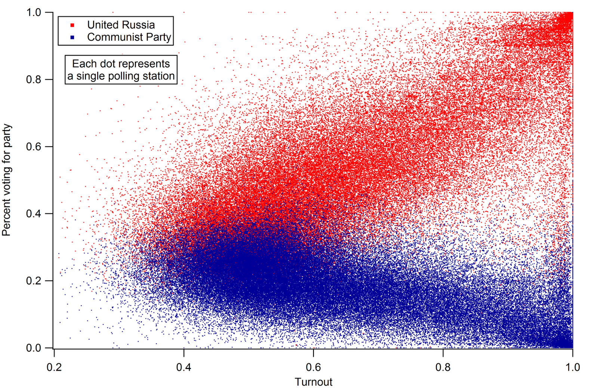

Slide 34
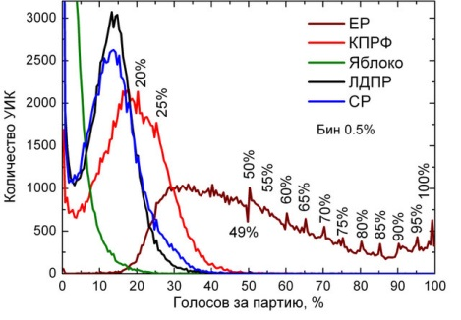

Slide 35
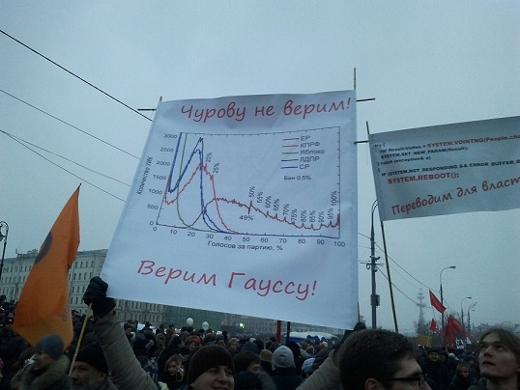

Slide 36
Did banking play a role?
Sberbank was the main bank in Russia in 1999-2000 and state-owned (both still true).
Majority of depositors and deposits
Largest lender to firms and households
Potential political mechanism
Firm managers are political activists and motivated by increased access to Sberbank credit (survey evidence)
Hypothesis:
Increased Putin popularity Dec 1999 - March 2000 driven by increased Sberbank firm lending before the election

Slide 37
Empirical approach
Explain the change in votes between December 1999 and March 2000
Main explanatory variable: change in Sberbank firm credits to the region in months before election
Controls: Sberbank credits to households, private domestic bank credits, regional variables
Placebo regressions: is the effect there in other non-election months?

Slide 38
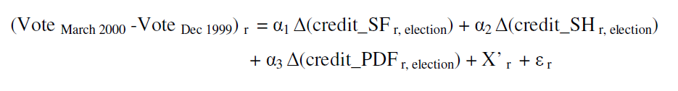
Specification
If α₁ > 0 only in months for election:
Political effect of Sberbank lending on Putin votes

Slide 39
Underlying identification ideas
Within country regional variation in political outcomes,
so no confounding factors so typical of cross- country studies
Sberbank monthly regional variation in firm credits (SF),
so there is a state controlled channel to firm managers
Controls for within Sberbank household credits (SH)
to identify channel of firm managers (households vs. firms)
Controls for other credits by private domestic banks (PDF)
to control regional patterns that are unobserved
Regional variables to control for regional characteristics that may drive Putin support, other than banking
Placebo regressions for other months
to make sure these are not just seasonal Sberbank credit patterns

Slide 40
On timing
The payments system was still relatively inefficient by 1999
Between August 1998 – early 1999 (Russia default) the payments system was jammed
In 1999 transfers to regions could take 3 weeks – a month to actually settle (manual operations needed)
in addition the managers need to see the money and act by mobilizing their workers
So we expect the main effect to a jump in credits to the right regions in January

Slide 41
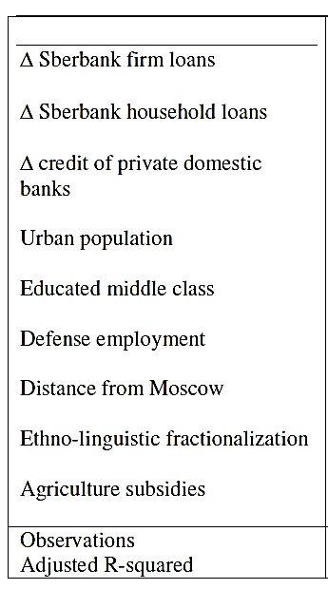
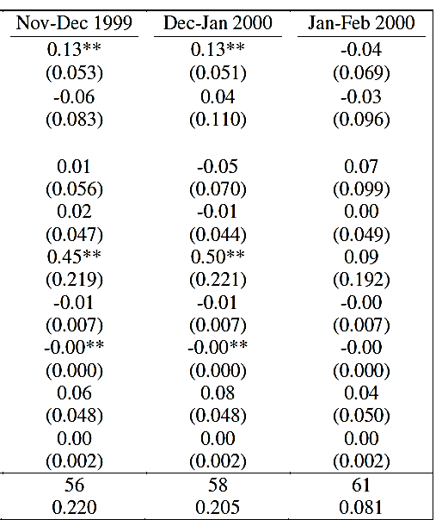
Main results
α₁ > 0 !

Slide 42
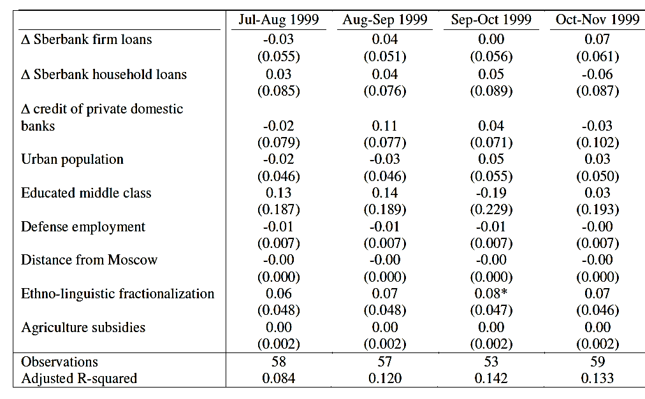
Placebo regressions before: since May-June (before Putin)
α₁ = 0

Slide 43
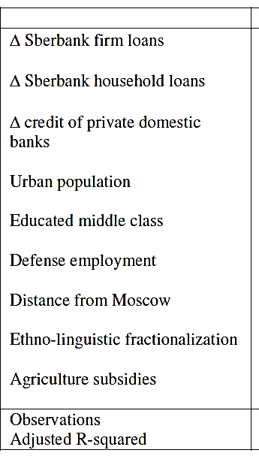
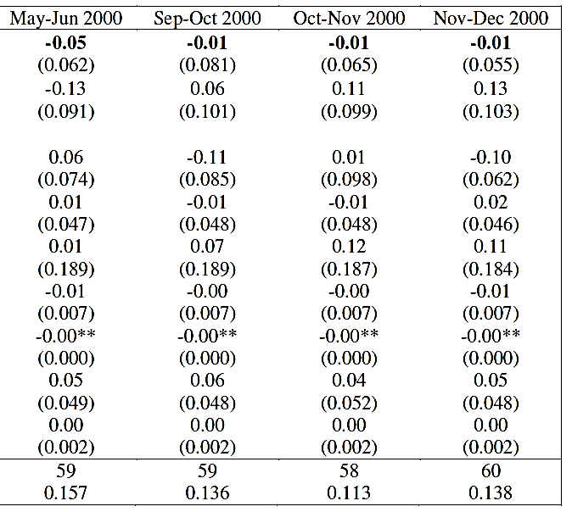
Placebo regressions Post election – Dec 2000
α₁ = 0

Slide 44
What is the mechanism
We believe mangers are given incentives to be politically active
The incentives take the form of one-off additional Sberbank credits
They react by rallying their workers to come out and vote for Putin
So not only the votes for Putin should rise
But also voter turnout should rise with Sberbank credits

Slide 45
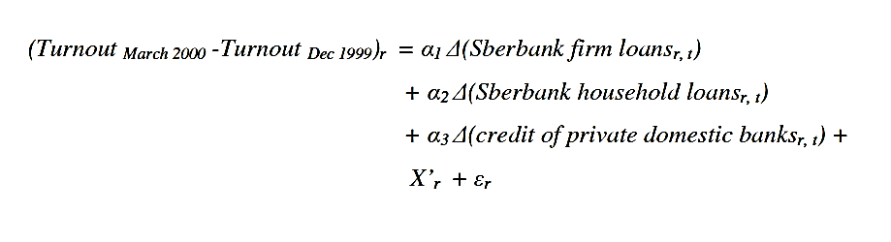
Specification
If α₁ > 0 only in months for election:
Political effect of Sberbank lending on voter turnout

Slide 46
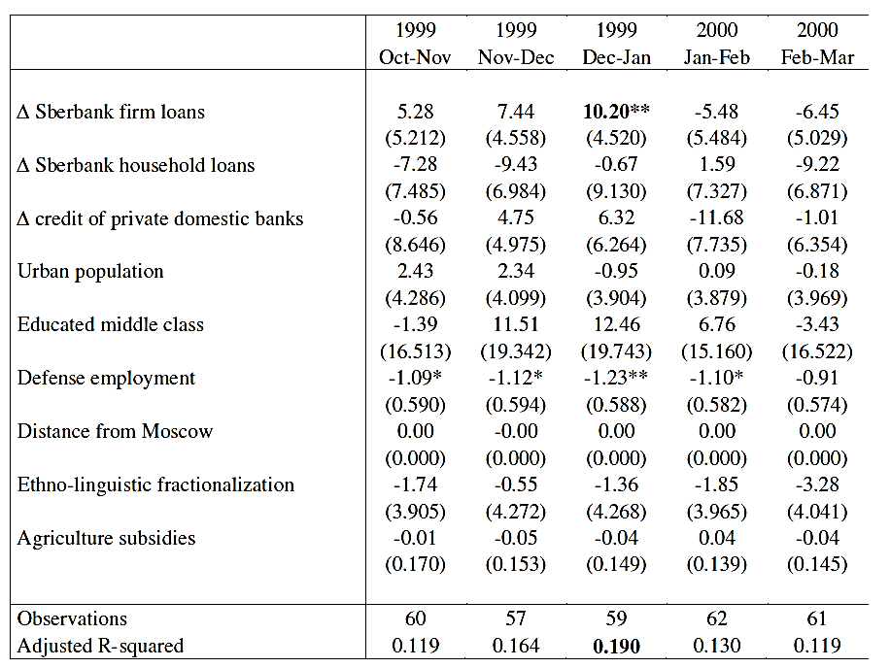
Dependent variable D(turnout)
α₁ > 0 !

Slide 47
Deeper analysis of mechanism
Regional leaders appointed by Yeltsin?
Seems not to be the case
State employment
Seems to work through private(ised) firms
Wage arrears
Possibly, but looking for data
Siloviki
Bingo

Slide 48
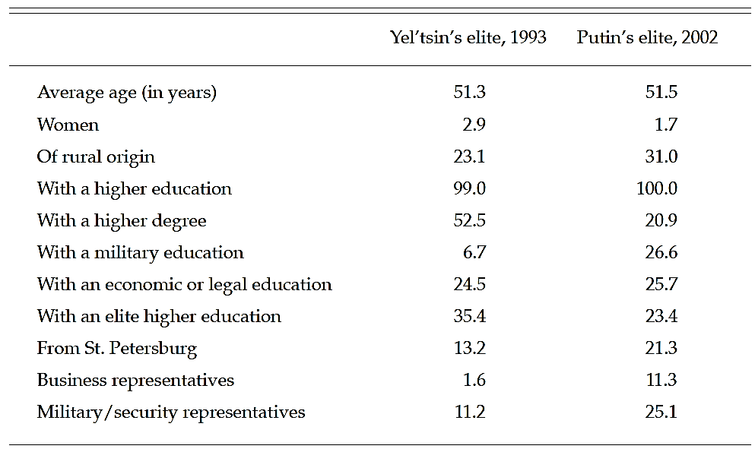
Russian elite under Yeltsin and Putin

Slide 49
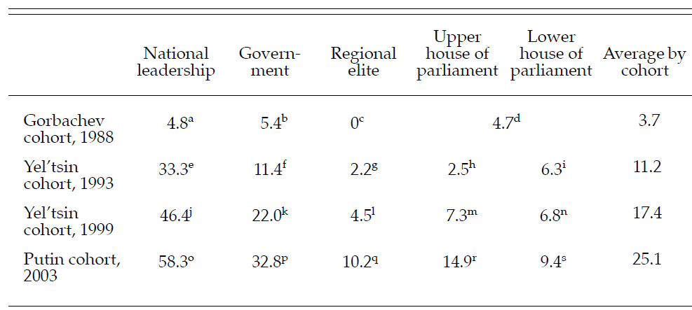
Share of military in elite groups
In fact 8% of regions end 1999 in our sample

Slide 50
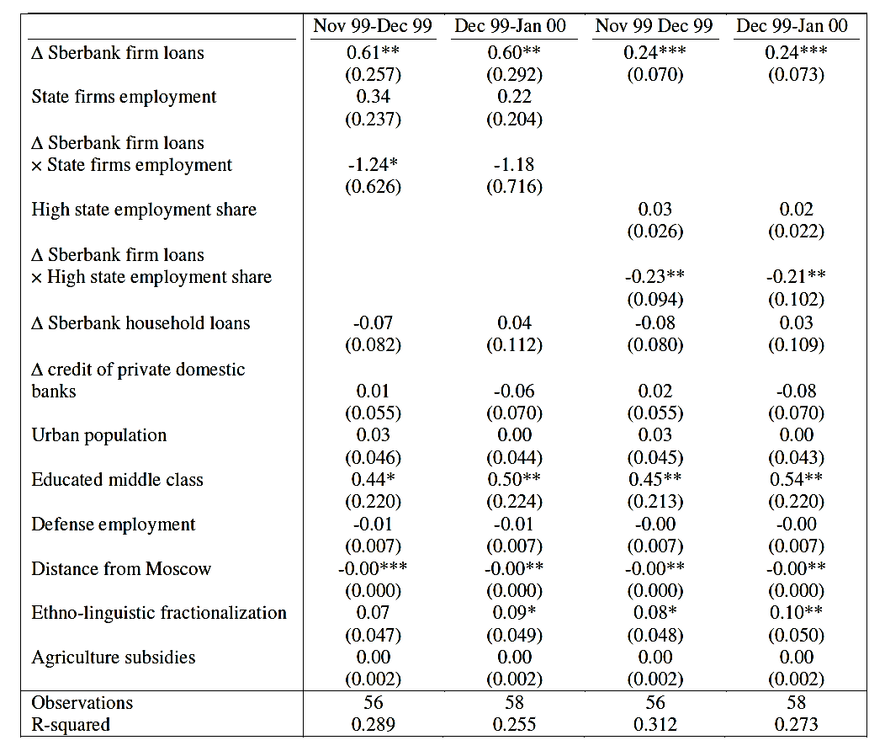
State employment

Slide 51
State employment
Interpretation average effect 0.13
But really 0.24 in with low state E regions
And no effect in high state E regions

Slide 52
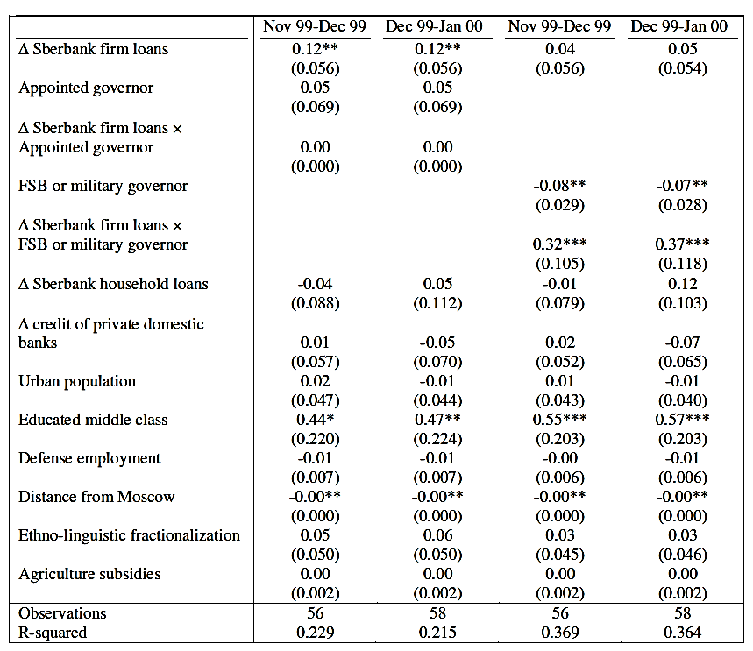
Siloviki

Slide 53
Interpretation
Not clear whether there was centralised effort to mobilise Sberbank/firm managers to win election
Results are in line with the interpretation that security related interests saw Putin’s rise to power as an opportunity and rose to the occasion
By mobilising Sberbank funding
And using it to incentivise managers from privatised firms
Because indeed the main Sberbank effect disappears after interaction with the FSB/military dummy.

Slide 54
Conclusion
Correlation between increase in Sberbank firm rouble credits and increase in popularity of Putin
Not due to regional growth perspectives
Not due to deep drivers of Sberbank credit
Confirms literature, but much better identification
indicates that this strategy of using bank loans for political gains can be successful
Evidence that the connections with the siloviki are part of the mechanism
Suggestive of the siloviki seeing an opportunity in bringing Putin to power

Slide 55
Bank stability and media freedom
Very little banking crises in autocracies
But if they occur it is very bad
Underlying idea of a trade-off
The autocrat limits media freedom just to keep power and to signal strength
That also limits the access to info about economic troubles
Implying that banks will be more stable, until the economic levies break and trust collapses altogether
So media freedom implies that depositors will worry earlier, but keep more trust

Slide 56
Identification
In 1998 Russia there is one free TV channel (NTV) and a massive financial meltdown
This gives us within country (and even city) variation in media freedom ☺
We located all bank addresses without branches in 1998 (coordinates)
We calculate the NTV signal strength at that location (antenna coordinates & inclination)
Link this to monthly household deposit runs

Slide 58
There seems to be something

Slide 59
Conclusion
A lot of great exciting stuff to do
Especially in the big economies (US, UK, Germany, France): yes it happens there too !!!!!
Map the connections beyond campaign contributions
Political
Revolving doors, ...
Link to outcomes
Performance
Access to soft loans, government contracts, forbearance, ......

