Slide 1
Institutional Environment and Corporate Political Strategy:
A Comparative Perspective
Nan Jia
Marshall School of Business, University of Southern California
Thursday, 19th May 2016
Prepared for the IOEA 2016, Corsica, France

Slide 2
A Comparative Approach
Importance
  Theory development and testing
  Some methodological advantages
Challenges
  Finding “comparable” contexts
  Strike the right balance between institutional details and theoretical abstraction (e.g., Acemoglu and Robinson, 2005)
Current State
  Not so common in strategy (but is much needed)
  Theoretical and practical implications

Slide 3
The Institutional Environment
“Economic conditions”
  Economic performance: outcomes
“Institutional conditions”
  Key theoretical dimensions?
    Political/legal/cultural (reading)
    Three pillars of market-supporting institutions
    Relevant dimensions for the research question
    Institutional variation within a country
Unbundle them
  Inherently related (e.g., Acemoglu et al., 2014 NBER WP)
  But not always bundled (e.g., Acemoglu and Johnson, 2005)

Slide 4
Corporate Political Strategy
“Institutional Strategy”
  Political strategy
  Nonmarket strategy
  Stakeholder management
Political strategy varies across institutional environment
  Note: need to go beyond that political strategies matter in emerging markets
  Changing value in market settings in as markets develop (e.g., Haveman et al, forthcoming, Administrative Science Quarterly)
  Differential value in nonmarket settings across institutional environments (e.g., Ang and Jia, 2014, Journal of Politics)

Slide 5
Haveman, Jia, Shi, & Wang (Forthcoming, Administrative Science Quarterly)
Firm Performance
Ties between Chinese firms and state bureaucrats…
  provide access to resources (e.g., land and capital)
  allow access to customers (e.g., business permits)
  reduce regulatory burdens, fees, and taxes
  improve legal oversight (property rights)
Benefits outweigh the costs
  Pressure to achieve political goals (e.g., employment)
  Bureaucrats have lower human capital
Therefore, such ties…
  reduce the uncertainty facing firms
  make it easier for firms to grasp new opportunities
  make firms more competitive
  → Improve firm performance
When a firm becomes politically connected
Gap
When a firm is not politically connected
But this is not what we focused on in this paper

Slide 6
Dynamic Value of Political Connections in as Markets Develop
Firm Performance
H2: The interaction between political embeddedness & market development is stronger in more competitive industries.
When a firm becomes politically connected
Gap enlarges as market develops
H3: The interaction between political embeddedness & market development is stronger for smaller firms.
Gap
When a firm is not connected
Market Development

Slide 7
Data & Measures
Sample: All firms listed on the Shanghai and Shenzhen stock exchanges, 1992 to 2007: 11,145 firm-year records
Political embeddedness/connection: Resumes of executives & directors → whether they had served as chief officers or deputy chief officers & if so, at what level (ministry, department, division, section, staff).
  Only counted former officials at the division [chu] level or above
  Binary variable for each firm-year observation
  Count variable in robustness check
Market development
  Based on employment: log percentage of labor force working in non-state-owned firms each year
  Based on capital (fixed-asset) investment: log percentage of fixed-asset investments by non-state-owned firms each year
  Robustness check: period indicator: years after 2003, when significant reforms were put in place as a result of China’s accession into the WTO
Firm performance: return on assets (ROA)

Slide 8
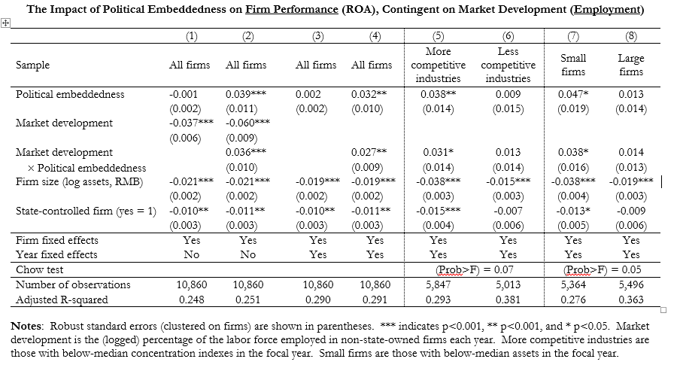
Results

Slide 9
Results: Partial Mediation of Bank Loans
Market Development (Employment)
X
Political Embeddedness
Firm
Performance
0.027** (0.009)
Access to Bank Loans
0.053* (0.027)
0.117*** (0.007)
Market Development (Employment)
X
Political Embeddedness
Firm
Performance
0.023** (0.009)

Slide 10
Results: Mediation of Legal Oversight (Related Party Transactions)
Market Development (Employment)
X
Political Embeddedness
Firm
Performance
0.027** (0.009)
Related Party Transactions
-0.060** (0.020)
-0.043*** (0.010)
Market Development (Employment)
X
Political Embeddedness
Firm
Performance
0.025** (0.010)

Slide 11
Differential value of political connection in nonmarket contexts
Ang and Jia, 2014, Journal of Politics
Political connection and use of courts to resolve disputes
H2(b): Where legal services capacity is higher (i.e., the knowledge gap is smaller), the positive association between PC and the use of courts is stronger.
Political Advantages
Positive association between political connections and use of courts (H1(b))
Higher levels of legal services capacity
H2(a): Where legal services capacity is higher (i.e., the knowledge gap is smaller), the positive association between PC and the use of courts is weaker.
Knowledge Advantages

Slide 12
Data Source
Repeated cross sectional surveys of a total of 3980 privately owned firms across all provinces and all industries in 1995, 1997, and 2000
“Which is the most frequently method used to resolve disputes encountered by your ﬁrm?’’ (1) use courts, (2) negotiate and mediate, (3) seek intervention from government, and (4) other
Political Connection: firm owner
  Former officials at the division level [chu] and above
  Delegates of the Congress or the Conference
  Others: Former public employees, Party member
Legal Services Capacity: province-level indices (NERI)
  Availability of professional legal services: # of lawyers/population, # of accountants/population
  Court capacity: # of business lawsuits filed the year/GDP, # of business lawsuits concluded in the year/GDP

Slide 13
Data and (one set of the) results

Slide 14
Corporate Political Strategy (Cont’d)
Political strategy varies across institutional environment (Cont’d)
  Which firms? (Antecedents to the willingness to act)
    Firm characteristics (for a review see e.g., Hillman et al., 2004)
    Institutional conditions (e.g, Li et al., 2006, Economic Inquiry)
    Institutional conditions X firm characteristics (e.g., Jia, 2016, Management and Organization Review)
  How?
    Collective vs Individual
      Individual level: freeriding problem (Olson, 1965; many follow-ups)
      Institutional environment (e.g, Jia, 2014, SMJ; redistribution vs infrastructure)
  Who?
    Revolving door (e.g., Blanes-i-vidal, 2014, AER)
    Formal structural ties, e.g., board and TMT (e.g., Faccio, 2006, AER)
    Informal ties (e.g., Siegel, 2007 ASQ)
    Make or buy (Jia, WP)
  When?
    Political system (e.g, Choi et al., 2015, Organization Science)
    Regional variation within a country

Slide 15
Choi, Jia, Lu (2015, Organization Science)
“Entry point” and “veto point” in the structure of political system
Political competition
  Political competition → more veto points → more difficult for firms to influence policy (e.g, Henisz 2000, Holburn and Vanden Bergh 2008; Holburn and Zelner, 2010)
  Political competition → more chances for the firm to find politicians with similar policy stance → easier for firms to influence politics (e.g., Macher et al., 2011; Macher and Mayo, 2014)
  Our theory
    Entry point is important only when politicians cannot change existing policy positions
    depends on the likelihood of contravene voter preferences: Electoral accountability
    Political competition and electoral accountability are distinct
Government Tiers and Decentralization
Data: World Bank Enterprises Survey (2002-2006) in 38 countries, repeated cross sectional

Slide 16
Corporate Political Strategy (Cont’d)
Political strategy varies across institutional environment (Cont’d)
  Which tactics?
    Generic tactics: Hilman and Hitt (1999)
      Institutional env’t: Bribe or lobby (e.g., Harstad and Svensson, 2011, AJPS)
  Marquis and Raynard’s classification of institutional strategy
    Relational strategy
      Include corporate political strategy
    Infrastructure building
      Sometimes can be achieved by political strategy (e.g., Jia, 2014, SMJ; redistribution vs infrastructure)
    Socio-cultural bridging
      Weaker link? (e.g., Doronbantu et al., 2015 WP)

Slide 17
Theoretical approaches
Multiple disciplines
  Institutional economics and political economy
  Sociology (Marquis and Raynard)
    Organization and community (or external environment); elites; resource dependence
    Institutional entrepreneurship & Institutional theory
  Political Science
  Strategy and International Business
    All theories applied
    “Institutional-based view” “institutional rents” etc
“Trend” in strategy
  Integration with market strategy

