Slide 1
Culture and Economics
Gerard Roland

Slide 2
Introduction
Very active literature developed in the last 10-15 years on the effects of culture on institutions and development.
Economists have traditionally shied away from introducing culture into economics.
Difficult to ignore that differences in values and beliefs across the world have many economic implications, be it in influencing attitudes towards thrift, work and effort, innovation, trade, the role of women, openness towards other countries and other cultures, or in affecting political and legal institutions.
Many data bases now exist that make possible to have quantitative analysis of the role of culture in economics development.

Slide 3
Some history of thought
Karl Marx (1818-1883) downplayed role of culture and considered that values derived are from economic interest. Thrift is in interest of capitalism, collectivism in interest of workers. Religion in interest of capitalists. Chicago school has similar views that beliefs determined by interests.
Max Weber (1864-1920) put Marx on his head and saw culture as driving force of economic change. “The Protestant Ethic and the Spirit of Capitalism”. Protestantism put higher emphasis on thrift and hard work.
Karl Polanyi (1886-1964) : religion and moral values mitigate excesses of the market and of greed.
Thornstein Veblen (1857-1929) : culture where wealth is a symbol of social status leads to conspicuous consumption. Other cultures emphasize knowledge or piety or courage in combat.

Slide 4
Culture is important.
Pioneering work of Greif (1994) showed effects of differences between individualist and collectivist beliefs in late medieval Mediterranean period (Maghribi vs. Genoese traders).
Experimental literature found early on stark country differences in bargaining games (Roth et al. 1991). See also Henrich et al. (2001)
Research on understanding determinants of individual preferences (in particular trust) led to finding that national fixed effects more important than individual characteristics (see e.g. Tabellini, 2008; Algan and Cahuc, 2014).
Evidence of specific effects of culture distinct from institutions (Fisman and Miguel, 2007 on corruption, Miguel et al. 2008 on culture of violence).

Slide 5
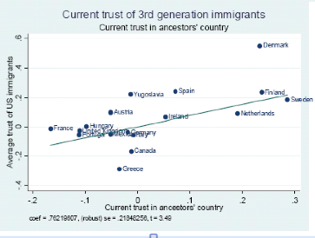

Slide 6
An example: U.N. parking tickets in New York.
Fisman and Miguel (2007) found that diplomats’ parking violations in New York are correlated with their corresponding country’s World Bank measure of control of corruption (Figure 19.2).
Diplomats are facing the same rules with no other incentives than their own social norms.

Slide 7
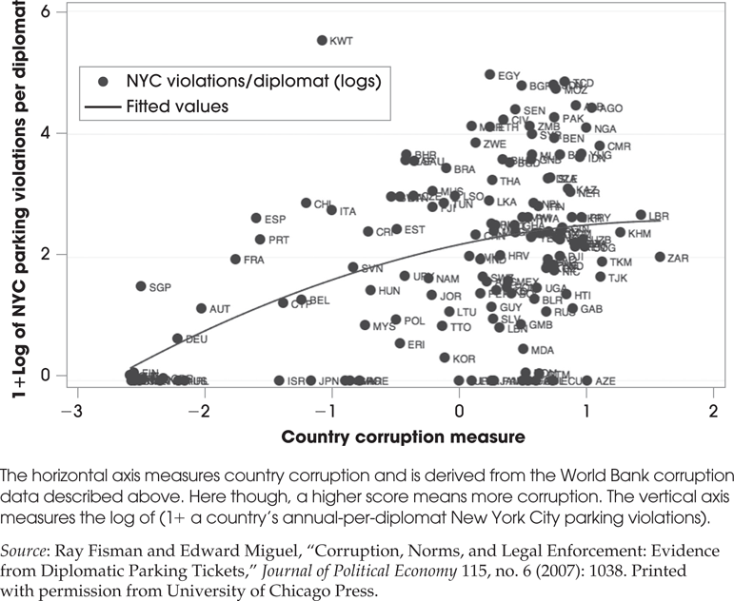

Slide 8
Definition of culture
The set of values and beliefs people have about how the world (both nature and society) works as well as the norms of behavior derived from that set of values.
Comprehensive definition. Close to religion but somewhat more inclusive. Culture evolves somewhat more than religion
Not culinary or clothing habits.
Culture is mostly transmitted from parents to children but also via peers (Bisin and Verdier, 2000).
Because of vertical transmission, lots of evidence that culture is slow-moving and has a lot of inertia.

Slide 9
Most common methods in the research on culture
Cross-country approach. Exploits various large international data bases with comprehensive coverage of values.
  Advantage: comprehensive and extensive coverage.
  Disadvantage: limited to spatial, and not across time, comparison. Requires good instrumental variables, which is difficult in macro framework. Trade-off between internal and external validity with studies exploiting within country (or region) heterogeneity.
Epidemiological approach. Exploits the different countries of origins of migrants to the US as well as the time of arrival.
Laboratory experiments. Usual advantages and pitfalls.

Slide 10
Economic effects of culture.
Effects of trust (generalized morality, civic culture, willingness to cooperate) the most researched topic.
Started with literature on social capital (Putnam, 2000) behavioral and experimental literature (trust games) distinguishing between altruism, reciprocity and trust.
Survey question: "Generally speaking, would you say that most people can be trusted, or that you can’t be too careful when dealing with others?" (European Social Survey, the General Social Survey, the World Values Survey, Latinobarómetro, and the Australian Community Survey). Basis for cross-country studies.

Slide 11
Effects of trust.
Income per capita and growth: (Knack and Keefer, 1997; Algan and Cahuc, 2010). Problem of confounding factors and other cultural variables.
Trade and investment: Guiso et al. (2004a),
Financial market development: Guiso et al. (2004b), Cole et al. (2012).
Firm organization: Cingano and Pinotti (2012), Bloom et al. (2012). More delegation and decentralization.

Slide 12
Effects of trust.
Labor relations: Algan and Cahuc (2009). More flexibility and insurance.
Institutions: Tabellini (2008) on quality of institutions, Aghion et al. (2010) and Pinotti (2012) on trust and regulation, Aghion et al. (2011) on trade unions.
Electoral accountability: Nannicini et al. (2013).

Slide 13
Individualism-collectivism.
First introduced in Greif (1994) as differences in beliefs.
Platteau (2000) documented in the context of development how collectivist culture emphasizes conformity and embeddedness in larger groups, and frowns on deviation from conformity. (see also Platteau 2000; Baland et al. 2007, Comola and Fafchamps, 2010; Jakiela and Ozier, 2011; )
Hofstede’s (2001) measure of individualism vs. collectivism. Initially based on surveys among IBM employees across the world to understand cultural differences within a corporation. Was generalized to 76 countries later on. Based on factor analysis of survey questions. Loads positively on valuing individual freedom, opportunity, achievement, advancement, recognition and negatively on valuing harmony, cooperation, relations with superiors. Measure validated by studies on smaller samples.

Slide 14
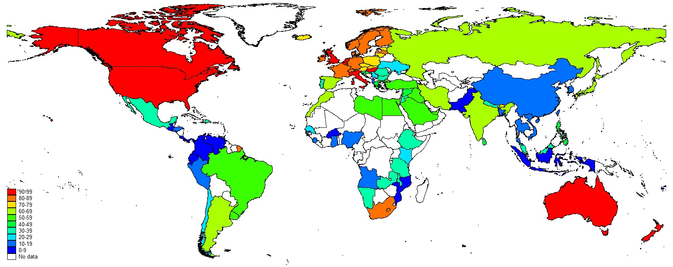
Individualism (Hofstede)

Slide 15
Effects of individualism
Innovation, TFP and long run growth: Gorodnichenko and Roland (2016). IV: neutral genetic markers, frequency of alleles coevolving with collectivism, historical pathogen prevalence.
Democratization: Gorodnichenko and Roland (2013).
Outsourcing decisions of firms: Gorodnichenko et al. (2015).
Quality of institutions: Klasing (2012), Kyriacou (2015).

Slide 16
Values on gender roles
Effects on labor force participation of women (Fernandez, 2007; Fernandez and Fogli, 2009 – cultural background of husband mattters more - )
Effects on fertility choices (Fernandez and Fogli, 2006, 2009).
Preference for boys and sex ratio: (Almond et al. 2009).

Slide 18
Effects of culture.
Causality difficult to establish in cross-country studies but difficult to deny that culture has economic effects.
Literature suggests comprehensive and diverse effects of cultural differences on economic outcomes.
Effect of culture on institutions (democracy, regulation, corruption, etc…) seems important. Not surprising given slow-moving character of culture.

Slide 19
Murrell and Schmidt (2012): culture’s influence on Glorious Revolution.
Evidence that “whig” culture predated the Glorious revolution of 1688.
Political change affected by cultural change and not vice versa.
Political and legal changes came later.

Slide 21
Effects of culture.
Number of cultural variables not that large compared to outcome variables.
Some cultural variables are more comprehensive than others, and cultural variables are strongly correlated with each other.
Cultural psychology finds that the most internationally relevant cultural cleavage seems to be the individualism-collectivism cleavage. Huge literature in cultural psychology documenting these differences, their origins and implications. Not surprising since reflects two fundamentally different worldviews with numerous implications: independent versus interdependent self (Markus and Kitayama, 1991).

Slide 26
The inertia of culture.
Bisin and Verdier (2000, 2001), Bisin, Topa and Verdier (2004): models of vertical cultural transmission that yield cutural inertia
Contrary to evolutionary models (see e.g. Boyd and Richerson, 1985 ), cultural assimilation may be prevented via stronger cultural transmission. Bisin et al. (2006) show that minority identity stronger in mixed rather than segregated neighborhoods in U.K.

Slide 27
Culture of “honour” in US South
More aggressive behavior in US South related to different sources of migration.
Migrants in Northern US were more from farming origin, migrants in Southern US more from herders (Scottish-Irish). Cattle is more easily stolen than land and cattle-herders had to develop aggressive behavior to defend themselves against thieves. Reinforces by presence of weak states.
Cohen and Nisbett(2000) did lab experiments on males from North and South and found differences in agressiveness (testosterone).

Slide 28
Culture of “honour” in US South
Grosjean (2014) found that counties in US South with more Scottish-Irish Immigration prior to 1790 have higher rates of homicide today.
This pattern does not exist in counties where Scottish-Irish were in minority (effect of horizontal cultural transmission).

Slide 29
Waves of migration to the U.S.
Fischer (1989): different waves of settlers introduced different institutions that were conform to their cultural values and beliefs.
First wave (1629-1641) were puritans who settled in Massachussetts. They introduced institutions adapted to their beliefs in the importance of education and order: universal education, high tax rates, large size of government, swift justice, town meetings…
Second wave (1642-1675) were Cavaliers who migrated to Virginia motivated by primogeniture in order to find estates. They believed that inequality was natural and adopted different institutions: low education and taxes, lack of formal justice…

Slide 30
Waves of migration to the U.S.
Third wave were Quakers (1675-1725) who settled in Delaware. Culture of high priority to personal freedom. Introduced limited government, equal rights, less harsh justice.
Fourth wave were Scottish-Irish (1717-1775): believed in freedom from the law and right to armed resistance. Led to limited government and vigilante justice.
Overall, institutions were influenced by culture of migrants.

Slide 31
What explains cultural change?
Becker et al. (2011): influence of Habsburg versus Ottoman Empire on culture of trust and corruption.
Grosjean (2011): Coexistence of more than 100 years in same Empire reduced cultural difference by a third.
Tabellini (2007, 2010), Cassar et al. (2013): Good institutions may lead to transmission of values of cooperation.
Nunn and Wantchekon (2009): African slave trade and mistrust.

Slide 32
What explains cultural change?
Understanding of determinants of cultural change is very limited. Evolutionary models help understand the dynamics, but say little about initial triggers for change (technology, institutions, climate,war, …)
We know even less about determinants of cultural change in developing countries.
Most consistent historical evidence concerns roles of large empires.
Why were large empires successful at cultural change (spread of Christianity, Islam, orthodox religion, Confucianism,…) ?
Hypothesis: Education of elites influenced by emerged empires and spread to populations by educated elites and vertical transmission. Joint effect of vertical and horizontal transmission triggered by Empires.

Slide 33
What explains cultural divergence?
Why is the West individualistic and the East more collectivist? Why differences in trust?
Length of agricultural history: Olsson and Paik (2015) argue that length of farming history was a determinant of collectivism.
Climate volatility: Durante (2010) finds that larger climate volatility between 1500 and 1700 associated to more trust and less strong family ties.
Soil type and the plough: Alesina et al (2011) on plough and gender roles.
Pastoral societies and culture of violence: Grosjean (2014).

Slide 34
What explains cultural divergence?
Ostrom (1990): more trust in communities relying more on coordination such as in upland regions.
Greif and Tabellini (2015): divergence between clan and city in China and Europe and effect on generalized versus limited morality.
Gorodnichenko and Roland (2013, 2015) build on Fincher et al. (2008): stronger historical pathogen prevalence gave advantage to collectivist values.
Rice production fostered collectivism in China: Talhelm et al. (2014).

Slide 35
What explains cultural divergence?
Evidence so far only partial. Need to understand better comprehensive sources of divergence between most important cultural families.
Most likely combination of random production of philosophies, geography, genes, institutional environment.
Need for deep historical research combining archeology, anthropology, climate science, genetics, history of religion and philosophy.

Slide 36
Future paths for research.
Culture is a social phenomenon (not just about individual preferences), so it is not easy to measure precisely effects of culture. More precise measurement implies subnational analysis, but has its own limitations. Trade-off between internal and external validity and limitations in outcome measurements.
Epidemiological method should be used more outside the US.
Need to understand link between different dimensions of culture and have as comprehensive a measure of cultural differences across the world. Cultures are derived from views of the world.
More international lab experiments to understand better effects of culture.

