Slide 1
Firm Political Strategy
Rick Vanden Bergh
University of Vermont
IOEA 2016, Corsica, France.

Slide 2
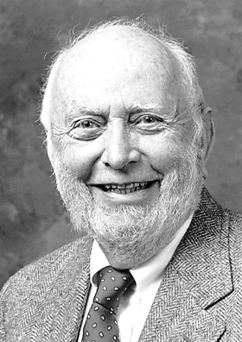

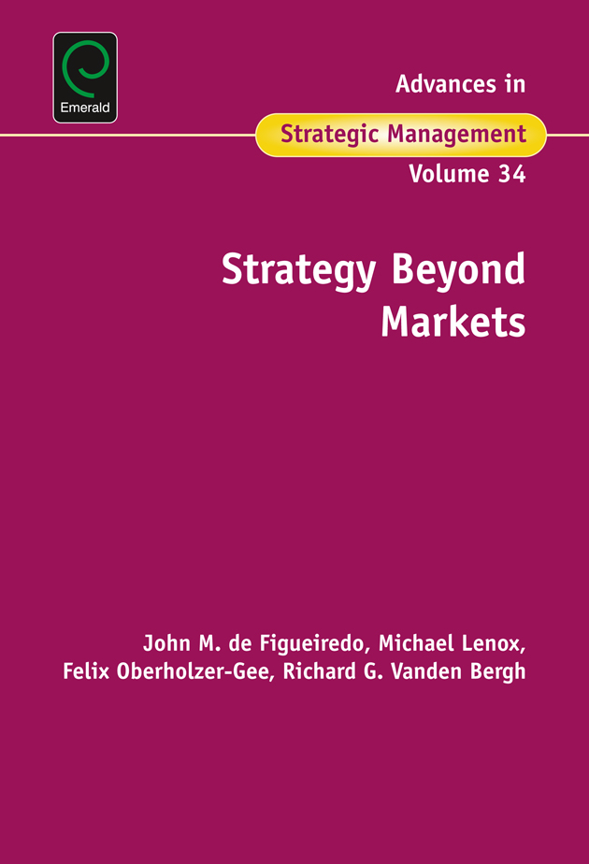

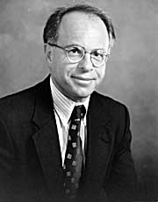

Firm Political Strategy
(shameless plug)
Strategy in Political Markets
Nonmarket Strategy
Strategy Beyond Markets
Past Presidents of SIOE
“Founding Fathers” & Important Influences
Notes:
Different names found in the literature – synonymous
North with the importance of Political Instutitons to economic development
OEW not only is TCE utilized to help understand some questions in Political Strategy but he also chaired or served on the dissertation committees of many scholars that have made important contributions in the field (de Figueiredo, Silverman, Henisz, Zelner, Macher and yours truly).
Weingast & Spiller among the first to model (using logic of economics) the behavior of policy makers and the design of political institutions which provides an important theoretical approach for scholars in the firm political strategy field
John de Fig has contributed directly to many areas in the literature

Slide 3
Lecture Outline
Political Strategy
  Broad Themes
  Motivating example
  Political Markets Framework
  Literature -- Theory & Empirics -- IOE perspective
  Assumptions
  “Suppliers” of Policy – a little theory
  “Demanders” of Policy – brief discussion of new project
  Design & Implementation
Limitations and Opportunities

Slide 4
Market vs Nonmarket arena
Market Environment
  Interactions among a focal firm and entities such as suppliers, consumers, shareholders, employees, and competitor firms.
Nonmarket Environment
  interactions among a focal firm and entities such as community organizations, NGOs, activist groups, and government policy makers
Strategy
  Concerted actions by the focal firm to create and capture long run economic value
    Market Strategy Examples – IOE related
    Williamson, 1991;
    Oxley, 1997;
    Nickerson & Silverman, 2003

Slide 5
Two Broad Themes in Political Strategy
Private Politics
  concerned with the interactions between firms and special interest groups like activist environmental groups or international NGOs
  Activist groups often launch campaigns to get firms to change practices and self-regulate & to avoid “Public Politics”
    Baron & Diermeier, 2007; King, 2008;Lenox & Eesley, 2009
  Tools include media campaigns (Baron, 3005; Bonardi & Keim, 2005) and boycotts (Friedman, 1986)
  Limited incorporation of institutional environment at the country level (Breitinger & Bonardi 2016)
Public Politics
  “concerned with the interactions between firms and government officials that have the authority to pass new legislation, promulgate regulatory rules or issue statutory interpretations”
  (AiSM Strategy Beyond Markets 2016, introduction)
World Bank survey (2014) & PwC Survey (2015) –
  CEOs ranked Public Politics ahead of Market Strategy when considering investments and threats to returns
Notes:
Theory with Private
-- who will activistists target – strategically based upon the cost of consumers switching to other products and the cost of the campaign for the target firm Baron & Diermeier JEMS
-- strong brands avoiding reputational damage (King, 2008 ASQ), large, visible and successful; polluting industries (Lenox & Eesley, 2009 JEMS)
Breitinger & Bonardi find support for the strategic targeting since firms in country’s with higher education levels,
The World Bank asked CEOs to rank the most important
constraints for their firms when deciding to invest. The executives
ranked the uncertainty of public policy as the second most significant
constraint, ahead of more traditional market-based constraints such as
identifying market opportunities, raising financial capital and attracting
human capital
PwC CEOs viewed regulation as a greater potential disrupter to firm
success than market threats such as increased competition, changes in consumer
preferences, or supply chain changes

Slide 6
Motivating Example
Exelon & PSEG announce merger and acquisition
PSEG has operating utilities in New Jersey & Pennsylvania
M&A requires approval by policy makers in both New Jersey & Pennsylvania
Typical Month
M&A-Window Month

Slide 7
Interesting Phenomenon for Research
Why different political strategy?
  the same firm,
  the same policy issue at the same point in time,
  the same general policy making process across the two states
We also observe:
Time variation in firm strategy within a single state
Cross sectional variation in firm strategy within a single state

Slide 8
The Political Market (Public Politics)
(Buchanan & Tullock, 1962; Bonardi, et. al. 2005; Baron, 2013)
Public policy outcomes
(determine firm’s nonmarket performance)
Demanders of
public policies
Suppliers of public policies
Policy Issue
Focal Firm
NGOs, Activists
Other Firms
Elected Officials
Regulators
Courts
“Medium of Exchange”
Votes, Information
Financial support, other
Special Interest Groups
Political Institutions
Political Strategy

Slide 9
Political Markets Framework:
Assumptions about Demanders & Suppliers
Firms maximizing profits: compare the π(x) vs π(y)-c(y)
  For examples: Holburn & VdB (2004); Baron (199x; 20xx); Shotts (2016)
  Willing to influence for policy y in the political market place if π(y) - π(x) > c(y)
Politicians also maximizing an objective function made up of:
  Ideal policy: electoral (Mayhew, 1974) and ideology (Kalt & Zupan, 1984)
  Utility of policy outcome relative to ideal: (e.g., Shepsle & Bonchek, 1996)
  Politically valuable resources received from the firm’s political strategy
  U(x(j) vs. U(y(j) + C(y) (e.g., Grossman & Helpman (2001)
  Willing to support policy y if C(y) > U(x(j)) – U(y(j))
Notes:
“Politics without romance” –

Slide 10
Obvious question:
What is the likely policy outcome x
without Interest Group influence?

Slide 11
Model the decision making of the Suppliers
Public policy outcomes
(determine firm’s nonmarket performance)
Demanders of
public policies
Suppliers of public policies
Policy Issue
Focal Firm
NGOs, Activists
Other Firms
Elected Officials
Regulators
Courts
“Medium of Exchange”
Votes, Information
Financial support, other
Special Interest Groups
Political Institutions
Political Strategy

Slide 12
Positive Political Theory (PPT)
Unpacking political institutions vs. Government as a self-interested but unitary actor (e.g., Stigler, 1971; Peltzman, 1976)
In late 1980s and early 1990s, PPT emerged as scholars realized that policy maker behavior within single political institution may be influenced by behavior in other political institutions
  Legislatures and Agencies (e.g.., McCubbins, Noll & Weingast 1987 & 1989, Calvert, McCubbins & Weingast, 1989, Banks and Weingast 1992, de Figueiredo & Vanden Bergh 2003 and 2004)
  Agencies and Courts (e.g., Spiller and Spitzer 1992, McCubbins, Noll, & Weingast 1997, Tiller and Spiller 1999)
Pivotal Politics (e.g., Krehbiel 1998, 1999)
Notes:
Positive vs Normative
Still see “Government” treated as a single actor in recent political strategy literature (e.g., Shotts, 2016

Slide 13
a simple PPT model with implications for Political Strategy

Slide 14
Assumptions
Single dimensional policy space
Preferences of Policy Makers
  Each policy maker has an “Ideal Policy”
  Single Peaked Utility function
Pol #1
Pol #2
Need a “Collective Action Rule”
Utility for Pol #1
Utility for Pol #2
Assume: Simple Majority Voting
Low
Weak
High
Strong

Slide 15
Pivotal Politicians –
Median Voter Theorem (Black, 1948)
Given assumptions:
MV is key to gaining support for a policy change within single political institution
Policy changes move toward MV’s ideal policy
Policy located at MV’s ideal policy is an equilibrium x*
MV
Change Voting Rule → different Pivotal Politician
X* = MV
If x₀ to the left of MV
Utility for MV
Policy moves
If x₀ to the right of MV
Policy moves

Slide 16
Interaction Across Political Institutions
(e.g., Holburn & Vanden Bergh, 2004 & 2008)

Slide 17
Simple PPT model -- Regulator, Legislature & Executive
Incorporate Institutional Rules Governing Process
Step 1: Regulators define the “Social Cost of Carbon” for a Carbon Tax
  Simple Majority among commissioners; MV ideal policy $60 per tonne of CO2
Step 2: Legislature may overturn the Regulator with a new law
  Simple Majority required for new policy otherwise regulatory decision stands
  MV ideal policy $40 per tonne of CO2
Step 3: The Executive must agree with Legislature’s proposed policy otherwise regulatory decision stands
  Ideal Policy $50 per tonne of CO2

Slide 18
Simple PPT model -- Regulator, Legislature & Executive
Incorporate Institutional Rules Governing Process
Step 1: Regulators define the “Social Cost of Carbon” for a Carbon Tax
  Simple Majority among commissioners; MV ideal policy $60 per tonne of CO2
Step 2: Legislature may overturn the Regulator with a new law
  Simple Majority required for new policy otherwise regulatory decision stands
  MV ideal policy $40 per tonne of CO2
Step 3: The Executive must agree with Legislature’s proposed policy otherwise regulatory decision stands
  Ideal Policy $50 per tonne of CO2

Slide 19
Simple PPT model -- Regulator, Legislature & Executive
Incorporate Institutional Rules Governing Process
Step 1: Regulators define the “Social Cost of Carbon” for a Carbon Tax
  Simple Majority among commissioners; MV ideal policy $60 per tonne of CO2
Step 2: Legislature may overturn the Regulator with a new law
  Simple Majority required for new policy otherwise regulatory decision stands
  MV ideal policy $40 per tonne of CO2
Step 3: The Executive must agree with Legislature’s proposed policy otherwise regulatory decision stands
  Ideal Policy $50 per tonne of CO2

Slide 20
PPT stylized example of regulators decision
Legislature MV
Executive
Regulator MV
$40
$50
$60
Social Cost of Carbon ($/tonne of CO2)

Slide 21
What is the equilibrium policy choice?
Use “Backward Induction”
Notes:
One goal from developing such a model is to answer the positive question, what is the equilibrium policy that emerges from this process? We will use Backward Induction to derive the equilibrium. This means that to understand what Social Cost of Carbon the regulator will choose we first analyze the expected decisions of the executive in Step 3 and the legislature in Step 2. Of course each of the pivotal politicians would like to see the Social Cost of Carbon defined as close to their ideal as possible.

Slide 22
Step 3: Regulator considers Executive’s Decision
X_{R} = $60?
Legislature MV
Executive
Regulator MV
$40
$50
$60
Social Cost of Carbon ($/tonne of CO2)
Notes:
So an obvious place to start the analysis is to ask will the regulator define the Social Cost of Carbon at the pivotal regulator’s ideal of $60? $60 would be an equilibrium if we analyzed the regulator in isolation, but is this still an equilibrium choice when the regulator can be overturned by other political institutions? To answer this question, first the regulator considers the Step 3 decision by the executive.

Slide 23
Step 3: Regulator considers Executive’s Decision
X_{R} = $60?
Legislature MV
Executive
Regulator MV
$40
$50
$60
Social Cost of Carbon ($/tonne of CO2)
Notes:
By including the utility function of the Executive in the graph, we can see that there are many alternatives that the Executive would prefer to a Social Cost of Carbon of $60.

Slide 24
Step 3: Regulator considers Executive’s Decision
Alternative policies the Executive prefers vs $60
X_{R} = $60?
Legislature MV
Executive
Regulator MV
$40
$50
$60
Social Cost of Carbon ($/tonne of CO2)
Notes:
Based upon this utility function, the gray area captures all the alternative policies that the Executive would prefer. So any policy proposal from about $41 up to about $59 will be signed and approved by the Executive and will overturn the regulators $60 choice.

Slide 25
Step 2: Regulator considers Legislature’s Decision
Given Executive’s set of preferred alternatives, Legislature proposes an alternative X_{A} ≈ $41
X_{A} ≈ $41
X_{R} = $60?
Legislature MV
Executive
Regulator MV
$40
$50
$60
Social Cost of Carbon ($/tonne of CO2)
Notes:
Moving to Step 2: given the executive’s set of preferred alternatives, the legislature is predicted to propose an alternative that is as close to the pivotal politician’s ideal as possible and still get the approval of the executive. In this example, it looks like the legislature will propose an alternative close to $41 and the executive will approve the proposal.

Slide 26
Step 1: Given response by Legislature & Executive, Regulator’s choice of X_{R} = $60 is NOT an equilibrium.
X_{A} ≈ $41
X_{R} = $60? NO
Legislature MV
Executive
Regulator MV
$40
$50
$60
Social Cost of Carbon ($/tonne of CO2)
Notes:
So in Step 1: Given the expected response by the Legislature & Executive, a choice of $60 is not advisable for the regulator since it is not a stable equilibrium. While $60 would maximize the utility of the pivotal regulator, it will not be a stable outcome. It will be overturned and the resulting social costs of carbon of about $41 will be much further from the pivotal regulator’s ideal. Using a similar process we could see that $59 or $58 or $57 are also not equilibrium choices for the regulator. So what is? It is fairly straightforward to see which policy choice will be made by the regulator in stage 1.

Slide 27
Step 1: Given threat by Legislature & Executive,
Regulator chooses policy close as possible to its ideal policy
X*_{R} = $50
Legislature MV
Executive
Regulator MV
$40
$50
$60
Executive represents a constraint
Pivotal
Social Cost of Carbon ($/tonne of CO2)
Notes:
Given the threat posed by the Legislature and Executive, the Regulator chooses a policy of $50. This is as close to the pivotal Regulator’s ideal as possible without being overturned. X* sub R represents the equilibrium. It will not be overturned even though the legislature prefers policies closer to the pivotal legislator’s ideal of $40. $50 won’t be overturned because the executive will veto any alternative proposal. In this political environment we can see that the Executive represents a constraint on the decision of the Regulator. We can think of the Executive branch of government as the Pivotal Political Institution in this political context.

Slide 28
Comparative Statics
Consider a political environment with one difference:
Regulator’s ideal policy = $45
Notes:
Consider one change in the model. The institutional rules governing the regulatory process are the same, but assume the distribution of ideal points within the regulatory commission differs such that the median voter within the regulatory commission has an ideal policy of $45.

Slide 29
Different Distribution of Ideal Points in the Regulatory Commission →
Different Equilibrium Policy
X*_{R} = $45
Legislature MV
Regulator MV
Executive
$40
$45
$50
Regulator not constrained by Executive or Legislature
Regulator is Pivotal
Social Cost of Carbon ($/tonne of CO2)
Notes:
This is a different political environment and leads to a change in the equilibrium. Here the regulator can define the Social Cost of Carbon at its ideal and this will be a stable equilibrium. Any alternative proposed by the legislature that moves closer to $40 will be vetoed by the executive. In contrast to the previous political context, here the regulator is not constrained by the other two branches of government from achieving its ideal. In essence the Regulators are the pivotal political institution.

Slide 30
Comparative Statics
Consider one more change :
Regulator’s ideal policy = $35

Slide 31
Different Distribution of Ideal Points in the Regulatory Commission →
Different Equilibrium Policy
Regulator
MV
X*_{R} = $40
Legislature MV
Executive
$35
$40
$50
Legislature represents constraint
Pivotal
Social Cost of Carbon ($/tonne of CO2)

Slide 32
3 Political Contexts -- Incorporate Firm’s preferences
X*_{R}
Legislature MV
Executive
Regulator MV
$40
$50
$60
X*_{R}
FIRM
Legislature MV
Regulator MV
Executive
$40
$45
$50
Regulator
MV
X*_{R}
Legislature MV
Executive
$35
$40
$50
Social Cost of Carbon ($/tonne of CO2)
Notes:
Example Novelis
One insight that comes out of this analysis is that in a political system with checks and balances, the constraints on decision making differ depending upon the details of the political context. These constraints affect which political institution is Pivotal. In the first example the executive branch is the pivotal political institution while in the second the regulators are pivotal. In the third the MV in the Legislature is pivotal.
For interest groups which would like to influence the policy outcome, on the margin they must first target the pivotal political institution. In the first example model, it won’t help the interest group to target the regulator on the margin, because the regulator will still be constrained by the executive. Similarly, the interest group won’t target the legislature. So the prediction that comes out of this model is that the interest groups are likely to first target the Executive Branch. This adds to the insight from the first two videos. While the model predicts that an interest group will target the Pivotal Political Institution, within that single institution, the interests group will first target the pivotal politician.

Slide 33
Testable Implications - Firm Political Strategy
Firm will target their political strategy at the Pivotal Institution
  At times firms implement strategy to indirectly influence
  Pivotal politician within pivotal institution
Empirical Support for the Pivotal Politics approach
  Pivotal Institutions
    (e.g., Holburn & VdB, 2007, 2014; deFigueiredo & Edwards, 2016)
  Pivotal Politicians within institutions
    (e.g., Snyder, 1990; Grier & Munger, 1991; Stratmann, 1995; VdB & Holburn, 2007; Cooper, Gulen and Ovtchinnikov, 2010)
Notes:
Note on the margin

Slide 34
Limitations of theoretical model presented:
Assumes all policy makers have homogeneous capabilities in crafting policy. Wiseman & Volden (2016) develop a model with heterogeneous capabilities across legislatures.
Other than identifying pivots for firms to allocate strategy on the margin, this model says nothing about the detailed design and implementation of the firm’s strategy
No competing interest groups?
Notes:
Regarding the 2nd point – if I have time I will come back to this. There are scholars doing important and interesting work in this area. We have one with us here in Corsica looking at these issues. Nan Jia from USC has published many fine articles looking at the design and implementation of firm’s political strategy.

Slide 35
Model effect of Demanders
Public policy outcomes
(determine firm’s nonmarket performance)
Demanders of
public policies
Suppliers of public policies
Policy Issue
Focal Firm
NGOs, Activists
Other Firms
Elected Officials
Regulators
Courts
“Medium of Exchange”
Votes, Information
Financial support, other
Special Interest Groups
Political Institutions
Political Strategy

Slide 36
Demand Side of Political Market: Degree of Rivalry
Private Politics vs. Public Politics literature on stakeholder rivalry
  Boycotts, protests, civil suits (e.g., Lenox & Eesley, 2009)
  Negative performance impact (e.g., King & Soule, 2007)
  Firms strategically pre-empt gov’t response (Lyons & Maxwell, 2016)
Perhaps more consistent interaction with rivals in public politics
  Theoretical models of interest group competition argue rivalry positively related to political strategy costs
    (e.g., Baron, 2001; Bonardi, et.al., 2005; Grossman & Helpman, 1994)
  Very little empirical tests of firm political strategy responses to the degree of rivalry
    (for a recent exception see de Figueiredo & Edwards, 2016).
Notes:
Baron has a narrative description of the interest group’s decision
Use Novelis again to illustrate no action on bottle bills --
Baumgartner & Leech (2001) showed from analysis of 137 randomly selected cases that firms are not typically engaged in hotly contested battles with rival groups

Slide 37
Corporate Political Strategy in Contested Regulatory Environments: Evidence from the Electric Utility Industry
Adam Fremeth, Ivey Business School – University of Western Ontario
Guy Holburn, Ivey Business School – University of Western Ontario
Rick Vanden Bergh, University of Vermont

Slide 38
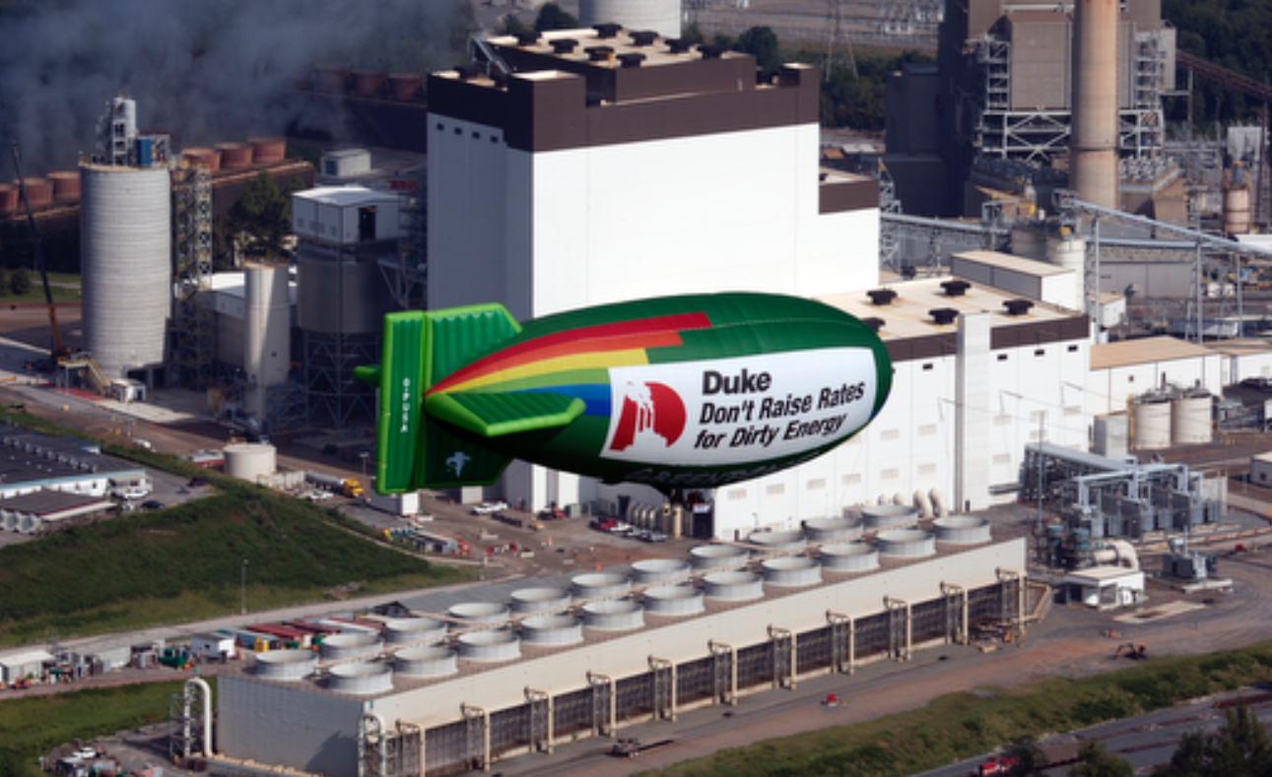
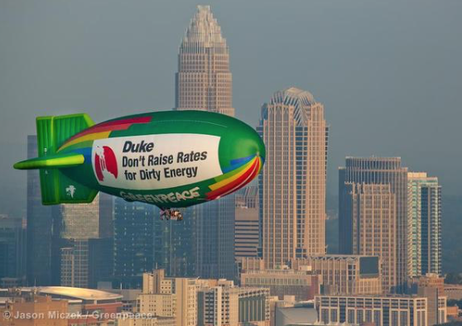

Slide 39

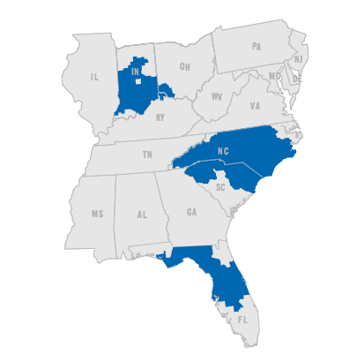
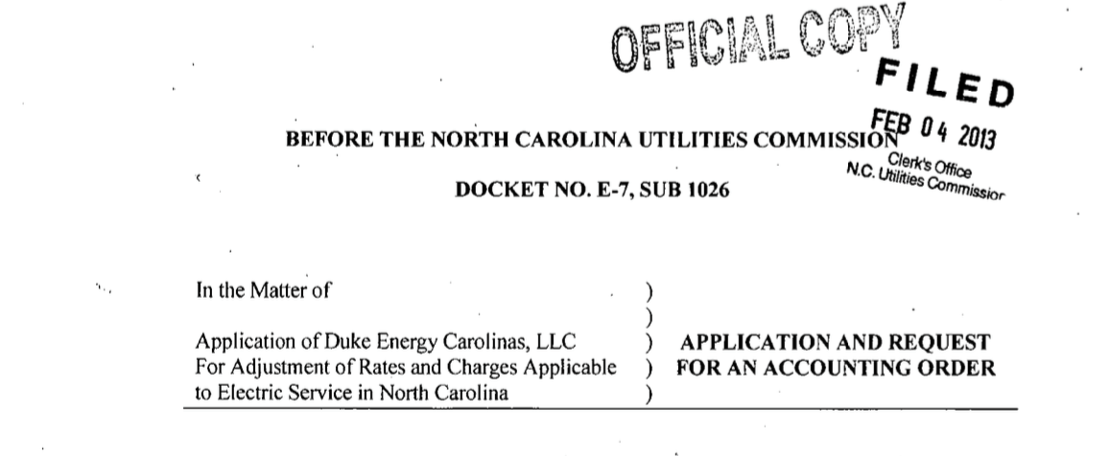
A stylized model of the regulatory process
Initiation
Hearings
Regulatory decisions
Judicial and political oversight
Firm or regulator can initiate
e.g. application for new drug approval, construction permit, M&A, utility rate review
Stakeholder participation
Administrative hearings governed by APAs
Evidence-based
Expert testimony
Regulator issues rule or order
Approval, denial, modification
Conditional
Rationalization
Ex post court appeal by parties
Ex post political review
Seeking a rate increase of $446.1M (about a 10% increase)
  Plant Modernization
  Environmental Compliance
  Cost increases from storm reserve funding and nuclear decommissioning
Case launched a year and a half after that last increase of 9%.

Slide 40
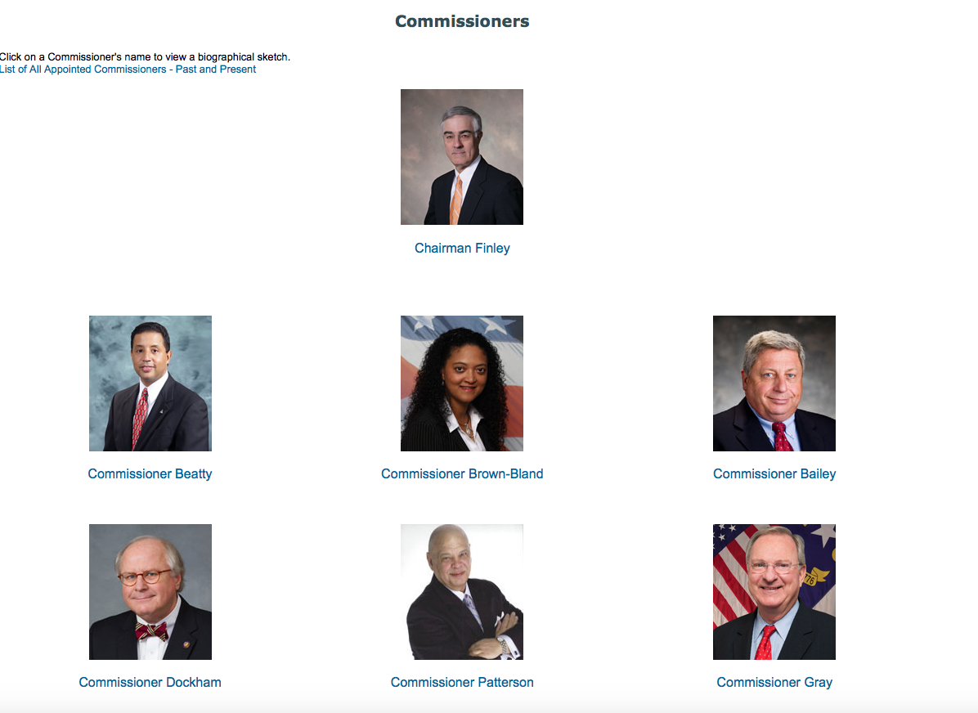
Hotly contested (13 intervenors) and received significant media attention.
Notes:
Appointed by Governor for 6 year terms. Split between republicans and democrats. Get paid about $125k.

Slide 41
This Project
How does the degree of rivalry from other Demanders of Policy in the regulatory arena influence the intensity of a firms corporate political strategy?
What’s the mechanism that may allow such influence to operate?

Slide 42
Rivals in Regulatory Arenas (Institutional details)
Administrative Procedure Act provides mechanism for engagement in regulatory process.
    (e.g., de Figueiredo & Vanden Bergh, 2004; McNollGast, 1987 & 1989)
  Relatively low bar to enter a case as an intervenor
  Funds provided to such groups (often paid for by the firm)
  Opportunity to access confidential firm records, present evidence, question witnesses
    Regulated firms benefit from information asymmetries, so when stakeholders enter they can reshape the informational environment by providing data and arguments the commission would not otherwise have
        (e.g., Stigler, 1971; Fremeth & Holburn, 2012)

Slide 43
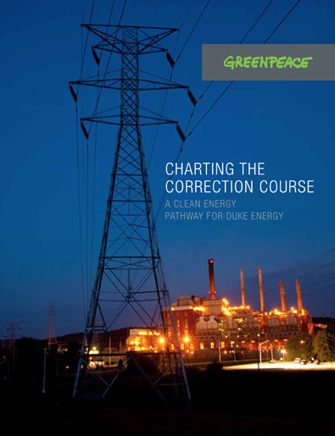
Set the record straight about Duke’s performance relative to competitors
Highlight shortcomings in Duke’s current investment plans
Propose Specific solutions that reap benefits for ratepayers, the environment, and investors

Slide 44
Consider relevant variation in the institutions:
Experience of Regulators
Experienced regulators can more effectively discern the quality of information presented
  (e.g., Fremeth & Holburn, 2012; Bolton, et. al. 2016)
Rely on in depth knowledge and past interactions with firms & intervenors with personal insight into the plans and proposals of both
Less likely to be swayed by weaker arguments or political pressure
Expect the information processing capabilities of longer tenured regulators to be greater, enhancing their ability to overcome information asymmetries
  Experienced regulators are more likely to be pivotal
Incentive for a firm to influence a regulator through political channels in response to a more contested environment varies based on the experience of the regulator.
Notes:
The Bolton, et. al. piece just published in JLEO – they look at Officie of Information and Regulatory Affairs (OIRA). 22,000 regs reviewed, they show that OIRA organizational features inhibits the timing of regulatory reviews. They look at organizational capacity (workflow to staffing) but it relates a bit with our argument about information processing capacity.
Pivotal especially vis-à-vis the courts (tend to overturn only in cases where regulators have been arbitrary & capricious)

Slide 45
Predictions
Firms make greater political campaign contributions in more contested environments
The positive relationship between firm campaign contributions and degree of rivalry is moderated negatively by the experience of the regulators

Slide 46
Data and Summary Statistics
25,066 firm-month-year observations
  1999-2010
  All investor owned utilities across 48 states – 182 Firms
  Several data sources: Energy Information Administration, state regulators, National Institute on Money in State Politics, etc.
Variables | Mean | Standard Deviation
Monthly Campaign Contributions | $2,589 | $12,938
Intervenors in last rate case | 7.4 | 6.2
Days of Experience | 1678 | 923
Other
Notes:
Days of experience – Average days of experience across the commission for that month

Slide 47
Response of Campaign Contributions to Contestation
Campaign Contributions_{its} = β₁Intervenors_{its} + β₂ Experience_{ts}+ β₃₋₁₂X_{ist} + fe_{ist} + ε_{ist}
Intervenors | 114.869*** (34.149)
Experience | -0.395*** (0.102)
One Standard Deviation increase in the number of Intervenors in the last rate case increases monthly campaign contributions by 28%
Includes firm, state and month-year fixed effects. Robust standard errors clustered by
firm in parentheses. *p<0.1; **p<0.05; ***p<0.01

Slide 48
Response of Campaign Contributions to Contestation moderated by Regulator Experience (Interactions)
Campaign Contributions_{its} = β₁ Intervenors_{its} + β₂ Experience_{ts}+
β₃Intervenors_{its}*Experience_{ts}+ …
Marginal Effect of an Additional Intervenor
As the collective experience of a regulatory commission increases, a firm decreases their campaign contributions in response to the presence of an additional intervenor
 | Experience
Min | 198.79***
Mean - 1 std. dev. | 159.85***
Mean - 1/2 std. dev. | 135.43***
Mean | 111.07***
Mean + 1/2 std. dev. | 86.66**
Mean + 1 std. dev. | 62.30*
Max | -232.39
Models Include firm, state and month-year fixed effects. Robust standard errors clustered
by firm. *p<0.1; **p<0.05; ***p<0.01

Slide 49
Design and implementation of Political Strategy
Public policy outcomes
(determine firm’s nonmarket performance)
Demanders of
public policies
Suppliers of public policies
Policy Issue
Focal Firm
NGOs, Activists
Other Firms
Elected Officials
Regulators
Courts
“Medium of Exchange”
Votes, Information
Financial support, other
Special Interest Groups
Political Institutions
Political Strategy

Slide 50
Medium of Exchange (i.e., types of action)
Campaign Finance (Money)
  Money Changes Hands from firm to policy-maker
Lobbying (Information)
  No money changes hand, only information directly from firm to policy-maker
Constituency Building (Votes)
  Information to and mobilization of voters needed for reelection

Slide 51
Empirical Issues for Campaign Contribution
Ansolbehere, de Figueiredo & Snyder (2003) inconsistent findings linking contribution patterns to policy/performance
  Positive – (e.g., Kau, Keenan, Rubin 1982; Stratmann (1991, 1995, 2002)
  None/negative -- (e.g., Wright, 1990; Langbein, 1993; Hadani & Schuler, 2013)
Potential solutions from pivotal politics approach
  Identifying Pivotal Institution, Pivotal Politician empirically challenging
    Coarse measure of distribution of ideal points (partisan control of political institutions)
    Nominate scores may provide help (e.g., Poole & Rosenthal, 1991; McCarty & Shor, 2011)
  Identify alignment between contributions and pivots
    Nickerson & Silverman (1997 & 2003) study of TCE alignment & firm survival in Trucking
Challenging to disentangle consumption vs investment
  Type of contributor & incorporate salient policy timing

Slide 52
Lobbying
Opportunities to link recent findings to Pivotal Politics/Institutions --
  E.g., Blanes I Vidal, et.al. 2012, Faccio, 2006, Faccio, et. al. 2006
  Do the value of ties vary with linked to pivotal politician.
Notes:
Bertrand, et. al., 2014 find that lobbyists switch the issues that they cover as the Senators they used to be tie to switch committee assignments.

Slide 53
Firm organizational choices of political actions
Make vs. Buy
  De Figueiredo & Silverman (2001) lobbying the FCC
  Jia present a new paper at SIOE in Paris
Internal Organization of nonmarket activities
  Minor (2016) -- variation in degree of integration across firm vs. separate division

Slide 54
Interesting research opportunities
Direct linkages between political strategy and performance
in policy outcomes and/or in economic value captured
  Identify alignment between theoretical political markets prediction & strategy employed -- Aligned strategies see better performance a.la. Nickerson & Silverman, 2003

Slide 55
Interesting research opportunities
Connection between political activities theoretically and empirically
  Combinations of political activities that link to political market context
  Need to develop data sets that combine lobbying & contribution data
Dorabantu, et. al. using a governance based logic to synthesize – present at SIOE at Paris 2016
Sustainability of political strategy
  Organizational alignment
  Developing Capabilities – Jia & Mayer (2016)

Slide 56
Thank you!

Slide 57
Demand Side of Political Market: Degree of Rivalry
Which Interest Groups Act in Political Market and Why?
  Scholars assume other interest groups maximizing profit:
    For examples see: Keim & Baysinger (1985); Baron (1995; 2013)
  Interest Groups act if Benefits of political action outweigh Costs (Baron)
  Benefits
  Costs
    Vis-à-vis relevant political institutions -- constituency connection of Interest Group
    free-rider problems (Olson, 1965)
How prevalent is intense rivalry in politics markets?
  Baumgartner & Leech (2001)
Notes:
Baron has a narrative description of the interest group’s decision
Use Novelis again to illustrate no action on bottle bills --
Baumgartner & Leech (2001) showed from analysis of 137 randomly selected cases that firms are not typically engaged in hotly contested battles with rival groups

