Slide 1
Network Effects on Social Networks
Quoc-Anh Do
(Sciences Po, Paris)
Institutional and Organizational Economics Academy
22-26 May 2017

Slide 2
Social Networks and Economics
“Social networks” in economics?
Economic sociology: Embeddedness of economic activities/interactions in non-economic relationships, even in market economies (Mark Granovetter)
Modern economics: structure of pairwise relations that conditions all individual choices.
Examples: trade costs due to physical and non-physical distances (global, local levels), trust and organization of the firm (mergers/acquisitions), friends/relatives/compatriots and labor market choices
Recent boom in economic research on social networks.
Empirical economists rely heavily on the persuasiveness of the empirical methodology used to test hypotheses on data

Slide 3
Definition of social networks in economics
Mathematical definition of a social network: a graph
A set of nodes/vertices: V
A set of edges/links/connections: E. Edges may be directional or undirectional. They may carry weights (distance).
There can be different types of edges, corresponding to different dimensions of a network (e.g. links between family members, between creditors-debtors, between co-workers)
Some simple examples:
Trade between countries (total/by industry)
Group structure: classroom, ethnic group, etc.

Slide 4
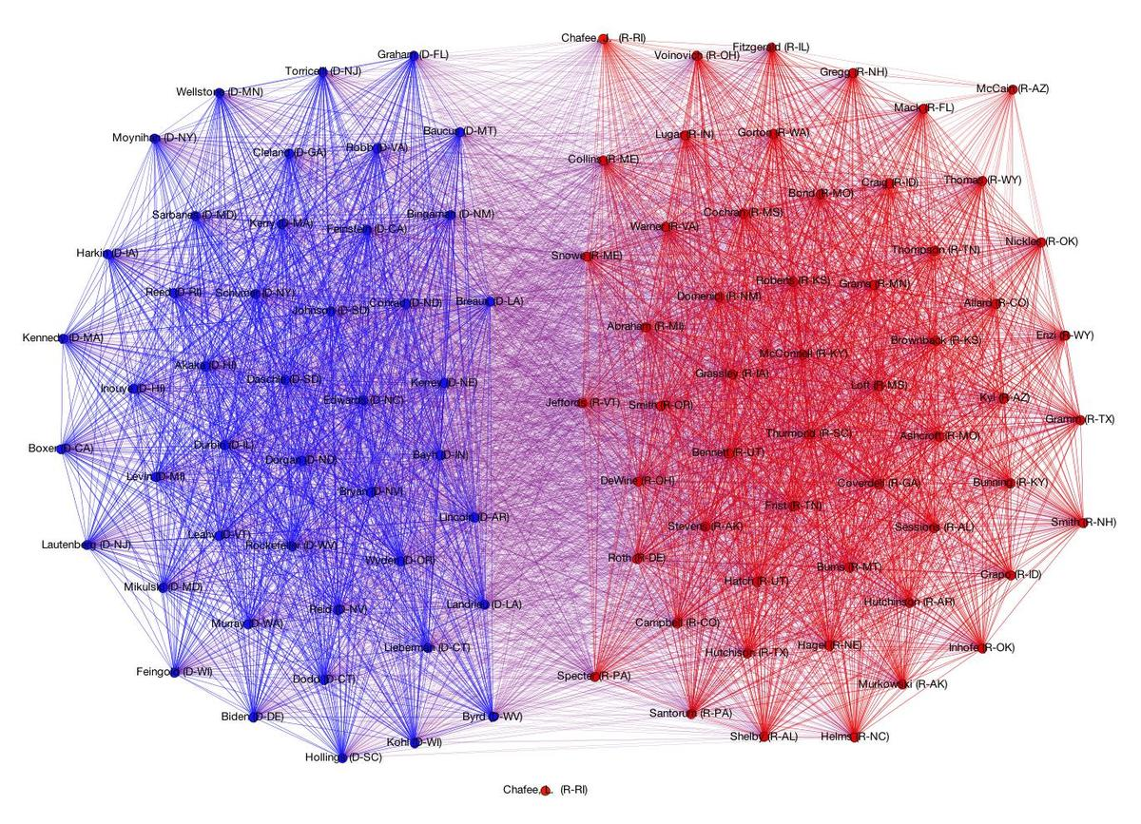
Network of U.S. senators, 1999

Slide 5
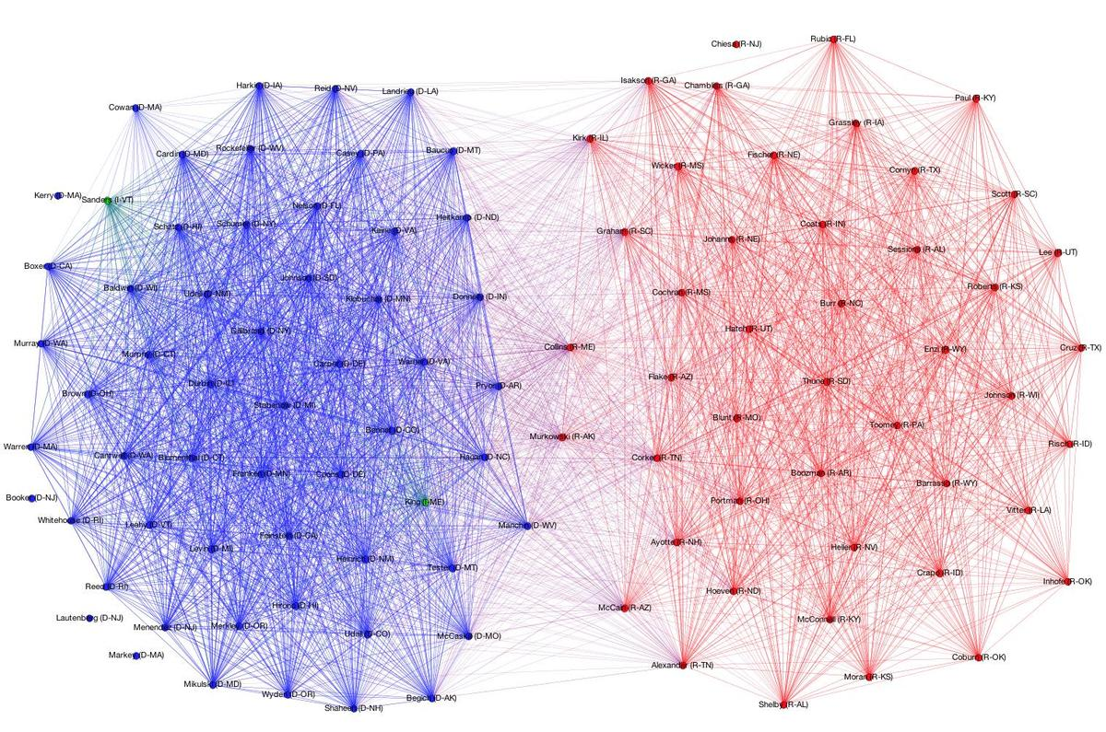
Network of U.S. senators, 2013

Slide 6
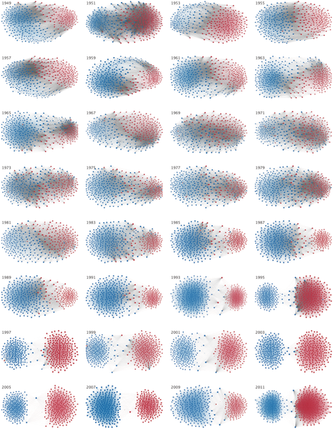
Andris C, Lee D, Hamilton MJ, Martino M, Gunning CE, et al. (2015) The Rise of Partisanship and Super-Cooperators in the U.S. House of Representatives. PLOS ONE 10(4): e0123507. https://doi.org/10.1371/journal.pone.0123507
http://journals.plos.org/plosone/article?id=10.1371/journal.pone.0123507

Slide 7
Empirical questions on social networks
What determines the network structure?
Testing theories of network formation
Individual/pairwise/full-network determinants of links
Does the network matter? To what extent?
Links versus non-links
Variation among peers/connected nodes
Network position
Testing different theories based on given network structure, such as information diffusion, social learning, games on network, etc.
In reality: usually both stages

Slide 8
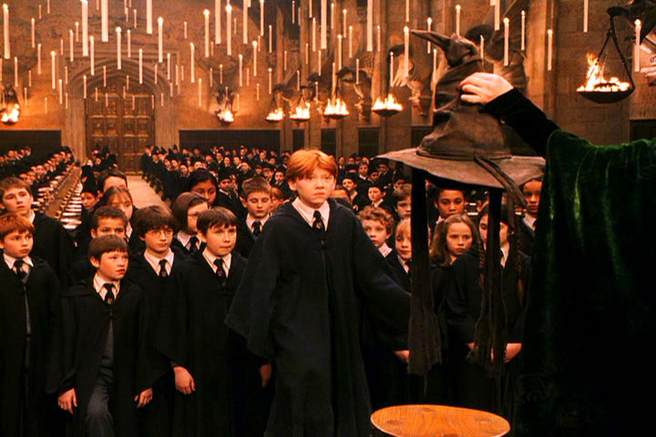
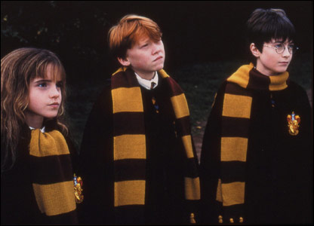
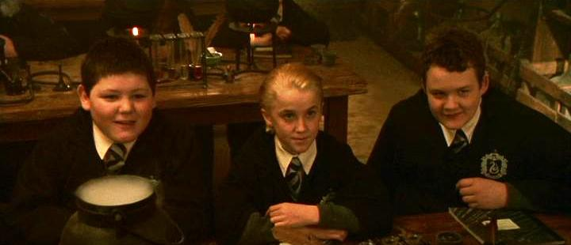
A typical example from the literature
Hogwarts: Assignment into groups by “magic hat”. Same-group students interact a lot
Friendship forms more among
same-group students
… and less across different groups
Notes:
A typical example from the literature, similar to most cases studied before

Slide 9
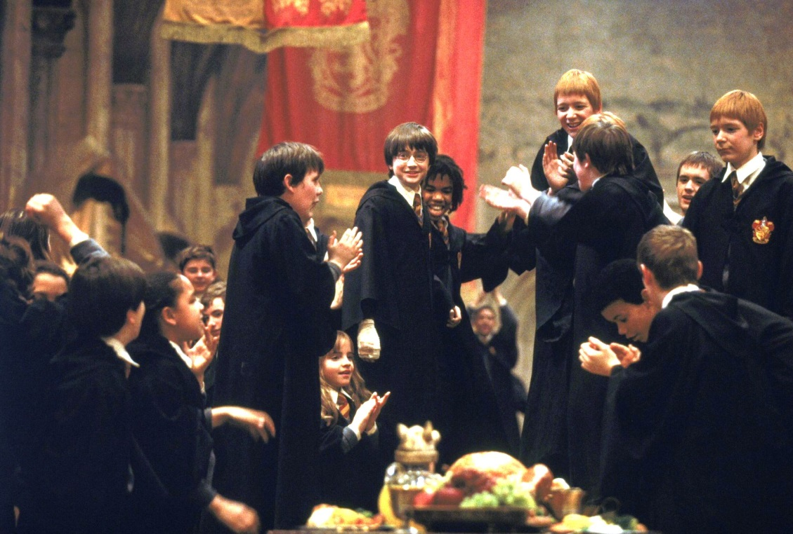

Same-group and friendship influences
Peers in the same group may affect each other
But true friends have much
more influence

Slide 10
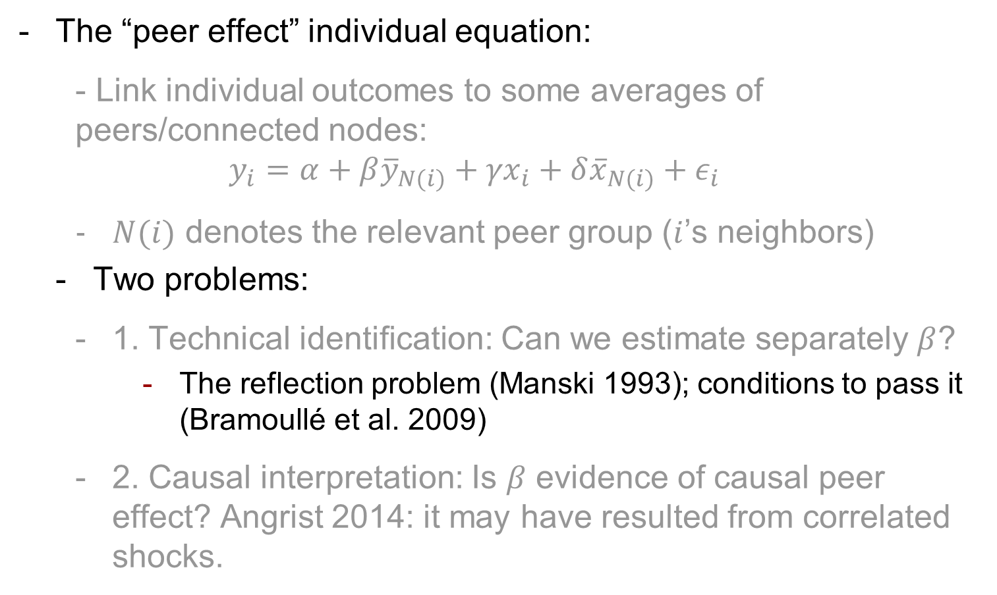
Empirical challenges
The “peer effect” individual equation:
Link individual outcomes to some averages of peers/connected nodes:
$$y_{i}=α+β{\overline{y}}_{N(i)}+{γx}_{i}+{δ\overline{x}}_{N(i)}+ε_{i}$$
$N(i)$ denotes the relevant peer group ($i$’s neighbors)
Two problems:
1. Technical identification: Can we estimate separately $β$?
The reflection problem (Manski 1993); conditions to pass it (Bramoullé et al. 2009)
2. Causal interpretation: Is $β$ evidence of causal peer effect? Angrist 2014: it may have resulted from correlated shocks.

Slide 11
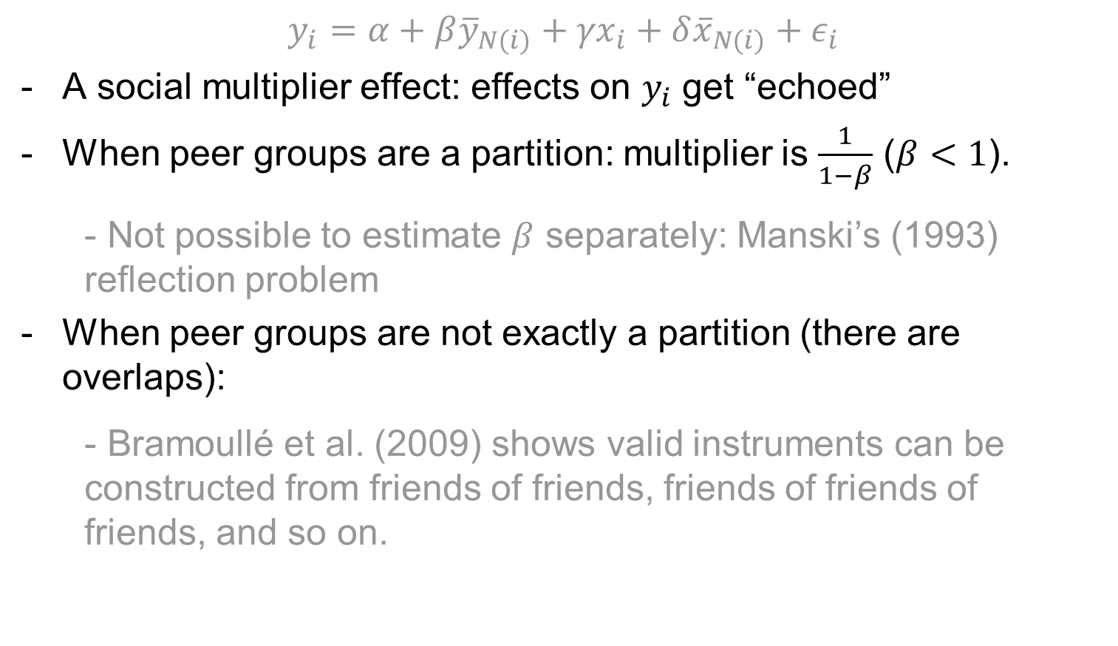
Difficulties of estimating beta
$$y_{i}=α+β{\overline{y}}_{N(i)}+{γx}_{i}+{δ\overline{x}}_{N(i)}+ε_{i}$$
A social multiplier effect: effects on $y_{i}$ get “echoed”
When peer groups are a partition: multiplier is $\frac{1}{1−β}$ ($β<1$).
Not possible to estimate $β$ separately: Manski’s (1993) reflection problem
When peer groups are not exactly a partition (there are overlaps):
Bramoullé et al. (2009) shows valid instruments can be constructed from friends of friends, friends of friends of friends, and so on.

Slide 12
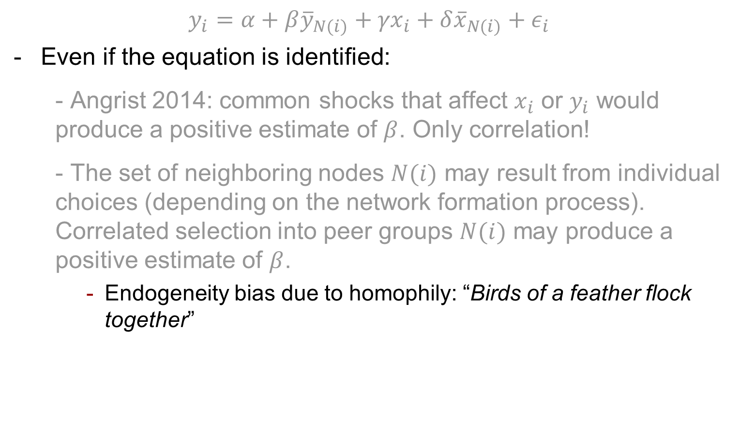
Difficulties of causal interpretation
$$y_{i}=α+β{\overline{y}}_{N(i)}+{γx}_{i}+{δ\overline{x}}_{N(i)}+ε_{i}$$
Even if the equation is identified:
Angrist 2014: common shocks that affect $x_{i}$ or $y_{i}$ would produce a positive estimate of $β$. Only correlation!
The set of neighboring nodes $N(i)$ may result from individual choices (depending on the network formation process). Correlated selection into peer groups $N(i)$ may produce a positive estimate of $β$.
Endogeneity bias due to homophily: “Birds of a feather flock together”

Slide 13
Elements of solution
Angrist’s suggestion: Separate “receiver” and “source” of peer effects; with exogenous shocks from those sources
Example: Kling et al.’s (2007) study of Moving To Opportunities
Treated households are randomly given vouchers to move to better-off neighborhoods
Estimate the effect of the neighborhood on treated households
To address homophily: randomize connections, or find an exogenous instrument variable for connections
Implementation of an IV for connection is difficult in a framework of individual-level equation

Slide 14
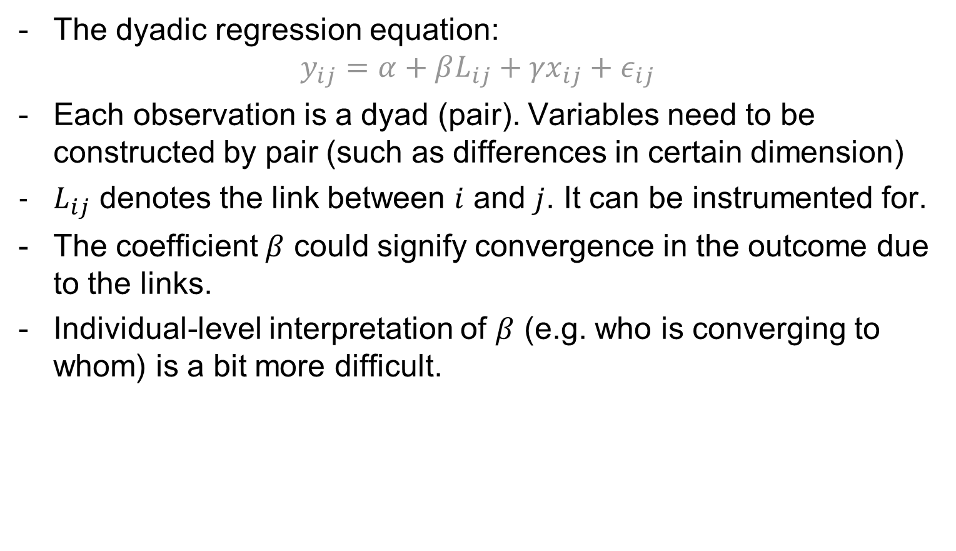
Alternative specification
The dyadic regression equation:
$$y_{ij}=α+βL_{ij}+{γx}_{ij}+ε_{ij}$$
Each observation is a dyad (pair). Variables need to be constructed by pair (such as differences in certain dimension)
$L_{ij}$ denotes the link between $i$ and $j$. It can be instrumented for.
The coefficient $β$ could signify convergence in the outcome due to the links.
Individual-level interpretation of $β$ (e.g. who is converging to whom) is a bit more difficult.

Slide 15
Some examples on firms’ political connections
First example on estimating impacts of political connections
Question: Do firms draw unmerited benefits from social connections with politicians?
We will go through standard designs + my own work

Slide 16
Cross-country evidence: Faccio 2006 AER
1)
Politician
Top corporate officers/ Large shareholders
2)
Politician
Top corporate officers/ Large shareholders
Chiefs of State (government, parliament)
3)
Politician
Firm
Politician → Board
Officers/Large SHs → Politics
Politician
Firm
Cumulative Abnormal Returns
4)

Slide 17
Connections to Parties: Goldman et al. 2009
1)
Political Party
Board Members
2)
Political Party
Board Members
board members with political positions
Change in control of both House and Senate following 1994 midterm election, and 2000 Δ in presidency
3)
Politician
Firm
Politician
Firm
CAR, Procurement
4)

Slide 18
Connections to VP Dick Cheney
1)
VP Dick Cheney
Firms
2)
VP Dick Cheney
Firms
Past CEO, board members, and Halliburton’s board
3)
Politician
Firm
Heart attacks, Cheney becomes running mate
Politician
Firm
CAR
4)

Slide 19
Do et al.’s empirical design
Elected Congressman
E
Board member
M
Market reaction to value
Former classmates
Firm A
Differential Value of Connection
RDD of close elections: At the limit when vote margin→0, equivalent to randomization between winner and loser
Defeated Candidate
D
Board member
N
Market reaction to value
Former classmates
Firm B
Notes:
We construct the social links between politicians and directors using former classmate networks. Politician E and director M are considered connected if they graduated from the same university program within 1 year of each other.
Our identification comes from RDD of close elections to US Congress, and our outcome variable is post-election market reaction to value of connected firms.
That is, suppose firm A is connected to winning politician E through director M, and firm B is connected to defeated politician D through director N, our treatment effect measures the differential market reaction to firm A and firm B right after the election, which can be interpreted as the value of the connection to the elected politician.
Endogeneity and causality problems
Unobserved characteristics of elected/appointed politicians and firms; homophily of links
Reverse causality: strong firms connect to strong politicians
Events are subject to endogeneity issues
Concurrent events; prediction precision of event probabilities, especially for rare events
Measurement of social networks of politicians and firms
By previous experiences, ownerships: endogenous
By campaign contributions: hard to address connections to individual politicians, because firms cannot contribute
Connections to individual politicians: Look at alumni networks

Slide 20
Main results of the paper
On average: Negative effect on firm value when directors’ friends are elected to Congress
Effect dominated by politicians from positions in state politics, not by politicians from federal offices (incl. incumbents)
Explanation: loss of benefits when politicians leave (corruptible) state politics
Different from Shleifer Vishny’s (1994) effect as tested by Bertrand et al. 2008
This loss is stronger for more corrupt states, better-governed firms, possibly because of intense media scrutiny differences between federal and state politics

Slide 21
Contributions
New finding: Smaller benefits when friends are elected to higher offices
Benefits are not just function of power, but also scrutiny
Explains Tullock’s (1972) puzzle “Why is there so little money in politics?” (complement Ansolabehere Snyder 2003 JEP)
Implications on corporate behaviors, institutional design of elections, and checks and balances
Results focus on a well-defined type of connections: former university classmates
RDD avoids reverse causation, endogeneity of connections, of events; RDD is robust to market’s prediction errors of events
Notes:
Our paper contributes a new finding that in the context of US Congress election, higher offices may entail smaller benefits, and benefits depend not only on power but also on scrutiny. This novel finding helps explain Tullock’s puzzle “…”. This provides implications on “…”.
In addition, by implementing RDD, we also greatly improve the quality of the evidence, compared to previous works based on event studies. Finally, we look at a different type of connection, social links instead of direct links.
Simple point: scrutiny matters, because favoritism in a democracy can lead to legal problems (unlike nondemocracies)
Ansolabehere Snyder 2003 JEP: campaign money is a form of political participation, because low impact on politicians’ decision.
“This finding helps to explain Tullock’s (1972) puzzle. Money has little leverage
because it is only a small part of the political calculation that a re-election oriented
legislator makes. And interest group contributors—the “investors” in the political
arena—have little leverage because politicians can raise sufficient funds from
individual contributors. It is true that when economic interest groups give, they
usually appear to act as rational investors (for example, Snyder, 1990, 1992, 1993;
Grier and Munger, 1991; Romer and Snyder, 1994; Kroszner and Stratmann, 1998,
2000; Ansolabehere and Snyder, 1999, 2000a). However, this “investor” money
from organized groups accounts for only a small fraction of overall campaign
funds. Since interest groups can get only a little from their contributions, they
give only a little. As a result, interest group contributions account for at most a
small amount of the variation in voting behavior. In fact, after controlling for
legislator ideology, these contributions have no detectable effects on the behavior
of legislators.”
“Since interest groups can get only a little from their contributions, they
give only a little. As a result, interest group contributions account for at most a
small amount of the variation in voting behavior. In fact, after controlling for
legislator ideology, these contributions have no detectable effects on the behavior
of legislators.”

Slide 22
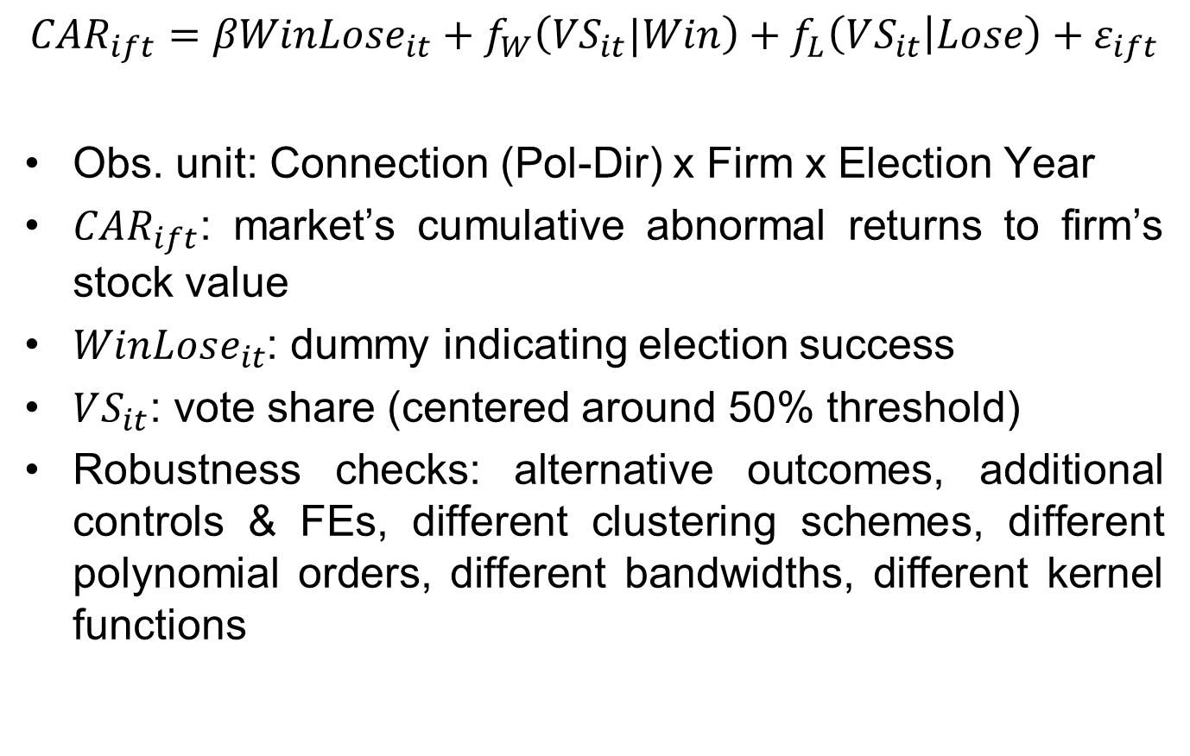
RDD implementation
$$CAR_{ift}=βWinLose_{it}+f_{W}\left({VS}_{it}|Win\right)+f_{L}\left(VS_{it} | Lose\right)+ε_{ift}$$
Obs. unit: Connection (Pol-Dir) x Firm x Election Year
$CAR_{ift}$: market’s cumulative abnormal returns to firm’s stock value
$WinLose_{it}$: dummy indicating election success
$VS_{it}$: vote share (centered around 50% threshold)
Robustness checks: alternative outcomes, additional controls & FEs, different clustering schemes, different polynomial orders, different bandwidths, different kernel functions
Notes:
Our empirical strategy relies on sharp RDD implementation. …

Slide 23
Economic interpretation
Treatment effect of a connection to an elected Congressman, compared with a connection to a defeated candidate
Positive effect: Congress connection more valuable vs. alternative
Negative effect: Congress connection less valuable vs. alternative
Weighted average treatment effect among firms connected to politicians, weighted by politician’s probability of running a close election.
Notes:
The treatment effect measures the value of a connection to an elected Congressman, compared to that of a connection to a defeated candidate.
Our estimate is a WATE among connected firms, weighted by the politician’s probability of running a close election.

Slide 24
Politician-director connection
Politicians: Hand-collected for all politicians involved in 5%-vote margin elections for US Congress, 2000-2008
Directors: BoardEx covering past education, employment, other activities of all boards of major public firms, 1999-2010
Classmate networks: connect politician-director if they finished the same university program within a 1 year gap (Cohen et al. JPE 2008)
Missing data: 2 year gap birth dates
University program: undergraduate, general graduate, professional (business, law, medical), precise to campus
Other measures: 2-3 year gap
Alumni network: no condition on year gap

Slide 25
Outcome variable CAR
Outcome variables: Cumulative Abnormal Returns (CAR) of connected-firms’ stocks (cumulated daily changes in stock prices, minus predicted changes estimated by standard market model)
Different windows of events: 1 week before to 1 month after; Benchmark: 1 day before to 1 week after (-1, +5)
Robustness checks with different market models (using different market factors), raw returns, different windows
Notes:
Standard market model: regressions of firm returns on market returns using daily data from one year to 2 months before the event date, separately for each firm. Standard practice in the finance literature.
FF 3 factor: additional D(small & lager caps), D(high & lower market to book)
A Z-shaped graph of CAR as function of vote margin

Slide 26
Cross-sectional identification by RDD
When election result is partly predicted, CAR only reflects the unpredicted part (pitfall of event studies looking at CAR)
Suppose that the market’s prior for a politician’s win is 90%. The return to his actual winning reflects only 10% of the value. Same for his opponent.
With close election RDD, pre-election probability does not matter
Election result almost randomized at threshold → controls, FEs, market factors used in CAR construction have no expected impact on estimate, but can help reduce noises
Notes:
Some examples of bad market predictions of probabilities: Brexit, Trumpit
Justin Wolfers’ calculation of market value of Trump’s presidency based on future market’s predicted probabilities: off by a large margin

Slide 27
Data summary
Number of close elections | 101 | Number of connected firms | 1,268
# of Senate elections | 20 | median market cap ($ million) | 595
# of Congress elections | 81 | median employment | 1,480
election average margin | 2.57% | average CAR(-1,+5) | 0.00
% of wins by Democrats | 57% | avg. # of connected politicians | 1.3
Number of politicians | 170 | Number of connected directors | 1,171
# coming from state politics | 64 | avg. # of connected politicians | 1.1
# coming from federal offices | 89 | avg. # of firms | 1.3
% of Democrats | 54% | Number of universities | 117
avg. # of connected directors | 7.7 | % of undergraduate connections | 88%
avg. # of connected firms | 9.8 | % of graduate connections | 12%
Final sample includes 1,312 Pol x Dir connections, resulting in 1,819 observations at (Pol-Dir) x Firm x Election Year level.

Slide 28
Covariate tests for selected politician, director, and firm characteristics
 | (1) | (2) | (3) | (4) | (5) | (6) | (7) | (8) | (9) | (10) | (11) | (12)
 | Politician characteristics |  |  |  | Director characteristics |  |  | Firm characteristics (1-Year Lag)
DEPVAR | Gender | Age | Grad. Degree | State Politics | Gender | Age | Grad. Degree | Log (Emp.) | In-state Activi-ties | Gov. Con-tracts | Hldgs. by Inst. Owners | Board Size
Win/Lose | 0.100 | 2.673 | 0.024 | -0.173 | -0.030 | 2.685 | -0.016 | 0.309 | 0.024 | 45.96 | 0.010 | -0.113
 | [0.119] | [2.098] | [0.238] | [0.196] | [0.041] | [2.053] | [0.080] | [0.269] | [0.050] | [28.64] | [0.020] | [0.547]
Obs. | 1,817 | 1,797 | 1,819 | 1,819 | 1,819 | 1,722 | 1,819 | 1,484 | 1,809 | 1,717 | 1,087 | 1,244
No significant differences between winners and losers, between directors connected to winners and losers, or between firms connected to winners and losers.

Slide 29
Connections to elected Congresspersons bring negative values
CAR(-1,+5) | (1) | (2) | (3) | (4) | (5) | (6) | (7)
Sample | Full sample | State Politics | Federal Offices | State Politics & Local Firms | State Politics & Non Local Firm | Congress (Incum-bent) | Non-Congress Federal Offices
Win/Lose | -0.0265 | -0.0481 | -0.0119 | -0.0580 | -0.0273 | -0.0129 | -0.0085
 | [0.0085]*** | [0.0131]*** | [0.0138] | [0.0199]*** | [0.0170] | [0.0141] | [0.0253]
Difference |  | -0.0362
 |  | [0.0181]**
Observations | 1,819 | 594 | 742 | 352 | 242 | 598 | 144
Significant 4.8% difference in CAR between firms connected to losers and winners coming from state politics; even stronger effect among local firms.
Effect robust to additional controls & FEs, different clustering schemes, polynomial orders, bandwidths, CAR constructions, and non-parametric procedure.

Slide 30
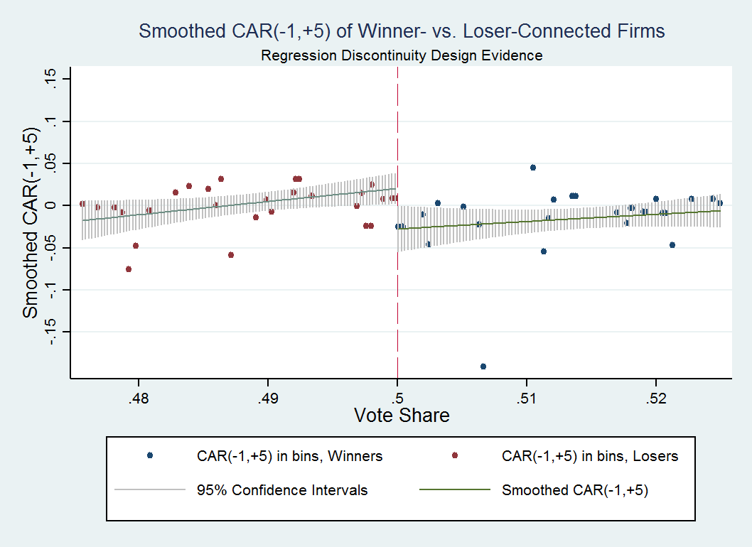
The negative discontinuity effect

Slide 31
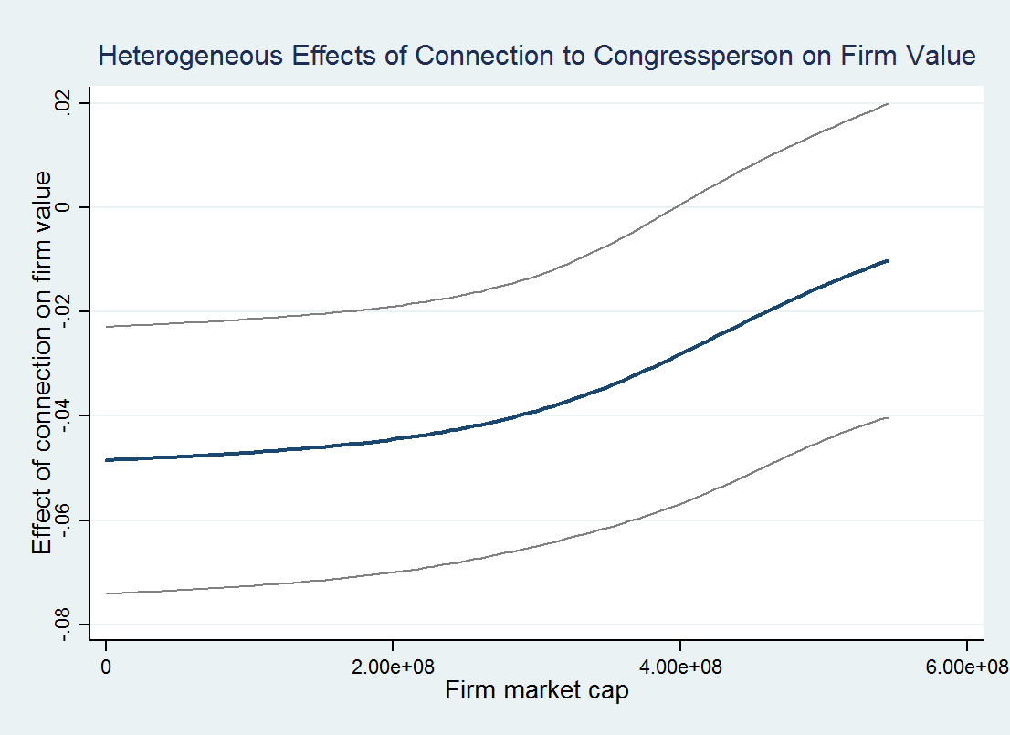
Effects vary by firm size

Slide 32
Some anecdotal cases
Senator George Allen:
Closely elected in 2000
Previous Governor of VA
Graduate from UVA
Connected to Theodore Coburn of Measurement Instruments Inc.
CAR suffered a big loss the week after election
Senator Bob Corker
Closely elected in 2006
Previous mayor of Chattanooga, TN (with controversies)
Graduate from U of TN
Connected firms such as First Acceptance Corp, Wright Medical Group in TN lost significant value

Slide 33
What explains the negative effect?
Value decrease from State to Federal
State politics is more corrupt (Glaeser Saks 2006) → connection to State politicians creates value for firms
Federal politics is more scrutinized (Fisman et al. 2012) → previous value of connection is lost
Also: “Somebody” in state becomes “nobody” in Congress
Also: Longer distance leads to less frequent interactions
Alternative view: Politicians force firms to over-employ (Shleifer Vishny 1994, Bertrand et al. 2008)
Exploratory tests for value from connection to state politics:
Post-election firm’s real outcomes
Effect by firm’s corporate governance quality
Effect by state’s corruption level & institution quality
Media scrutiny & effect by distance to DC

Slide 34
Reduction in government contracts
 | (1) | (2) | (3) | (4) | (5) | (6) | (7) | (8)
2-Year Change in: | No. of Obligated Transactions |  | Having Obligated Transactions |  | No. of Procurement Contracts |  | Having Procurement Contracts
Sample | State Politics | Federal Offices | State Politics | Federal Offices | State Politics | Federal Offices | State Politics | Federal Offices
Win/Lose | -67.57 | 2.49 | -0.143 | 0.024 | -32.20 | 12.70 | -0.109 | -0.063
 | [30.56]** | [41.82] | [0.051]*** | [0.058] | [18.68]* | [35.70] | [0.057]* | [0.074]
Observations | 561 | 690 | 561 | 690 | 561 | 690 | 561 | 690
Number of government contracts goes down among firms connected to winning politicians with coming from state politics.
Notes:
The first piece evidence of the channel is reduction in number of government contracts within 2 years of the election. The decrease happens in both the number of actual transactions (obligated transactions), and the number of contracts (procurement contracts), and most importantly, only among firms connected to state-level politics.
Data source: Federal Procurement Data System
Columns (1)-(2): 2-year changes in number of obligated transactions
Columns (3)-(4): changes in whether the firm is awarded at least one obligated transaction
Columns (5)-(6): changes in number of all procurement contracts
Columns (7)-(8): changes in whether the firm is awarded at least one procurement contract

Slide 35
Reduction in in-state activities, employment, director’s tenure
 | (1) | (2) | (3) | (4) | (5) | (6)
DEPVAR | Post-Election Change in Local Newspaper Mentions |  | Post-Election Change in log(Employment) |  | Director’s RemainingYears
Sample | State Politics | Federal Offices | State Politics | Federal Offices | State Politics | Federal Offices
Win/Lose | -0.0096 | -0.0046 | -0.0669 | -0.0195 | -2.832 | -0.572
 | [0.0044]** | [0.0042] | [0.0354]* | [0.0486] | [1.484]* | [1.109]
Observations | 593 | 741 | 480 | 623 | 594 | 742
Connected-firms reduce (in-state) activities and employment after politician wins.
Connected-directors remain with the firm for shorter period after politician wins.
Noisy but qualitatively similar results for other firm real outcomes.
Notes:
Columns (1)-(2): Firm activities are measured in a given state in a given year as "Firms Reported In Local Newspapers" (FRILN), namely the number of search hits for the firm's name in local newspapers normalized by the number of search hits for the neutral keyword "September” (Saiz and Simonsohn’s (2008) idea of “downloading wisdom”).

Slide 36
Better-governed firms are more affected
CAR(-1,+5) | (1) | (2) | (3) | (4) | (5) | (6) | (7) | (8)
Sample | Politicians Coming from State Politics
 | Larger Hldgs. by Inst. Block Owners | Smaller Hldgs. by Inst. Block Owners | More Inst. Block Owners | Fewer Inst. Block Owners | Smaller Board Size | Larger Board Size | Higher Shares of Indepen-dent Dir. | Lower Shares of Indepen-dent Dir.
Win/Lose | -0.099 | 0.023 | -0.112 | -0.002 | -0.082 | -0.032 | -0.059 | -0.057
 | [0.028]*** | [0.018] | [0.039]*** | [0.023] | [0.031]** | [0.034] | [0.031]* | [0.033]*
Difference | -0.122 |  | -0.109 |  | -0.050 |  | -0.001
 | [0.037]*** |  | [0.052]** |  | [0.054] |  | [0.052]
Observations | 182 | 169 | 162 | 279 | 244 | 145 | 218 | 171
Effect is stronger under stronger corporate governance: loss of value due to loss of state-political connections after the politicians’ successful elections
Notes:
If it were Schleifer & Vishny story (i.e. loss of value by being forced to do favors for winning politicians), we would expect better governed firms to suffer less of a value loss.

Slide 37
Effect is stronger in states with higher corruption level (1/2)
CAR(-1,+5) | (1) | (2) | (3) | (4) | (5) | (6)
Sample | Politicians Coming from State Politics
 | More Corrupt Main City | Less Corrupt Main City | More Corrupt State | Less Corrupt State | More Corrupt Conviction | Less Corrupt Conviction
Win/Lose | -0.0806 | -0.0191 | -0.0728 | -0.0402 | -0.0770 | -0.0412
 | [0.0264]*** | [0.0186] | [0.0228]*** | [0.0211]* | [0.0406]* | [0.0183]**
Difference | -0.0615 |  | -0.0326 |  | -0.0359
 | [0.0321]* |  | [0.0308] |  | [0.0442]
Observations | 318 | 276 | 341 | 253 | 258 | 336
Effect is stronger in states/main city with more mentions for corruption in the news, and in states with more convictions of corruption case.
Notes:
Columns (1) & (2): use Exalead.com 2009 search hits for the word “corruption” close to name of main city, normalized by hits for name of main city
Columns (3) & (4): use Newslibrary.com 2009 all newspapers search hits for “corruption” close to name of state, normalized by hits for name of state
Columns (5) & (6): Glaeser and Saks (2006) -- extract actual conviction data from the Department of Justice’s “Report to Congress on the Activities and Operations of the Public Integrity Section” to form a measure of the ratio of convicted corruption cases by population size, averaged from 1976 to 2002 to remove periodical noises

Slide 38
Effect is stronger in states with higher corruption level (2/2)
CAR(-1,+5) | (7) | (8) | (9) | (10) | (11) | (12)
Sample | Politicians Coming from State Politics
 | More Regulations | Fewer Regulations | Higher ALD 1970 | Lower ALD 1970 | Higher Generalized Trust | Lower Generalized Trust
Win/Lose | -0.0720 | -0.00409 | -0.0606 | -0.0417 | -0.0544 | -0.0272
 | [0.0148]*** | [0.0180] | [0.0238]** | [0.0173]** | [0.0181]*** | [0.0117]**
Difference | -0.0679 |  | -0.0188 |  | -0.0272
 | [0.0231]*** |  | [0.0292] |  | [0.0214]
Observations | 364 | 230 | 269 | 325 | 306 | 288
Effect is stronger in states with more regulations passed, more isolated capital city (measured by Average Log Distance), and higher generalized trust.
Notes:
Colums (9) & (10): ALD as a proxy for quality of governance, measure least likely to be affected by reverse causation.
Columns (7) & (8): The index of regulation by state is measured for 1999 in Clemson University’s Report on Economic Freedom, http://freedom.clemson.edu. This report combines information on labor and environmental regulations and regulations in specific industries such as insurance.

Slide 39
Change in media scrutiny post-election
 | (1) | (2) | (3) | (4)
VAR | Change in Normalized Local Newspaper Mentions
Sample | Winners from State Politics | Losers from State Politics | Winners from Federal Offices | Losers from Federal Offices
Mean | 0.0464 | -0.0137 | 0.0217 | -0.0671
 | [0.0141]*** | [0.00670]* | [0.0155] | [0.0223]***
Observations | 30 | 34 | 48 | 41
Winners get mentioned more in local newspaper after their successful elections (compared to before the elections).

Slide 40
Winners are more scrutinized, while distance to DC does not matter
 | (1) | (2) | (3) | (4)
DEPVAR | Change in Normalized Local Newspaper Mentions |  | CAR(-1, +5)
Sample | State Politics | Federal Offices | Shorter distance to DC | Longer distance to DC
Win/Lose | 0.0527 | 0.160 | -0.0392 | -0.0388
 | [0.0293]* | [0.0544]*** | [0.0218]* | [0.0180]**
Observations | 64 | 89 | 355 | 239
Winners get mentioned more in local newspaper after their successful elections (compared to losers).
Effect does not seem to vary with distance between firm’s headquarter and DC.

Slide 41
Effect diminishes with social distance
CAR(-1,+5) | (1) | (2) | (3) | (4) | (5) | (6) | (7)
Sample | Within 1Y | Within 2Y | Within 3Y | Within 4Y | Alumni | Election within 1 Year of Last Reunion | Election Not within 1 Year of Last Reunion
Win/Lose | -0.0265 | -0.0183 | -0.0148 | -0.0143 | -0.0053 | -0.0541 | -0.00659
 | [0.009]*** | [0.008]** | [0.007]** | [0.007]** | [0.006] | [0.0228]** | [0.0353]
Difference |  |  |  |  |  | -0.0475
 |  |  |  |  |  | [0.0412]
Observations | 1,819 | 3,071 | 4,232 | 5,370 | 28,074 | 295 | 215
Effect is weaker as strength of politician-director relationship weakens.
Effect is much stronger in the year of alumni reunion.

Slide 42
How does it work?
Requirement: Information is known to a few individuals, who can trade on the related stocks
Abnormal Trading Volume (Campbell Wasley 1996):
Sampled stocks are traded more around the elections (significant at 1%)
(-5,-1): 5.21% more. (-1,+5): 2.22% more. All significant at 1%.
Lots of build-up → reason to believe the market is informed and prices pre-election information

Slide 43
Summary
Key findings:
Firms need not benefit from social connections to politicians in higher office, if they are more scrutinized
State-level connections matter more to firms, especially in corrupt states, and for well-governed firms
Empirical strategy: RDD of close elections using classmates social network
Companion paper (Do et al. 2017): close gubernatorial elections. Benefits to connected firms are positive.
Implications: Room for rent-seeking from corporate and political perspectives → design of checks and balances at state level

Slide 44
Some further thoughts
Narrow targeting versus broad-based targeting:
Corruption versus lobbying
Positive spillover from one firm to similar firms in the industry (i.e. network effects on the same side)
Test: control for/estimate the effect on similar firms
Result: strong evidence of narrow targeting.
Homophily issue:
Related to broad-based targeting (but not the same)
Difficult to control completely for, unless one finds an exogenous source of variation in the formation of links.

Slide 45
Some examples on firms’ political connections
Second example on estimating impacts of friendships on political opinion
Question: Do people listen to their friends?
When people with different beliefs meet and interact in a social network:
Do beliefs really converge?
How?

Slide 46
Targets of the empirical design
Causal effect of a friendship link on beliefs between pairs
Endogeneity bias due to homophily (towards higher correlation between beliefs and friendship): “Birds of a feather flock together”
Average friendship effects may hide important heterogeneity: possibly no effect among common group peers, or divergence
“I don't need a friend who changes when I change and who nods when I nod; my shadow does that much better.” – Plutarch
Psychology: the need to distinguish oneself among friends

Slide 47
Empirical design
Context: Exogenous allocation of study groups at college entry in Sciences Po
Design:
Survey social networks, opinions and attitudes
Use same-group membership as IV for friendship
Look at (variation of) friendship’s effects on belief difference
Contributions:
Friends, not just peers (classmates)
Beliefs and (some) actions
Separation of friendship influence from homophily bias

Slide 48

Setting of tutorial groups
Students attend few large lectures, then gather in small classes in fixed tutorial groups (triplettes, ~20 students)
Tutorial groups are the primary reason to meet other students in 1st year
3 mandatory core classes each semester in 1st year
Classroom materials are synchronized
No elective classes before 2nd year, except arts and sports

Slide 49
Assignment into tutorial groups
Tutorial group assignment is essentially exogenous
Students mostly choose on course schedule:
Students are told to log in separately from home, at a specific time. They see the schedule of one class (out of 3) at a time. All triples of tutorials are balanced with unattractive and attractive timing.
Assignments are done within minutes. Enrollment is hectic, and few get their first choices. Very difficult to coordinate.
No summary document is available to students. Information is very limited.
No information on instructors, on next semester’s schedules.

Slide 50
Data collection
March 2014: Online survey/game for two classes (entry in 2013 and 2009, with focus on 2013)
Incentive-compatible questions to elicit social networks (Leider et al 2009)
Each student chooses up to 10 friends
Friends’ names are from “autosearch” lists
Incentives on cross-validation by friends (name, first meeting)
High incentives to get high participation rate (Chandrasekhar Lewis 2014)
No priming on tutorial groups
Questions on political opinions, attitudes (similar to European Value Survey)
Retrospective questions on pre-Sciences Po political opinions.
Other data obtained from administrative records: tutorial groups, student characteristics, etc.
Planned: a second survey in June 2015, further online experiments (trust, cooperation, etc.) in September 2015.

Slide 51
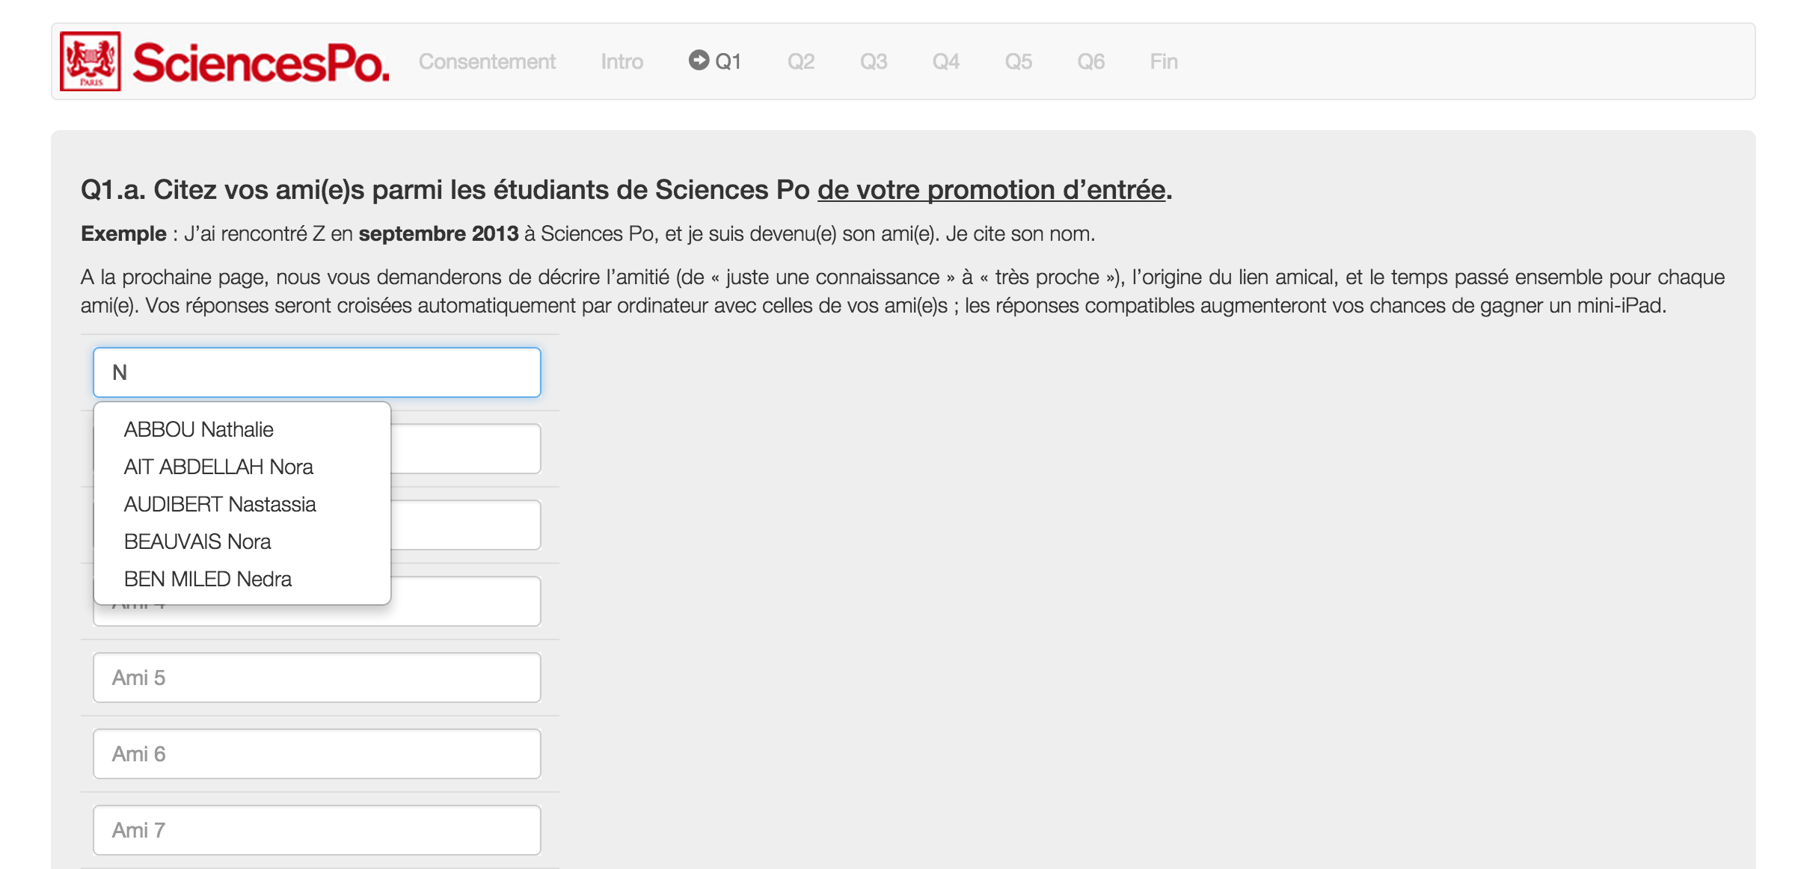
Survey design

Slide 52
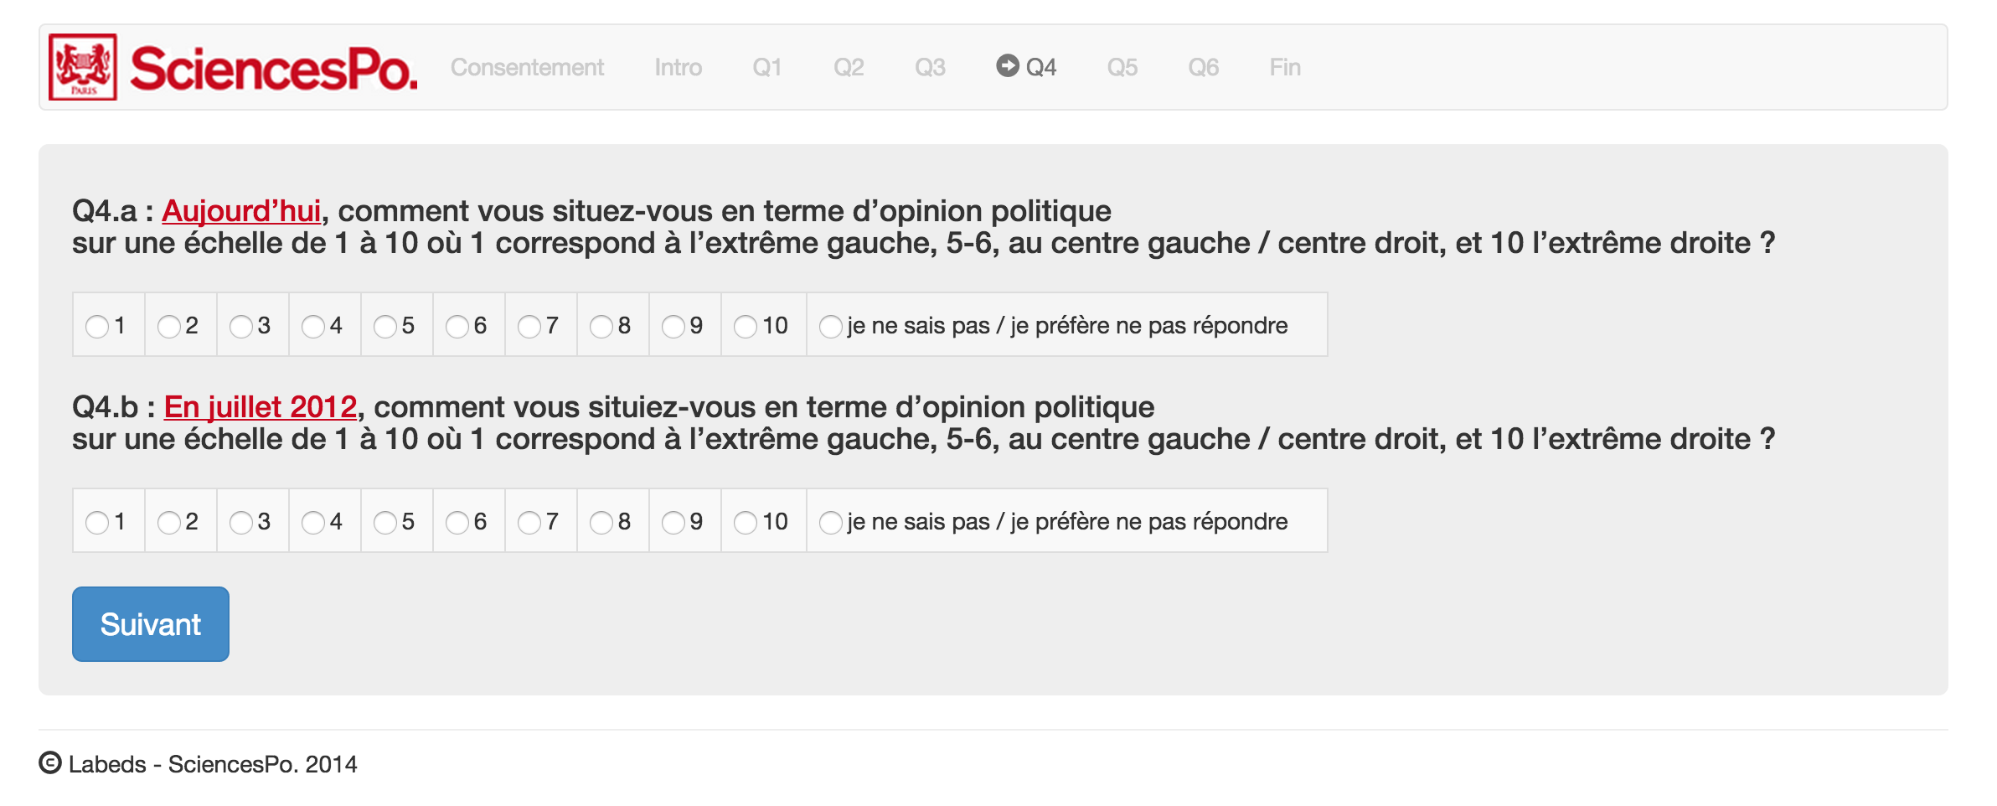

Slide 53
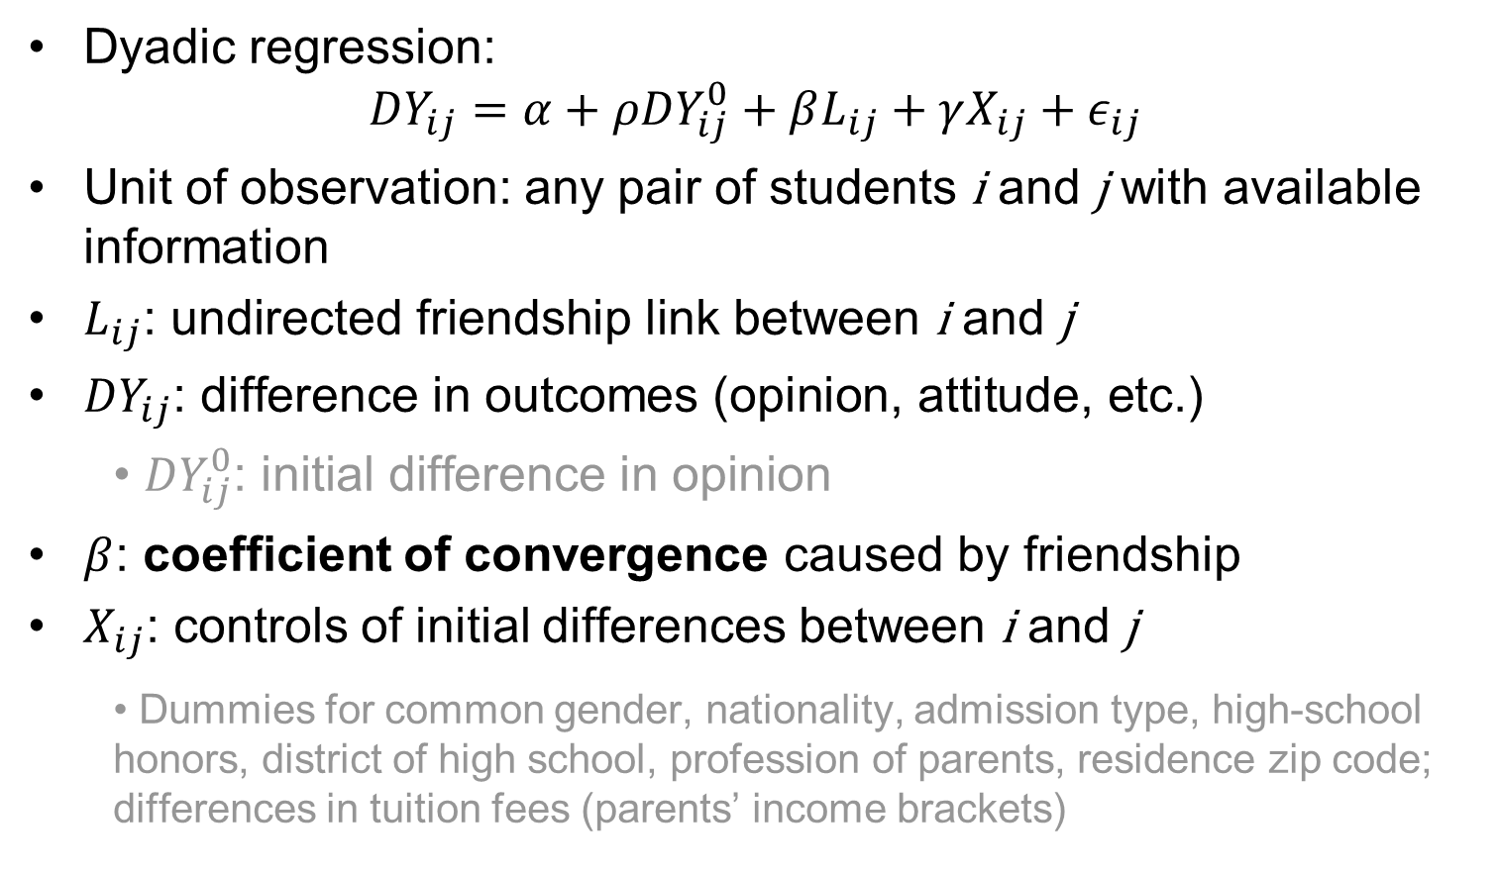
Empirical design
Dyadic regression:
$${DY}_{ij}=α+ρ{DY}_{ij}^{0}+βL_{ij}+γX_{ij}+ε_{ij}$$
Unit of observation: any pair of students i and j with available information
$L_{ij}\text{: }\text{undirected} \text{friendship} \text{link} \text{between} \text{i} \text{and} \text{j}$
${DY}_{ij}\text{: }\text{difference} \text{in} \text{outcomes}\text{ (}\text{opinion}\text{, }\text{attitude}\text{, }\text{etc}\text{.)}$
${DY}_{ij}^{0}\text{: }\text{initial} \text{difference} \text{in} \text{opinion}$
$β$: coefficient of convergence caused by friendship
$X_{ij}$: controls of initial differences between i and j
Dummies for common gender, nationality, admission type, high-school honors, district of high school, profession of parents, residence zip code; differences in tuition fees (parents’ income brackets)

Slide 54
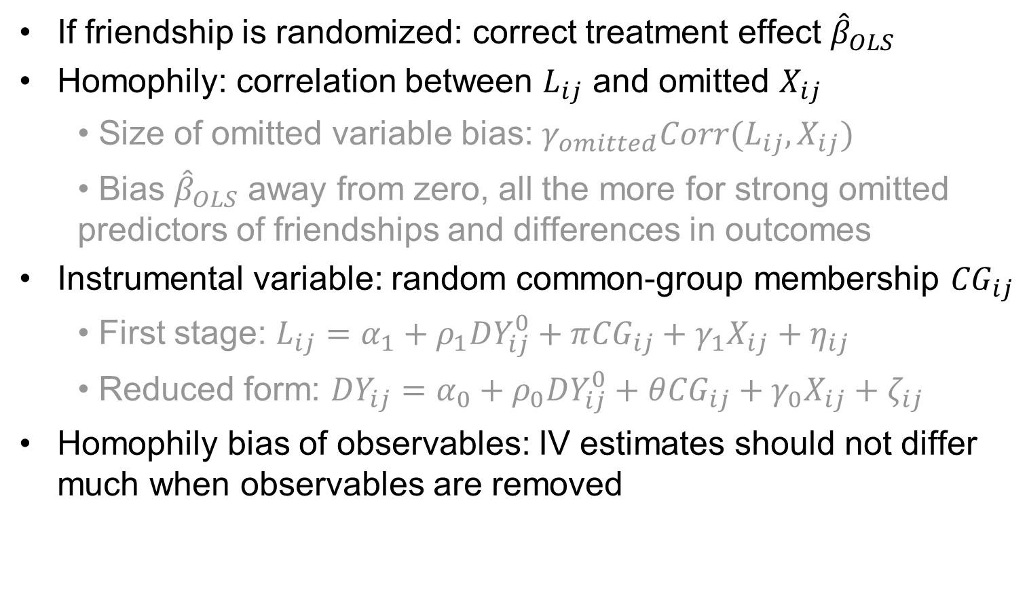
Instrumental Variable strategy
If friendship is randomized: correct treatment effect ${\hat{β}}_{OLS}$
Homophily: correlation between $L_{ij}$ and omitted $X_{ij}$
Size of omitted variable bias: $γ_{omitted}Corr(L_{ij}, X_{ij})$
Bias ${\hat{β}}_{OLS}$ away from zero, all the more for strong omitted predictors of friendships and differences in outcomes
Instrumental variable: random common-group membership ${CG}_{ij}$
First stage: $L_{ij}=α_{1}+ρ_{1}{DY}_{ij}^{0}+π{CG}_{ij}+γ_{1}X_{ij}+η_{ij}$
Reduced form: ${DY}_{ij}=α_{0}+ρ_{0}{DY}_{ij}^{0}+θ{CG}_{ij}+γ_{0}X_{ij}+ζ_{ij}$
Homophily bias of observables: IV estimates should not differ much when observables are removed

Slide 55
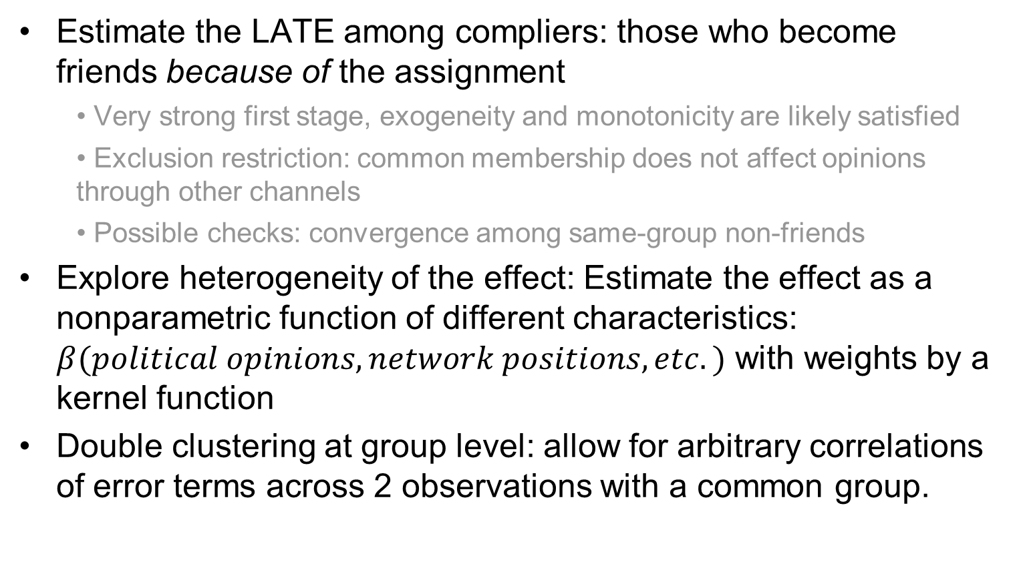
Interpretation and Inference
Estimate the LATE among compliers: those who become friends because of the assignment
Very strong first stage, exogeneity and monotonicity are likely satisfied
Exclusion restriction: common membership does not affect opinions through other channels
Possible checks: convergence among same-group non-friends
Explore heterogeneity of the effect: Estimate the effect as a nonparametric function of different characteristics: $β(political opinions, network positions, etc.)$ with weights by a kernel function
Double clustering at group level: allow for arbitrary correlations of error terms across 2 observations with a common group.

Slide 56
Data description
Quality of network survey:
Participation rate of 66% (completed survey) for the 2013 cohort: in line with Leider et al (2009), Goeree et al (2010)
High quality of reported friendship
 | mean
VARIABLES | (sd)
Number of reported friends | 8.560
 | (2.056)
Number of reciprocal friends | 4.064
 | (1.998)
Correct answer : meeting | 0.760
 | (0.274)
Correct answer : time spent | 0.521
 | (0.337)
Correct answer : activity | 0.461
 | (0.305)
Correct answer : strength of the relationship | 0.515
 | (0.310)
Observations | 498

Slide 57
Network structure and characteristics
We use the “OR” undirected network from the network survey (Leider et al 2009, 2010, Goeree et al 2010)
Network statistics are similar to the literature
Network statistics | Value
Mean number of degree per individual | 8.8625
Variance number of degree per individual | 18.4842
Median number of degree per individual | 10
Maximum number of degree per individual | 21
Minimum number of degree per individual | 0
Diameter of the network | 9
Average path length | 3.7008
Overall clustering coefficient | 0,241
Average clustering coefficient | 0,271

Slide 58
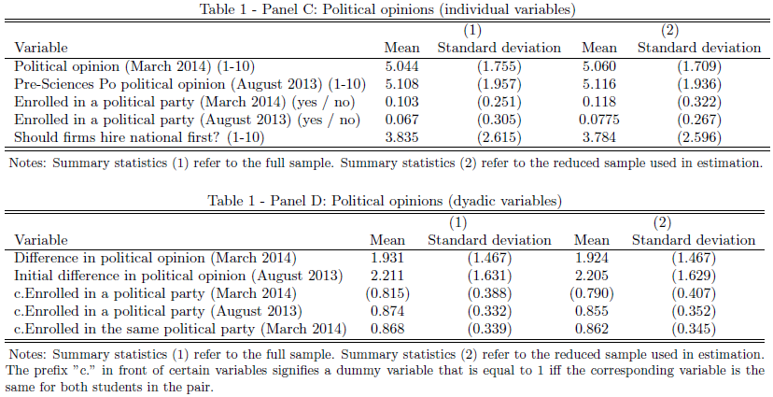
Outcome variables

Slide 59
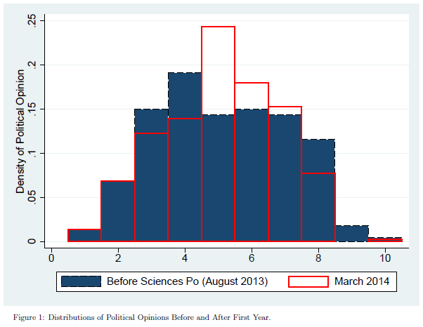
Political opinion distribution
Distribution of opinions before and after the first year

Slide 60
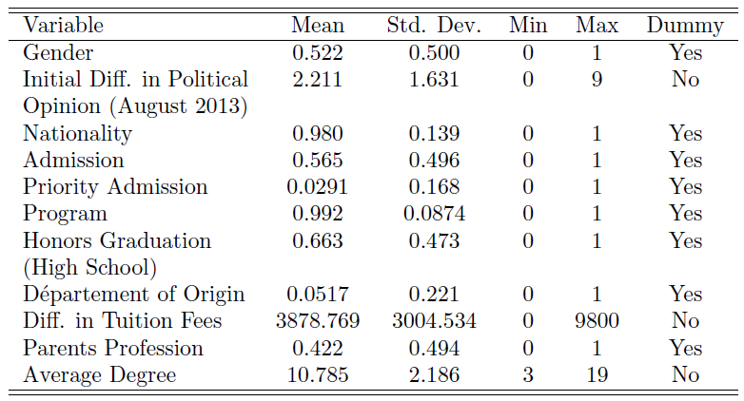
Dyadic control variables
Common (binary) characteristics, differences in continuous variables

Slide 61
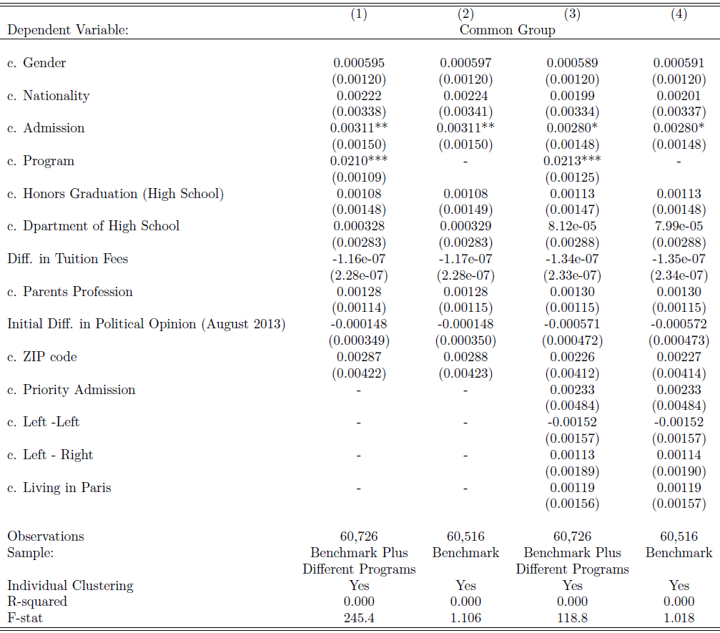
Balancing tests
Most variables are really balanced
Unbalanced in program and some special admission types, because of double degree requirements.

Slide 62
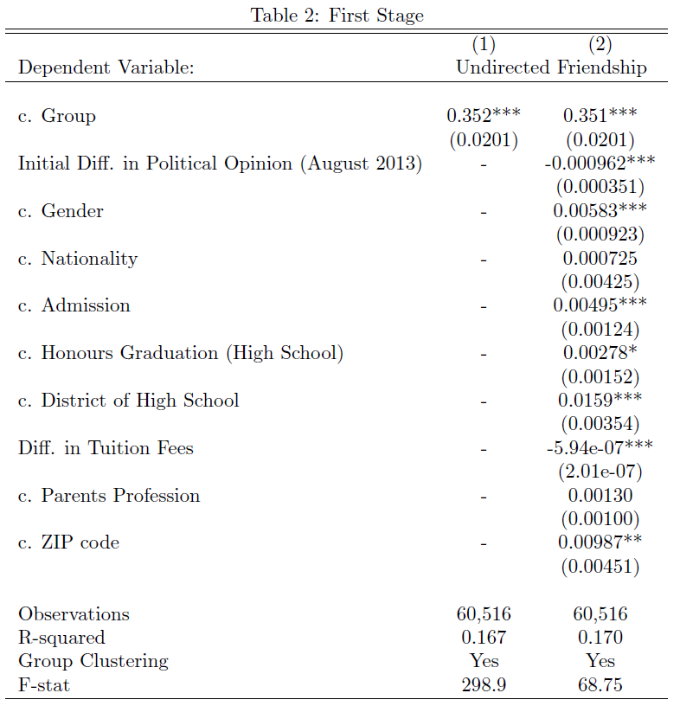
Results
Strong first stage: common group membership predicts friendship

Slide 63
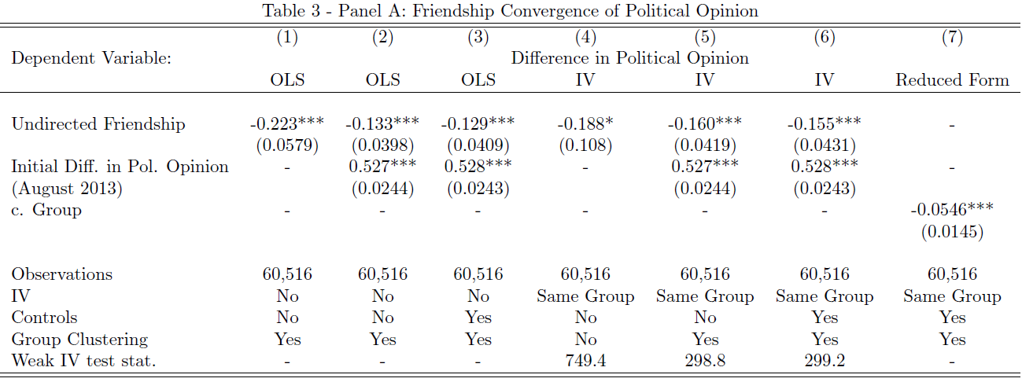
Convergence of political opinion
Convergence of about 11% of standard deviation
Half-life of political differences: roughly 4 years.
Most control variables do not matter to IV
IV estimate is bigger than OLS

Slide 64
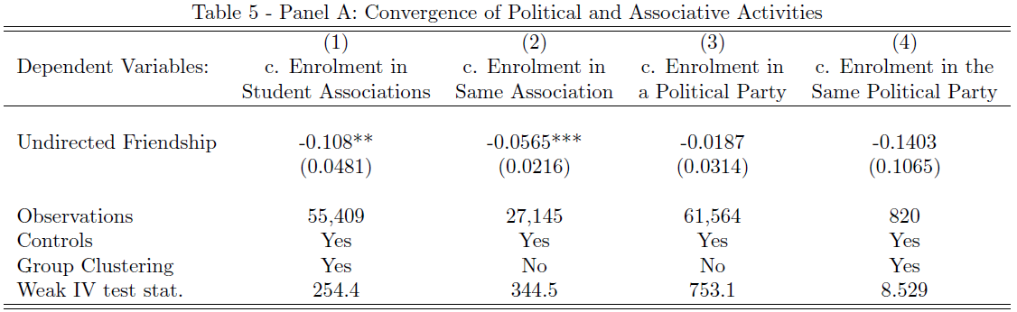
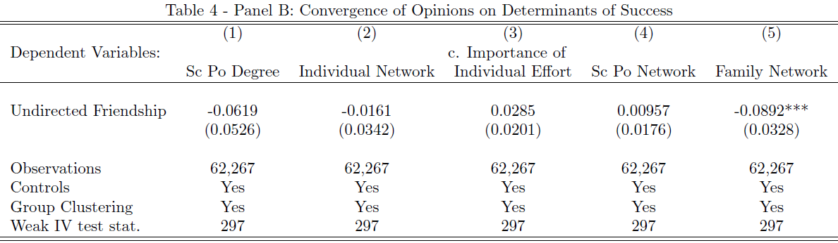
Convergence in other outcomes
Political and associative participations
Determinants of success

Slide 65
Benchmark results
There is convergence on political opinions, determinants of success, and associative and political participation
The estimated bias (IV-OLS) is not in the direction predicted by homophily
It is probably due to heterogeneous effects: LATE on compliers (those who become friends because of same-group exposure)
Effects are stronger among compliers, compared to always-takers and never-takers
Policy driven convergence is strong

Slide 66
On the exclusion of common shocks
The design takes care of potential homophily biases in network formation: common group membership uncorrelated with common characteristics/differences in characteristics
Another identification concern: within-group common shocks that lead to convergence (exclusion hypothesis)
First test: Subsample of non-friend dyads, common group membership does not lead to convergence.
Second test: Convergence effect along social distances

Slide 67
Heterogeneous effects
Heterogeneity of convergence effects with respect to pre-Sciences Po distances (political opinion, common gender, common admission group).
The instruments include common group membership and its interactions with those variables.
Heterogeneity of convergence effects with respect to predicted propensity to become friends between pairs, excluding the effect of same group membership.
Run probit regressions of undirected friendship on control variables.
Then predict the propensity to become friends between any pairs of students.

Slide 68
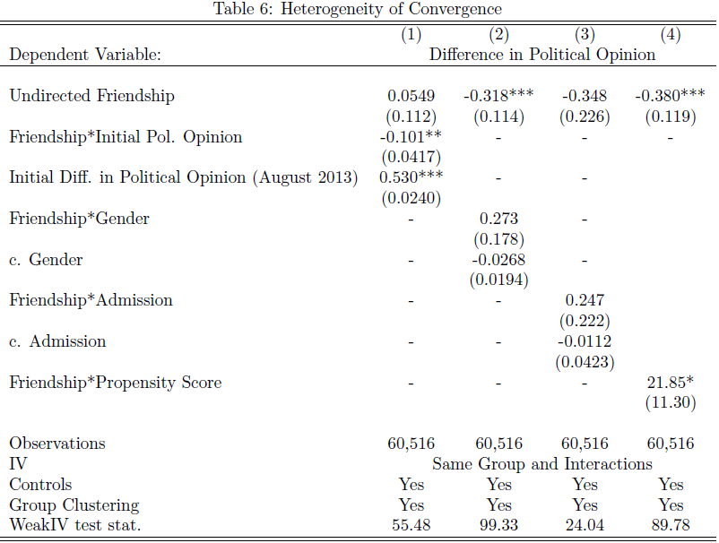
Heterogeneous convergence
Convergence is higher among students with more initial differences

Slide 69
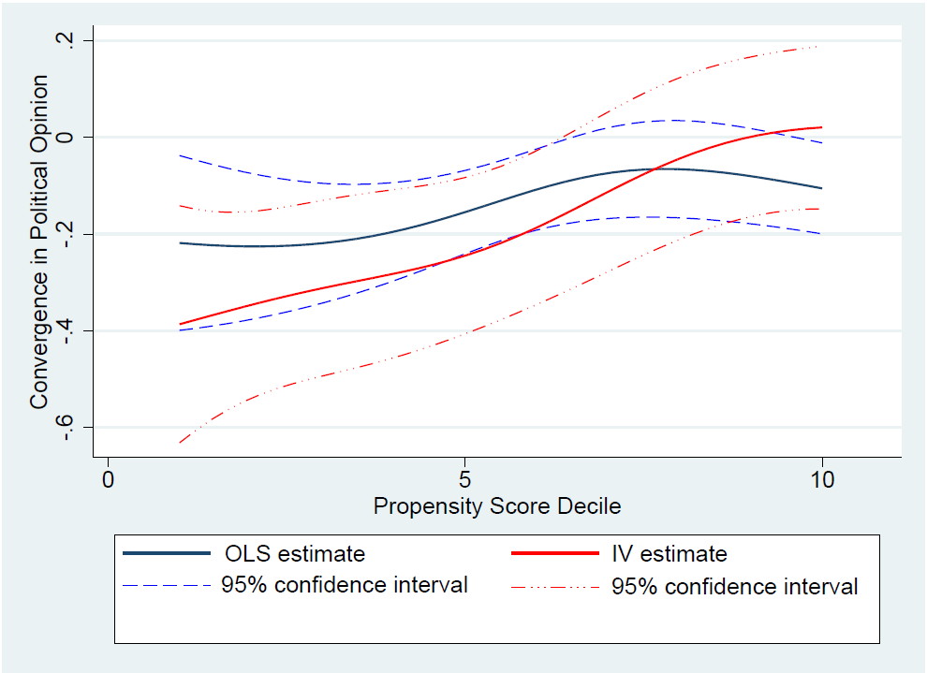
Propensity score of friendship and convergence
Convergence is strong among unlikely friends
Not much difference between OLS and IV. Homophily bias unlikely strong.
Effect over propensity score similar to avoidance of double counting.

Slide 70
Convergence, divergence, and extremism
Convergence of political opinion, by initial political opinion

Slide 71
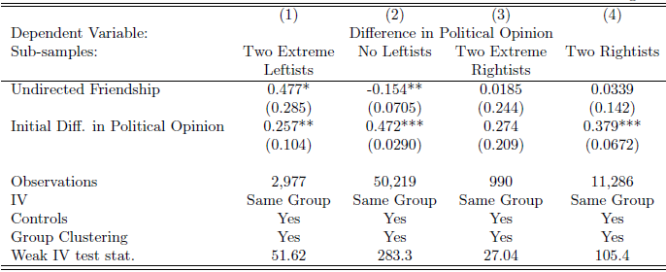
Extremism and divergence
Divergence among extreme leftists in political opinion:

Slide 72
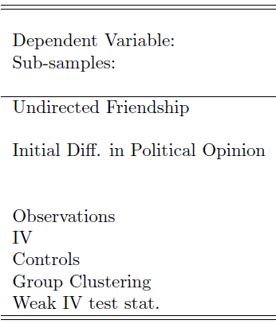
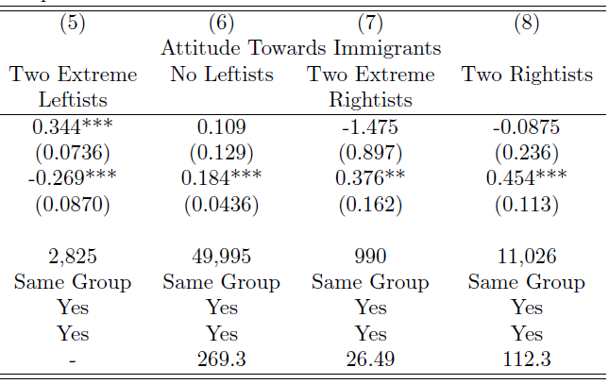
Extremism and divergence
… and attitude towards immigration

Slide 73
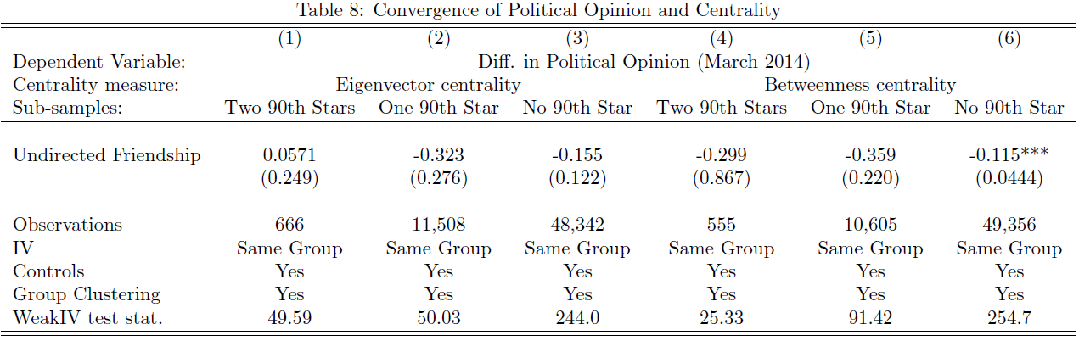
Convergence and eigenvector centrality
Convergence seems strongest between a star (top 10% centrality) and a non-star (bottom 90% centrality)

Slide 74
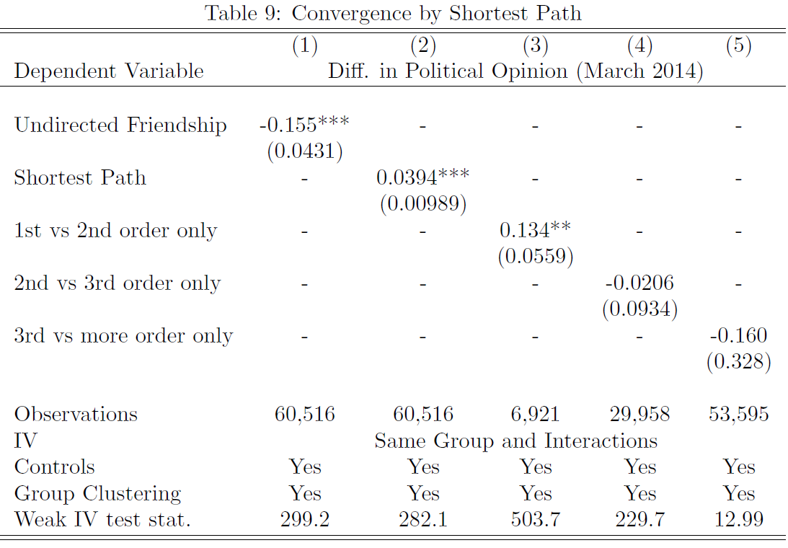
Path lengths and convergence
Use same-group membership as IV for path length between pairs: convergence from reduction in path lengths
Convergence takes place mostly among direct friends

Slide 75
Summary
Beliefs on politics among friends converge rapidly after one year
Overall, homophily matters, but homophily bias seems weak.
Convergence is highly heterogeneous:
It is strongest among least likely friends, friends with most different predetermined characteristics
Homophily reduces beliefs diffusion even more (complementary to Golub Jackson 2012)
Divergence among extreme leftists
How networks structure matters to convergence:
Works mostly through direct friends
Convergence towards star
Common friends matter

Slide 76
Thank you!

Slide 77
Social connections and firm values
INTRODUCTION
Important direct links (former/present employment or ownership) to top-level politics may increase firm value
In developing countries: Fisman 2001 AER (Suharto), Johnson Mitton 2003 JFE (Mahathir), Khwajia Mian 2005 QJE (Pakistan), Faccio 2006 AER (cross countries)
In American politics (strong safeguards against bribery for favor): Fisman et al. 2012 (Dick Cheney brings no value) vs. Goldman et al. 2008 RFS (Rep. Party links bring huge value), Acemoglu et al. JFE forth. (Tim Geithner), Roberts 1990 AJPS (dead U.S. senator)
Our question:
Do social connections in the U.S. between politicians and corporate directors affect firm value?
Who make it stronger/weaker? A comparative look into U.S. politics
Notes:
Covering the topic of political connections and firms values, there has been strong evidence in developing countries that firms benefit from direct links to top politics, such as in the case of Indonesia, Malaysia, or Pakistan.
In the US, there are stronger safeguards against corruption, and similar works on the US have yielded mixed results. For example, Fisman et al. finds that connection to Dick Cheney brings no value, while Goldman et al. finds that Republican links brings huge value to firms after the 2000 election.
Moreover, all of these studies look at direct, explicit links, defined by former/present politicians’ employment or ownership in the firm.
Our paper, on the other hand, explores social links (friendships) between politicians and businessmen, and studies the value of these links in the US context.
Fisman 2001 AER: Suharto health problems → 23% of firm value explained by connection to the Suharto family (provided by a consultancy)
Johnson Mitton 2003 JFE: stronger control of capital flow during 1997 crisis benefits firms connected to Malaysian president & key government officials
Khwajia Mian 2005 QJE: firms directed by politicians participating in elections (matched based on names) get favorable loans
Faccio 2006 AER: worldwide dataset of directly connected firms & effect of announcements of politicians→business and businessmen→politics
Fisman et al 2006: Dick Cheney connections bring no value
Goldman Rocholl So 2008 RFS: election 2000 & R. vs. D. connections (former politicians/officials in firms). Another paper: effect on procurement.
Acemoglu et al. JFE forth.: firms connected to Tim Geithner (Obama’s 1st Treasury Secretary) experience the value of connection in a crisis. Identification by synthetic control & CARs.
Roberts 1990 AJPS: a dead senator (Henry “Scoop” Jackson tells no lie). Returns of firms connected (in different ways) to dead senator. Seniority in Congress pays.
Cohen et al 2007 JPE: information transmission among friends from firms & fund managers
Knight 2007 JPubE: industries that benefit from economic platform of Bush & Gore.
Snowberg et al 2007 QJE: prediction market & bond yields.
Bertrand et al 2008: France, test Shleifer Vishny’s idea. Politicians induce firms to hire more in election year elections affect equity prices
Nguyen 2008: France, friendship between CEO & board members → CEO remains longer at firm, less likely to be fired

Slide 78
Further robustness checks
Collapse the data by different levels
Using different weighting schemes
CAR calculated from raw returns, Fama-French 3-factor and 4-factor models
Standard error clustering at different levels
Near-randomness of assignment: no pre-election variable predicts election results

Slide 79
RDD Implementation
(Semi-)Parametric Regression: CAR_{ift} on Win/Lose_{it}
Unit of observation: Political Connection – Firm – time.
Clustered standard errors are obtained from regression
Non-parametric procedure:
Run non-parametric (local linear/polynomial) regressions of CAR_{ift} on VoteShare_{it} on each side of the cutoff
Take the difference at the cutoff & calculate standard errors.
Robustness check with different polynomial orders and different bandwidths.

Slide 80
Generalizability of Estimator
DATA & METHODOLOGY: METHODOLOGY – TO SKIP
Heterogeneous effect:
The estimator is:
This estimates the Weighted Average Treatment Effect on a firm’s cumulative abnormal returns
It is not just the effect at the cutoff.

Slide 81
Methodology Details
Alternative outcome measures:
Different windows of event: -7 to -1 to +5 to +20
CAR, CAR normalized by volatility, returns of Buy-and-Hold portfolios
Alternative specifications:
Narrow down the vote gap: 5% to 2%
Non-parametric tests: Estimate a non-parametric function of vote share separately on each side of the 50% threshold, then take the difference
Use “hypothetical thresholds” at 48% - 52%: no effect is expected
Use quantile regressions instead of OLS to avoid impact of outliers
Control of polynomial in Vote Share: Use linear controls in tables.
Additional robustness checks:
Check different weighting schemes
Standard errors clustered in several ways (by politician-election in tables)
Check near-randomness of assignment

Slide 82
Homophily Concerns
Even when election results are almost random, homophily concerns are still relevant
Homophily: like-minded directors and politicians chose the same school → issue of of untargetted policy
Untargetted policy: A politician promotes policies that benefit a like-minded director’s firm, without favoring that specific network link
Address by within-school-election-year and within-industry-election-year comparisons
Notes:
Selection into ‘connected pairs’ because of similar characteristics: a question of external validity
Effect conditioned on specific type of social network

Slide 83
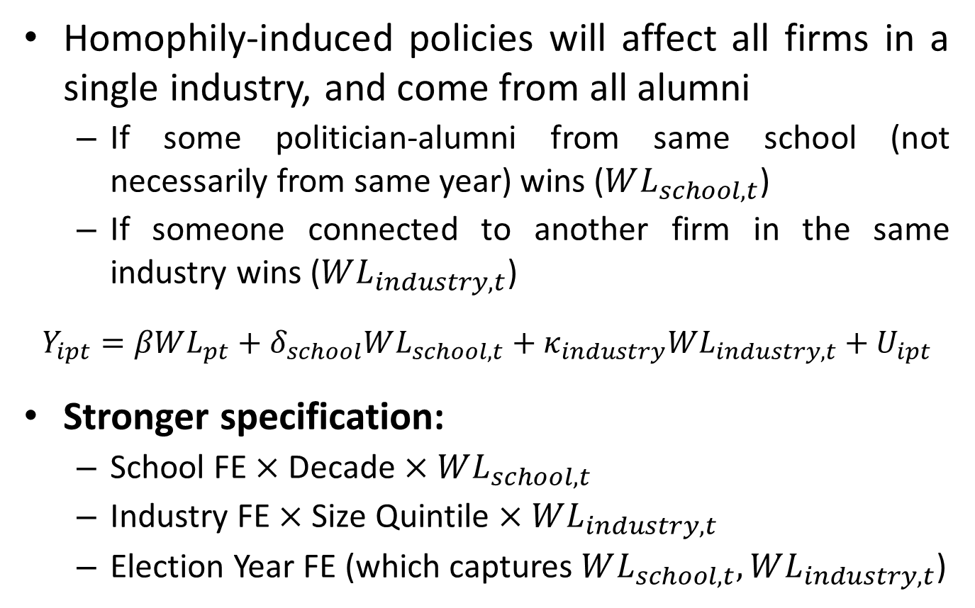
Internal Validity for Homophily Concern
NETWORK ANALYSIS
Homophily-induced policies will affect all firms in a single industry, and come from all alumni
If some politician-alumni from same school (not necessarily from same year) wins ($WL_{school,t}$)
If someone connected to another firm in the same industry wins ($WL_{industry,t}$)
$$Y_{ipt}=βWL_{pt}+δ_{school}WL_{school,t}+κ_{industry}WL_{industry,t}+U_{ipt}$$
Stronger specification:
School FE $×$ Decade $×WL_{school,t}$
Industry FE $×$ Size Quintile $×WL_{industry,t}$
Election Year FE (which captures $WL_{school,t}, WL_{industry,t}$)
Notes:
Untargetted policy response from homophily: People sharing same values/interests attend same college, and later run companies and promote policies in the same direction
Stronger specification:
School * Election Year FE or Industry * Election Year FE
Let homophily effect vary over time (i.e. time-variant school culture) or firm size

Slide 84
Treating Homophily
NETWORK ANALYSIS
CAR (-1,+5) | (1) | (2) | (3) | (4) | (5) | (6) | (7) | (8)
FE included | School * Decade * Elec. Year | School * Decade * Win(Sch.) | Industry * Elec. Year | Industry * Win(Ind.) | Industry * Size Q. * Elec. Year | Industry * Size Q. * WL(Ind.) | (2) and (4) | (1) and (3)
Win/Lose | -0.0274 | -0.0281 | -0.0203 | -0.0276 | -0.0246 | -0.0308 | -0.0383 | -0.0448
 | [0.0157]* | [0.0120]** | [0.0094]** | [0.0010]*** | [0.0110]** | [0.0113]*** | [0.0129]*** | [0. 0172]***
Vote Shares (Win & Lose) | Yes | Yes | Yes | Yes | Yes | Yes | Yes | Yes
Observations | 1,819 | 1,819 | 1,804 | 1,804 | 1,804 | 1,804 | 1804 | 1804
Homophily does not matter to the qualitative conclusion
In the most stringent tests: homophily may have biased results towards zero.

Slide 85
Relation to other existing literatures
Transmission of Beliefs and Trust:
Persistence: Putnam (1993), Guiso et al. (1997)
Transmission within families (Bisin-Verdier 2001, Tabellini 2008, Guiso Sapienza Zingales 2008, Benabou Tirole, 2003) and social interactions (Benabou Tirole 2010)
Role of education in shaping Beliefs:
Capitalist indoctrination: Bourdieu Passeron (1970), Bowles Gintis (1976)
Education and Beliefs: Dewey (1944), Helliwell Putnam (2007), Milligan et al. (2004), Heckman (2008)
Social networks and Beliefs:
Social preferences on existing social networks: Leider et al (2009, 2010), Goeree et al (2010)
Belief formation and social networks: Mobius Rosenblatt (2014), DeGroot (1974)
Diffusion in networks: Banerjee et al (2013, 2014), Jackson Yariv (2007)
Peer effects, and (quasi-)experimental evidence:
Sacerdote (2014), Sacerdote (2001), Marmaros Sacerdote (2006), Carrell et al (2013), Shue (2013), Ahern et al (2014), Manski (1993)
Identification of social networks effects:
Bramoullé et al (2009), De Giorgi et al (2010), Jackson (2008), Durlauf Ioannides (2010), Blume et al (2010)
Structural estimation to deal with homophily: Goldsmith-Pinkham Imbens (2013), Christakis et al (2010)

