Slide 1
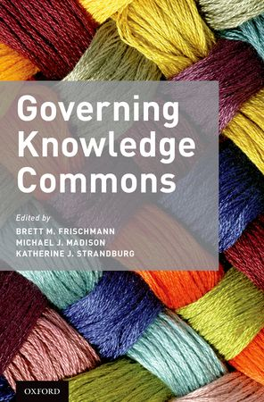
Knowledge Commons Studies
http://knowledge-commons.net/
Brett Frischmann, Michael Madison, Katherine Strandburg, and many others!

Slide 2
IOEA Workshop Plan
Governing Knowledge Commons Studies
Two rare disease research consortia case studies: UCDC and NAMDC
New Research Area: Privacy Commons
Future: Research and Collaboration Opportunities
Q&A / Open Discussion

Slide 3
Knowledge Commons Studies
Governing Knowledge Commons (OUP 2014)
Governing Medical Research Commons (Cambridge 2017)
Book Series with Cambridge: Cambridge Studies on Knowledge Commons
Main aim has been descriptive, but we also learn a lot about various community values and individual motivations.

Slide 4
Knowledge Commons
What is Commons?
Why Commons?
How Commons?

Slide 5
Knowledge Commons
What is Commons?
  Commons are resource management /governance institutions that enable sustainable shared use of certain resources within a community.
Why Commons?
How Commons?

Slide 6
Knowledge Commons
What is Commons?
  Commons are resource management /governance institutions that enable sustainable shared use of certain resources within a community.
  Knowledge is broad, inclusive set of intellectual resources (and resource systems, e.g., science)
Why Commons?
How Commons?

Slide 7
Science Commons
What is Commons?
  Commons are resource management / governance institutions that enable sustainable shared use of certain resources within a community.
Why Commons?
    Science is a complex resource system.
    Many shared resources are infrastructural.
    The scientific community defines and is defined by commons.
How Commons?

Slide 8
Science Commons
What is Commons?
  Commons are resource management / governance institutions that enable sustainable shared use of certain resources within a community.
Why Commons?
    Science is a complex resource system.
    Many shared resources are infrastructural.
    The scientific community defines and is defined by commons.
How Commons?
  Open access works for some resources.
  But for most, governance is complex, contextual, resource-specific and community-specific.
    Much more than “openness.”
    Many different dilemmas to overcome

Slide 9
MOTIVATION FOR THE
KNOWLEDGE COMMONS PROJECT
Standard IP theory overly-simplistic
  Dichotomy btw property/ “public domain”
  Incentive/free rider story
  Difficulty making useful predictions – empirically unresolved balancing
Not markets/not public domain/not firms
  Approaches to creating intellectual resources that are
    Collective/collaborative
    Governed informally or formally by private ordering
Cooperative/collaborative modes of creativity
  String of “one-off” case studies reveals important of norms, governance
  How to systematize the inquiry?

Slide 10
The Ostrom Approach
Construct a framework for analyzing various case studies to identify and categorize potentially important variables
  Organizes empirical inquiry by specifying general sets of variables and relationships to each other
  Allows integrated and comparative inquiry across domains
  Useful when one needs to identify and build theories
  Initial goal is to map our parameter space

Slide 11
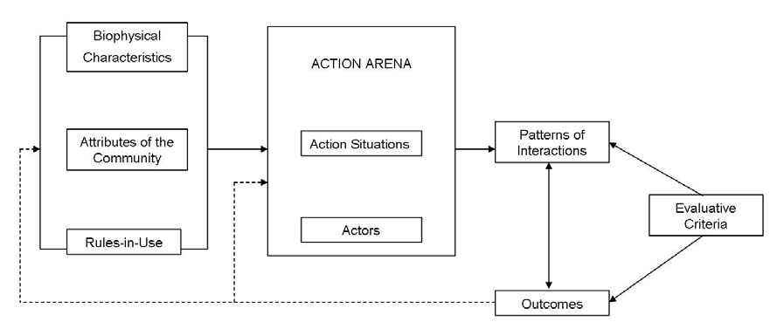
The IAD Framework for structured case study analysis

Slide 12
The IAD Framework for structured case study analysis
Can be used to study many different phenomena
E.g. soccer league, fishery, agricultural cooperative

Slide 13
The IAD Framework for structured case study analysis
Soccer field
Soccer game
E.g. soccer league

Slide 14
The IAD Framework for structured case study analysis
Soccer field, weather, players (ages, skill level), rules.
League season
Skill, team-building, fun, revenue
Soccer game
E.g. soccer league

Slide 15
The IAD Framework for structured case study analysis
Soccer field, weather, players (ages, skill level), rules.
League season
Skill, team-building, fun, revenue
Soccer game
E.g. soccer league, fishery, agricultural cooperative

Slide 16
Results of Ostrom’s Approach:
  Design Principles for Governing Sustainable Resources
    Clearly defined boundaries
    Proportional equivalence btw benefits and costs
    Governance by those affected
    Monitoring
    Graduated sanctions
    Conflict-resolution mechanisms
    Minimal recognition of rights for self-organization
    Nested enterprises
We apply a similar approach to study knowledge commons, but we do not anticipate uncovering the same design principles because intellectual resources are different in important ways –
  Nonrivalry
  Resources must be created, not just managed

Slide 17
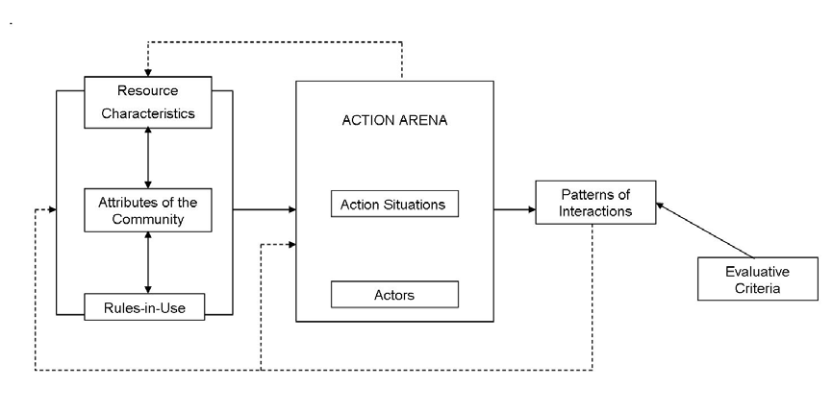
MAPPING TO THE CULTURAL ENVIRONMENT:
  IAD Framework must be adapted
    In natural resource context resource characteristics are primarily exogenous, actions focus on use
    In cultural context resources are human-made, actions focus on production and use
Actions produce resources
Outcomes are resources/ attributes

Slide 18
Background Environment
  What is the background context (legal, cultural, etc.) of this particular commons?
  What is the “default” status of the resources involved in the commons? Patented? Copyright? Open?
Attributes of the Commons
  Resources
    What resources are pooled and how they are created or obtained?
    What are the characteristics of the resources, such as whether they are rival or non-rival, whether they are tangible or intangible,
    What technologies and skills are needed to create, obtain, maintain and use them?
  Community Members
    Who are the community members and what are their roles?
    What are the degree and nature of openness of the community with respect to each type of community member and the general public?
  Goals and Objectives
    What are the goals and objectives, including obstacles or dilemmas to overcome?
    What are the history and narrative of the commons?
Governance
  What are the governance mechanisms of the commons (e.g., membership rules, resource contribution or extraction standards and requirements, conflict resolution mechanisms, sanctions for rule violation)?
  Who are the decision-makers and how are they selected?
  What are the institutions that govern decision-making?
  What informal norms govern the commons?
  How do nonmembers interact with the commons? What institutions govern those interactions?
  What legal structures (including intellectual property rules, subsidies, contract and licensing law, antitrust provisions) govern the functioning of the commons?
Patterns and Outcomes
  What benefits are delivered to members and to others (including innovations and creative output, production, sharing, and dissemination of those innovations and output to a broader audience, and social interactions that emerge from the commons?)
  What costs and risks are associated with the commons, including, for example, any negative externalities?

Slide 19
Background Environment
  What is the background context (legal, cultural, etc.) of this particular commons?
  What is the “default” status of the resources involved in the commons? Patented? Copyright? Open?
Attributes of the Commons
  Resources
    What resources are pooled and how they are created or obtained?
    What are the characteristics of the resources, such as whether they are rival or non-rival, whether they are tangible or intangible,
    What technologies and skills are needed to create, obtain, maintain and use them?
  Community Members
    Who are the community members and what are their roles?
    What are the degree and nature of openness of the community with respect to each type of community member and the general public?
  Goals and Objectives
    What are the goals and objectives, including obstacles or dilemmas to overcome?
    What are the history and narrative of the commons?
Governance
  What are the governance mechanisms of the commons (e.g., membership rules, resource contribution or extraction standards and requirements, conflict resolution mechanisms, sanctions for rule violation)?
  Who are the decision-makers and how are they selected?
  What are the institutions that govern decision-making?
  What informal norms govern the commons?
  How do nonmembers interact with the commons? What institutions govern those interactions?
  What legal structures (including intellectual property rules, subsidies, contract and licensing law, antitrust provisions) govern the functioning of the commons?
Patterns and Outcomes
  What benefits are delivered to members and to others (including innovations and creative output, production, sharing, and dissemination of those innovations and output to a broader audience, and social interactions that emerge from the commons?)
  What costs and risks are associated with the commons, including, for example, any negative externalities?
Don’t worry about the content of this slide.
Too much text!!!
Just note the structure and approach.
Common set of questions, variables, etc. to shape interviews, doc review, analysis of data, etc. and enable comparative analysis and learning.

Slide 20
Author | Title | Commons
Cole, Daniel | Learning from Lin: Lessons and Cautions from the Natural Commons for the Knowledge Commons | Theory
Benkler, Yochai | Between Spanish Huertas and the Open Road: A Tale of Two Commons? | Theory
Contreras, Jorge | Constructing the Genome Commons | Gene data
Von Overwalle, Geertrui | Van Overwalle, Geertrui, Governing Genomic Data: Plea for an ‘Open Commons’ | Gene data
Strandburg, Frischmann, & Cui | The Rare Diseases Clinical Research Network and the Urea Cycle Disorders Consortium as Nested Knowledge Commons | Rare disease research
Madison, Michael | Commons at the Intersection of Peer Production, Citizen Science, and Big Data: Galaxy Zoo | Astronomical data
Schweik, Charlie | Toward the Comparison of Open Source Commons Institutions | OSS
Morell, Mayo Fuster | Governance of online creation communities for the building of digital commons | Online creation communities
Shah, Sonali and Moody, Cyrus | Creating a Context for Entrepreneurship: Examining How Users’ Technological & Organizational Innovations Set the Stage for Entrepreneurial Activity | User Innovation
Meyer, Peter | An inventive commons: Shared sources of the airplane and its industry | Airplane invention
Murray, Laura | Exchange Practices Among Nineteenth-century US Newspaper Editors: Cooperation in Competition | Journalism
Piper, Tina | How War Creates Commons: General McNaughton and the National Research Council, 1914-1939 | Military Technology
Fagundes, David | Labor and/as Love: Roller Derby’s Constructed Cultural Commons | Roller derby names
Daniels, Brigham | Legispedia | Congress

Slide 21
Author | Title
Abbott, Ryan | The Sentinel Initiative as a Knowledge Commons
Boggio, Andrea | Biobanking Governance: A Case Study of Knowledge Commons
Bubela, Tania; Adams, Rhiannon; Chandrasekharan, Shubha; Mishra, Amrita; Liu, Songyan | Governance of Biomedical Research Commons to Advance Clinical Translation: Lessons from the Mouse Model Community
Larson, Maja & Chon, Margaret | The Greatest Generational Impact: The Open Neuroscience Movement as an Emerging Knowledge Commons
Contreras, Jorge L. | Leviathan in the Commons: Biomedical Data and the State
Evans, Barbara J. | Genomic Data Commons
Flowers, Stephen | Chronic Disease, New Thinking and Outlaw Innovation: Patients on the Edge in the Knowledge Commons
Lee, Peter | Centralization, Fragmentation, and Replication in the Genomic Data Commons
Mattioli, Michael | Cancer: From a Kingdom to a Commons
Oliveira, Pedro; Zejnilovic, Leid ; Canhão, Helena | Challenges and opportunities in developing and sharing solutions by patients and caregivers, the story of a knowledge commons for patient innovation
Pedraza-Farina, Laura | The National Physicians Cooperative: Bridging Oncology and Reproductive Endocrinology
Saxe, Glenn | The Application of User Innovation and Knowledge Commons Governance to Mental Health Intervention
Torrance, Andrew | Better to Give than to Receive: An Uncommon Commons in Synthetic Biology
Bechtold, Stefan & Strandburg, Katherine | The Eosinophilic Esophagitis Research Community and the NIH Rare Disease Clinical Research Network
Frischmann, Brett & Strandburg, Katherine | The North American Mitochondrial Disease Consortium: An Emerging Knowledge Commons

Slide 22
Themes from GKC case studies
Knowledge commons may confront diverse obstacles or social dilemmas, many of which are not well described or reducible to the simple free rider dilemma.
Complex relationships between knowledge commons and the systems within which they operate and/or are nested. (complex, nested systems)
Knowledge commons often depended on shared infrastructure
Informal governance institutions, and especially trusted leadership, often played key roles
Commons governance often evolved over time, and commons seemed to play an important role in early stages of some industries (evolution)
Knowledge commons governance often did not depend on one strong type or source of individual motivations for cooperation. (many motivations; complex)

Slide 23
Themes from GKMC case studies
Knowledge commons may be clustered in complex ways as well as nested within each other: In medicine and health, we see patient-related commons; clinician/researcher-related commons; infrastructure and tools-related commons; data and analytics-related commons.
Social dilemmas addressed by knowledge commons may relate to multiple creation, curation, and coordination dilemmas from demand-side (patients), supply-side (clinician/researcher), and both at once (infrastructure/tools, analytics).
Trusted leadership often plays a central role in sustaining commons.
The state is often a key institutional actor in defining action arenas and providing formal governance devices.

Slide 25

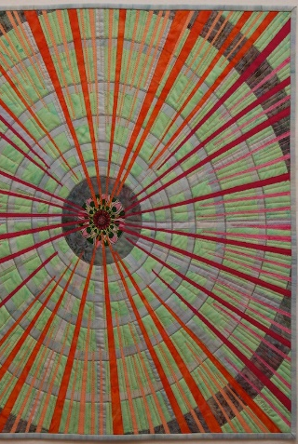
The North American Mitochondrial Disease Consortium (NAMDC): An Emerging Knowledge Commons
Katherine Strandburg & Brett Frischmann
Project:
  Rare Disease Research Consortia as Nested Commons
Case Studies:
  (1) Urea Cycle Disorder Consortium
  (2) North American Mitochondrial Disease Consortium
  … more to come …
Governing Medical Commons
Edited by
Frischmann
Madison &
Strandburg
Cambridge

Slide 26
The Rare Disease Problem
Few patients per disease (officially < 200K in US, often only a few thousand globally)
No “blockbuster” pharma profits
Patients are geographically scattered
Latest science: many diseases “rare” in the sense that treatments must be personalized?
Requirements for research and treatment advances:
Patient recruitment for studies and drug trials
Protocol standardization and data aggregation
Cooperation among widely scattered researchers

Slide 27
What is the Rare Disease Clinical Research Network?
Established in 2003 by NIH
Peer-reviewed grants of about $1.25M/yr
Now 19 Consortia (each dealing with a different cluster of rare diseases)
Goals:
Explore methods for rare disease research
Overcome obstacles of small numbers/geographical isolation
Establish shared resources for rare disease research and treatment development

Slide 28
Why Study the RDCRN?
Obvious importance of rare disease research
Good test bed for the framework/methodology
  Several consortia to be compared
  Nested structure
Began by studying one consortium in depth: UCDC (Urea Cycle Disorders Consortium)
NAMDC is our second RDR case study

Slide 29
Nested Structure: RDCRN Level
Zoom in
Here
RDCRC
RDCRC
UCDC
RDCRC
NAMDC
RDCRC
Coalition of
Patient Advocacy Groups
RDCRC
RDCRC
NIH Office of
Rare Disease Research
RDCRC
RDCRC
RDCRN
Steering Committee
RDCRC
RDCRC
Data Management
Coordinating Center
(DMCC)
RDCRC
RDCRC
RDCRC
RDCRC
RDCRC
RDCRC
RDCRC

Slide 30
Nested Structure: Consortium Level
Data Management
Coordinating Center
(DMCC)
Zoom in
Here
Columbia’s Statistical
Analysis Center
Clinical
Research Site
NIH
Science Officer
Consortium
PIs
NIH
Project Officer
Study
Coordinator
Clinical
Research Site
UMDF (PAG)
Pharma
Company
Consortium
Steering Committee
Clinical
Research Site
Clinical
Research Site

Slide 31
Nested Structure: Site Level
Data Management
Coordinating Center
(DMCC)
Study
Coordinator
Consortium
Steering Committee
Site PI
Site
Coordinator
Patients and
Families
Consortium
PIs
Other
Researchers
Pharma
Company
Neurologists,
etc.

Slide 32
Main Objectives for RDCRCs
Create a pool of research subjects and patient data
Sustain and grow community
Promote knowledge sharing within community (and to outside communities)
Cooperate with patients in setting research priorities and communicating results
Translate research into treatment (pharma)

Slide 33
Analysis
RDCRCs involve many resources and outcomes
Funding, patients as research subjects, DMCC, knowledge about the disease and about research practice, publications, research and treatment protocols, drugs, data, website (public and researcher only) …
RDCRCs involve many types of actors
MD/PhD researchers (pediatricians, metabolic and genetic specialists), Study PIs, Site PIs, study coordinator, site coordinators, patients, patient advocacy group, NIH officials, pharma representatives …
RDCRCs involve many action situations
Longitudinal Study (required by NIH), other research projects, clinical trials, treatment of patients, training of junior researchers (required by NIH), production of publications, protocols, website

Slide 34
Analysis
Differences from default “typical NIH-funded medical research” environment
Need to recruit large fraction of all patients
  Important role of patient advocacy groups and importance of relationship to patients
Need to involve many clinical sites
  Importance of recruiting researchers to participate despite potential issues: researcher competitiveness or researcher disinterest/lack of career potential
  Governance and leadership issues
Difficulty attracting pharmco interest
    Cost/benefit issues for small patient pool

Slide 35
NAMDC
Mitochondrial diseases are a challenge because they are probably the most diverse human disorders at every level: clinical, biochemical, and genetic. Some are confined to the nervous system but most are multi-systemic, often affecting the brain, heart, liver, skeletal muscles, kidney and the endocrine and respiratory systems. Although severity varies, by and large these are progressive and often crippling disorders. They can cause paralysis, seizures, mental retardation, dementia, hearing loss, blindness, weakness and premature death.
Because of the range of symptoms and the frequent involvement of multiple body systems, mitochondrial diseases can be a great challenge to diagnose. Even when accurately diagnosed, they pose an even more formidable challenge to treat, as there are very few therapies and most are only partially effective.
NAMDC website
Many of us believe that … mitochondrial diseases [are] in a very unique position. Because if we solve mitochondrial disease or at least understand it, you’ve solved or understand diabetes, the aging process itself; Parkinsons, Alzheimer’s disease, muscle loss during the ‘70s and ‘80s. … we think that mitochondrial disease is unique in terms of rare diseases because it’s so important, it’s the holy grail of 50% of what’s going on in American health
Interviewee

Slide 36
Methodology (NAMDC study)
Literature review, incl. policies, industry agreements, minutes
22 Semi-structured interviews with NIH officials, researchers, administrator, biostatistician, data manager, patient advocacy group representative
Attended annual consortium meeting
Surveyed consortium members

Slide 37
GKC Framework
Actions produce resources/ community
Outcomes are resources/ attributes

Slide 38
Background Environment
  What is the background context (legal, cultural, etc.) of this particular commons?
  What is the “default” status of the resources involved in the commons? Patented? Copyright? Open?
Attributes of the Commons
  Resources
    What resources are pooled and how they are created or obtained?
    What are the characteristics of the resources, such as whether they are rival or non-rival, whether they are tangible or intangible,
    What technologies and skills are needed to create, obtain, maintain and use them?
  Community Members
    Who are the community members and what are their roles?
    What are the degree and nature of openness of the community with respect to each type of community member and the general public?
  Goals and Objectives
    What are the goals and objectives, including obstacles or dilemmas to overcome?
    What are the history and narrative of the commons?
Governance
  What are the governance mechanisms of the commons (e.g., membership rules, resource contribution or extraction standards and requirements, conflict resolution mechanisms, sanctions for rule violation)?
  Who are the decision-makers and how are they selected?
  What are the institutions that govern decision-making?
  What informal norms govern the commons?
  How do nonmembers interact with the commons? What institutions govern those interactions?
  What legal structures (including intellectual property rules, subsidies, contract and licensing law, antitrust provisions) govern the functioning of the commons?
Patterns and Outcomes
  What benefits are delivered to members and to others (including innovations and creative output, production, sharing, and dissemination of those innovations and output to a broader audience, and social interactions that emerge from the commons?)
  What costs and risks are associated with the commons, including, for example, any negative externalities?

Slide 39
GKC Framework applied to NAMDC
We focused on seven Action Arenas, which we grouped loosely into three categories:
creating and sustaining a collaborative research community,
developing and managing a shared pool of research subjects, patient data and biological specimens, and
managing relationships with pre-existing mitochondrial disease organizations.
Actions produce resources/ community
Outcomes are resources/ attributes

Slide 40
GKC Framework applied to NAMDC
We focused on seven Action Arenas, which we grouped into three categories:
creating and sustaining a collaborative research community,
  determining NAMDC’s membership, (2) promoting knowledge sharing and collaboration, and (3) recruiting and training mitochondrial disease clinical researchers.
developing and managing a shared pool of research subjects, patient data and biological specimens: NAMDC Patient Registry and Biorepository Study
  1) developing the NAMDC Research Diagnostic Criteria; 2) recruiting patients and collecting the relevant data and biospecimens; and 3) managing and using the pooled research resources.
c) managing relationships with pre-existing mitochondrial disease organizations.

Slide 41
NAMDC as emerging knowledge commons
New medical science—rapidly evolving, incredibly complex to diagnose, much less treat
  DIAGNOSTIC DILEMMA —developing diagnostic criteria for clinical vs. research purposes in the face of considerable uncertainty = Major Action Arena
New consortium—history and early stage development of community, governance institutions, etc.
  Early failures to obtain RDCRN funding, ARRA funding, 2011 transition into RDCRN, 2014 renewal of RDCRN grant
  2014 emergence of Committees – see next slide

Slide 42
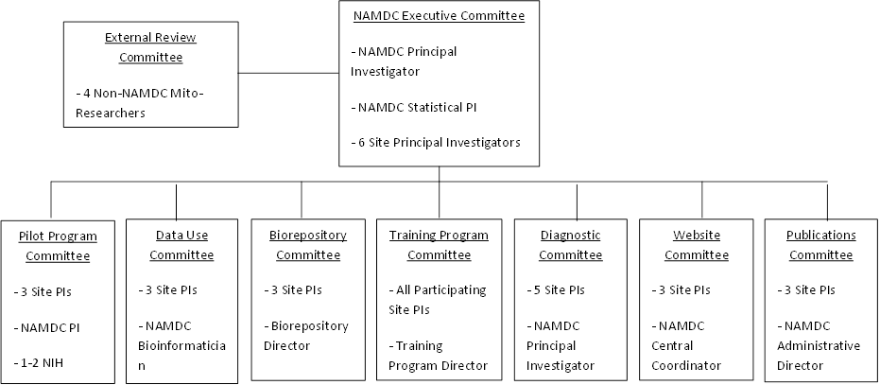
Committee Structure (2014)

Slide 43
Committee Structure (2014)

Slide 44
“One of the great problems in our field is diagnosing mitochondrial disease. It’s not one disease but many, probably hundreds or more. It’s a dilemma.”
“Frankly, I think among rare diseases, mitochondrial diseases are among the most overdiagnosed and underdiagnosed because they’re so diverse. They’re underdiagnosed because people just don’t recognize them, and then they’re overdiagnosed because whenever there’s a patient with a complex multi-systemic disease, people throw up their hands and say, "Must be a mitochondrial disease". We felt obliged to really set up criteria for our sake, for stratifying the registry, the patients in a registry. Also for research purposes, because we take the possible and probable patients and we may do additional genetic or molecular studies to define them better. And also just to say that there are a couple of patients that are very unlikely to have mitochondrial disease even though they were diagnosed by supposed experts who entered all these patients into the registry. [W]e’re trying to use that as an educational tool so that when we put the patients through the diagnostic criteria, or their information through the criteria, we send back a letter to the site investigators and inform them what their NAMDC diagnosis is and level of probability. We’re actually going through this exercise, and we’re having people reevaluate their original diagnosis to see if they agree with the NAMDC criteria or not and if not why, and we’re revising our diagnostic criteria. It’s a back and forth activity here that’s in progress.”

Slide 45
Limited expertise (x2)
“Why do you need diagnostic criteria [when] you have experts diagnosing people? There’s two [reasons]: One is … there’s very few of these experts, and so if they feel that mitochondrial disease is under diagnosed, you want to give [the diagnostic criteria] to people who aren’t experts so they can check off the checklist and say, "Oh, you’ve got mitochondrial disease," or, "You don’t." But the other, which goes unsaid, is that there’s very little agreement between these experts, and the same people will say, "Yes, you’ve" - I mean some of them are unambiguous; the very syndromes are unambiguous, but a lot of them are ambiguous, and there’ve been long, not fights, but vigorous conversations about how to define each one. And still, we had … a version that we came up with and then we ran it against the actual patient population, and the results of that were very controversial.”

Slide 46
For research purposes …
“[Y]ou want as clean a population as you can study, and so the diagnostic criteria are much tighter.”

Slide 47
Limited expertise, data entry, and the “computer”
“In my head, if I have liver disease, I would check off hepatopathy, or something. But if a person who does not understand the term hepatopathy, is entering the data for you, he or she sees a spreadsheet, the liver enzymes are abnormal, all the liver functions are abnormal, but there is no place to enter the liver enzymes are abnormal. So he/she does not mark that column there is liver involvement. The computer looks at it and says how can you call it Alpers when you don’t have liver involvement? I am rejecting it.”

Slide 48
Diagnostic criteria and the unknown
“So one of the inherent catch-22s in all this is that you set up criteria based upon what you know. But if you only know 15% of the causes of diseases then your criteria are only going to let you capture that 15%. It’s not going to let you capture the unknown.”
“For example, the new mito disease that we just discovered it’s showing to affect the bones. We don’t ask one question about bones [in the diagnostic criteria]. Zero. Zip. … So we would never capture the disease that involved the bones because we never asked.”

Slide 49
Bottom line: diagnostic criteria is its own complex knowledge problem that requires a scientific approach that can dynamically adjust to deal with significant uncertainties
Yet it is a critical precursor to other knowledge production activities, including building a usable patient database, data mining, research, and clinical trials.
Highlights a different type of knowledge dilemma, one familiar to those who study research tools, but different in some dimensions such as role of clinical diagnoses of current patients and need to use their data.

Slide 50
Some interesting differences btw UCDC and NAMDC
Very different diseases in terms of biology, diagnosis, treatments, …
Diagnostic action arena
Community: inclusion of site coordinators
  Participation in meetings; attendance; collaboration
  Funding models
    UCDC: annual sum $ to each site
    NAMDC: pays sites on a per-patient basis

Slide 51
If time permits,
Successes and failures
  Moderate success in building its community (sites, researchers, patients) and resources (patient registry, database platform, diagnostic criteria)
  Less successful with longitudinal study – follow-up with patients, and with biorepository
  Increase in collaboration, as seen in significant increase in co-authorship among PIs
  Success in getting RDCRN funding

Slide 52
Exploring Privacy as Commons
Madelyn Sanfilippo,
Brett Frischmann,
and
Kathy Strandburg
Governing Medical Commons
Edited by
Frischmann
Madison &
Strandburg
Cambridge

Slide 53
Thesis
Privacy refers to (i) a form of community management or governance that (ii) applies to resources and (iii) involves a group or community of people but (iv) does not denote the resources, the community, a place, or a thing; (v) privacy is the institutional arrangement of these elements.

Slide 54
When a meeting, or part thereof, is held under the Chatham House Rule, participants are free to use the information received, but neither the identity nor the affiliation of the speaker(s), nor that of any other participant, may be revealed.
  Privacy?
  Knowledge commons?
  Both.
  What are the relevant resources, actors (members, nonmembers), objectives, dilemmas, rules?

Slide 55
Commons refers to a form of community management or governance. It applies to resources, and involves a group or community of people, but commons does not denote the resources, the community, a place, or a thing. Commons is the institutional arrangement of these elements. “The basic characteristic that distinguishes commons from noncommons is institutionalized sharing of resources among members of a community.” Critically, commons governance is used by a wide variety of communities to manage many different types of resources. Commons governance confronts various obstacles to sustainable sharing and cooperation. Some of those obstacles derive from the nature of the resources and others derive from other factors, such as the nature of the community or external influences. Communities can and often do overcome obstacles through constructed as well as emergent commons.
Applied to various knowledge commons; often raise privacy issues
  e.g., UCDC and NAMDC case studies

Slide 56
Privacy refers to a form of community management or governance. It applies to resources, and involves a group or community of people, but privacy does not denote the resources, the community, a place, or a thing. Privacy is the institutional arrangement of these elements. The basic characteristic that distinguishes privacy from nonprivacy is institutionalized sharing of resources among members of a community.” Critically, privacy governance is used by a wide variety of communities to manage many different types of resources. Privacy governance confronts various obstacles to sustainable sharing and cooperation. Some of those obstacles derive from the nature of the resources and others derive from other factors, such as the nature of the community or external influences. Communities can and often do overcome obstacles through constructed as well as emergent privacy.
Applied to various knowledge commons; often raise privacy issues
  e.g., UCDC and NAMDC case studies

Slide 57
Privacy as Sharing?
Two friends
  Chatham house rules
Bank responds to subpoena and shares bank records
  Institutionalized sharing according to rules-in-use, which encompass rules adopted by bank-patron community as constrained by public law
  Normative evaluation is separate (important) inquiry, but doesn’t undermine the descriptive, conceptual, or institutional analysis

Slide 58
Privacy as Community?
Members and non-member; insiders and outsiders; club, etc.
  Relational
  N > 1
  N < everyone (i.e., short of open access)
Governance / rules concerning membership, roles within community, decision-making
  Who belongs? What influence?
Also, raises questions about effects on non-members or society more generally

Slide 59
Privacy as Resource Governance
Focus on institutional analysis
Wider range of resources and actors – cast a wide net and focus on contextual details (which matter more than conventional theories often acknowledge)
Hopefully, grounds normative analysis in more rigorous descriptive analyses of resources, people, and institutions; helps distinguish and clarify means and ends

Slide 60
Adv. of systematic study using GKS framework:
learn more about variance in communities, obstacles/dilemmas, objectives, and institutions
more nuance and details, sorted into coherent categories (one hopes)
intersections with knowledge commons can be explored; hugely important in big data world
might learn what people really care about and why; bottom up learning about normative values
possibility of improving institutional design; design principles
more nuanced understanding of social (non-market, non-government) institutions
Limits to the approach:
doesn’t work at the extremes: privacy with n=1; privacy with n=everyone
might not work with physical resources; not sure; could use old IAD?
Sidelines normative debate and values
Takes a long time and needs dedicated research community

Slide 61
Fourteen cases analyzed:
Galaxy Zoo (Madison, 2014),
Online Creation Communities (Morell, 2014),
Biobanks (Oggio, 2017),
LINK indigenous knowledge commons (Joranson, 2008),
the Rare Disease Clinical Research Network (Strandburg, Frischmann, & Cui, 2014),
the Oncofertility Consortium (Pedraza-Fariña, 2017),
Patient Innovation project (Oliveira, et al., 2017),
the Sentinal Initiative (Abbott, 2017),
The Open Neuroscience Movement (Larson & Chon, 2017),
Aviation Clubs (Meyer, 2014),
Nineteenth century newspaper editors (Murray, 2014),
Congress (Daniels, 2014),
Biomedical data commons (Contreras, 2016; 2017), and
Genome Commons (e.g. Contreras, 2014; Van Overwalle, 2014).

Slide 62
Knowledge Commons | Case Synopsis | Privacy Concerns | Personal Information
Rare Disease Clinical Research Network | A network connecting patients of rare diseases to clinical researchers for treatment development | Given the sensitive nature of health information, a variety of concerns about privacy and appropriate information flow have arisen, including: appropriate consent for release of patient contact information to researchers, control over release of data to third parties | Clinical medical records; Research subject and Researcher personally identifiable information; Patient contact information; Researcher activities and uses of resources

Slide 63
Illustrative governance features of member-driven commons
Institution Type Concern | Strategies | norms | rules
Participation | Community members will participate when they view knowledge production as threatened without commons (e.g. LINK & Rare Disease Clinical Research Network) | Participants’ patient status is a prerequisite for membership (e.g. Rare Disease Clinical Research Network & Oncofertility Consortium)
Information Resources | Users will become knowledge contributors when they see value (e.g. aviators, OCCs, & the Galaxy Zoo) | Patient participants must contribute personal health information (e.g. Oncofertility Consortium & Patient Innovation project) | Information must be disclosed or else funding is revoked (e.g. the Sentinel Initiative & the Open Neuroscience Movement)
Appropriate Flows | Direct flows toward pharmaceutical research, when patients benefit (e.g. Patient Innovation project) | Flows should not leave the commons to encourage valuable participation (e.g. Congress & the Sentinel Initiative) | Knowledge produced subject to publicly financed grants must be available to the public (e.g. Genome Commons & the Open Neuroscience Movement)
decision making | Personal disclosures to establish credibility or expertise (e.g. Wikipedia & patients) | Sub-community decisions are democratic (e.g. the Patient Innovation Project & OCCs) | Some decisions are made by those who provide the commons platform (e.g. the Galaxy Zoo, nineteenth century newspaper editors, & Biobanks)

Slide 64
Knowledge Commons Framework and Representative Research Questions
Background Environment
 | What is the background context (legal, cultural, etc.) of this particular commons?
 | What normative values are relevant for this community?
 | What is the “default” status of the resources involved in the commons (patented, copyrighted, open, or other)?
 | How does this community fit into a larger context? What relevant domains overlap in this context?
Attributes
Resources | What resources are pooled and how are they created or obtained?
 | What are the characteristics of the resources? Are they rival or nonrival, tangible or intangible? Is there shared infrastructure? What is personal information relative to resources in this action arena?
 | What technologies and skills are needed to create, obtain, maintain, and use the resources?
 | What are considered to be appropriate resource flows? How is appropriateness of resource use structured or protected?

Slide 65
The Future
More case studies (more researchers and contributors)!
More books (series established with Cambridge UP)!
Entrepreneurship * Higher Education * ICT * Environmental Policy * Agriculture
International Association for the Study of the Commons meetings on knowledge commons.
Building the Knowledge Commons commons: A database of case studies; a manual to code existing and new cases; experimental work; collaboration with practitioners and with the Ostrom Workshop at Indiana University; graduate students …
Interdisciplinary, global research network established at http://knowledge-commons.net

