Slide 1
In the Interest of Others
Organizational Leadership, Belief Change, and an Expanded Community of Fate
Margaret Levi
Director, Center for Advanced Study in the Behavioral Sciences (CASBS) @ Stanford University
Professor of Political Science

Slide 2
Beliefs and Behavior: Key Concepts
Quasi-voluntary compliance
Trustworthy government
Leadership
Legitimating beliefs
Community of fate

Slide 3
Papers with Audrey Sacks & Tom Tyler using survey data
Levi, Margaret, and Audrey Sacks. 2009. "Legitimating Beliefs: Concepts and Measures." Regulation & Governance 3 (December):311-33.
———. 2012. "Gobierno Eficaz, Consentimiento Cuidadano y, Quiza Legitimidad." In Democracia y socialdemocracia: Homenaje a Jose Maria Maravall, ed. A. Przeworski and I. Sanchez-Cuenca. Madrid: Centro de Estudios Politicos y Constitutucionales.
Levi, Margaret, Audrey Sacks, and Tom R. Tyler. 2009. "Conceptualizing Legitimacy, Measuring Legitimating Beliefs." American Behavioral Scientist 53 (3):354-75.
Sacks, Audrey, and Margaret Levi. 2010. "Measuring Government Effectiveness and Its Consequences for Social Welfare in African States." Social Forces 88 (5 (July)):2325-52.

Slide 4
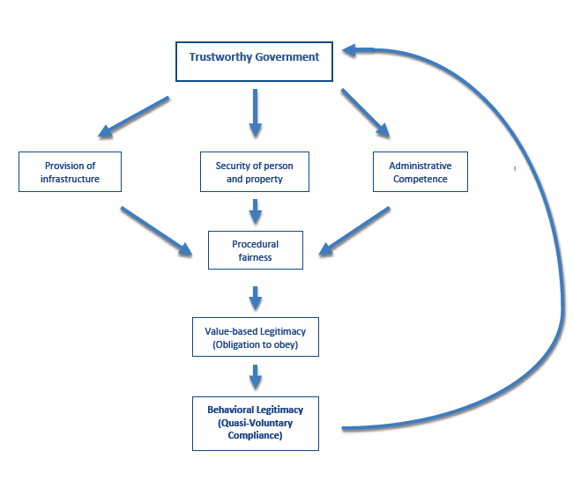
Virtuous Circle of Governance

Slide 6
Multimethod
Analytic narrative
  Based on work with Bates, Greif, Rosenthal, and Weingast
  Deep knowledge of case, which has unique qualities
  Formal model
    Disciplines narrative
    Provides counterfactual
    Generates testable implications
Sources of data
  Survey
  Geographic data
  Content analysis of conventions and meetings
  Oral histories

Slide 7
Scope of my interest
Organizations or governments whose purposes are to improve the well-being of members and citizens
  Unions—wages, benefits, job security, social insurance
  Governments—law, security, public goods, social insurance
with members/citizens who are
  Heterogeneous politically and ideologically
  Not self-selected in on basis of politics and ideologies
  High costs of exit
Where membership in organization can/might transform willingness to act in the interest of others
Community of fate the dependent variable (although may also explain things)

Slide 8
Definitions
A community of fate: those with whom individuals come to perceive their own interests as bound and with whom they are willing to act in solidarity
  Community identifies those whose situations individuals see as distinct possibilities for themselves: there but for the grace of god go I
  Identifies those engaged in similar struggles
  Identifies both a common interest and a common enemy

Slide 9
Further clarifications
Not the “righteous mind” (Haidt), which is fixed and moralistic (or may use this as a base)
A collective action
  not just particularly altruistic individuals
  Not suicide bombers
  Exemplified by military service in Ontario vs. Quebec in WWI & WWII

Slide 10
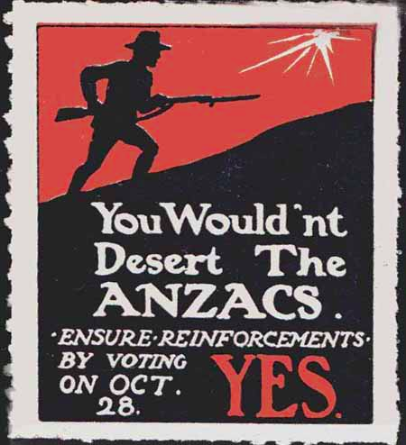
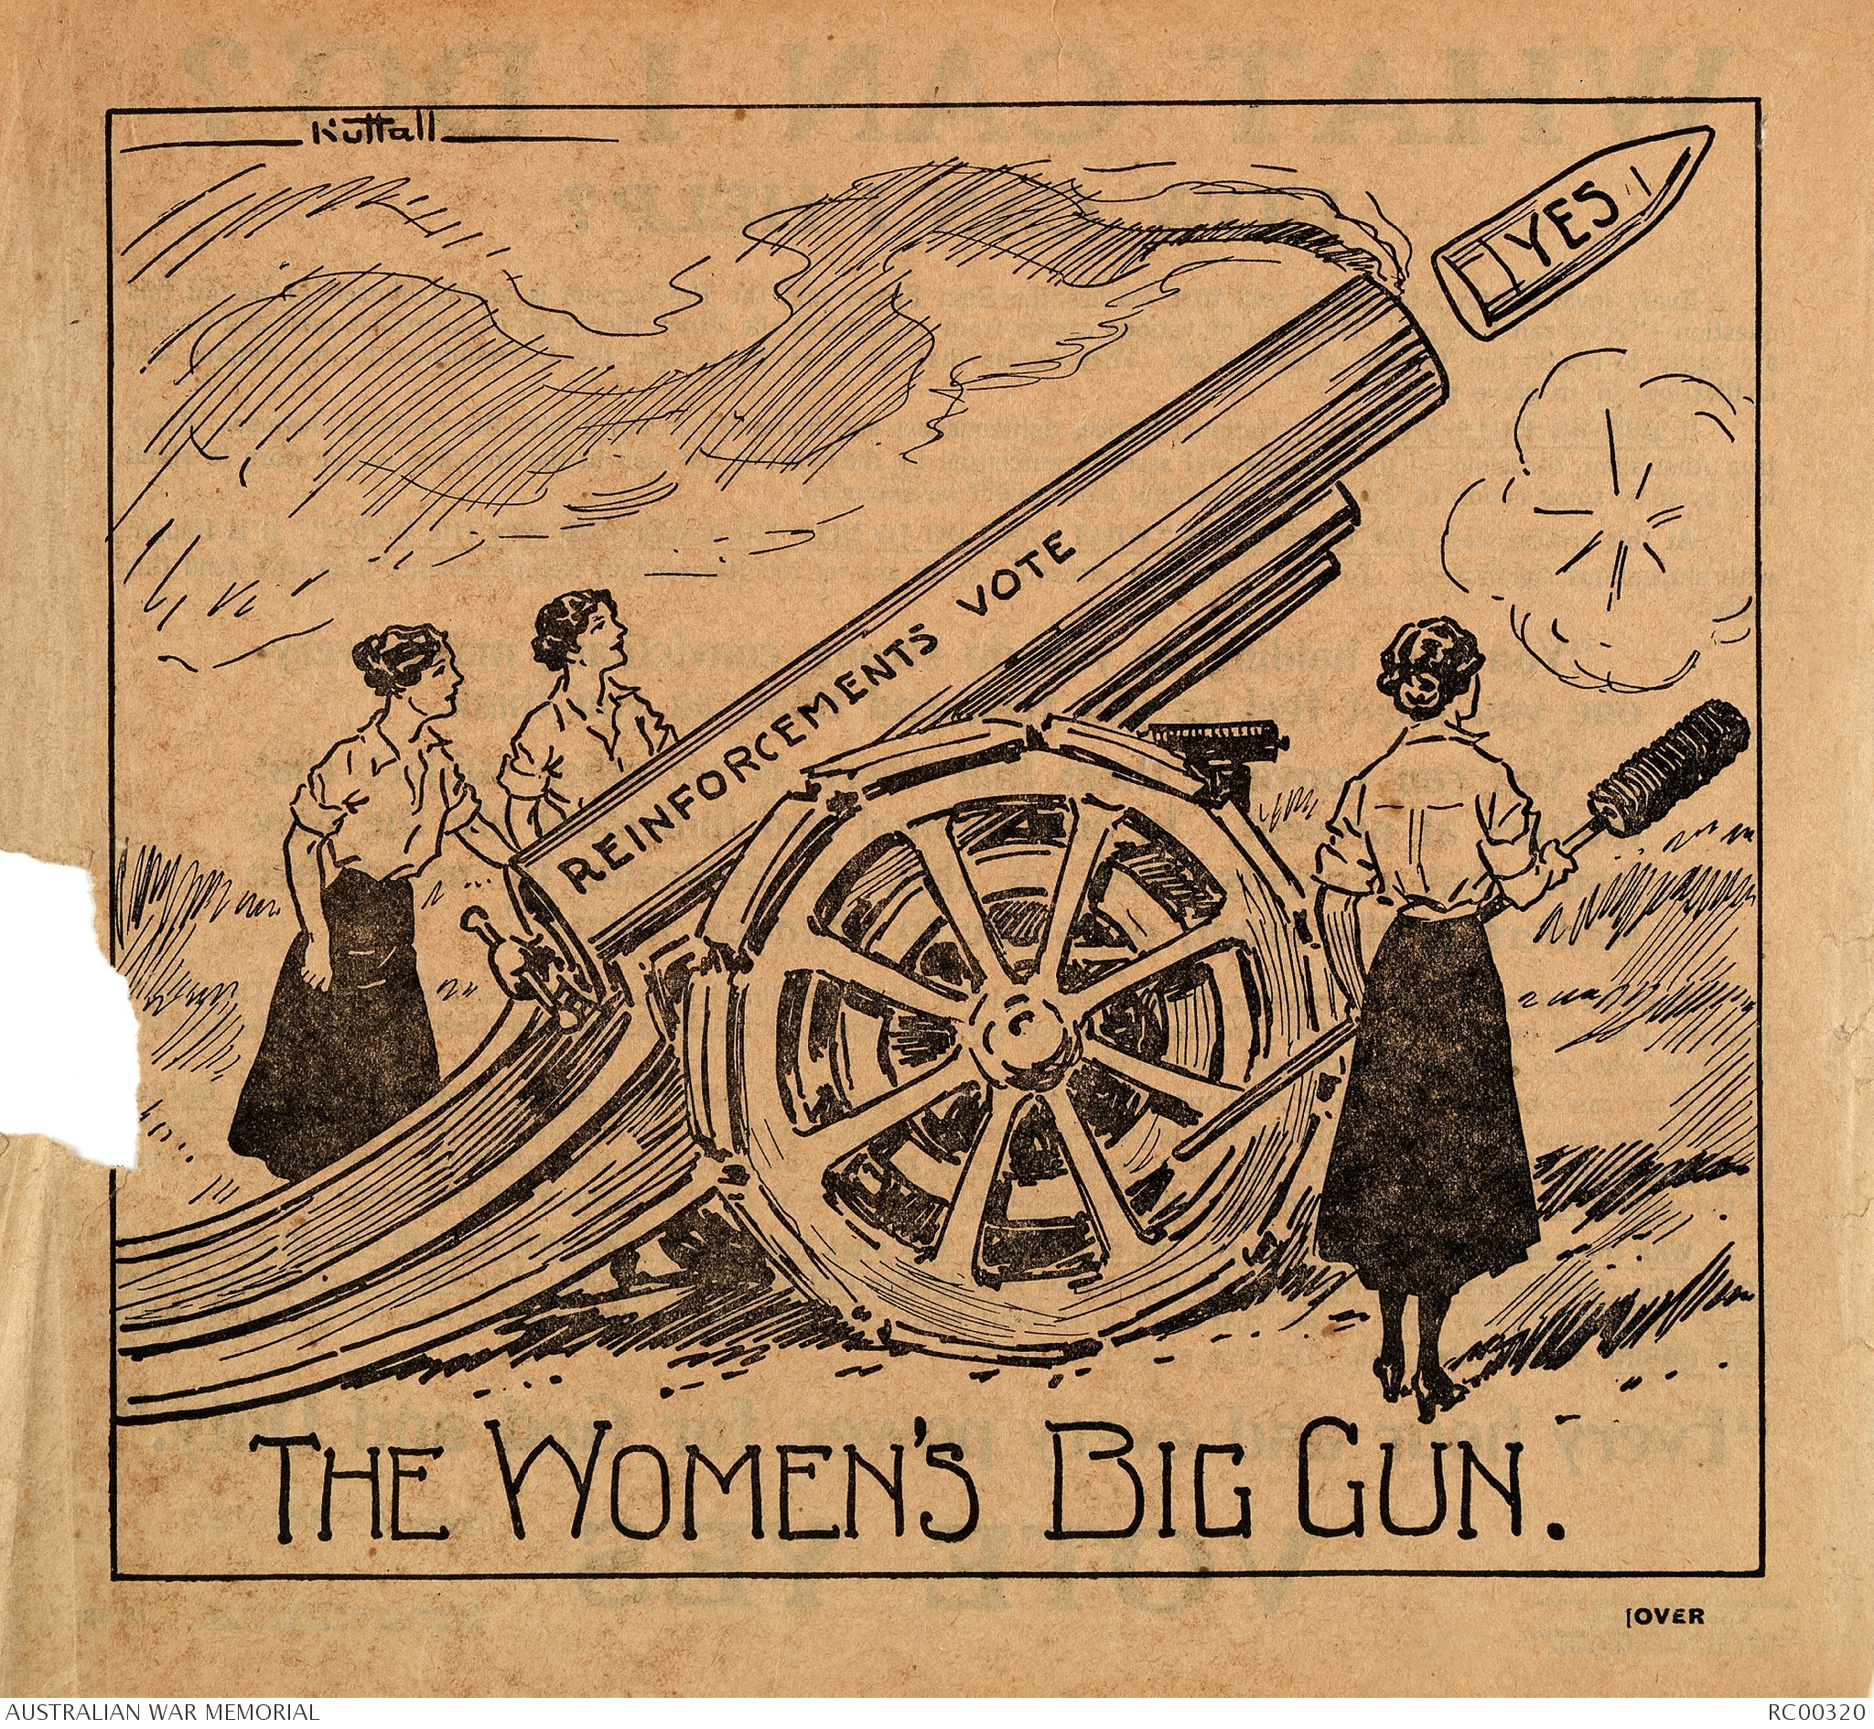
Pro Conscription Campaign in WWI Australia
Appeals to Women & Nationalism

Slide 11
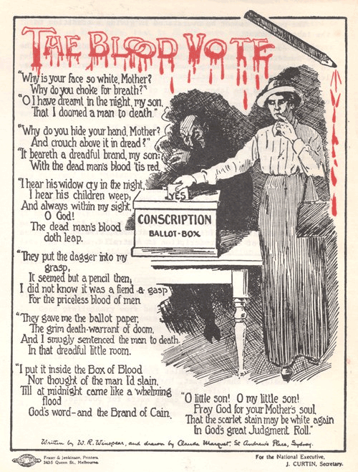
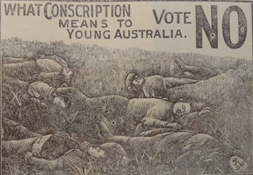
Australian Anti-Conscription Campaign
A class vote
Notes:
Trust in government? Legitimacy of war?

Slide 12
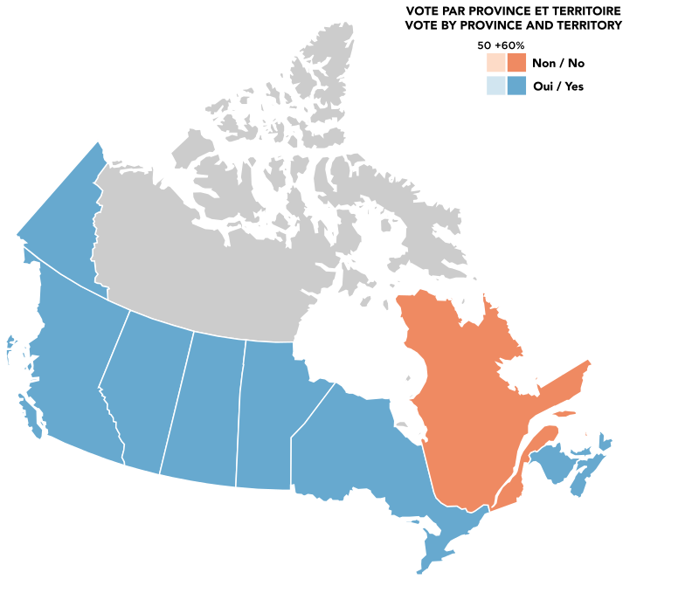
Canadian Conscription vote, 1943
Language/Religious Split
Notes:
Clearly no trust in government around conscription OR constitution
Question about legitimacy of war
Result: variation in contingent consent

Slide 13
A social construction
Paul Collier’s claim: beliefs in part generated through social networks
Mark Snyder and colleagues on volunteering
  Matching motives with call and opportunity
    Initial vs sustained actions—byproducts crucial for second
    Side benefits a crucial ingredient throughout
    but do need to worry about undermining intrinsic motivations
  Importance of community
    A cyclical process
    Intragroup vs inter group
    Psychological sense of community increases “intentions to become involved in one’s community”

Slide 14
Expanded communities of fate
Beyond family and “natural” determinants of solidarity and sacrifice
Evokes costly actions on behalf of
  Strangers, often distant strangers
  Some collective or public good

Slide 15
Examples
Late 1930s: Longshore workers closing down ports on behalf of Chinese peasants in Manchuria when it was taken over by Japanese
White churches and synagogues thato organized for civil rights in 1960s U.S.
NGOs and other groups who engage in dangerous aid work, e.g. Medicines sans frontieres

Slide 16
Costs & Benefits
  Costs of acting in the interests of others
    Threat of wage or job loss
    Threat of imprisonment
    Possible injury or loss of life
  Benefits of acting in the interests of others
    “pleasure of agency” (Wood)
    solidarity
    identity
    community

Slide 17
Types of leadership I
Structural (social choice)
  Salient by virtue of position
  Manipulate choices
  Affect dimensions of choice—and therefore choices in set
Informational (coordination games w Bayesian updating)
  Salient (or focal point) because of access to critical information
  Necessary establishment of credibility

Slide 18
Types of leadership II
Economic rent-seeking
  Can be totally corrupt and self-serving
  Could be contractual
Political rent-seeking
  Requires a signal: a form of Hermalin’s “leading by example”
  Requires credible commitments enforced by constitutional and institutional arrangements
Notes:
Lead by sacrifice: The leader makes a gift to the members out of her
pocket.
Lead by example: the leader exerts (costly) effort in order to influence others to follow suit

Slide 19
Attributes of leadership
Relational
Asymmetrical with followers
Salient
Domain specific
Instrumental
Enforcement capacity
Notes:
Ahlquist & Levi in ARPS

Slide 20
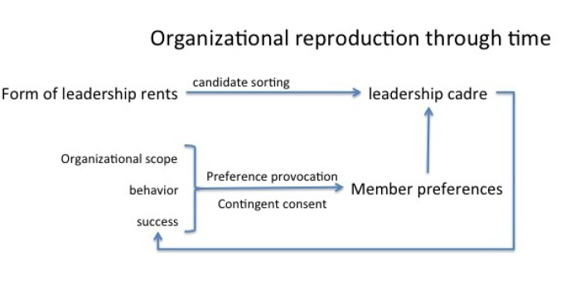

Slide 21
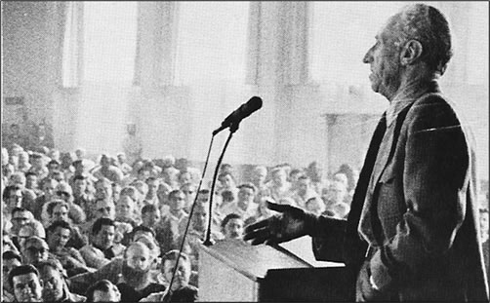
Harry Bridges Photo
ILWU International Officers regularly meet with the rank and file to discuss union policy, as Harry Bridges does here discussion the M&M agreement at a Local 10 meeting, circa 1959.
From The ILWU Story : Six Decades of Militant Unionism

Slide 22
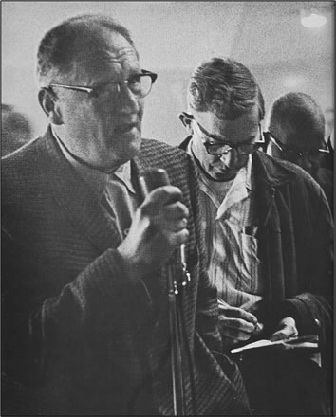
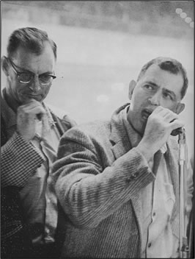
From Men and Machines : A Story about Longshoring in the West Coast Waterfront
By Otto Hagel and Louis Goldblatt

Slide 23
Expanding the community of fate
Governance arrangements
  Insuring credibility and trustworthiness of leadership
  Providing participatory and challenge mechanisms for “followers”, members, citizens
Effective leadership
  Delivers the goods
  Information provision
  Communication of goals
  Socialization processes
Neighborhood & network effects help

Slide 24
Belief change
What the world is like (partially an informational issue)
What you can do about the world (enabling efficacy)

Slide 25
Evidence of belief change
Perhaps even preference change
Oral histories, interviews, and stories
Survey (see our article in International Organization)
Behavior

Slide 26
Within a state: What’s Possible?
Identity creation beyond race, religion, ethnicity and other cultural markers that we already know about
  Nation-building
    Frenchman out of peasants: socialization, laws, and language
    Nationalism: war & security threat—rationality of fear
  Service for one’s country or people: usually a side benefit involved
    Peace Corps
    Teach for America

Slide 27
Taxes—also involves a community of fate if not going to rely on coercion
Voting—community activity undermined by removing polling place?
Intertwining the fate of another’s people to one’s own (different than a security threat)
  Refugee crisis
  Intervention—humanitarian or military—to protect and help others

