Slide 1
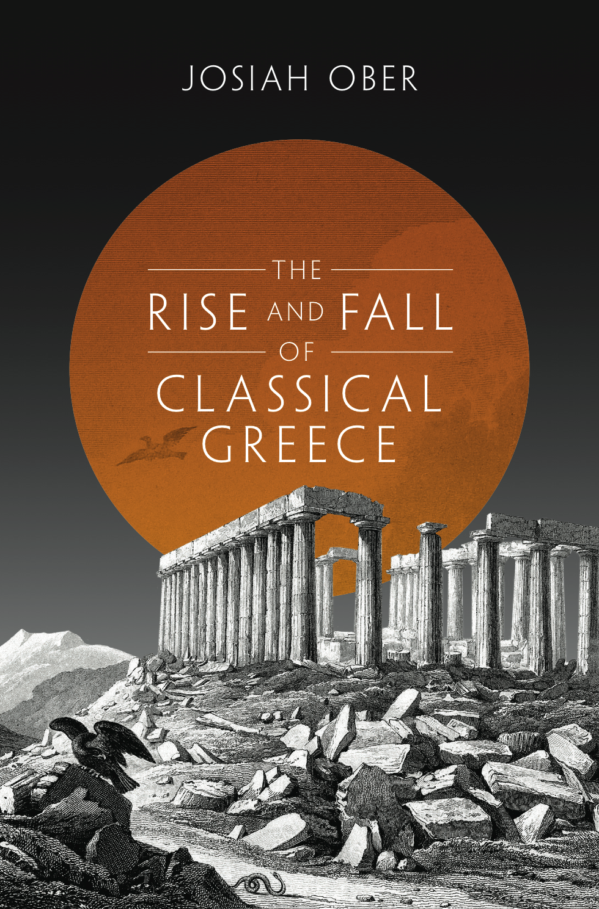
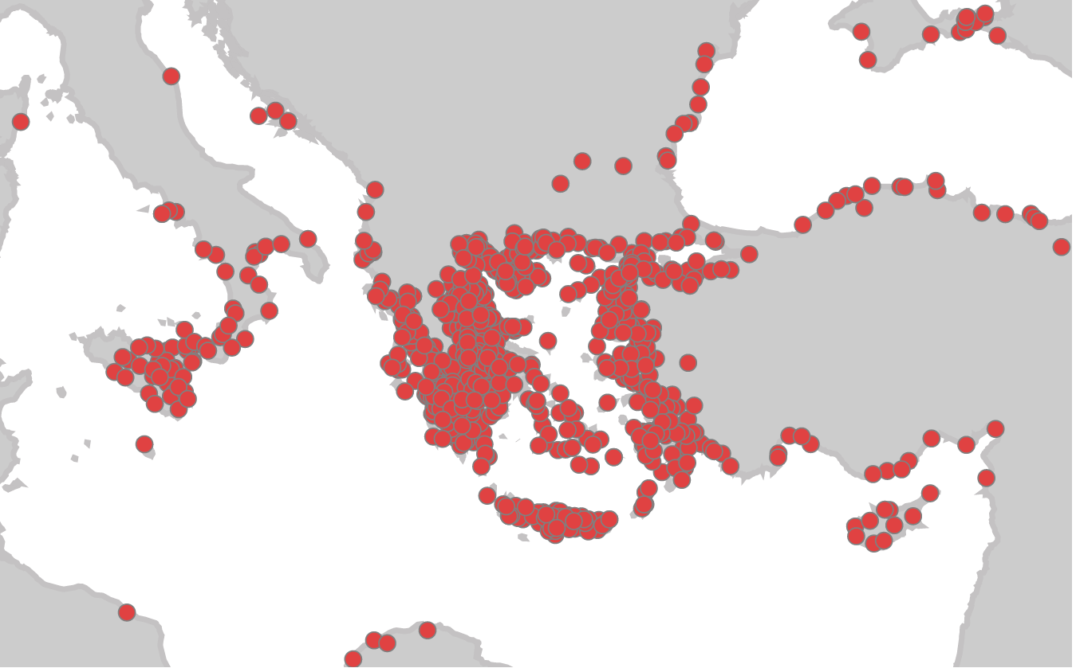
http://polis.stanford.edu
Princeton University Press
2015

Slide 2
Theory formation and testing in institution economics
In the book, I seek to establish a causal relationship between ancient Greek political institutions and economic change over time by
measuring economic performance (via proxy data and comparisons with other societies)
proposing a theory relating citizen-centered institutions in a small-state ecology to growth
developing testable hypotheses from the theory
testing the hypotheses against Greek history over the long run

Slide 3
Economic outcomes
Behavioral choices
Political inputs
From ‘nature’ via rules and competition to efflorescence

Slide 4
Social Science and ancient history
Classical Greece is distinctive in institutional development (large, long-lived, ecology of many small & relatively democratic states).
And data-rich due to text survival, intensive archaeology, and recent encyclopedic work.

Slide 5
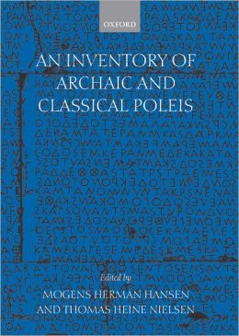
Social Science and ancient history
Classical Greece is distinctive in state and institutional development (polis, democracy).
And remarkably data-rich due to intensive archaeology and recent encyclopedic work.
M. H. Hansen, T. Nielsen,
Inventory of Archaic and Classical Poleis
(2004) = IACP
Catalogues standardized information for 1035 poleis, 800 - 323 BCE.
Now digitized: http://polis.stanford.edu

Slide 6
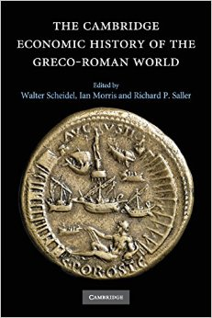
Social Science and ancient history
Data remains (by modern standards) sparse and noisy, but is (I claim) adequate for hypothesis testing.
Historians of antiquity are now able to employ some of the theories, models, methods of contemporary social science.

Slide 7
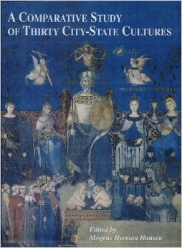
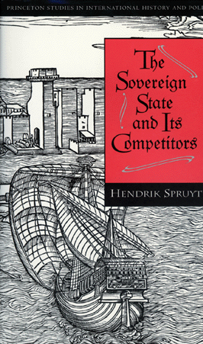

Market-like ecology of states.
Hellas is the largest, longest lasting documented ecology of city-states (Hansen 2000). It is a prominent example of peer-polity interaction (Renfrew and Cherry 1986) in a system of many small states (Spruyt 1994).

Slide 8

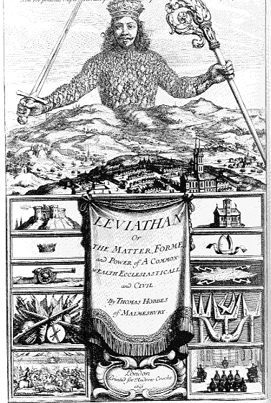
Market-like ecology of states.
Hellas is the largest, longest lasting documented ecology of city-states (Hansen 2000). It is a prominent example of peer-polity interaction (Renfrew and Cherry 1986) in a system of many small states (Spruyt 1994).
History of Greek world tests neo-Hobbesian claims for the economic value of centralization.

Slide 9


Market-like ecology of states.
Hellas is the largest, longest lasting documented ecology of city-states (Hansen 2000). It is a prominent example of peer-polity interaction (Renfrew and Cherry 1986) in a system of many small states (Spruyt 1994).
History of Greek world tests theories of causal relationship between regime characteristics and economic change.

Slide 10
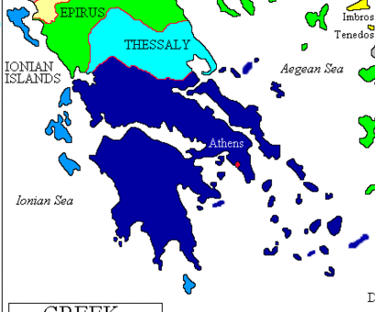
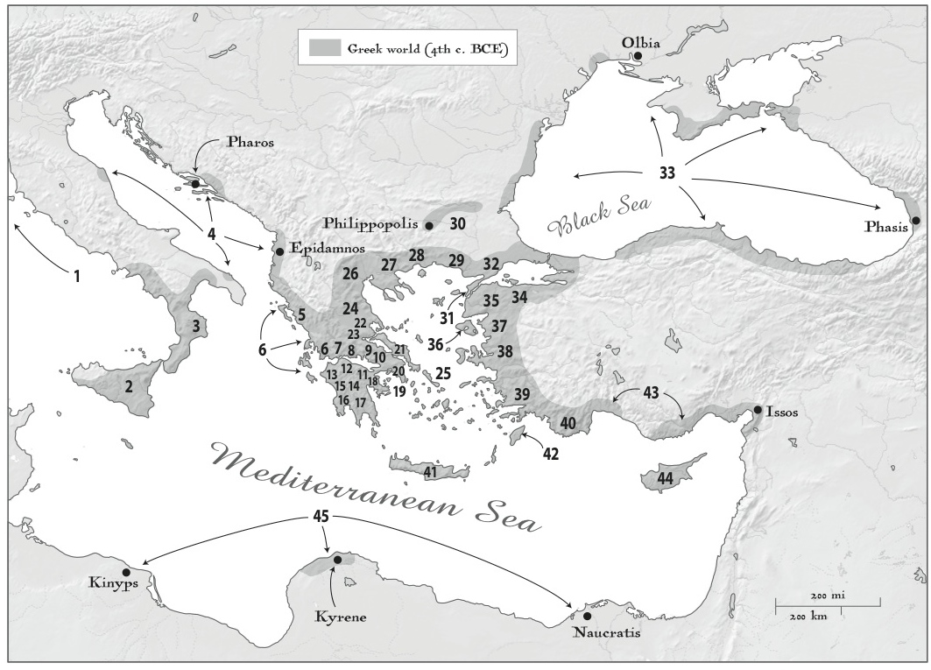
Political and economic development in Greece in the long run
Run = ca. 1300 BCE (Late Bronze Age) – ca. 1900 CE
Greece = “Core Greece” and “Greek world”
  -- Core Greece = Territory of Greek state in 1890.
  -- Greek world =
  Territory of ca. 1100 culturally Greek city-states

Slide 11
Core Greece. Development index, 1300 BCE to 1900 CE.
(Population & consumption estimates)

Slide 12
Core Greece. Development index, 1300 BCE to 1900 CE.
(Population in millions x consumption in multiples of bare subsistence)
Homer
Marx
Marcus
Aurelius

Slide 13
Core Greece. Development index, 1300 BCE to 1900 CE.
(Population in millions x consumption in multiples of bare subsistence)
Plato,
Aristotle

Slide 14
Core Greece. Development index, 1300 BCE to 1900 CE.
(Population in millions x consumption in multiples of bare subsistence)
Classical era
Efflorescence
Premodern Normal
Plato,
Aristotle

Slide 15
Core Greece. Development index, 1300 BCE to 1900 CE.
Estimated population (millions) x consumption (multiples of subsistence)
Classical
Hellenistic
Imperial Roman

Slide 16
Development index,
Ca 400 BCE – 200 CE.
Lagia 2015. Protein intake in Athenian diet.
Ca, 400 BCE – 200 CE
Temporal comparison of mean δ¹⁵N
(high values = better nutrition)

Slide 17
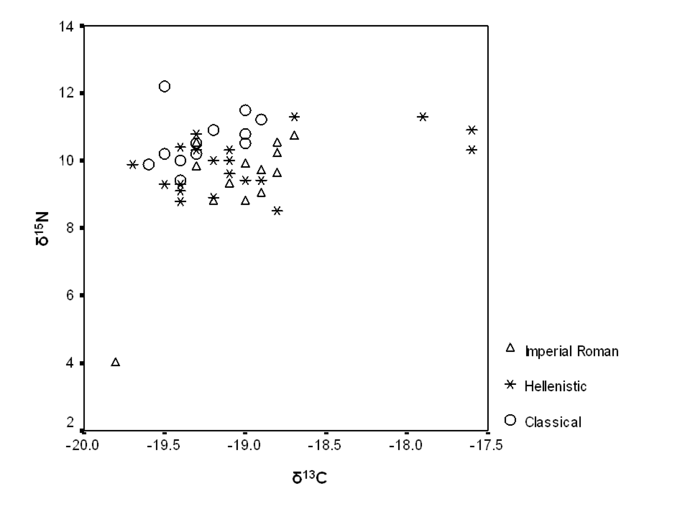
Lagia 2015. “Diet and the polis.”
“Diachronic analysis of isotopic signatures in Athens demonstrates a decline in protein levels from the Classical period to Imperial Roman times. This was found to be significant between the Classical and Hellenistic, and the Classical and Imperial Roman periods, but not between the Hellenistic and Imperial Roman times.”
Figure 4. Temporal comparison of δ¹³C and δ¹⁵N collagen values in Athens.

Slide 18
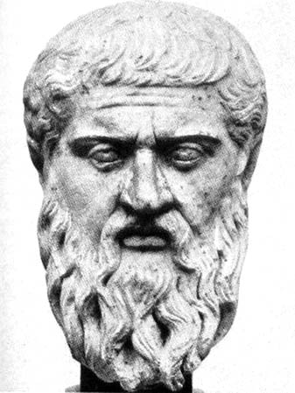
Shape of the Greek World:
A decentralized ecology of many small states.
The earth is very large and we [Greeks] … live in a small part of it about the sea, like ants or frogs around a pond….
Plato Phaedo 109b

Slide 19
Shape of the Greek World:
A decentralized ecology of many small states.
The earth is very large and we [Greeks] … live in a small part of it about the sea, like ants or frogs around a pond….
http://polis.stanford.edu
Plato Phaedo 109b

Slide 20
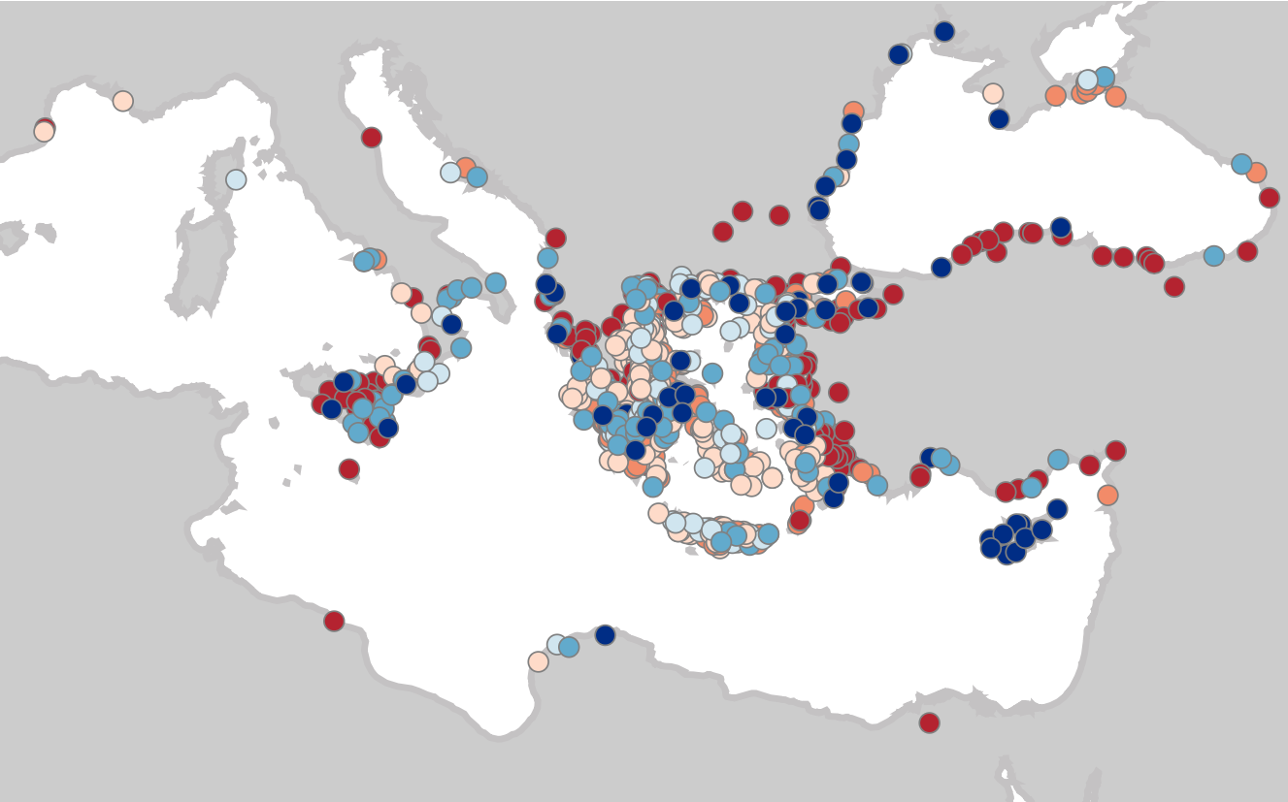
http://polis.stanford.edu
All Inventory poleis, ranked by size
5,6,7 = dark blue, 4 = mid-blue, 3 = light blue, 2 = red, 1 = orange, beige = size unknown

Slide 21
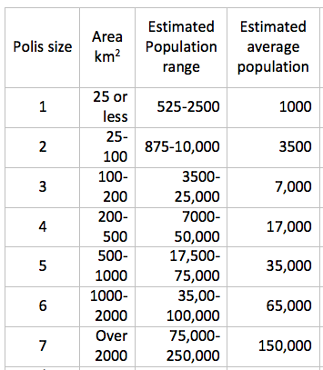
Populations of poleis (n = 1100)
Based on Hansen 2006, 2008
Smaller to Bigger

Slide 22
Populations of poleis (n = 1100)
Based on Hansen 2006, 2008
4/5 of poleis were small,
Smaller to Bigger

Slide 23
Populations of poleis (n = 1100)
Based on Hansen 2006, 2008
4/5 of poleis were small, but 2/3 of Greeks lived in middling to large sized poleis.
Smaller to Bigger

Slide 24
But most Greeks live in middling to large poleis
Most poleis are small

Slide 25
Size and Fame.
Similar truncated bell curves: Long right tails =
Many quite small and obscure states, few large and prominent.
Greek history as interaction between a few “super-poleis,” several dozen mid-ranked poleis, and hundreds of small poleis. And, of course, non-Greek states and cultures.
Greek history is of “small and great poleis alike.”
Herodotus 1.5.3
Size
Athens, Sparta, Syracuse
Fame

Slide 26
Measuring economic change
Proxies for assessing economic performance
Relative measures (change over time)
Demographic growth
Size of houses
Supply of coined money
Investment in civic infrastructure

Slide 27
Measuring economic change
Proxies for assessing economic performance
Relative measures (change over time)
Demographic growth
Size of houses
Supply of coined money
Investment in civic infrastructure
Comparative measures (differences between societies)
Population density
Urbanization
Median income/non-elite consumption
Inequality

Slide 28
Change over time:
More people
Greece, total population (in millions), 1000 - 300 BCE
Data:
ca. 300 BCE:
Hansen 2006, 2008
ca. 1000 BCE:
S.C. Murray 2013
Homer
Aristotle

Slide 29
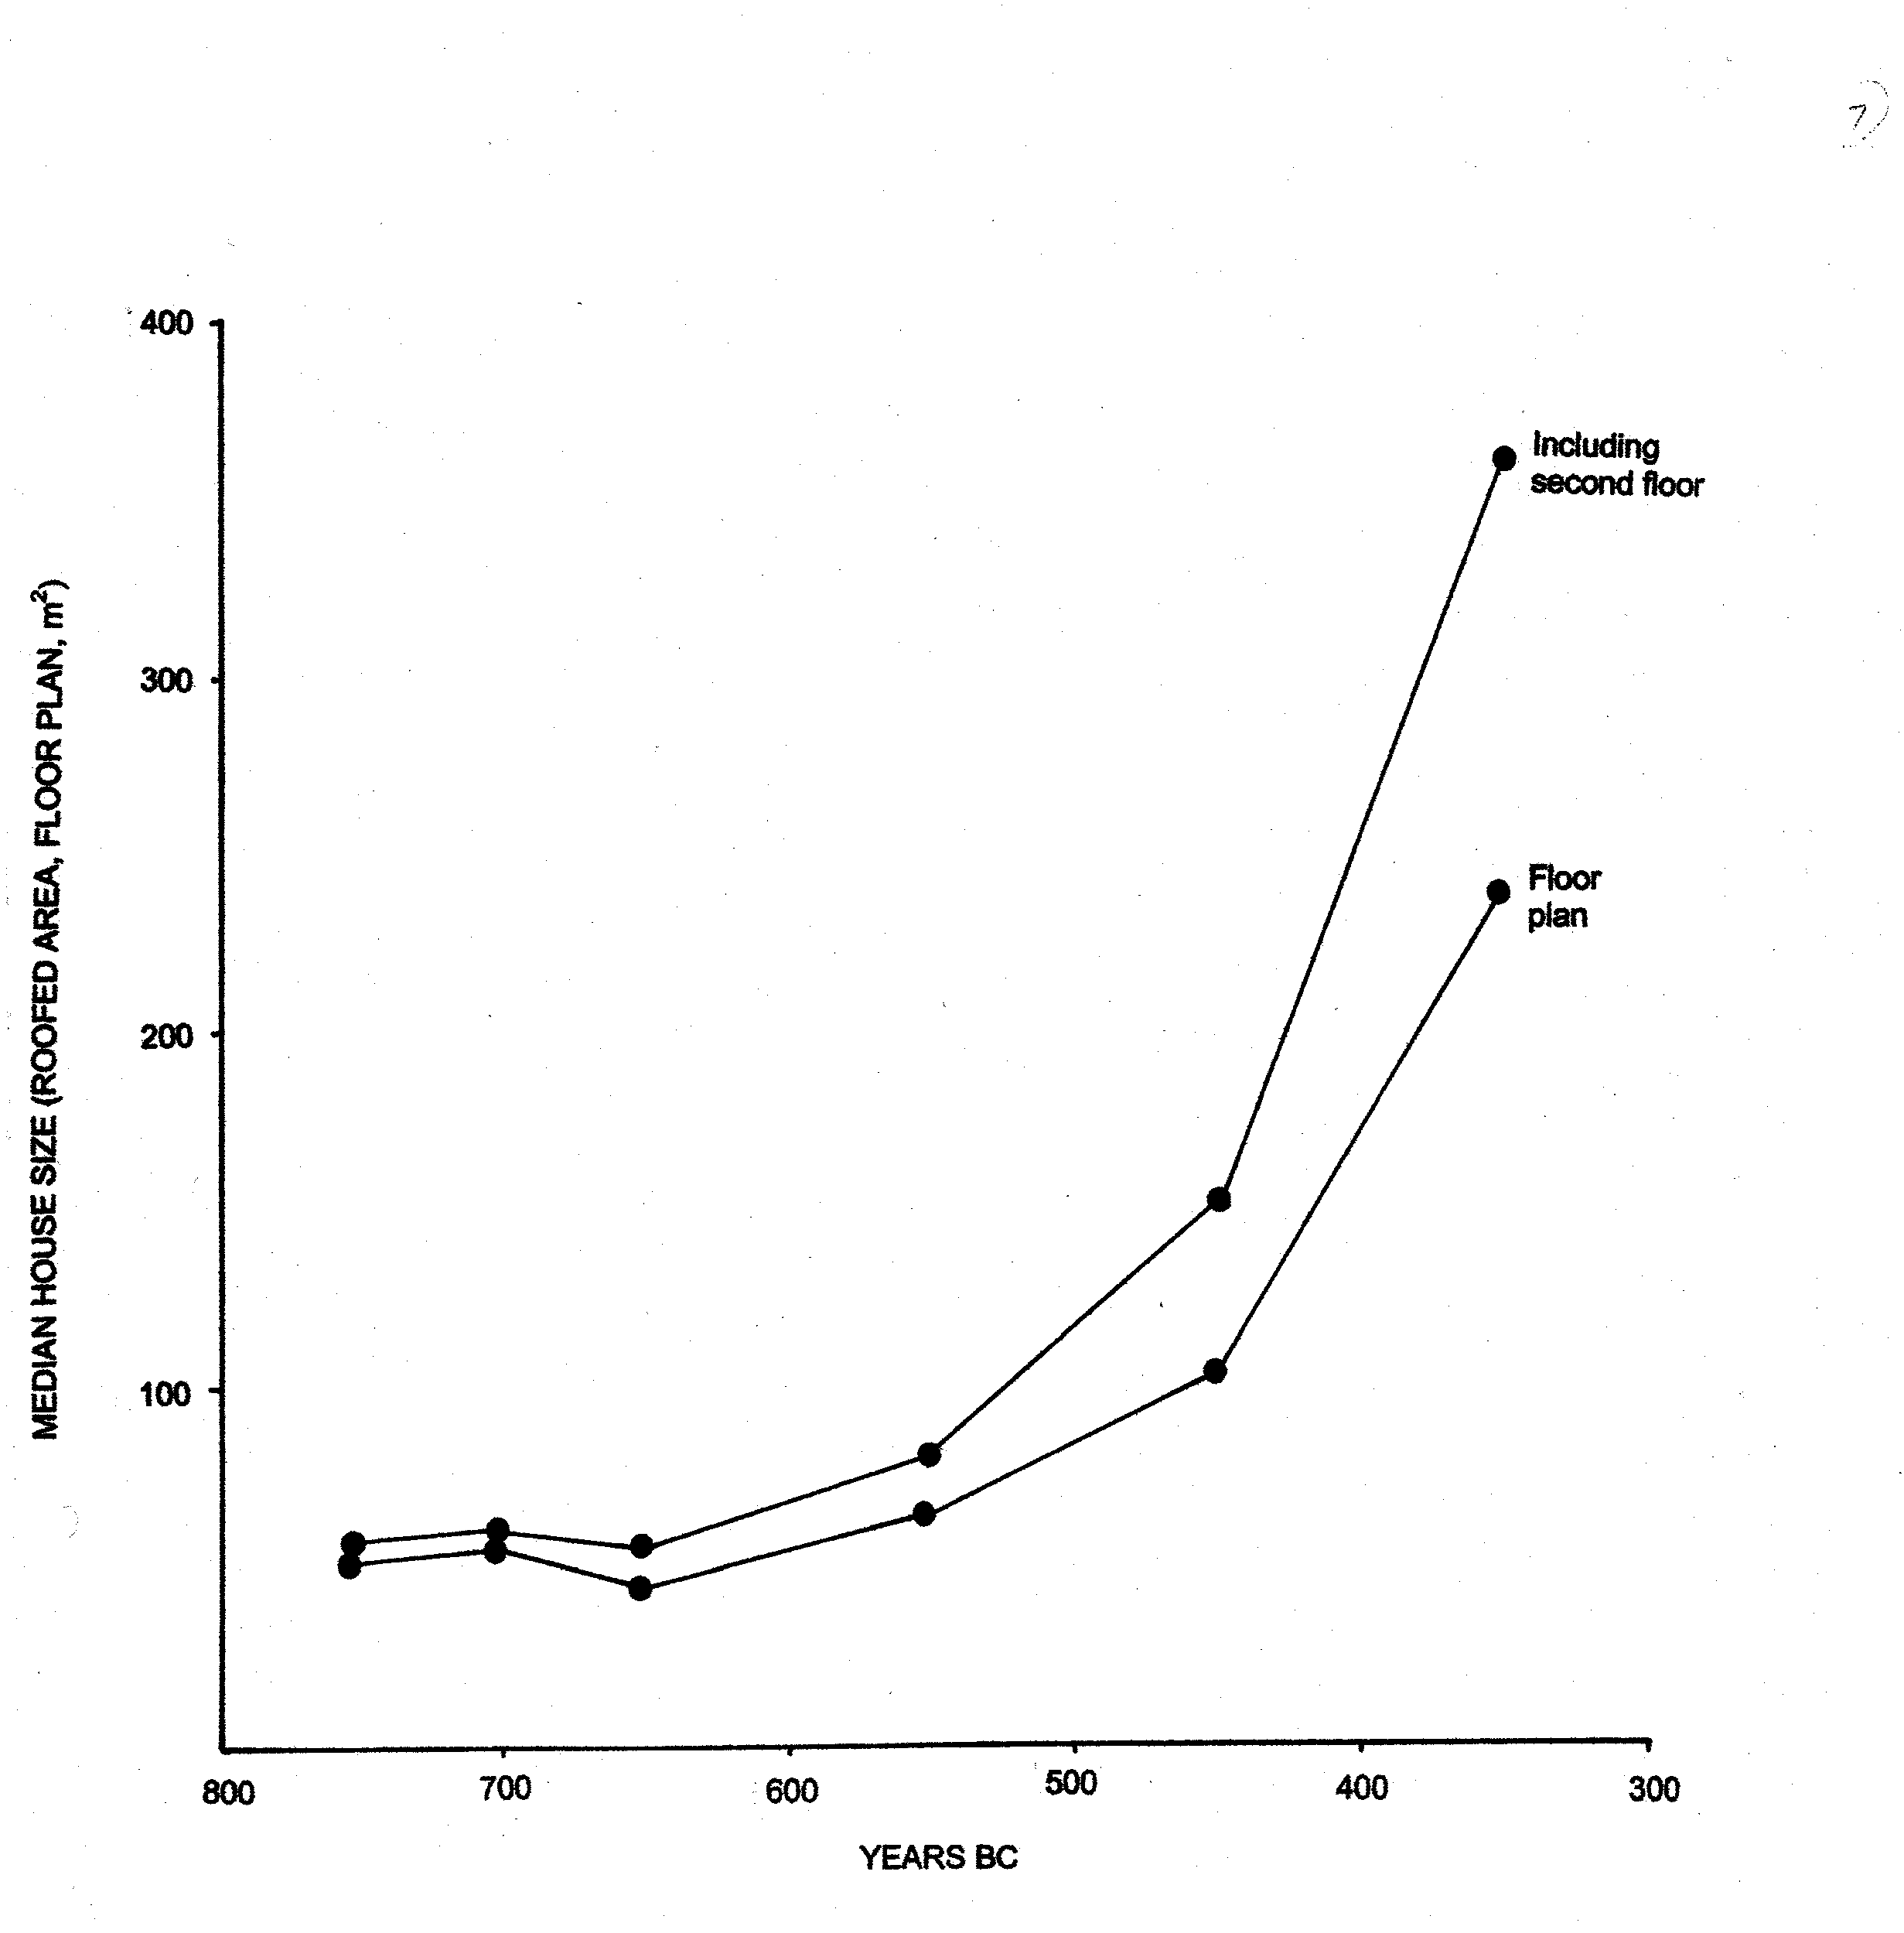
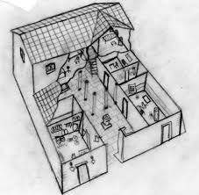
Bigger houses Greek house sizes: 800-300 BC. Including and excluding hypothetical second floors.
I. Morris. 2004
n. = 405
Homer
Aristotle

Slide 30
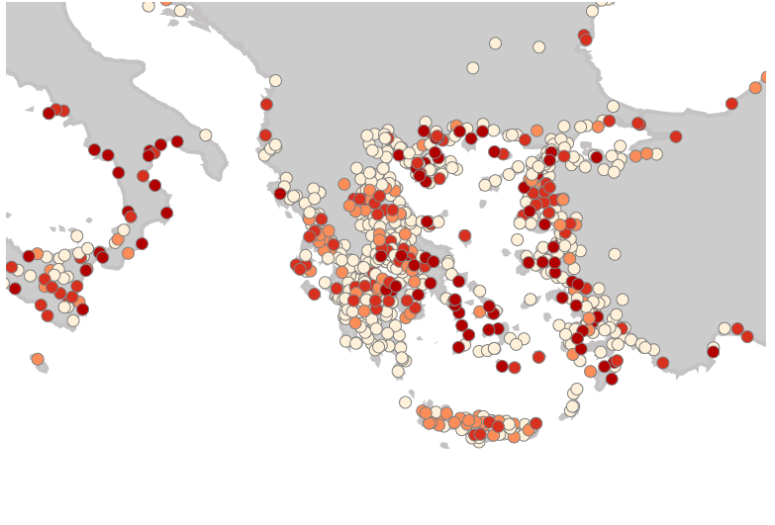
http://polis.stanford.edu
Increased minting:
Dark red: Polis mints silver coins by 6th century BCE,
Light red by 5th, orange by 4th, beige no known mint
Data: IACP, corrected by Peter van Alfen (ANS).

Slide 31
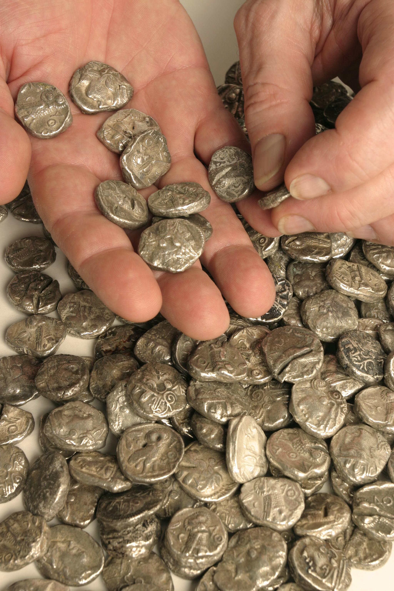
More money in circulation
Aristotle
J. Ober/D. Teegarden. Data: IGCH

Slide 32
Bigger pots of money
Aristotle
J. Ober/D. Teegarden. Data: IGCH

Slide 33
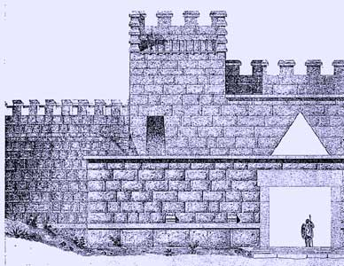
More investment in civic infrastructure.
Homer
Aristotle
Fortified poleis, 900 to 323 BCE
Data: Frederiksen 2011, IACP

Slide 34
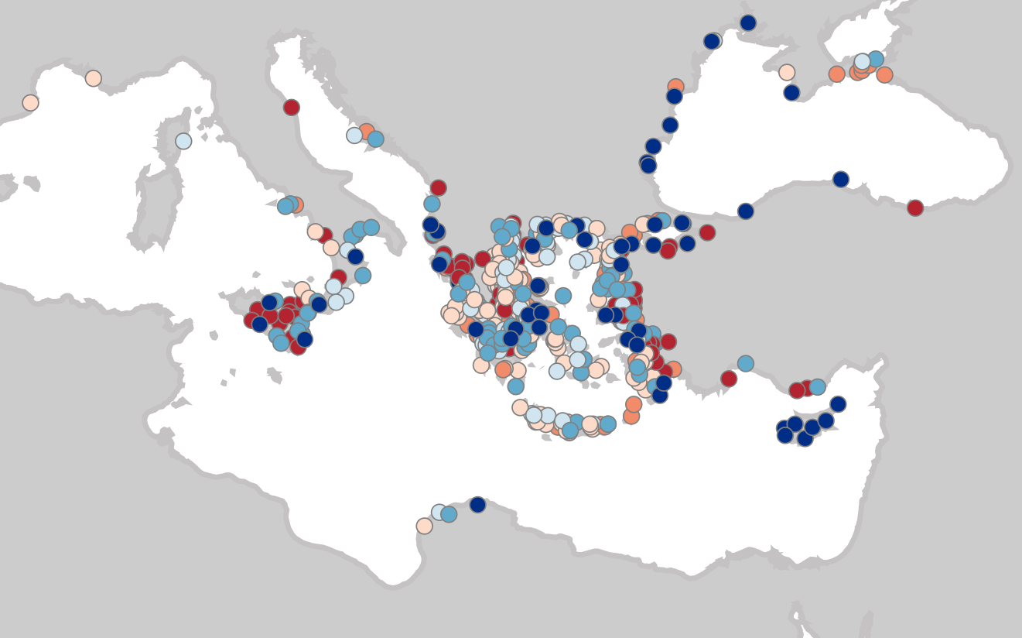
http://polis.stanford.edu
Walled poleis (by 323 BCE), sorted by size.
5 = dark blue, 4 = mid-blue, 3 = light blue, 2 = red, 1 = orange, beige = size unknown

Slide 35
Summary of proxy-indicators of relative economic growth in the Greek world, 800-300 BCE. Minimal conclusion: enough growth to demand explanation

Slide 36
Population density (persons per square kilometer). Comparisons.
Non-Greek data: Milanovic, Lindert, and Williamson 2011.

Slide 37
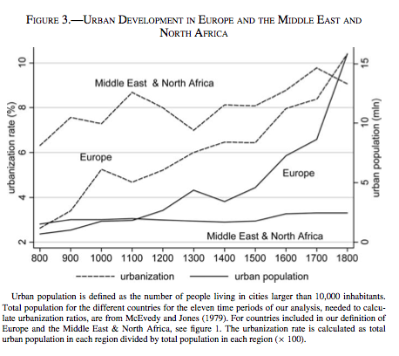
Urbanization. Comparisons: AD 800-1800
(% of population in towns of >10,000)
Solid lines: millions of people living in towns of more than 10,000 people.
Dotted lines percentage of total population living in towns of more than 10,000 people
Bosker, Buringh, & van Zanden 2013

Slide 38
Urbanization. Comparisons
(% of population in towns of >10,000)
Hellas late 4th c. BCE:
Ca. 20-24% urbanized at 10,000+ level
Total of ca. 2m persons.
Hellas urban pop. (millions)
Bosker et al. 2013

Slide 39
Hellas urbanizatiion (%)
Urbanization. Comparisons
(% of population in towns of >10,000)
Hellas late 4th c. BCE:
Ca. 20-24% urbanized at 10,000+ level
Total of ca. 2m persons.
Hellas urban pop. (millions)
Bosker et al. 2013

Slide 40
Urbanization. Comparisons
(% of population in towns of >5000)
Hansen 2006, adapted

Slide 41
Urbanization. Comparisons
(% of population in towns of >5000)
Hansen 2006, adapted
Bowman & Wilson 2011
Premodern Europe data: Milanovic, Lindert, and Williamson 2011

Slide 42
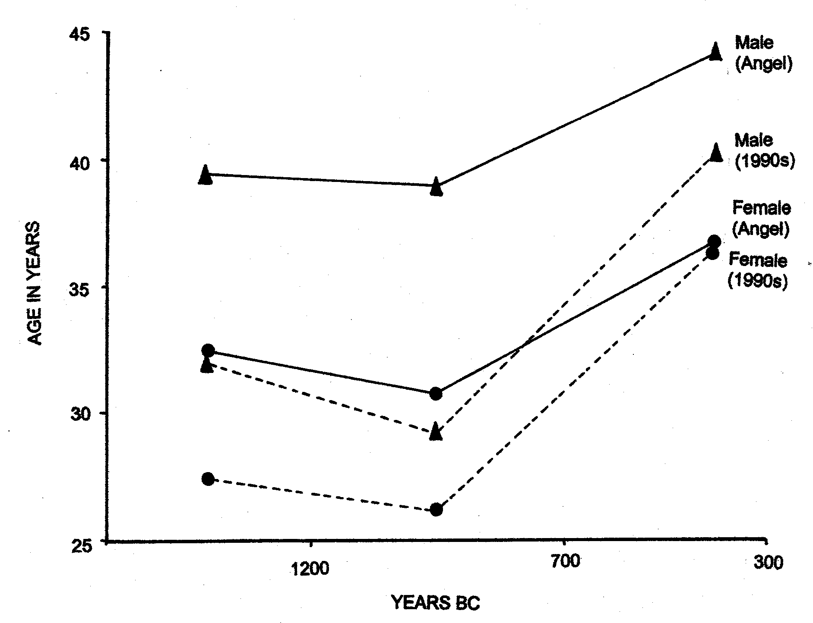
Much more urbanized population …
… but much longer lives
Average age at death
(skeletal analysis)
I. Morris
2004
Angel n =
433 male
294 female
1990s n =
357 male
416 female
EIA NADIR
CLASSICAL PEAK

Slide 43
Much more urbanized population …
… and better nutrition
Lagia 2015. “The analysis of carbon and nitrogen stable isotopes in the three chronological periods reveals that adequate amounts of protein comprised diet overall in the urban center of Athens and even in the small sample from the rural cemetery at Laurion possibly related to the mines…“Overall evidence suggests that the largest part of the population enjoyed a high quality dietary level during adult life.” ”

Slide 44
Athens 4th c
High real wages for laborers.
Athens in 5th and 4th c BCE stands out when compared to other premodern societies.
Athens 5th c
Delos 3rd c
Daily wages of unskilled laborers in Afroeurasia, 1800 BCE to 1800 CE,
in liters of wheat equivalent (Source: Scheidel 2009)
Key: red = Athens, orange = Delos

Slide 45
Athens 4th c
High real wages.
Athens in 5th and 4th c BCE stands out when compared to other premodern societies.
Babylon
Athens 5th c
Delos 3rd c
Ancient/Medieval Normal
Daily wages of unskilled laborers in Afroeurasia, 1800 BCE to 1800 CE,
in liters of wheat equivalent (Source: Scheidel 2009)
Key: red = Athens, orange = Delos
Hamm-urabi
Kant

Slide 46
Athens 4th c
High real wages.
Athens in 4th c BCE --comparable to “Golden Age” Holland of
16th – 18th c CE.
Babylon
Athens 5th c
Delos 3rd c
Ancient/Medieval Normal
Daily wages of unskilled laborers in Afroeurasia, 1800 BCE to 1800 CE,
in liters of wheat equivalent (Source: Scheidel 2009)
Key: red = Athens, orange = Delos

Slide 47
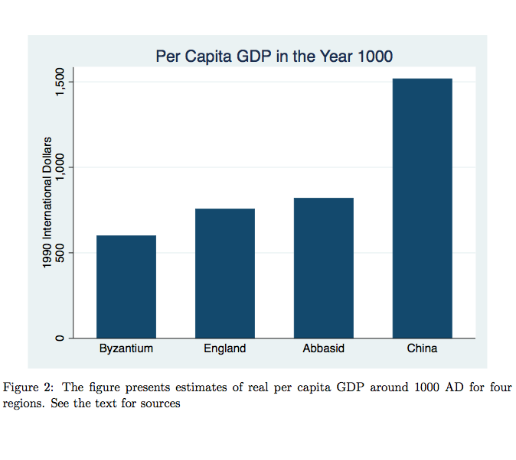
$1350 PPP
Athens
Ca 330 BCE
Data other than Athens: Stasavage Forthcoming (in Annual Reviews in PS)

Slide 48
Athens 330s BCE
Income and population model. 34 groups of “estates”: Citizens, metics, and slaves.
Notes: dr = drachmas.
T = talents (6000 drachmas). Estates = families or individuals.
dr/day assumes most, but not all income is made by adult male “head of family.”
Days worked is only for groups assumed to make most of income as wages.
Subsistence multiple is calculated only for groups assumed to reside as families.

Slide 49
<– Richer / Poorer –>
Median

Slide 50
Athens 330s BCE population/income model. Summary.
Population: 226,703 total in 123,170 households (citizens, metics, slaves).
Total income: 7,179.6 Talents total per annum. = ca. 43m drachmas.
GDI per capita (mean income): 192 dr = 4.5 x subsistence = 1350 $PPP
Gini coefficient (income) = 38 (on scale of 100)
Maximum feasible Inequality (G*) = 78
Inequality Extraction Ratio = 49 (on scale of 100)
Top 1% income share = 16.25% of total income
Top 1% per capita income = 14.25x mean income
Top 0.1% per capita income = ca. 30x mean income
Median income = 138 dr = 3.5 x subsistence
Median income = 74% of mean (average) income
“Lower class” (below middle) = 23% of pop. (avg. 1.67x subsistence)
“Middle class” (0.75 – 1.25 median) = 55% of pop. (2.67 - 4x subsistence)
“Upper class” (above middle) = 22% of the pop. (5.6x subsistence & above)

Slide 51
Top 1% Income Shares.
Modern States 2010/Athens ca. 330 BCE
Source data (except Athens): World Top Incomes Database & IMF

Slide 52
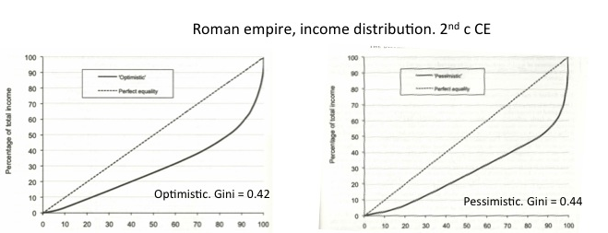
Athens 330’s compared to Roman empire
Greek mainland: Major increase in inequality from classical era to Roman era readily visible in archaeological record:
Cities shrink, much more inequality in house sizes, small farms replaced by “villa estates”
Bintliff 2012. ch. 13; 2014
Athens 330’s BCE
Gini = 0.37
Roman empire. Lorenz curves and Gini: Scheidel and Friesen 2009

Slide 53
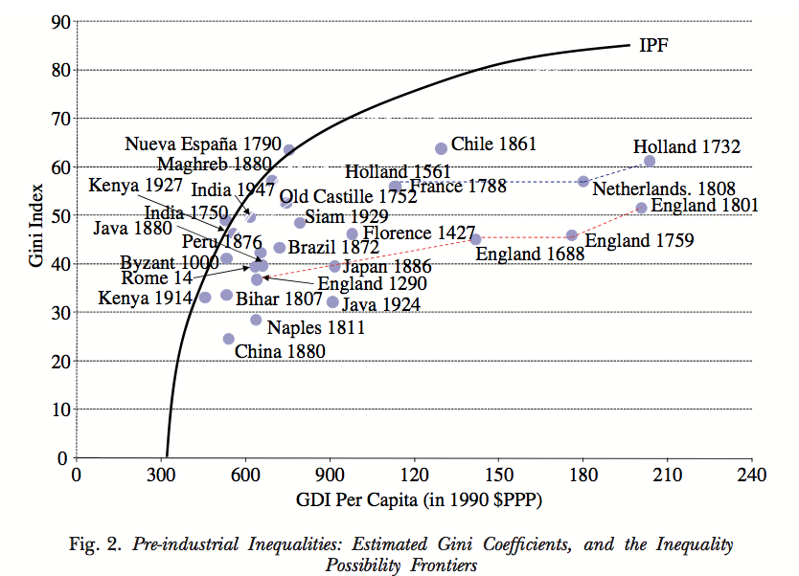
(After Milanovic, Lindert, and Williamson 2010)
Athens 330’s BCE

Slide 54
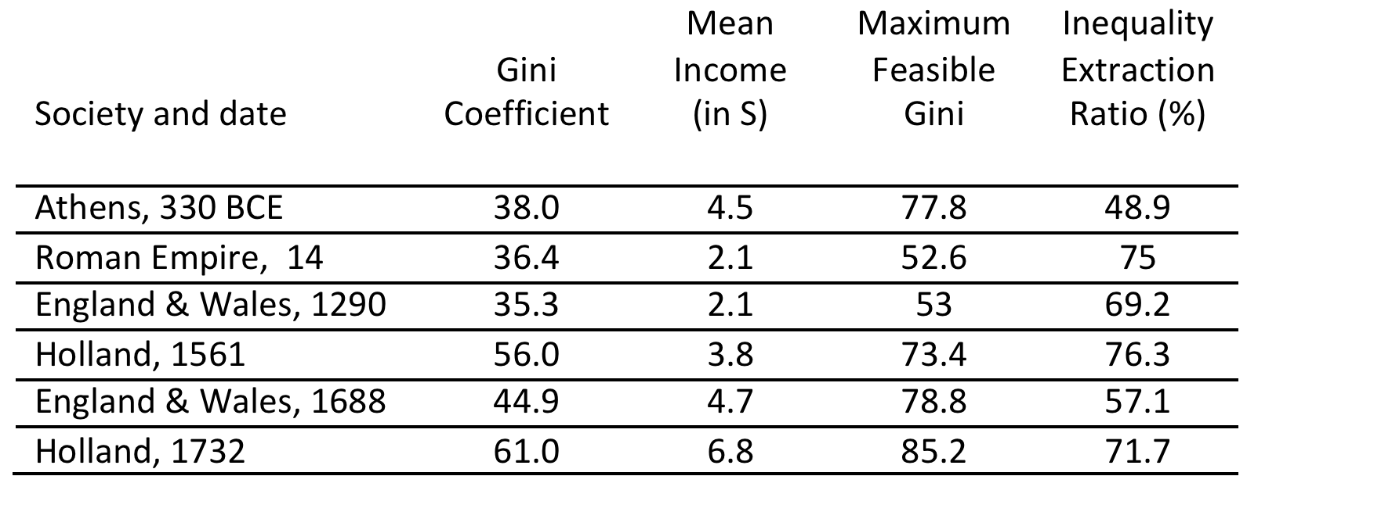
Income inequality comparisons
Notes: S = subsistence minimum. All data, other than Athens, from Milanovic, Lindert, and Williamson 2011. Note that Scheidel and Friesen 2009 estimate a higher Gini coefficient for the Roman empire, and a lower Mean Income, which would yield an IER so high (over 100) as to imply some imperial residents were living below subsistence, and thus dying due to deprivation.

Slide 55
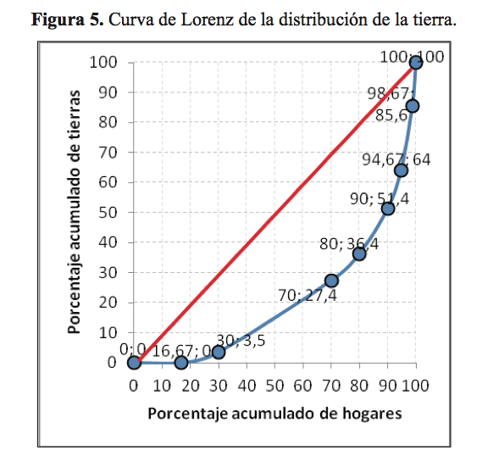
Gallego 2016: Low inequality in distribution of agricultural land among Athenian citizens. 4th century BCE
Gini = 0.441
“The conclusion is that the distribution of land in fourth-century Athens was reasonably egalitarian, compared to other cases, and that the peasantry continued to have a significant role.”

Slide 56
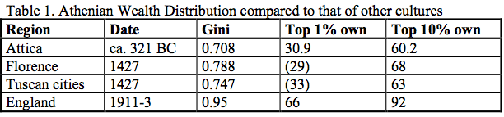
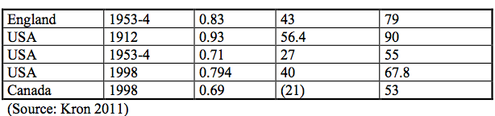
Kron (2002) Athens wealth Gini.

Slide 57
Lagia 2015. Athens: Low overall nutritional inequality.
“The Laurion samples were not found to differ from the urban center, nor were any significant differences observed between the two urban cemeteries, arguing against the occurrence of significant population differences with respect to adult diet.”
Lagia 2015. Figure 1. Graph of δ¹³C and δ¹⁵N for collagen from humans buried at the Kerameikos, Plateia Kotzia and Laurion cemeteries (all periods combined).

Slide 58
Lagia 2015. Athens: Low overall inequality.
“The Laurion samples were not found to differ from the urban center, nor were any significant differences observed between the two urban cemeteries, arguing against the occurrence of significant population differences with respect to adult diet.”
Contrast high observed inequality in Bronze Age & Medieval diets:
Knipper et al. 2015
Buikstra & Lagia 2009: 18
Lagia 2015. Figure 1. Graph of δ¹³C and δ¹⁵N for collagen from humans buried at the Kerameikos, Plateia Kotzia and Laurion cemeteries (all periods combined).

Slide 59
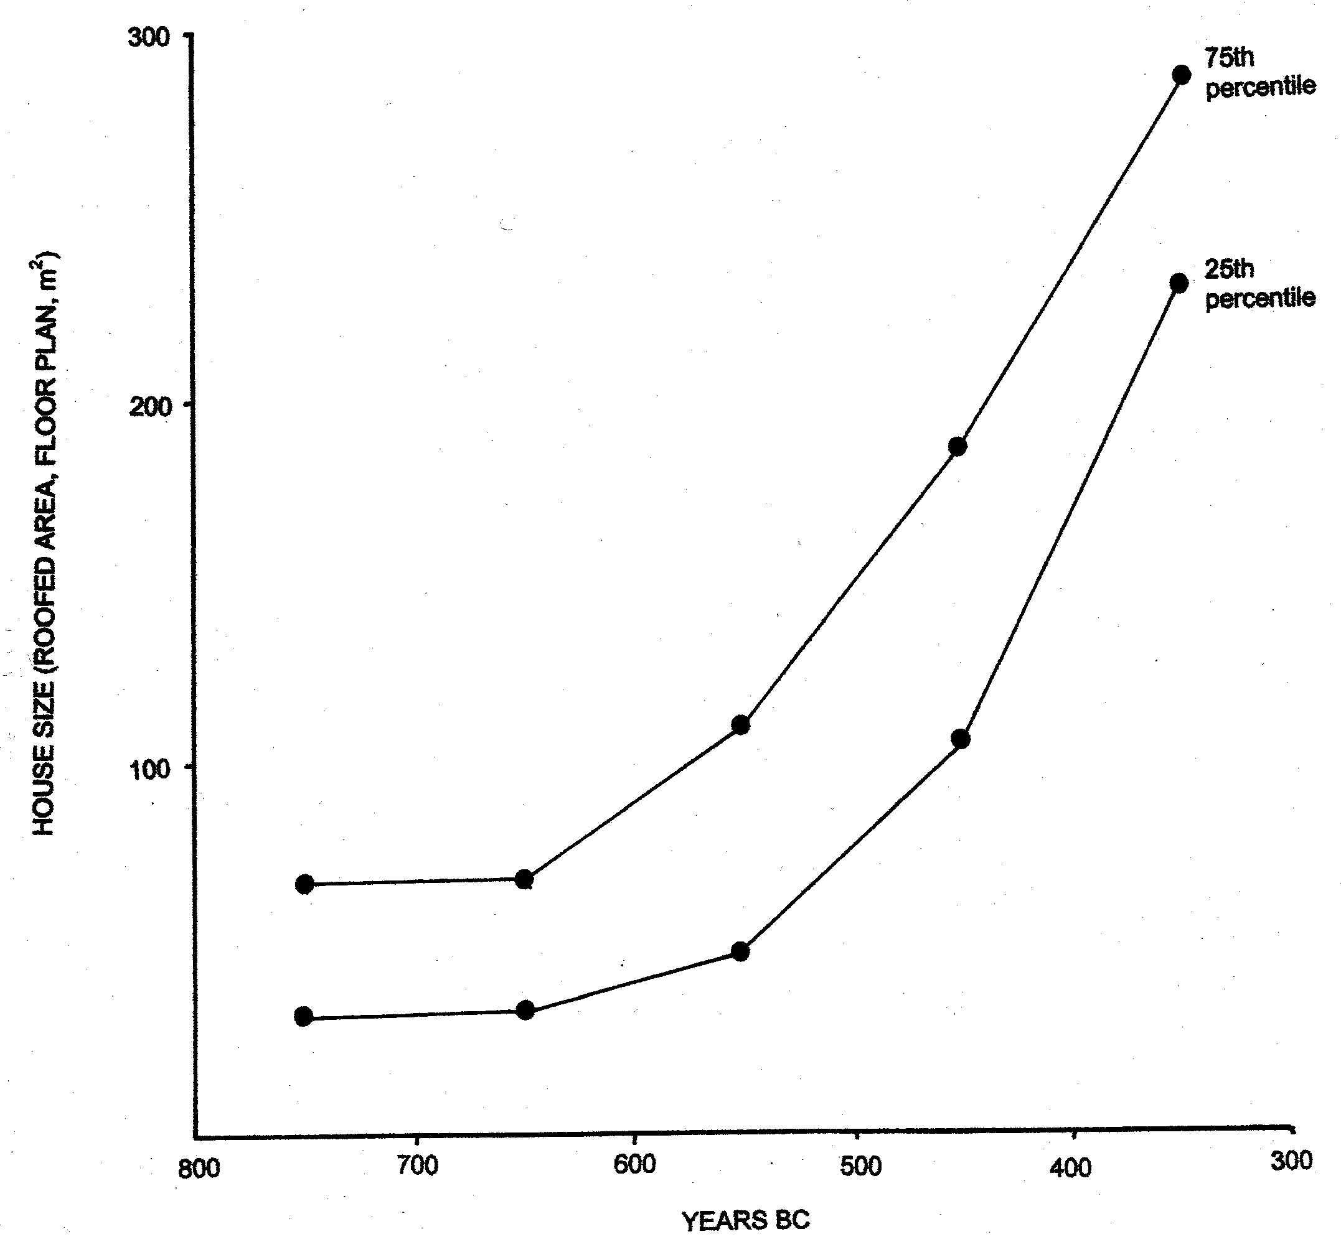
Low Inequality. Greek world. House size.
Larger houses (75th percentile) compared to smaller houses (25th percentile).
Source:
I. Morris 2004.

Slide 60
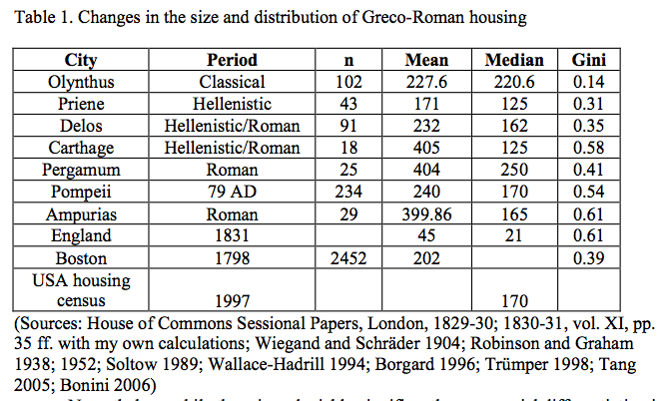
Kron (Forthcoming) House size inequality Greek/Roman.

Slide 61
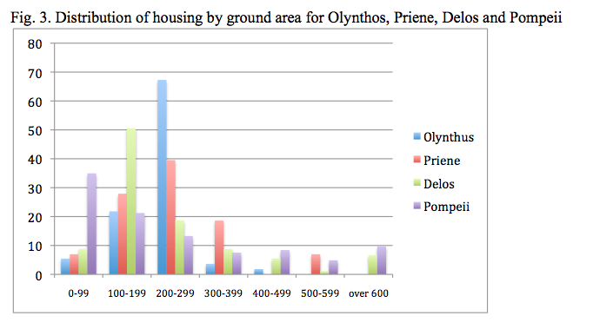
Kron (Forthcoming). Increasing inequality in type-site house from Classical to Hellenistic to Roman eras.
Classical
Hellenistic
Hellenistic/Roman
Roman

Slide 62
Explaining classical Greek economy. High growth & low inequality
Hypothesis:
Fair rules (equal & open access to institutions) and fierce competition within a market-like ecology of states incentivized capital investment (human, social, financial) and rewarded innovation (by individuals and by states), while lowering transaction costs.

Slide 63
Economic outcomes
Behavioral choices
Political inputs

Slide 64
Greek polis development, ca. 850-450 BCE
11th-10th c: Following collapse, egalitarian* poverty in small, geographically isolated villages
9th to 6th c: Recovery: competition favors communities with high mobilization & morale
  Innovative egalitarian*civic institutions (Sparta, Athens) stabilize equality of high political standing among many adult males
  More egalitarian/civic states mobilize more high-morale warriors
*Egalitarian, that is, compared to hierarchical king-centered premodern states

Slide 65
Greek polis development, ca. 850-450 BCE
Egalitarian/civic regimes are adaptive in a multi-state ecology, dominate neighbors, get & stay bigger
  But strong local & civic identity limits territorial expansion of any given polis
Population pressure drives colonization (foundation of new independent Greeks states)
  Citizen-centered institutions make Greeks effective colonizers enables expansion into non-Greek territories (Sicily, N Africa)
  –> Colonization rewards citizen-centered rules

Slide 66
Greek polis development, ca. 850-450 BCE
Colonization rewards specialization & exchange (Sicilian wheat for Athenian vases)
Egalitarian rules reward high individual human capital investments (Spartan infantry training, Athenian pottery industry) > more specialization
Information exchange, inter-state learning and competitive emulation drive some tendency to convergence on “institutional best practices”

Slide 67
Prediction following from hypothesis:
Institutions featuring fair rules and offering competitive advantage will prove adaptive, and will be widely adopted across the ecology of Greek city-states.

Slide 68
Prediction following from hypothesis:
Institutions featuring fair rules and offering competitive advantage will prove adaptive, and will be widely adopted across the ecology of Greek city-states.
Many familiar features of Greek civilization are thus explained
Argued in detail in Rise and Fall, chapters 6-11 (historical narrative)

Slide 69
Predictions based on hypothesis
1. Refinement of fairness rules under competitive pressure & convergence of poleis upon adaptive institutions
Democracy
Federalism
2. Creative destruction: Failure of states not following path of convergence
Sparta in 370s forward.
Tyrant-dominated Sicilian poleis in mid-4th century
3. Expansion of polis world as adaptive polis institutions adopted by Greeks’ neighbors
Caria (western Anatolia)
Macedon
4. More specialization, more mobile specialists

Slide 70
Predictions based on hypothesis
1. Refinement of fairness rules under competitive pressure & convergence of poleis upon adaptive institutions
Democracy
Federalism
2. Creative destruction: Failure of states not following path of convergence
Sparta in 370s forward.
Tyrant-dominated Sicilian poleis in mid-4th century
3. Expansion of polis world as adaptive polis institutions adopted by Greeks’ neighbors.
Caria (western Anatolia)
Macedon
4. More specialization, more mobile specialists

Slide 71
Athens. Democratic institutions
Frequent innovations/refinements
Constitutional law
Executive accountability
Taxation and finance
Military organization
Key institutions are stable
Quasi-federalism
Citizen Council
People’s Courts
Athenian institutions adopted by other poleis
Quasi-federalism
Constitutional law
Taxation and finance

Slide 72
Athens. Democratic institutions
Frequent innovations/refinements
Constitutional law
Executive accountability
Taxation and finance
Military organization
Key institutions are stable
Quasi-federalism
Citizen Council
People’s Courts
Athenian institutions adopted by other poleis
Quasi-federalism
Constitutional law
Taxation and finance

Slide 73
Athens. Democratic institutions
Frequent innovations/refinements
Constitutional law
Executive accountability
Taxation and finance
Military organization
Key institutions are stable
Quasi-federalism
Citizen Council
People’s Courts
Athenian institutions adopted by other poleis
Quasi-federalism
Constitutional law
Taxation and finance

Slide 74
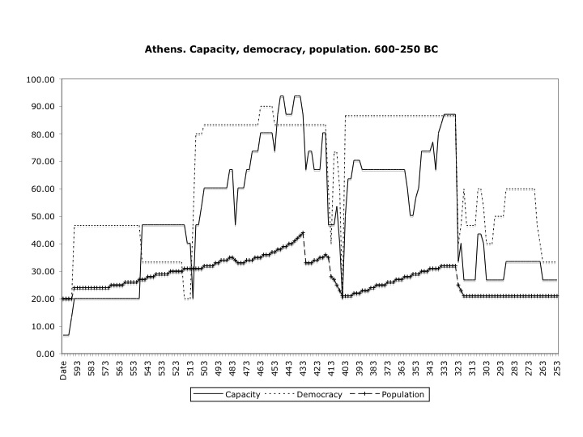
Democratic advantage? State capacity tracks democracy
Pre-democratic era
Democratic
era
Macedonian domination

Slide 75

Democratic robustness to exogenous shock
Shocks, but no regime change
⇒
⇒
⇒
⇒
⇒
⇒
Shocks, performance failures, ephemeral oligarchies
Pre-democratic era, tyranny, oligarchy
Macedonian domination

Slide 76
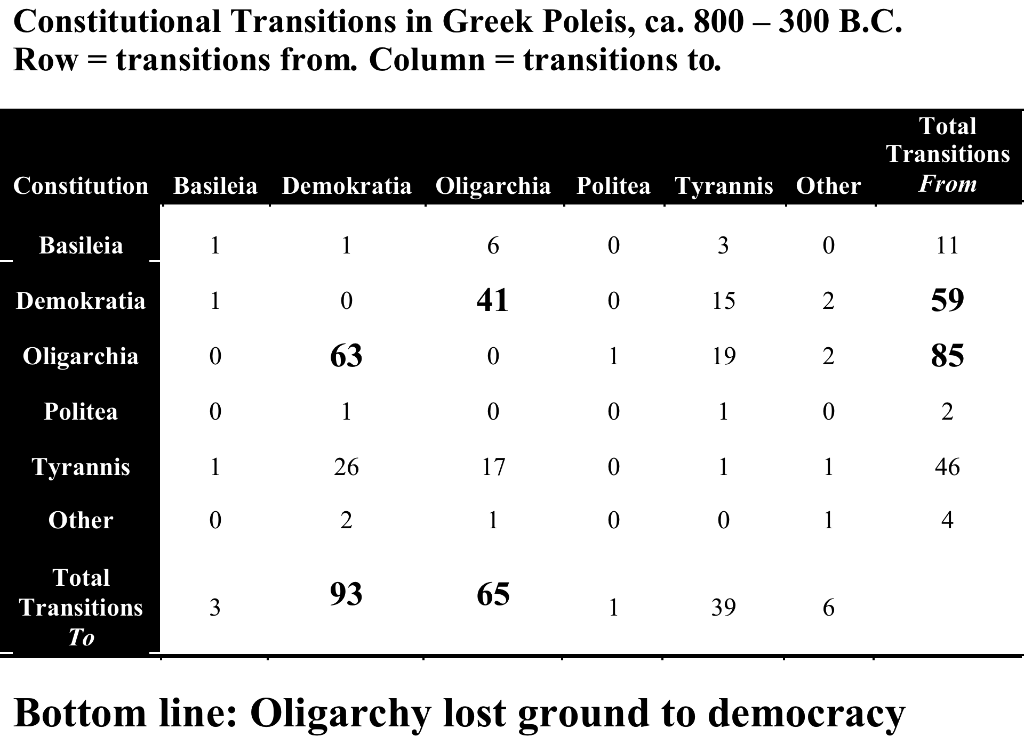
Source: T. Johnson, Data IACP

Slide 77
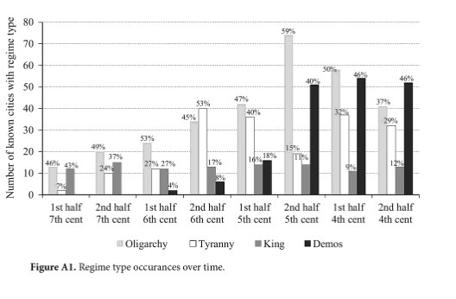
Regime counts. 7th through 4th centuries BCE.
Tyranny. Oligarchy. Democracy.
David Teegarden, Death to Tyrants (PUP 2014)

Slide 78
More …
Political fall (conquest of Greece by Macedon, later Rome)
Economic & political change in post-classical era

Slide 79
Explaining the fall (Late 4th c. BCE)
Market in specialization:
Highly skilled specialists in fields relevant to military and financial success, are mobile and available for hire.
Philip II and Alexander III grasp the value of institutions and expertise developed within the market-like ecology. They selectively emulate and adapt Greek institutions, hire Greek experts, and drive innovations that make imperial Macedon in some ways “polis-like”
Thus, growing specialization and transfer of ideas, goods, and services within the polis ecology help to explain the fall as well as the rise of classical Greece.

Slide 80
Explaining sustained prosperity (3rd -2nd c. BCE)
Restraints on Kings.
Premises:
Macedonian Kings post Alexander III were (mostly) warlords: short time horizons, seek plunder (M.M. Austin 1986).
Counterfactual: They plunder at will –> end of efflorescence
In fact: No abrupt economic fall (pre Roman takeover)
The Hellenistic Greek world overall flourished economically.
Polis culture expanded
Many poleis enjoyed local autonomy.
Democracy continues to expand
WHY? Taxes to Kings were negotiated not imposed.

Slide 81
Explaining sustained prosperity (3rd -2nd c. BCE)
Restraints on Kings.
Premises:
Macedonian Kings post Alexander III were (mostly) warlords: short time horizons, seek plunder (M.M. Austin 1986).
Counterfactual: They plunder at will –> end of efflorescence
In fact: No abrupt economic fall (pre Roman takeover)
The Hellenistic Greek world overall flourished economically.
Polis culture expanded
Many poleis enjoyed local autonomy.
Democracy continues to expand
WHY? Taxes to Kings were negotiated not imposed.

Slide 82
Infrastructure investment in massive city walls:
Emphasized by Aristotle, Politics
As regards walls, those [i.e. Plato] who aver that cities which pretend to valor should not have them hold too old-fashioned a view—and that though they see that the cities that indulge in that form of vanity are refuted by experience. …[because] the superior numbers of the attackers may be too much for the human valor of a small force, if the city is to survive and not to suffer disaster or insult, the securest fortification of walls must be deemed to be the most warlike, particularly in view of the inventions that have now been made in the direction of precision with missiles and artillery for sieges. ... not only must walls be put round a city, but also attention must be paid to them in order that they may be suitable … in respect of military requirements, especially the new devices recently invented. For just as the attackers of a city are concerned to study the means by which they can gain the advantage, so also for the defenders some devices have already been invented and others they must discover and think out; for [potential aggressors] do not even start attempting to attack those who are well prepared (ἀρχὴν γὰρ οὐδ᾽ ἐπιχειροῦσιν ἐπιτίθεσθαι τοῖς εὖ παρεσκευασμένοις).
7.1330b-1331a

Slide 83
King, City, Elite Game.
Players: K = King. C = City. E= Elite. L = Lottery.
Outcomes:
N = Negotiate King’s rents/tax on City at rate Q.
S = Submission of City
B_{O} = Bluff of King called (city oligarchic).
B_{D} = Bluff of King called (city democratic).
A_{O} = King attacks (city oligarchic).
A_{D} = King attacks (city democratic).
p = probability A_{D} succeeds. 1-p = probability A_{D} fails.
p’ = probability A_{O} succeeds. 1-p’ = probability A_{O} fails.
A_{D} Lottery.
King: (0.6(10)+0.4(-10) = 2
City: (0.6(-15)+0.4(10))/2 = -5
Elite: (City payoff – 2) = -7

Slide 84
Conclusions
Classical Greece was wealthy – populous, urbanized, high levels of consumption
  Compared to earlier, later periods of Greek history and compared to premodern societies
Classical Greece had comparatively low levels of economic inequality
Wealth and low inequality were, in large part, products of competition and by relatively fair and open political institutions (rules).

Slide 85
Conclusions
Classical Greece was wealthy – populous, urbanized, high levels of consumption
  Compared to earlier, later periods of Greek history and compared to premodern societies
Classical Greece had comparatively low levels of economic inequality
Wealth and low inequality were, in large part, products of competition and by relatively fair and open political institutions (rules).

Slide 86
Conclusions
Classical Greece was wealthy – populous, urbanized, high levels of consumption
  Compared to earlier, later periods of Greek history and compared to premodern societies
Classical Greece had comparatively low levels of economic inequality
Wealth & low inequality are correlated. They were products of competition & relatively fair and open political institutions (rules).

Slide 87
Final thoughts
By combining established methods of classics and ancient history with some basic techniques from social science we can subject theories to empirical tests.
We can show that some theories fail the test, and that others survive (in the present state of our evidence).
So we can make make progress in our attempt to explain (not just describe) the ancient past.

Slide 88
Final thoughts
By combining established methods of classics and ancient history with some basic techniques from social science we can subject theories to empirical tests.
We can show that some theories fail the test, and that others survive (in the present state of our evidence).
So we can make make progress in our attempt to explain (not just describe) the ancient past.

Slide 89
Final thoughts
By combining established methods of classics and ancient history with some basic techniques from social science we can subject theories to empirical tests.
We can show that some theories fail the test, and that others survive (in the present state of our evidence).
So we can make make progress in our attempt to explain (not just describe) the ancient past.

Slide 90
That’s all, Folks!

Slide 91
Core Greece.
(1890 borders)
Contemporary
Greece?
(1947 borders?)

