Slide 1
Public-Private Governance and Political Feedbacks
Elisabeth S. Clemens
Sociology, University of Chicago
IOEA, Corsica, May 2025
Notes:
Thank Eric and organizers. A joy and an honor to be included. Ask indulgence – my talk is both an overview of the work of others and an effort to think aloud about how I might frame my own next project.

Slide 2
Whether we think of governance or governing arrangements, private organizations are everywhere:
  Thinktanks, consultants, lobbying organizations, nonprofit organizations, for-profit firms, and more
The list of troubles associated with the role of private organizations in public business is equally long:
  Corruption, self-dealing, lack of accountability, inflated contracts, poor quality of service, and on and on.

Slide 3
Carillion collapse: two years on, ‘government has learned nothing’: Lack of action on accounting rules to prevent corporate disaster is shocking, Unite says
  The Guardian, Jan. 20, 2020
Trump Team Eyes Politically Connected Startup to Overhaul $700 Billion Government Payments Program
  ProPublica, April 17, 2025
For profit immigration detention expands as Trump accelerates detention plans
  Tucson Sentinel, April 19, 2025
How Universities Became So Dependent on the Federal Government
  New York Times, April 18, 2025
Episcopal Church says it won’t help resettle white South Africans granted refugee status in U.S.
  nbc.com, May 12, 2025

Slide 4
In each of these instances, trouble erupts around a relationship between formal government agencies and some private organization (for-profit or non-profit) that is engaged in “governance”
Q?: How, if at all, does the organization of (democratic) governance influence democratic politics?
  In addition to efficiency and quality, this question requires thinking about visibility, accountability, and legitimacy.
Notes:
Follow Guanchi’s comment in one of the small seminars yesterday. If the first rule of projects is to love your dependent variable, I’m not asking the economists here to fall out of love with efficiency, but perhaps to consider just a bit of a dalliance with other possible outcomes.

Slide 5
Not a survey of a well-defined literature, but my effort to bring together some of the resources helpful to addressing the question.
Begin by suggesting how important traditions of political theory and practice have often made it difficult to think about the role of private organizations in democratic politics. This exercise is not exhaustive.
  Bright boundaries between public and private.
  Interest group pluralism
  Both speak to the “input” side of politics
Sketch political developments in mid-century that made it ever more difficult to ignore the question.
Reconceptualizations
  Organizational state and infrastructural power
  Policy feedbacks
Making sense of public/private arrangements in contemporary governing arrangements:
  Public-private partnerships – potential for revival
  Policy feedbacks on interest and advocacy groups – theoretically developed, empirically open
  Structural power: new modes of business influence – emerging

Slide 6
Bright Lines: Private organizations are dangerous to democracy
The lines were particularly stark in revolutionary France:
  Loi Le Chapelier (1791) banned guilds and strikes; not annulled until 1864 when right of association is established.
  Pierre Rosanvallon, The Demands of Liberty (2007)
  1995: “theft from the state”
Rights of association much more established in the US. But:
  Madison: worries about faction (but hopes factions will control one another)
  Repeated efforts to separate private organizations from political life:
    Open access society and the move toward general incorporation as opposed to individual charters (D. North, J.J. Wallis, B. Weingast, Violence and Social Orders)
  Laws of charitable bequests
  Prohibitions/restrictions on corporate political contributions
  Prohibitions on emoluments (from WWI spyglasses to luxury 747’s)
  New Deal – with respect to relief, public money was to flow exclusively through public institutions (with a major exception).
  Infrastructure an entirely different issue – the viability of this theoretical position came to an end with public works and mobilization for WWII.

Slide 7
Democracy as Interest Group Pluralism
1830s: Alexis de Tocqueville offered “the art of association” as the key to understanding the success of that democratic revolution (references are to vol. 1, part II, ch. 4).
Given the right of association . . .
  “When an opinion is represented by an association, it has to be expressed in a clearer, more precise form than would otherwise be the case. It calls upon supporters to stand up and be counted . . . . links the efforts of divergent minds and vigorously propels them toward a single goal, which in unambiguously designates.”
  “The second stage in the exercise of the right of association is the ability to assemble. . . . Men can see one another, pool their resources, and exchange views with a forcefulness and warmth that the written word can never achieve.”
  “In the political realm . . . people who share a common view can join together in electoral bodies and choose delegates to represent them in a central assembly.”
Tocqueville then illustrates how this works with a discussion of the 1831 mobilization that generated first a convention, then a petition, opposing tariffs.
But he ends with a warning: “unlimited freedom of association in the political realm is, of all forms of liberty, the last that a people can tolerate. If it does not plunge them into anarchy, it often brings them close to it. Yet in one respect this very dangerous freedom does offer guarantees. In countries where associations are free, secret societies are unknown. In America, people join factions, but they do not become conspirators.”

Slide 8
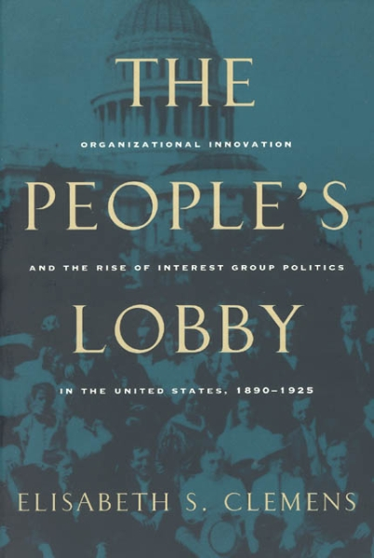
Associations as machinery for generating combinations of constituents and demands for policy
A great deal of organizational innovation goes into figuring out how to do this.
  Invention of the mass party (Weber, “Politics as a Vocation”)
  Social movements develop new methods (Clemens, 1997)
  Those methods are then imitated by business
By the 1910s and 1920s, political scientists publish classic accounts of the “group theory” of politics and comment on the proliferation of “blocs” (Bentley 1908; Herring 1929)
Becomes canonical post-WWII: e.g. Truman, The Governmental Process (1951)
Notes:
Group Representation Before Congress. By E. Pendleton Herring (Baltimore: Johns Hopkins Press. 1929.

Slide 9
Pathologies of Pluralism
Theodore Lowi, “The Public Philosophy: Interest-Group Liberalism” APSR (1967)
Until 1937, “the perennial issue underlying all debate on public policy . . . Was the question of the nature of government itself and whether expansion or contraction best produced public good”.
But once “the principle of positive government” is established, a philosophy emerges that “seeks to justify power and to end the crisis of public authority by parceling out public authority to private parties.”
Private groups demand government action; politicians legitimate that programs through arrangements of “self-government by organized groups . . . [that] could be justified as so decentralized and permissive as to be hardly federal at all. Here began the ethical and conceptual mingling of the notion of organized private groups with the notions of ‘local government’ and ‘self-government.’”
→ a literature on regulatory capture, iron triangles, etc. etc.

Slide 10
Private organizations in liberal/democratic political theory and practice
  One tradition leads to theories of interest group pluralism
  The other to the exclusion of private organizations from the polity
  Each suggests a particular way of understanding the problem of private organizations in politics
Yet both miss key elements of the “troubles” of contemporary democracy:
  Both theories focus on the “input” side of politics rather than on governing/implementation.
  Both focus on the formal political system rather than the complex relations of governing/governance
    Here, recall Jan Aart Scholte’s argument about polycentrism

Slide 11
The limitations were exacerbated by mid-century political and policy developments in both the US and Europe.
“Positive government” in Lowi’s sense expanded greatly
  In the US, through public/private forms (e.g. Smith and Lipsky, Nonprofits for Hire)
  In Europe, postwar public welfare states (some consociational) would then be transformed by projects of privatization and austerity from the 1980s →
  By the turn of the 21st century, waves of enthusiasm for privatization and market-driven policies swept repeatedly across these regimes.
Q? How does the public/private character of so much contemporary governance shape contemporary politics?
  Answers can be built on two productive moves . . .

Slide 12
The state as complex organizational array
Contrast with conceptualizations as an input/output function or as a coherent, centralized, hierarchical bureaucracy.
  Part of a larger discussion about “bringing the state back in” after decades of “process” analysis that tended to end with the passage of legislation.
  “The state” was recognized as more than formal institutions of government:
    Michael Mann (1984): infrastructural power as “the capacity of the state to actually penetrate civil society, and to implement logistically political decisions throughout the realm.”
    Timothy Mitchell (1995): public/private as a boundary driven through a complex network of relationships
  Revived interest in public administration, with particular attention to variation across different agencies and programs (attention to design):
    Yuen Yuen Ang, “Beyond Weber: Conceptualizing an alternative ideal type of bureaucracy in developing contexts, Regulation and Governance” (2017)
    Erin McDonnell, Patchwork Leviathan (Princeton, 2020)

Slide 13
Political feedbacks
Reverse the assumption that social pressures and politics make policy; instead think about how policy makes politics.
Political feedbacks: The major types of such effects include defining membership; forging political cohesion and group divisions; building or undermining civic capacities; framing policy agendas, problems, and evaluations; and structuring, stimulating, and stalling political participation.” (Mettler & Soss, 2017)
At the most basic level, are citizens/constituents pleased by what government does?
  “It is often held that the establishment of electoral democracy is key to the creation of political legitimacy . . . . [But] Legitimacy turns out to be created, maintained, and destroyed not at the input but at the output side of the political system.” (Rothstein 2009: 311).
But people may not always recognize what is or isn’t a government output.
Perceptions of outputs may be contingent on political identities (particularly in the context of heightened polarization).

Slide 14
Policy feedbacks: the submerged state
In order for the government (or the party in power) to get credit for what it does, citizens have to recognize that government has done something.
  2009: Obama and the behavioral economists
  2020: Trump, Covid, and the stimulus checks.
  Consider how this might enrich understanding of how investments (e.g. in water systems) might or might not enhance the reputation of the parties to the contract.
Obscuring accountability in austerity politics:
  Paul Pierson, Dismantling the Welfare State: Thatcher, Reagan, and the Politics of Retrenchment (Cambridge 1995); also Jacob Hacker, “Privatizing Risk,” APSR.
Suzanne Mettler, The Submerged State (Chicago, 2011)
  What is hidden? What is seen?
  Survey experiment: early question asks if the respondent has received government benefits; later set of question asks about specific benefits.
  Who responds no to the first, but yes to some of the specific benefits?

Slide 15
“Reconstituting the Submerged State: The Challenges of Social Policy Reform in the Obama Era,”
Perspectives on Politics 8, 3 (2010): 803-24

Slide 17
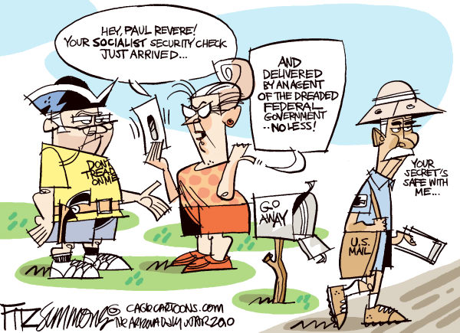
44.1% of recipients of Social
Security Retirement and
Disability reported NOT
receiving a government benefit
28.2% of recipients of Social
Security Disability reported
NOT receiving a government
benefit
Dave Fitzsimmons
Arizona Daily Star, 2010

Slide 18
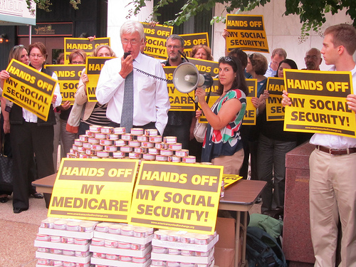


Slide 19
Policy feedbacks on political participation
Andrea Campbell, How Policies Make Citizens: Senior Political Activism and the American Welfare State (Princeton, 2003: 47)

Slide 20
Easily recognized benefits may amplify participation

Slide 21
Q? How does the public/private character of so much contemporary governance shape contemporary politics?
Two political traditions: understanding why the question has been hard to ask.
Useful concepts:
  State as complex organizational array that includes relations of “infrastructural power”
  Policy feedbacks
Three examples of how these concepts can be put in motion to address the question:
  Public-private partnerships
  Feedbacks on interest groups/associations
  Business influence as “structural power”

Slide 22
Public-Private Partnerships
Government may decide to contract with private firms for many reasons
But whatever the reason, there are likely consequences for the visibility of costs/benefits to citizens
  Private financing may extend the costs of a project out for years (across multiple electoral cycles), making it difficult for voters to compare costs and benefits.
  Government officials themselves may have limited visibility into the firm, creating problems of accountability – both firm accountability to the agency, and agency accountability to voters.
  Although there have been attempts to create “stakeholder” committees as a functional substitute for control by voters, these have met with little success.

Slide 23
In surveying the literature, there seems to have been great interest and enthusiasm for the topic in the 1990s through 2010s.
Carillion collapse: two years on, ‘government has learned nothing’: Lack of action on accounting rules to prevent corporate disaster is shocking, Unite says
  The Guardian, Jan. 20, 2020
“Never mind”
Spectacular failures, but also opportunities for learning more about success with respect to both benefits and perception of benefits (≈ Cary Coglianese’s call for research on successful regulation)
  E.g. Simon Porcher’s discussion: not only a question of whether contracts encourage investment but also of whether taxpayers/consumers perceive that investment as beneficial in some way (or even recognize that the investment has been made at all).

Slide 24
Policy Feedbacks on Private Organizations
Bo Rothstein (early work): comparison of early unemployment programs, administered either through unions or by the state. Policy design impacts not only the perception of benefits but the future strength of advocacy groups.
Cihan Tugal: Comparison of Islamic charity in Egypt and Turkey; the coherence of the organizational field has consequences for the extent to which government projects can work through private organizations (e.g. neoliberal political socialization).
“Supreme Court's conservatives lean toward allowing country’s first religious public charter school”
  Nbc.com, April 30, 2020
  E.g. Charter schools & AZ Speaker of the House
  Also escalating power of the technology sector in US politics
How Universities Became So Dependent on the Federal Government
  New York Times, April 18, 2025
  Relationships run both ways; flows of resources create vulnerabilities to coercion.
Notes:
DeLeon, Desai & Tugal – political articulation.

Slide 25
Business Influence as “Structural Power”
Andrew S. Kelly, “Private Power in Public Programs: Medicare, Medicaid, and the Structural Power of Private Insurance,” Studies in American Political Development (2023)
Medicare (65+, payroll taxes plus general revenues) and Medicaid (mix of state and federal revenues). Recall how these programs figured in the “submerged state analysis”
In the context of the austerity politics of the 1990s, push to shift enrollments in both programs into privately managed plans. Private enrollments grew, although there were few if any savings.
2019: 70% of Medicaid patients in MCOs (other #’s)
  53m enrollees
  280 companies
  $300 billion in state and federal revenues.
[25] “private actors were given new and more direct
responsibility over the health of millions of beneficiaries.
[20] “The structural power of insures has pushed Medicare away from its liberal, social insurance origins, but that same power has also acted to constrain conservative efforts to retrench Medicare, block grant Medicaid, and repeal the Affordable Care Act (ACA).”

Slide 26
Submerged/delegated policies generate private power
“First, by using private companies to deliver public services, public policies become more complex and the role of government as the ultimate source of benefits is obscured from the general public.”
“Second, by using private companies to delivery public services, industries generate revenues from state and federal governments that are reinvested in political influence.”
“Third, when delegated policies deliver “half solutions” with outcomes deemed “good enough,” the result can be to demobilize broader reform efforts and reduce the salience of a particular reform.” [p. 29]
Kludge.
As we sit here, House Republicans are designing a budget plan that will substantially cut Medicaid spending BUT in some way that voters do not notice and the impacts are delayed past the next one, perhaps two, electoral cycles.
Policy delegation redistributes power with cumulating consequences over time.

Slide 27
What is to be done?
As scholars attuned to the design of economic relations, consider adding visibility, accountability, legitimacy to your list of dependent variables
  Recall yesterday’s discussion of the importance of rule of law as the context for “best practices” in contracting.
As citizens, hold on to the possibility of political invention. The mass political party and the popular interest group represented new methods for mobilizing in a formally democratic regime, realizing something like popular sovereignty.
As we think about the design of policy (and policy implementation), think hard about new models that might avoid damaging feedbacks and, perhaps, even set constructive feedbacks in motion.

