Slide 1




EU Policy-making and Politics
Selected Topics
Timothy Yu-Cheong YEUNG
Centre for European Policy Studies

Slide 2
My job

Slide 3
Overview
Part A: How non-institutional actors can influence EU policy-making
Part B: EU Politics in the Court of Justice of the EU
with some discussion of selected papers
Objective: Understand how EU policies are shaped and enforced, and the legal mechanisms behind political decisions.

Slide 4
EU Policymaking
EU, or the three EU institutions, is often misunderstood.
The Commission – the ‘bureaucracy monster’?
The Parliament – the powerless?
The Council – the myth?
How external experts can influence policymaking?

Slide 5
When Are External Experts Consulted?
European Commission:
Impact assessments
Review
European Parliament (EPRS):
Research for parliament discussion
Committee of the Regions (CoR):
Provide study for policy discussion
Who do the research?
Research institutions, think tanks, consultancy, universities, etc.

Slide 6
Better Regulation Toolbox (Criteria – Part 1)
Necessity
Does the problem require intervention at the EU level (subsidiarity)?
Effectiveness
Will the proposed action achieve the intended policy objectives?
Efficiency
Are the benefits of the regulation proportionate to its costs?
Coherence
Is the proposal consistent with other EU policies and existing legislation?
Proportionality
Is the level of intervention appropriate to the scale of the problem?

Slide 7
Better Regulation Toolbox (Criteria – Part 2: Competitiveness)
Competitiveness Check (added in newer Toolbox versions)
Does the proposed regulation support or hinder the competitiveness of EU businesses?
Impact on SMEs (Small and Medium-sized Enterprises)
Innovation potential
Costs to businesses
International trade and investment implications

Slide 8
Role of Lobby and Advocacy Groups
Functions
Provide expertise and information
Represent civil society interests
Channels
Expert groups / civil dialogue groups
Public consultations
Useful datasets: Public consultations, Transparency Register and Register of Expert Groups

Slide 9
Paper 1: Alves, A. M. (2020). Corporate political strategies in Europe: The determinants of firms' access to the European Commission. Business and Politics, 22(2), 307-338.
Research question: what determine a firm’s access to the European Commission?
Dependent variable: Frequency of meetings with the Commission officials
Main independent variable:
Experience is the difference in days of register date and the reference date.
Firm’s size
Brussels presence

Slide 10
Paper 1: Alves, A. M. (2020). Corporate political strategies in Europe: The determinants of firms' access to the European Commission. Business and Politics, 22(2), 307-338.
Zero-inflated Negative Binomial regression (ZINB)
Sample size: 808 firms
Experience is significant across different specifications together with firm’s size and Brussels presence
Conclusion: political knowledge, connection, experience matter

Slide 11
Brainstorm some other research questions?
How to measure lobbying?
How to measure influence?
How to measure network?

Slide 12
Part B
Court of Justice of the EU

Slide 13
Structure of the CJEU
Two Courts:
- European Court of Justice (ECJ): Highest authority on EU law
- General Court (GC): Handles individual, company, and MS cases (since 1989)
Judges: Appointed by MS, act independently

Slide 14
Types of Legal Procedures
1. Preliminary Ruling (Art. 267 TFEU):
Interpretation of EU law by national courts
2. Infringement Proceedings (Arts. 258–260 TFEU):
Failure to comply with EU law
3. Action for Annulment (Art. 263 TFEU):
Challenges to legality of EU acts

Slide 15
Intervention by Member States
Actions for Annulment:
MS can support either party
Infringement Proceedings:
- Art. 258: European Commission to initiate infringement proceedings against a Member State.
Other MS may intervene
- Art. 259: Member State to bring an action directly against another Member State for failure to comply with EU obligations
MS and institutions may intervene

Slide 16
Paper 2: Alves, A. M., Brousseau, E., & Yeung, T. Y. C. (2021). The dynamics of institution building: State aids, the European commission, and the Court of Justice of the European Union. Journal of Comparative Economics, 49(3), 836-859.
Research question: how does the EU build its institutions?
The Commission constructs the European integration/centralisation facing the resistance from Member States.
The CJEU independently protects the interests of Member States
State aid control

Slide 17
Paper 2: Alves, A. M., Brousseau, E., & Yeung, T. Y. C. (2021). The dynamics of institution building: State aids, the European commission, and the Court of Justice of the European Union. Journal of Comparative Economics, 49(3), 836-859.
What is state aid?
Any advantage granted by public authorities through state resources on a selective basis to any organizations that could potentially distort competition and affect trade between EU member states.
National governments have incentive to protect/support their own companies while the Commission would discipline Member States for maintaining the Single Market.

Slide 18
Paper 2: Alves, A. M., Brousseau, E., & Yeung, T. Y. C. (2021). The dynamics of institution building: State aids, the European commission, and the Court of Justice of the European Union. Journal of Comparative Economics, 49(3), 836-859.
Data: State aid cases since 2000 (~6000 cases)
Measure of resistance: Transposition deficit (% of all directives not transposed)
Analysis:
First stage: Commission approval decisions
Second stage: CoJ decisions over appeals

Slide 19
Paper 2: Alves, A. M., Brousseau, E., & Yeung, T. Y. C. (2021). The dynamics of institution building: State aids, the European commission, and the Court of Justice of the European Union. Journal of Comparative Economics, 49(3), 836-859.
Result:
Commission state aid control tends to be unfavourable if one’s transposition deficit is high.
CoJ appeal decisions tend to be favourable if one’s transposition deficit is high.
Evidence of bias by the Commission against integration resistance

Slide 20
Paper 3: Yeung, T. Y. C., Ovádek, M., & Lampach, N. (2022). Time efficiency as a measure of court performance: evidence from the Court of Justice of the European Union. European Journal of Law and Economics, 53(2), 209-234.
Research question: to what extent the court reform improve the productivity of the Court of Justice of the EU?
Data: all cases submitted
Measure of performance/productivity: time efficiency (length of verdict divided by days needed to revolve the case)

Slide 21
Paper 3: Yeung, T. Y. C., Ovádek, M., & Lampach, N. (2022). Time efficiency as a measure of court performance: evidence from the Court of Justice of the European Union. European Journal of Law and Economics, 53(2), 209-234.
Research question: to what extent the court reform improve the productivity of the Court of Justice of the EU?
Introduction of the General Court
Data: all cases submitted since 1953
Measure of performance/productivity: time efficiency (length of verdict divided by days needed to revolve the case)

Slide 22
Paper 3: Yeung, T. Y. C., Ovádek, M., & Lampach, N. (2022). Time efficiency as a measure of court performance: evidence from the Court of Justice of the European Union. European Journal of Law and Economics, 53(2), 209-234.
Method: Vector Autoregression model
Result:
backlog causes time efficiency to fall
Resource (budget) effect is weaker

Slide 23
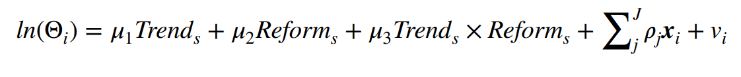
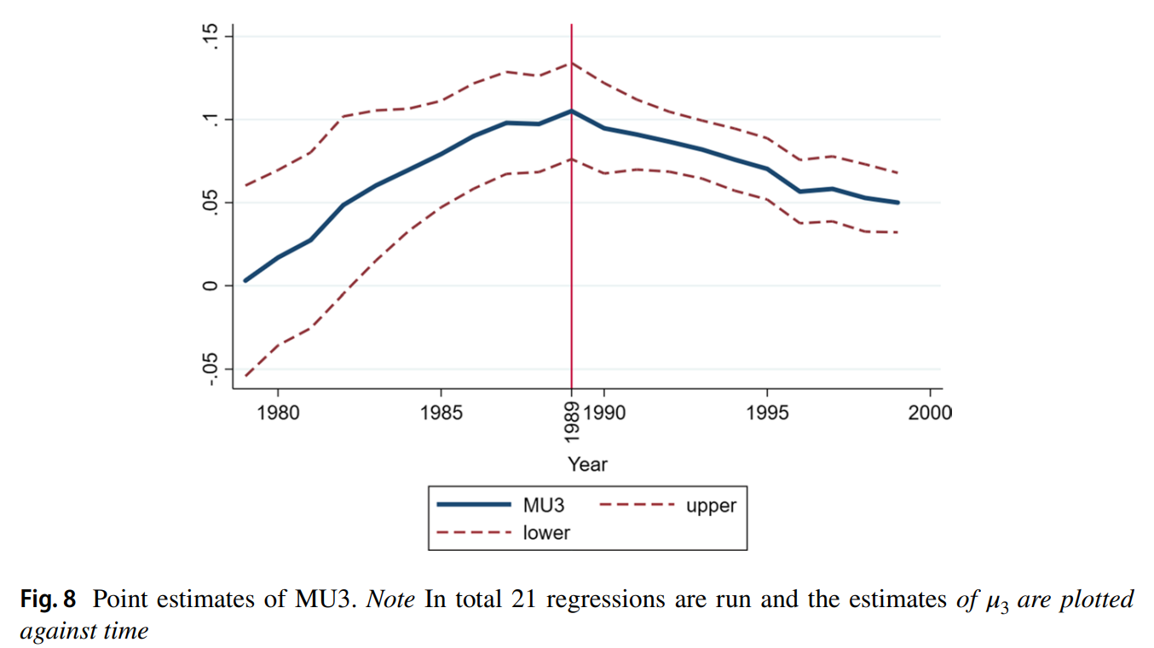
Paper 3: Yeung, T. Y. C., Ovádek, M., & Lampach, N. (2022). Time efficiency as a measure of court performance: evidence from the Court of Justice of the European Union. European Journal of Law and Economics, 53(2), 209-234.

Slide 24
Working paper: What explain the intervention networks at the Court of Justice of the EU?
Data: all interventions by Member States at CJEU
Network analysis
Friends and Foes

Slide 25
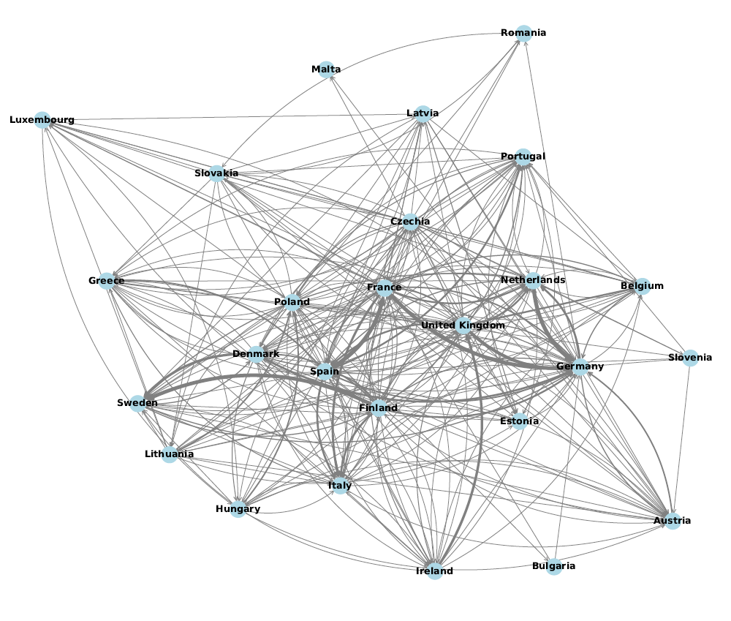
Friendly intervention network

Slide 26
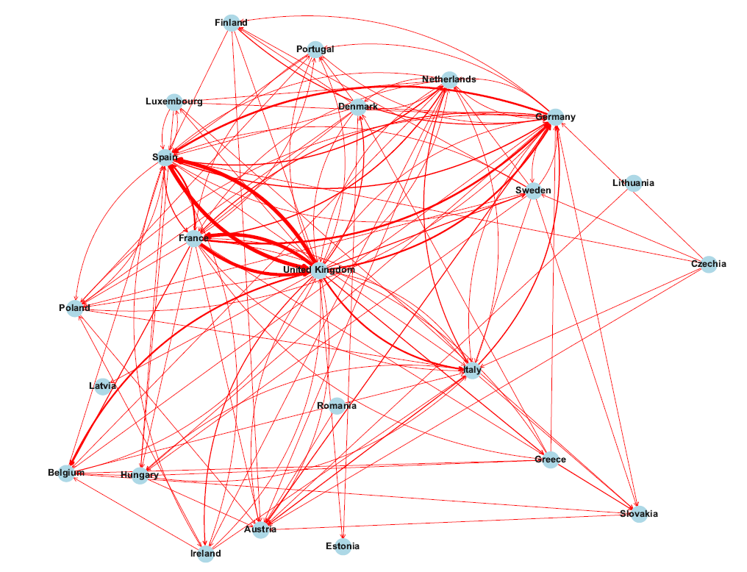
Foe intervention network

Slide 27
Discussion
What factors influence the network?

Slide 28
Thank you!

