Slide 1
Modeling cultural change
IOEA • Arthur Silve • 14/05/25

Slide 2
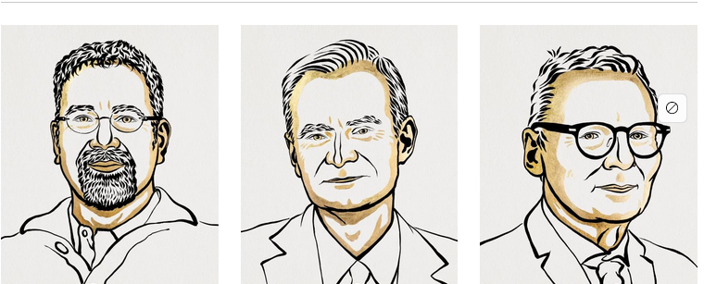
The Sveriges Riksbank Prize in Economic Sciences in Memory of Alfred Nobel 2024 was awarded jointly to Daron Acemoglu, Simon Johnson and James A. Robinson « for studies of how institutions are formed and affect prosperity »
The Sveriges Riksbank Prize in Economic Sciences in Memory of Alfred Nobel 2024

Slide 3
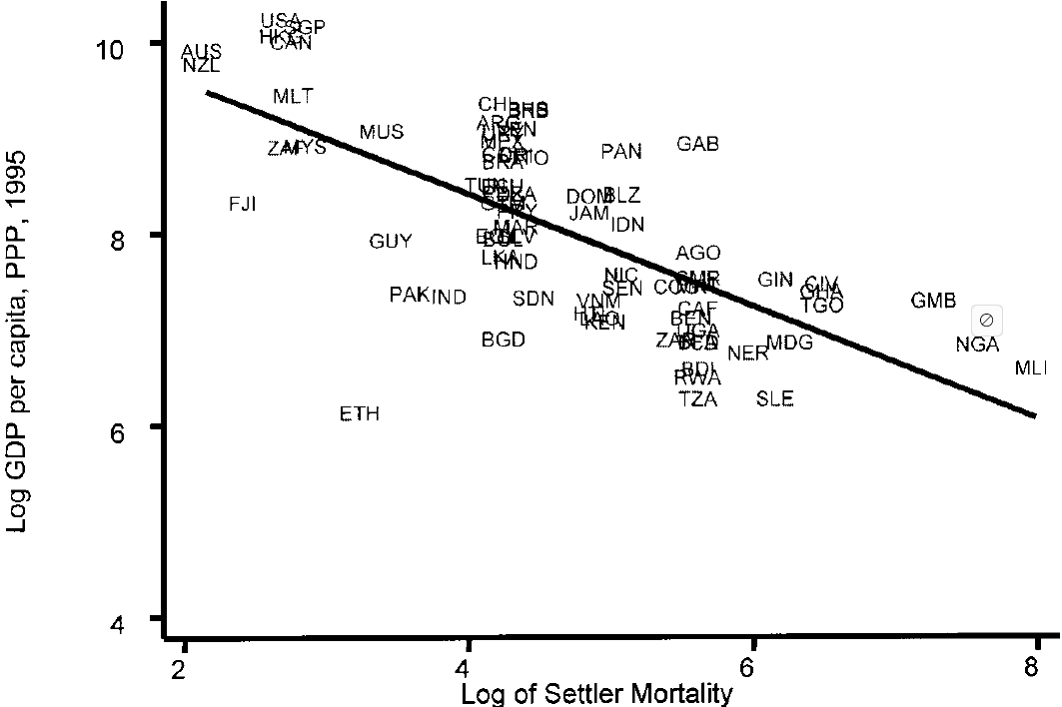
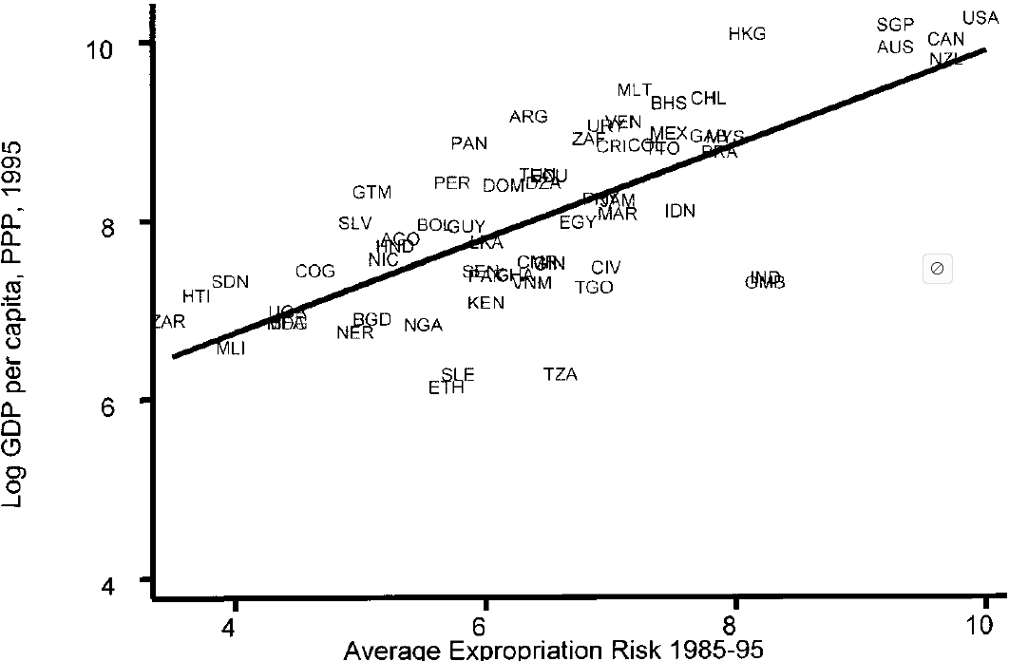
The colonial origins of comparative development

Slide 4
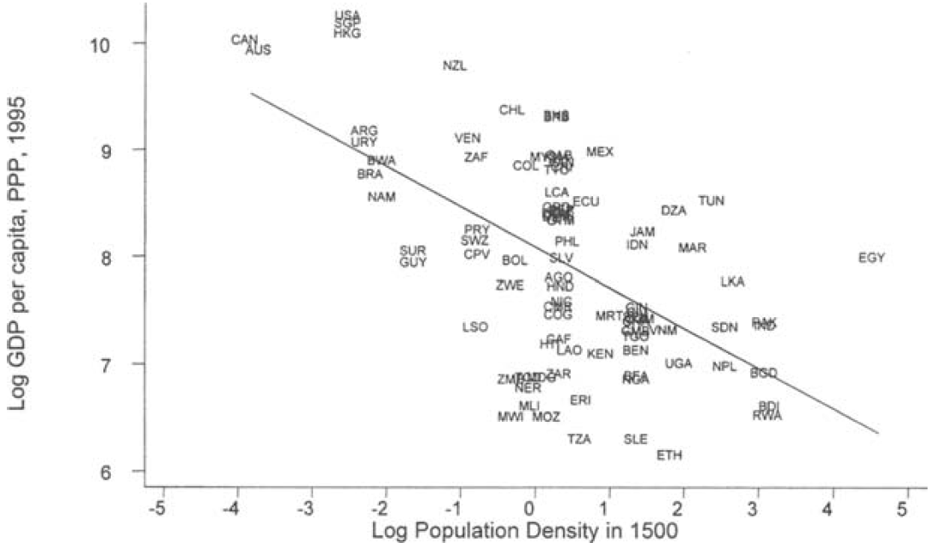
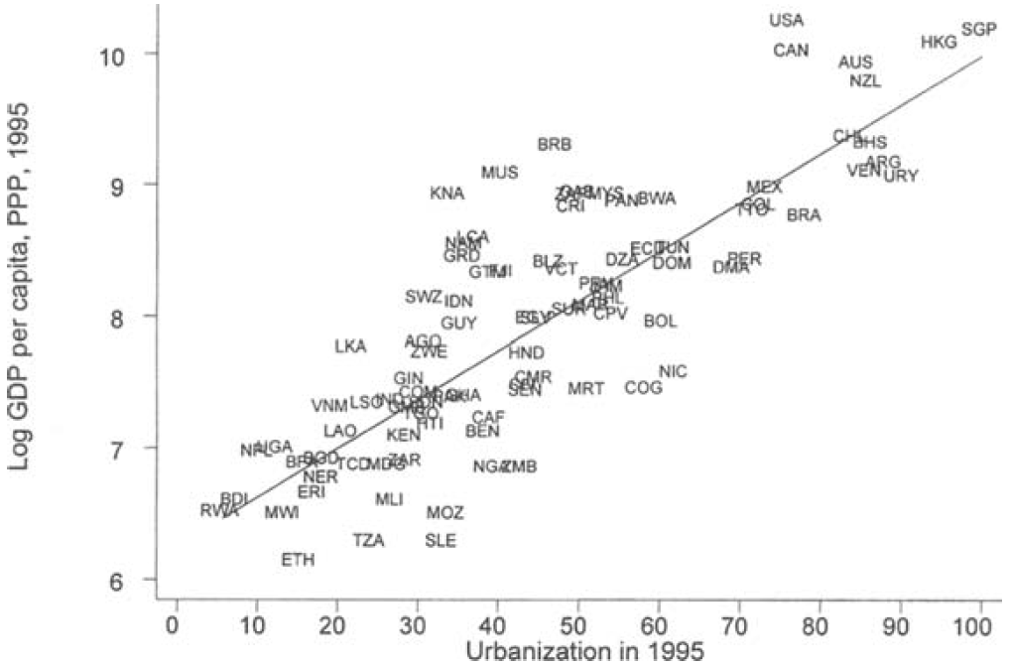
Reversal of fortune: geography and institutions in the making of the modern world income distribution

Slide 5
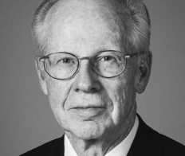
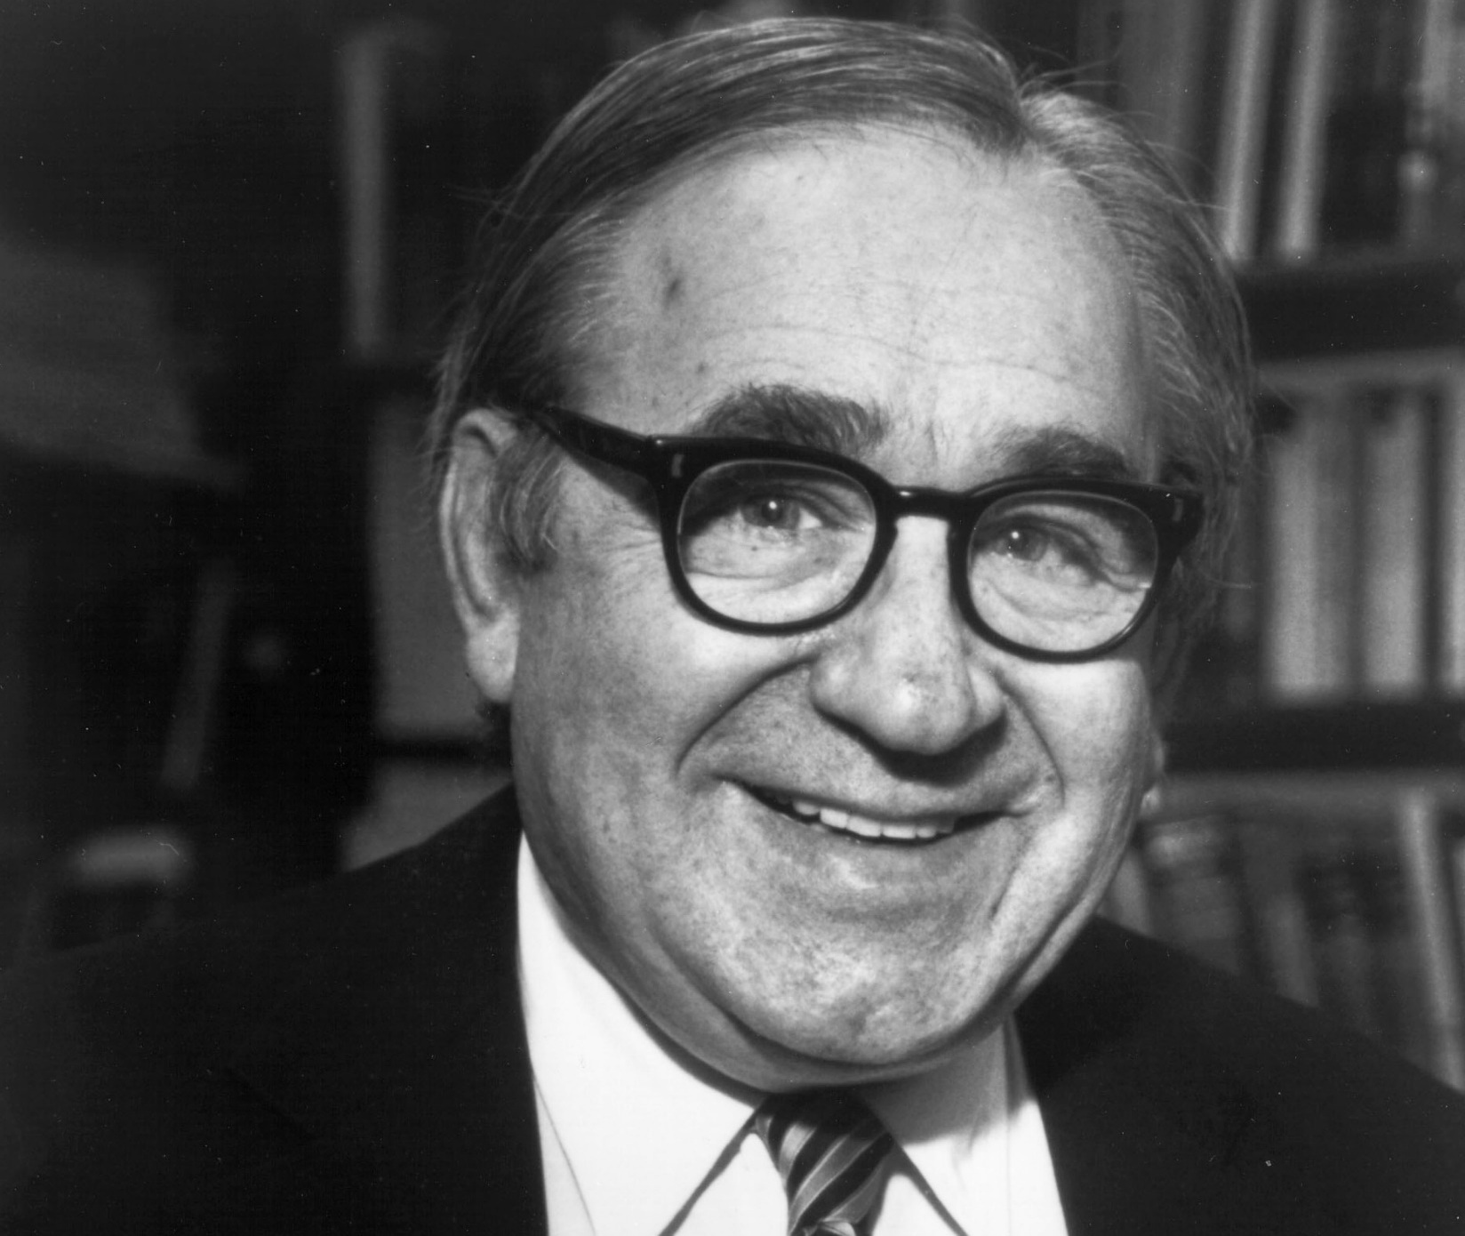
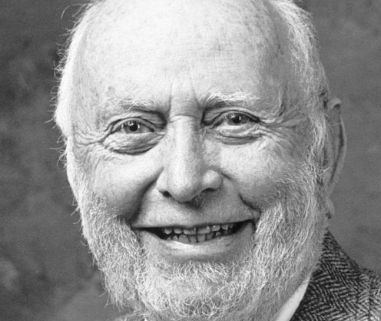
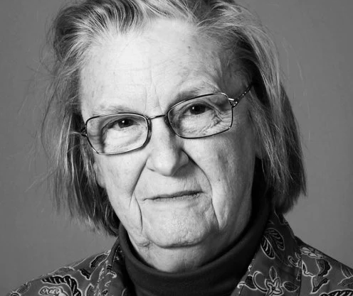
The role of instituions in economic development
- an idea that dates back to Adam Smith and John Stuart Mill
- 1993: Douglass North and Robert Fogel for their discoveries on the role of institutions in economic history
- 2009: Elinor Ostrom for her analysis of economic governance, particularly of the commons
- 2009: Oliver Williamson for his analysis of economic governance, particularly the frontiers of the firm
- and therefore, 2024, for their analysis of where institutions come from and how they affect development

Slide 6
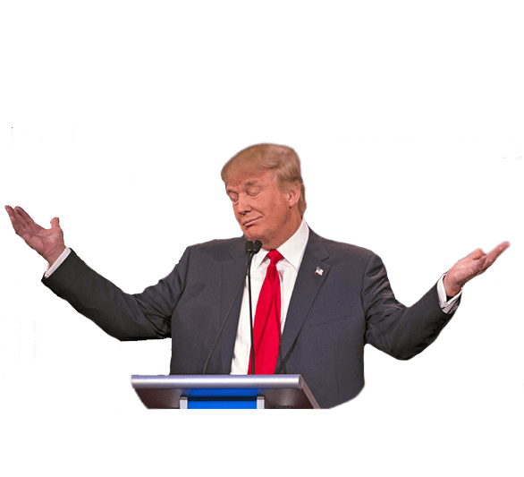
The next Nobel prize in institutional economics?
« for his demonstration that institutions don’t matter after all »

Slide 7
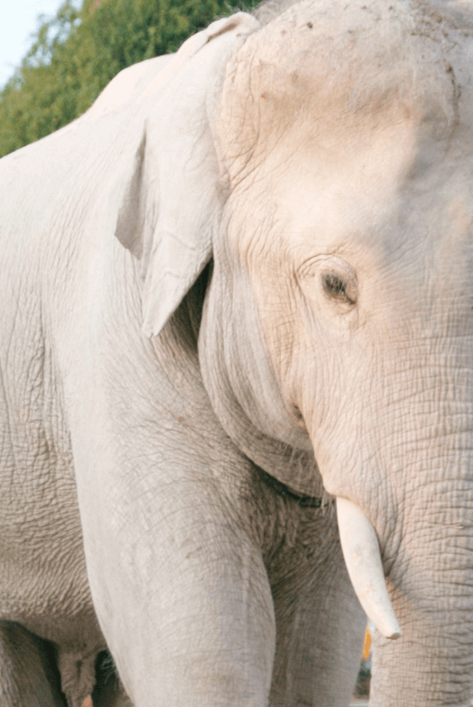
Institutions are supported by norms and culture
Of course this should be surprising to noone
- hard academic evidence, as in Salmon & Serra (JEBO, 2017) who show that culture matters in limiting bad behavior
- So many cases of failed transposition of institutions (land titling, anti-corruption hotlines, microcredit in South Africa etc)
« Context matters », not only incentives, also culture

Slide 8
Definition
Culture is « socially transmitted information that shapes behavior and can evolve independently of genes » (Boyd & Richerson)
  Minimal definition, measurable, can be adapted to language features or norms, and we can (and we will) model transmission
  It permits evolution. Culture is not only heritage, it changes under selective pressure
  Institutions ⬄ Culture

Slide 9
Outline of the workshop
Bisin & Verdier’s model of horizontal transmission
Shayo’s model of identification and status
A quick tour of interdisciplinary considerations

Slide 10
Alberto Bisin & Thierry Verdier

Slide 11
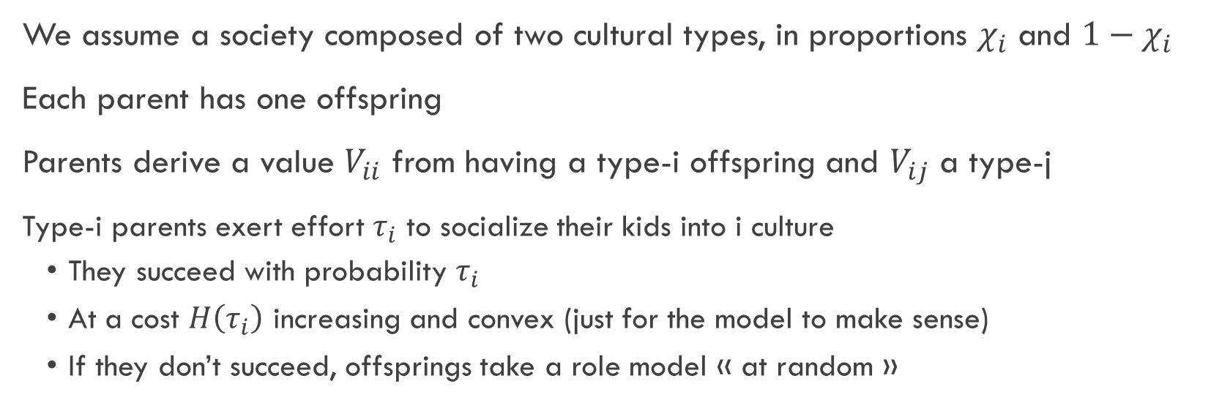
A setup inspired from evol bio and anthropology
We assume a society composed of two cultural types, in proportions $χ_{i}$ and $1−χ_{i}$
Each parent has one offspring
Parents derive a value $V_{ii}$ from having a type-i offspring and $V_{ij}$ a type-j
  Type-i parents exert effort $τ_{i}$ to socialize their kids into i culture
  They succeed with probability $τ_{i}$
  At a cost $H\left(τ_{i}\right)$ increasing and convex (just for the model to make sense)
  If they don’t succeed, offsprings take a role model « at random »

Slide 12

Solving the model
  $$\max_{τ_{i}}\left(τ_{i}+\left(1−τ_{i}\right)χ_{i}\right)V_{ii}+\left(1−τ_{i}\right)\left(1−χ_{i}\right)V_{ij}−H(τ_{i})$$
To simplify the exposition, let’s assume $H\left(τ_{i}\right)=\frac{τ_{i}^{2}}{2}$, and all will be linear
We get
  $$τ_{i}=\left(1−χ_{i}\right)\left(V_{ii}−V_{ij}\right)$$
And a symmetrical solution for type-j individuals

Slide 13


Dynamics and equilibrium
If we start with proportions $χ$ and $1−χ$ where do we go next?
$\left(1−χ\right)\left(1−τ_{j}\right)χ$ offspring of type-j parents become type-i, and $χ\left(1−τ_{i}\right)\left(1−χ\right)$ offspring of type-i parents become type-j
So in the next generation
  $χ_{t+1}=χ_{t}+ \left(1−χ_{t}\right)\left(1−χ_{t}ΔV_{j}\right)χ_{t}−χ_{t}\left(1−\left(1−χ_{t}\right)ΔV_{ii}\right)\left(1−χ_{t}\right)$
  And in (the only stable) equilibrium
  $$χ∗ =\frac{ΔV_{i}}{ΔV_{i}+ΔV_{j}}$$

Slide 14
Discussion
Horizontal transmission of culture
Path dependence
Persistence of minority cultures
The limits of norm-homogenizing policies – think public schooling and a common history curriculum

Slide 15
Open ideas for extensions
(also check Bisin & Verdier ARE 2023)
Network-based horizontal transmission (transmission tech)
Wage-affecting traits (and possibly evolutionary consequences)
Multiple and continuous traits
Feedback effects between culture and institutions
What traits are subject to cultural transmission? (Measuring culture)

Slide 16
Moses Shayo

Slide 17
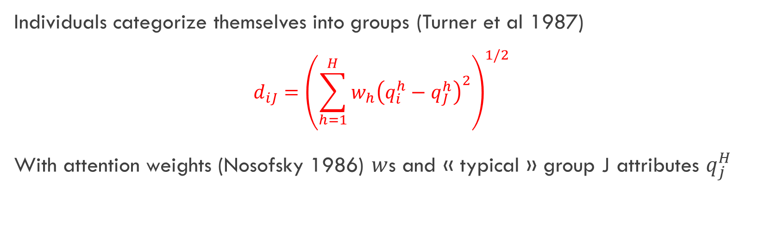
A setup inspired from social psycho and experimental econ
Individuals categorize themselves into groups (Turner et al 1987)
  $$d_{iJ}={\left(\sum_{h=1}^{H}{w_{h}{\left(q_{i}^{h}−q_{J}^{h}\right)}^{2}}\right)}^{1/2}$$
With attention weights (Nosofsky 1986) $w$s and « typical » group J attributes $q_{j}^{H}$

Slide 18

A setup inspired from social psycho and experimental econ
Groups J have a status based on social comparison to other groups (Tajfel & Turner 1987)
  $$S_{j\left(t\right)}=σ_{o}^{J}+σ_{1}^{J}\left({\tilde{π}}_{J}\left(t\right)−{\tilde{π}}_{r\left(J\right)}\left(t\right)\right)$$
  With comparison group $r\left(J\right)$, and a group measure of material payoff ${\tilde{π}}_{J}\left(t\right)$ dependent on policy $t$.
  Individual « identifies with » group $J$ if utility decreases in distance and increases in group status
  $$U_{i}\left(t\right)=π_{i}\left(t\right) −βd_{iJ}+γS_{J}\left(t\right)$$

Slide 19

Multiple social equilibria
  Typically interested in identification to class or nation (but could also be ethnic group…)
  This is a coordination game – the process of how we get there is not explicit – but we can describe features of the equilibria
  E.g. plug it into a Meltzer - Richard model of redistribution, you get the following ordering for the poor’s prefs : $t_{N}^{∗}\left(y_{P}\right)<t^{∗}\left(y^{P}\right)<t_{P}^{∗}\left(y^{P}\right)$
  There exists a social equilibrium in which people identify with their class and a relatively high level of redistribution
  There can be a social equilibrium in which the poor identify with the nation and a relatively low level of redistribution – more likely if $w_{N}$ is high, $σ_{0}^{N}$ high, $σ_{0}^{P}$ low, etc.

Slide 20
Discussion
Context-dependent norms can trump material incentives
Status-driven identity and distance to each group
Multiple equilibria
Identity salience shifts with exogenous shocks and political entrepreneurs

Slide 21
Open ideas for extensions
Cultural reaction to shocks
Endogenize group status with media campaigns, elite rhetoric, policy etc.
Adapt identities to various situations and multiple identities
Network-based identity shocks (combination with ABMs)
Dynamic model of institutions / culture interaction

Slide 22
Interdisciplinary considerations

Slide 23
Other definitions of culture
Classical Anthropology | Knowledge, belief, art, morals, law, custom, and any other capabilities | inventory aspect; useful breadth, little causal guidance
Interpretive Anthropology | Webs of significance humans themselves have spun; thick description of meanings | Beliefs matter
Sociology | Tool kit of symbols, stories, and rituals that people draw on to construct strategies of action | Scripts and narratives depends on context.
Evolutionary biology | Socially transmitted information that affects behavior | Lends itself to mathematical modeling and empirical testing.

Slide 24
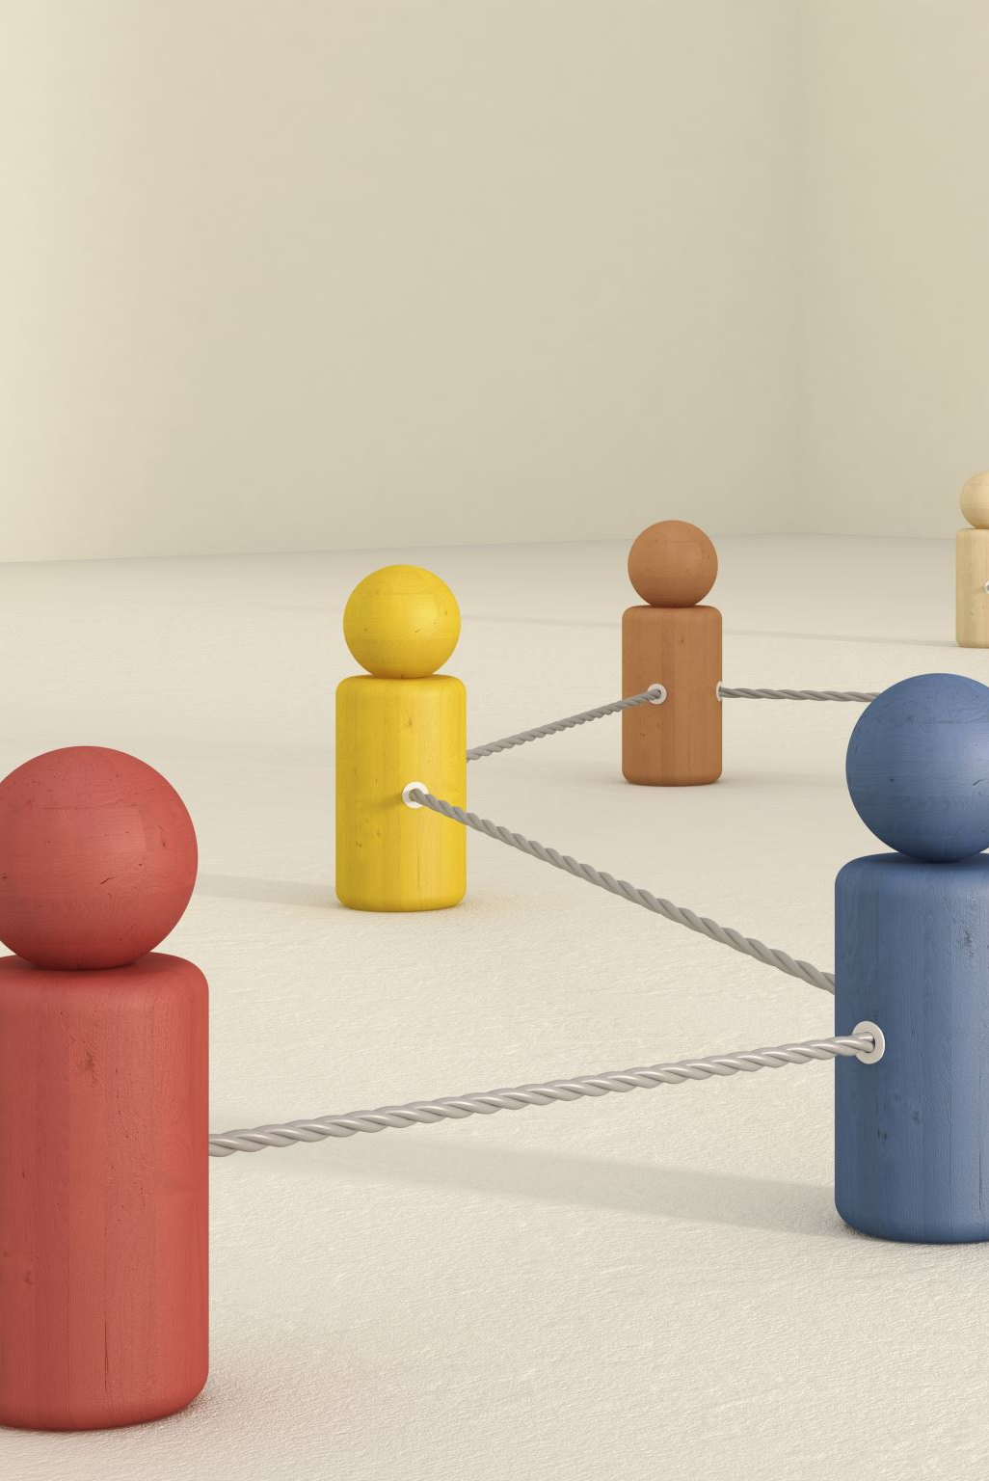
Modern theories of cultural evolution
(Also check Boyd & Richerson PNAS 2024)
Dual-inheritance framework
  Faster adaptation to quickly changing environments
  Cooperation emerging from individual learning behavior
  Gene-culture co-evolution
  Institutions affect payoffs so powerfully they affect our biology
  Cumulative culture
  Technology diffusion mirrors cultural transmission, not only factor substitution
  Cultural group selection
  Multilevel inter-group vs intra-group selection

Slide 25
Methods from other disciplines
Phylogenetic methods
Reconstruct historical diffusion using language or machine-learning coding of stories
E.g. Coevolution of religious and political authority in Austronesian societies, Sheehan et al, Nature Human Behavior 2023
Big data and text analysis
Track norm changes via newspapers and social media
E.g. Quantitative Analysis of Culture Using Millions of Digitized Books, Michel et al, Science 2014
Agent-based models
Simulate individuals with simple social-learning rules on networks; accounts for heterogeneity, direct interaction, and nonlinearity
E.g. The Dissemination of Culture: A Model with Local Convergence and Global Polarization, Axelrod, Journal of Conflict Resolution 1997

Slide 26
Some takeaways
Culture is measurable, can be modeled, and changes
Formal institutions depend on a cultural substrate
Cultural evolution offers tractable micro-foundations
Interest in what other disciplines have to say is not a luxury

