Slide 1
The Governance of Contractual Relationships:
Past, Present and Future
Giorgio Zanarone
HEC Lausanne, University of Lausanne
IOEA Lecture, May 14, 2025

Slide 2

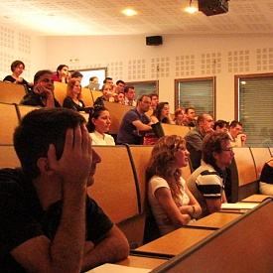
How nice to be back a 3rd time…
2005
2009
Notes:
2

Slide 3
Plan for this talk
The economics of governance: a brief tour
New frontiers in governance research
  Design
  Govern-ance meets Govern-ment
  Management
Discussion
Notes:
3

Slide 4

What is governance?
“The means by which to infuse order, thereby to mitigate conflict and realize mutual gain.”
Notes:
4

Slide 5
Where is governance?
Within organizations
  Employment contracts; organizational structure; management practices
Between organizations
  Outsourcing agreements; alliances; public-private partnerships
Notes:
5

Slide 6

Dis-order
Ever been here?

Slide 7
The Civil Servant Game
(output-salary, salary-effort)
work
E
hire
shirk
B
(-salary, salary)
not hire
(0, 0)
(The first entry is Boss’s (B) payoff, the second is Employee’s (E) payoff)

Slide 8

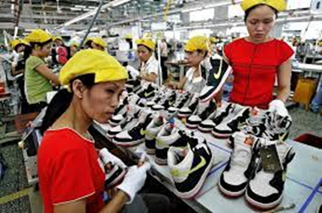

Trust games between firms
Will my distributor
  Clean the store?
  Be nice to customers?
Will my supplier
  Invest in quality?
  Customize inputs for me?
  Avoid reputation-damaging practices (e.g., child labor)?
Will my alliance partner
  Share know-how with me?
  Steal mine?

Slide 9
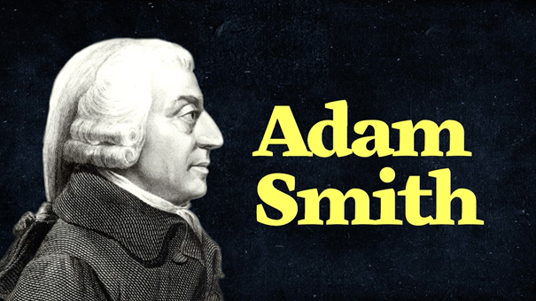
“Infusing order” in Micro 101
Firm 1 Supply
Firm 2
Supply
Firm N
Supply
P*
Market Supply
Market Equilibrium
(P*, Q*)
q₁*…q_{N}*
Market
Demand

Slide 10
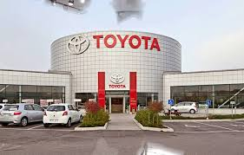





Real vs. theoretical markets
Real
(most of the times)
Theoretical
(and sometimes real too)

Slide 11
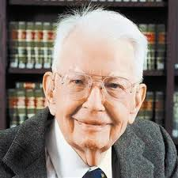

Enter governance
“If markets were perfect, would we need firms?”
Classic TCE: vertical integration $↑$ when buyer and supplier are “locked in”
  Monteverde & Teece 82; Masten 84; Joskow 85
“Within a firm, in place of exchange transactions is substituted the entrepreneur/co-ordinator, who directs production”
→ integration = governance
Notes:
11

Slide 12
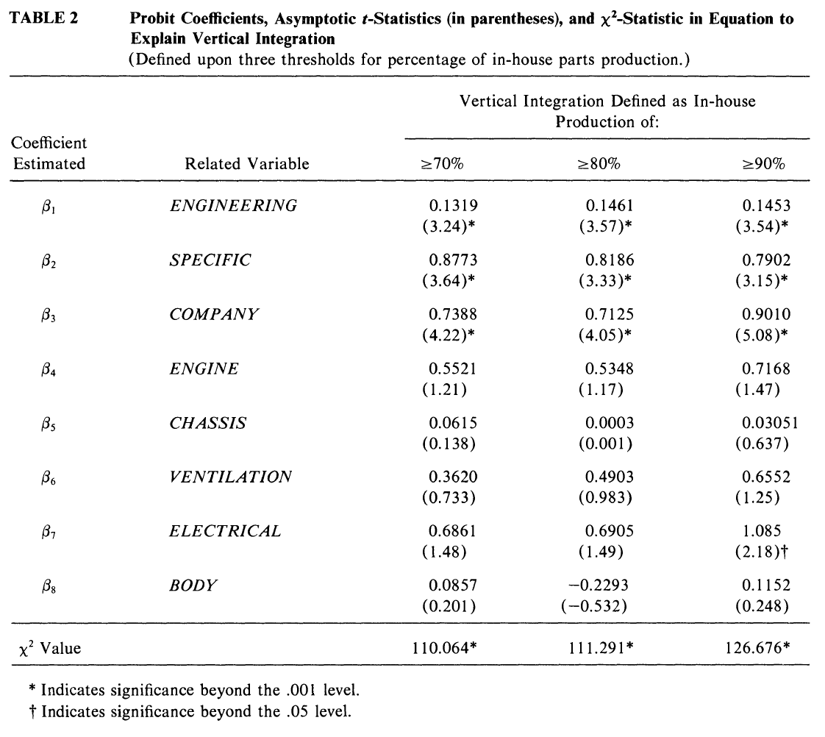
Specific and knowledge-intensive inputs are produced in house!

Slide 13
Questions raised by Coase’s question
How does “integration” improve on spot mkts?
Is integration necessary to improve on spot mkts?
Is “improving on spot mkts” the same as “governance”?
  Infusing order?
  Directing production in a coordinated fashion?
2nd wave of governance research: theory of the firm, contract theory
3rd wave: economics of relational contracts
Notes:
13

Slide 14


How does integration improve on spot mkts?
4 theories…
Property rights theory
  Integration concentrates decision rights
  Buyer’s expects higher surplus share → invests more ex ante
    But seller invests less!
Adaptation & rent-seeking theories
  Integration concentrates decision rights
  More coordinated (but possibly selfish) adaptations; less haggling
Incentive system theory
  Integration removes payoff rights from agent
  Mutes her incentives, makes her more willing to follow instructions

Slide 15
…and some evidence
Property rights theory
  Acemoglu et al. 10
Adaptation theory
  Forbes & Lederman 09, 10
Incentive system theory
  Baker & Hubbard 04? Hansmann et al. 20?
Hard to disentangle these theories!
This is an opportunity

Slide 16

Is integration necessary to improve on spot mkts?
Early TCE: No!
  Lock-in → more sophisticated contracts (not only more VI)
  Joskow 87; Crocker & Masten 91
You don’t even need integration to have a “boss”
  Lerner & Merges 98; Arrunada et al. 01; Zanarone 09, 13
Agency theory & contract theory
  Contract = mechanism to commit to…something
  Tradeoffs b/w commitment mechanisms (2nd best)
Vast body of empirical evidence
  E.g., see review by Lafontaine & Slade 13

Slide 17
Questions raised by Coase’s question
How does “integration” improve on spot mkts?
Is integration necessary to improve on spot mkts?
Is “improving on spot mkts” the same as “governance”?
  Infusing order?
  Directing production in a coordinated fashion?
VI, contracts = mechanical instruments of commitment → SECOND BEST
Economics of relational contracts
Notes:
17

Slide 18
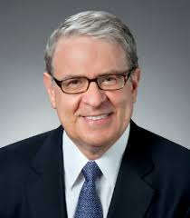

From commitment mechanisms to governance
Neither integration nor contracts mechanically implement desired behavior → agents have discretion they can abuse
So maybe the “coordinator who directs production” is a (subgame perfect) equilibrium…
  Baker et al. 99; Rantakari 23
…that can be reached from different allocations of rights…
  Integration or non-integration; contract A or contract B
…but maybe certain allocations make it easier to reach it, and we need to discover which ones and when

Slide 19
Relational contracts
Present gains from defection
Future gains from cooperation
(net value of the relationship)
The threat to revert to defection tomorrow (“trigger strategy”) can sustain cooperation today:
If there is no known “last period”
If players care about future payoffs (forward-looking, patient)

Slide 20
For a “relational contract” to be self-enforcing, we need:
  Credibility: parties cares about relationship → perform for fear of losing it
  Clarity: parties must agree on principles: what “good performance” means, who/when should be rewarded

Slide 21
Credibility problems: non-integration
reward
(R - bonus, bonus - [cost + effort])
supplies high-q
Temptation (min bonus)
B
demands high-q
default
S
(R, - cost - effort)
supplies low-q
B
(0, 0)
demands low-q
(0, 0)
(The first entry is Buyer’s (B) payoff, the second is Supplier’s (S) payoff)

Slide 22
Credibility problems: integration
reward
(R - bonus, bonus - effort)
supplies high-q
Temptation (min bonus)
E
demands high-q
default
E
(R, - effort)
supplies low-q
B
(0, 0)
demands low-q
(0, 0)
(The first entry is Buyer’s (B) payoff, the second is Employee’s (E) payoff)

Slide 23

A growing literature
Repeating the game (under fixed formal allocation) helps
  Theory: Bull 87; MacLeod & Malcomson 89; Levin 03
  Evidence: Gil 13; Macchiavello & Morjaria 15; Gil et al. 22
Some formal allocations help more than others
  Theory: Klein 96, 00; Baker Gibbons & Murphy 94, 02, 11
  Evidence: Barron et al. 20
We have dedicated reviews of this literature
  Theory: Malcomson 13; Gil & Zanarone 17, 18 25; Macchiavello 22
We even have a yearly workshop!

Slide 24
For a “relational contract” to be self-enforcing, we need:
  Credibility: parties cares about relationship → perform for fear of losing it
  Clarity: parties must agree on principles: what “good performance” means, who/when should be rewarded
MUCH LESS STUDIED!!!

Slide 25
Governance, revisited
“If markets were perfect, would we need firms?”
“Within a firm, in place of exchange transactions is substituted the entrepreneur/co-ordinator, who directs production”
→ integration = governance
Notes:
25

Slide 26
Governance, revisited
“If contracts were perfect, would we need bosses?”
In place of mechanical contracts is substituted a system of formal allocations of rights and relational arrangements, which produces order & cooperation in equilibrium
→ integration = one of many formal tools to reach governance
Notes:
26

Slide 27
Plan for this talk
The economics of governance: a brief tour
New frontiers in governance research
  Design
  Govern-ance meets Govern-ment
  Management
Discussion
Notes:
27

Slide 28
Plan for this talk
The economics of governance: a brief tour
New frontiers in governance research
  Design
  Govern-ance meets Govern-ment
  Management
Discussion
Notes:
28

Slide 29




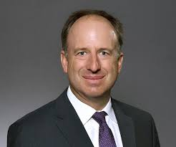





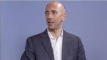
Using an industry as a lab
US electricity industry
(VI, contract design)
Franchising
(VI, contract design)
US trucking industry
(VI, contract design, relational contracting)
US airline industry
(VI, relational contracting)
Notes:
29

Slide 30
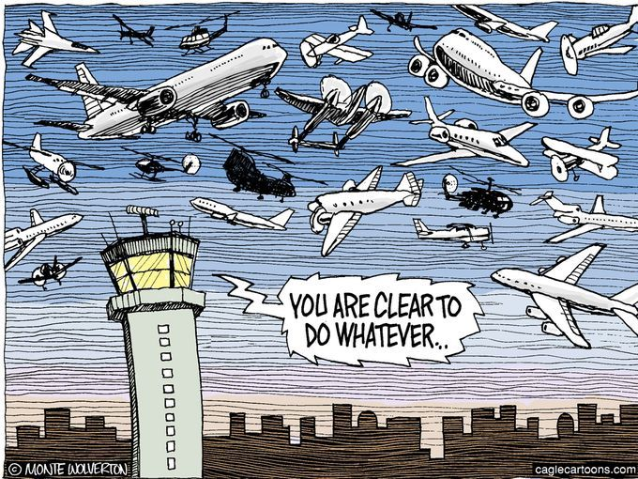
US airlines as a lab to study governance
Cooperation problem: slot exchange (adaptation)
  Multiple governance forms used
    Do-it-yourself
    Vertical integration (owned regional company)
    Relational contracting (independent regional company)
    Arm’s length contracting
Notes:
30

Slide 31
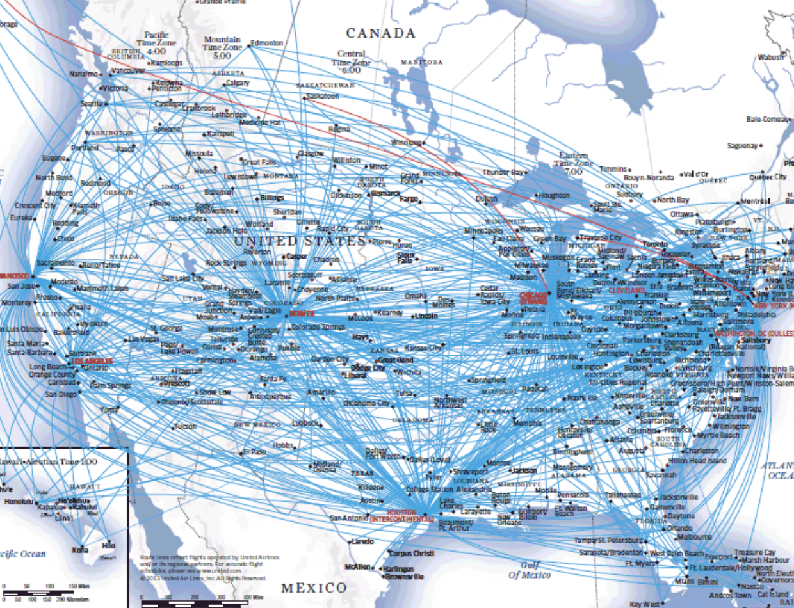
United Airlines network

Slide 32
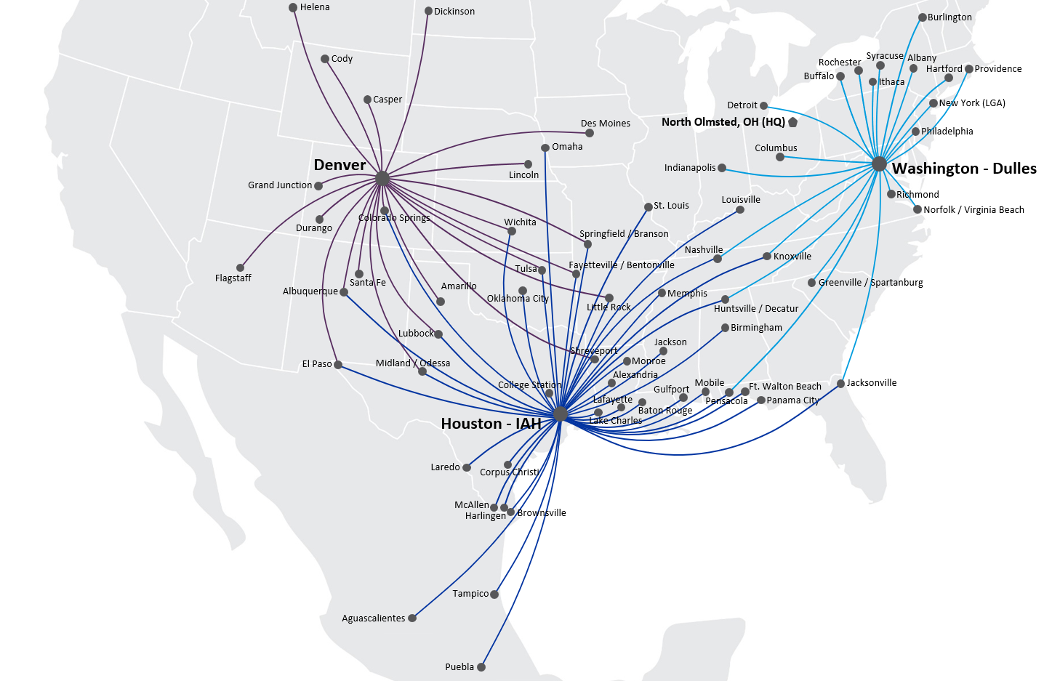
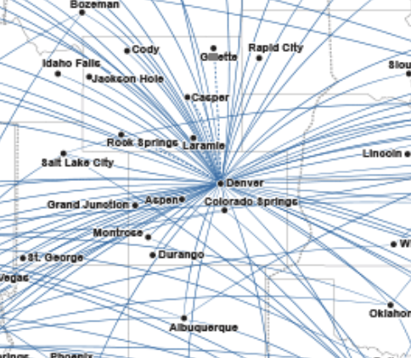
United in Denver
CommutAir
SkyWest

Slide 33
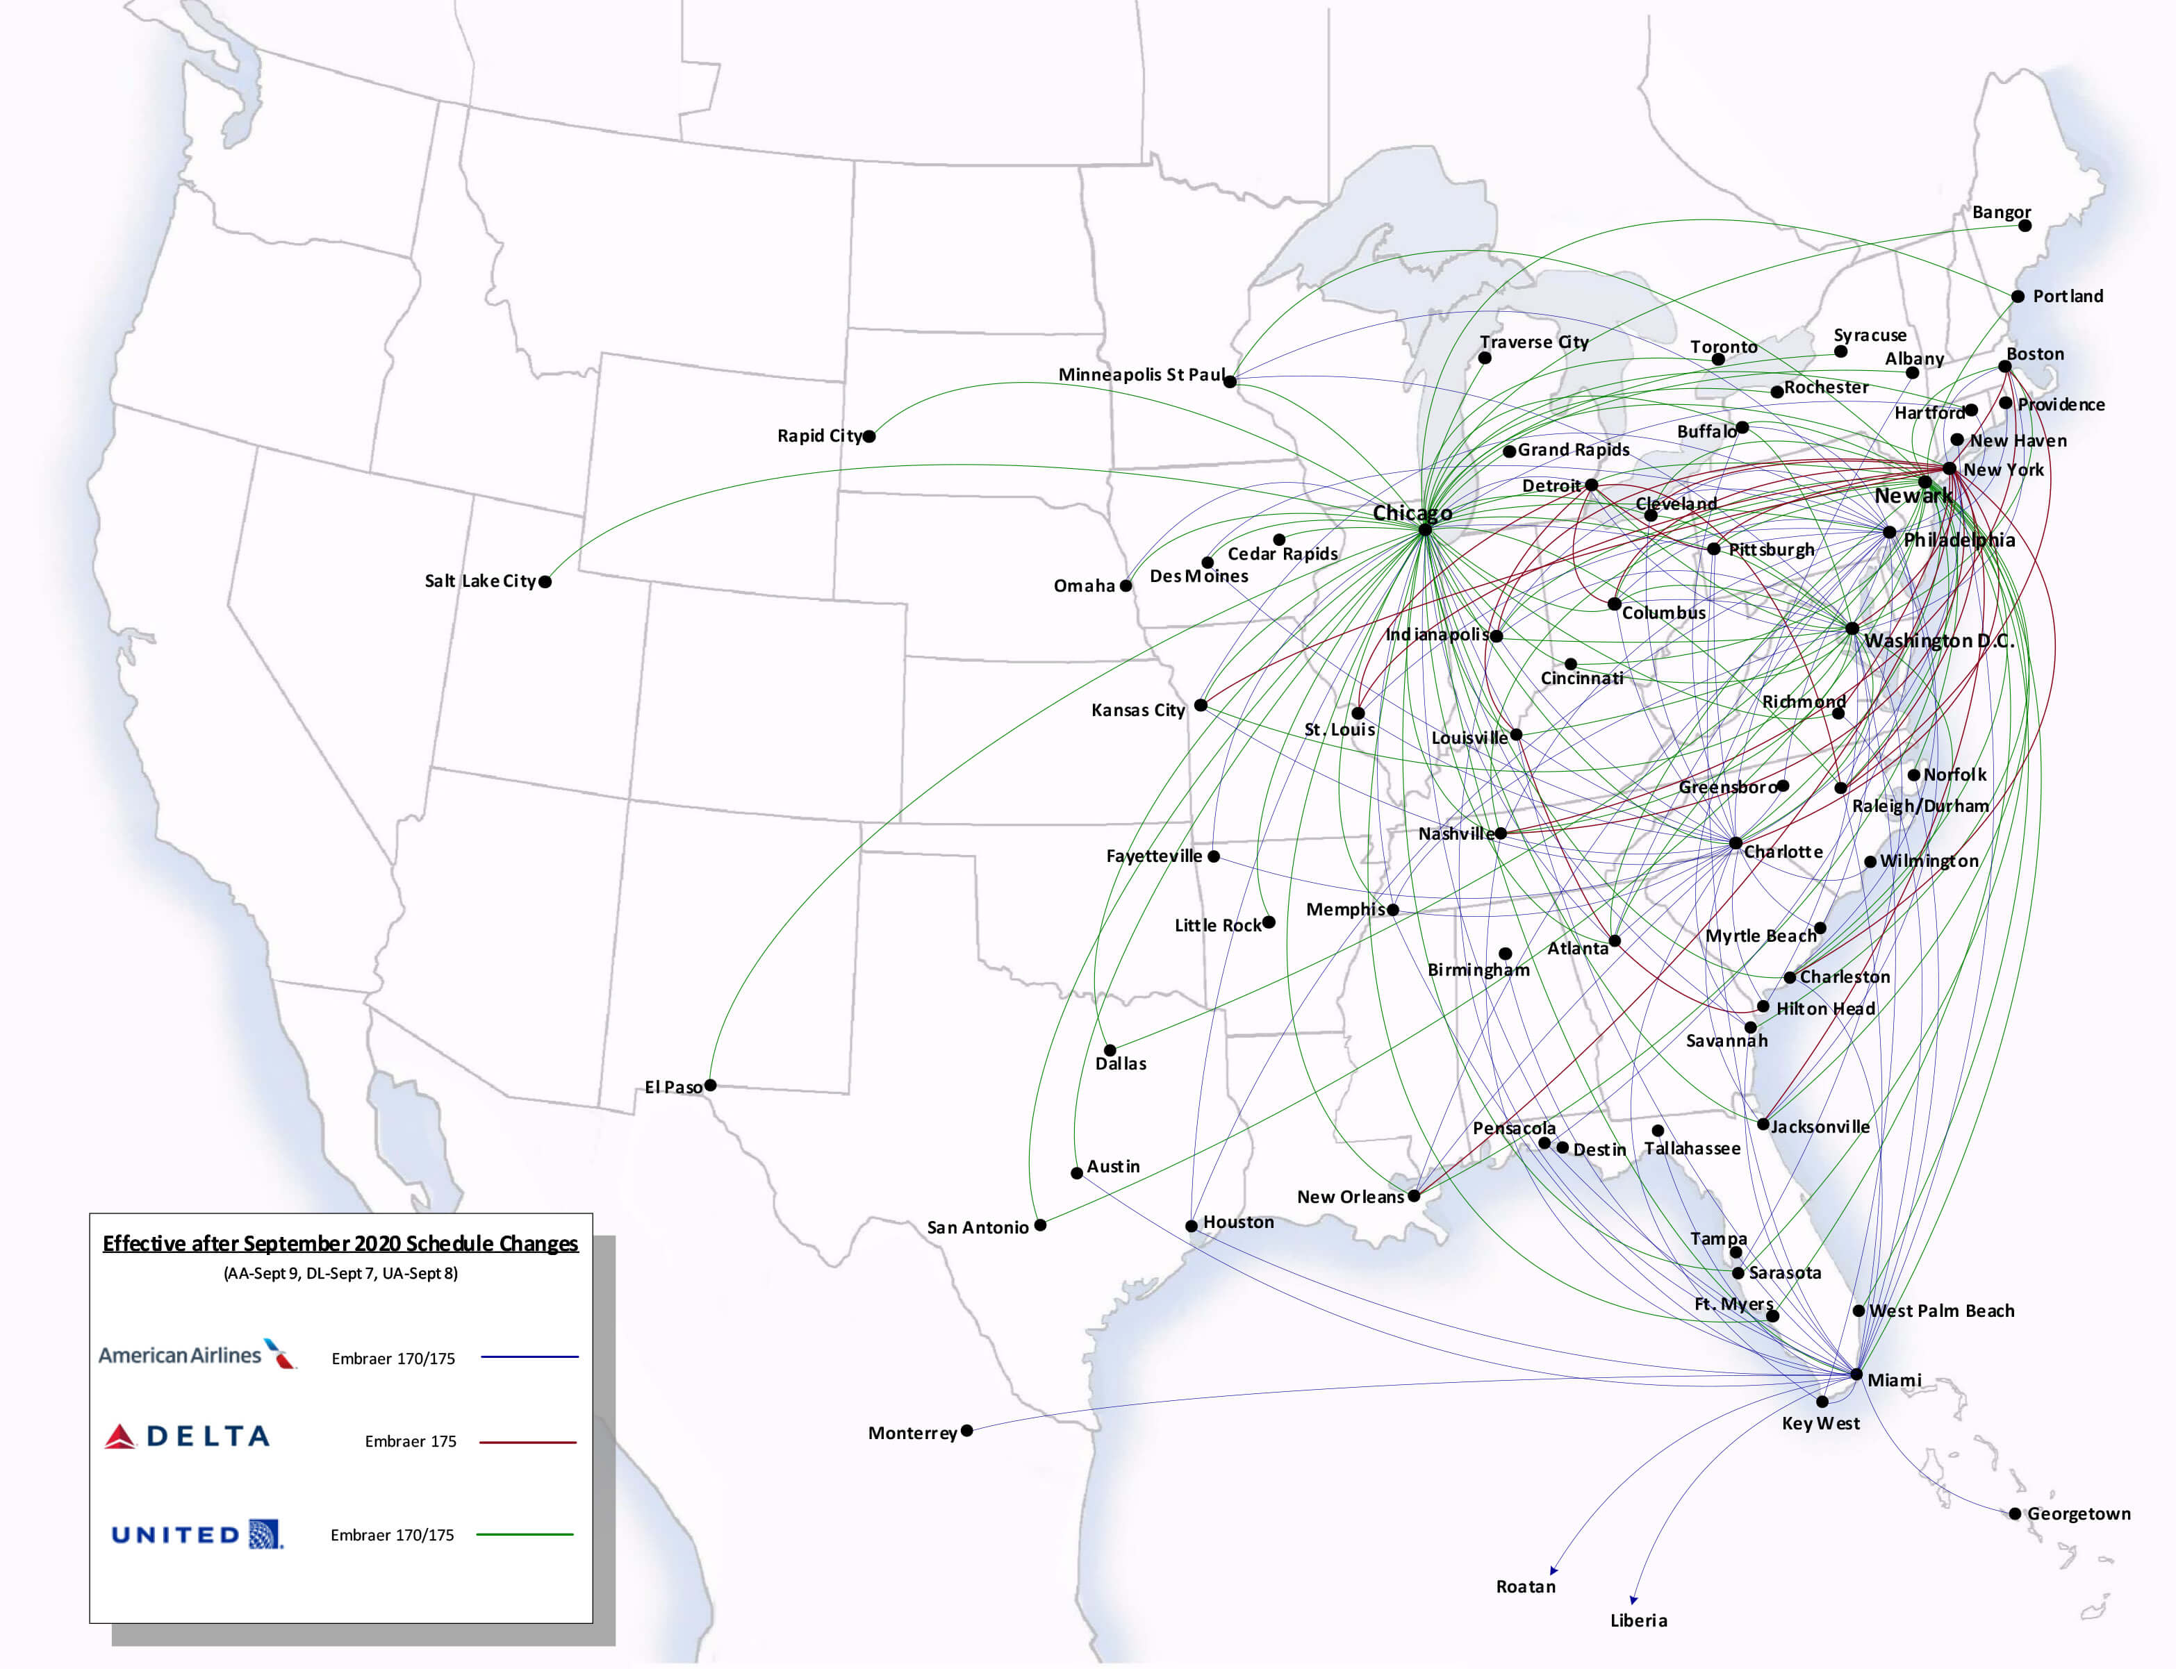
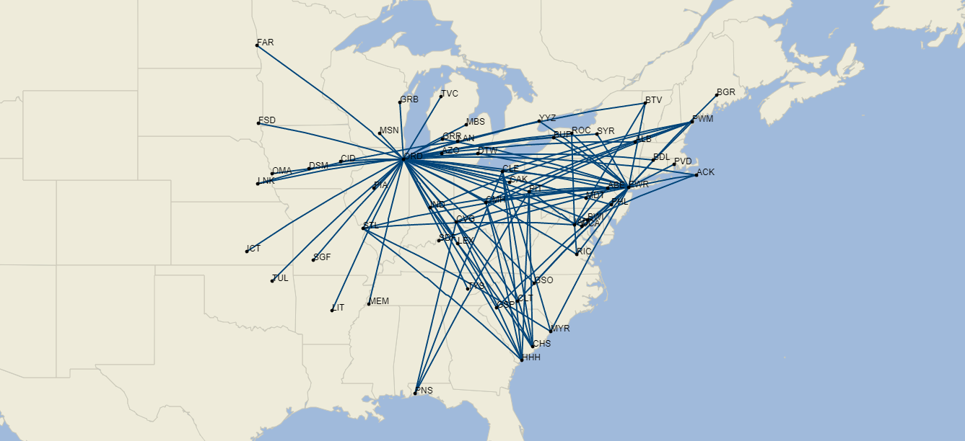
United in Chicago
Air Wisconsin
SkyWest
Republic
GoJet

Slide 34
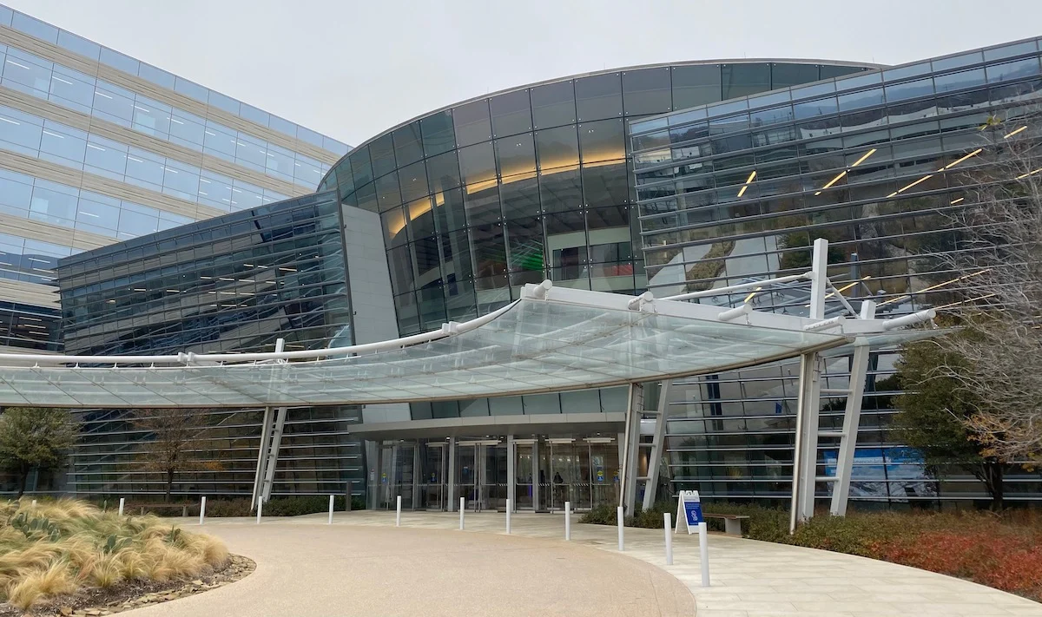


Adaptation
AA Operations Control Center (OCC),
Fort Worth, TX
Yo, we are submitting this slot exchange package to the FAA, we are moving your NYC-Dallas flight #1984. OK?
Mesa Airlines OCC, Phoenix, AZ
fAlrighty!

Slide 36
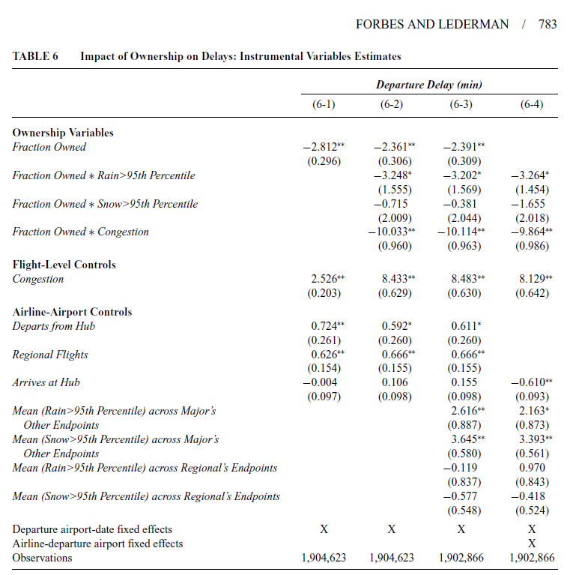
Does centralized control help?
Notes:
36

Slide 37


Does it also help in outsourcing?
Airport 1
Airport 2
Mesa operates 180 flights for AA
Mesa operates 180 flights for AA
= 20% of AA regional flights
(lower SPC)
= 30% of AA regional flights
(higher SPC)
Mesa gives more slots to AA in airport 2
AA gives more slots to Mesa in airport 2
Our hypothesis

Slide 38
Reducing # “bosses” in outsourcing
Notes:
38

Slide 39
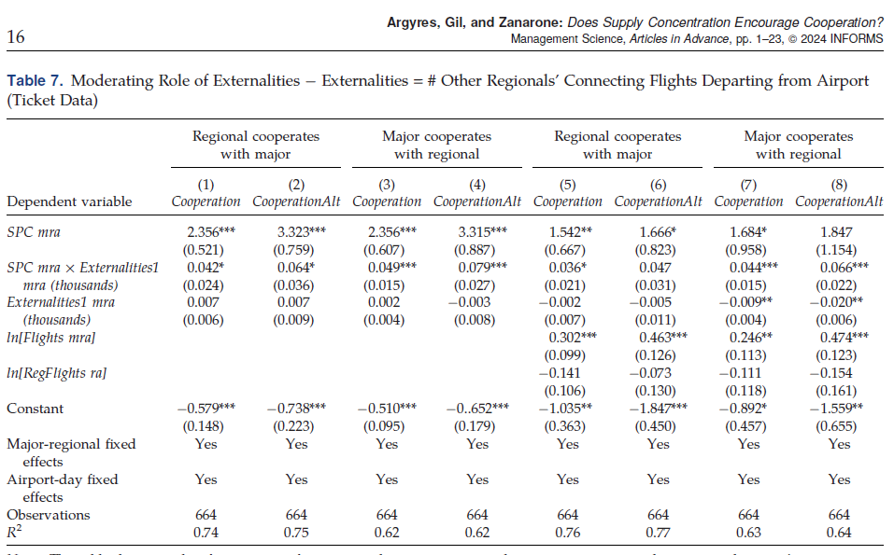
Why does it help?
Notes:
39

Slide 40
More questions we can ask…
Multiple governance forms can transfer control from one boss to another: which does it better?
  Horserace between “visible hands”
Is governance only about shifting control?
  Disentangling adaptation view from incentive view
Are control and payoff rights complements?
  Holmstrom & Milgrom 94; Holmstrom 99 (subeconomy)
Notes:
40

Slide 41
What does governance do? Evidence from the Airline Industry
Silke Forbes
Tufts University
Ricard Gil
IESE Business School
Giorgio Zanarone
HEC Lausanne
Work in progress

Slide 42
Shifting control: which governance does it better?
Notes:
42

Slide 43
Does governance also shift incentives?
Notes:
43

Slide 44
Plan for this talk
The economics of governance: a brief tour
New frontiers in governance research
  Design
  Govern-ance meets Govern-ment
  Management
Discussion
Notes:
44

Slide 45
Contracting in the Wild: How Political Institutions Affect the Governance of Firms
Gani Aldashev (ULB & ECARES)
Heikki Rantakari (University of Rochester)
Giorgio Zanarone (HEC Lausanne)

Slide 46
Political institutions & firms
Economics emphasizes best practices of firm governance
  Private ownership (Shleifer 98; Megginson & Netter 01)
  High-powered incentives (Bloom-Sadun-Van Reenen WMS program)
Firms in countries with weak rule of law deviate from those
  High SOE rate (La porta et al. 02); weak incentives (Bloom et al. 12)
Mistake or 2nd-best adaptation? Key but neglected question
  Most models of firms abstract from pol. inst.
    Coase, Williamson, Hart, Holmstrom, Tirole, etc.
  Most models of political institutions abstract from firms
    North, Olson, Greif, Weingast, Acemoglu, etc.
Joint model of firm governance and political institutions

Slide 47
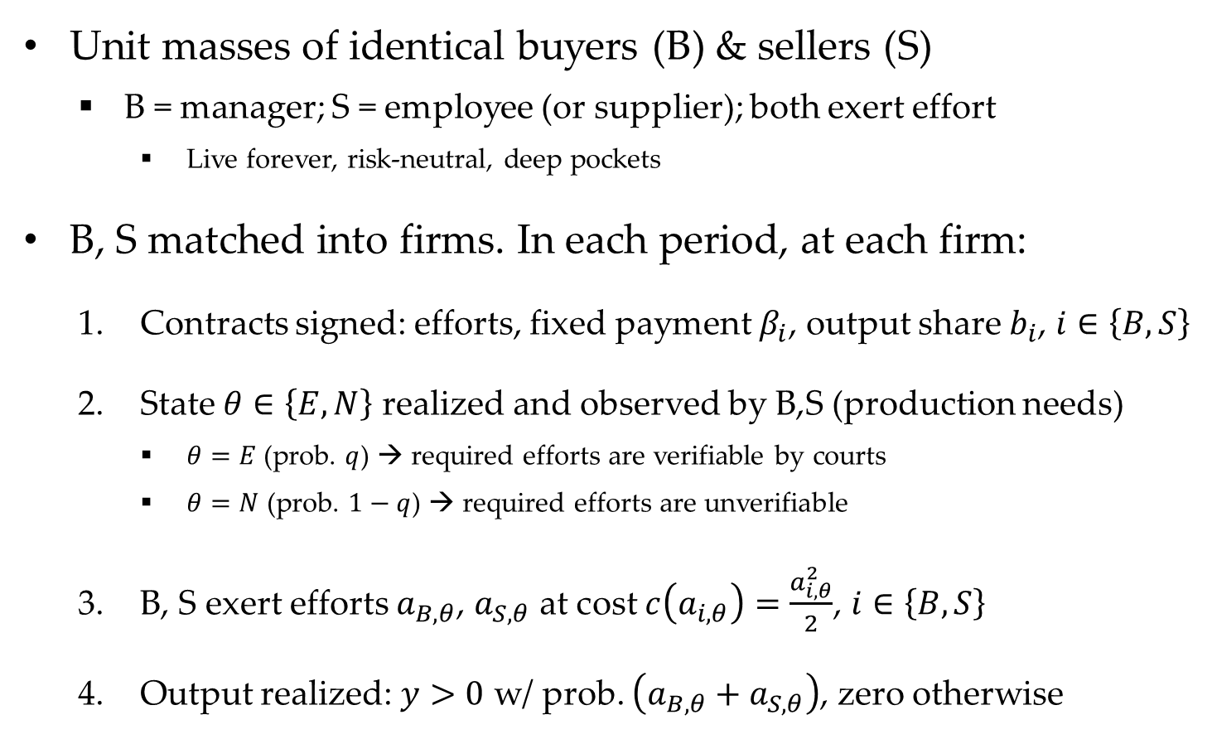
An (almost) standard agency model…
  Unit masses of identical buyers (B) & sellers (S)
    B = manager; S = employee (or supplier); both exert effort
      Live forever, risk-neutral, deep pockets
  B, S matched into firms. In each period, at each firm:
    Contracts signed: efforts, fixed payment $β_{i}$, output share $b_{i}$, $i∈\left\{B,S\right\}$
    State $θ∈\left\{E,N\right\}$ realized and observed by B,S (production needs)
      $θ=E$ (prob. $q$) → required efforts are verifiable by courts
      $θ=N$ (prob. $1−q$) → required efforts are unverifiable
    B, S exert efforts $a_{B,θ}$, $a_{S,θ}$ at cost $c\left(a_{i,θ}\right)=\frac{a_{i,θ}^{2}}{2}$, $i∈\left\{B,S\right\}$
    Output realized: $y>0$ w/ prob. $\left(a_{B,θ}+a_{S,θ}\right)$, zero otherwise
Tasks can be contracted
Tasks must be incentivized
Interpretation 1 = court quality; interpretation 2 = technology (monitoring, IT)
Notes:
47

Slide 48
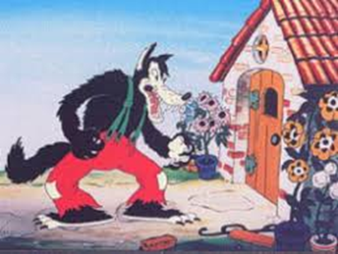
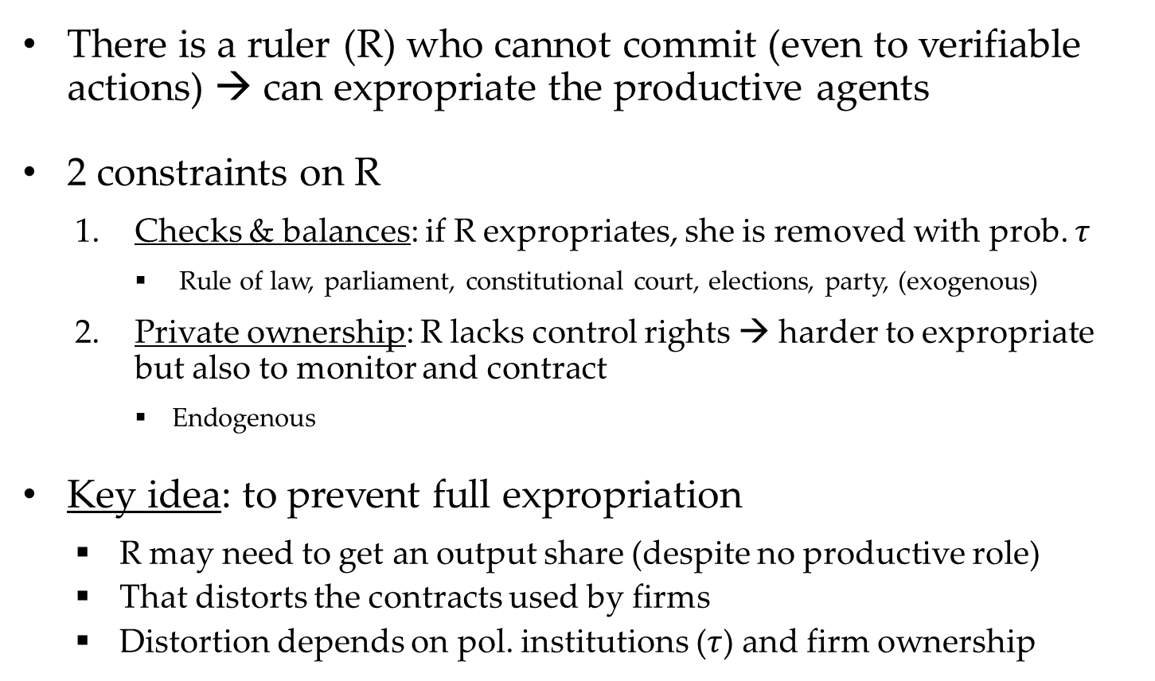
…with a ruler
  There is a ruler (R) who cannot commit (even to verifiable actions) → can expropriate the productive agents
  2 constraints on R
    Checks & balances: if R expropriates, she is removed with prob. $τ$
      Rule of law, parliament, constitutional court, elections, party, (exogenous)
    Private ownership: R lacks control rights → harder to expropriate but also to monitor and contract
      Endogenous
  Key idea: to prevent full expropriation
    R may need to get an output share (despite no productive role)
    That distorts the contracts used by firms
    Distortion depends on pol. institutions ($τ$) and firm ownership
Notes:
48

Slide 49
Contracting under state ownership
  R contracts w/ B & S, observes efforts and collects output
Firm
Ruler
Buyer
Seller
Notes:
49

Slide 50
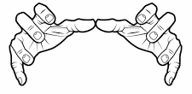
Contracting under private ownership
  B contracts w/ S, observes efforts and collects output
  R out of firm, collects taxes but does not observe efforts
Ruler
Firm
Buyer
Seller
Notes:
50

Slide 51
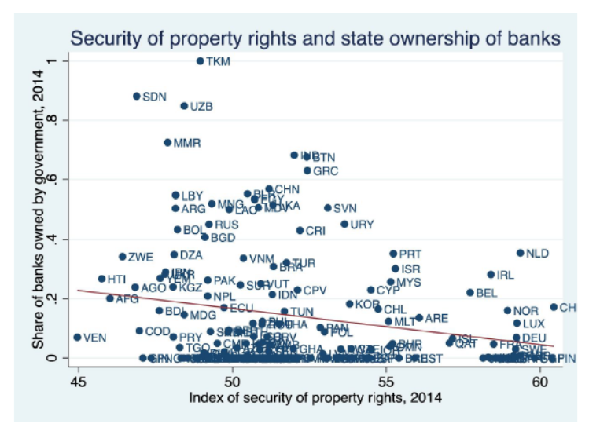
Governance (formal incentives only)
Unconstrained ruler → low non-contractible effort under any ownership → SOE wins as it ensures more efficient employment of contractible efforts
As ruler becomes more constrained, private firms improve faster than SOE (checks & balances more effectively constrain expropriation)
Explains why firms under weak political instit. don’t adopt ‘’best’’ governance
(not ‘’best’’ after all!)
Notes:
51

Slide 52
Governance (formal + relational incentives)
Notes:
52

Slide 53



Exporting best practices?
Toyota-like private firms:
High performance
Piece rate + relational incentives
Almost Toyota-like SOEs:
High performance
Relational incentives only
Private firms but not Toyota-like: Low performance
Piece rate only
Notes:
53

Slide 54
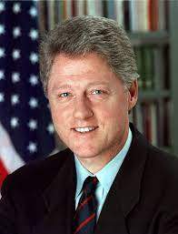
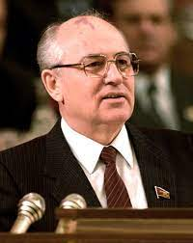
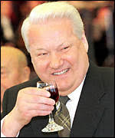
Privatization trap
SOEs under autocracy
Private firms under democracy
Private firms in a transition
Notes:
54

Slide 55
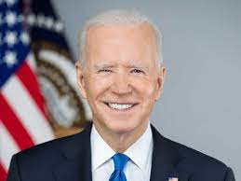
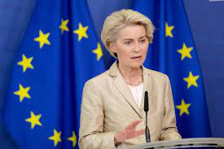
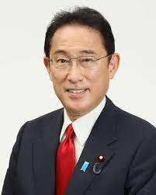
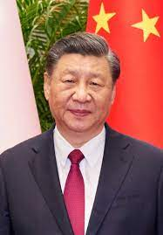
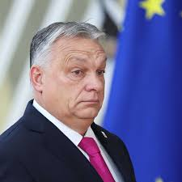
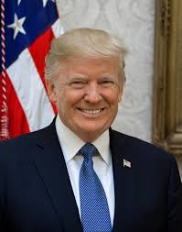
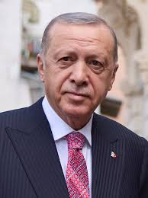

Autocracy trap
Notes:
55

Slide 56
Much more to be done
Theory
  Look at more governance tools “in the wild” (integration?)
  Governance under non-political “rulers” (corporate CEO?)
Empirics
  Management & ownership under different pol. regimes
Notes:
56

Slide 57
Plan for this talk
The economics of governance: a brief tour
New frontiers in governance research
  Design
  Govern-ance meets Govern-ment
  Management
Discussion
Notes:
57

Slide 58
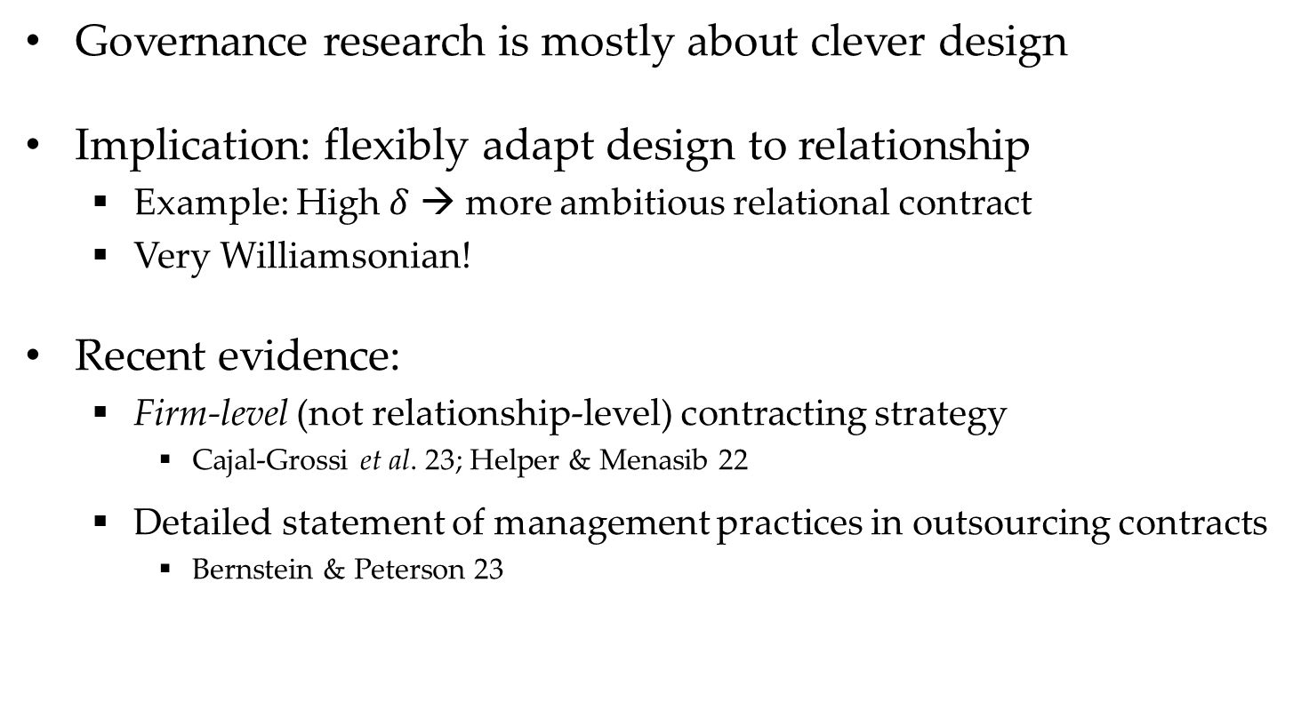
Is it all about design?
Governance research is mostly about clever design
Implication: flexibly adapt design to relationship
  Example: High $δ$ → more ambitious relational contract
  Very Williamsonian!
Recent evidence:
  Firm-level (not relationship-level) contracting strategy
    Cajal-Grossi et al. 23; Helper & Menasib 22
  Detailed statement of management practices in outsourcing contracts
    Bernstein & Peterson 23

Slide 59
Why firm-level contracting strategy?
Helper & Menasib, 2022: “Economies of scope in governing global supply chains: Evidence from the automotive industry”

Slide 60

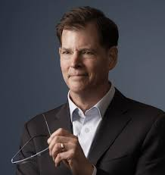
Management practices b/w firms
18 WMS management practices also appear in buyer-supplier contracts & handbooks

Slide 61
Issues in managing relationships
Clarity problems
  Theory: Gibbons & Henderson 12, 13; Hart & Frydlinger 24
  Experimental evidence: Gibbons et al. 23
  Field evidence: none?
Contracts between organizations (not individuals)
  Negotiators and implementers may work at cross purposes
    Ertel 04
  Key according to practitioners; yet no theory, no systematic evidence

Slide 62
For a “relational contract” to be self-enforcing, we need:
  Credibility: parties cares about relationship → perform for fear of losing it
  Clarity: parties must agree on principles: what “good performance” means, who/when should be rewarded
MUCH LESS STUDIED!!!

Slide 63
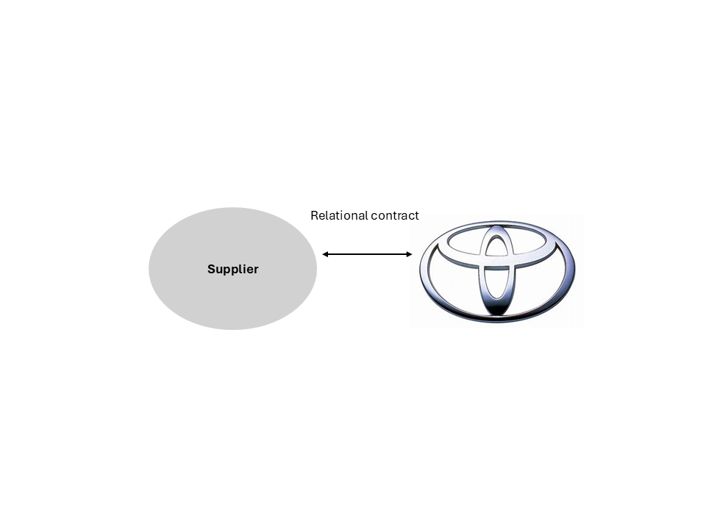
Notes:
63

Slide 64
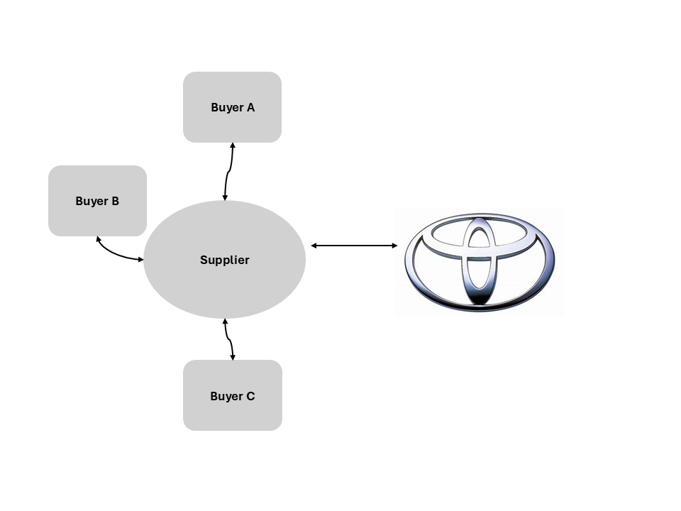
Notes:
64

Slide 65
Notes:
65

Slide 66
Notes:
66

Slide 67
What did we agree upon?
Notes:
67

Slide 68
Notes:
68

Slide 69
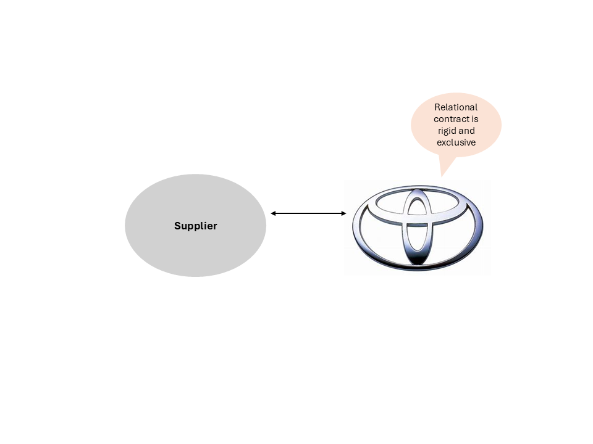
Notes:
69

Slide 70
Clarity Problem!
Notes:
70

Slide 71
Why is clarity a problem?
Notes:
71

Slide 72
Low clarity in trust-based relationship
→ Risk of breakdown
Notes:
72

Slide 73
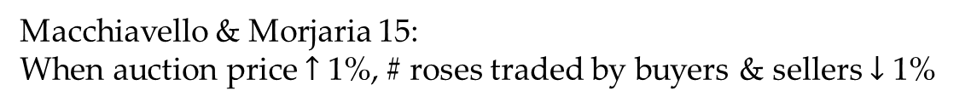
Sometimes this problem is solved…
Measures of relationship PDV
Following the financial crisis shock, lower-value relationships renegotiate their relational contract
Macchiavello & Morjaria 15:
When auction price $↑$ 1%, # roses traded by buyers & sellers $↓$ 1%

Slide 74
…other times it isn’t

Slide 75
Key open questions
  When do clarity problems lead to a breakdown of trust?
  Does the breakdown risk generate pre-emptive behavior?
    E.g., over-cooperation to appease partner?
  How do we prevent clarity problems from destroying trust?
  No theory (but maybe we need evidence first)
  No evidence (experiments seem the natural starting point)
Notes:
75

Slide 76
Does lack of clarity destroy relationships?
Experimental Evidence
Hagay Volvosky (Tel Aviv University)
Giorgio Zanarone (HEC Lausanne)
Christian Zehnder (HEC Lausanne)
Early-Stage Work in Progress

Slide 77

Thank you, Eric!
My next career goal: come a 4th time, stay at the villa
Notes:
77

