Slide 1
POLYCENTRISM HOW GOVERNING WORKS TODAY
Institutional and Organizational Economics Academy
Spring School 2025
Cargèse, Corsica
Jan Aart Scholte
Leiden University

Slide 2
GOVERNANCE
governance = the regulatory dimension of social relations; processes of bringing (some) regularity and ordered change to society
governing = processes of formulating, implementing, enforcing, reviewing, and adjusting (societal) rules
governance > government
untenable statism

Slide 3
GOVERNING: SEVEN KEY FEATURES
transscalar (global-regional-national-local)
transsectoral (official-commercial-civil society-academic-technical)
diffuse (spread over many forces)
fluid (in continual flux)
overlapping spheres
ambiguous hierarchies
no final decision point

Slide 4
NAMING THE BEAST
‘multi-level governance’
‘regime complex’
‘complex sovereignty’
‘liquid authority’
‘transnational legal orders’
‘empire’
‘disaggregated world order’
‘new medievalism’
‘hypercollective action’
‘governmentality’
‘global governance’
‘bricolage’/‘patchwork’
‘networked governance’
‘actor-network’
‘multinucleated politics’
‘fragmentation’ and ‘fragmegration’
‘new constitutionalism’
‘multi-scalar metagovernance’
‘heterarchy’
‘assemblage’
‘nébuleuse’
‘polycentrism’

Slide 5
WHY ‘POLYCENTRISM’?
The wider original broader conception of Polanyi (1951): ‘a social system of many decision centers … operating under an overarching set of rules’
Combines diversity, disaggregation, diffusion (‘poly’) with position, grouping, order (‘centricity’)
More direct, vivid and easily remembered than other terminology
Not tied to any disciplinary or theoretical approach, so a meeting point for exploratory interdisciplinary dialogue

Slide 6


Slide 7
BROAD APPROACHES
legalism
rationalism
institutionalism
practicism
structuralism
talk to each other and combine insights

Slide 8
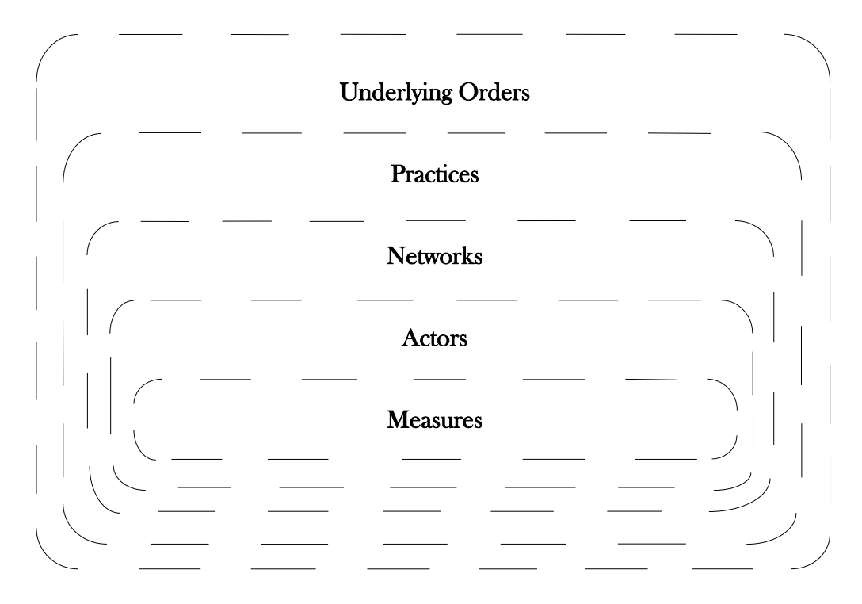

Slide 9
REGULATORY MEASURES
statutes, bills
treaties, customs
resolutions, declarations, directives
memoranda of understanding
reports and recommendations
standards, guidelines, best practices, benchmarks, certification schemes
indexes, rankings, ratings
principles, norms

Slide 10
GOVERNANCE ACTORS
 | PUBLIC | PRIVATE and HYBRID
GLOBAL
REGIONAL
COUNTRY
LOCAL

Slide 11
MANY ACTORS GOVERNING THE INTERNET
 | PUBLIC | PRIVATE and HYBRID
GLOBAL | GAC, ITU, WIPO, WTO, UN, OECD, G7/20, Commonwealth | ICANN, IETF, NRO, IEEE, Unicode, IAB, gTLD registries, ISO, ISOC, IGF, SOs/ACs, NETmundial, W3C, ETSI, global companies (Google, etc.)
REGIONAL | ASEAN, AU, EU, Council of Europe, Nordic Council, HLIG, NATO | RIRs, regional ccTLD associations, regional NOGs, EuroDIG, regional IGFs, regional IXP bodies, PITA
COUNTRY | state ministries and coordination bodies; legislatures; courts; some ccTLD registries; state-owned ISPs | some ccTLD registries, NIRs, national IGFs, national NOGs, national commercial ISPs
LOCAL | substate governments e.g. Tamil Nadu, US states | university-based ccTLD registries, community free wireless networks

Slide 12
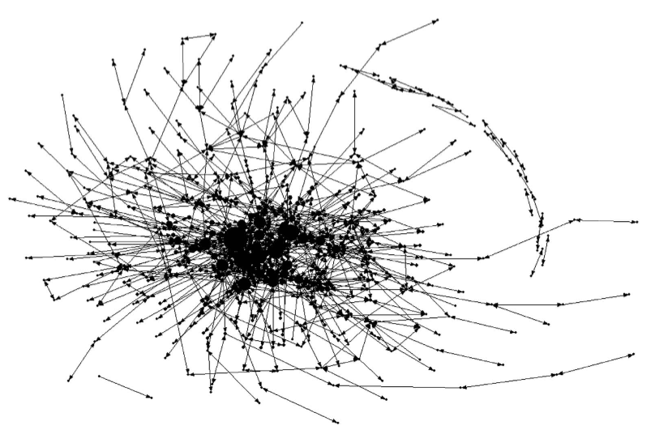
GOVERNANCE NETWORKS

Slide 13
GOVERNANCE STRUCTURES
governing happens partly because of the perceptions, intentions, decisions, tactics and other forces arising from the actors themselves
but there is also the content of the network links
social forces that put actors in their respective places
social structure (patterns, ordering principles)
practices (micro structures)
underlying orders (macro structures)

Slide 14
MICRO STRUCTURES: PRACTICES
practice matters – ‘how things are done’ has an impact on governing that is distinct from the actors who enact those ways
institutional practices
behavioural practices
material practices
discursive practices

Slide 15
MACRO STRUCTURES: UNDERLYING ORDERS
intangible, not directly visible structures
‘deeper’ than tangible and directly visible actors and practices
often operate unconsciously or semi-consciously
underlying orders on local-to-global scales
governing usually reproduces and reinforces, though it can also resist and change
structural power of underlying orders – people are substantially constrained to reproduce them

Slide 16
MACRO STRUCTURES: UNDERLYING ORDERS
social stratifications (by age, ethnicity/race, gender, etc.)
anthropocentrism
capitalism
hegemonic state
militarism
nationalism
rationalism
single primary or several co-constituting?

Slide 18
LOOKING AHEAD
governance as a co-constitution of regulatory measures, actor rationalities, organizational networks, everyday practices, and underlying orders
here have presented more a metatheoretical guide than an explanatory framework – for the latter need to decide WHICH measures, actors, networks, practices and underlying orders to emphasise
methodologically, established and new research techniques need to be combined, reconciled, discarded, and reinvented in order to achieve a new methodological coherence

Slide 19
LOOKING AHEAD
polycentrism demands a degree of interdisciplinary dexterity that tends to lie beyond the capacity of a solo researcher – implies more team research than ‘social’ sciences are used to
anticipate considerable resistance among established scholars, as many an influential academic career is invested in legalist, rationalist, institutionalist, practicist, and structuralist assumptions; risky to work across and combine approaches – and to subordinate one’s particular insight to a larger knowledge

